Slide 1

Live Computer Generated Visuals Based on the Sound Waves of Music
Nadia Abouelleil
Date 12/9/2023

Slide 2

Background
Motivation
Personal passion for music and art

Slide 3
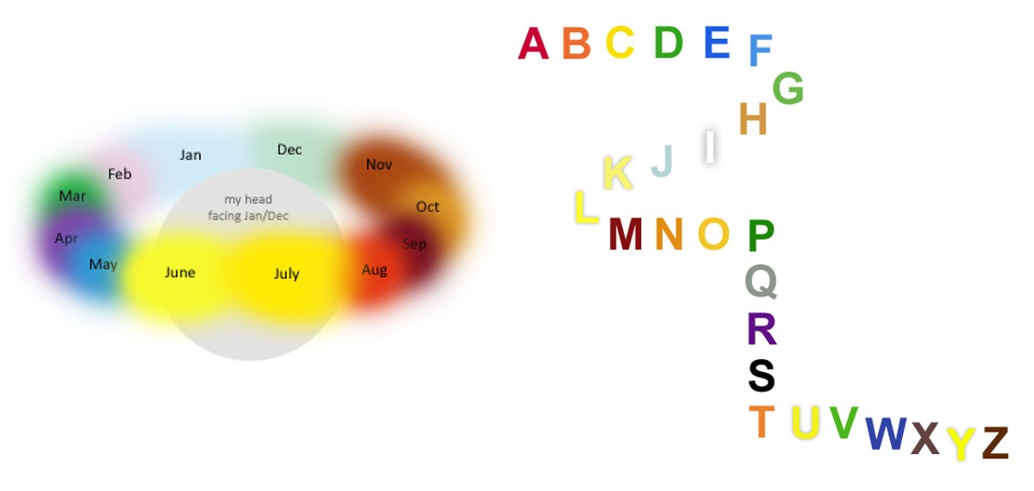
Background
Motivation
Synaesthesia - neurological phenomenon in which one sensory input evokes a response in another sense

Slide 4
Background
Motivation – Psychedelic Music/Videos
Tame Impala concert, and YouTube “acid trip” videos

Slide 5
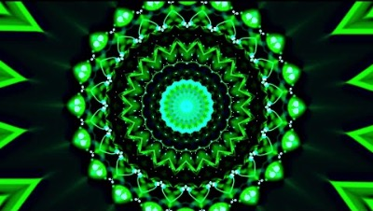
Background
Motivation – YouTube Acid Trip Video Example

Slide 6
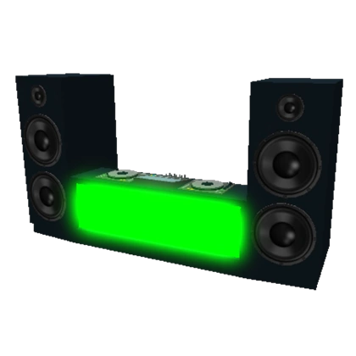
Background
Motivation – Applications
Create immersive experiences and increase audience engagement in the entertainment industry
Creative tool for artists to analyse and develop their music
Create an engaging atmosphere in nightclubs behind DJ sets

Slide 7

Background
Literature Reviews
An exploration of existing works that attempt to visually represent music.
A study of methodologies, technologies, and approaches employed by predecessors in this domain.

Slide 8
Background
Literature Reviews – The Colour of Music
The Colour of Music: Real-time Music Visualisation with Synaesthetic Sound-Colour Mapping by Kia Ng, Joanne Armitage, and Alex McLean (2014)
Explores the world of synaesthesia, where auditory stimuli evoke visual perceptions.
Investigates the potential of synaesthesia for real-time music visualisation.
Details techniques and challenges in translating music nuances into accurate visual representations.
Emphasises user experience and iterative system improvements.

Slide 9
Background
Literature Reviews – Composing Visual Music
Composing Visual Music: Visual Music Practice at the Intersection of Technology, Audio-Visual Rhythms and Human Traces by Julie Watkins (2018)
Chronicles the historical trajectory of visual music and its evolution.
Emphasises the importance of 'human traces' in visual music composition.
Outlines methodologies in visual music composition, balancing auditory and visual components.
Discusses challenges in integrating technology and audience preferences.

Slide 10
Background
Literature Reviews – An Audio-Driven System For Real-Time Music Visualisation
An Audio-Driven System For Real-Time Music Visualisation by Max Graf, Harold Chijioke Opara, and Mathieu Barthet (2021)
Highlights the importance of real-time music visualisation in live performances.
Details the technical framework, algorithms, and methodologies of the developed system.
Discusses the artistic dimension of the system, ensuring emotional resonance with audiences.
Emphasises iterative feedback loops and system adaptability.

Slide 11
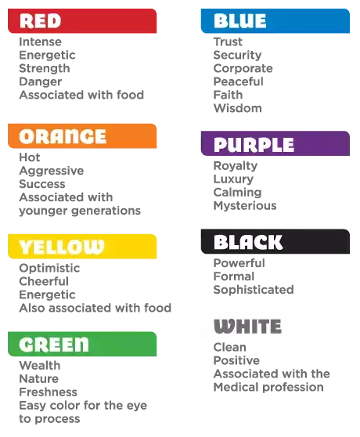
Music → Mood → Colour Mapping
Mood | Intensity | Timbre | Pitch | Rhythm
Happy | Medium | Medium | Very High | Very High
Exuberant | High | Medium | High | High
Energetic | Very High | Medium | Medium | High
Frantic | High | Very High | Low | Very High
Anxious/Sad | Medium | Very Low | Very Low | Low
Depression | Low | Low | Low | Low
Calm | Very Low | Very Low | Medium | Very Low
Contentment | Low | Low | High | Low

Slide 12
Related Work
The realm of music visualisation isn't entirely uncharted. Several tools and platforms exist, turning sound into sights.
However, the emphasis on real-time adaptation, user interactivity, and personalisation sets this project apart.
Leveraging modern libraries and technologies, the tool pushes the boundaries of what's been done before in this domain.

Slide 13
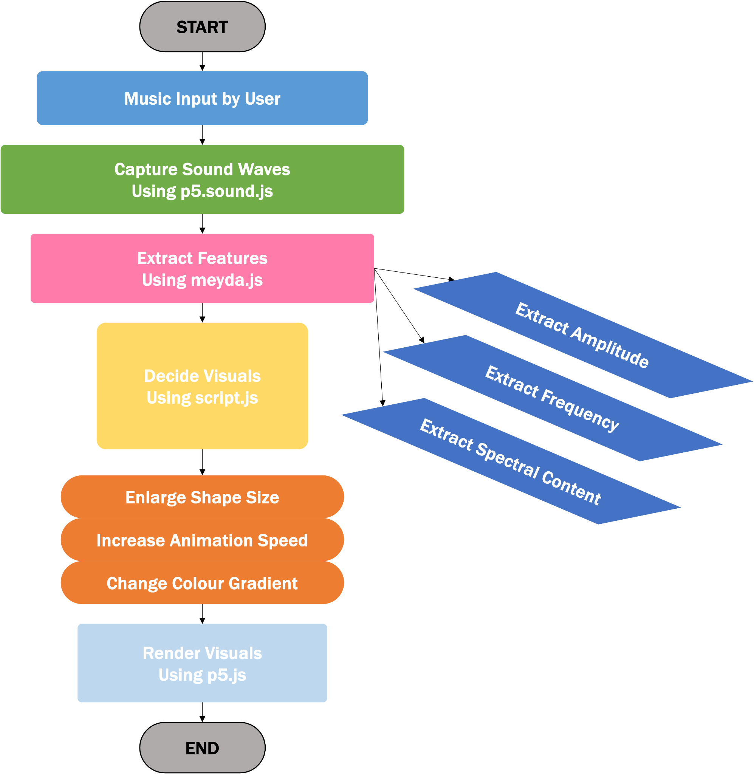
Design

Slide 14
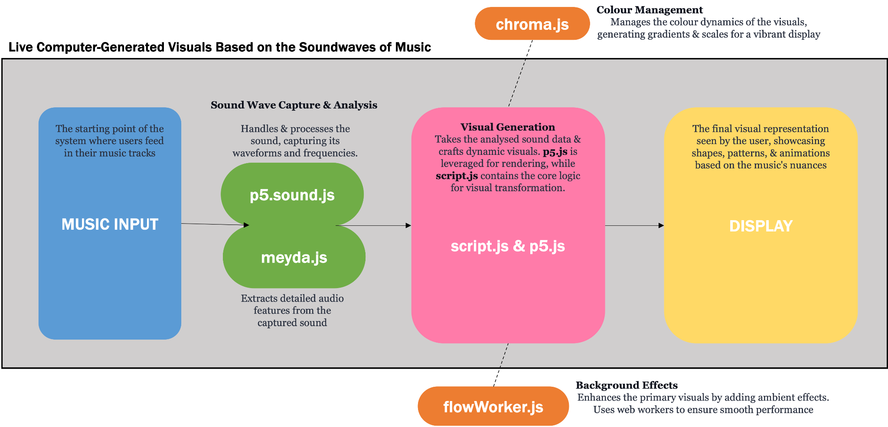
Design
High-Level System Architecture

Slide 15
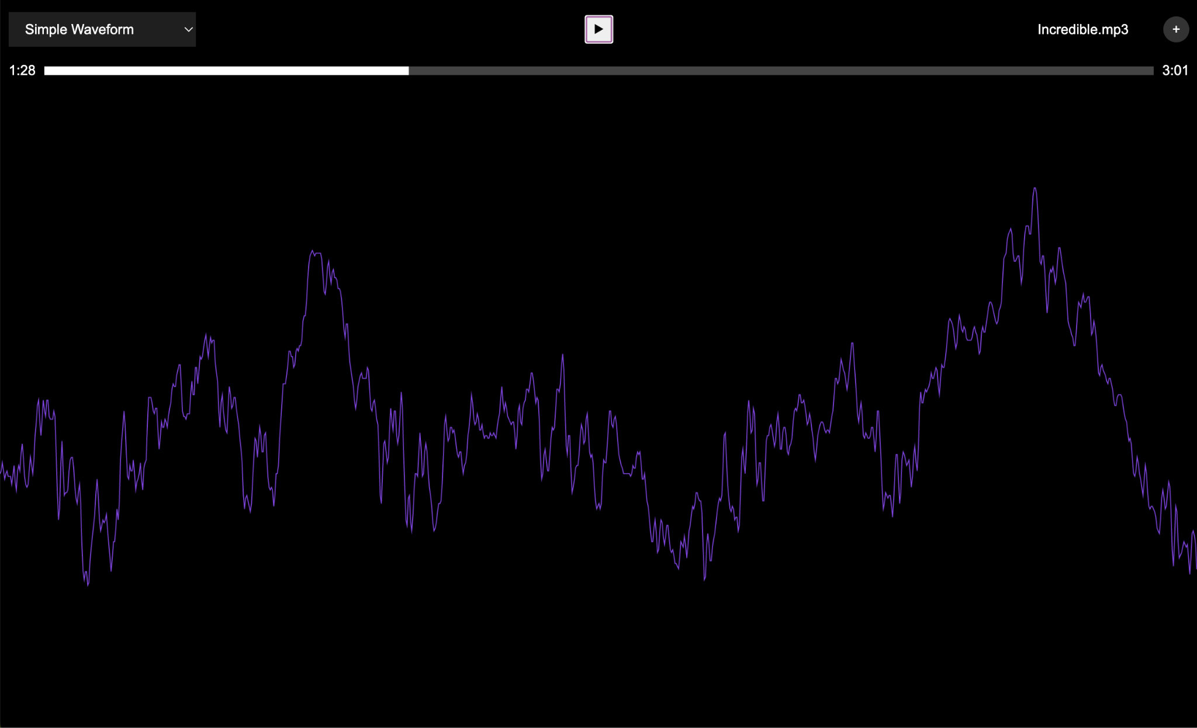
Design
User Interface and Interaction
User engagement is central to the design. The interface allows for music uploads, offers playback controls, and provides progress indicators. Interactivity is managed via event listeners and integrated functions, ensuring a responsive experience.
Visualisation Options Dropdown Menu
Play/Pause Button
Song Upload
Progress Bar

Slide 16
Implementation Issues
Slide: Implementation Issues
Title: Implementation Issues
Content:
Real-time Responsiveness: Ensuring the application remains responsive under varying loads, especially when processing complex sound waves in real time.
Sound-Colour Mapping: Achieving accurate translation of musical notes and intricacies into corresponding visuals using the chroma.js library.
Browser Compatibility: Ensuring consistent performance and appearance across different web browsers, given the intricacies of HTML5 and JavaScript.
Algorithmic Complexity: The challenge of optimising algorithms, especially when processing sound wave data with the meyda.js library.
User Feedback Integration: Adapting and refining the application based on diverse user feedback while ensuring stability and performance.

Slide 17

Demo of Project

Slide 18
Evaluation
Technical Assessment: Rigorous testing phases to ensure optimal efficiency. Evaluation of real-time visual generation capabilities, leveraging libraries like p5.js, meyda.js, and chroma.js.
Visualisation Accuracy: A deep dive into the application's ability to effectively translate musical sound waves into accurate and dynamic visuals, emphasising nuances like tempo, pitch, and rhythm.
User Experience & Compatibility: Comprehensive usability testing across various web browsers to determine the intuitiveness, responsiveness, and adaptability of the interface to diverse musical genres.

Slide 19
Conclusion
Lessons Learnt
Technical Challenges: Recognising the complexities of real-time sound wave analysis and visualisation and the importance of choosing the right tools and libraries.
User Feedback's Value: The significance of iterative feedback in shaping the project, emphasising that a user-centric approach often leads to a more successful outcome.
Adaptability: Understanding the importance of creating a system that can adapt to various musical genres and user preferences.
Synthesis of Art and Tech: Realising the profound impact of merging artistic sensibilities with technical prowess in creating an immersive experience.

Slide 20
Conclusion
Reflection
Personal Growth: Acknowledging the growth experienced throughout the project, from understanding the complexities of the domain to managing implementation challenges.
The Project's Impact: Recognising the potential of the application in revolutionising music visualisation and enhancing audience experiences.
Future Potential: Contemplating the future of the project, from potential refinements to its broader applications in the entertainment industry.

Slide 21
Conclusion
Future Potential
Explore integration with other music platforms for wider accessibility.
Develop mobile applications to reach a broader audience.
Enhance visual customisation options, offering users more creative control.
Incorporate machine learning for more adaptive and personalised visuals.

Slide 22
Questions ?

Slide 23
Thank You

