Slide 1
Approach PPT for the prediction of the probability of stroke happening for patients

Slide 2
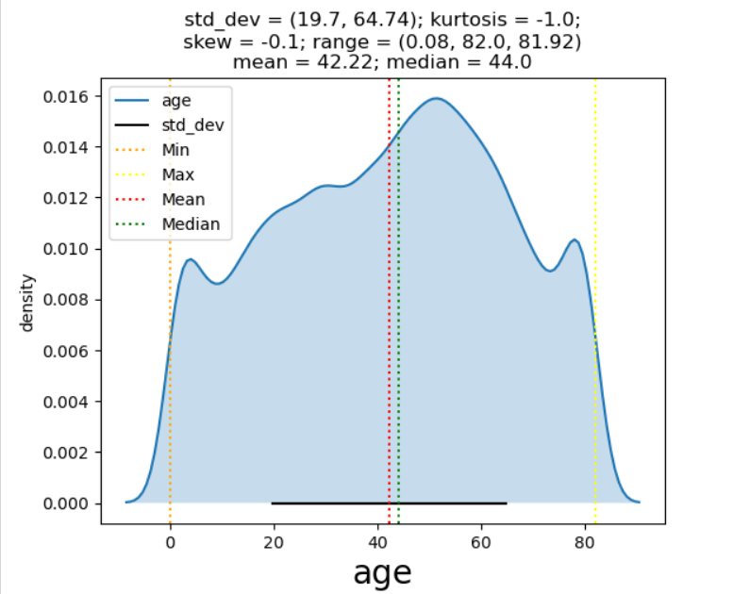
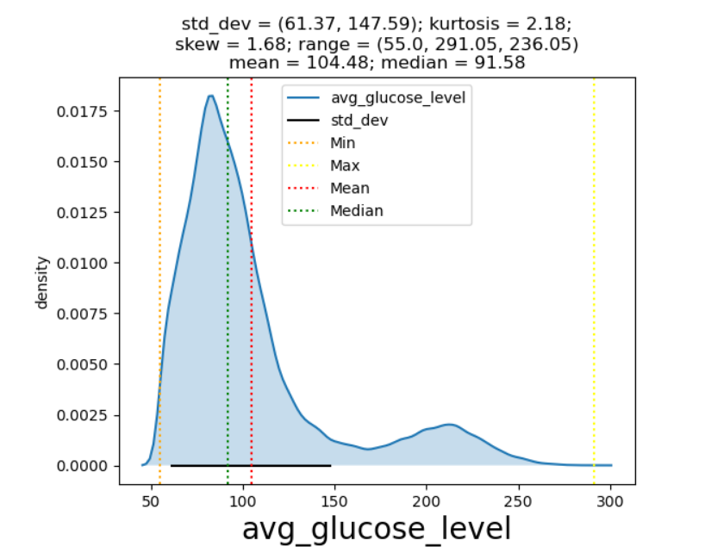
Insights from EDA and most important data visualization
Numerical Variables: Age, Body Mass index, Average of glucose level

Slide 3
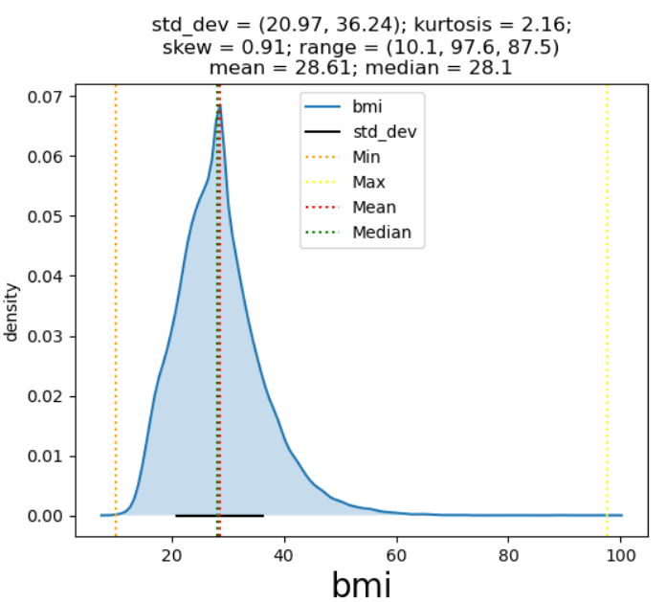
Insights from EDA and most important data visualization
Numerical Variables: Age, Body Mass index, Average of glucose level

Slide 4
Insights from EDA and most important data visualization
Numerical Variables: Age, Body Mass index, Average of glucose level
id:
variable is unique for every patient, Hence uniform distribution.
This variable does not contribute any information
Can be eliminated from data
age:
Median Age = 44
Most customers age between 20 to 65
skewness -0.1 : The age is almost symmetrical, skewness is negligeable
kurtosis = -1; very less likely to have extreme/outlier values.
Average glucose level :
Most of Glucose level range from 60 to 150 .
skewness 1.68 : this is right skewed, variable is significantly biased towards lower levels of glucose.
Kurtosis = 2.18: Extreme values and Outliers are very likely to be present in average glucose level.
A trend may be present for glucose level between 200 and 250 (Should be further investigated)
Body mass index
Most of bmi range from 20 to 38.
skewness 0.91 : BMI is negligible biased towards lower level of BMI
Kurtosis = 2.16: Extreme values and Outliers are very likely to be present in average glucose level.

Slide 5
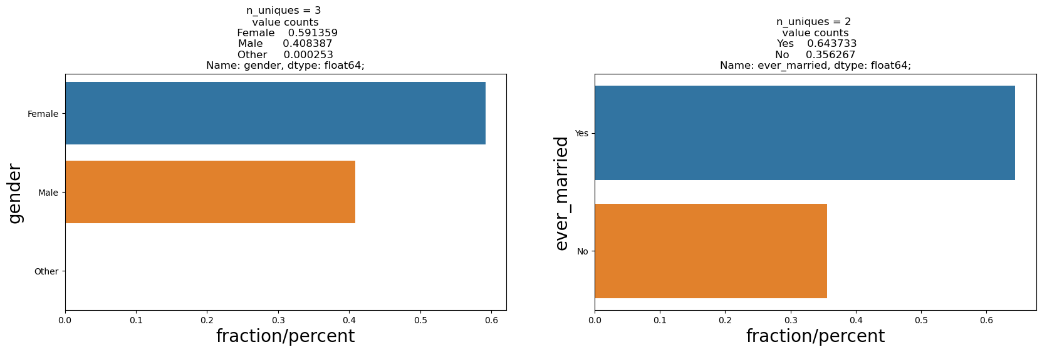
Insights from EDA and most important data visualization
Categorical Variables: 'gender', 'ever_married', 'work_type', 'Residence_type', 'smoking_status', 'hypertension', 'heart_disease‘

Slide 6
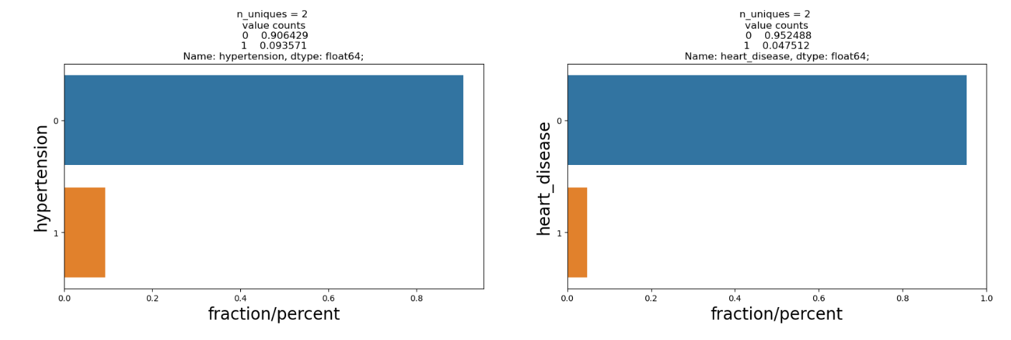
Insights from EDA and most important data visualization
Categorical Variables: 'gender', 'ever_married', 'work_type', 'Residence_type', 'smoking_status', 'hypertension', 'heart_disease‘

Slide 7
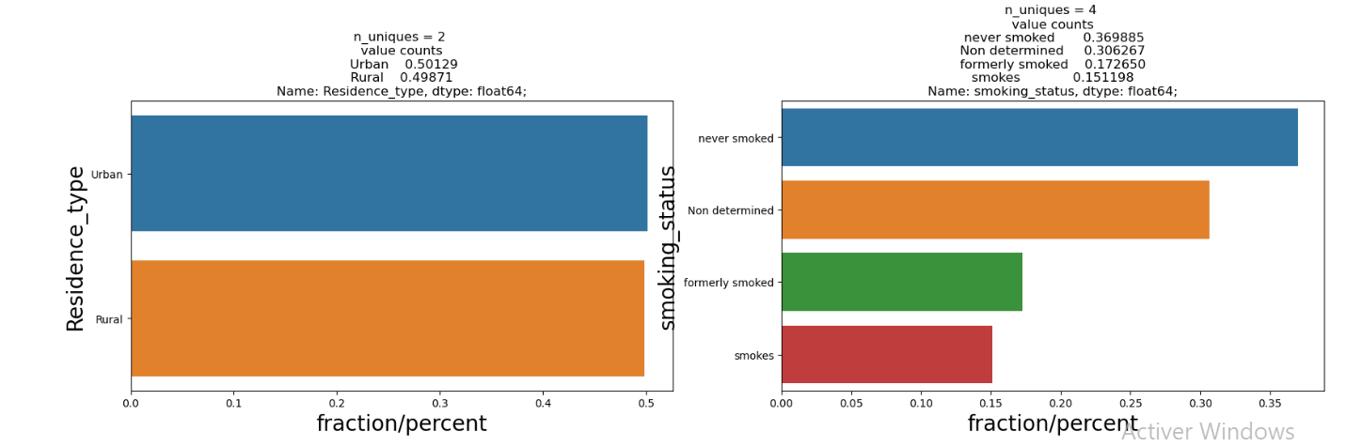
Insights from EDA and most important data visualization
Categorical Variables: 'gender', 'ever_married', 'work_type', 'Residence_type', 'smoking_status', 'hypertension', 'heart_disease‘

Slide 8
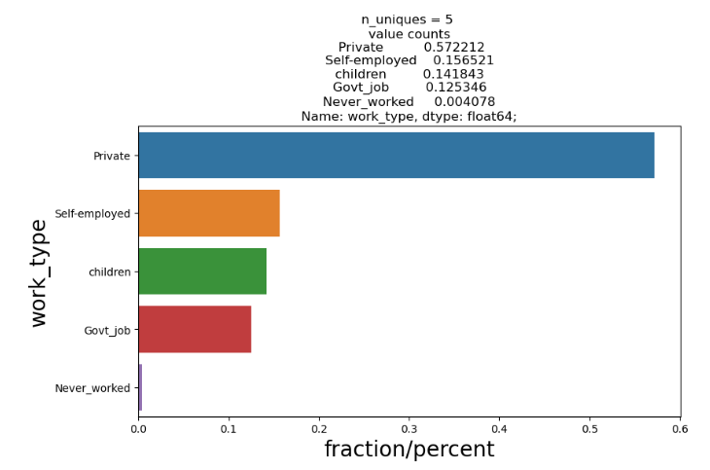
Insights from EDA and most important data visualization
Categorical Variables: 'gender', 'ever_married', 'work_type', 'Residence_type', 'smoking_status', 'hypertension', 'heart_disease‘

Slide 9
Insights from EDA and most important data visualization
Categorical Variables: 'gender', 'ever_married', 'work_type', 'Residence_type', 'smoking_status', 'hypertension', 'heart_disease‘
~40% of patients are male and ~60 % are female
~35% of patients are not married and ~ 65% are married
Majority of patients do not have heart disease neither hypertension
Same patients percentage lives in rural and urban areas
Majority of patients work in private sector and never smoke
~30% of patients did not give any information about their smoking habits
~28% of patients are confirmed to smoke

Slide 10
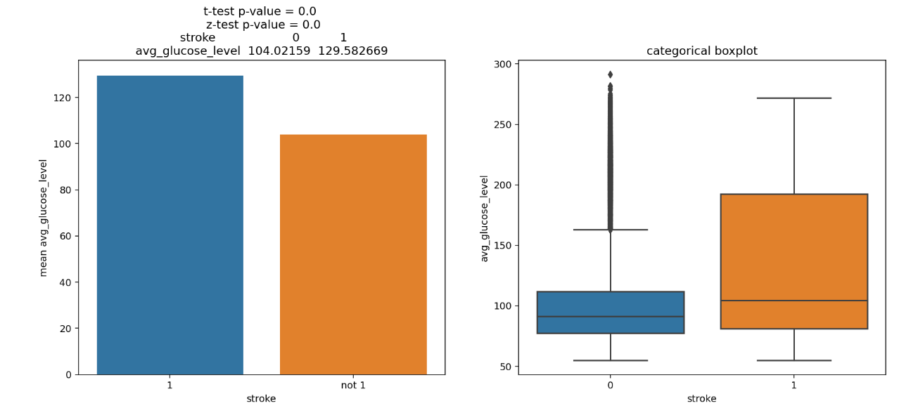
Insights from EDA and most important data visualization
glucose level is higher for those who has a stroke , results are significantly different
Boxplot for patients having stroke shows distribution without outliers on. For those who are likely to have a stroke, outliers are present on the upper end.

Slide 11
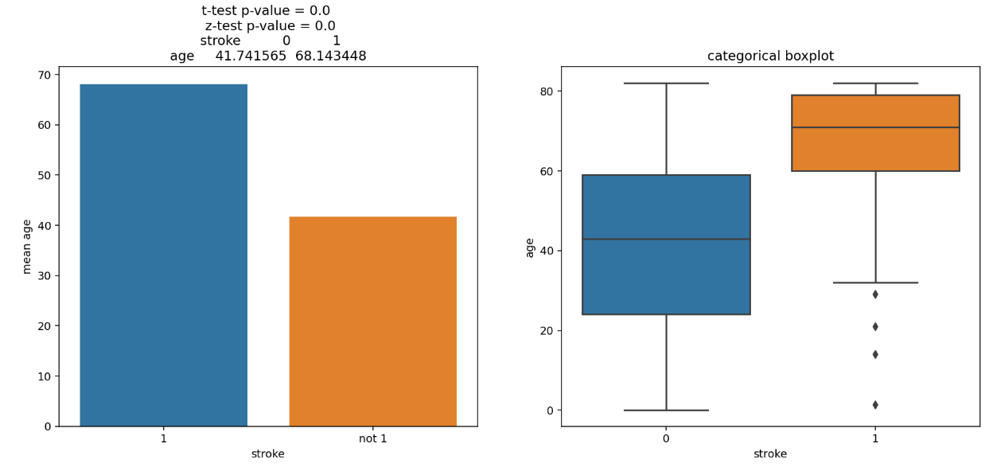
Insights from EDA and most important data visualization
Aged people are likely to have a stroke , results are significantly different
Boxplot for patients with no stroke shows distribution without outliers on. For those who are likely to have a stroke, outliers are present on the lower end.

Slide 12
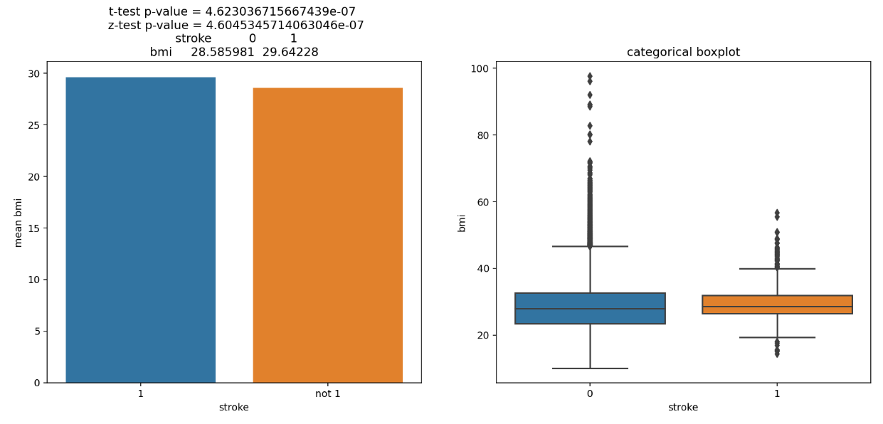
Insights from EDA and most important data visualization
BMI is higher for those who are likely to have a stroke , but results are not significantly different
Boxplot shows distribution with outliers on upper end. For those who are likely to have a stroke, outliers are present on both the upper and lower end.

Slide 13
Insights from EDA and most important data visualization
Categorical Variables: 'gender', 'ever_married', 'work_type', 'Residence_type', 'smoking_status', 'hypertension', 'heart_disease‘
Gender group has insignificant effect on the stroke.
Marriage status has significant effect on the stroke.
Work Type status has significant effect on the stroke.
Rural/ Urban group has insignificant effect on the stroke.
Smoking status group has significant effect on the stroke.
Hypertension / Heart disease has significant effect on the stroke.

Slide 14
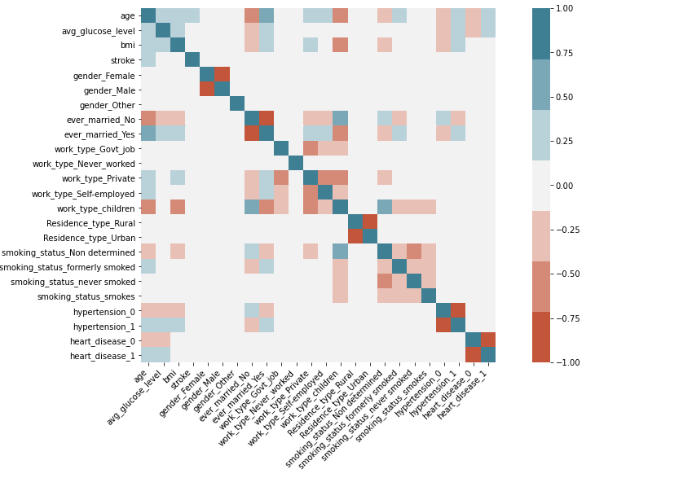
Data Preprocessing & missing value imputation steps for each variable
Missing Values: bmi and average glucose level
Replace missing bmi values by the mean
Group missing values of smoking status into a new category ‘Non determined’
Replace ‘Other’ gender by the most frequent category
Conversion of categorical Variables using one hot encoding scheme
Standardization of numerical variables using Standard Scaler
No log transformation are performed on data, sicne they seem legerly skewed
Removal of multicolinear features ('Residence_type_Urban', 'ever_married_Yes',
'gender_Male', 'heart_disease_1', 'hypertension_1 ) (Correlation index higher than 0,8)

Slide 15
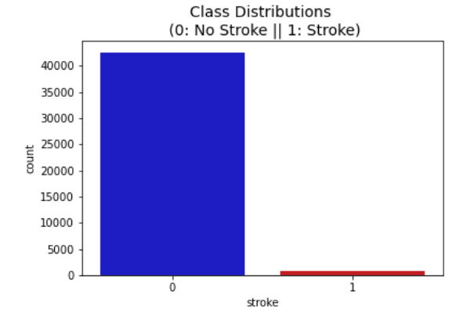
Final Model Description along with parameters
1) Split and test data
xtrain, xvalid, ytrain, yvalid = train_test_split(X,y,test_size=0.3,stratify=y, random_state=11)
2) Baseline Model Parameters
Features with correlation index less than 0.8
Use logistic regression
Set the class weights parameters class weights to balanced (the target is imbalanced)
3) New model with improved classification performance)
3,1) Feature selection of the 9 first ranked variables using RFE
3,2) Hypertuning of model parameters
3,3) Use of ROC_AUC as metric evaluation

