Slide 1
Info Session: Virtual Environments
By Nadia Blostein

Slide 2
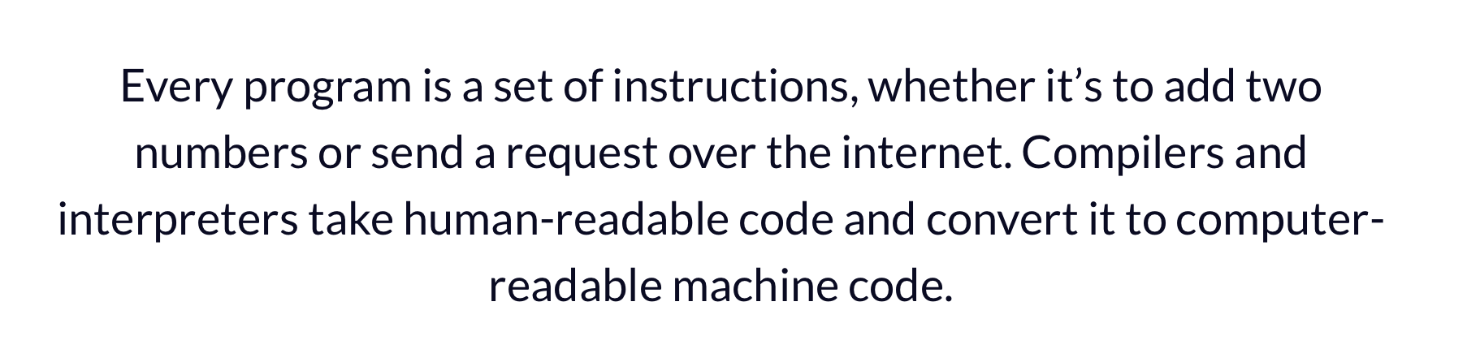
Interpreted vs Compiled Programming Languages: What's the Difference?
“
”

Slide 3
About Python...
“Python is an interpreted, high-level and general-purpose programming language” (Wiki)
Interpreted: executed line-by-line
High-level: human readable (as opposed to machine readable)
General purpose: designed for variety of applications
Python interpreter:
“The Python interpreter is a virtual machine, meaning that it is software that emulates a physical computer.” (https://www.aosabook.org/en/500L/a-python-interpreter-written-in-python.html)
Thus, when you install a version of Python on your computer, you are installing a version of a Python interpreter
The Python interpreter can read and execute Python code line-by-line
Practise (from your command line):
$ python test_script.py
you are asking your Python interpreter to read and execute each line in test_script.py
Python installation: https://wiki.python.org/moin/BeginnersGuide/Download
NOTATION. $ some_text_here: some_text_here is a command-line argument (you can just copy-paste it into your terminal!)

Slide 4
About Python...
“Python is an interpreted, high-level and general-purpose programming language” (Wiki)
Interpreted: executed line-by-line
High-level: human readable (as opposed to machine readable)
General purpose: designed for variety of applications
Python interpreter:
“The Python interpreter is a virtual machine, meaning that it is software that emulates a physical computer.” (https://www.aosabook.org/en/500L/a-python-interpreter-written-in-python.html)
Thus, when you install a version of Python on your computer, you are installing a version of a Python interpreter
The Python interpreter can read and execute Python code line-by-line
Practise (from your command line):
$ python test_script.py
you are asking your Python interpreter to read and execute each line in test_script.py
Python installation: https://wiki.python.org/moin/BeginnersGuide/Download
Great! Now that your computer has a Python interpreter, all you’re just missing is...

Slide 5
MODULES, LIBRARIES AND PACKAGES
module < library < packages. (https://stackoverflow.com/questions/16997950/whats-the-difference-between-module-package-and-library-in-haskell)
“A module is a set of functions, types, classes, ... put together in a common namespace.
A library is a set of modules which makes sense to put together and that can be used in a program or another library.
A package is a unit of distribution that can contain a library or an executable or both. It's a way to share your code with the community.”
Cool… But how does Python download, store and resolve packages?

Slide 6
How does Python download, store and resolve packages?
System packages: packages that are part of the standard Python library (automatically downloaded when you download your interpreter)
Site Packages: 3rd party packages, usually installed using pip or easy_install commands
PyPI (Python Package Index): 3rd party software repository for Python (Wiki)
Pip: standard package-management system used to install and manage software packages written in Python. Many packages can be found in the default source for packages and their dependencies — Python Package Index (Wiki)

Slide 7
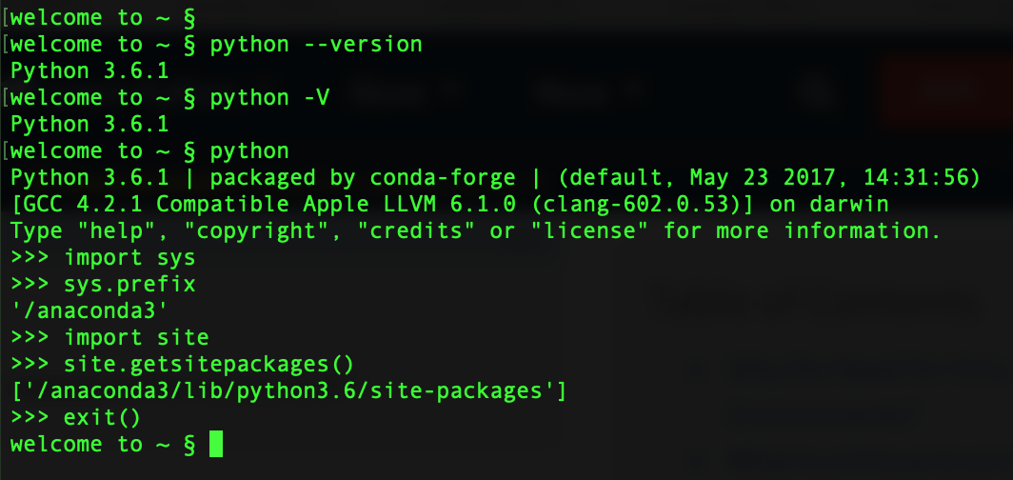
How does Python download, store and resolve packages?
Command line prompt (usually takes commands in a language called Bash)
Notes:
OPEN COMMAND LINE (easier on Mac or Linux)

Slide 8
How does Python download, store and resolve packages?
Check what Python interpreter you are using

Slide 9
How does Python download, store and resolve packages?
Tell your OS that you now want to use the Python interpreter
(ie write commands in Python instead of in Bash)

Slide 10
How does Python download, store and resolve packages?
You are now using your Python interpreter

Slide 11
How does Python download, store and resolve packages?
RECALL:
System packages: standard Python library
Site Packages: 3rd party packages (usually from PyPI)
Find out where your system packages are stored!

Slide 12
How does Python download, store and resolve packages?
RECALL:
System packages: standard Python library
Site Packages: 3rd party packages (usually from PyPI)
Find out where your system packages are stored!

Slide 13
How does Python download, store and resolve packages?
RECALL:
System packages: standard Python library
Site Packages: 3rd party packages (usually from PyPI)
Find out where your site packages are stored!

Slide 14
How does Python download, store and resolve packages?
RECALL:
System packages: standard Python library
Site Packages: 3rd party packages (usually from PyPI)
Find out where your site packages are stored!

Slide 15
How does Python download, store and resolve packages?
or: CTRL + D
stop using your Python interpreter

Slide 16
How does Python download, store and resolve packages?
System packages: packages that are part of the standard Python library
Site Packages: 3rd party packages
Virtual Environments:
Python tool for package management and project isolation
Allow for site packages (3rd party packages) to be installed in a local directory (ex: specific project) instead of globally
ie create a “local” (project-specific) site-packages directory that can use its own version of Python!
Why? https://towardsdatascience.com/virtual-environments-104c62d48c54#ee81
“Resolve dependency issues by allowing you to use different versions of a package for different projects.
Make your project self-contained and reproducible by capturing all package dependencies in a requirements file.
Install packages on a host on which you do not have admin privileges.
Keep your global site-packages/ system site-packages directory tidy by removing the need to install packages system-wide which you might only need for one project.”

Slide 17
Virtual Environments: Motivation
Project B examines the relationship between TBV and age in a new dataset
project_B.py (script) loads & analyzes new_dataset.csv (data file)
Dependencies:
numpy v 1.19
pandas v 1.1.2
matplotlib 3.3.1
Project A examines the relationship between TBV and age in an old dataset
project_A.py (script) loads & analyzes dataset.csv (data file)
Dependencies
numpy v 1.15
pandas v 1.1.2
matplotlib 3.3.1,
linearmodels

Slide 18
Virtual Environments: Motivation
Project B examines the relationship between TBV and age in a new dataset
project_B.py (script) loads & analyzes new_dataset.csv (data file)
Dependencies:
numpy v 1.19
pandas v 1.1.2
matplotlib 3.3.1
Project A examines the relationship between TBV and age in an old dataset
project_A.py (script) loads & analyzes dataset.csv (data file)
Dependencies
numpy v 1.15
pandas v 1.1.2
matplotlib 3.3.1,
linearmodels
Alert! Different package dependencies → store in separate virtual environments

Slide 19
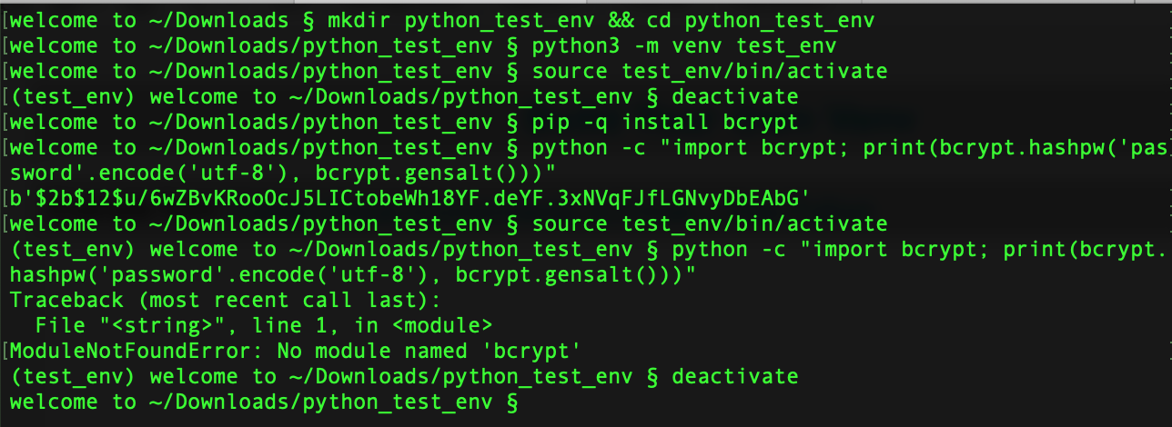
Build Your Own Venv
Example from: Python Virtual Environments: A Primer – Real Python
Note: this example assumes that you are using Python 3

Slide 20
Build Your Own Venv
Example from: Python Virtual Environments: A Primer – Real Python
Make a directory and cd into it

Slide 21
Build Your Own Venv
Example from: Python Virtual Environments: A Primer – Real Python
Create a virtual environment (can name it anything you want)

Slide 22
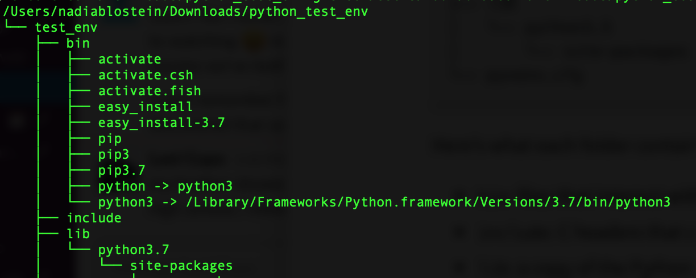
Build Your Own Venv
Example from: Python Virtual Environments: A Primer – Real Python
Create a virtual environment (can name it anything you want)

Slide 23
Build Your Own Venv
Example from: Python Virtual Environments: A Primer – Real Python
contains script that allows you to switch from global venv to local venv

Slide 24
Build Your Own Venv
Example from: Python Virtual Environments: A Primer – Real Python
Copy of your local env’s version of Python

Slide 25
Build Your Own Venv
Example from: Python Virtual Environments: A Primer – Real Python
Where the 3rd party packages of the local venv are stored

Slide 26
Build Your Own Venv
Example from: Python Virtual Environments: A Primer – Real Python
Switch from global to local venv

Slide 27
Build Your Own Venv
Example from: Python Virtual Environments: A Primer – Real Python
Switch from global to local venv

Slide 28
Build Your Own Venv
Example from: Python Virtual Environments: A Primer – Real Python
Switch from local to global venv

Slide 29
Build Your Own Venv
Example from: Python Virtual Environments: A Primer – Real Python
Switch from local to global venv
Notes:
Command line prompt is back to normal

Slide 30
Build Your Own Venv
Example from: Python Virtual Environments: A Primer – Real Python
Install 3rd party package in global site-packages directory
Notes:
Command line prompt is back to normal

Slide 31
Build Your Own Venv
Example from: Python Virtual Environments: A Primer – Real Python
Use bcrypt to hash a password
Notes:
Command line prompt is back to normal

Slide 32
Build Your Own Venv
Example from: Python Virtual Environments: A Primer – Real Python
Use bcrypt to hash a password
Notes:
Command line prompt is back to normal

Slide 33
Build Your Own Venv
Example from: Python Virtual Environments: A Primer – Real Python
Switch back to your local venv
Notes:
Command line prompt is back to normal

Slide 34
Build Your Own Venv
Example from: Python Virtual Environments: A Primer – Real Python
Switch back to your local venv
Notes:
Command line prompt is back to normal

Slide 35
Build Your Own Venv
Example from: Python Virtual Environments: A Primer – Real Python
Use bcrypt to hash a password
Notes:
Command line prompt is back to normal

Slide 36
Build Your Own Venv
Example from: Python Virtual Environments: A Primer – Real Python
ModuleNotFoundError !
Notes:
Command line prompt is back to normal

Slide 37
Anaconda and Miniconda
Pip: package manager
Virtualenv: environment manager
Conda: both!
Packaging tool and installer (like pip!) → packages from Anaconda Repository and Anaconda Cloud (instead of PyPI)
Creates a virtual environment (like virtualenv!)
Command line tool: does not require a Python interpreter
Conda Cheat Sheet
Anaconda: Python and R distribution, “aims to simplify package management and deployment” (Wiki)
Python interpreter (any version you chose) + Conda + “meta-packages anaconda” (predetermined set of Python packages)
Miniconda:
Python interpreter (any version you chose) + Conda
manually install any packages/dependencies you need
⊕: less space, quicker to install, customizable
⊖: requires a better understanding of venvs as well as what your project requires
READ MORE:
Anaconda vs. Miniconda vs. Virtualenv
Understanding Conda and Pip

Slide 38
Build your own Conda Virtual Environment!
(1) Download the correct files from the CobraLab Google Drive: CobraLab → PRESENTATIONS → LAB MEETINGS → Info_Session_2020 → 2020-09-16-virtual-environments → test_conda_env.tar.gz:
https://drive.google.com/drive/folders/1Ngtmwn-ePr-8Kt5ai8CluKVG93E3qupI?usp=sharing
(2) Unzip the .tar file and cd into through your terminal!
NOTATION
$ some_text_here: some_text_here is a command-line argument (you can just copy-paste it into your terminal!)

Slide 39
Build your own Conda Virtual Environment!
OPTION 1 (2nd option later):
(3) Create your conda environment:
$ conda create --name my_conda_env python=3.8.3
(2) Activate your condal environment:
$ source activate my_conda_env
(5) Download all of the right packages and dependencies to be able to run HCP_interactive_plot.ipynb:
$ conda install numpy
$ conda install pandas
$ conda install plotly
$ conda install dash
$ conda install -c conda-forge -c plotly jupyter-dash
$ conda install jupyter
$ conda install nb_conda_kernels
(6) Launch Jupyter Notebook!
$ jupyter notebook

Slide 40
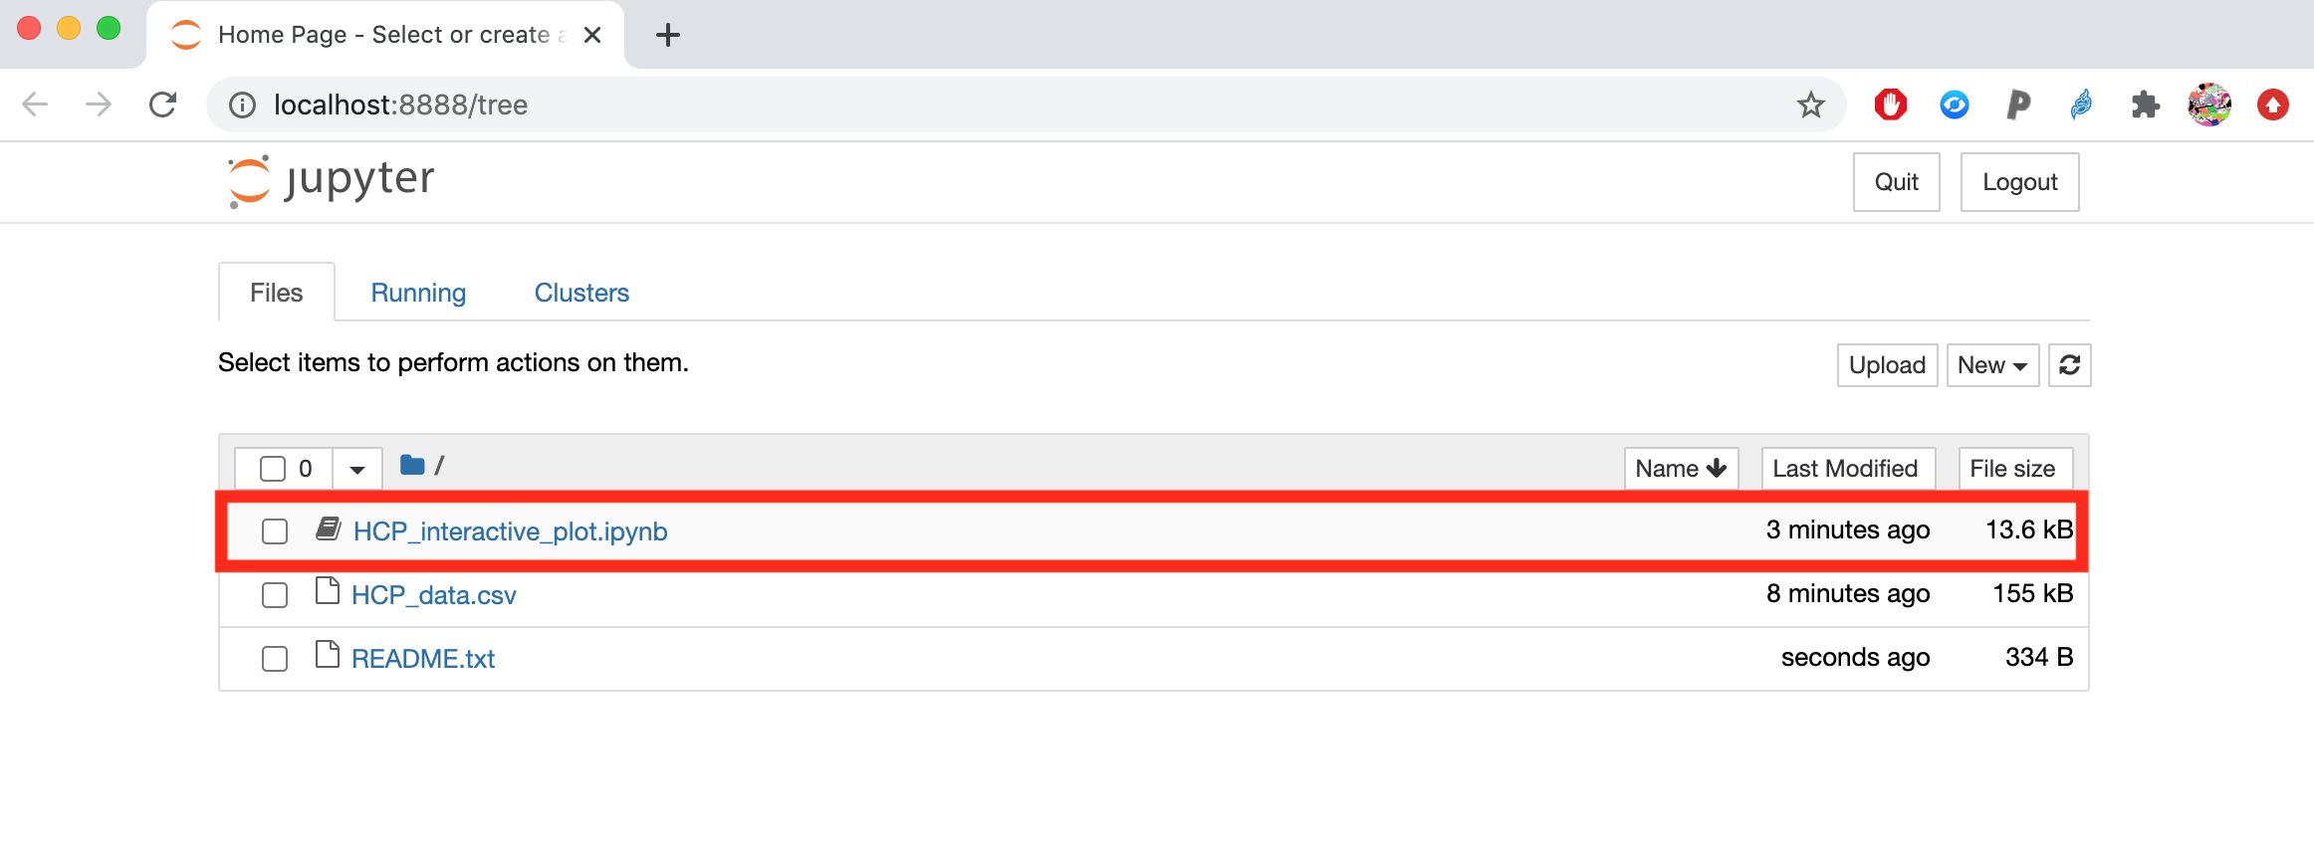
Build your own Conda Virtual Environment!
(8) Open the Jupyter Notebook:

Slide 41
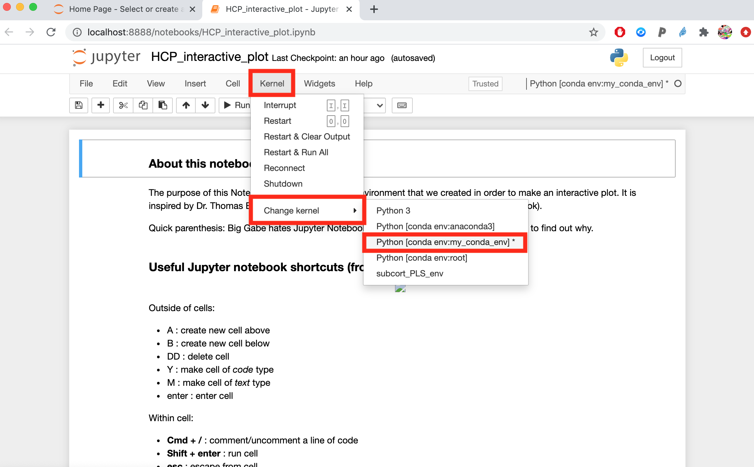
Build your own Conda Virtual Environment!
(9) Make sure you are using the right kernel

Slide 42
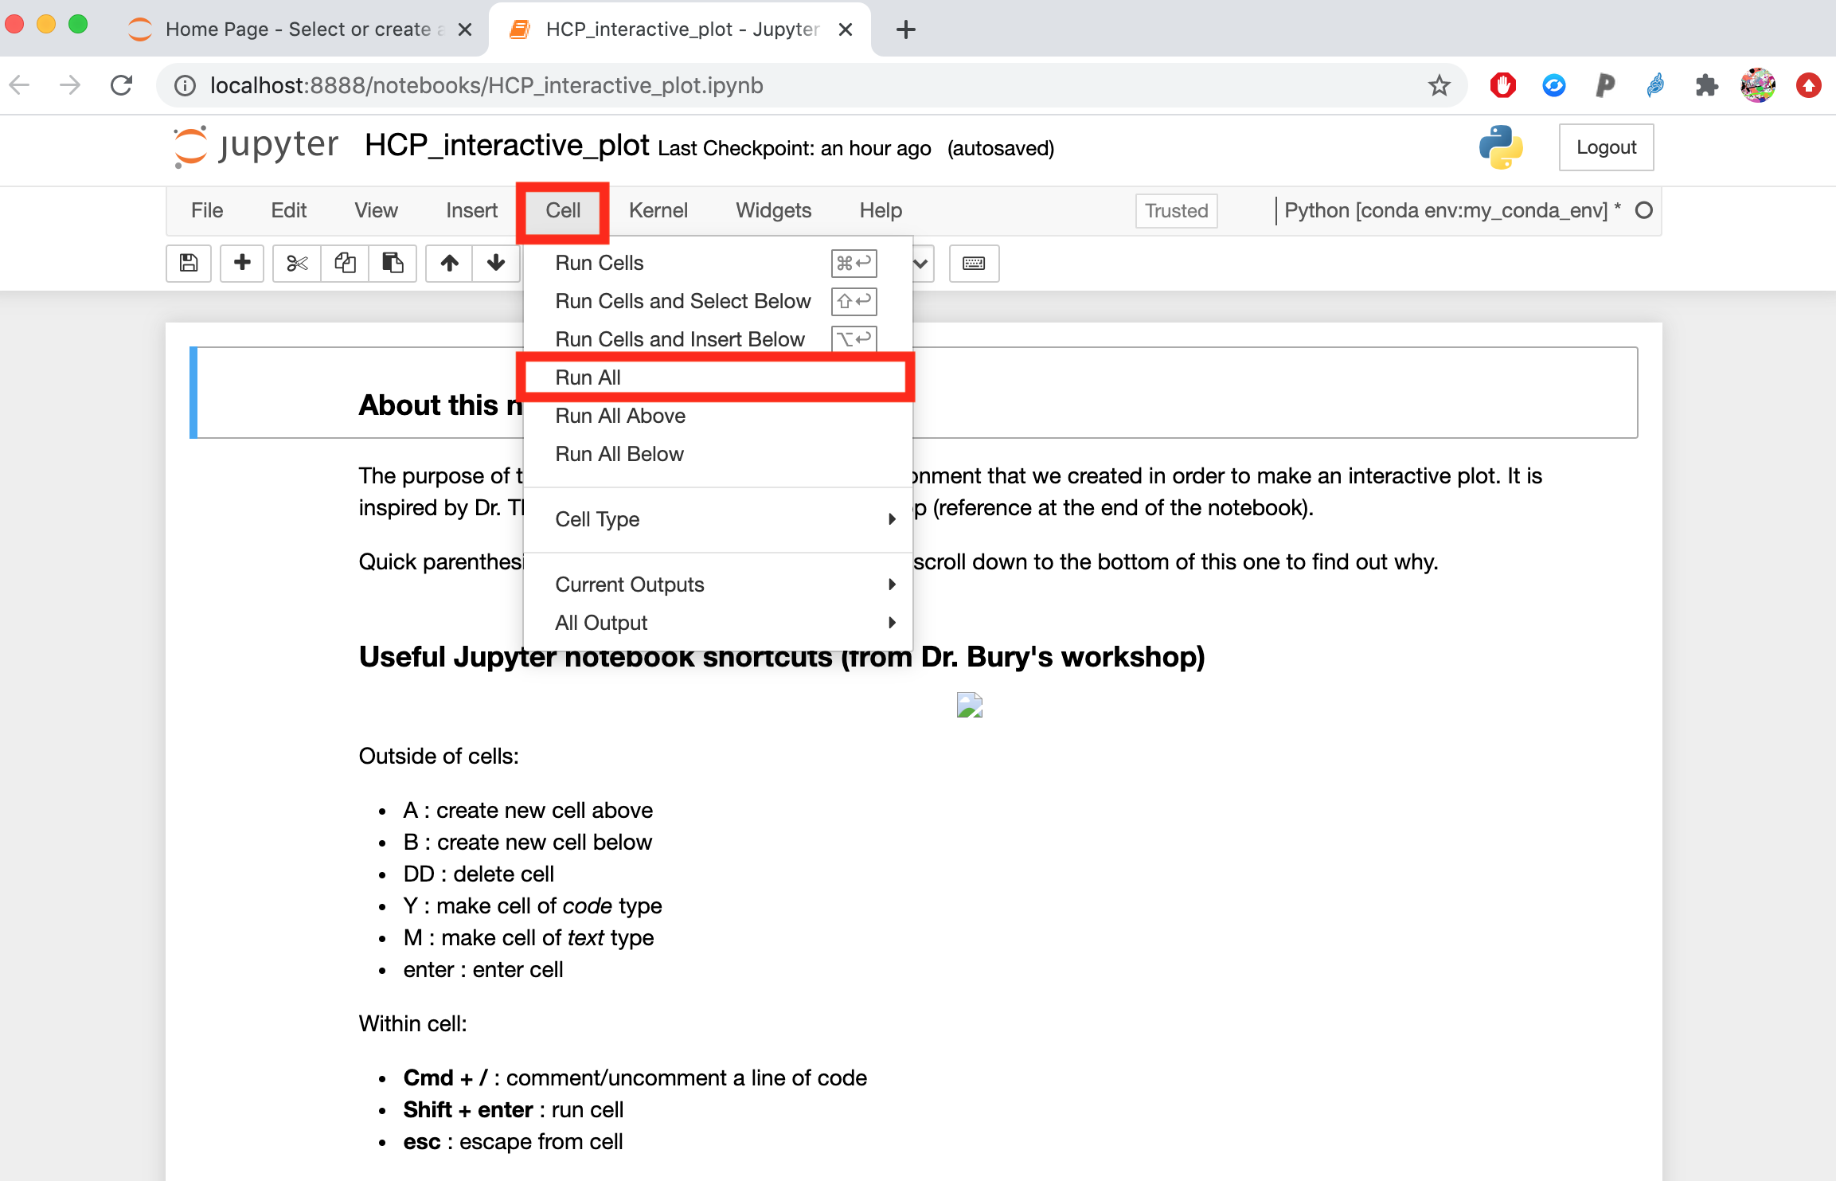
Build your own Conda Virtual Environment!
(10) Run all of the cells

Slide 43
Maintaining good habits
Your final goal is for anybody (including yourself) to be able reproduce your results whenever and as seamlessly as possible, whilst minimizing the steps required to do so.

Slide 44
Maintaining good habits… save dependencies
pip freeze: virtual environments (venv)
List all packages in the current environment:
$ pip freeze -l
Save packages for future use:
$ PATH_TO_ENV_1/bin/pip pip freeze > requirements.txt
Reinstall packages from an export file:
$ PATH_TO_ENV_2/bin/pip install -r requirements.txt
conda list: conda environments
List all packages in the current environment:
$ conda list
List all packages installed into the environment 'myenv':
$ conda list -n myenv
Save packages for future use:
$ conda list --explicit > package-list.txt
Reinstall packages from an export file:
$ conda create -n myenv --file package-list.txt
Makefiles
Deploying software, sharing projects

Slide 45
Build your own Conda Virtual Environment!
OPTION 2: package list
(3) Create your conda environment:
$ conda create --name my_conda_env python=3.8.3 --file=package-list.txt
(4) Activate your condal environment:
$ source activate my_conda_env
(5) Launch Jupyter Notebook!
$ jupyter notebook or $ python HCP_interactive_plot.py

Slide 46
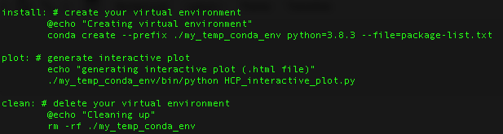
Build your own Conda Virtual Environment!
OPTION 3: makefile
makefile anatomy

Slide 47
Build your own Conda Virtual Environment!
OPTION 3: makefile
(3) $ make install
makefile anatomy

Slide 48
Build your own Conda Virtual Environment!
OPTION 3: makefile
(3) $ make install
(4) $ make plot
makefile anatomy

Slide 49
Build your own Conda Virtual Environment!
OPTION 3: makefile
(3) $ make install
(4) $ make plot
(5) $ make clean
makefile anatomy

Slide 50
Thank you!

