Slide 1
Python
presented by Eng. Mona Qasem

Slide 2
Session 1
Introduction

Slide 3
Course outcomes:
Introduction
Print function
Variables
Receive input
Type conversion
Strings
Formatted Strings
String Methods
Arithmetic Operations
Operator Precedence
Math Functions
If Statements
Logical Operators
Comparison Operators
While Loops
For Loops
Nested Loops
Lists
2D Lists
List Methods
Tuples
Unpacking
Dictionaries
Exceptions
Comments
Classes
Constructors
Inheritance
Modules
Packages
Generating Random Values
Working with Directories
Pypi and Pip

Slide 4
objectives:
Introduction
Print function
Variables

Slide 5
Introduction
Python is a general-purpose interpreted, interactive, object-oriented, and high-level programming language
Why to Learn Python?
Python is a high-level, interpreted, interactive and object-oriented scripting language. Python is designed to be highly readable. It uses English keywords frequently whereas other languages use punctuation, and it has fewer syntact constructions than other languages.
Applications:
Web Development
Game Development
Scientific and Numeric Applications
Artificial Intelligence and Machine Learning
Software Development
Enterprise-level/Business Applications
Education programs and training courses
Language Development

Slide 6
Course Projects
Automation
The process of creating a system to replace repeatable processes and reduce manual intervention.

Slide 7
Software
Install software :
Python.org → downloads → download
Downloads → add python to path → install
Code editor:
Pycharm: jetbrain.com/pycharm → downloads → community
Downloads → install
Create new project → new → python file ( app.py)
Online compiler:
Repl.it

Slide 8
Basic concepts:
Flow diagram/ instructions
Index
Variables
Data types
Functions (return/ non-return)
Parameters
Decision making
Arithmetic and logic operations
Loops

Slide 9
Write first code
Print function
x=10
print()

Slide 10
Print:
print(‘’)
print (“ ”)
print (10)
print (x)
print (‘*’ * 10)
print (‘’+’’)

Slide 11
Variables
Age = 26 // integer // int
Price = 4.99 // float // float
Name =”Mona” //string // str
Is_active = True // boolean // bool

Slide 12
Check list
Introduction
Print function
Variables

Slide 13
Thank you

Slide 14
Session 2
Input and Strings

Slide 15
Objectives:
Receive input
Type conversion
Strings
Formatted Strings
String Methods

Slide 16
Receiving Input
StringVar = input(‘msg’_ )
name = input (‘what is your name?’ )
Task: ask the user two questions, about their name and age the print a customized message
E.g. Mona is 26 years old

Slide 17
Welcome mona, you are 27 years old
You were born in 1994

Slide 18
Ask the user to enter their weight in kg then convert it to lbs and print the result

Slide 19
Type conversion
Implicit Type Conversion
Explicit Type Conversion

Slide 20
Type conversion
int()
bool()
float()
str()

Slide 21
Task:
Ask the user for their birth year, then calculate their age and print the result as such:
Mona is 26 years old

Slide 22
Strings:
name= ‘mona’
Last_name = ”qasem”
Text =’’’ hello
This is python for beginners
Welcome ‘’’
Name[0] = ‘m’ // strings are arrays of characters

Slide 23
Session 3
Math and logic

Slide 24
Objectives:
Formatted Strings
String Methods
Arithmetic Operations
Operator Precedence
Math Functions
Logical Operators
Comparison Operators

Slide 25
Formatted Strings:
name = “mona”
print (f” my name is {name} ”)

Slide 26
String methods
Methods are specific functions that belong to an object
txt=’hello’
=txt.upper()
txt.lower()
print(txt.find(‘e’)) // returns index
txt.replace(‘old value’,’new value’)
‘P’ in txt // boolean expression
len(txt) // general purpose function returns number of
characters in string

Slide 27
Arithmetic operations
addition
subtraction
* multiplication
/ division # float
// floor division # int
% modulus division ( remainder) #int
** exponential

Slide 28
Augmented assignment operator
x= 10
x= x+1 → x+=1
x= x-1 → x-=1
x= x*1 → x*=1
x= x/1 → x/=1
x= x//1 → x//=1
x= x%1 → x%=1
x= x**1 → x**=1

Slide 29
Operator precedence
Brackets ()
Exponent **
Division and multiplication * /
Addition and subtraction + -

Slide 30
Math functions (built in)
round()
abs()
Math module : separate file with reusable code
Import math
math.sin() // access method using .
.
. ( python 3 math module )
.

Slide 31
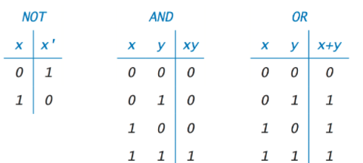
Logic operators: ( and / or / not )

Slide 32
Comparison operators
> greater than
>= greater or equal than
< less than
<= less or equal than
== equal
!= not equal

Slide 33
Check list
Formatted Strings
String Methods
Arithmetic Operations
Operator Precedence
Math Functions
Logical Operators
Comparison Operators

Slide 34
Session 4
Decision making

Slide 35
Objectives:
Execution of code when making decisions
If statements
Else
Else if
Exercices

Slide 36
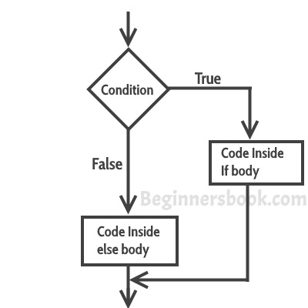
Decision making flowchart:

Slide 37
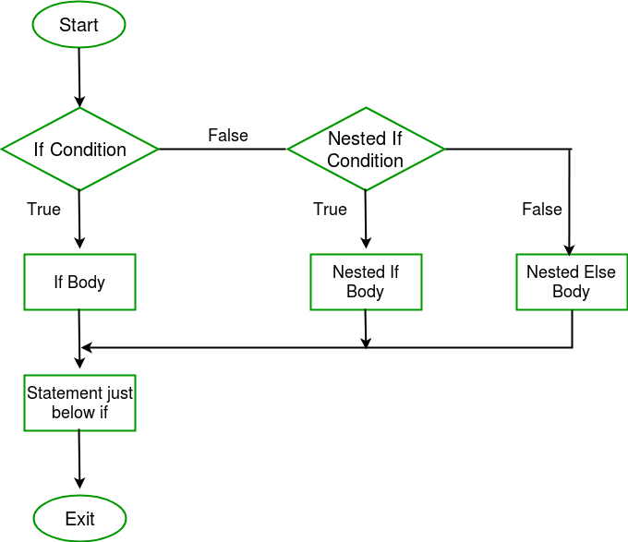
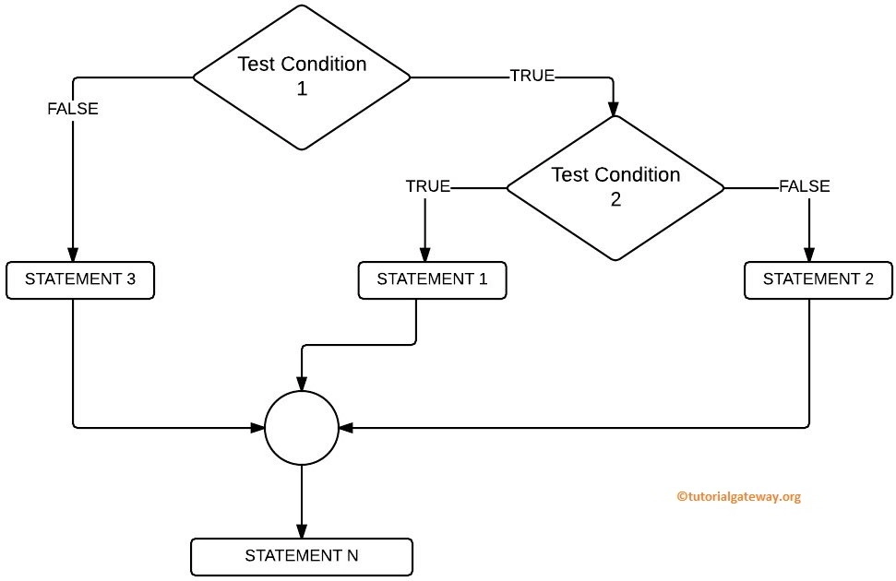
Nested if conditions:

Slide 38
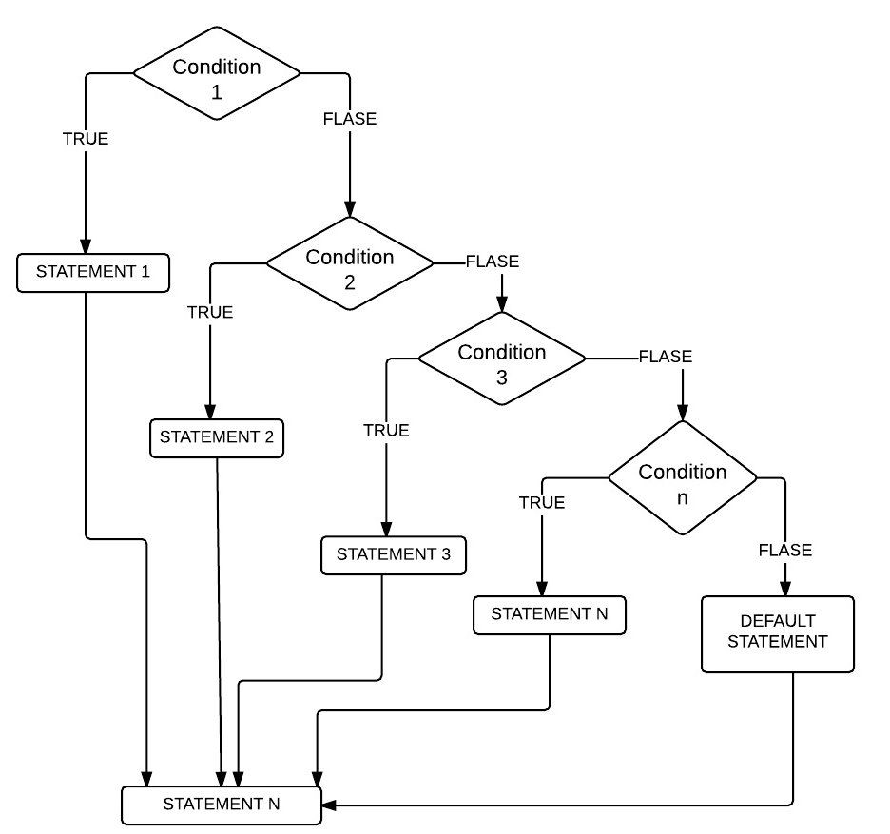
Elif condition:

Slide 39
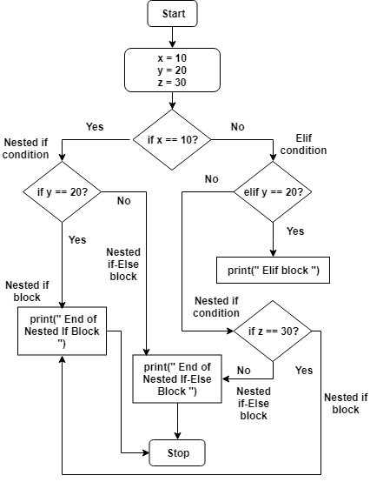
example:

Slide 40
Syntax
if boolean expression:
Action
Action
.
.
else:
action
if boolean expression:
elif boolean expression:
elif boolean expression:
else:

Slide 41
Exercises:
Write a program that checks whether a person can vote in the elections, ask the user for their nationality and their age, if the user is Jordanian and the age is over 18, they have access to vote.
A gym membership is 150 JD, however the gym gives a discount of 30% for people who have been clients for 24 months or more, or for children who are under 16 . Write a program that tells each member their fees.

Slide 42
Exercises:
3. Write a program that receives a student’s grade from 100 and grades it (A, B, C, D, F, invalid grade) the marks are from 0 to 100
[90 - 100] = A
[80 - 90) = B
[70-80) = C
[60-70) = D
[0-60) = F
Other than that = invalid grade

Slide 43
Exercises:
4. Write a guessing game where the user has to guess a number from 1 to 5
5. Write a program that asks the user for a number and determines whether is even or odd
6. Write a program that asks the user for the item’s price, checks whether the user has a voucher, and for the discount amount if there is a voucher, then prints the total cost

Slide 44
Check list
Execution of code when making decisions
If statements
Else
Else if
Exercices

Slide 45
Thank you

Slide 46
Session 5
Flow control

Slide 47
Objectives:
Flow control
While Loops
Exercises

Slide 48
While loop Syntax
while condition : // condition = boolean expression
Action
Action // as long as condition == true action is executed repeatedly
If :
break // exit loop
else:
Action // gets executed if the loop is completed without any break
i= 1
while i<=5:
print(i)
i +=1
i= 1
while i<=5:
print(i*”*”)
i +=1

Slide 49
While loop mul table 4-40
*
**
***
****
*****

Slide 50
Exercises:
Exercise 1
Write a program that asks the user to guess a number and gives him three guesses, if he uses all the guesses without winning print “game over”, if he guess print “correct” and exit the loop
Exercise 2
Write a code that asks the user for commands for controlling a car (stop, start, help, quit)
Help → displays all instructions with description
Start and stop → control the car
Quit → exits loop
Extra : you can’t start or stop the car if it’s already started - stopped

Slide 51
Session 6
Flow control

Slide 52
objectives:
For loops
In function
Len function
Continue function
Pass function
Nested loops
Exercices

Slide 53
While vs for:
Write a program that prints the letters of any string entered by the user individually

Slide 54
for loop Syntax
For loop is a loop executed on arrays elements
for item in list:
Action // execute function on each element
break
else:
Action // executed if for loop completed without breaks

Slide 55
Range function
range(10) → o….9
range (5,10) → 5...9
range(5,10,2) → 5, 5+2,7+2, → 5,7,9 // last parameter is the step

Slide 56
Exercise 1
Write a program that adds the prices of an item’s list and prints the total
l=[10,40,34,23,68]
Exercise 2
Write a program that prints a list of arranged pairs (x,y)
X → 0-4
Y → 7,10

Slide 57
Thank you

Slide 58
Session 7
Evaluation

Slide 59
Session 8
Lists

Slide 60
objectives:
Lists
List methods
Create lists
Check if value is present in list
Change value in list
Add items
Remove items
Join lists
Make copy of list
Count duplicates
Sort lists

Slide 61
Collection Data types:
There are four collection data types in the Python programming language:
List is a collection which is ordered and changeable. Allows duplicate members.
Tuple is a collection which is ordered and unchangeable. Allows duplicate members.
Set is a collection which is unordered and unindexed. No duplicate members.
Dictionary is a collection which is unordered and changeable. No duplicate members.
When choosing a collection type, it is useful to understand the properties of that type. Choosing the right type for a particular data set could mean retention of meaning, and, it could mean an increase in efficiency or security.

Slide 62
Lists:
Lists are used to store multiple items in a single variable.
Ordered
When we say that lists are ordered, it means that the items have a defined order, and that order will not change.
If you add new items to a list, the new items will be placed at the end of the list
Changeable
The list is changeable, meaning that we can change, add, and remove items in a list after it has been created
Allow Duplicates
Since lists are indexed, lists can have items with the same value

Slide 63
Create a List:
Method 1: square brackets
LIstName = [ item1 , item2 , …... ] # items can be any data type (int , str, bool ..)
Method 2: list() constructor
ListName = list (( item1 , item2 , …... ))

Slide 64
Examples:
Students = [“Omar” , “Zaid” , “Sara” , “Mona” , “Manal”]
print(Students) # prints entire list
Numbers = list(( 5 , 4 , 7 , 13 ))
print (Numbers[2]) # prints item selected by index
Data = [5 , “hello” , True , 2.1 ]
print(len(Data)) # prints number of items inside list
# lists can have different data type
Use the type function → type(Data) / type(Data[0]) / ...

Slide 65
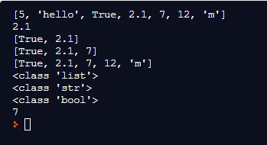
Example:
Data =[5,"hello",True,2.1,7,12,"m"]
print(Data)
print(Data[3])
print(Data[2:4])
print(Data[2:5])
print(Data[:])
print(type(Data))
print(type(Data[1]))
print(type(Data[2]))
print(len(Data))

Slide 66
Check if item is present in list
fruits = ["apple","orange","mango","banana","cherry"]
if "mango" in fruits:
print ("mango is present")
if "watermelon" in fruits:
print ("watermelon is present")
else:
print ("watermelon is not present")

Slide 67
Change item in list:
ListName = [ item1 , item2 , item3 , item4, …. ]
listName [3] = new value # set the item with index 3 to a new value
Change range of items:
LIstName = [ item1 , item2 , item3 , item4, …. ]
listName [1:4] =[ new value1,new value 2 , new value 3] # set the item with indexes 1, 2 ,3 to new values

Slide 68
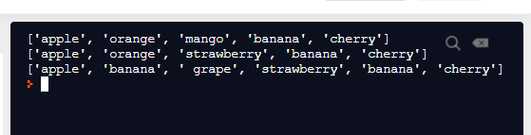
Example:
fruits = ["apple","orange","mango","banana","cherry"]
print(fruits)
fruits[2]= "strawberry"
print(fruits)
fruits [1:3]=["banana"," grape"]
print(fruits)

Slide 69
Add items to list
append() : adds item at the end of a list
ListName = [ item1 , item2 , item3 , item4 ]
ListName.append(new value)
ListName = [ item1 , item2 , item3 , item4, new value ]
insert() : adds item at certain index and shifts the rest of the items forward
ListName = [ item1 , item2 , item3 , item4 ]
ListName.insert( index, new value)
ListName = [ item1 , item2 , new value , item3 , item4 ]

Slide 70
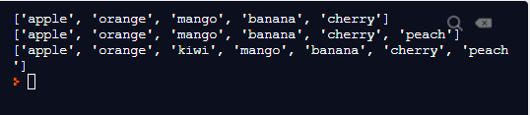
Examples:
fruits = ["apple","orange","mango","banana","cherry"]
print(fruits)
fruits.append("peach")
print(fruits)
fruits.insert(2,"kiwi")
print(fruits)

Slide 71
Remove items from list
remove() : removes given value and shifts the rest of the items backwards
myList.remove(value)
delete: deletes given item and shifts the rest of the items backwards,
or deletes entire list; list no longer exists
del myList[3]
del myList
pop() : deletes given index and shifts the rest of the items backwards, or deletes last item if no index is given
myList.pop(3)
myList.pop()
clear(): empties list, but list still exists
myList.clear()

Slide 72
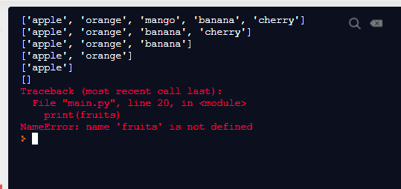
Examples:
fruits = ["apple","orange","mango","banana","cherry"]
print(fruits)
fruits.remove("mango")
print(fruits)
del fruits[3]
print(fruits)
fruits.pop()
print(fruits)
fruits.pop(1)
print(fruits)
fruits.clear()
print(fruits)
del fruits
print(fruits)

Slide 73
Join lists :
list1 = [1,2,3,4,5]
list2 = [6,7,8]
extend(): list1.extend(list2) → list1 =[1,2,3,4,5,6,7,8] , list2 = no change
list2.extend(list1) → list2 =[6,7,8,1,2,3,4,5] , list1 = no change
+: list3=list1+list2 → list3= [1,2,3,4,5,6,7,8] , list1 and 2 no change
append(): append each item of second list using for loop
for item in list2:
list1.append(item) → list1 =[1,2,3,4,5,6,7,8] , list2 = no change

Slide 74
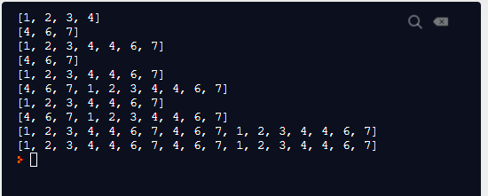
Example:
list1 = [1,2,3,4]
list2 =[4,6,7]
print(list1)
print (list2)
list1.extend(list2)
print(list1)
print (list2)
list2.extend(list1)
print(list1)
print (list2)
list3 =list1+list2
print(list1)
print (list2)
print (list3)
for i in list2:
list1.append(i)
print (list1)

Slide 75
Make copy: create a copy of the list and store it in a new location
copy(): newList = oldList.copy()
Example:
myList =[4,3,4,5,8,7,4,7,1,4]
newList = myList.copy()
list():newList = list(oldList)
Example:
myList =[4,3,4,5,8,7,4,7,1,4]
newList = list(myList)

Slide 76

Count duplicates: count how many times a value was repeated inside a list
myList.count(value)
Example:
myList =[4,3,4,5,8,7,4,7,1,4]
print(myList.count(4))
print(myList.count(3))
print(myList.count(9))

Slide 77
Sort lists:
list.sort() # alphabetically
list.sort() # numerically
list.sort(reverse = True) # numerically descending

Slide 78
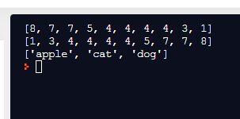
Example:
myList =[4,3,4,5,8,7,4,7,1,4]
wordsList=["cat","dog","apple"]
myList.sort(reverse = True)
print(myList)
myList.sort()
print(myList)
wordsList.sort()
print(wordsList)

Slide 79
Exercices:
Write a program that fills a list using numeric data received from user until the user types quit, then shows the length of the list and sorts the numbers ascendantly
Write a program that removes duplicates from a list
[2,4,6,4,3,2,3,4,6,7,3,9]
Write a program that creates a list of 5 items filled by the user, if the user repeats one of the items the program will ask the user to enter a new value.

Slide 80
Session 9+10
Tuples, sets , dictionaries

Slide 81
objectives:
Tuples
Sets
dictionaries

Slide 82
Tuples:
Tuple items are ordered, unchangeable, and allow duplicate values.
Tuple items are indexed, the first item has index [0], the second item has index [1] etc.
Ordered
When we say that tuples are ordered, it means that the items have a defined order, and that order will not change.
Unchangeable
Tuples are unchangeable, meaning that we cannot change, add or remove items after the tuple has been created.
Allow Duplicates
Since tuple are indexed, tuples can have items with the same value

Slide 83
Create a tuple:
Method 1: using brackets
tupleName = (item1,item2,item3...)
Method 2 : using tuple() constructor
thistuple = tuple(("apple", "banana", "cherry"))
Items can be accessed using index:
print (tupleName [0])
print (tupleName [2:4])
Items can be any data type:
tuple1 = ("apple", "banana", "cherry")
tuple2 = (1, 5, 7, 9, 3)
tuple3 = (True, False, False)

Slide 84
Create Tuple With One Item
To create a tuple with only one item, you have to add a comma after the item, otherwise Python will not recognize it as a tuple.
Example :One item tuple, remember the comma:
thistuple = ("apple",)
print(type(thistuple))
#NOT a tuple
thistuple = ("apple")
print(type(thistuple))

Slide 85
type()
From Python's perspective, tuples are defined as objects with the data type 'tuple':
<class 'tuple'>
Example
What is the data type of a tuple?
mytuple = ("apple", "banana", "cherry")
print(type(mytuple))

Slide 86
Tuple Length
To determine how many items a tuple has, use the len() function:
Print the number of items in the tuple:
thistuple = ("apple", "banana", "cherry")
print(len(thistuple))
Delete tuple
The del keyword can delete the tuple completely:
thistuple = ("apple", "banana", "cherry")
del thistuple
print(thistuple) #this will raise an error because the tuple no longer exists

Slide 87
Update Tuples ( update, add, remove)
Tuples are unchangeable, meaning that you cannot change, add, or remove items once the tuple is created. But there are some workarounds.
Change Tuple Values
Once a tuple is created, you cannot change its values. Tuples are unchangeable, or immutable as it also is called.
But there is a workaround. You can convert the tuple into a list, change the list, and convert the list back into a tuple.
Example : Convert the tuple into a list to be able to change it
x = ("apple", "banana", "cherry")
y = list(x)
y[1] = "kiwi"
x = tuple(y)
print(x)

Slide 88
Unpacking a Tuple
Means to extract the values from a tuple back into variables
Example:
coordinates =(3,7,2)
x,y,z = coordinates → #x=3, y=7, z=2
This is used for easier access to the values
x instead of coordinate[0]
y instead of coordinate[1]
z instead of coordinate[2]

Slide 89
Join Two Tuples
To join two or more tuples you can use the + operator:
Example
Join two tuples:
tuple1 = ("a", "b" , "c")
tuple2 = (1, 2, 3)
tuple3 = tuple1 + tuple2
print(tuple3)
Multiply Tuples
If you want to multiply the content of a tuple a given number of times, you can use the * operator:
Example
Multiply the fruits tuple by 2:
fruits = ("apple", "banana", "cherry")
mytuple = fruits * 2
print(mytuple)

Slide 90
Tuple Methods
Python has two built-in methods that you can use on tuples.
count()
Returns the number of times a specified value occurs in a tuple
index()
Searches the tuple for a specified value and returns the position of where it was found

Slide 91
Sets:
use {} to create a set or the set() constructor
Set items are unordered, unchangeable, and do not allow duplicate values.
Duplicate values will be ignored:
thisset = {"apple", "banana", "cherry", "apple"}
thisset = set(("apple", "banana", "cherry"))
print(thisset)
Get length :
print(len(thisset))
Get type
print(type(myset))

Slide 92
Accessing set items:
Access items through for loop
Find item using in function
Can’t change items but can add new items

Slide 93
Add items
add() : add one new item to the set
mySet.add(new item)
update() : add another set, list or tuple to an existing set
Set1 ={ }
Set2 = { }
list1= [ ]
set1.update(set2)
Set2.update (list1)

Slide 94
Remove items:
Remove : removes one item , if item is does not exist, error is raised
myset.remove(“banan”)
Discard : removes one item, if item does not exist no error is raised
myset.discard(“banana”)
Pop : removes last item in set, which is random (items not ordered) and returns removed item
X = myset.pop()
Clear :empties set, set still exist
myset.clear()
Delete: deletes set
del myset

Slide 95
Join sets: (duplicates are dropped)
union()
set3= set1.union(set2) // returns new set
update()
set1.update(set2) // adds set2 to set1 and stores in set1
intersection()
set3 = set1.intersection(set2) // returns new set with common items
intersection_update()
set1.intersection_update(set2) // set1= only common items
symmetric_difference_update()
Keep the items that are not present in both sets
symmetric_difference()
Return a set that contains all items from both sets, except items that are present in both

Slide 96
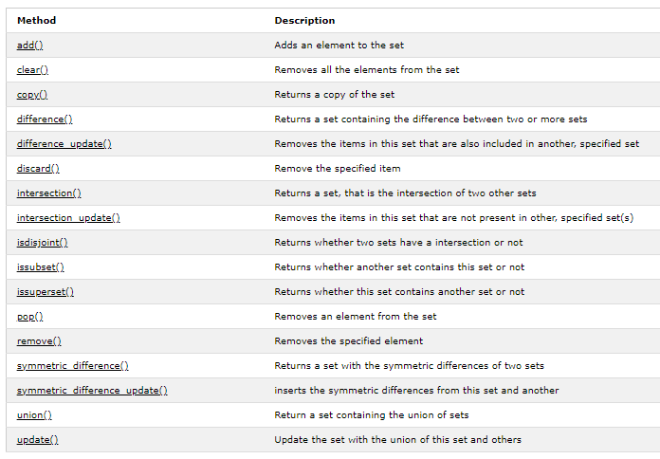
Set methods:

Slide 97
Dictionaries:
Dictionaries are used to store data values in key:value pairs.
A dictionary is a collection which is unordered, changeable and does not allow duplicates.
Dictionaries are written with curly brackets, and have keys and values
Example
Create and print a dictionary:
thisdict = {
"brand": "Ford",
"model": "Mustang",
"year": 1964
}
print(thisdict)

Slide 98
Accessing item using key and square brackets:
thisdict = {
"brand": "Ford",
"model": "Mustang",
"year": 1964
}
print(thisdict["model"])
Accessing item using the get() method
thisdict.get(“model”)

Slide 99
Keys cannot be duplicated but values can
car{ "year": 1964 ,
"price": 1964 ,
"price": 100}
Each item can be any data type including list
"brand": "Ford",
"electric": False,
"year": 1964,
"colors": ["red", "white", "blue"]
Items can be updated
car[“price”] =2000
New items can be added
car["color"] = "white"

Slide 100
Dictionaries methods:
len(dict)
type(dict)
keys()
values()
items()
update({“key”:value})
pop(“key”)
popitem()
del dict[“key”]
clear()
copy()
dict()

Slide 101
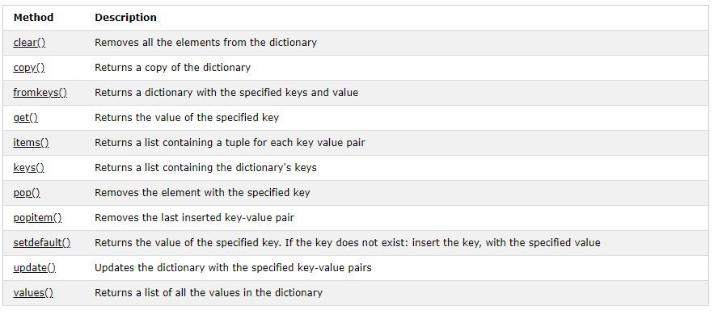

Slide 102
Session 11
Functions

Slide 103
objectives:
Creating a function
Arguments
Arbitrary arguments
Keywords argument
Default parameter value
Return value
Pass statement
Recursion
Lambda

Slide 104
Creating a function:
In Python a function is defined using the def keyword:
Example:
def my_function():
print(“welcome”)
Calling a function:
my_function()

Slide 105
Functions
A function is a block of code which only runs when it is called.
You can pass data, known as parameters, into a function.
A function can return data as a result

Slide 106
Arguments:
Information can be passed into functions as arguments.
Arguments are specified after the function name, inside the parentheses. You can add as many arguments as you want, just separate them with a comma.
The following example has a function with one argument (fname). When the function is called, we pass along a first name, which is used inside the function to print the full name:
def my_function(fname):
print(fname + " Refsnes")
my_function("Emil")
my_function("Tobias")
my_function("Linus")

Slide 107
Parameters or Arguments?
The terms parameter and argument can be used for the same thing: information that are passed into a function.
From a function's perspective:
A parameter is the variable listed inside the parentheses in the function definition.
An argument is the value that is sent to the function when it is called.
When calling a function, the right number of arguments must be sent

Slide 108
Keyword Arguments
You can also send arguments with the key = value syntax.
This way the order of the arguments does not matter.
Example
def my_function(child3, child2, child1):
print("The youngest child is " + child3)
my_function(child1 = "Emil", child2 = "Tobias", child3 = "Linus")

Slide 109
Default Parameter Value
The following example shows how to use a default parameter value.
If we call the function without argument, it uses the default value:
Example
def my_function(country = "Norway"):
print("I am from " + country)
my_function("Sweden")
my_function("India")
my_function()
my_function("Brazil")

Slide 110
Arbitrary Arguments, *args
If you do not know how many arguments that will be passed into your function, add a * before the parameter name in the function definition.
This way the function will receive a tuple of arguments, and can access the items accordingly:
Example
If the number of arguments is unknown, add a * before the parameter name:
def my_function(*kids):
print("The youngest child is " + kids[2])
my_function("Emil", "Tobias", "Linus")

Slide 111
Return Values
To let a function return a value other than None , use the return statement:
Example
def my_function(x):
return 5 * x
print(my_function(3))
print(my_function(5))
print(my_function(9))

Slide 112
The pass Statement
function definitions cannot be empty, but if you for some reason have a function definition with no content, put in the pass statement to avoid getting an error.
Example
def myfunction():
pass

Slide 113
Recursion:
Python also accepts function recursion, which means a defined function can call itself.
Recursion is a common mathematical and programming concept. It means that a function calls itself. This has the benefit of meaning that you can loop through data to reach a result.
def tri_recursion(k):
if(k > 0):
result = k + tri_recursion(k - 1)
print(result)
else:
result = 0
return result
print("\n\nRecursion Example Results")
tri_recursion(6)

Slide 114
Python Lambda:
A lambda function is a small anonymous function.
A lambda function can take any number of arguments, but can only have one expression.
x = lambda a : a + 10
print(x(5))
x = lambda a, b : a * b
print(x(5, 6))
x = lambda a, b, c : a + b + c
print(x(5, 6, 2))

Slide 115
Exercices:
Write a function that receives the number of items, the price of the items (assume all items have the same price) and the discount percentage as a decimal value, then returns the total cost and prints a message informing the user. calculate_price
calc_p(3,10,0.2)
Write a function that calculates the average of a number of values ( the values and their number is specified by the user)
Write a Python function to find the Max of three numbers
Write a Python function to sum all the numbers in a list
Write a Python program to print the even numbers from a given list [2,7,8,9,4,5,8,7,4,1]
even_l=[2,8,4,8,4] , odd_l=[7,9,5,7,1]
Separate even and odd nums in two lists returns and print the two lists
Write a Python function that takes a number as a parameter and check the number is prime or not

Slide 116
Session 12
classes

Slide 117
objectives:
Classes
Create class
Create object
Init function
Object methods
Self parameter

Slide 118
Python Classes/Objects
Python is an object oriented programming language.
Almost everything in Python is an object, with its properties and methods.
A Class is like an object constructor, or a "blueprint" for creating objects.
An object has attributes and methods.

Slide 120
Create a Class
To create a class, use the keyword class:
Example
Create a class named MyClass, with a property named x:
class MyClass:
x = 5
Create Object
Now we can use the class named MyClass to create objects:
Example
Create an object named p1, and print the value of x:
p1 = MyClass()
print(p1.x)

Slide 121
The __init__() Function
The examples above are classes and objects in their simplest form, and are not really useful in real life applications.
To understand the meaning of classes we have to understand the built-in __init__() function.
All classes have a function called __init__(), which is always executed when the class is being initiated.
Use the __init__() function to assign values to object properties, or other operations that are necessary to do when the object is being created:
Example
Create a class named Person, use the __init__() function to assign values for name and age:
class Person:
def __init__(self, name, age):
self.name = name
self.age = age
p1 = Person("John", 36)
print(p1.name)
print(p1.age)

Slide 122
Object Methods
Objects can also contain methods. Methods in objects are functions that belong to the object.
Let us create a method in the Person class:
Example
Insert a function that prints a greeting, and execute it on the p1 object:
class Person:
def __init__(self, name, age):
self.name = name
self.age = age
def myfunc(self):
print("Hello my name is " + self.name)
p1 = Person("John", 36)
p1.myfunc()

Slide 123
The self Parameter
The self parameter is a reference to the current instance of the class, and is used to access variables that belongs to the class.
It does not have to be named self , you can call it whatever you like, but it has to be the first parameter of any function in the class:
Example
Use the words mysillyobject and abc instead of self:
class Person:
def __init__(mysillyobject, name, age):
mysillyobject.name = name
mysillyobject.age = age
def myfunc(abc):
print("Hello my name is " + abc.name)
p1 = Person("John", 36)
p1.myfunc()

Slide 124
Modify attribute:
point1.x=11 #assign new value
Delete attribute:
del Student1.age
Delete object:
del student1
Pass statement:
class myClass:
pass

Slide 125
Session 13
Inheritance
Modules
Random

Slide 126
Python Inheritance
Inheritance allows us to define a class that inherits all the methods and properties from another class.
Parent class is the class being inherited from, also called base class.
Child class is the class that inherits from another class, also called derived class.

Slide 127
Create a Parent Class
Any class can be a parent class, so the syntax is the same as creating any other class:
Example
Create a class named Person, with firstname and lastname properties, and a printname method:
class Person:
def __init__(self, fname, lname):
self.firstname = fname
self.lastname = lname
def printname(self):
print(self.firstname, self.lastname)
#Use the Person class to create an object, and then execute the printname method:
x = Person("John", "Doe")
x.printname()

Slide 128
Create a Child Class
To create a class that inherits the functionality from another class, send the parent class as a parameter when creating the child class:
Example
Create a class named Student, which will inherit the properties and methods from the Person class:
class Student(Person):
pass

Slide 129
Exercise:
create a parent class named students:
each student must have a name, ID number ,major, a method to print an ID card.
create a child class of IT students:
each med student must have:
name, ID number, major, a method to print an ID card,
a method to create a gmail account using this format: firstname.lastname.yearofbirth@gmail.com
create a child class of law students:
each law students must have:
a name, ID number ,major, a method to print an ID card, a method to select an internship company randomly (out of 5 companies)

Slide 130
Modules:
Consider a module to be the same as a code library.
A file containing a set of functions you want to include in your application.
Create a Module
To create a module just save the code you want in a file with the file extension .py:
Example
Save this code in a file named mymodule.py
def greeting(name):
print("Hello, " + name)

Slide 131
Use a Module
Now we can use the module we just created, by using the import statement:
Example
Import the module named mymodule, and call the greeting function:
import mymodule
mymodule.greeting("Jonathan")

Slide 132
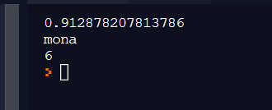
Random module:
import random
print(random.random())
L= ["sara", "omar","zaid","mona","manal"]
print(random.choice(L))
print(random.randint(1,6))

Slide 133
Exercise:
Create a module named math_tools with the following functions:
maximum_num (x,y,z)
even_num(x)
prime_num(x)

Slide 134
Session 14
File handling
Directories
Packages
Try except

Slide 135
File Handling
The key function for working with files in Python is the open() function.
The open() function takes two parameters; filename, and mode.
There are four different methods (modes) for opening a file:
"r" - Read - Default value. Opens a file for reading, error if the file does not exist
"a" - Append - Opens a file for appending, creates the file if it does not exist
"w" - Write - Opens a file for writing, creates the file if it does not exist
"x" - Create - Creates the specified file, returns an error if the file exists

Slide 136
Open a File on the Server
Assume we have the following file, located in the same folder as Python:
demofile.txt
Hello! Welcome to demofile.txt
This file is for testing purposes.
Good Luck!
To open the file, use the built-in open() function.
The open() function returns a file object, which has a read() method for reading the content of the file:
Example
f = open("demofile.txt", "r")
print(f.read())

Slide 137
Read Only Parts of the File
By default the read() method returns the whole text, but you can also specify how many characters you want to return:
Example
Return the 5 first characters of the file:
f = open("demofile.txt", "r")
print(f.read(5))

Slide 138
Write to an Existing File
To write to an existing file, you must add a parameter to the open() function:
"a" - Append - will append to the end of the file
"w" - Write - will overwrite any existing content
Example
Open the file "demofile2.txt" and append content to the file:
f = open("demofile2.txt", "a")
f.write("Now the file has more content!")
f.close()
#open and read the file after the appending:
f = open("demofile2.txt", "r")
print(f.read())

Slide 139
Example
Open the file "demofile3.txt" and overwrite the content:
f = open("demofile3.txt", "w")
f.write("Woops! I have deleted the content!")
f.close()
#open and read the file after the appending:
f = open("demofile3.txt", "r")
print(f.read())

Slide 140
Create a New File
To create a new file in Python, use the open() method, with one of the following parameters:
"x" - Create - will create a file, returns an error if the file exist
"a" - Append - will create a file if the specified file does not exist
"w" - Write - will create a file if the specified file does not exist
Example
Create a file called "myfile.txt":
f = open("myfile.txt", "x")

Slide 141
Delete a File
To delete a file, you must import the OS module, and run its os.remove() function:
Example
Remove the file "demofile.txt":
import os
os.remove("demofile.txt")

Slide 142
Package:
Is a folder containing a number of modules used to organize our code.
Example:
Import mypackage.mymodule
mypackage.mymodule.myfunction()
Or
Import mypackage.mymodule as pm
pm.myfunction()
Or
From mypackage import mymodule
mymodule.myfile()

Slide 143
Try and except:
Use this method to avoid raising an error and stopping the execution of your code
Try:
Code..
Code..
Except:
Action taken if error is raised
Rest of the code # gets executed even anyways

Slide 144
Session 15
Project 1

Slide 145
objectives:
Software download
Pypi and pip
Main packages
Install packages
Openpyxl

Slide 146
Software
Install software :
Python.org → downloads → download
Downloads → add python to path → install
Code editor:
Pycharm: jetbrain.com/pycharm → downloads → community
Downloads → install
Create new project → new → python file ( app.py)

Slide 147
Pypi and pip
Python package index is a directory that contains thousands of packages created by python developers for anyone to use
To access those packages go to
https://pypi.org/
Search for the package
Copy install command
Paste in terminal

Slide 148
Main packages:
Sylenium : open-source web-based automation tool, a testing framework used to validate web applications across different browsers and platforms.
Numpy : is a Python library used for working with arrays. It also has functions for working in domain of linear algebra, fourier transform, and matrices. NumPy was created in 2005 by Travis Oliphant. It is an open source project and you can use it freely. NumPy stands for Numerical Python.
Panda is a software library written for the Python programming language for data manipulation and analysis. In particular, it offers data structures and operations for manipulating numerical tables and time series.
Openpyxl: a Python library to read and write Excel 2010 xlsx/xlsm/xltx/xltm files.

Slide 149
Openpyxl functions:
Load workbook and access sheet:
wb object = load_workbook(filename) # load xlsx file
sheet= wb[‘Sheet1’] # access sheet
Access cells:
cell = sheet[‘a1’] # returns coordinates
cell = sheet.cell(row,col)
cell.value # returns the content of the cell
sheet.max_row # returns maximum number of rows in a column

Slide 150
Access values of a column (eg 3):
for row in range(1, sheet.max_row)
cell= sheet.cell(row,3)
print(cell.value)
Save file:
wb.save(filename) # new file or overwrite

Slide 151
Charts classes:
Package openpyxl → module chart → classes : BarChart , Reference:
from openpyxl.chart import BarChart , Reference
Reference: used to return values in table
values = Reference(sheet, min_row, max_row, min_col, max_col)
BarChart: create chart
chart object = BarChart()
chart.add_data(values) # send values from reference, to add them to chart
sheet.add_chart(chart, ‘F2’) # add chart to sheet, top left coordinate

Slide 152
Session 16
Project

Slide 153
Create a system for a school that will:
-Upload an excel sheet with the name of the students
-asks the user to enter three grades for each student
-Save the grades in the corresponding cell
-Calculate the average of each student
-Print the name of the top of the class in cell H4

Slide 154
example:
import openpyxl as xl
from openpyxl.chart import BarChart, Reference
def update_workbook(filename):
wb = xl.load_workbook(filename)
sheet = wb['Sheet1']
for row in range(2, sheet.max_row):
cell = sheet.cell(row, 3)
new_value = cell.value * 2
new_value_cell = sheet.cell(row, 4)
new_value_cell.value = new_value
values = Reference(sheet, min_row=2, max_row=sheet.max_row, min_col=4, max_col=4)
chart = BarChart()
chart.add_data(values)
sheet.add_chart(chart, 'e2') # chart top left starts e2
wb.save('new.xlsx')
update_workbook('test.xlsx')

