Slide 1

IUBAT – International University of Business Agriculture and Technology
Course Name: Visual Programming (Lab)
Course Code: CSC-440
Section: F
Department of Computer Science and Engineering
Submitted By
Submitted To
Name | ID
Nadia Zaman Jeni | 22103150
Sumaiya Akter | 22103115
Md. Abdullah Al Nayeem | 22103151
Jessica Alam Jui | 22103352
Sheekar Banerjee
Lecturer
IUBAT, Dept. of CSE
Date of Submission: 01/09/2025

Slide 2
Pharmacy Management System
ASP.NET Core MVC Project
Presentation

Slide 3
Introduction
A Pharmacy Management System is designed to automate and streamline pharmacy operations.
Helps manage medicines, customers, sales, and inventory efficiently.
Reduces manual work, errors, and improves customer service.
This project follows .NET Layered MVC Architecture, which separates Database, Business Logic, and Presentation into different layers for better maintainability and scalability

Slide 4
Objectives
Maintain accurate medicine inventory.
Enable easy customer order processing
Track sales and purchases efficiently.
Support admin and user login for security.
Generate reports for better decision-making

Slide 5
Features
User Login: Admin and Customer authentication.
Medicine Management: Add, update, delete, search medicines.
Customer Management: Register and manage customer orders.
Order Processing: Place, track, and manage orders.
Reports: Generate sales, inventory, and daily transaction reports

Slide 6
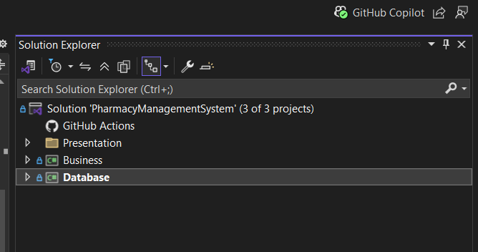
System Architecture
Model = Database layer+ Business layer
Presentation layer :
Controller = ASP.NET Core API Controllers
View = React frontend

Slide 7
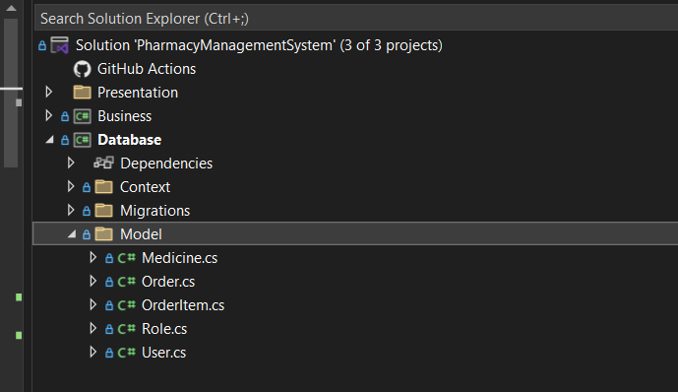
Backend Development Database Model
Represents DB Tables and map class properties to tables column .
Data Annotation are applied in model classes

Slide 8
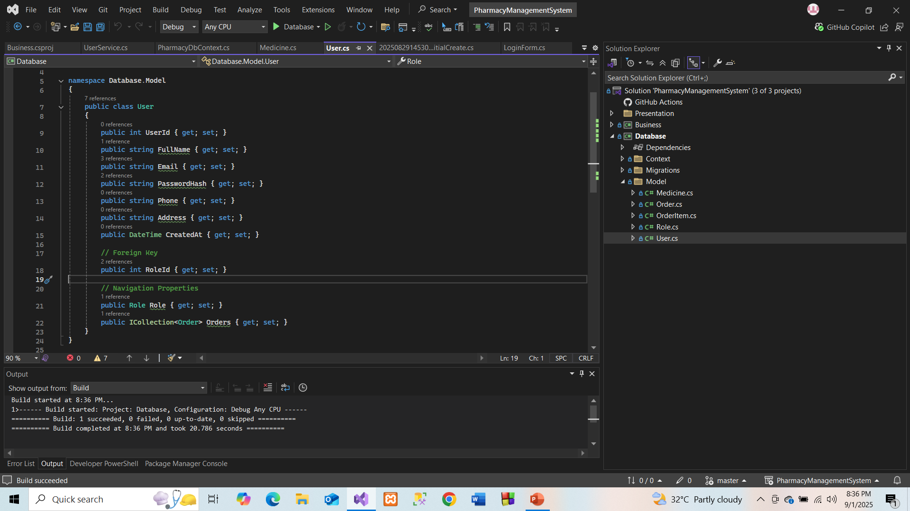

Slide 9
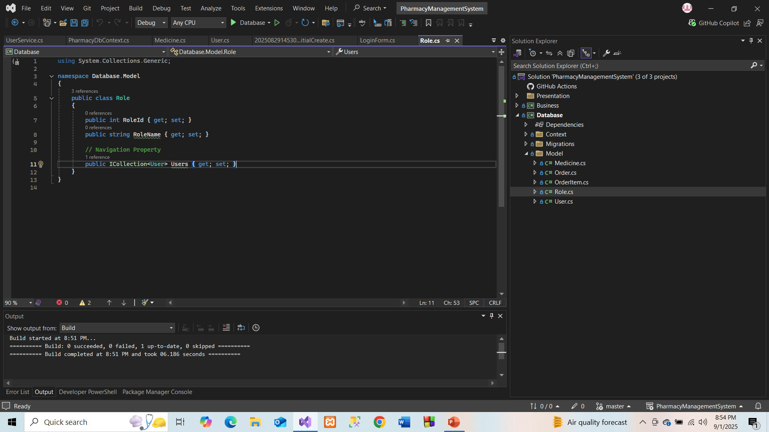

Slide 10
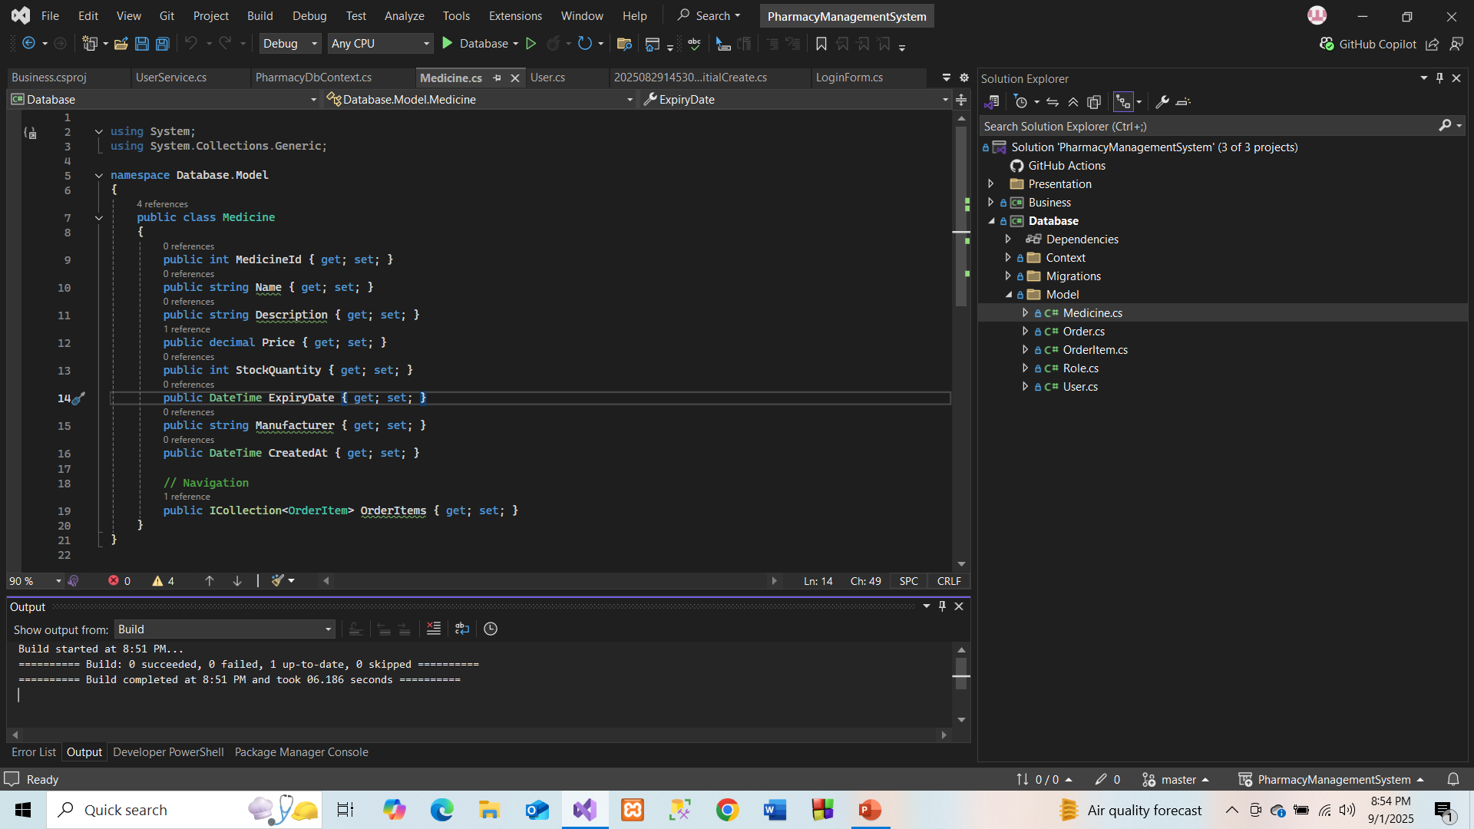

Slide 11
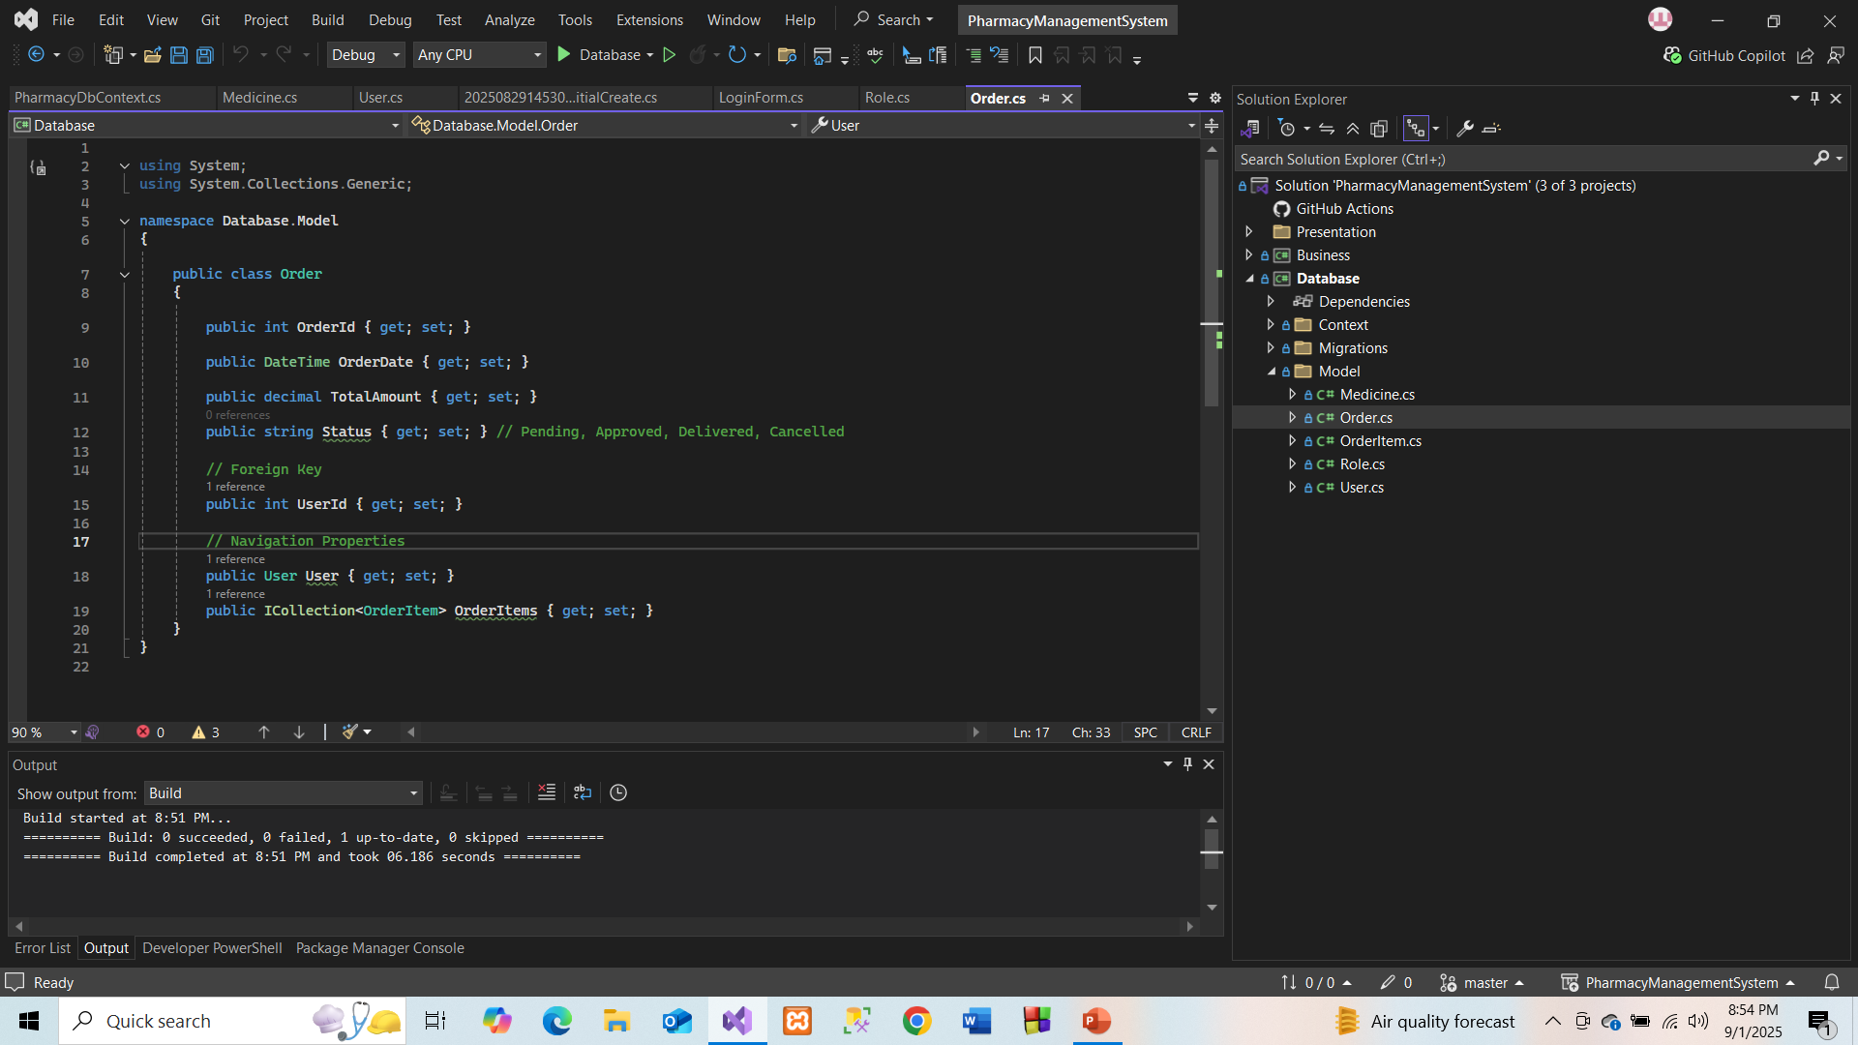
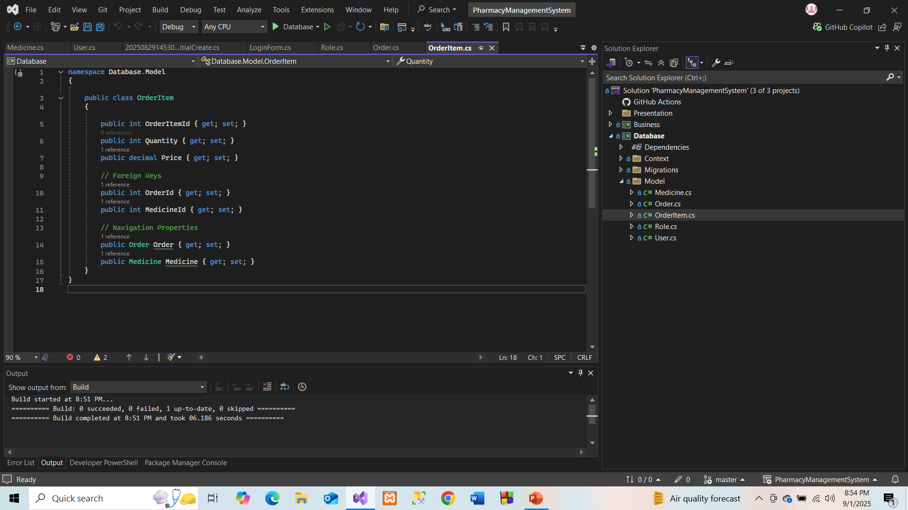

Slide 12
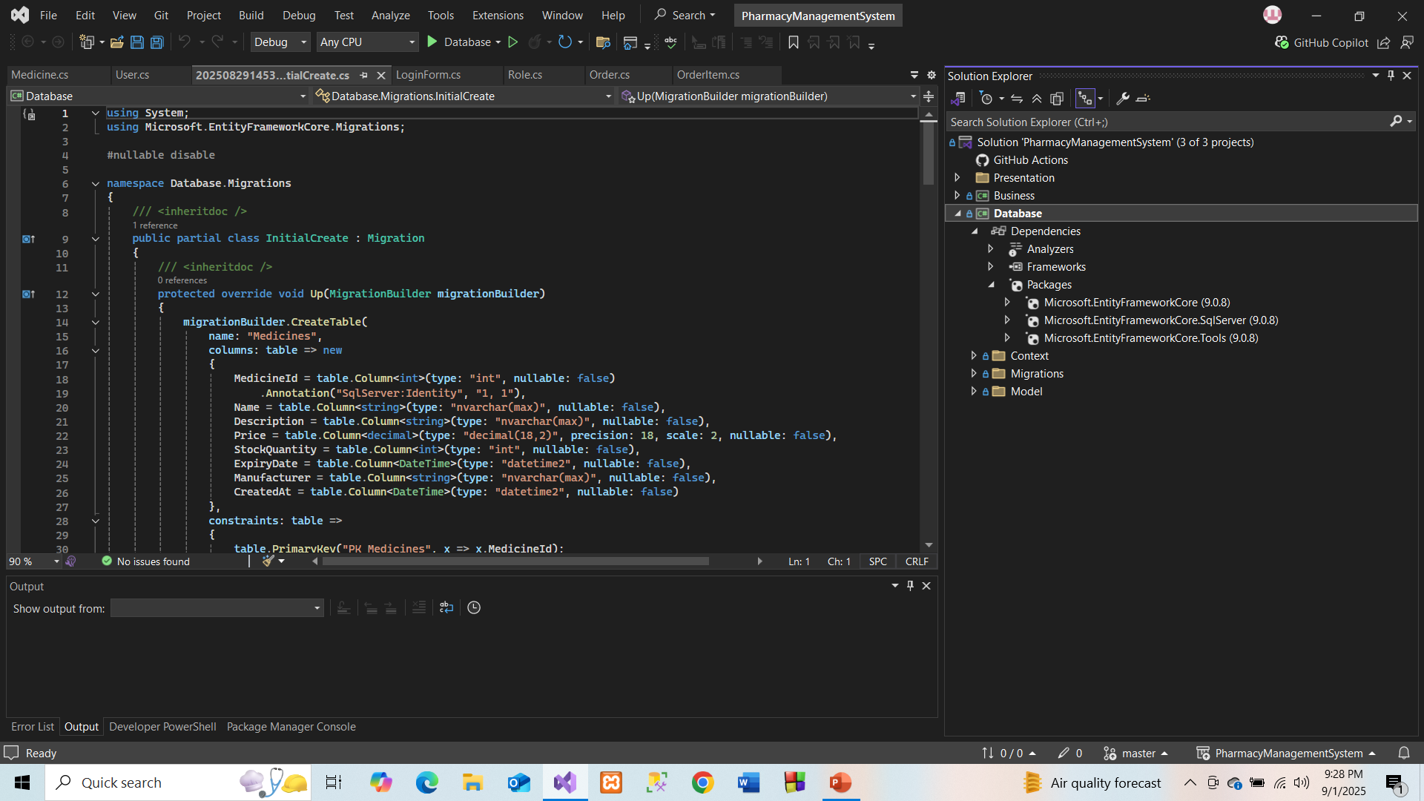
Nuget Packages

Slide 13
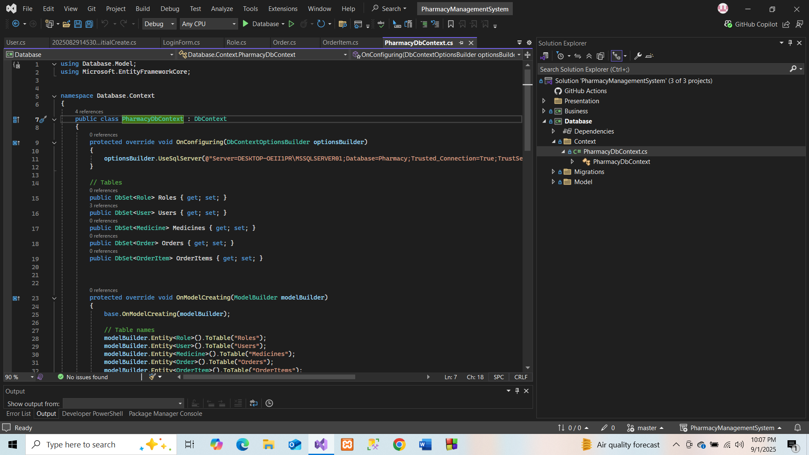
DbContext

Slide 14
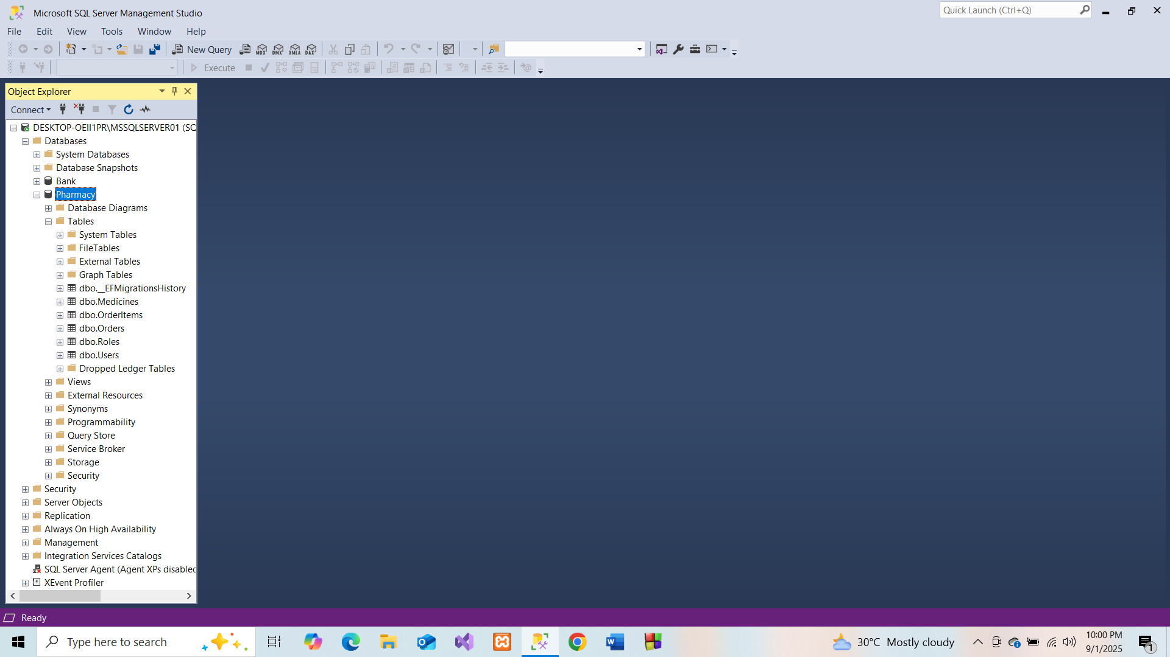
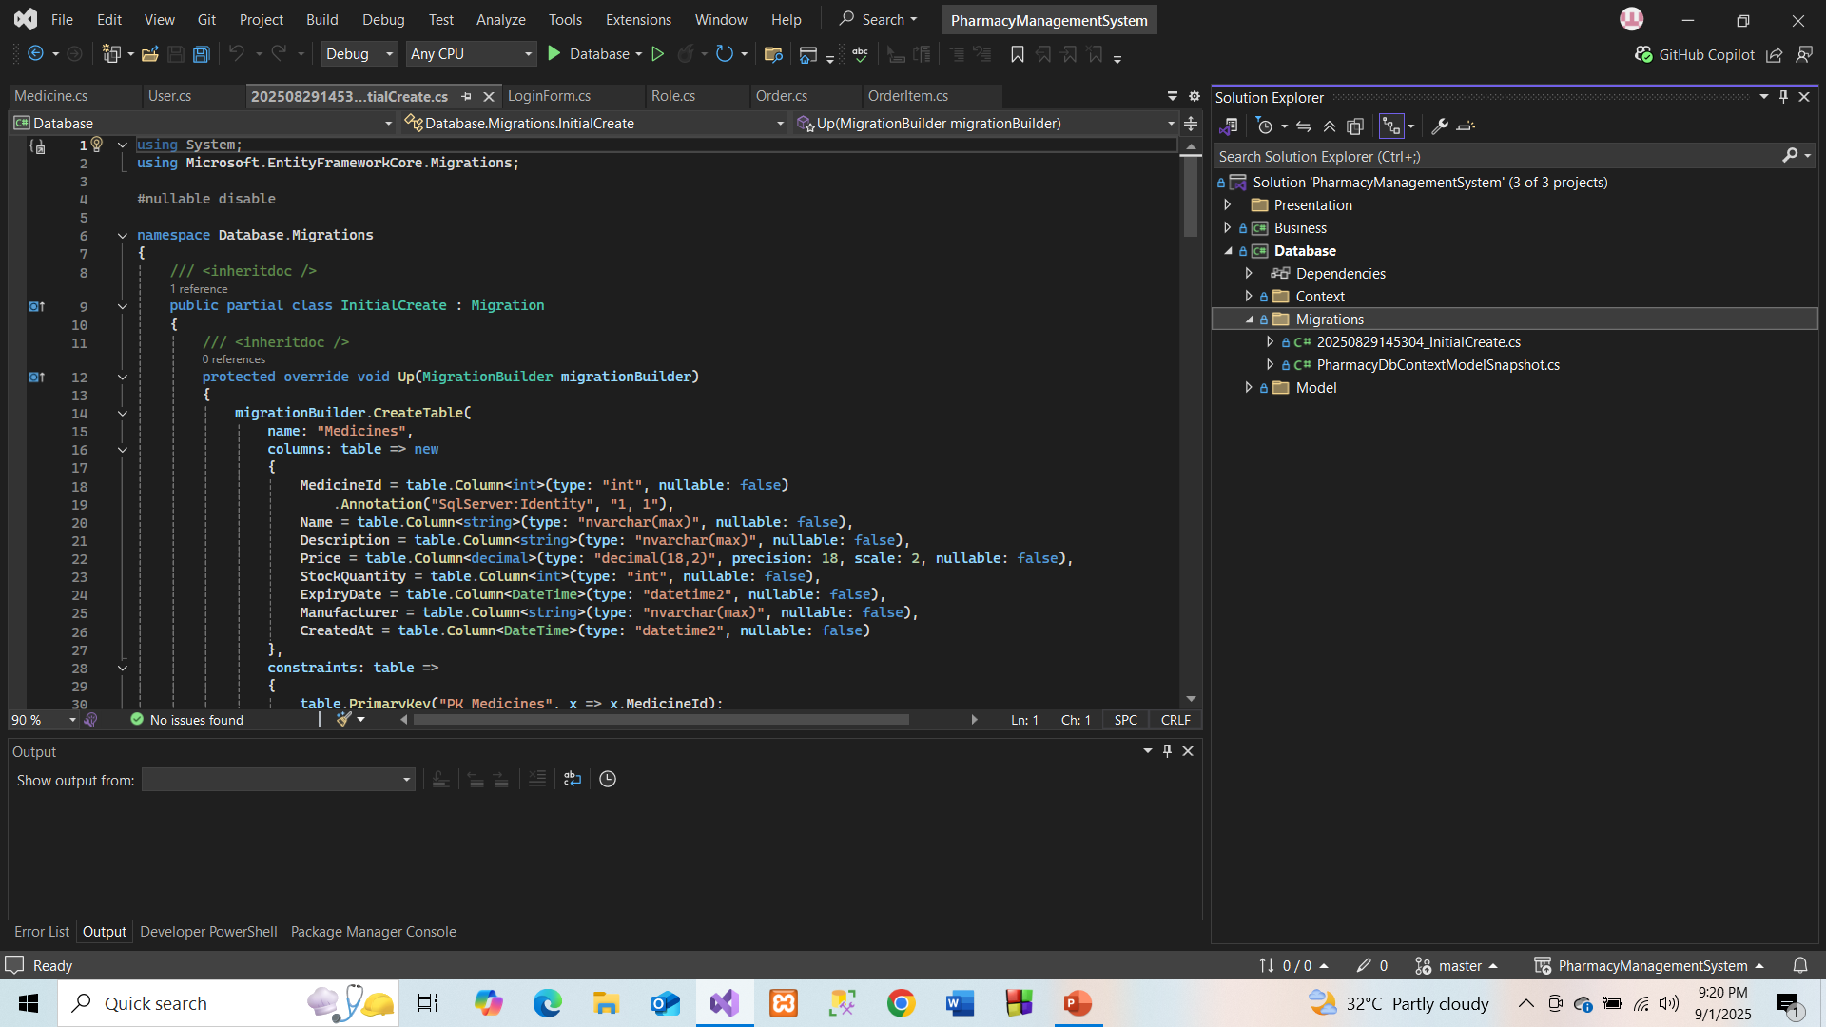
Migration & Database

Slide 15
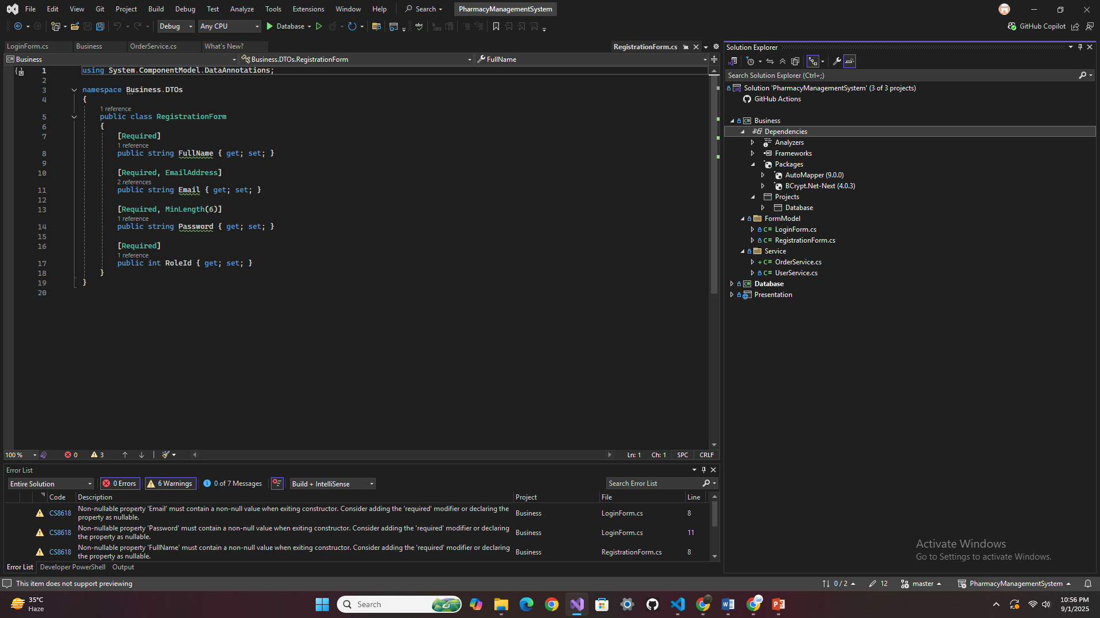
Business Layer

Slide 16
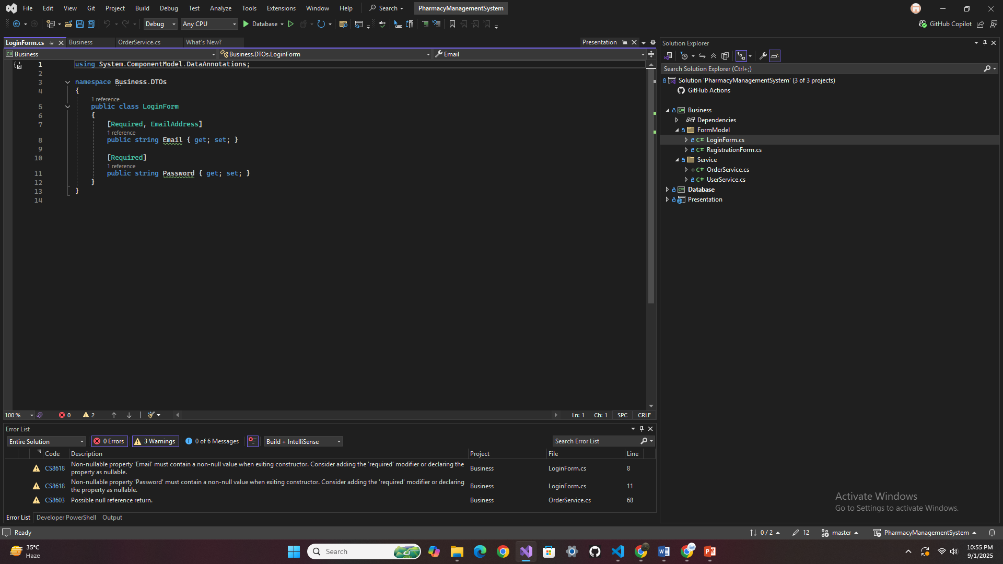
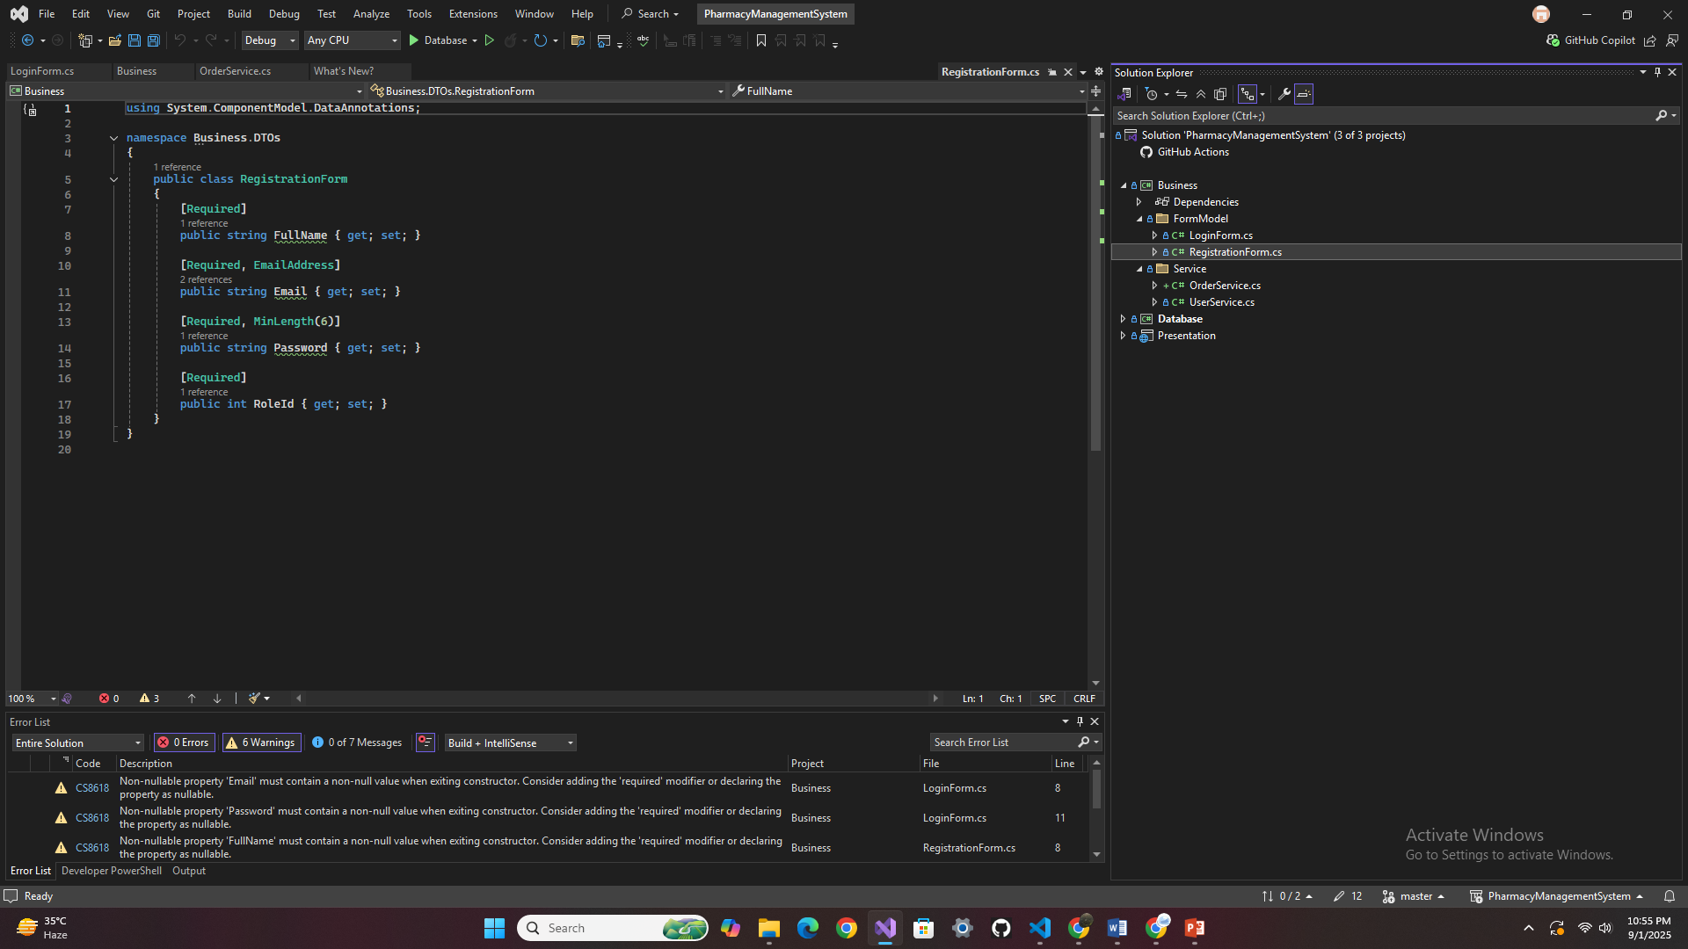
Log in and Registration Form Model

Slide 17
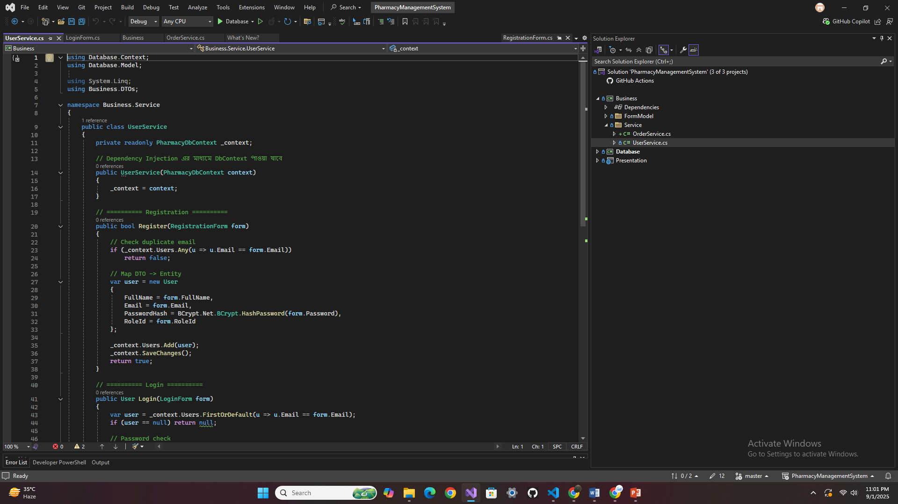
UserService Class

Slide 18
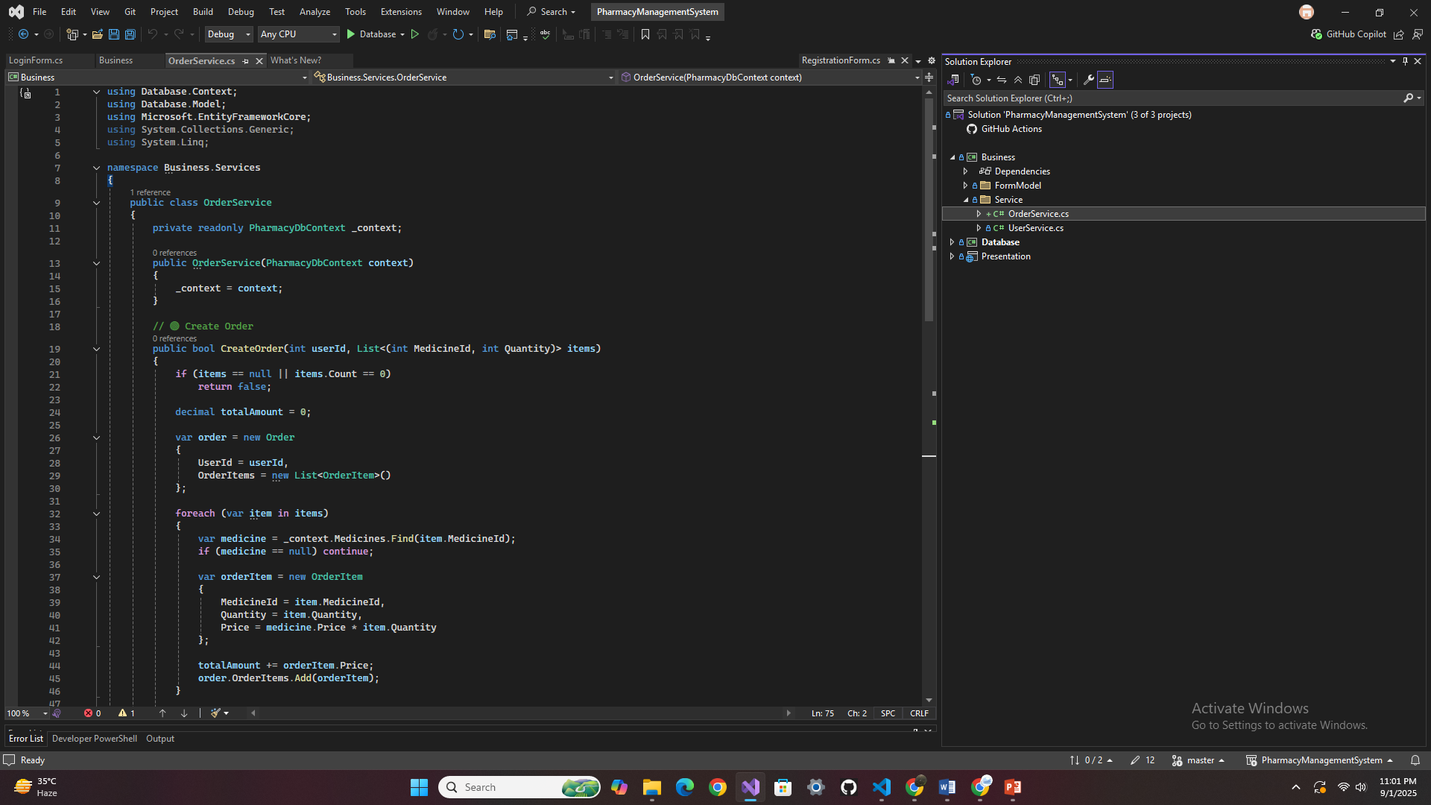
OrderService Class

Slide 19
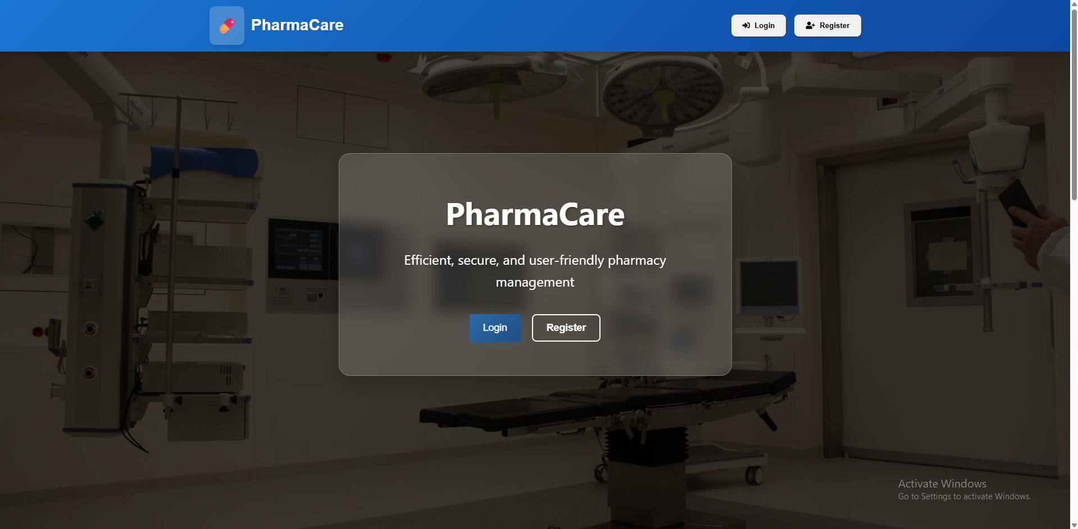
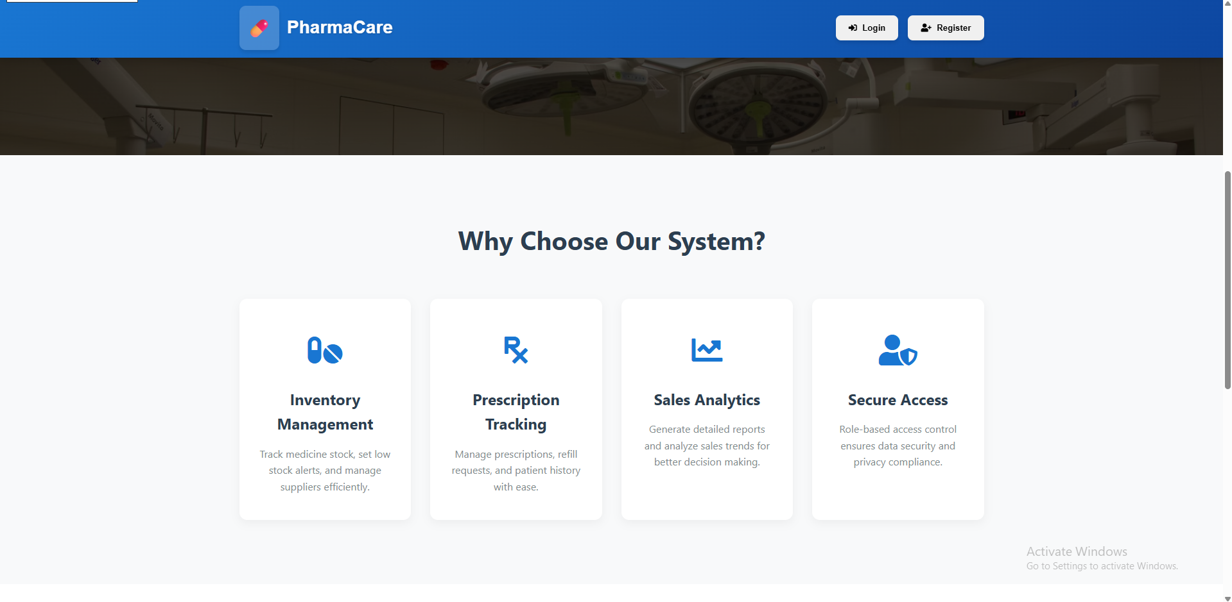
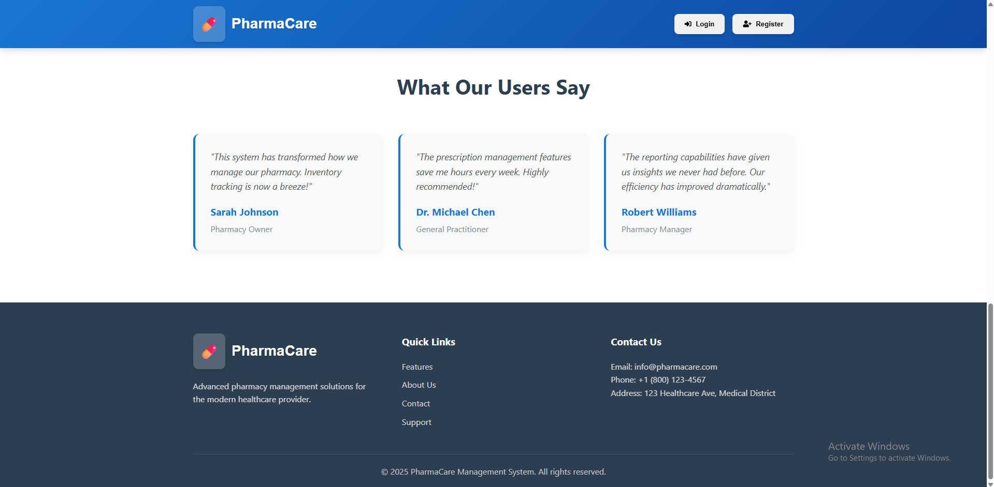

Slide 20
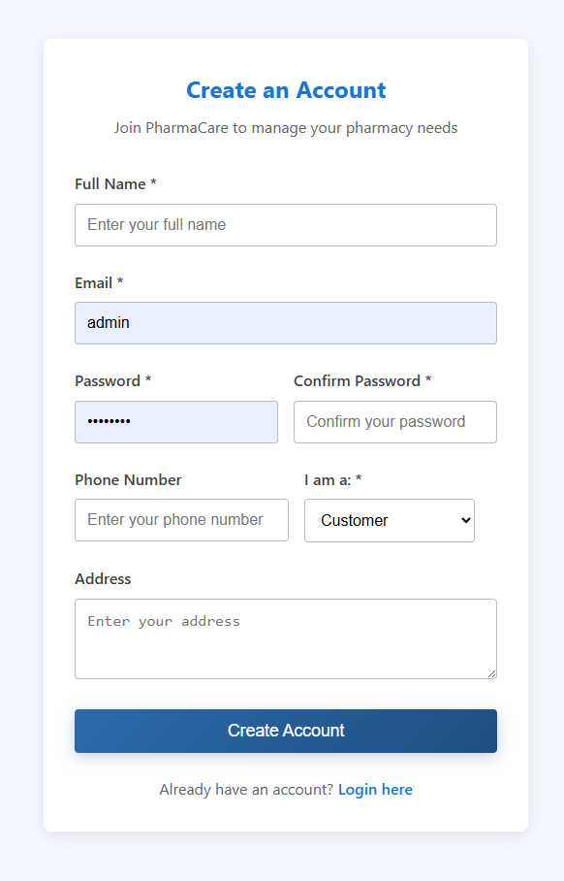
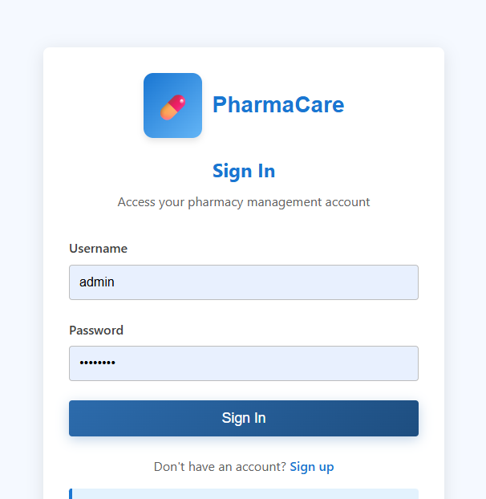

Slide 21
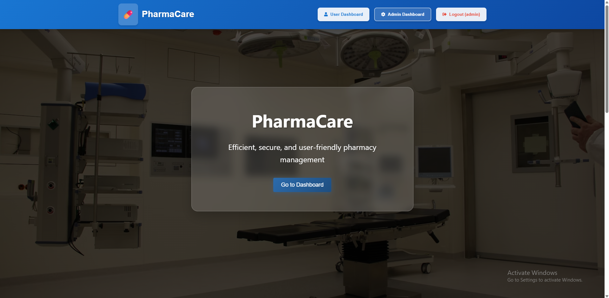

Slide 22
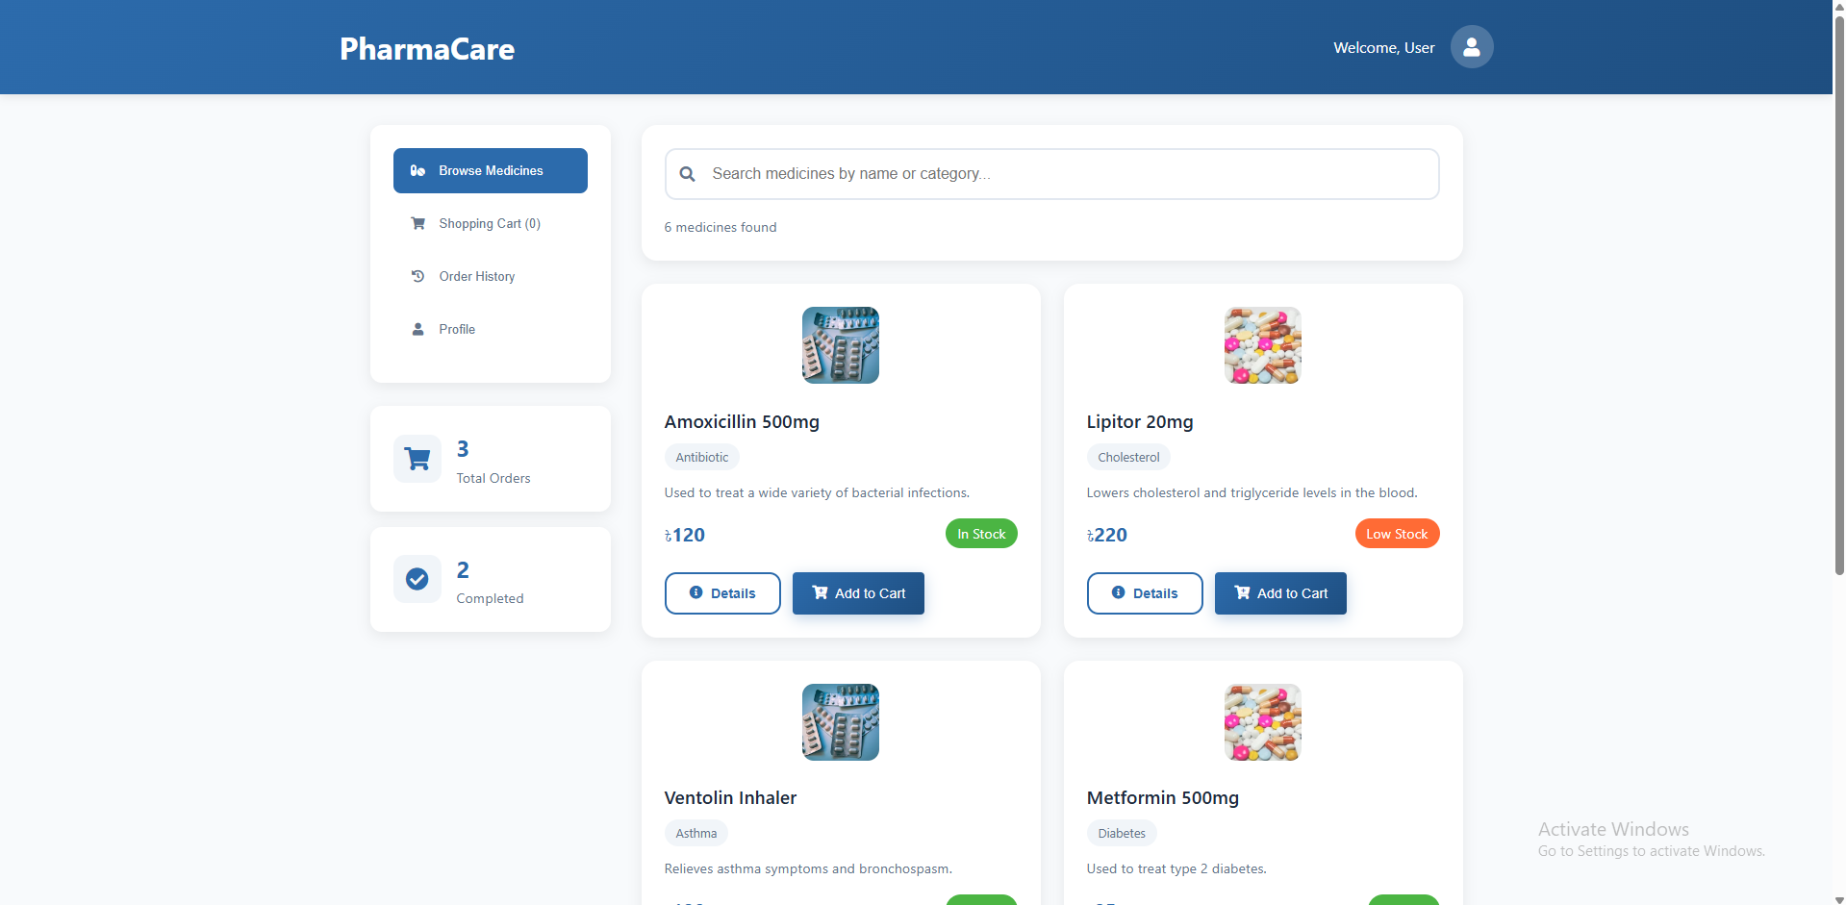

Slide 23
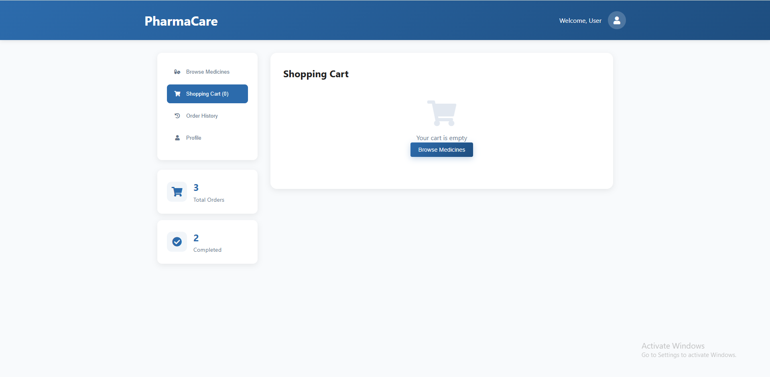

Slide 24
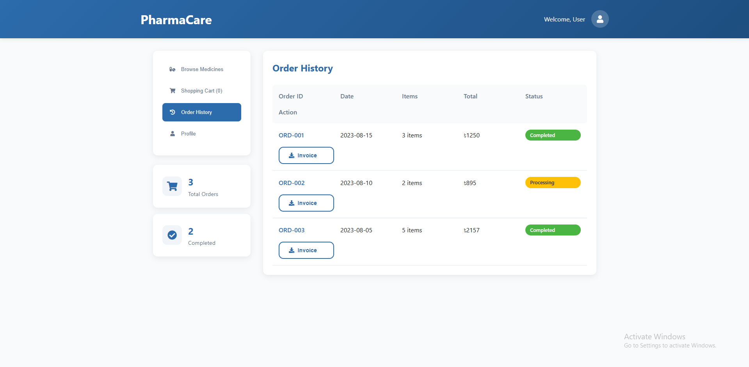

Slide 25
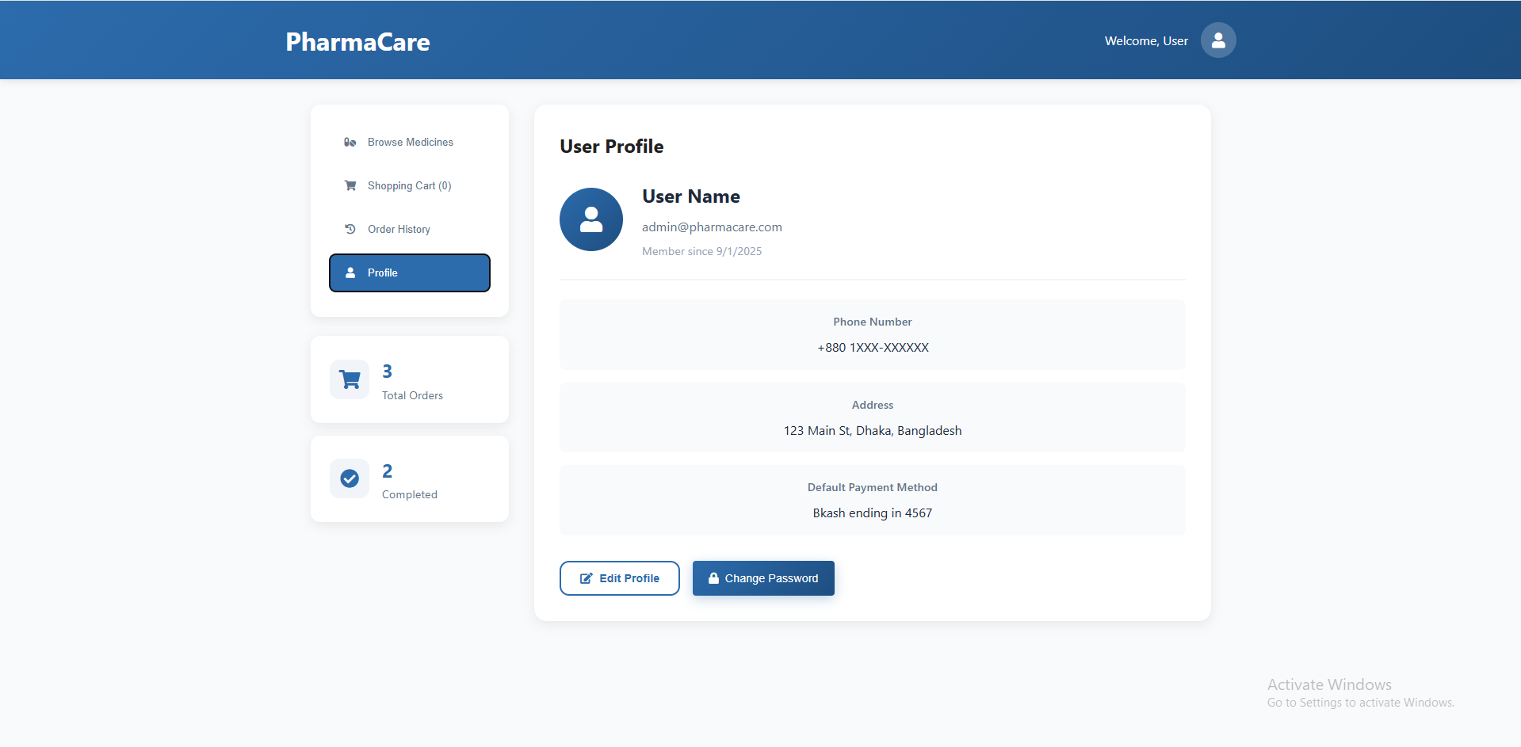

Slide 26
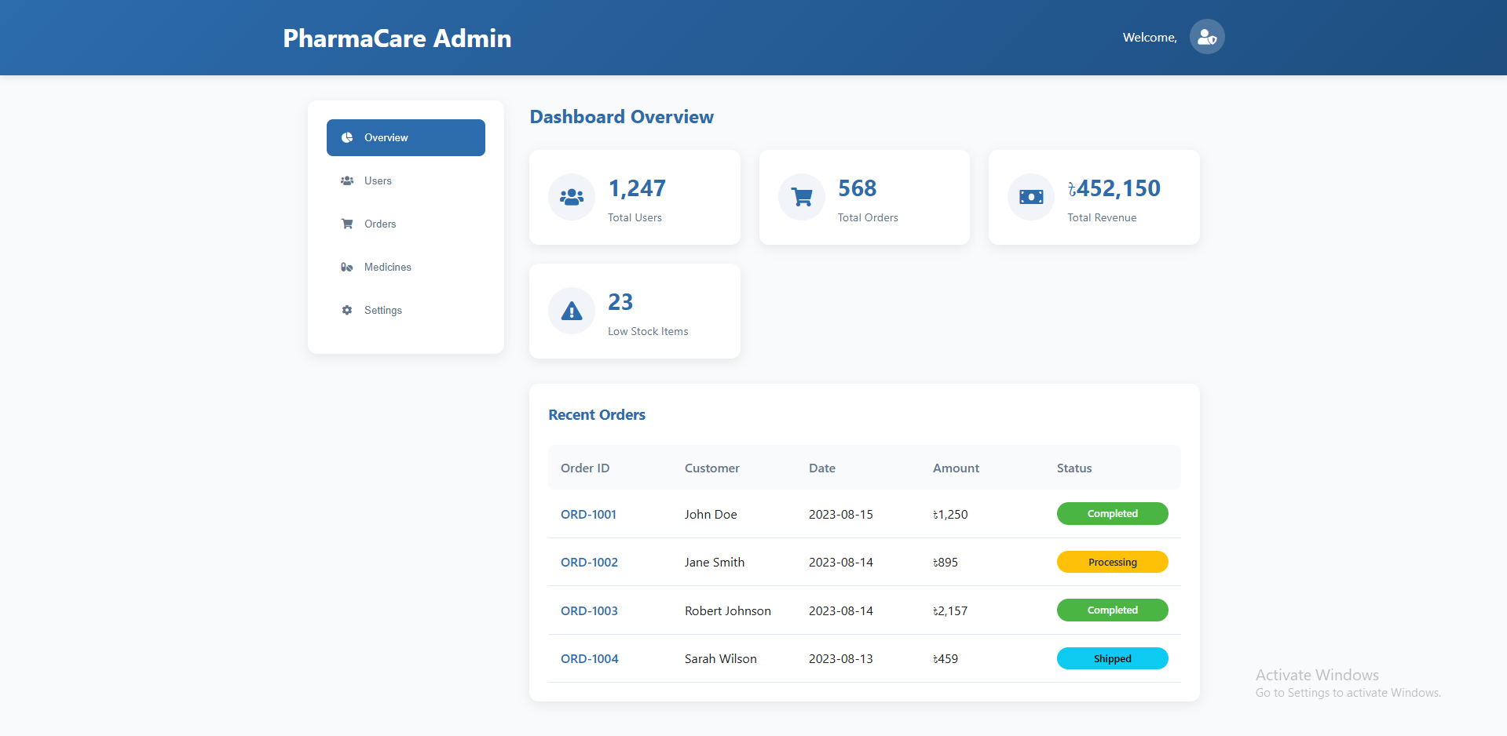

Slide 27
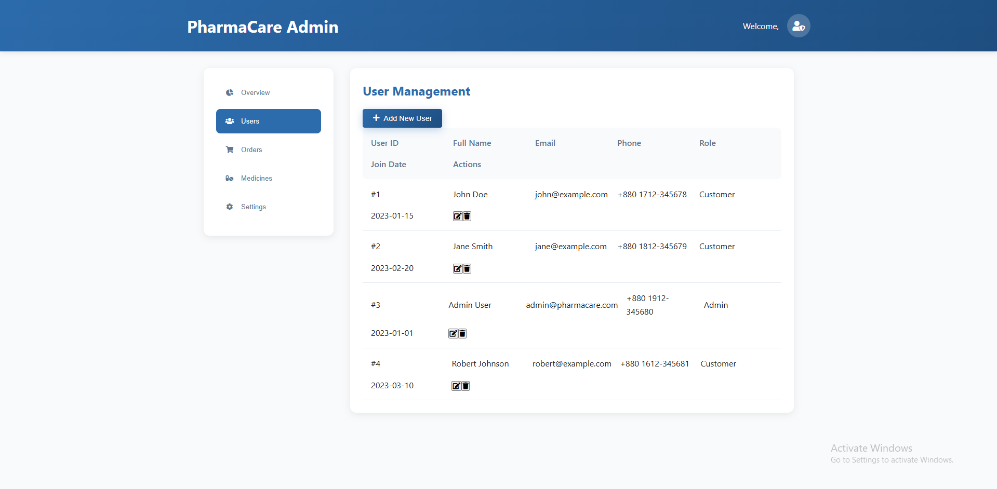

Slide 28
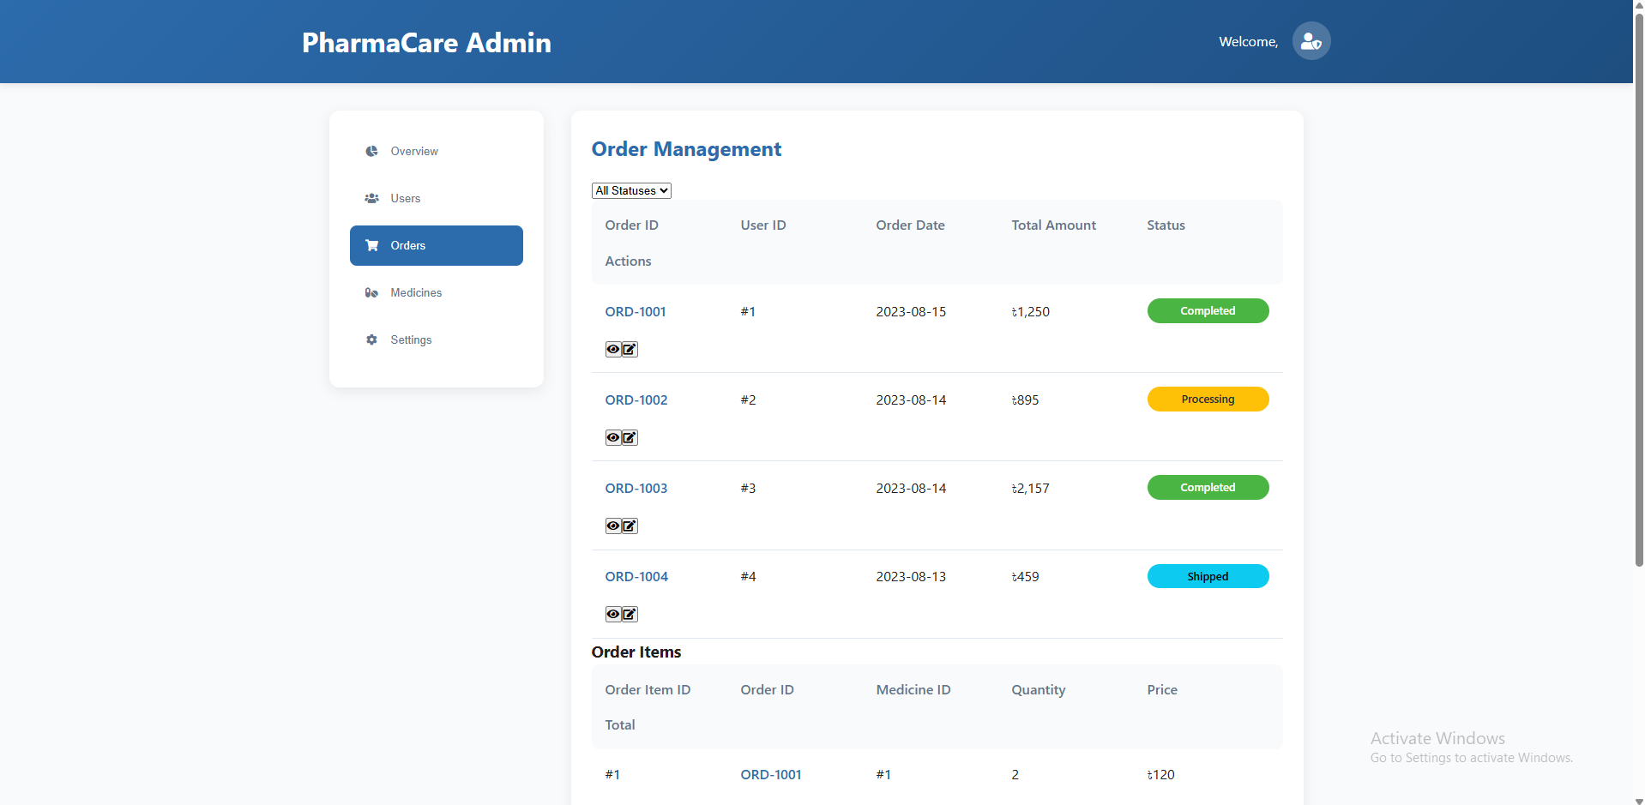

Slide 29
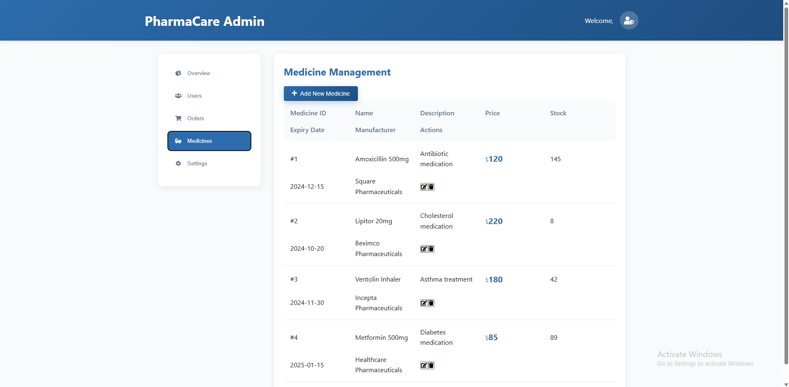

Slide 30
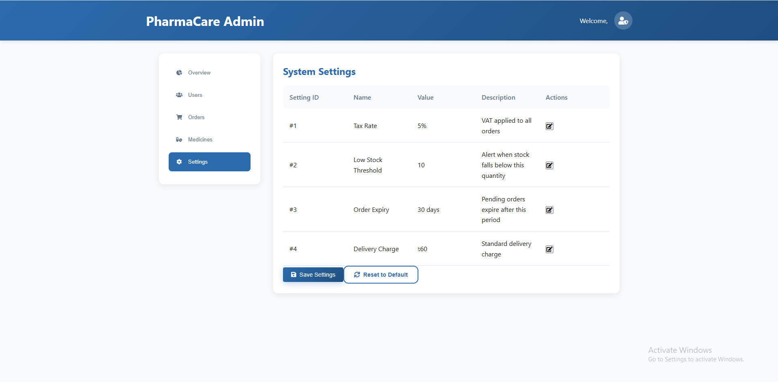

Slide 31
Limitations
Limited to basic pharmacy operations (medicine, customers, orders, reports)
No integration with third-party services (e.g., online payment, delivery system)
Requires internet & system knowledge for smooth operation
Security features are basic (e.g., role-based login only, no advanced encryption)
Reports are limited; advanced analytics not included

Slide 32
Conclusion
The system successfully automates core pharmacy tasks (inventory, sales, customers, reports)
Reduces manual workload and errors, improving overall efficiency
Provides a scalable foundation for future upgrades (online payment, mobile app, advanced analytics)
A useful step toward digital pharmacy management and better customer service

