Slide 1

Dasymetric Spatiotemporal Interpolation
Research presented (but not done) by J. Kasmire,
Research Fellow
Crime Data in R Workshop
Feb 10 – 12, 2021

Slide 2
What research am I presenting today?
Jeremy Mennis (2016) Dasymetric Spatiotemporal Interpolation, The Professional Geographer, 68:1, 92-102, DOI: 10.1080/00330124.2015.1033669
https://doi.org/10.1080/00330124.2015.1033669
`sf` and `areal` packages
https://github.com/slu-openGIS/areal

Slide 3
What’s the basic idea of dasymetrics?
Image you have a group of 10 people, about which you know:
5 are men and 5 are women and
Some of them live in London and the rest in Manchester.
How many women in this group live in Manchester?
Assuming an even distribution = 2.5
London is about 4x the size of Manchester. If we assume our group inherits this distribution - 1

Slide 4
What about dasymetric mapping?
Choropleth maps evenly colour a polygon according to a feature – e.g. counties are coloured to show population density
Other sources hint at distribution of the feature within the polygon e.g. land use maps indicate roads/parks/commercial spaces/etc.
Combining the sources reveals previously unavailable detail – e.g. Subtracting non-resident spaces reveals more accurate population density

Slide 5
And spatiotemporal dasymetrics?
Applies the same dasymetric interpolation logic to time when there are sources to support the assumption that the features are not uniformly distributed in time.
Most population density won’t change fast enough to warrant this assumption, but…

Slide 6
When might population density change?
Seasonal workers in rural areas - use info on crops grown, labour requirements, local demographics, etc.
Vacation towns in and out of holiday season – use info on holiday schedules, school break dates, local transport links, etc.
Commuters/shoppers/etc. in city centres – use info on local business distribution and typical opening hours, holiday schedules, etc.

Slide 7
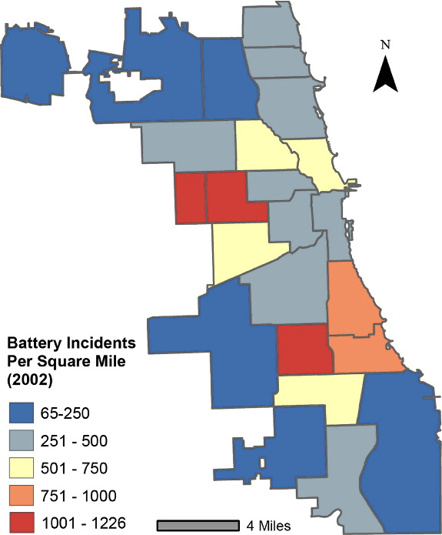
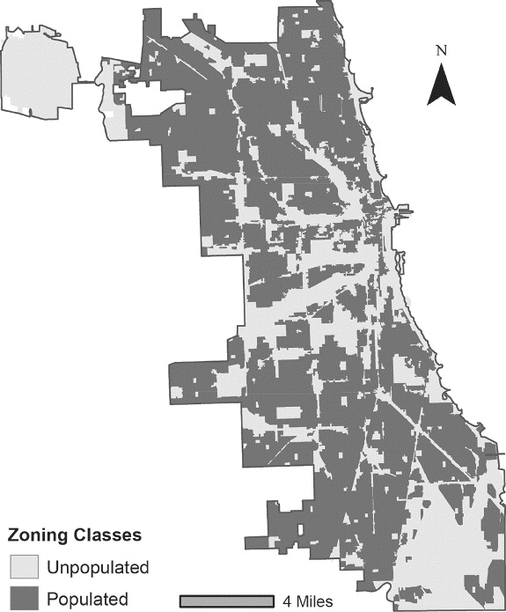
Mennis used a crime data example!

Slide 8
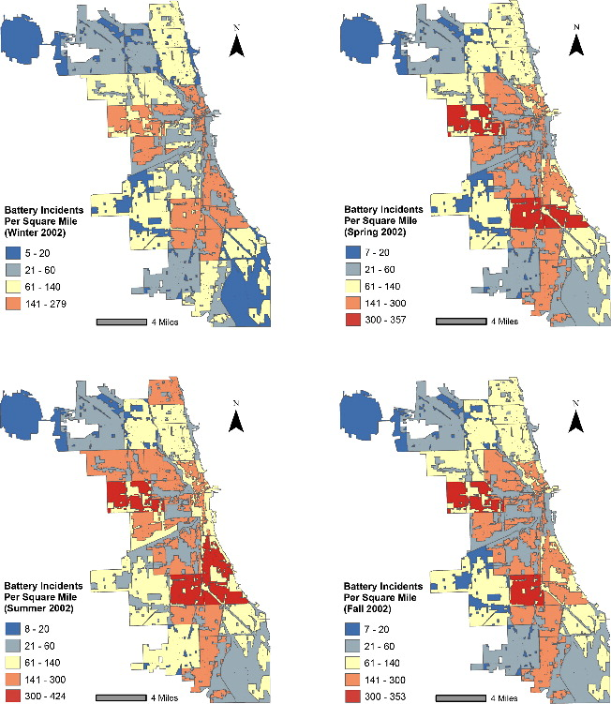

Slide 9
Key contributions are:
When supplemental data supports its use, temporal dasymetric interpolaton is a valid technique
Adding spatial OR temporal dasymetric interpolation will not always improve the analysis
Combined spatiotemporal dasymetric interpolation is more likely to improve the analysis as any weaknesses in one interpolation can be offset by the other

Slide 10
Key contributions are:
When supplemental data supports its use, temporal dasymetric interpolaton is a valid technique
Adding spatial OR temporal dasymetric interpolation will not always improve the analysis
Combined spatiotemporal dasymetric interpolation is more likely to improve the analysis as any weaknesses in one interpolation can be offset by the other

