Slide 1
Introduction to crime data available from the UK Data Service
Sarah King-Hele, UK Data Service, University of Manchester
Introduction to analysing data about crime using R
10 February 2021
Copyright © 2021 UK Data Service. Created by CMI, University of Manchester
Notes:
RD 1-9

Slide 2
What is the UK Data Service?
A comprehensive resource funded by the ESRC
A single point of access to a wide range of secondary social science data
Support, training and guidance
Notes:
The UK Data Service is a comprehensive resource funded by the ESRC.
It is made up of the former services ESDS, Census.ac.uk, and the Secure Data Service.
Our aim is to provide a single point of access to a wide range of social science data .
As well as providing data, we also provide support, training and guidance for users, whether students or more experience researchers .

Slide 3

Who is it for?
Academic researchers and students
Government analysts
Charities and foundations
Business consultant
Independent research centres
Think tanks
ukdataservice.ac.uk
Notes:
Who are we for?
Well, our services are essentially for everybody.
Many of our users come from academia, researchers and students like yourself.
We also have a lot of users that come from government departments
Charities business consultants
Also independent research centres and think tanks.

Slide 4
Sources of data
Official agencies, mainly central government
International government organisations
Research institutions
Individual academics - research grants
Market research agencies
Public records/historical sources
Notes:
Data comes from different organisations.
So, there are the national statistical authorities such as the Office for National Statistics they collect a lot of data.
But also, a lot of the government Department such as the Home Office Department for Work and Pensions
Intergovernmental organisations such as the World Bank
Also, a lot of large surveys are run by research institutes such as the Institute for social and Economic Research which is based up here in Essex.
And also, now some individual researchers who have been funded to collect data they make the data available for reuse as part of the terms and conditions of funding.
There are Market research agencies and public records/historical sources
So, data really come through different sources.

Slide 5
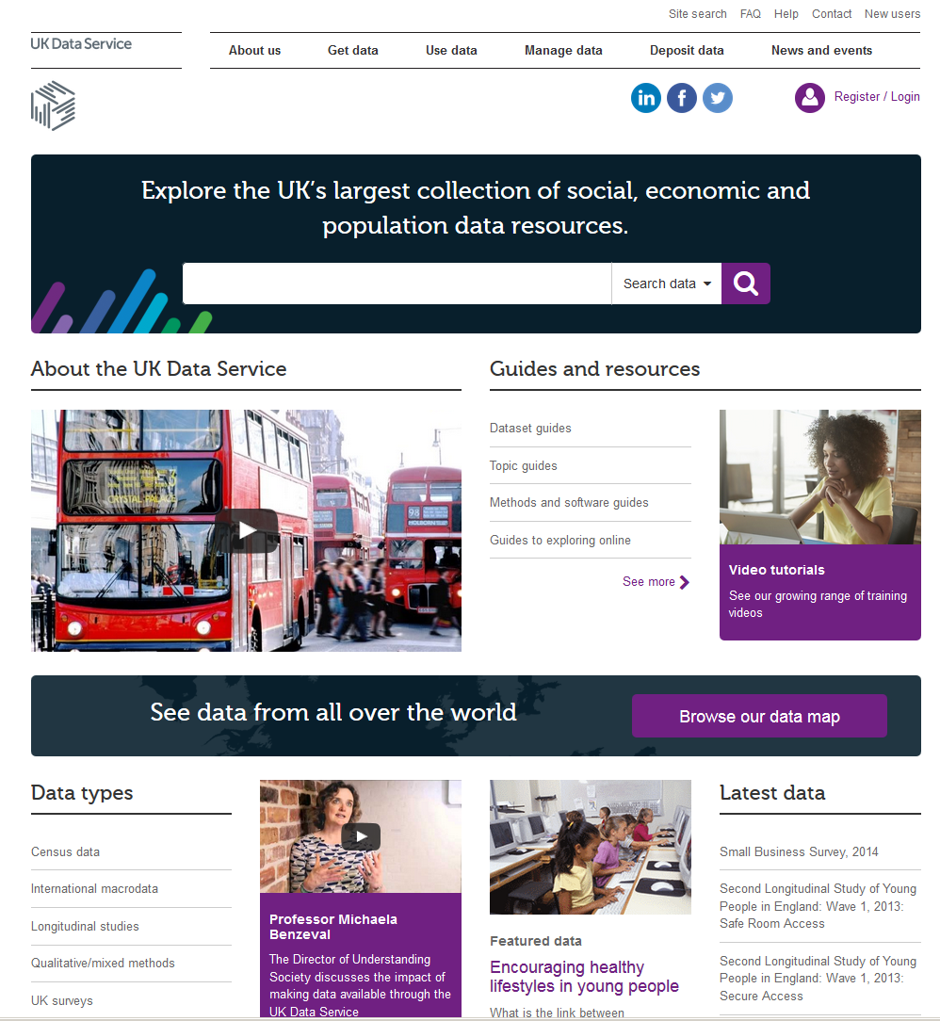
www.ukdataservice.ac.uk

Slide 6
What data do we hold?
Surveys
Longitudinal
International
Large-scale government funded UK and cross-national surveys
Major UK surveys following individuals over time
Multi-nation aggregate databanks and survey data
Census
Business
Qualitative
Census data 1961 – 2011
Microdata and administrative data
Range of multimedia qualitative data sources
Notes:
Next we are going to look at the different types of data help within the Service. The main types are national surveys, longitudinal studies, international databanks, the UK census data, business micro-data and qualitative data. We also host datasets produced by researchers during the courses of their research. In fact if you are funded by the ESRC, you are obliged to offer any data you produce to the UK Data Service. Many big funders now ask grantees to make the data they produce open and the UK Data Service is one platform you can use for this.

Slide 7
Other resources and support from UKDS
Helpdesk
Webinars , online workshops & conferences
Case studies
Guides, video tutorials, interactive modules
How others used the data
Individual support by e-mail
See events pages
Topic
Dataset
Methods and software
Notes:
We offer a wide range of support to our users.

Slide 8

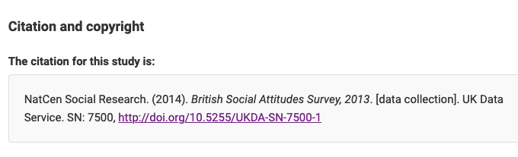
Cite the Data
Citations provided for every record and dataset
Use the UK Data Service citation tool to copy and paste the correct citation

Slide 9
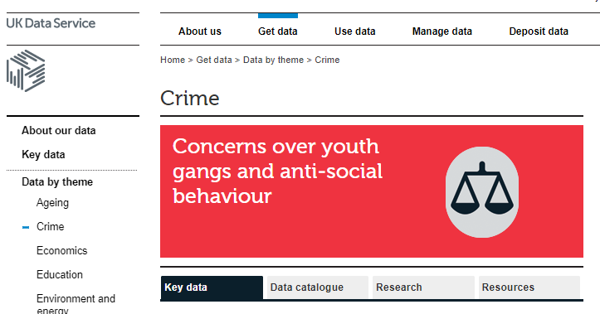
UKDS Crime data collection
Data by theme: Crime
List of key datasets
Examples on how to find data
Case studies
Teaching and case studies of data analysis on crime
Notes:
Crime' encompasses a wide range of issues that lie within the remit of several academic disciplines, including sociology, psychology, law and economics

Slide 10
UKDS Crime data collection (2)
Data collected by Research Centres and Government Organisations
Anonymised survey data at the individual level
Heavily used by academics, Government organisations and research community
Some of them used to obtain official statistics, i.e. CSEW, SCJS

Slide 11
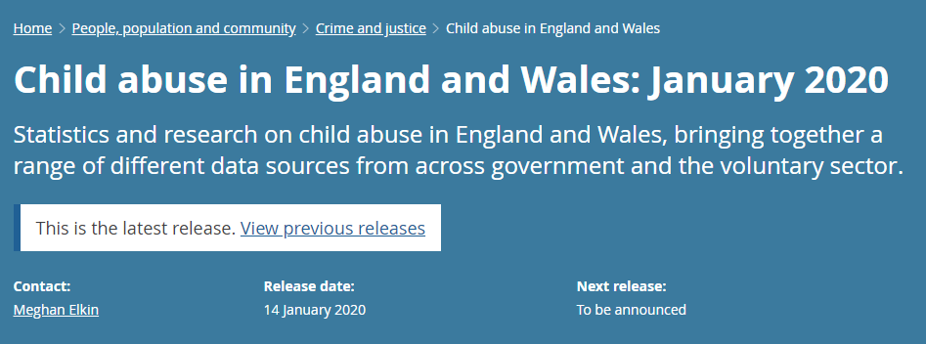
Crime Survey for England and Wales (CSEW)
https://www.ons.gov.uk/peoplepopulationandcommunity/crimeandjustice/bulletins/childabuseinenglandandwales/january2020

Slide 12
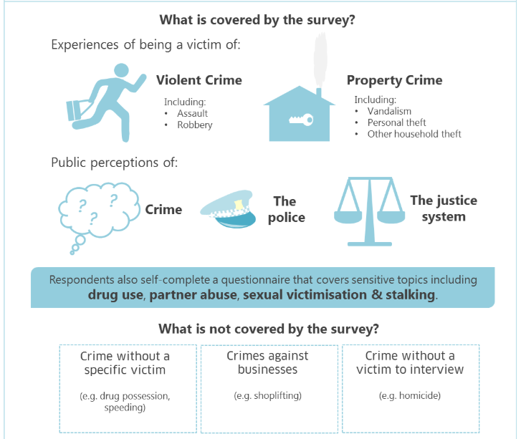
Scottish Crime and Justice Survey SCJS
https://www2.gov.scot/Topics/Statistics/Browse/Crime-Justice/crime-and-justice-survey
Notes:
What is covered by the survey?
Violent crime including assault and robbery
Property crime including vandalism, personal theft and other household theft
Public perceptions of crime, the police and the justice system.
Respondents also self-complete a questionnaire that covers sensitivie topics including drug use, partner abuse, sexual victimisation and stalking.
What is not covered by the survey?
Crime without a specific victim – e.g. drug possess, speeding
Crimes against businesses – e.g. shoplifting
Crime without a victim to interview – e.g. homicide.

Slide 13
Key data on crime
Repeated Cross-sectional data:
Crime Survey for England and Wales (CSEW)
Scottish Crime and Justice Survey (SCJS)
Commercial Victimisation Survey (CVS)
Cross-Sectional Data
Arrestee Survey, 2003-2006
Conflicts and Violence in Prison, 1998-2000 (qualitative)
Longitudinal
Edinburgh Study of Youth Transitions and Crime : Waves One to Four, 1997-2001 (not full collection)
Offenders Index Cohort Data, 1953-1997 (Cohort data)
Notes:
The Commercial Victimisation Survey (CVS) provides a source of information on crime and crime-related issues as they affect businesses in England and Wales.

Slide 14
Access
Three levels of access
Safeguarded Data
Special Licence (not all series of data)
Secure Access
How to access data held by the UKDS?

Slide 15
Access conditions
Data Type | Access conditions
Open access Most Census / International - Small number of survey teaching datasets | Open access
End User Licence Most research datasets | Requires registration and user name and password. UK academics and students login using their institutional username and password
Special Licence e.g. Most survey microdata with lower level geography | Restricted to ‘Approved Researchers’ under the Statistics and Registration Act
Secure access | Restricted to ‘Approved Researchers’ and access limited through a physical or virtual environment
Notes:
Another point about different kinds of access to our data – most of the data you can download after registration from the website but you may come across data with other licences so it might be useful just to be aware of what that means.
The different access arrangements reflect the risk of potential disclosure.
All the data are anonymised but if you had detailed information about, say, a persons job, which sector they work in, the area they live in as well as their age and gender and other information, there’s a danger that in some cases you could identify who that person is.
We have a small amount of open survey data that can be used for teaching but most of our data for research is in the second category – under the end user licence. To get this, you just register with the UK Data Service and then you are free to download these kinds of data from the website. Registration is quick and easy and takes less than ten minutes.
This kind of data is unlikely to lead to disclosure but when you agree to the end user licence, you’re agreeing to a range of things including that you won’t try to identify anybody in the data or share the data with anyone else.
The EUL data is good enough for most research, but if you need lower levels of geography or more detailed variables, you may need to use the special licence or secure access data. Note that these datasets are harder to obtain because they are more potentially disclosive – there’s more information about that on our website.
On a final note, we do not charge for our data unless it is for commercial use.

Slide 16
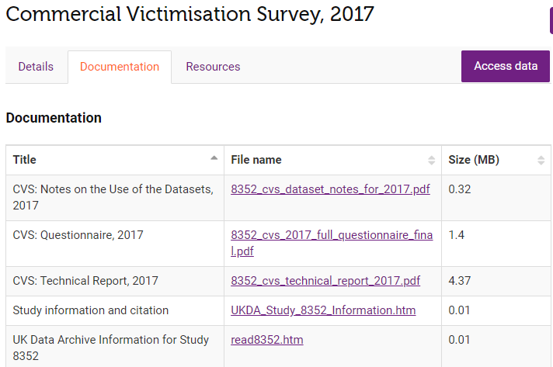
Documentation
Notes:
The documentation can be found in the second tab (called Documentation) in the catalogue page for each survey.

Slide 17
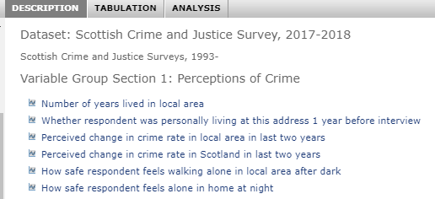
Where/how to analyse this data?
Online using
Nesstar
Directly on your
Computer using
SPSS
Stata
SAS
R or R Studio

Slide 18

Questions
Website:
www.ukdataservice.ac.uk
- New website in spring 2021
Contacts:
sarah.king-hele@manchester.ac.uk

