Slide 1
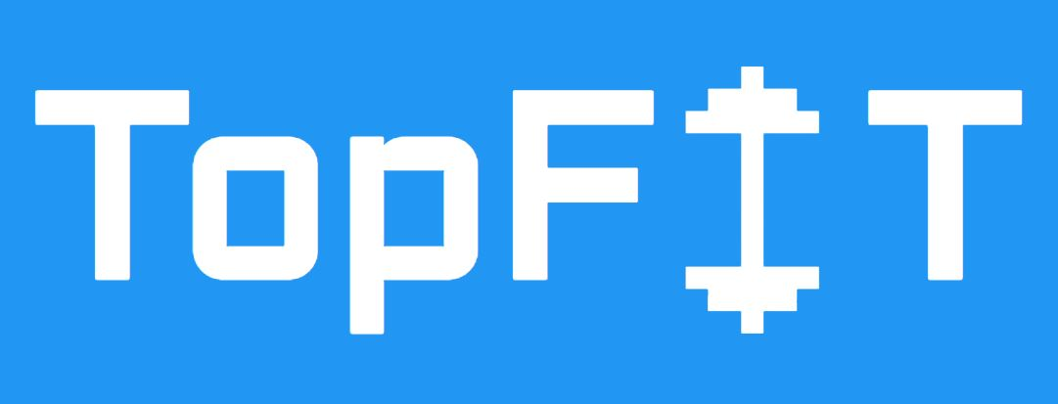
TopFit – Workout and Wellness
by Group T27

Slide 2
Who are we?
Nadezhda Mokhireva | Back-End Developer, Project Leader
Parisa Khataei | Back-end Developer, Tester, Front-end Developer
Mahdi Esmaeelpour | Back-end Developer, Database Administrator
Vladyslav Bordiug | Front-End Developer, UI Designer
Group T27: Team Charter
Notes:
Intro of team/roles - Nadia

Slide 3
Project Goals
User Goals:
Easy access to exercise
Motivation for a healthier lifestyle
Developer Goals:
Conduct a complete project
Practice mobile application development
Work in a team environment
Profit (eventually)
Notes:
Project Goals - Nadia
Easy access – mention covid

Slide 4
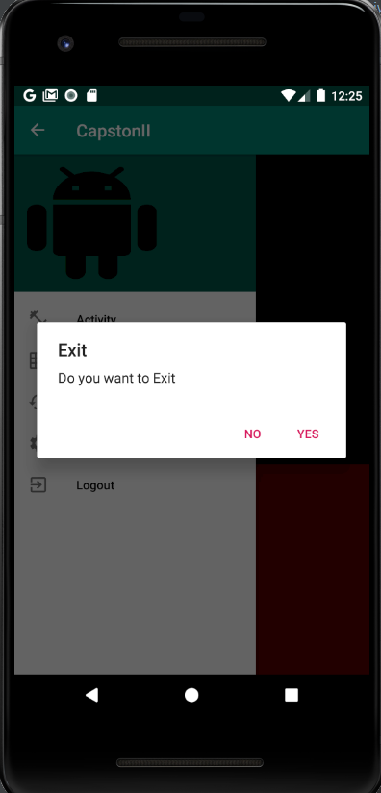
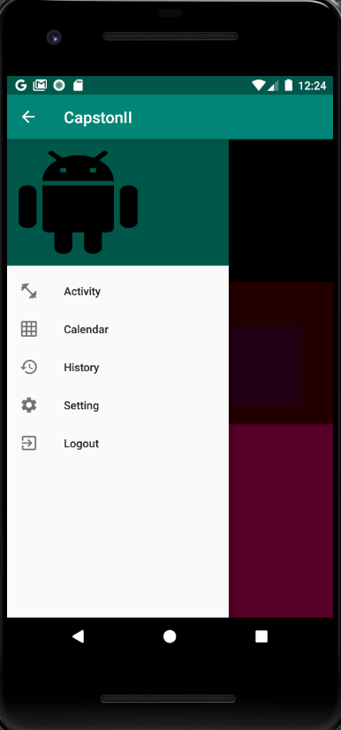
Ready to Get Fit?
Notes:
Detailed Demo of Project - Milad and Parisa
Mention UI
User module
Admin module

Slide 5
What did we use?
Database | MySQL instance
IDEs | Android Studio Visual Studio
Programming Languages | Java PHP
Testing Environment | IDE Simulator Mobile Devices Android OS v.8 (Oreo) Android OS v.7 (Nougat)
Hardware Resources | Mobile Devices Android OS v.8 (Oreo) Android OS v.7 (Nougat) Laptops Windows 10 Linux
Notes:
Technologies used – Vlad
Also, please mention Git for source control and how exactly it helped (easy collaboration, backups)

Slide 6
Deployment
Currently, the application can be downloaded through GitHub and either run in Android emulator or sideloaded on a physical device.
User Module: https://github.com/mahdiesmaeelpour/CapstoneII
Administrator Module: https://www.000webhost.com/cpanel-login
Project Documentation: https://github.com/NadiaMok/capstone
Notes:
Deployment - Vlad
At this point, the application is not packaged and publicly accessible through Google Play Market. This is outside of project scope, however, will still be done. Currently, the application can be accessed through GitHub. There are two different repositories, one for User Module and one for storing the project documentation.
As Nadia explained in the email, the source code repo is private to keep the code inaccessible to the entire internet. That’s why we asked for you github username, to give you access.
In order to run the application, either Android emulator or a physical device is required.
If you choose to use a physical device, you will need to enable developer options and sideload the application.

Slide 7
Project Closure Report
Project Values:
Experience
User Satisfaction
Income (eventually)
Lessons Learned:
Back up the source code
Consider all opinions
Be ready to help
Communicate
Best Practices:
Use VCS
Divide responsibilities correctly
Collaborate
Revisit Requirements
Project Closure Report
Notes:
Closure Report - Nadia

Slide 8
Any questions?
Contact the development team!
Nadezhda Mokhireva | nadezhda.mokhireva@georgebrown.ca
Parisa Khataei | parisa.khataei@georgebrown.ca
Mahdi Esmaeelpour | mahdi.esmaeelpour@georgebrown.ca
Vladyslav Bordiug | vladyslav.bordiug@georgebrown.ca
Notes:
Nadia

