Slide 1

Developed by Team 27

Slide 2

Introduction of Team
Parisa Khataei
Nadezhda (Nadia) Mokhireva
Mahdi (Milad) Esmaeelpour
Vladyslav (Vlad) Bordiug
Notes:
[INTRO OF TEAM] - Parisa
[please mention that at the bottom of the slides there’re links to the documents for more information]
Hello everyone. Thanks for having us here. We are from Group T27.
My name is Parisa, I would like to introduce my team member. Here we have Nadia, next to her are Milad and Vlad.

Slide 3
What is TopFit?
TopFit application suggests an innovative way to build a sport routine:
No more gym expenses!
No more fear of being judged by others in the gym / sport class!
No equipment!
No lengthy sessions!
Instead, we gladly offer…
More Details
Notes:
[PROJECT DESCRIPTION] - Parisa
Also, I would love give you an overview of our interesting project. With today’s busy lifestyle, it might be challenging to find either time or motivation for a workout. A whole hour of the precious time plus loads of research – that’s what it can take to build a sport routine.
So, wouldn’t it be easier to have all the exercises along with lifestyle tips in on place? That’s exactly what TopFit application is about!
With TopFit, users can schedule workouts, get reminders, track their activity and get advice on healthy habits.
TopFit can be installed on an Android device and is supported by a wide range of OS versions!
Also, I would like to define how this project addresses the business needs:
1. TopFit offers workouts of different length
2. Simple intuitive interface
3. All the content is free of charge
4. High accuracy estimations for faster results
5. Notifications about upcoming workouts
6. No need to purchase membership
7. Workouts can be completed from any convenient place
8. No partner / group is required to complete a workout
Now we are back to our team member. I believe they have a lot of things to say about project. To present the application at its best, my team will talk about the project scope and technical requirement. We would also like to demonstrate the prototype of the first version of the TopFit application.
Nadia… Milad… Vlad…

Slide 4
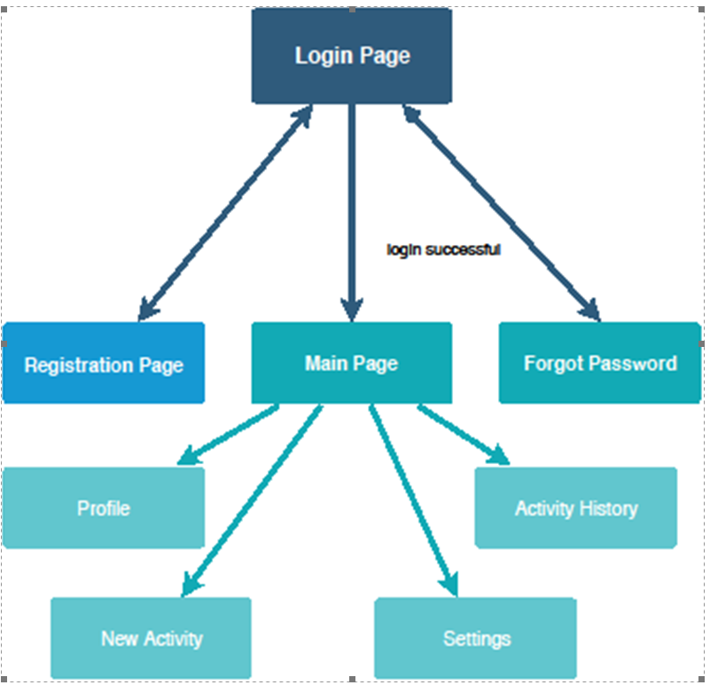
What is TopFit?
Notes:
[PROJECT DESCRIPTION] - Parisa
Also, I would love give you an overview of our interesting project. With today’s busy lifestyle, it might be challenging to find either time or motivation for a workout. A whole hour of the precious time plus loads of research – that’s what it can take to build a sport routine.
So, wouldn’t it be easier to have all the exercises along with lifestyle tips in on place? That’s exactly what TopFit application is about!
With TopFit, users can schedule workouts, get reminders, track their activity and get advice on healthy habits.
TopFit can be installed on an Android device and is supported by a wide range of OS versions!
Also, I would like to define how this project addresses the business needs:
1. TopFit offers workouts of different length
2. Simple intuitive interface
3. All the content is free of charge
4. High accuracy estimations for faster results
5. Notifications about upcoming workouts
6. No need to purchase membership
7. Workouts can be completed from any convenient place
8. No partner / group is required to complete a workout
Now we are back to our team member. I believe they have a lot of things to say about project. To present the application at its best, my team will talk about the project scope and technical requirement. We would also like to demonstrate the prototype of the first version of the TopFit application.
Nadia… Milad… Vlad…

Slide 5

What TopFit Can Offer?
GPS tracking of user’s activity
Automatic workout scheduling
Send the user notifications
Store personal statistics
Display the user’s progress
Free content
More Details
Notes:
[IN SCOPE] - Milad

Slide 6

What TopFit Cannot Offer?
Diet and nutrition information
Personal training
Communication within the application
More Details
Notes:
[OUT OF SCOPE] – Milad

Slide 7
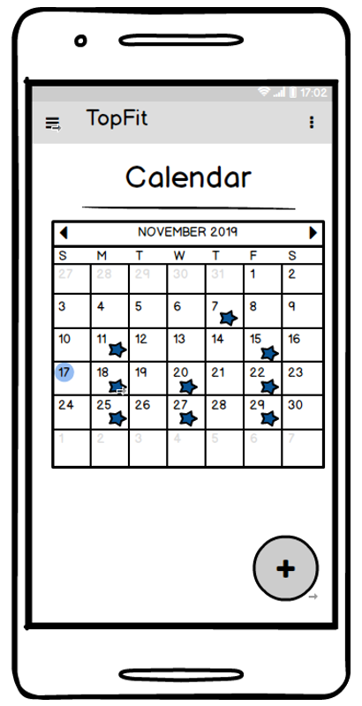
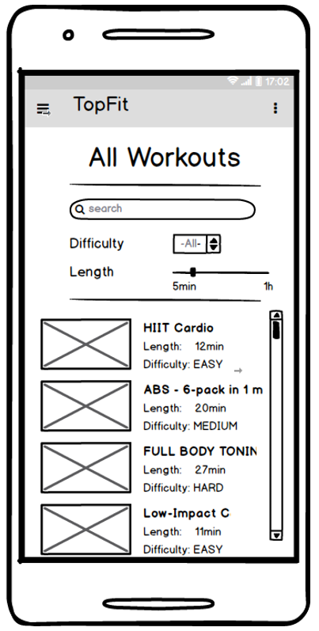
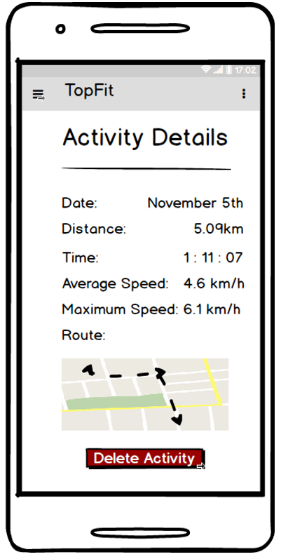
GUI Demo
Notes:
[MOCKUPS LINK] - Nadia

Slide 8
Technology Requirements
Database | MySQL
IDE | Android Studio
Programming languages | PHP Java
Hardware | Team members’ laptops Team members’ Android devises Testers’ Android Devices
More Details
Notes:
[TECHNOLOGY REQUIREMENTS] - Milad

Slide 9
Technology Requirements: Continued
Learning Plan:
Database structure with MySQL
API connections to the database and the GUI
Stacks, heaps work and the “garbage collection”
Bootstrap 4 & JS widgets with a sandbox environment
Web services
Secure form validation using Regular Expressions
More Details
Notes:
[TECHNOLOGY REQUIREMENTS] - Vlad
Learning plan

Slide 10
What’s Next?
Next Steps:
Evaluate the team performance during the term
Reflect on the instructor’s feedback
Start the development process
…but before that – have a nice Christmas break
Notes:
[CONCLUSION: NEXT STEPS] - Vlad

Slide 11
Thank you for your attention!
Do you have any questions?
Contact Us
Notes:
Parisa:
(to team member) Thanks guys you were awesome.
(to Audience) we appreciate for your interest and attention. If you have any questions and queries, we would love to hear about it.

