Slide 1

TopFit – Workout and Wellness
by Group T27

Slide 2
Who are we?
Nadezhda Mokhireva | Back-End Developer, Project Leader
Parisa Khataei | Back-end Developer, Tester, Front-end Developer
Mahdi Esmaeelpour | Back-end Developer, Database Administrator
Vladyslav Bordiug | Front-End Developer, UI Designer
Group T27: Team Charter
Notes:
Intro of team/role - Parisa

Slide 3
Project Goals
User Goals:
Easy access to exercise
Motivation for a healthier lifestyle
Developer Goals:
Conduct a complete project
Practice mobile application development
Work in a team environment
Profit (eventually)
Notes:
Project Goals - Nadia
Easy access – mention covid

Slide 4
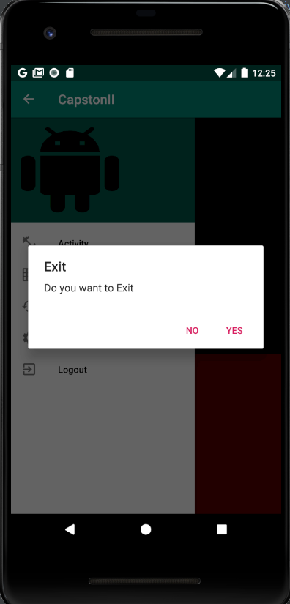
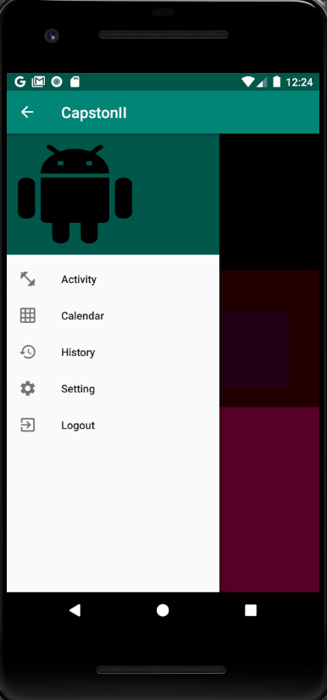
Ready to Get Fit?
Notes:
Detailed Demo of Project - Milad

Slide 5
What did we use?
Database | MySQL instance
IDEs | Android Studio Visual Studio
Programming Languages | Java PHP
Testing Environment | IDE Simulator Mobile Devices Android OS v.8 (Oreo) Android OS v.7 (Nougat)
Hardware Resources | Mobile Devices Android OS v.8 (Oreo) Android OS v.7 (Nougat) Laptops Windows 10 Linux
Notes:
Technologies used - Vlad

Slide 6
Deployment
Currently, the application can be downloaded through GitHub and either run in Android emulator or sideloaded on a physical device.
User Module: https://github.com/mahdiesmaeelpour/CapstoneII
Administrator Module: https://www.000webhost.com/cpanel-login
Project Documentation: https://github.com/NadiaMok/capstone
Notes:
Deployment - Nadia
At this point, the application is not packaged and publicly accessible through Google Play Market. This is outside of project scope, however, will still be done. Currently, the application can be accessed through GitHub. There are two different repositories, one for User Module and one for Admin Module. In order to run the application, either Android emulator or a physical device is required.

Slide 7
Project Closure Report
Project Values:
Experience
User Satisfaction
Income (eventually)
Lessons Learned:
Back up the source code
Consider all opinions
Be ready to help
Communicate
Best Practices:
Use VCS
Divide responsibilities correctly
Collaborate
Revisit Requirements
Project Closure Report
Notes:
Closure Report - Nadia

Slide 8
Any questions?
Contact the development team!
Nadezhda Mokhireva | nadezhda.mokhireva@georgebrown.ca
Parisa Khataei | parisa.khataei@georgebrown.ca
Mahdi Esmaeelpour | mahdi.esmaeelpour@georgebrown.ca
Vladyslav Bordiug | vladyslav.bordiug@georgebrown.ca
Notes:
Parisa

