Slide 1

TopFit – Workout and Wellness
by Group T27

Slide 2
Who are we?
Nadezhda Mokhireva | Back-End Developer, Project Leader
Parisa Khataei | Back-end Developer, Tester, Front-end Developer
Mahdi Esmaeelpour | Back-end Developer, Database Administrator
Vladyslav Bordiug | Front-End Developer, UI Designer
Group T27: Team Charter
Notes:
Intro of team/role - Parisa

Slide 3
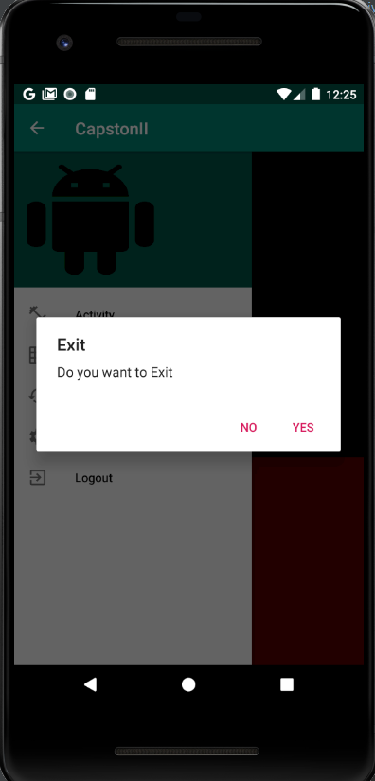
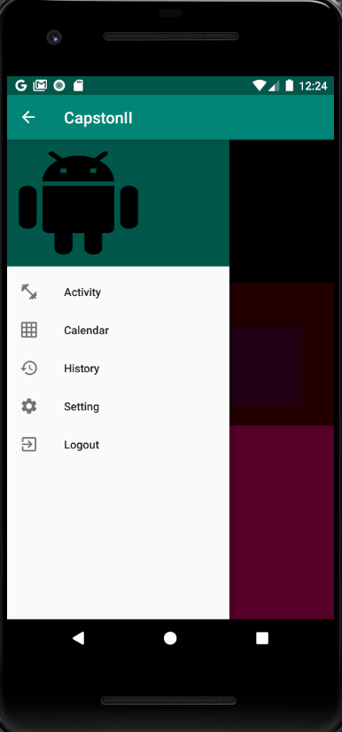

What has been done so far?
Project Repository
Notes:
Detailed Demo of Project as developed till date - Milad (show the video)

Slide 4
What did we use?
Database | MySQL instance
IDEs | Android Studio Visual Studio
Programming Languages | Java PHP
Testing Environment | IDE Simulator Mobile Devices Android OS v.8 (Oreo) Android OS v.7 (Nougat)
Hardware Resources | Mobile Devices Android OS v.8 (Oreo) Android OS v.7 (Nougat) Laptops Windows 10 Linux
Notes:
Technologies used - Parisa

Slide 5
What is next: Milestones
User Statistics
Synchronisation with the calendar
Upload content
Move to cloud server (AWS/Firebase)
UI: color scheme, styling
Group T27: Project Status Report
Notes:
Conclusion milestones – Nadia
Stats representation as chart
Our content (videos) is not merged with the main branch

Slide 6
What is next: Risks
User dislikes a feature
Hardware fails during development
Unable to implement a feature due to the lack of knowledge
Insufficient time to develop a feature
Group T27: Project Status Report
Notes:
Conclusion risks – Nadia
(We are getting protective over the app and care for the user to like it)
User won’t like the feature – collect feedback and fix
Hardware failure during dev – store all in github
Unable to implement a feature – ask Anjana / online communities. If nothing, look for n alternative
Time shortage – very unlikely, so far we are well on track. If happens – prioritize

Slide 7
Any questions?
Contact the development team!
Nadezhda Mokhireva | nadezhda.mokhireva@georgebrown.ca
Parisa Khataei | parisa.khataei@georgebrown.ca
Mahdi Esmaeelpour | mahdi.esmaeelpour@georgebrown.ca
Vladyslav Bordiug | vladyslav.bordiug@georgebrown.ca

