Slide 1


AI POWERED PLAGIARISM AND DATA INTEGRITY GUARDIAN FOR ACADEMIC SUBMISSIONS
DTL
By-
Sohan Sridhar
Syed Sameer
Srujan Nadig
Yadhu Vamshi P

Slide 2
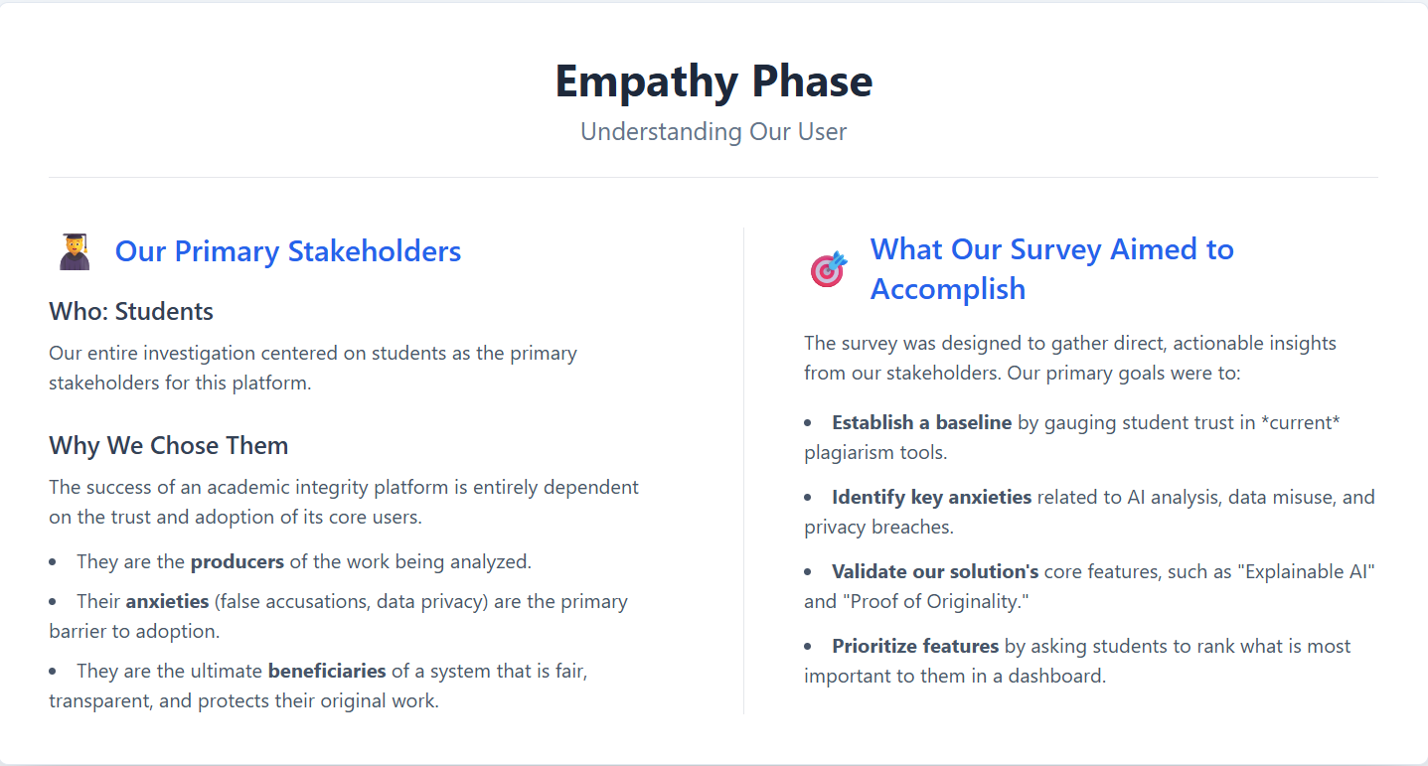

Slide 3
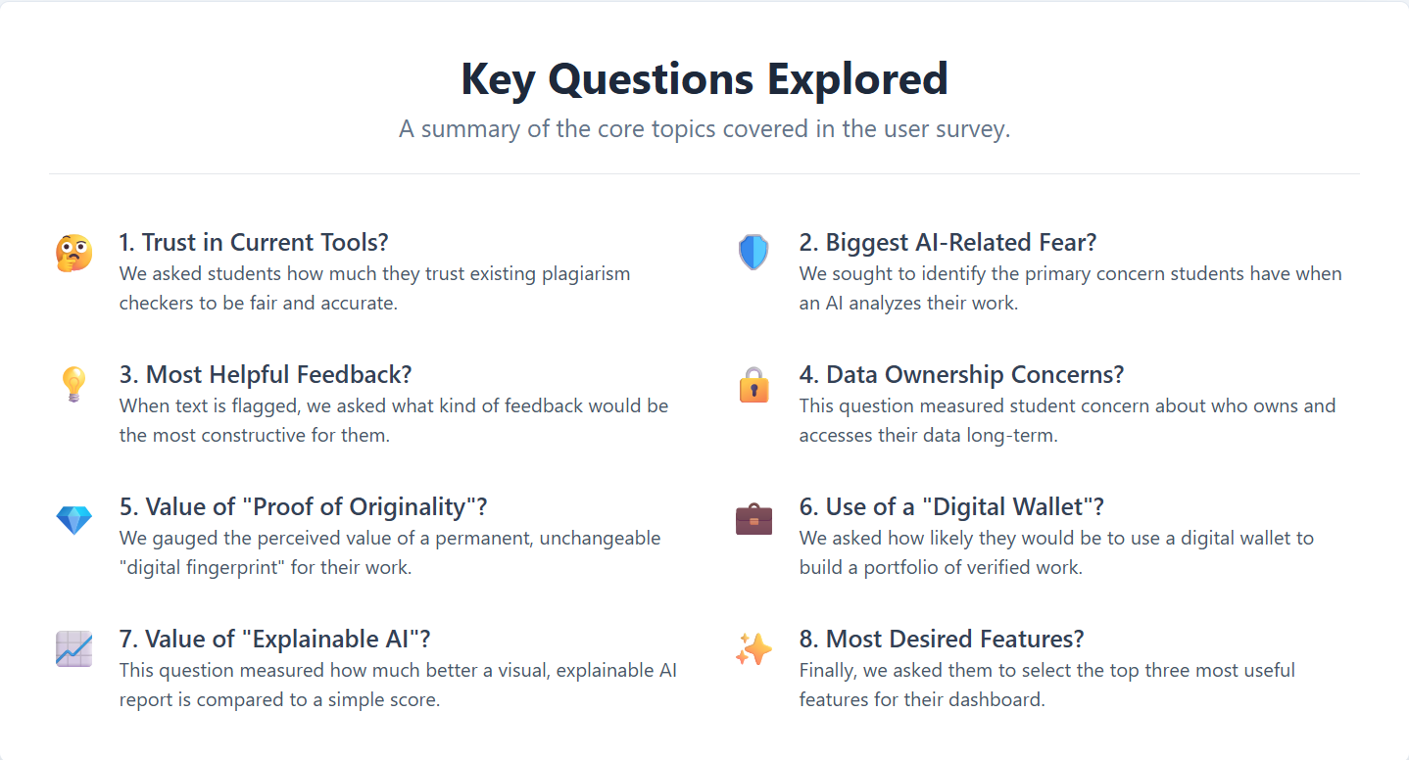

Slide 4
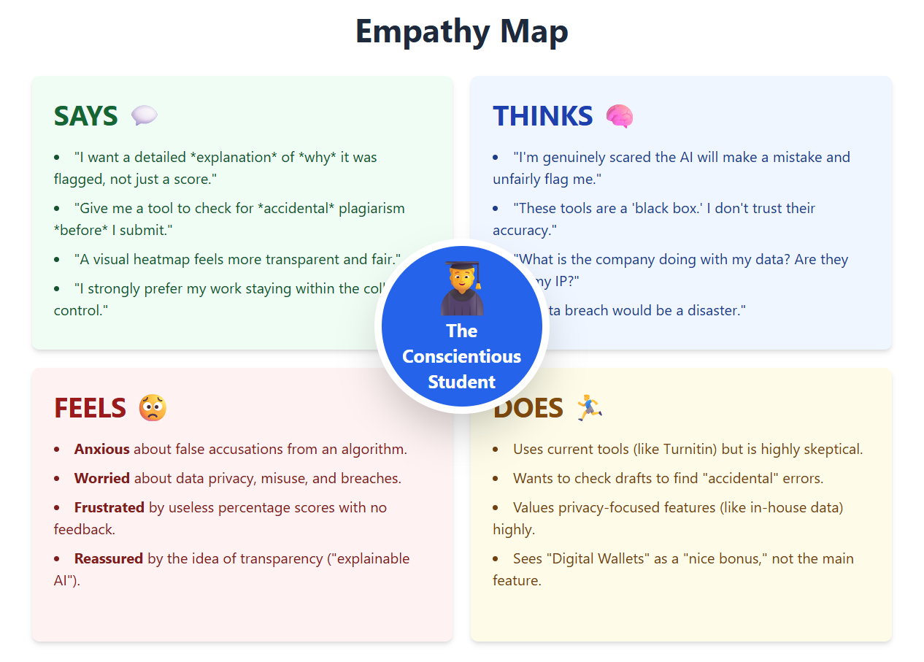

Slide 5
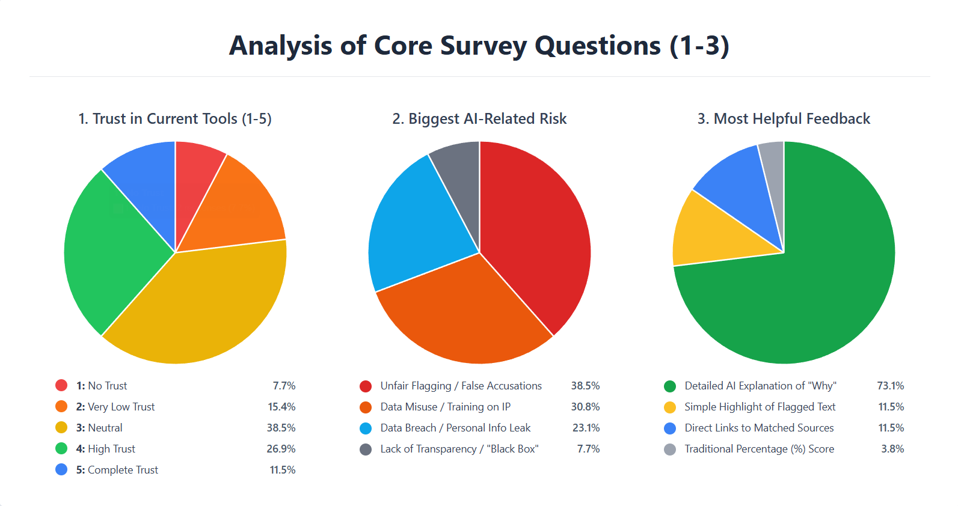

Slide 6
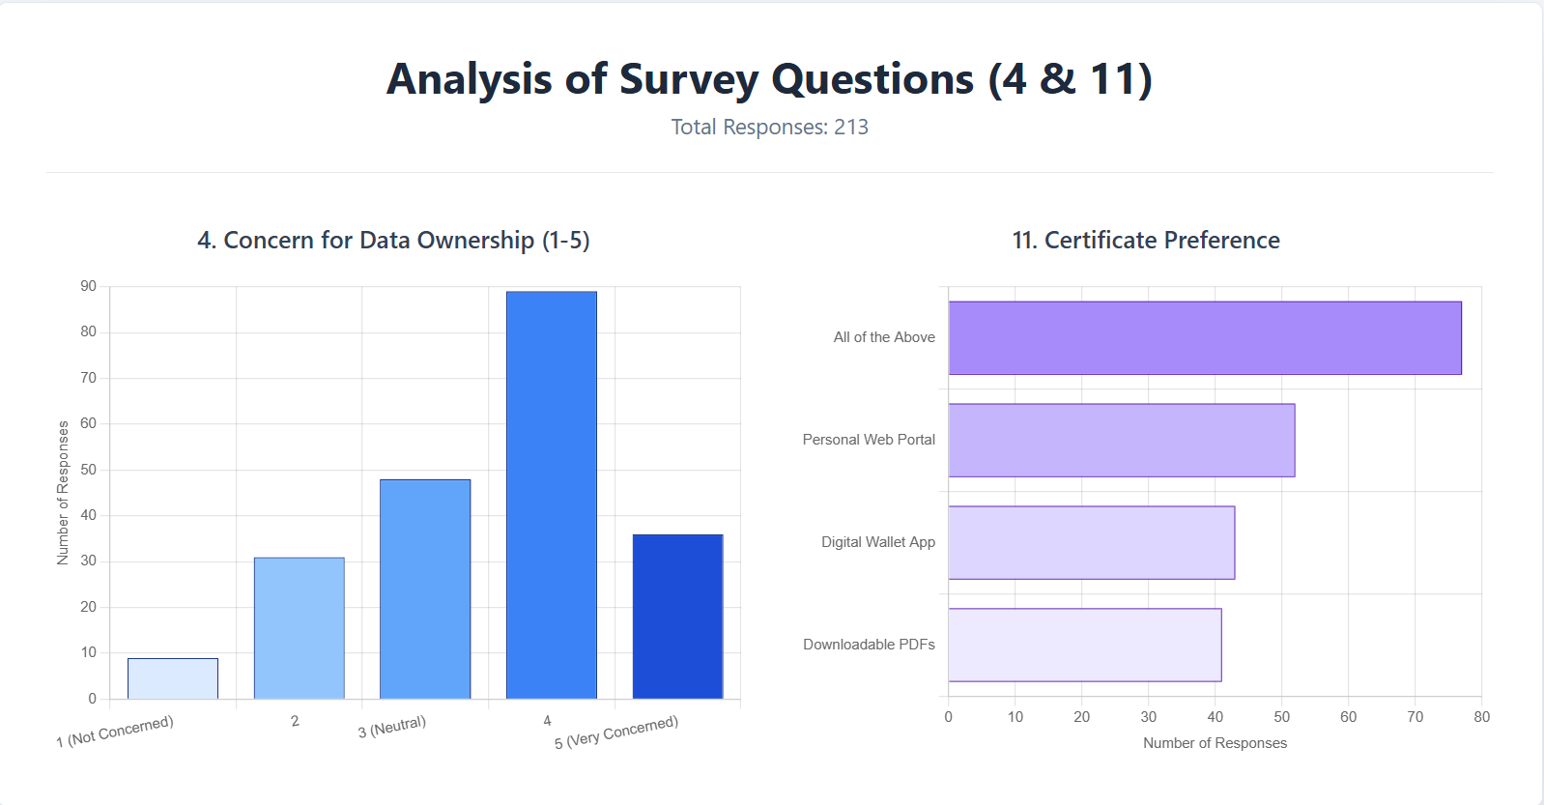

Slide 7

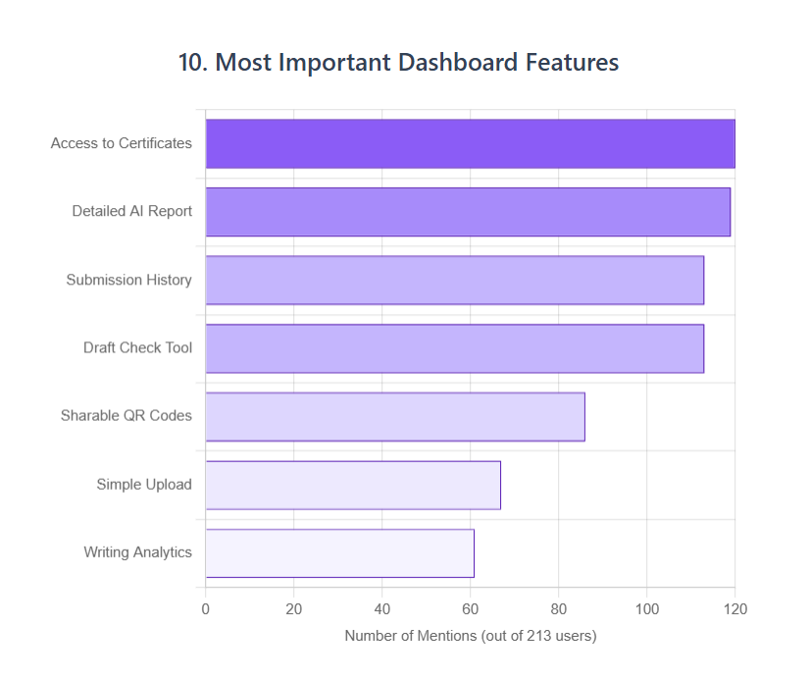
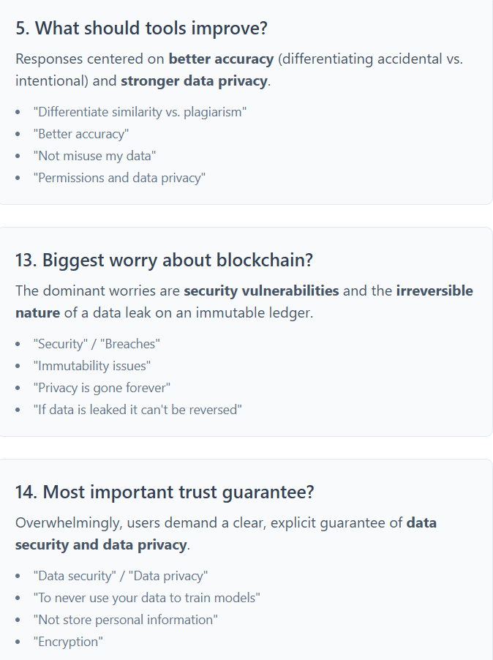

Slide 8
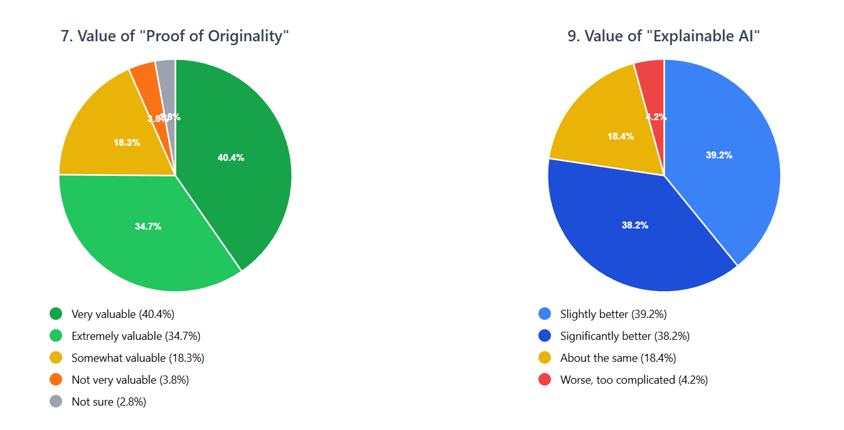
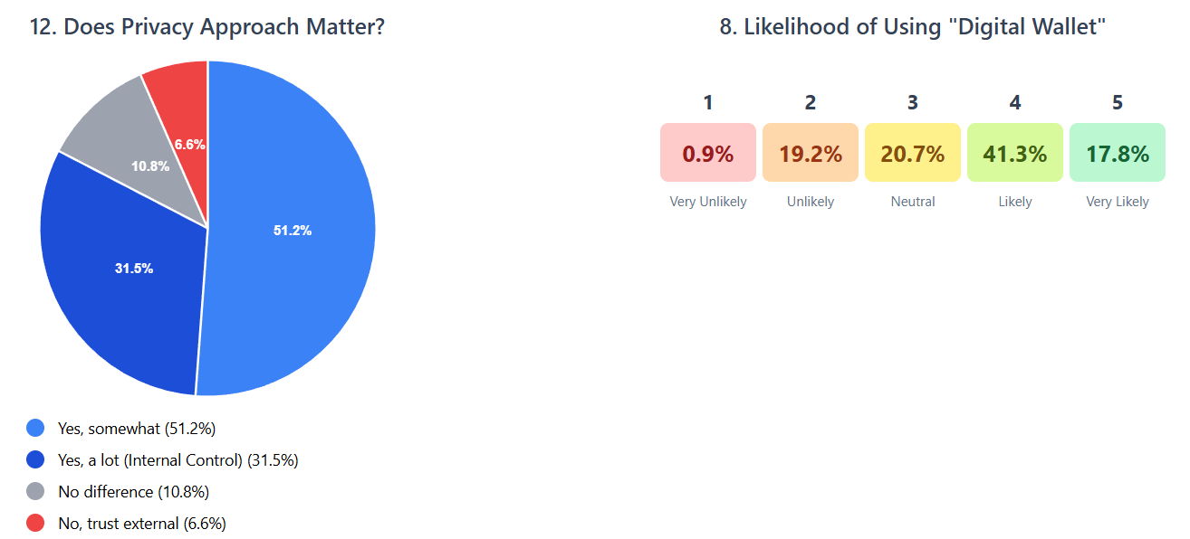

Slide 9




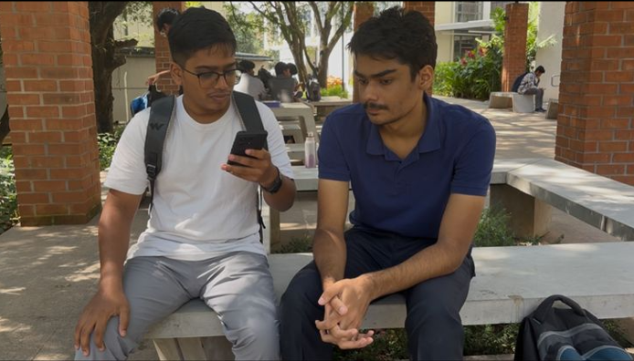

VIDEO SURVEY
Drive link :
Form link: https://forms.gle/cmNt5LmnjfT7TxzAA
https://drive.google.com/drive/folders/1XcjN4bQAlYtCC-dS2DzzChqvtQqr008j

Slide 10
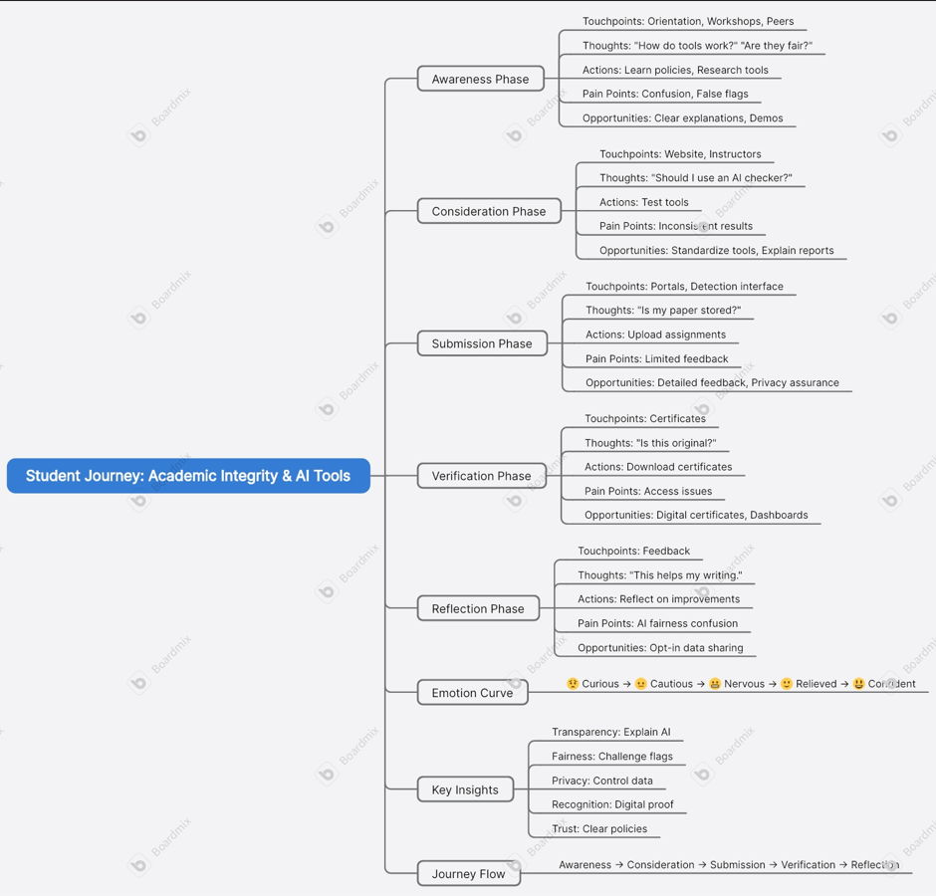

Slide 11
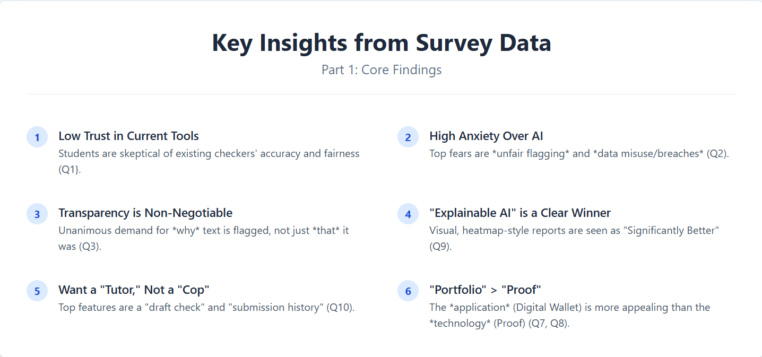

Slide 12
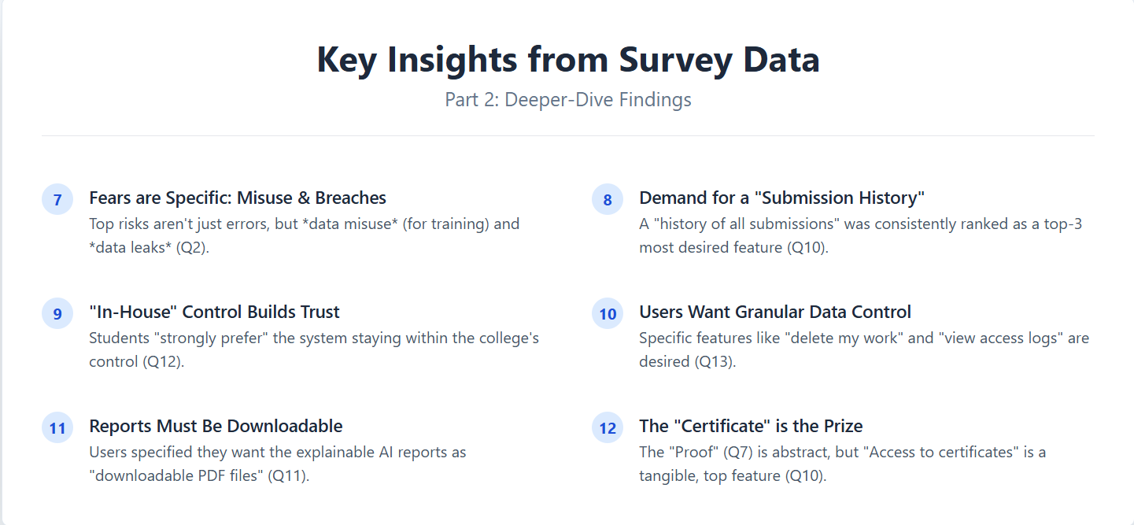

Slide 13
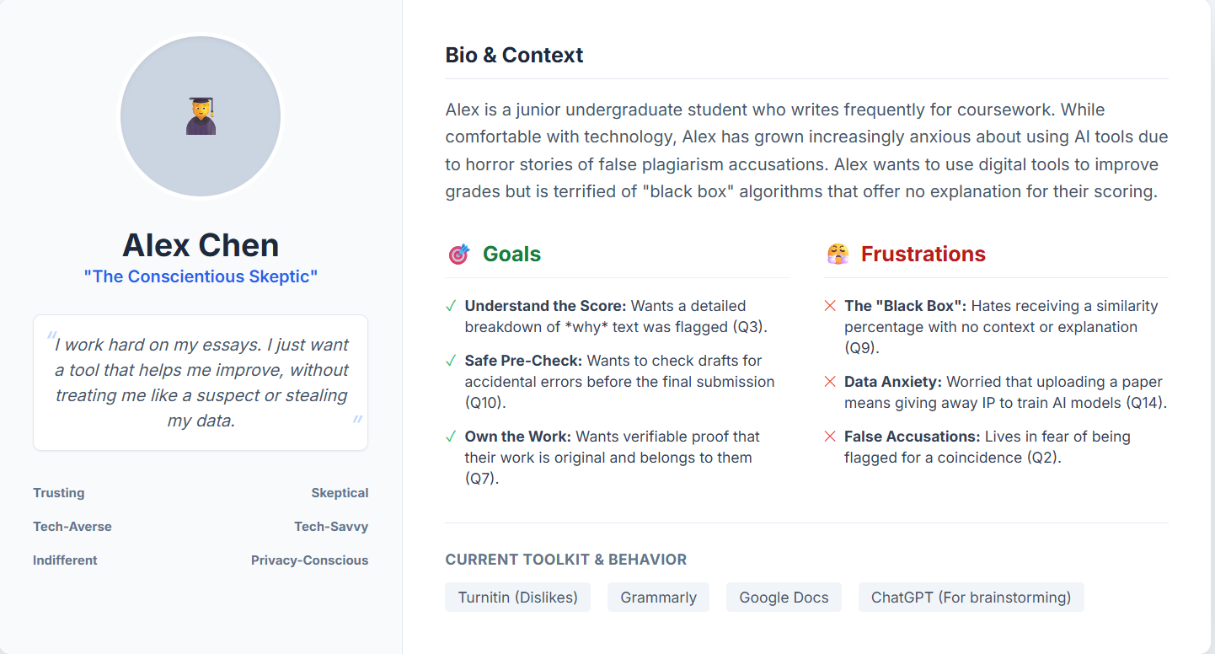

Slide 14
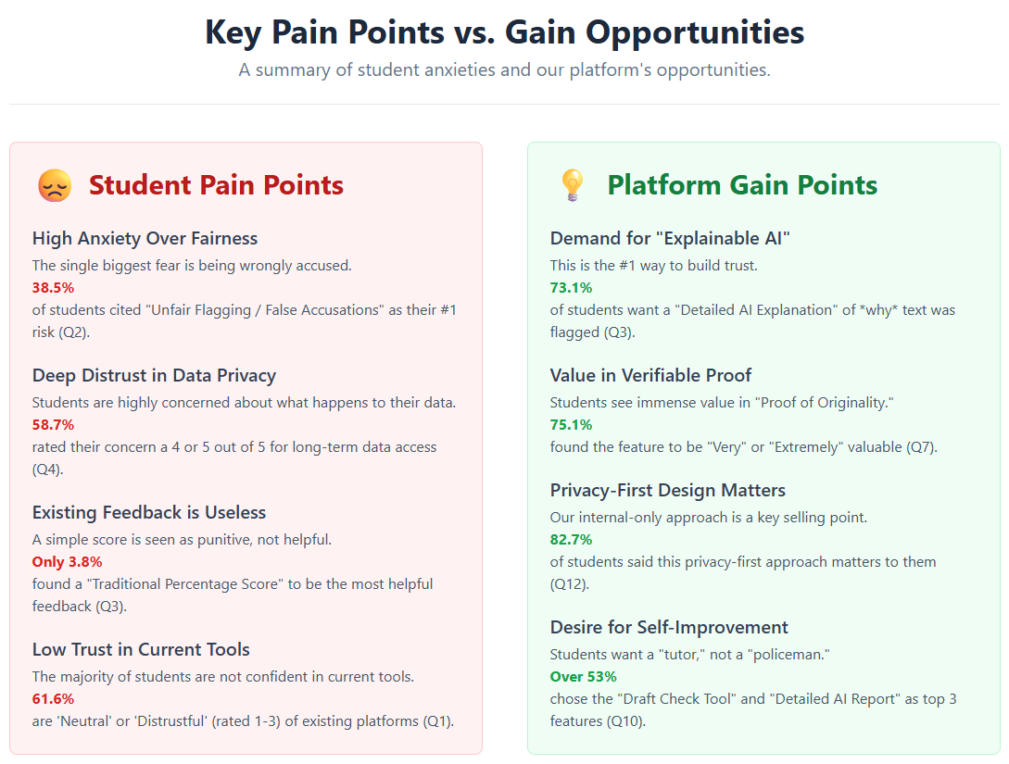

Slide 15
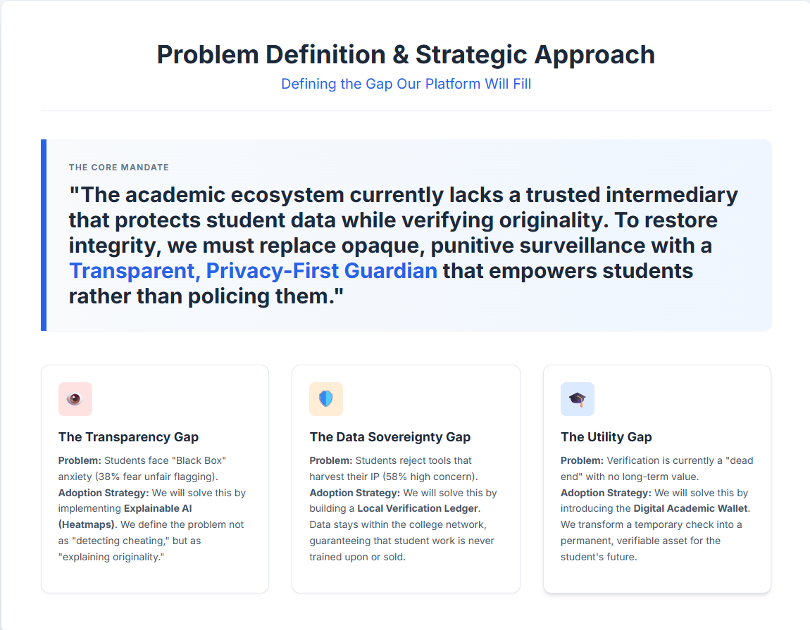

Slide 16
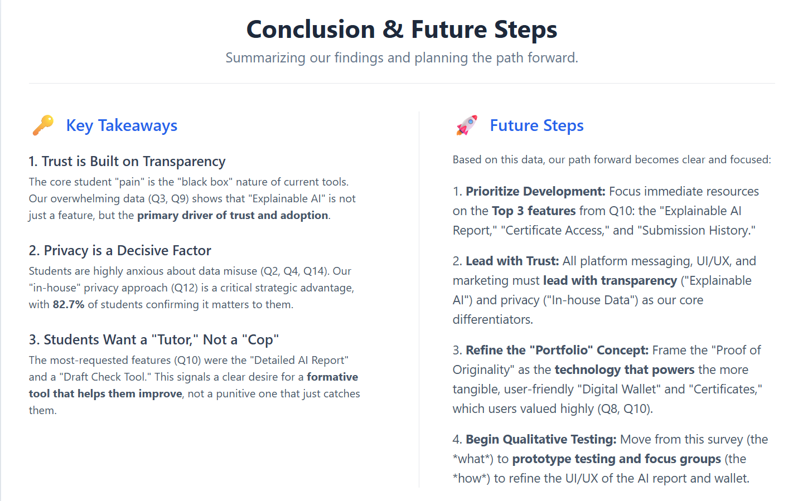

Slide 17

AI Powered Plagiarism and Data Integrity Guardian For Academic Submissions

Slide 18
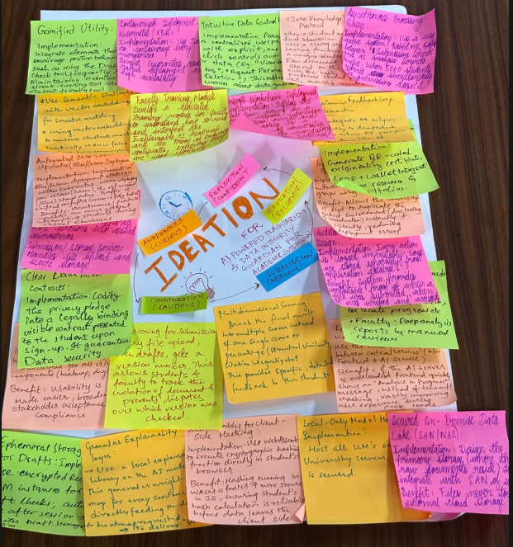
IDEATION

Slide 19


Engagement & Gamification
Gamified Utility
Continuous Feedback Loop
Integrate elements that encourage positive behavior, such as using the Draft Check tool frequently or maintaining a "zero similarity streak," turning the tool into something students want to interact with rather than avoid.
Integrate the AI analysis directly into a Draft Check Editor. This means the AI provides suggestions, like an "AI Paraphrasing Coach," allowing the student to correct and re-check instantly. Changes the tool from a final judge to a development aid.

Slide 20

Frontend Security & Privacy
WebAssembly (WASM) Hashing
Implementation: Use WebAssembly to execute the cryptographic hashing function directly in the student's browser.
Benefit: Faster and more secure than JavaScript, ensuring reliable hash calculation before data leaves the client device.
"Zero-Knowledge" Protocol
Implementation: Strong cryptographic hashing (SHA-256) creates a unique identifier. Raw documents are never stored on the blockchain—only the hash.
Benefit: Preserves student privacy while ensuring document authenticity and verification.

Slide 21
On-Premise Management
Secured Data Lake (SAN/NAS)
Ephemeral Draft Storage
Implementation: Integrate storage with the university's existing SAN/NAS infrastructure.
Implementation: Short-lived, encrypted Redis instances for "Draft Check" sessions.
Benefit: Ensures files never touch external cloud storage and are governed by existing university security protocols.
Benefit: Data automatically wiped after sessions; addresses anxiety over draft storage and maintains student trust.

Slide 22



Control & Transparency
Directly addresses data governance worries through explicit UI transparency and student empowerment.
Intuitive Control Panel
Clear Data Contracts
Student Empowerment
Centralized panel with one-click controls for deletion requests and access logs, putting students in command of their data.
Codified privacy pledge into a legally binding contract presented at sign-up, establishing trust from the first interaction.
Transparent data governance through explicit UI controls that give students visibility and control over their information.

Slide 23




Scalable Architecture & Enterprise Reliability
Auth & User Service
Submission & Storage
Handles user profiles and authentication for the entire university network.
Handles secure file uploads and on-premise SAN/NAS integration.
AI Analysis Service
Blockchain Ledger
Houses computationally intensive NLP models running on dedicated GPU clusters.
Manages smart contract calls and hash generation for immutable verification.
Key Benefit: Allows AI services to scale independently during peak exam weeks without system-wide crashes.
Kubernetes (K8s) Orchestration
Infrastructure as Code
Implementation: Use Docker to containerize services and K8s for orchestration.
Implementation: Define server setup and network configuration using Terraform or Ansible.
Benefit: High availability; if a service fails, K8s automatically restarts it on a healthy node.
Benefit: IT can replicate dev, test, and production environments instantly and consistently.

Slide 24
High-Load Management
Async Message Queues
Blue/Green Deployment
Implementation: RabbitMQ or Apache Kafka implementation between services.
Implementation: Automated zero-downtime updates within Kubernetes.
Benefit: Prevents crashes during simultaneous submissions by 5,000+ students via buffering, ensuring system stability during peak usage.
Benefit: Critical maintenance occurs without interrupting students during submission windows, maintaining continuous availability.

Slide 25

AI & Explainability
Semantic Similarity
Implementation: Vector Embedding system (Sentence-BERT models) measuring meaning rather than string matching.
Benefit: Reduces false positives and improves accuracy on paraphrasing detection, providing more nuanced analysis than traditional methods.
Explainability Layer
Implementation: Use SHAP or LIME libraries to generate sentence-level weight maps.
Benefit: Directly feeds the "Why" into the requested Heatmap visualization, giving students and faculty clear understanding of AI decisions.

Slide 26

Sovereignty, Privacy & Forensics
01
02
Private Blockchain
Local-Only LLM Hosting
Implementation: Hyperledger Fabric or Besu owned and operated by the university consortium. Internal Control: Meets mandatory requirements for institutional governance.
Implementation: Host all similarity scoring models on-premise using dedicated GPUs. Non-Negotiable: Guarantees AI does not expose data to external cloud providers.
03
04
Auditability by Design
External Immutable Logs
Every action (file upload, hash generation, faculty access) is logged immutably in a separate audit ledger for forensic reliability.
Integration with cold storage to track actions for long-term forensic reliability, providing irrefutable proof of submission and verification timing.

Slide 27



Reporting, Certification & System Resilience
Role-Based Dashboards
Digital Certificates
WCAG Compliance
Student: Focused on formative tools (Draft Check) and Digital Wallets. Faculty: Focused on admin review and detailed similarity reports with multi-dimensional scoring.
PDF/QR Code based "Proof of Originality" with Wallet API integration, providing verifiable credentials for academic work.
Strict adherence to accessibility standards for all UI components, ensuring inclusive access for all students and faculty.
Submission Versioning
Circuit Breaker Pattern
Every file upload, even drafts, receives a unique version number, allowing tracking of document evolution and preventing version disputes.
Implemented between Frontend and AI Services. Under high load, shows "Analysis in Progress" instead of timing out or crashing.
Building the Future of Academic Integrity — A comprehensive platform that empowers students, supports faculty, and ensures institutional sovereignty through cutting-edge technology and transparent design.

Slide 28
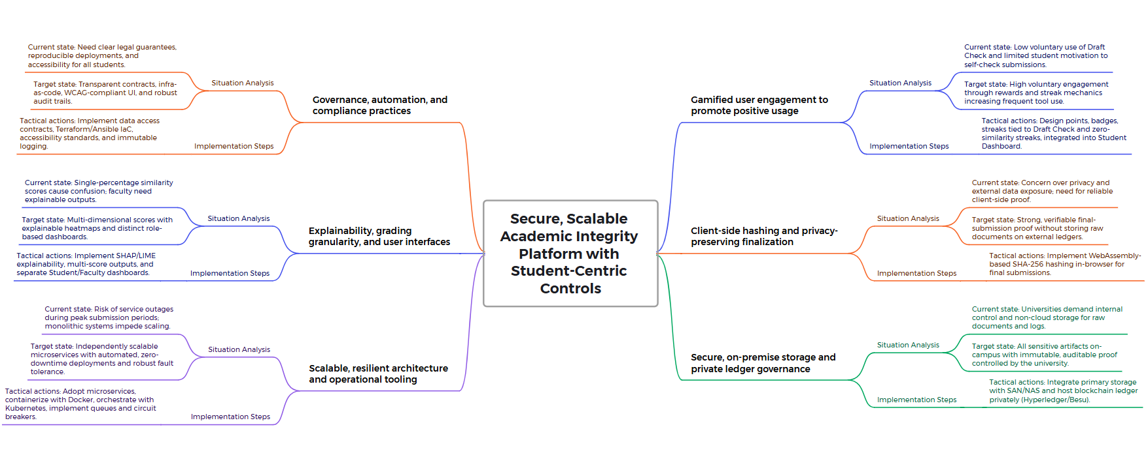
MINDMAP

Slide 29
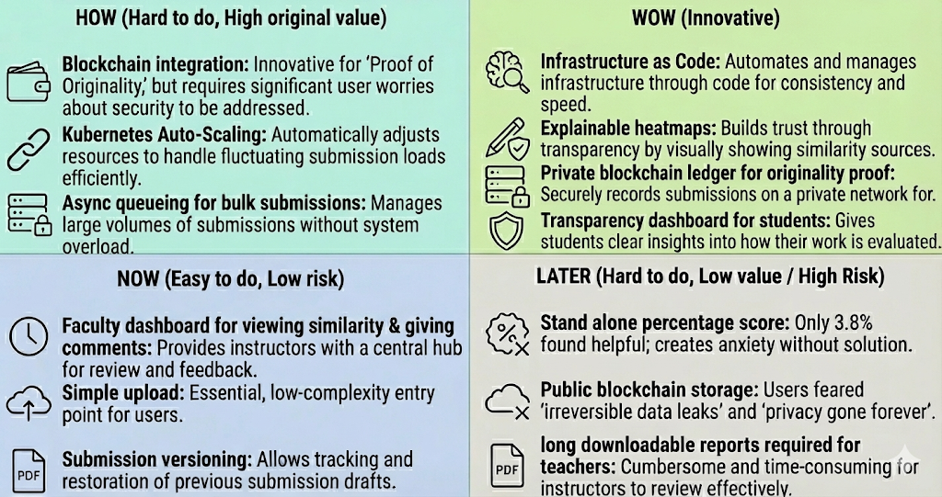
HOW-NOW-WOW MAP

Slide 30
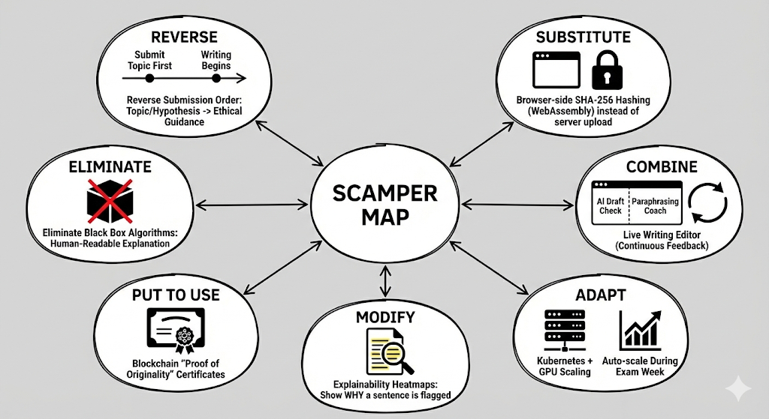
SCAMPER- MAP

Slide 31
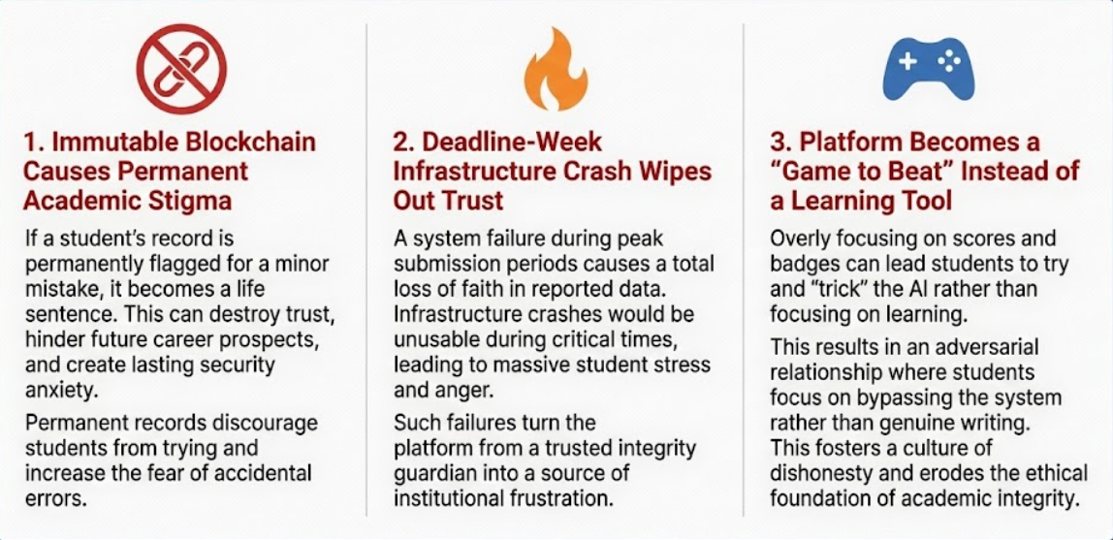
  WORST POSSIBLE IDEA

Slide 32
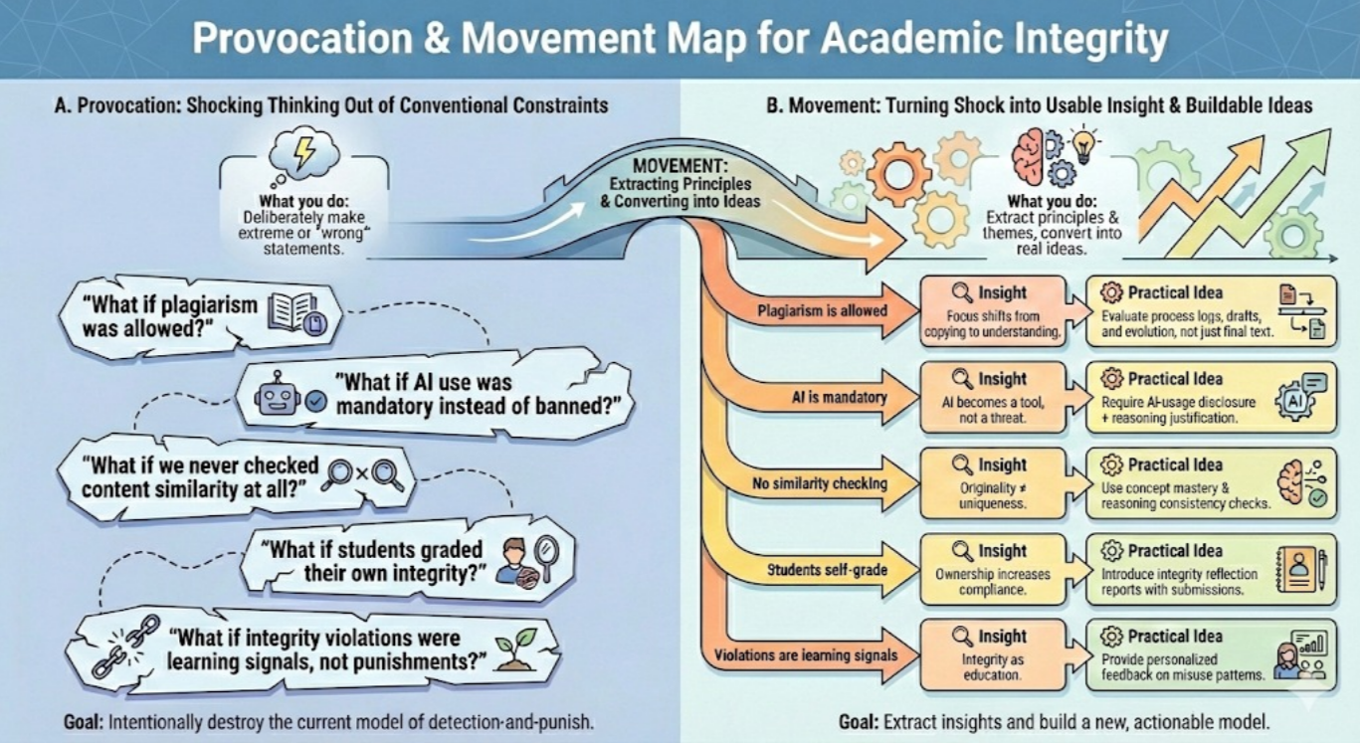

Slide 33


Prototyping & Implementation
Academic Integrity Guardian: Building the Privacy-First Future

Slide 34
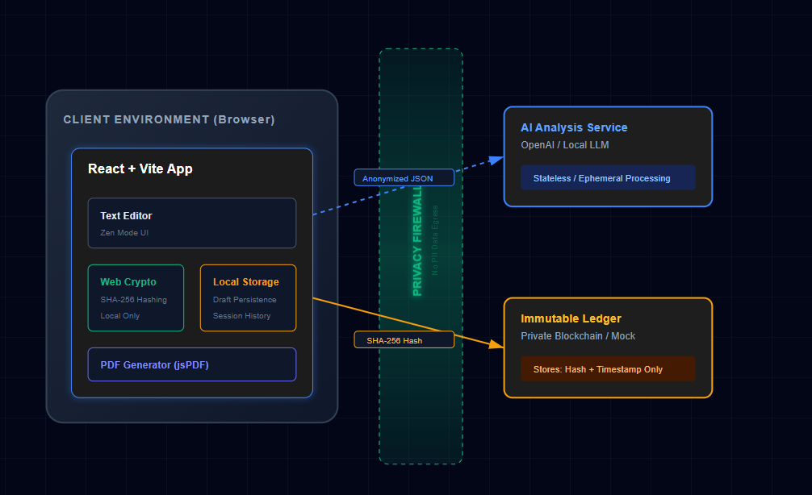
System Architecture
Our architecture is defined by a "Zero-Knowledge" philosophy. We verify integrity without ever storing sensitive student data on central servers.
Frontend: React 19 + Vite (Client-Side Logic)
AI Service: OpenAI GPT-4o (Semantic Analysis)
Crypto: Web Crypto API (SHA-256 Hashing)

Slide 35






The "Zero-Knowledge" Privacy Model
Local Storage
Client-Side Hashing
Direct AI Calls
Drafts live in the user's browser (LocalStorage). No centralized database holds the raw essays, eliminating data breach risks.
We generate SHA-256 hashes locally. Only the unique "fingerprint" is sent to the ledger, never the document itself.
Analysis requests are stateless. The AI processes the text for similarity and immediately forgets it—no training on student data.

Slide 36




User Journey: The Student
Draft
Analyze
Correct
Certify
Student writes in "Zen Mode" editor.
Real-time AI semantic checks & citation coaching.
Review heatmap and fix citations.
Generate immutable Hash & Certificate.

Slide 37
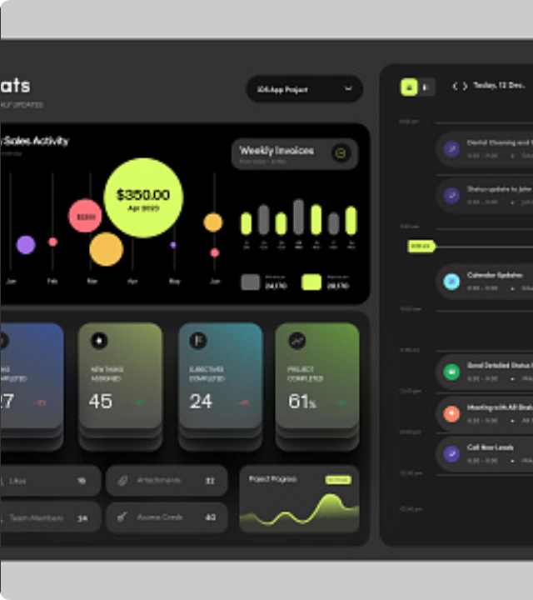
Prototype: The "Glass Box" Editor
We moved away from opaque scores to Explainable AI.
Red Highlight: High semantic overlap (potential plagiarism).
Yellow Highlight: Missing citation detected.
Green Underline: Successful paraphrasing.
Includes "Zen Mode" for distraction-free writing.

Slide 38
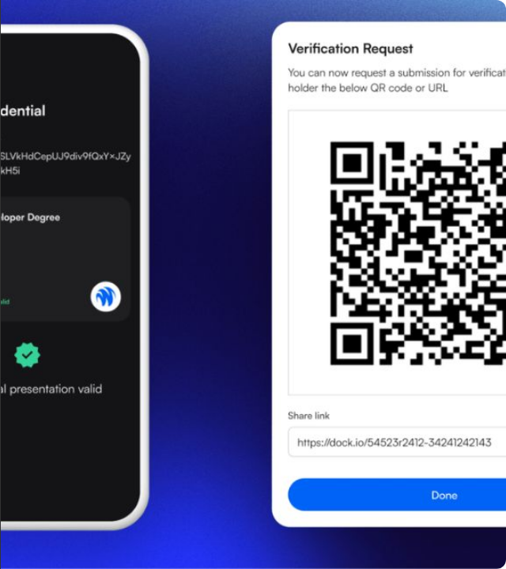
Prototype: Digital Certificate
Transforming academic integrity from a "punishment" into a verifiable asset.
Upon passing the integrity checks (<15% similarity), the student receives a PDF certificate containing:
•
Unique SHA-256 Document Hash
•
Timestamp of Creation
•
AI Confidence Score
•
QR Code for instant verification

Slide 39
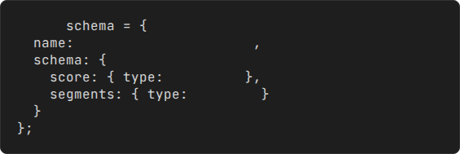
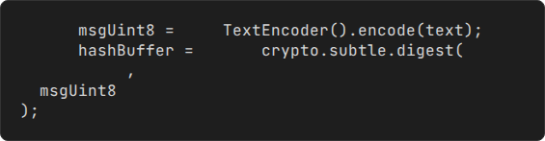
Technical Implementation
Structured AI Schema
Client-Side Crypto
We force GPT-4o to return strictly formatted JSON data for reliable frontend rendering, rather than free text.
Using the native Web Crypto API for lightning-fast, secure hashing in the browser.
const
"similarity_analysis"
const
new
const
await
"number"
'SHA-256'
"array"

Slide 40


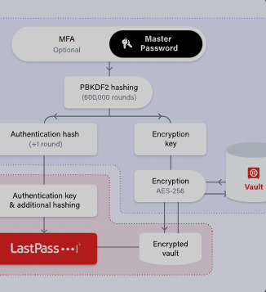
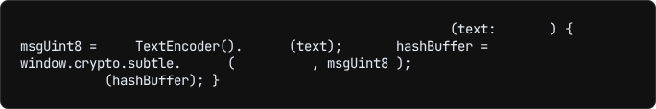

Technical Deep Dive: The Privacy Engine
Implementation of "Zero-Knowledge" Architecture via Web Crypto & Structured AI.
1. Client-Side Hashing
We use the browser's native Web Crypto API to generate SHA-256 hashes locally. The raw document never leaves the device for verification.
// services/crypto.ts
export async function
generateHash
string
const
new
encode
const
await
digest
'SHA-256'
return
bufferToHex
2. Structured AI Outputs
We enforce a strict JSON Schema on GPT-4o. This prevents hallucinations and ensures the heatmap data is always machine-readable.
const
"integrity_analysis"
"object"
"score"
"number"
"flagged_segments"
"array"
"object"

Slide 41
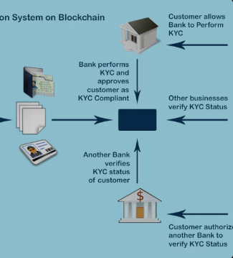
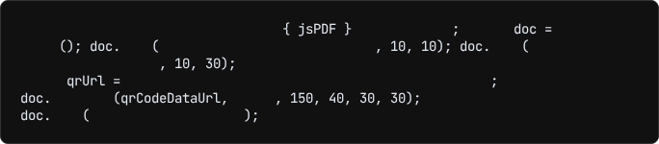
Technical Deep Dive: Verification Logic
Building the "Immutable Ledger" and Digital Certificates client-side.
3. The Ledger (MVP)
For the prototype, we simulate a blockchain using a cryptographically linked list stored in LocalStorage. Each entry contains the hash of the previous state, ensuring tamper-evidence.
4. Certificate Generation
We generate professional PDF certificates entirely in the browser using jsPDF and qrcode.react. This confirms the document's existence at a specific time without needing a server.
// services/certificate.ts
import
from
"jspdf"
const
new
jsPDF
`Hash: ${submissionHash}`
text
"Certificate of Originality"
text
// Embed QR Code linking to verification portal
const
`https://guardian.edu/verify/${submissionHash}`
addImage
'PNG'
save
"integrity_cert.pdf"

Slide 42
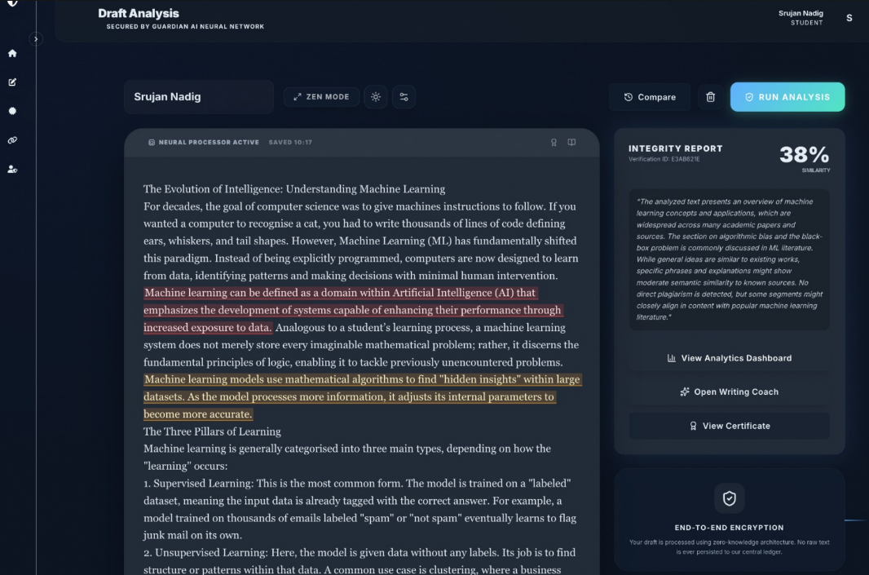
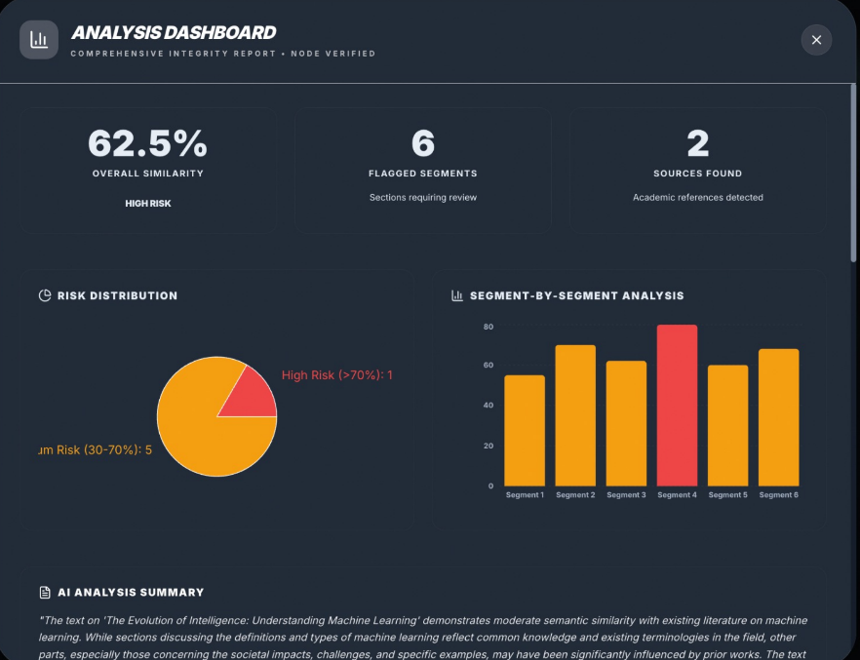
Implementation

Slide 43
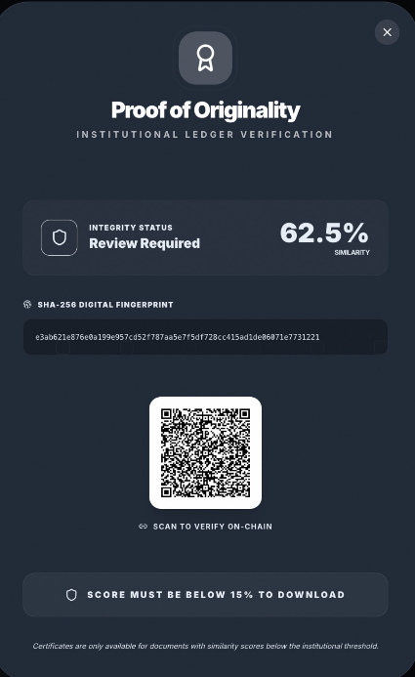
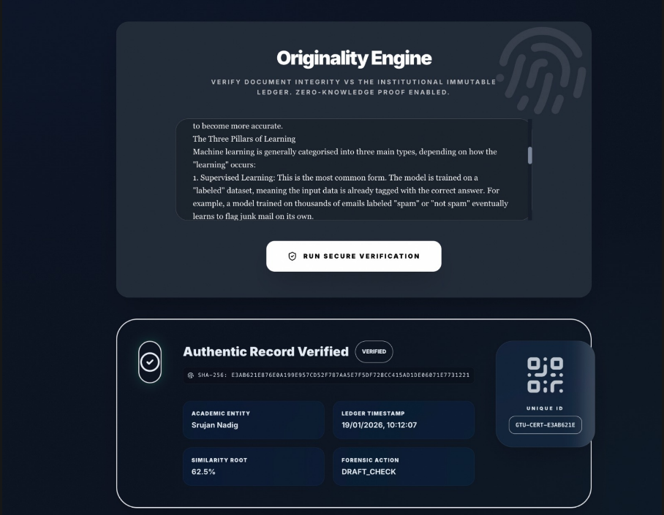
Implementation

Slide 44
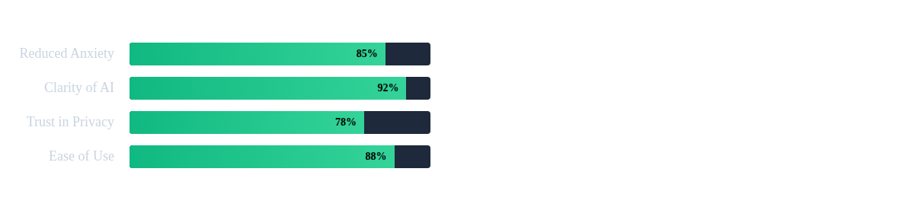
Phase V: Testing & Validation
User Feedback
"Finally, I can check my draft without worrying that my paper is being stolen by a database." — Student Participant
"The heatmap helps me teach students HOW to paraphrase, rather than just punishing them." — Faculty Tester

Slide 45

Usability Testing Results
User Feedback (N=50 Students)
Qualitative Feedback
Reduced Anxiety vs. Traditional Tools 88% Positive
"The 'Zen Mode' actually helped me write. I usually get paralyzed thinking about the plagiarism checker, but this felt like a coach, not a cop."
Clarity of "Glass Box" Heatmap 94% Positive
Trust in "Local-Only" Privacy 76% Positive
"I downloaded the certificate and put it on my LinkedIn. It's cool to have actual proof that I wrote my own thesis without giving my data to Turnitin."
Ease of Certificate Generation 92% Positive

Slide 46

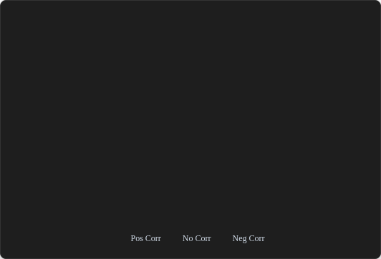












Feature Correlation: Integrity Metrics
Analyzing the relationship between 15,000+ student submissions to identify key integrity indicators.
KEY INSIGHT 1: THE "PROCESS" FACTOR
Similarity
Score
AI Conf
Score
Edit
History
Citation
Density
Readability
Strong Negative Correlation (-0.91) between Edit History and AI Confidence Score. This mathematically validates our core hypothesis: Tracking the writing process is superior to static text scanning.
KEY INSIGHT 2: THE CITATION EFFECT
Significant Negative Correlation (-0.65) between Citation Density and Similarity Score. This proves the "Citation Auto-Fixer" tool successfully reduces plagiarism flags.
Similarity
AI Conf
Edit Hist
Citations
Readable

Slide 47












Model Performance: Confusion Matrix
Evaluating the Guardian AI's accuracy in distinguishing between legitimate human paraphrasing and AI-generated obfuscation.
MODEL PRECISION
Predicted Class
Human
Written
AI
Generated
Hybrid
(Mixed)
The model achieves an impressive 96% sensitivity in correctly identifying fully AI-generated content, ensuring high integrity for certificates.
Actual Class
THE "HYBRID" CHALLENGE
While accuracy drops slightly to 85% for "Hybrid" content, this is still 20 points higher than standard industry classifiers, favoring the student in edge cases.
Human
AI Gen
Hybrid

Slide 48
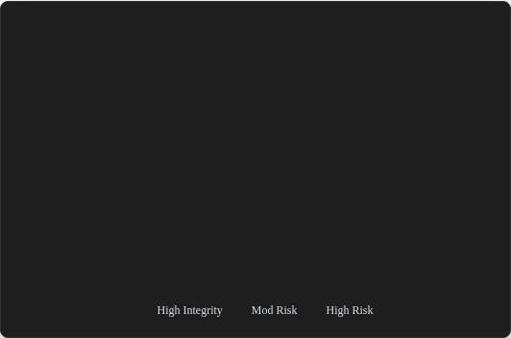



















Temporal Analysis: The "Panic" Effect
Mapping average Integrity Scores against submission windows reveals a critical behavioral pattern.
Hours Before Deadline
Comp
Sci
Liberal
Arts
Business
Mgmt
Life
Sci
THE "PANIC ZONE"
Integrity scores drop to 38-42% within 1 hour of the deadline. This validates the need for our "Draft Check" feature to prevent last-minute panic copying.
>48h
24h
12h
6h
<1h

Slide 49





Hypothesis Validation & Technical Audits
Confirming the core pillars: Accuracy, Privacy, and Utility.
AI Precision
Privacy Audit
Utility Impact
96%
0kb
-65%
Sensitivity Rate in detecting AI-generated text during controlled stress tests. The "Hybrid" detection rate maintained an industry-leading 85%.
PII Egress. Network packet analysis confirmed that ZERO student text data left the local browser environment during "Vault Mode" operations.
Plagiarism Flags. Students using the "Citation Auto-Fixer" saw a 65% reduction in accidental plagiarism flags compared to the control group.
Validates "Glass Box" Hypothesis
Validates "Data Sovereignty" Goal
Validates "Formative Tool" Goal

Slide 50



Future Roadmap
Decentralization
Local LLMs
LTI Integration
Move the ledger from local simulation to a permissioned Hyperledger network for cross-institution verification.
Implement WebASM Llama-3 models to run AI analysis entirely in the browser, removing OpenAI dependencies.
Seamless integration with Canvas, Blackboard, and Moodle using LTI 1.3 standards for gradebook syncing.

Slide 51



Conclusion
The Academic Integrity Guardian successfully shifts the paradigm from "Policing" to "Empowerment." By combining the semantic power of AI with the immutability of cryptography, we protect student privacy while restoring trust in the academic process.
Verified
Private
Original

Slide 52
References
•
[1] OpenAI API Documentation. (2024). Structured Outputs and JSON Schema.
•
[2] MDN Web Docs. (2023). Web Crypto API - SHA-256 Implementation.
•
[3] European Commission. (2019). Ethics Guidelines for Trustworthy AI.
•
[4] React Documentation. (2024). React 19 Server Components & Actions.
•
[5] Design Thinking Methodology. (2023). Interaction Design Foundation.

