Slide 1
Pneumonia Detection Using Several Algorithms and Comparison Between These
Presented By Group 1
Mahbubur Rahman, ID- 19-39918-1
Sumona Alam, ID- 19-39944-1
Nadim Hasan, ID- 20-43004-1
Najmun Jahan,ID- 19-43297-1

Slide 2

Contents
Problem Statement
Objectives
Methodology
Result & Discussions
Conclusion
References

Slide 3

1
Problem Statement

Slide 4
Problem Statement
Pneumonia is a widespread issue that affects both older and younger people equally. However, there hasn't been much of a technological revolution related to this problem in this age of rapid technological advancement. The outdated technology are still used to detect pneumonia. There is currently no effective method for properly identifying pneumonia from chest x-rays or pictures.

Slide 5
2
Objectives

Slide 6
Objectives
Our paper compares various algorithms for detecting pneumonia and takes a number of different techniques. The proposed system/model is tested and trained using Kaggle datasets. The system analyzes an image in real-time to determine whether or not a person has pneumonia. The retrieved pixel density from the photos is used as an input for a number of models, including kNN, CNN SVM, Random Forest, etc.

Slide 7
3
Methodology

Slide 8
Methodology Overview
Data collection
Validation
Feature Extraction
How the data was collected
How the data was validated
Feature extraction method used for data
Classification Algorithm
Analysis
Algorithms used for the model
How the data was analysed

Slide 9
Data collection
Dataset used was collected in various picture formats such as JPEG, PNG, and others.
Mixture of Kaggle’s dataset for Pneumonia Detection.
All the photos were from open-source resources, out of which some resemble real-world scenarios.

Slide 10
Data validation
TensorFlow and Keras are the primary building blocks for the proposed model.
80% of the dataset contributes to the training set and the rest to the testing set.
The input image is pre-processed and augmented using the steps described above. There is a total of
2 Conv2D layers with ReLu activation functions with a 3 x 3 filter
2 Max-Pooling Layers with a filter size of 2 x 2. Flatten and Dense are used as fully connected layers.
Binary-cross-entropy is used for calculation of the classification loss for the model. For a classification problem, it yields a value between 0 and 1 (probability value).

Slide 11
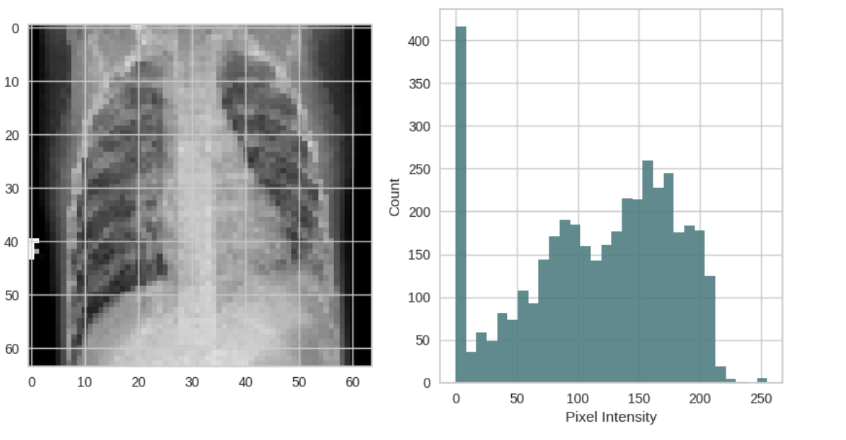
Feature Extraction
Images are resized into a fixed size of 64 x 64 to provide optimum results.
Each image in the arrays is represented by a 3D array of shape (64, 64, 3) representing the width, height, and RGB color channels of the image. By using the reshape method the 3D array.
Each image is flattened into a 1D array of length 64 * 64 * 3 = 12288, representing the pixel intensities of each color channel.

Slide 12
Classification Algorithm
The main components of architecture are divided into two parts. One using 2D convolutional layers (conv2D), pooling layer, activation functions and fully connected layers.
The proposed model comprises of a total of 2 Conv2D layers. Pooling layers decrease the size of the feature map. Thus, the number of trainable parameters is reduced, resulting in rapid calculations without losing essential features.
Two major kinds of pooling operations can be carried out: max pooling and average pooling. Max pooling implies making the most significant value present in the specific location where the kernel resides. On the other hand, average pooling computes the mean of every value in that region.
Activation functions are the nodes that are placed at the end or among neuronal networks (layers). They decide whether the neuron fires or not. The ReLU activation function is primarily used for hidden layers. This model is used with SVM, kNN, Random Forest etc.

Slide 13
Classification Algorithm
Another is using CNN method with image size of (224 * 224). Along with previous algorithms like max pooling and dense here also used batch normalization, SoftMax and activation ReLu.
After all Convolutional layers have been implemented, the FC layers are applied. These layers help to classify pictures in both the multi class and binary categories.

Slide 14
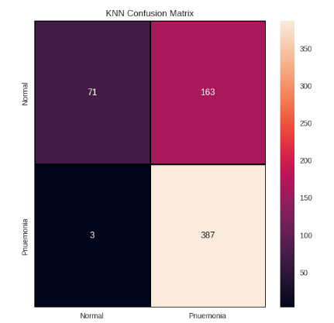
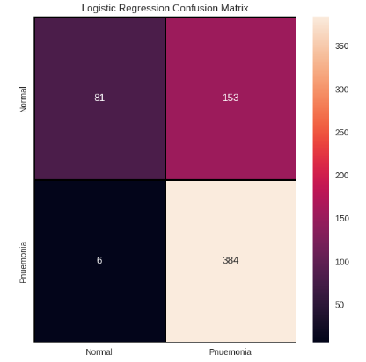
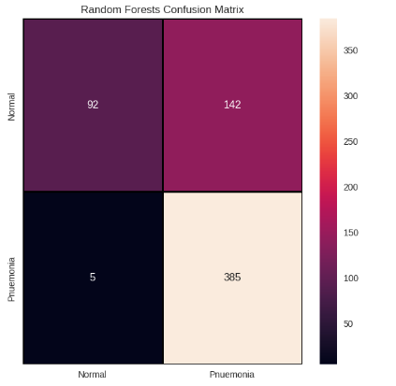
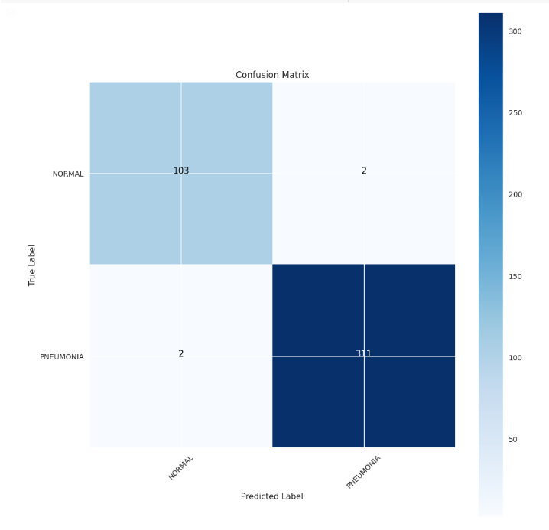
Analysis
The confusion matrix is used to analyze the performance of the different algorithms (K-Nearest Neighbors, CNN, Logistic Regression, Decision Tree, Random Forests, and Support Vector Machine) in classifying the test set data. The confusion matrix provides information on the number of true positives, true negatives, false positives, and false negatives for each class.

Slide 15
4
Result & Discussions

Slide 16
Result & Discussions
The experimental setup involved using a pneumonia dataset from Kaggle and implementing it in code lab for pneumonia detection using image pixel density. Initially, we applied algorithms such as KNN, SVM, and Random Forest, which resulted in an accuracy of 76%. However, when we applied the CNN algorithm with a bigger image size, we achieved a significantly higher accuracy of 99%. The results show that the CNN algorithm outperformed the other algorithms for pneumonia detection using image pixel density. This can be attributed to the fact that CNN is a deep learning algorithm that can identify complex patterns and features in the images, whereas the other algorithms are based on traditional machine learning techniques that may not be able to capture these patterns and features.

Slide 17
5
Conclusion

Slide 18
Conclusion
By using deep learning model for pneumonia detection our system classifies if a person is suffering from pneumonia or not using chest Xray images. The model we built has higher accuracy with training almost 5840 images. This research work can be crucial for the betterment of society. Also, our model hence can be integrated in several applications for successful scalability and real-world impact.The proposed technique can be very helpful for medical professionals dealing with pneumonia diseases and also can be integrated as a quick check method.

Slide 19
6
References

Slide 20
References
Salehi M, Mohammadi R, Ghaffari H, Sadighi N, Reiazi R. Automated detection of pneumonia cases using deep transfer learning with paediatric chest X-ray images. Br J Radiol. 2021 May 1;94(1121):20201263. doi: 10.1259/bjr.20201263. Epub 2021 Apr 16. PMID: 33861150; PMCID: PMC8506182.3. Cruz AP, Jaiswal J (2021) Text-to-image classification using attngan with densenet architecture. In:
Proceedings of international conference on innovations in software architecture and computational systems. Springer, pp 1–17
He K, Zhang X, Ren S, Sun J (2016) Deep residual learning for image recognition. In: Proceedings of the IEEE conference on computer vision and pattern recognition, pp 770–778. https://doi.org/10.1109/CVPR.2016.90
Shangjie Yao, Yaowu Chen, Xiang Tian, Rongxin Jiang, "Pneumonia Detection Using an Improved Algorithm Based on Faster R-CNN", Computational and Mathematical Methods in Medicine, vol. 2021, Article ID 8854892, 13 pages, 2021. https://doi.org/10.1155/2021/8854892

Slide 21
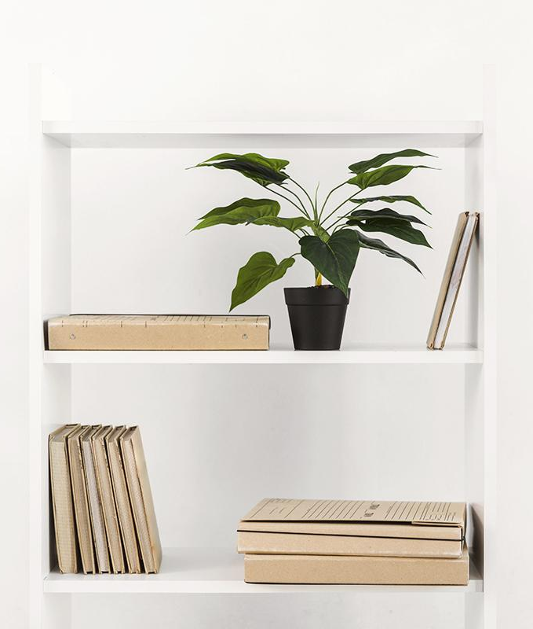
Thanks!
Do you have any questions?

