Slide 1
SESSION-01: UI/UX PRESENTATION (5 MINS)
PetSocial — The Next-Gen AI-Powered Pet Community
"A mobile-first social ecosystem empowering pet parents with dedicated pet profiles, 24/7 AI health triage, and community safety networks."
TEAM LEAD
DEVELOPER
DEVELOPER
Abu Zafor
Nadim Rahman
Rizvi Sarker
Vue.js 3 + Vite | UI/UX Session-01 | Duration: 5 Mins
Notes:
Good day everyone. Today I'm excited to present PetSocial—a purpose-built mobile social app designed specifically for pets and pet parents, integrating cutting-edge AI features with clean, human-centered UI/UX design.

Slide 2
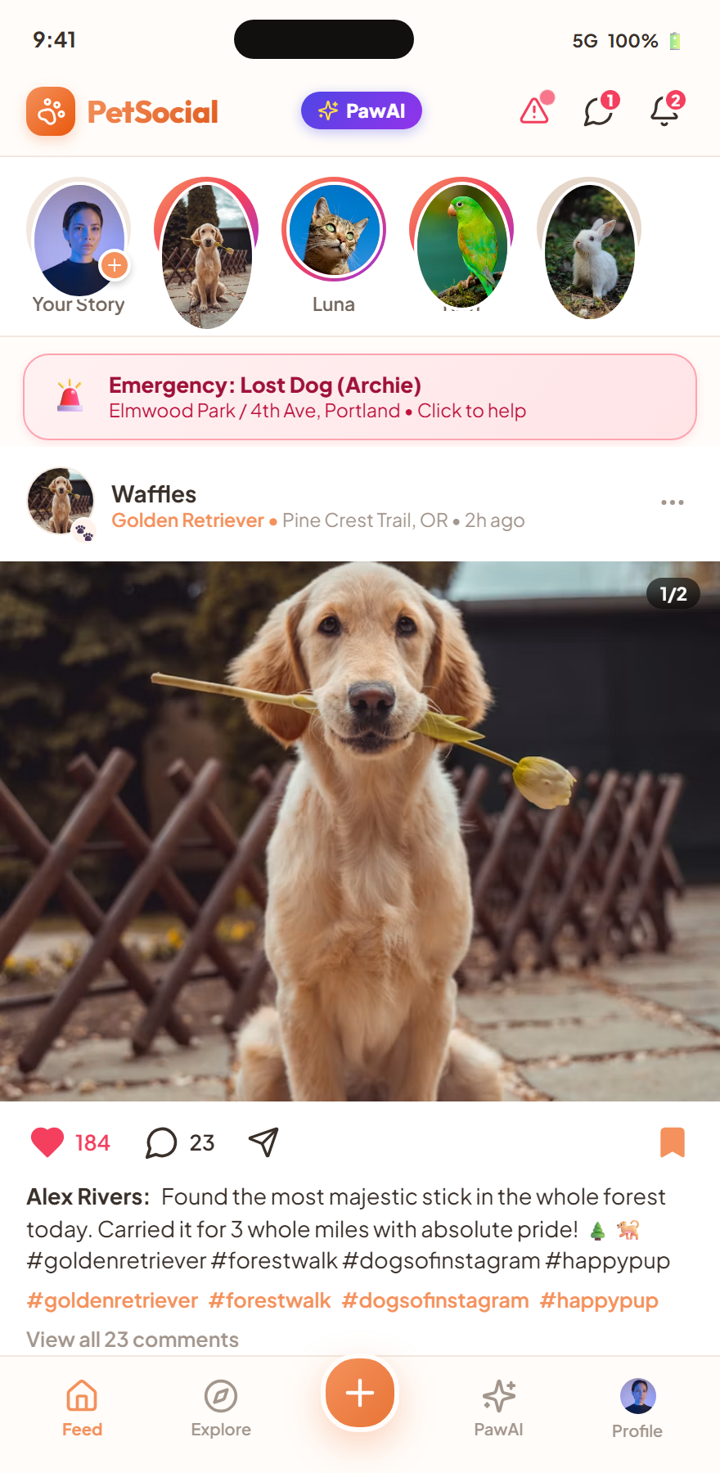
🐾 PetSocial (Nuzzle)
Slide 2 / 10 • UI/UX Pitch
SECTION 2 • UI/UX PRINCIPLES & INSIGHTS
Key Learnings from the UI/UX Session
1. Purpose-Driven Information Architecture
Eliminated visual clutter common in generic social apps. Every component serves an explicit pet welfare need (Health, Lost Alerts, Playdates).
2. Warm, Emotionally Resonant Aesthetic
Adopted warm paper tokens (#FFFCF9) and soft coral (#F4915C) to evoke warmth, care, and trustworthiness rather than cold tech interfaces.
3. Thumb-Zone Mobile Ergonomics
Bottom navigation bar, floating action buttons, and swipeable bottom sheets designed for single-hand mobile interactions.
4. Privacy & Anonymity by Design
Separation of Owner identity vs Pet identity, giving users seamless Ghost Mode controls without losing app functionality.
Notes:
From our UI/UX sessions, my biggest takeaway was that design isn't just decoration—it's empathy. We applied thumb-zone navigation, warm calming color palettes, and privacy-first anonymity.

Slide 3
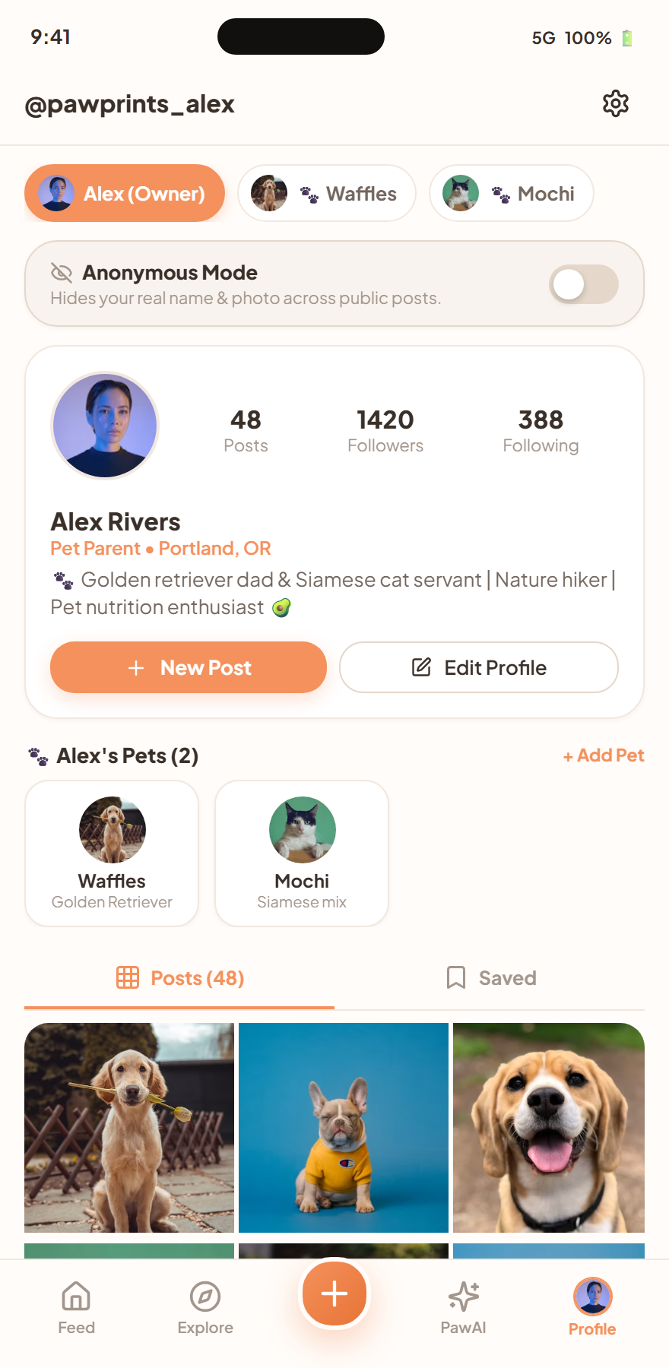
🐾 PetSocial (Nuzzle)
Slide 3 / 10 • UI/UX Pitch
SECTION 3 • PROBLEM STATEMENT & PERSONAS
Problem Statement & Target Users
⚠️ The Problem
Generic social media (Instagram, TikTok) mixes pet content with human clutter. Pet parents lack a dedicated space for health records, emergency lost alerts, and neighborhood pet compatibility.
👩‍🦰 Persona 1: The Devoted Pet Parent (Alex)
Wants a dedicated digital journal for her Golden Retriever, needs 24/7 symptom advice, and loves sharing daily milestones with fellow dog lovers.
👨‍⚕️ Persona 2: The Community Adopter & Vet
Needs a trustworthy channel to publish adoptable pets, verify medical passports, and offer slot bookings without scheduling chaos.
Notes:
Current platforms treat pets as an afterthought. Pet parents struggle with disorganized medical logs and frantic lost-pet searches. PetSocial provides a dedicated home for both pet identity and care.

Slide 4
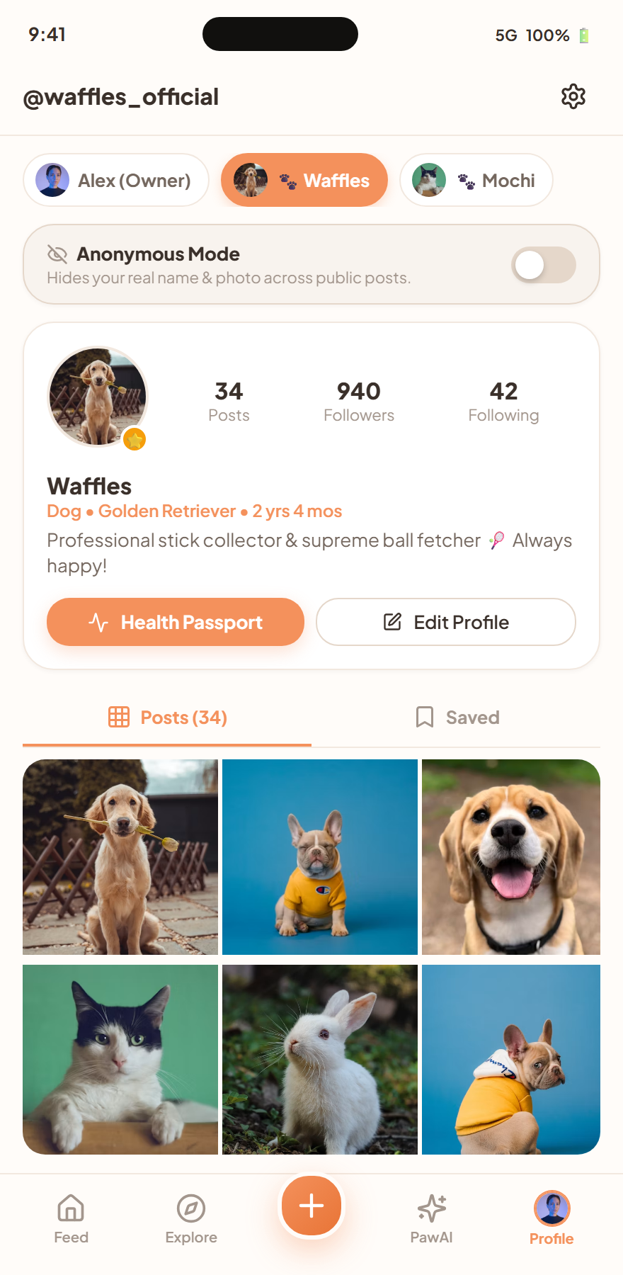
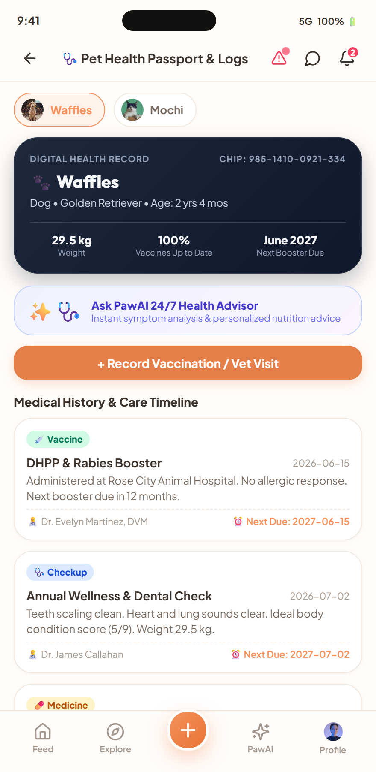
🐾 PetSocial (Nuzzle)
Slide 4 / 10 • UI/UX Pitch
SECTION 4 • DESIGN PROCESS & APPROACH
Design Process & User Flows
1. User Research & Empathy Mapping
Identified top friction points: emergency panic when a pet is lost, vet booking delays, and uncertainty over toxic foods.
2. Dual-Persona Architecture
Designed a switchable profile system where the Pet has its own followers and posts, decoupled from the owner's private account.
3. AI-First Interaction Layer
Positioned PawAI directly in the bottom navigation for 1-tap access to health vision scanning and symptom triage.
Notes:
Our user flows prioritize speed and emotion. Pet parents can switch seamlessly between their human profile and pet passport with one tap, keeping medical records always at hand.

Slide 5
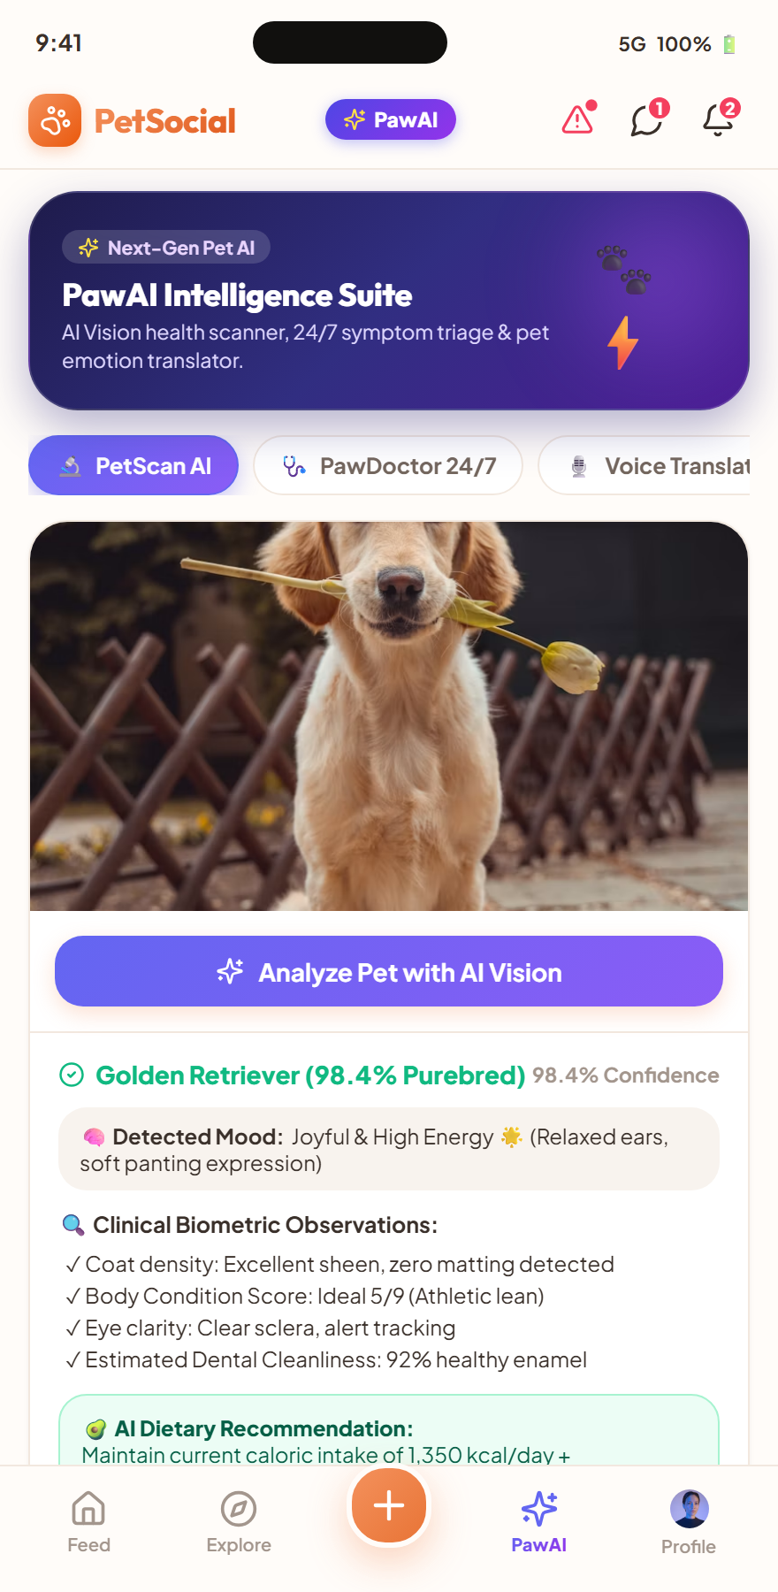
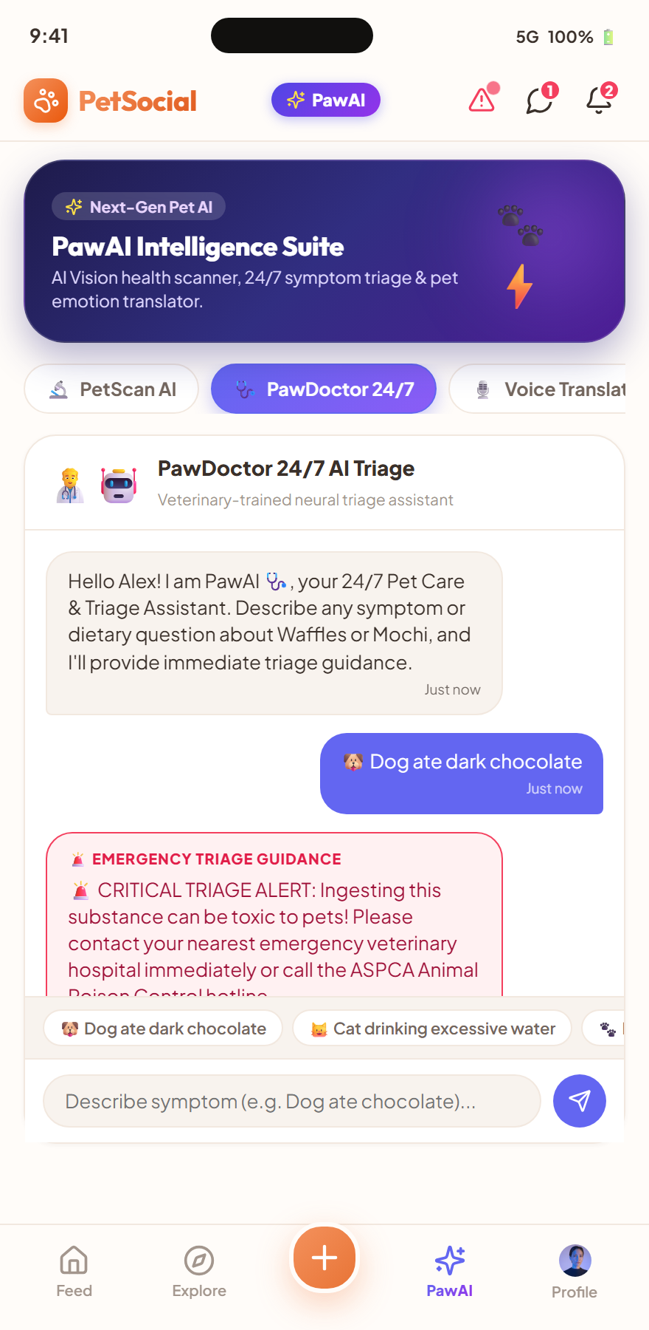
🐾 PetSocial (Nuzzle)
Slide 5 / 10 • UI/UX Pitch
SECTION 5 • PROTOTYPE WALKTHROUGH — AI SUITE
✨ PawAI Pet Intelligence Suite
🔬 PetScan AI (Vision & Biometrics)
Neural vision analyzes breed purity (98.4%), Body Condition Score (BCS 5/9), coat health, and mood detection in real-time.
🩺 PawDoctor 24/7 Triage Chat
Immediate veterinary-trained symptom triage with automated severity flags (Low, Moderate, Critical Emergency).
🎙️ Voice & Emotion AI Translator
Captures bark/meow audio waveforms and translates pet feelings into entertaining, heartwarming thoughts.
Notes:
Here is our standout innovation: the PawAI suite. Unlike Instagram, we provide active computer vision diagnostics and instant emergency triage when a pet ingests something harmful.

Slide 6
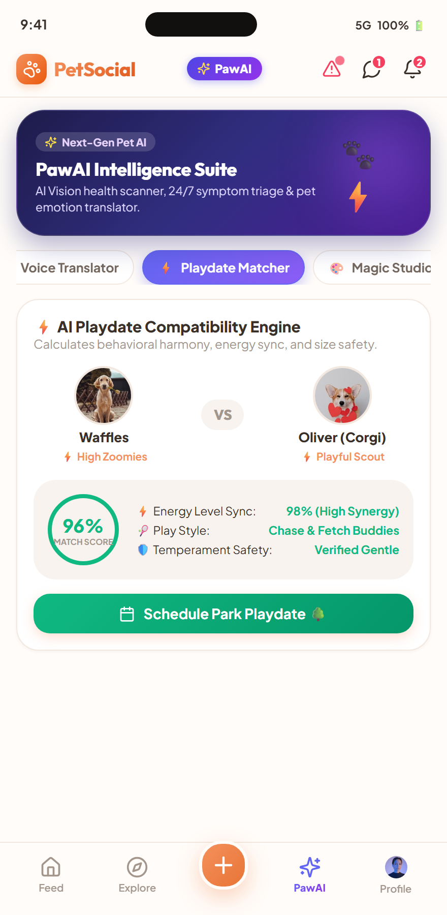
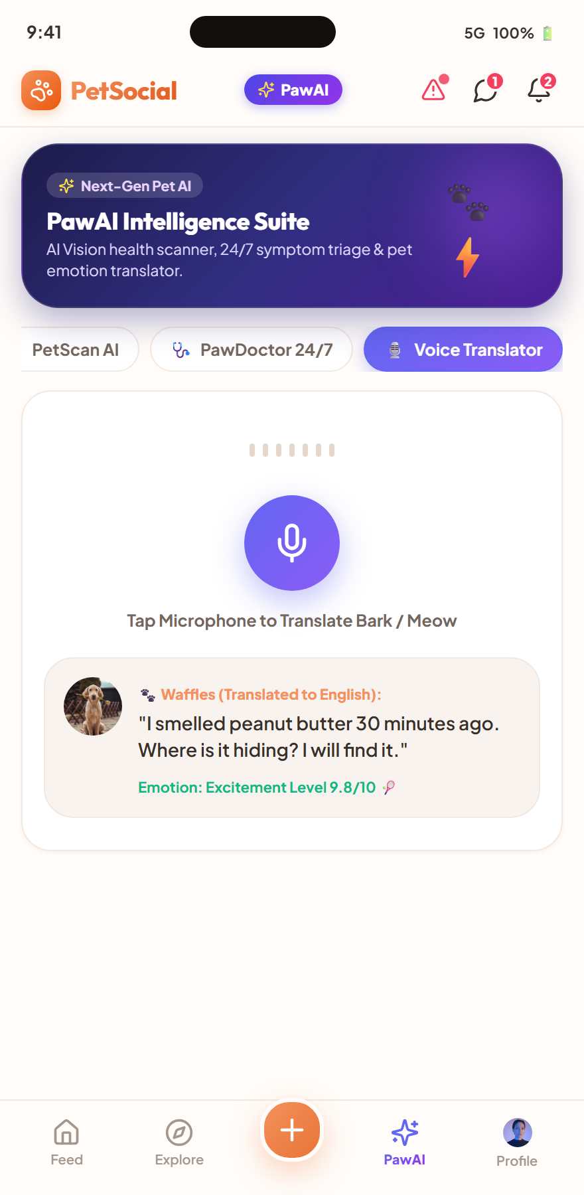
🐾 PetSocial (Nuzzle)
Slide 6 / 10 • UI/UX Pitch
SECTION 5 • PROTOTYPE WALKTHROUGH — SOCIAL & AI PLAYDATES
AI Playdate Matcher & Voice Translator
⚡ Playdate Harmony Engine
Calculates behavioral synergy (e.g. 96% Match between Waffles & Oliver) by matching energy levels and play styles.
💬 Direct Chat with Instant Scheduling
1-tap playdate invitations, encrypted messaging, and simulated real-time neighborhood coordination.
🎨 Magic Pet Portrait Studio
Generative AI transforms pet photos into Pixar 3D, Cyberpunk, and Renaissance fine art avatars.
Notes:
Socializing pets can be risky if energy levels clash. Our AI Harmony Matcher checks behavioral compatibility before dogs meet in the park, ensuring safe and fun playdates.

Slide 7
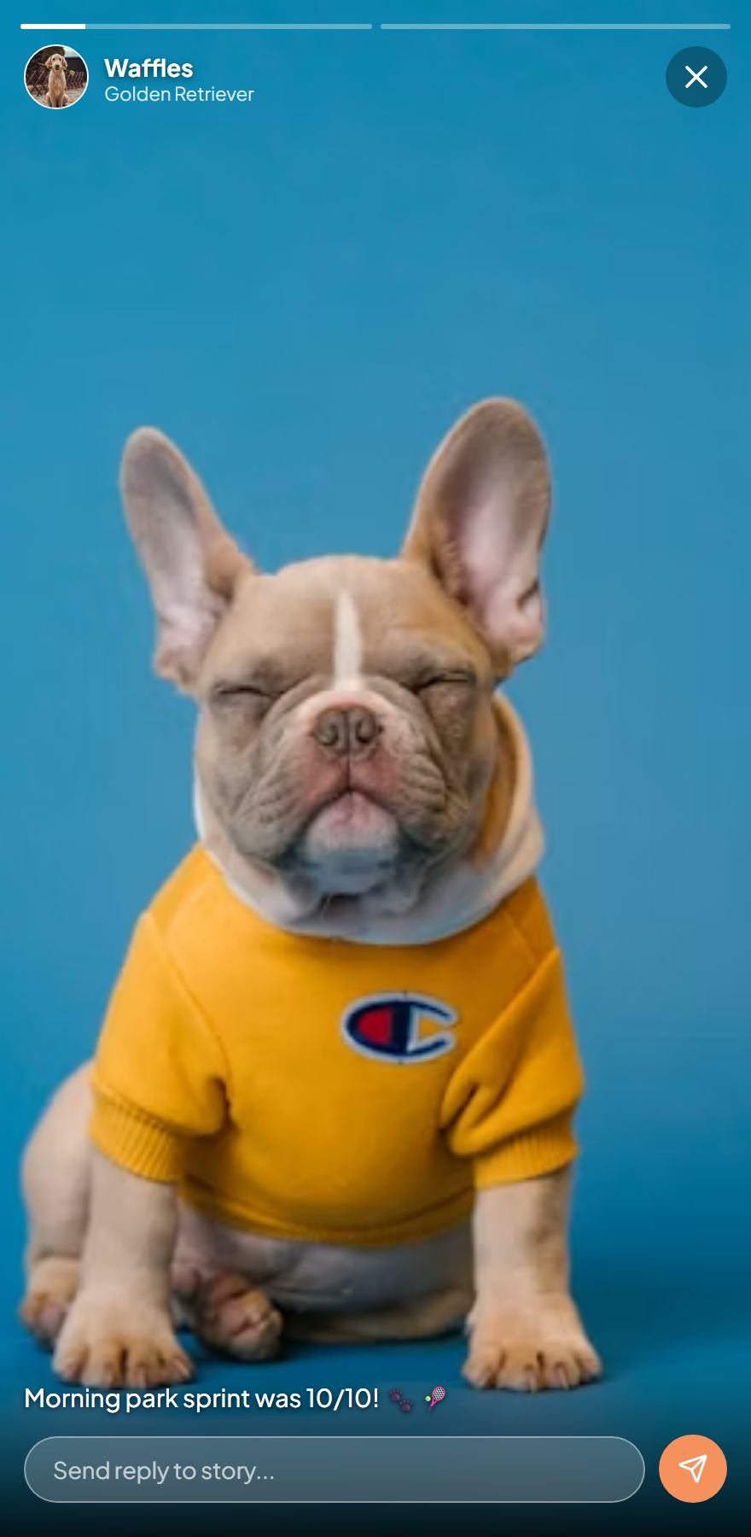
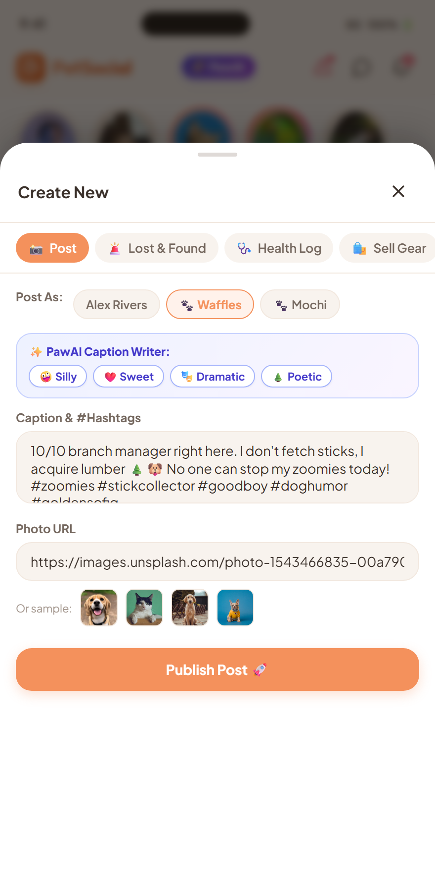
🐾 PetSocial (Nuzzle)
Slide 7 / 10 • UI/UX Pitch
SECTION 5 • PROTOTYPE WALKTHROUGH — MEDIA & FEED
Stories, Reels & AI First-Person Captions
📸 Interactive Story Rings & Viewer
Auto-advancing 24h stories with progress bars, tap navigation, hold-to-pause, and direct story replies.
✍️ AI First-Person Caption Writer
1-tap generative caption tones (Silly, Sweet, Dramatic, Poetic) written from the pet's perspective.
❤️ Haptic Double-Tap Micro-Interactions
Double-tap photo for floating heart burst animation, hashtag discovery, and identity-switched comments.
Notes:
Content creation is fun and effortless. Our built-in AI Caption Writer generates witty captions in the pet's voice, driving higher engagement across the community.

Slide 8
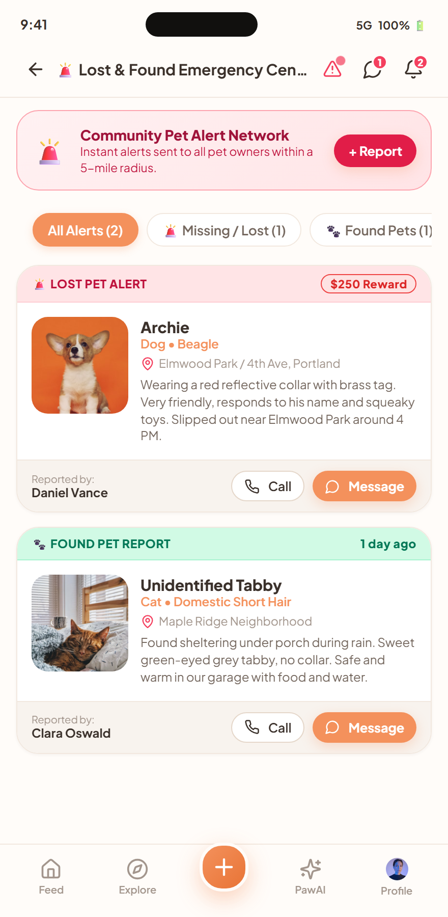
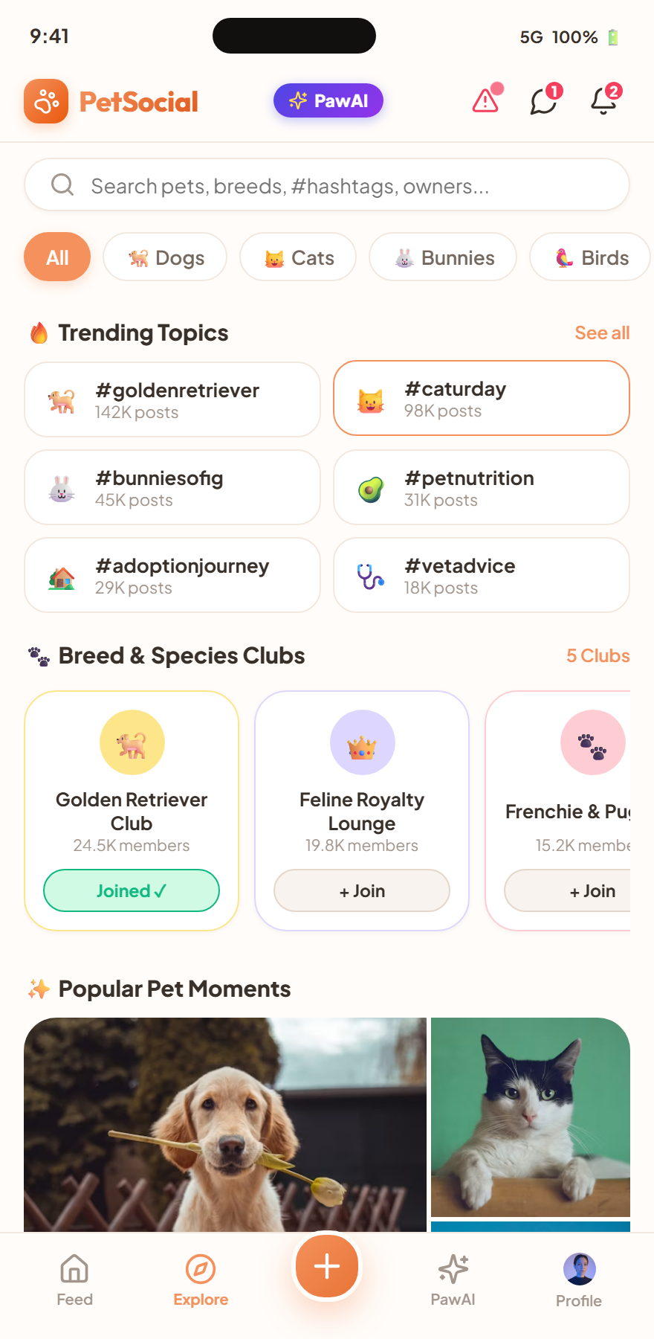
🐾 PetSocial (Nuzzle)
Slide 8 / 10 • UI/UX Pitch
SECTION 5 • PROTOTYPE WALKTHROUGH — SAFETY & ADOPTION
Emergency Alert Network & Adoption Hub
🚨 5-Mile Emergency Broadcast
Instant lost pet alerts pushed to nearby users with location markers, reward tags, and 1-tap call buttons.
🏡 Verified Pet Adoption Center
Filter by species, temperament tags, and vaccination status with direct shelter inquiry messaging.
🏥 Conflict-Free Vet Booking
Real-time slot calendar that prevents double bookings and syncs with the Pet Health Passport.
Notes:
Safety is central to PetSocial. When a pet goes missing, a 5-mile emergency alert is broadcasted immediately, transforming the neighborhood into an active search network.

Slide 9
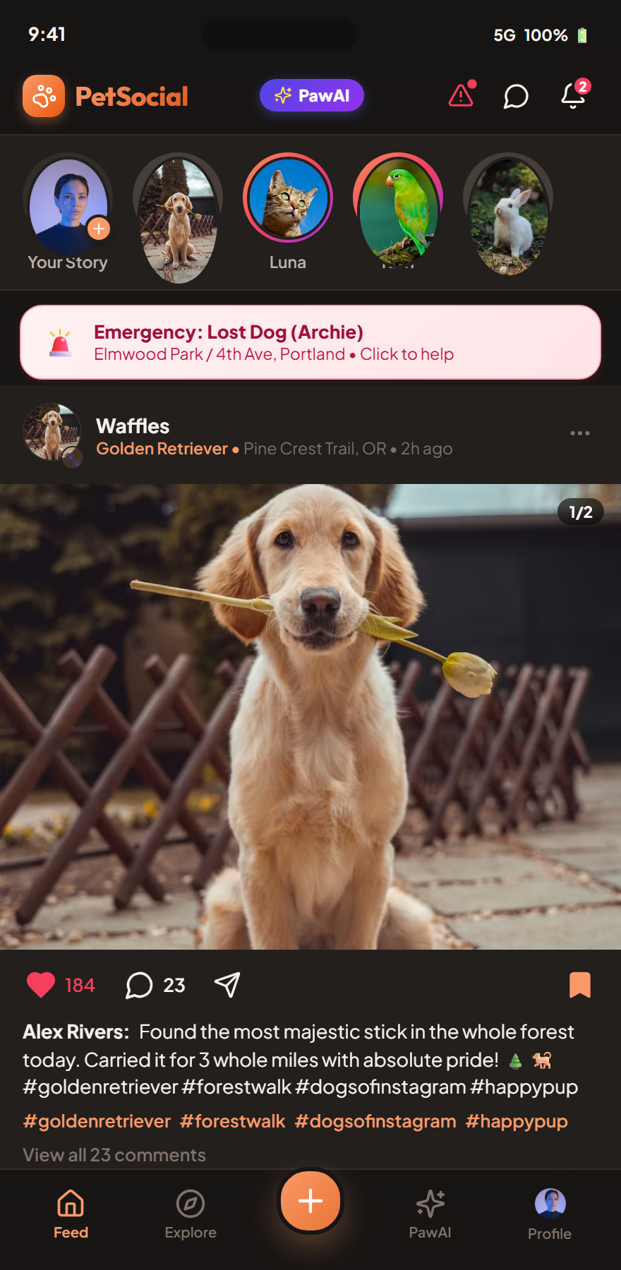
🐾 PetSocial (Nuzzle)
Slide 9 / 10 • UI/UX Pitch
SECTION 5 • DESIGN SYSTEM & THEMING
Design System, Typography & Dark Mode
🎨 Harmonious Color Palette
Warm paper background (#FFFCF9), Coral Primary (#F4915C), Emerald for verified health, and Obsidian Dark Mode.
🔤 Modern Typography Scale
Plus Jakarta Sans for crisp readability + Outfit for bold, friendly headings and brand identity.
🌙 True Dark Mode (#181615)
Reduced eye strain during nighttime pet logs and evening walks, preserving battery life on OLED screens.
Notes:
We built a robust design token system supporting both warm daylight mode and high-contrast dark mode with zero layout shift.

Slide 10
🐾 PetSocial (Nuzzle)
Slide 10 / 10 • UI/UX Pitch
SECTION 6 • CONCLUSION & NEXT STEPS
Conclusion & Future Roadmap
🎓 What We Learned
Domain-specific social UX succeeds when it solves real emotional and practical problems (health, safety, identity) rather than just copying generic feeds.
Thank You! 🐾
Questions & Live Prototype Demo
✨ PetSocial Vue 3 Prototype
🚀 Planned Next Steps
• IoT Smart Collar GPS integration for live walk tracking • Real-time audio model integration for voice translator • Telehealth video calls with licensed veterinary clinics
🐾 Closing Remark
"Pets are family. PetSocial gives them the dedicated, intelligent platform they deserve."
Notes:
Thank you for your time. PetSocial demonstrates how UI/UX and AI can combine to create meaningful, joyful products. I welcome any questions and would love to show the live prototype!

