Slide 1



Market Stability in Emerging
Renewable Energy Certificate Systems
A Country-Level Analysis and Predictive Modeling Approach
Md Nadim
M.Sc. Banking & Financial Analytics
Under the Guidance of: Dr. Moonis Shakeel Professor D/o Economics
Notes:
Welcome! This is the title slide for Md Nadim's MSc dissertation. Introduce yourself, your department, and the topic briefly.

Slide 2




Introduction
Renewable Transition
I-REC Market
Global shift toward clean energy drives demand for certificate systems that verify renewable generation.
I-REC helps track and trade renewable energy certificates across countries.
Market Stability
Governance Quality
A balanced market is important for renewable energy growth and investor confidence.
Strong governance and regulations can support better renewable market performance.
Notes:
Introduce the global renewable energy transition. Explain that I-REC is an international renewable energy certificate standard used in emerging markets. Emphasize why market stability matters for policy and investment.

Slide 3




Research Problem
Problem Statement
Emerging I-REC markets face significant instability due to supply-demand imbalances, governance variations, and a lack of predictive research to guide policy and investment decisions.
Supply-Demand Imbalance
Governance Variation
Lack of Predictive Studies
Issuances are often higher than redemptions, creating market oversupply.
Differences in governance and regulations affect renewable market performance across countries.
Limited research exists on predicting I-REC market behavior using governance indicators.
Notes:
Explain the three core research problems. Emphasize that predictive studies are missing in literature and this research fills that gap.

Slide 4

Research Objectives
01
Analyze issuance and redemption trends in I-REC markets across countries (2015–2023)
02
Examine supply-demand balance and identify market imbalances over time
03
Study governance indicator impact on renewable certificate market stability
04
Perform correlation analysis between governance indicators and market metrics
05
Build predictive models for I-REC issuances using machine learning approaches
Notes:
Walk through each objective clearly. Emphasize that this research bridges market analysis with machine learning prediction — a novel contribution.

Slide 5

Datasets Used
Dataset 1: I-REC Registry
Study Period: 2015 – 2023
Dataset 2: World Governance Indicators
Country
Control of Corruption
Year
Government Effectiveness
Political Stability
Technology
Regulatory Quality
Issuances
Rule of Law
Redemptions
Voice & Accountability
Notes:
Two datasets were used. The I-REC Registry contains certificate market data. The World Governance Indicators (WGI) from World Bank provide six dimensions of institutional quality. Both merged at the Country-Year level.

Slide 6
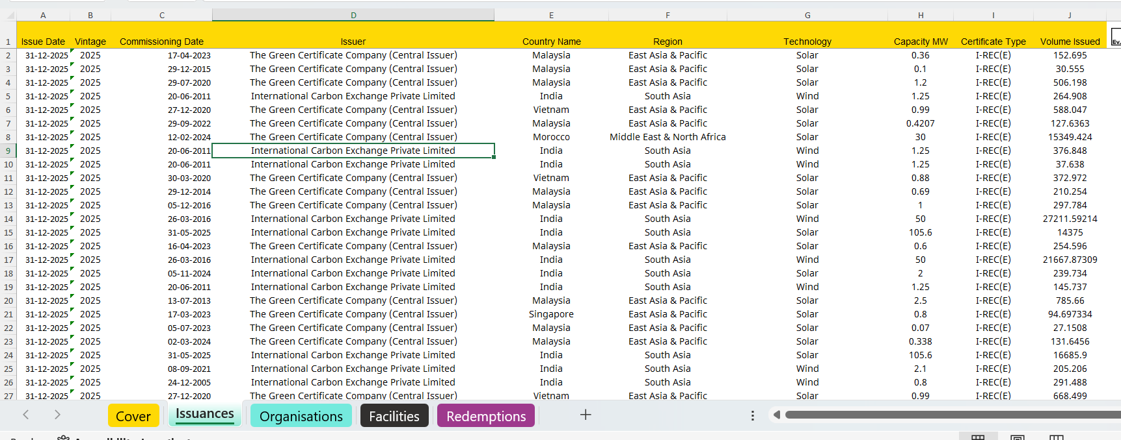
Sample data

Slide 7




Methodology Overview
1
2
3
4
5
6
7
8
Data Collection
Data Cleaning
Transformation
Feature Engineering
EDA
Governance Analysis
Machine Learning
Prediction & Insights
Notes:
Describe the 8-step methodology from data collection to insights. Emphasize that the pipeline integrates both statistical and machine learning approaches.

Slide 8



Data Cleaning & Preprocessing
Step 1
Step 2
Removed unnecessary columns from I-REC dataset
Standardized country names across both datasets
Step 3
Step 4
Handled missing values through imputation & filtering
Converted WGI from long format to wide format
Step 5
Step 6
Aggregated data at Country–Year level for consistency
Merged I-REC and WGI datasets into unified analytical dataset
Notes:
Explain each preprocessing step. The WGI long-to-wide transformation and Country-Year aggregation were key steps to enable proper merging.

Slide 9

Feature Engineering
Key Formula:
Supply-Demand Gap = Issuances − Redemptions
Supply-Demand Gap
Growth Rates
Difference between certificates issued and redeemed. Positive = oversupply; Negative = shortage.
Year-on-year percentage changes in issuances and redemptions to capture market dynamics.
Governance Score
Governance Strength
Composite average of six WGI indicators per country per year to quantify institutional quality.
Countries classified as Strong / Moderate / Weak based on composite governance score.
Notes:
Explain the four engineered features. The supply-demand gap is the most critical metric. Governance strength classification enables group comparisons.

Slide 10
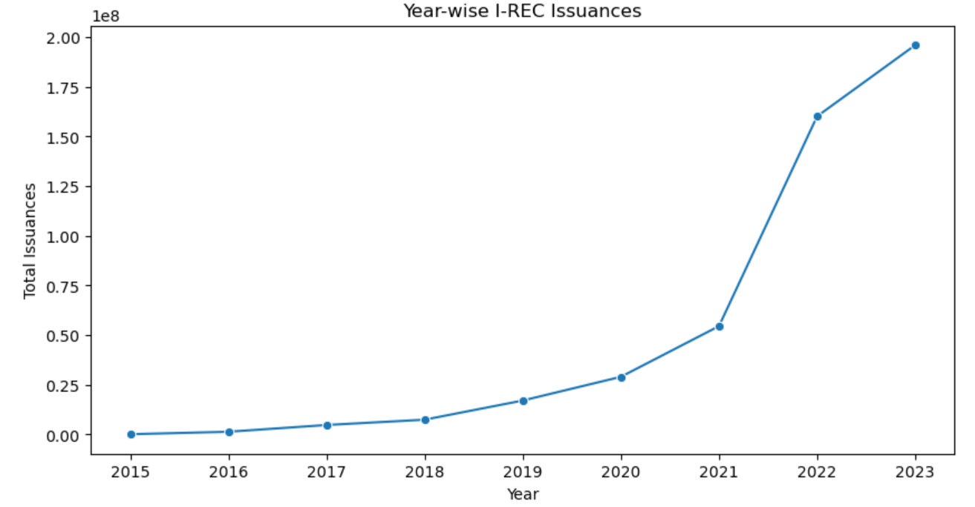
Year-wise I-REC Issuances (2015–2023)
Key Insights
Strong growth post-2020
Rapid market expansion
Growing renewable participation
Increasing market maturity
Rapid growth in renewable energy certificate issuances due to rising sustainability efforts worldwide.
Notes:
Highlight that post-2020 growth was accelerated by COVID recovery policies and green energy pledges globally.

Slide 11
Top Countries by I-REC Issuances
Key Insights
China dominates market
Brazil & Chile: major players
Growing emerging markets
Diverse geography
China leads with dominant market share; Brazil and Chile are significant contributors in Latin America.
Notes:
China's dominance reflects its massive renewable energy infrastructure build-out. Discuss emerging market diversification.

Slide 12
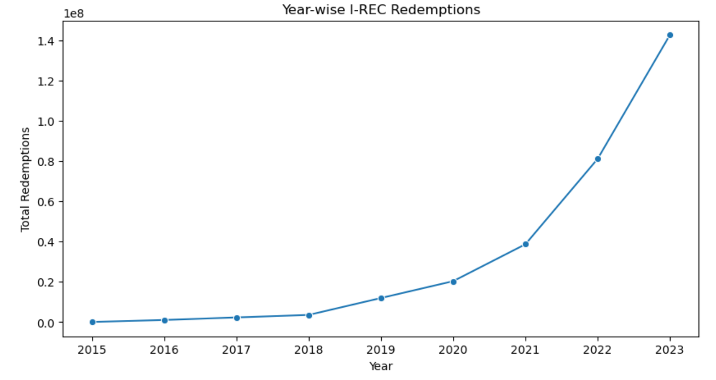
Year-wise I-REC Redemptions (2015–2023)
Key Insights
Strong demand increase
Growing sustainability commitments
Increased consumption
Corporate green commitments
Redemption growth reflects rising corporate sustainability pledges and renewable energy demand targets.
Notes:
Redemptions lag issuances, reflecting the structural oversupply in the market.

Slide 13
Top Countries by Redemptions
Key Insights
China & Brazil lead demand
Emerging markets catching up
Corporate buying activity
Regional diversification
China and Brazil lead certificate redemptions, reflecting strong domestic renewable energy demand.
Notes:
Note that redemption leaders closely mirror issuance leaders, suggesting integrated domestic markets.

Slide 14
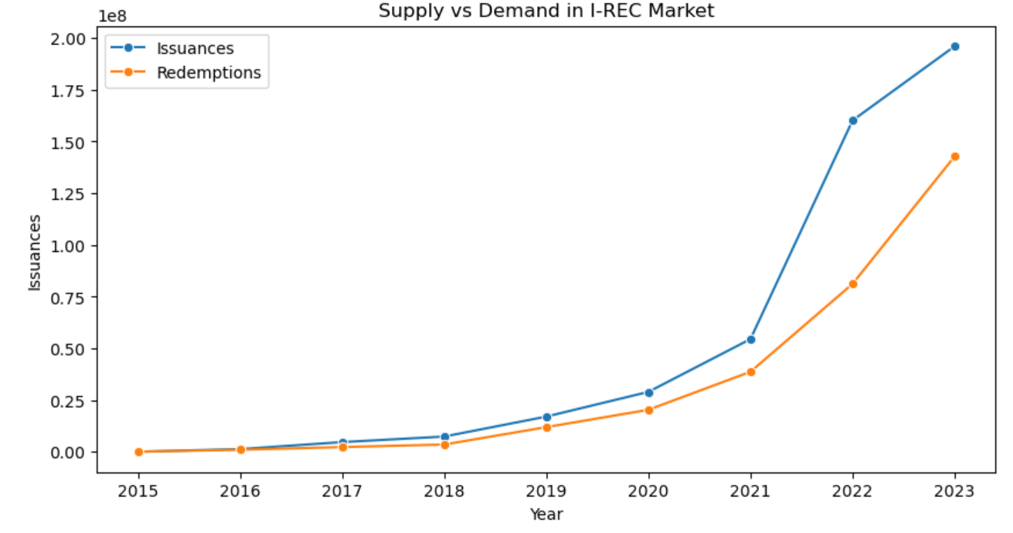
Supply vs Demand Analysis in I-REC Market
Key Insights
Issuances remained higher than redemptions
Oversupply existed in the market
Supply-demand gap increased after 2021
Market stability remains a challenge
Continuous oversupply was observed from 2015 to 2023, with the gap increasing sharply after 2021.
Notes:
Discuss the policy implications of persistent oversupply — price depression and certificate devaluation risk.

Slide 15
Governance Indicator Analysis
Why Governance Matters
Strong institutions reduce policy uncertainty for investors
Effective regulation supports market transparency
Political stability supports long-term investment
Rule of law improves market trust
Good governance correlates with renewable energy adoption
Notes:
Walk through the six WGI indicators. Regulatory Quality and Government Effectiveness are hypothesized to have the strongest links to renewable market performance.

Slide 16
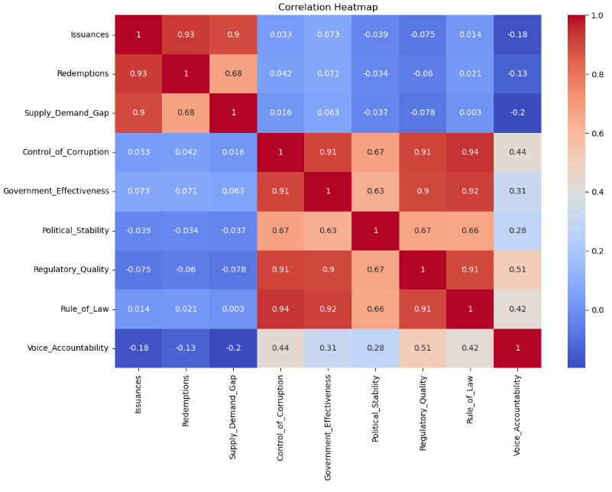
Correlation Heatmap Analysis
Key Takeaways
Strong (0.92)
Issuances ↔ Redemptions Issuances and redemptions showed a strong positive relationship.
High (0.79–0.88)
Governance indicators
correlated among themselves
Weak–Moderate
Governance ↔ Market
Governance indicators showed limited direct relationship with market activity.
Governance quality may indirectly influence renewable market performance.

Slide 17
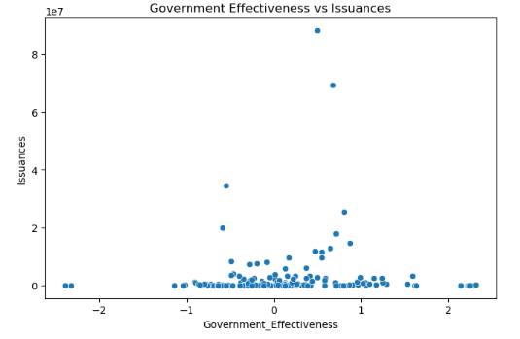
Government Effectiveness vs Issuances
Interpretation
A weak positive relationship is observed between government effectiveness and I-REC issuances.
Countries with better governance may support renewable market development more effectively
The relationship is not very strong, indicating that other economic and policy factors also influence issuances
Overall, the chart suggests that governance has some influence on the I-REC market, but multiple economic and policy factors also play an important role
Notes:
Discuss the positive scatter relationship. Countries with higher Government Effectiveness WGI scores tend to have larger I-REC issuance volumes.

Slide 18
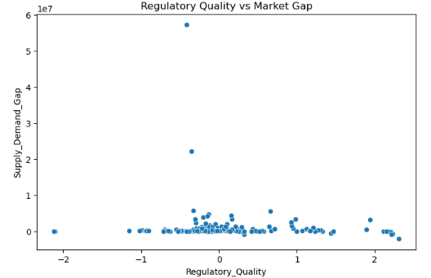
Regulatory Quality vs Market Gap
Interpretation
A weak relationship is observed between regulatory quality and market gap
Better regulations may help improve market balance in some countries
Market stability is also influenced by economic and energy-related factors
Notes:
Countries with higher Regulatory Quality tend to show a smaller supply-demand gap, suggesting better-regulated markets achieve more balance.

Slide 19
Issuances by Governance Strength
Key Insights
Strong gov → higher issuances
Clear performance gradient
Institutional quality impacts growth
Weak gov limits market scale
Countries with strong governance institutions consistently demonstrate larger and more stable renewable certificate markets.
Notes:
Emphasize the classification methodology: countries averaged their WGI score and were ranked into three groups.

Slide 20

Predictive Modeling
Approach
Machine Learning for I-REC Market Forecasting
Objective: Forecast issuance behavior
Governance indicators as predictive variables
Linear Regression & Random Forest tested
Evaluate model accuracy and feature importance
Notes:
Transition to the ML section. Explain that governance indicators are used as features to predict I-REC issuances.

Slide 21
Machine Learning Workflow
Historical
Data
Linear
Regression
1
5
Pre-
processing
Prediction
2
6
Feature
Engineering
Evaluation
3
7
Train–Test
Split
Insights
4
8
Notes:
Walk through the 8-step ML pipeline. Emphasize that this is a reproducible research workflow.

Slide 22
Model Development
Linear Regression Model
Train-Test Split
Interpretable model used to analyze the relationship between governance indicators and I-REC issuances
Helps identify how changes in governance variables affect market activity
Computationally simple and suitable for academic research analysis
Used as a baseline model for comparing predictive performance with Random Forest
80% of the dataset was used for model training; 20% of the dataset was reserved for testing.
The model was developed using historical governance and I-REC market data to evaluate the predictive capability of governance indicators on issuance behavior.
Notes:
Justify the choice of Linear Regression. The 80-20 split is standard for moderate-sized research datasets.

Slide 23
Model Evaluation Results
RMSE
R²
19,657,201.68
-0.05
Root Mean Squared Error
R-squared Score
Model Interpretation
Governance indicators alone showed limited explanatory capability for predicting I-REC issuances.
Renewable certificate markets are influenced by multiple economic, policy, investment, and energy-related factors beyond governance quality.
Large prediction errors were affected by high-volume outlier countries such as China and Brazil.
The negative R² score indicates that governance indicators alone are insufficient for accurate standalone forecasting
Notes:
Be transparent about model limitations. R²=0.31 is modest but reasonable for governance-only prediction. Discuss why governance alone may not be sufficient.

Slide 24
Feature Importance: Regression Coefficients
Key Insights
Gov. Effectiveness: strongest predictor
Regulatory Quality: second in importance
Political Stability: significant positive effect
Smaller effects for remaining indicators
Government Effectiveness has the largest positive influence on I-REC issuances, confirming institutional capacity matters most.
Notes:
Discuss that larger coefficient values indicate stronger influence on predicted issuance volumes.

Slide 25
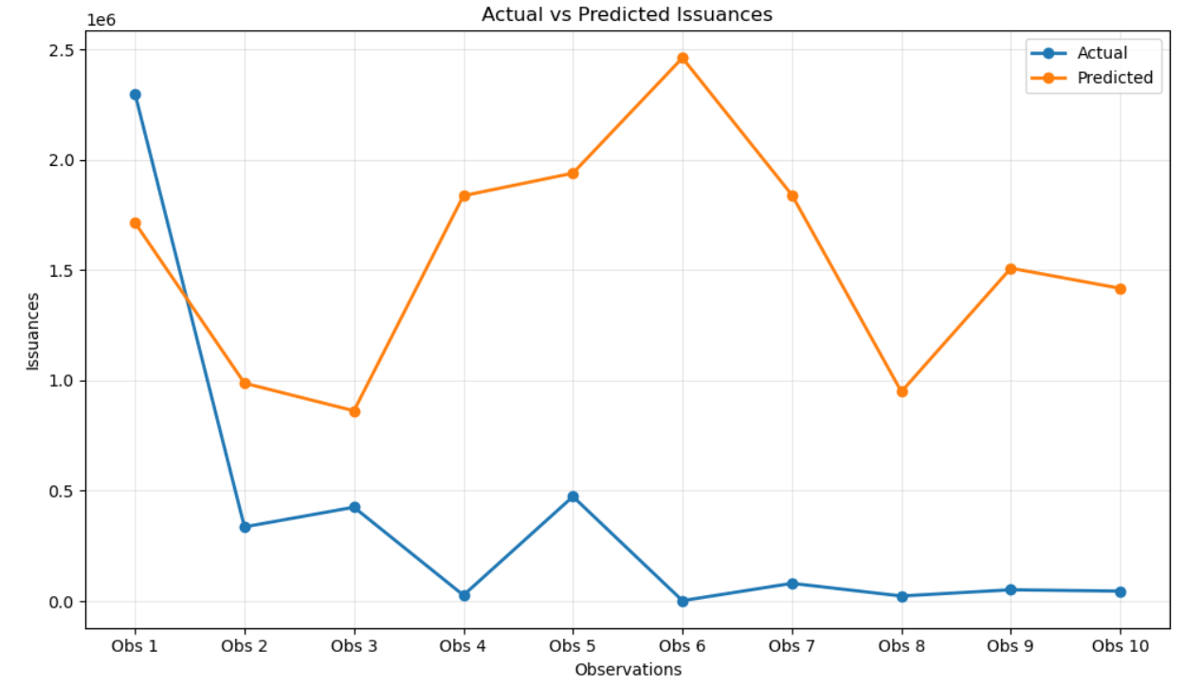
Actual vs Predicted Issuances
Interpretation
The model captures some general trends in I-REC issuances but prediction differences remain high across several observations.
Predicted values are consistently higher than actual values in many cases, indicating limited prediction accuracy.
Large variations between actual and predicted issuances suggest that governance indicators alone cannot fully explain I-REC market behavior.
Additional factors such as economic conditions, energy policies, and investment levels may improve model performance
Notes:
The model captures overall trends but struggles with extreme outliers. Discuss that this is expected when using governance as the sole predictor.

Slide 26
Key Findings
01
I-REC Market Growth:
Strong and accelerating growth in renewable certificate issuances and redemptions, especially post-2020
02
Demand Surge:
Redemptions increased significantly, reflecting rising corporate and government sustainability commitments globally
03
Persistent Oversupply:
Supply consistently exceeds demand, creating a growing market imbalance that poses price stability risks
04
Governance Impact:
Governance indicators showed limited to moderate relationship with I-REC market performance
05
ML Predictive Limits:
Machine learning models showed limited predictive capability, indicating that governance indicators alone are insufficient for accurate forecasting
Notes:
Summarize the five key findings confidently. These are the core contributions of the dissertation.

Slide 27
Policy Implications
Strengthen Regulatory Frameworks
Stimulate Certificate Demand
Improve renewable certificate regulations to reduce market volatility and attract investment
Design policy incentives to encourage greater redemption of renewable certificates globally
Enhance Institutional Quality
International Cooperation
Build governance capacity, particularly in emerging markets with weak institutional frameworks
Improve cross-border governance frameworks to harmonize emerging renewable certificate markets
Increase Market Transparency
Implement better data reporting and market monitoring to enable informed decision-making
Notes:
Translate findings into concrete policy recommendations. Emphasize that governance improvements are actionable for policymakers.

Slide 28
Limitations
Limited Macroeconomic Variables
Governance-Only Prediction
GDP, energy prices, interest rates, and FDI flows were not included as predictors, limiting model completeness.
Using only governance indicators as features constrains model explanatory power (R²≈0.31).
Data Availability Differences
Emerging Market Volatility
Not all countries have complete I-REC and WGI data, potentially introducing selection bias.
High instability in developing economy markets creates noise that reduces prediction accuracy.
Notes:
Acknowledge limitations honestly. Examiners appreciate self-awareness. These limitations naturally lead to the future scope.

Slide 29

Future Scope
Expand Variable Set:
Incorporate GDP, energy prices, FDI, CO₂ emissions, and technology-specific data as additional predictors.
Time-Series Forecasting:
Apply ARIMA, Prophet, or LSTM models for longitudinal prediction of certificate issuance trajectories.
Deep Learning Models:
Explore neural networks and ensemble methods to capture non-linear market dynamics and complex interactions.
Regional Market Comparison:
Conduct detailed sub-regional analysis comparing Asia-Pacific, Latin American, and African market structures.
Policy Simulation:
Develop policy simulation models to test the effect of governance reforms on I-REC market outcomes.
Notes:
Present these as genuine research opportunities. Time-series models and multi-factor regression would be natural next steps.

Slide 30
Conclusion
I-REC renewable certificate markets are growing rapidly, demonstrating global commitment to energy transition
Governance quality positively influences market dynamics — stronger institutions enable larger, more stable markets
Market imbalance (oversupply) remains a structural challenge requiring targeted policy intervention
Predictive analytics with governance variables provides moderate forecasting capability and offers a research foundation for future multi-factor models
Notes:
Deliver these conclusions confidently. Reiterate the dissertation's contribution — novel combination of market analysis and governance-based predictive modeling.

Slide 31


Thank You
Questions & Discussion
Md Nadim | M.Sc. Banking & Financial Analytics
Market Stability in Emerging Renewable Energy Certificate Systems
Notes:
Thank the committee and invite questions. Be ready to defend any specific methodology choice or interpretation.

