Slide 1
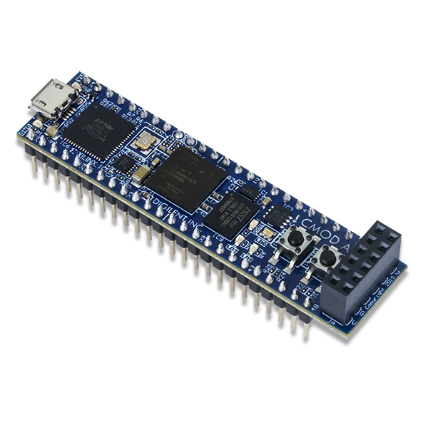


El Hanafi Nadim 894489
Informatica Industriale
n.elhanafi@campus.unimib.it
Microelectronics Group

Slide 2
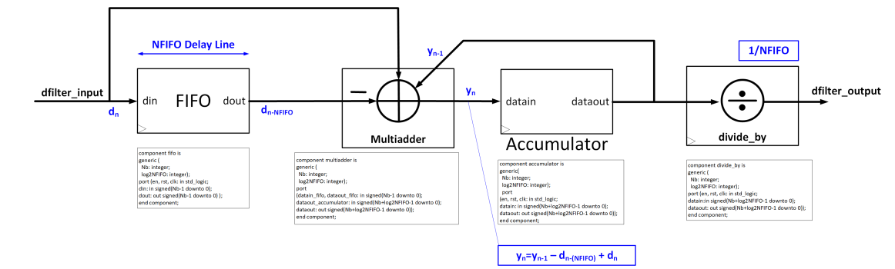
Introduction - filter_ma Architecture
Port / Generic | Type | Width | Description
Nbf | generic | integer | Number of bits (Nb = 8)
log2NFIFOf | generic | integer | log₂(NFIFO) ∈ {5, 6, 7}
en / rst / clk | in | 1 bit | Enable, Reset active-low, Clock 50 MHz
datain | in | Nbf bits | Input sample (signed)
dataout | out | Nbf + log2NFIFOf bits | Filtered output (signed)
Nb=8 fs=50 MHz tclk=20 ns f₀=195.3 kHz OVR=128 SNR_input=0 dB FS=256

Slide 3
Multiadder - Design
entity multiadder is generic (Nb: integer; log2NFIFO: integer); port ( datain_fifo, dataout_fifo: in signed(Nb-1 downto 0); dataout_accumulator: in signed(Nb+log2NFIFO-1 downto 0); dataout: out signed(Nb+log2NFIFO-1 downto 0)); end multiadder; architecture Behavioral of multiadder is signal datain_fifo_large, dataout_fifo_large: signed(Nb+log2NFIFO-1 downto 0); signal mask0: signed(log2NFIFO-1 downto 0) := (others => '0'); begin datain_fifo_large <= mask0 & datain_fifo; dataout_fifo_large <= mask0 & dataout_fifo; dataout <= dataout_accumulator - dataout_fifo_large + datain_fifo_large; end Behavioral;
Formula - Recursive MA Update
yₙ = yₙ₋₁ - dₙ₋ₙFIFO + dₙ Instead of summing NFIFO samples each cycle, only the oldest sample is subtracted and the newest added. O(1) complexity per clock cycle.
Signal Widths
• datain_fifo / dataout_fifo: Nb = 8 bit • dataout_accumulator (yₙ₋₁): Nb+log₂NFIFO bits • dataout (yₙ): Nb+log₂NFIFO bits Inputs UNSIGNED → zero-extension via mask0 (no sign error).
Key Implementation Note
Samples are unsigned (0…255). Upper log₂NFIFO bits padded with '0' using mask0 concatenation. Using signed arithmetic avoids overflow and simplifies accumulator feedback.

Slide 4
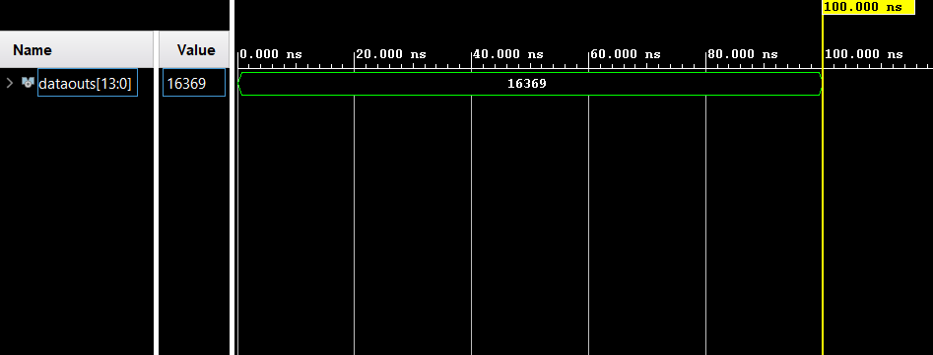
Multiadder - Testbench
Signal | Value (dec) | Binary (14 bit) | Role
datain_fifo | 1 | 00000000000001 | dₙ - current sample
dataout_fifo | 15 | 00000000001111 | dₙ₋ₙFIFO - oldest sample
dataout_accumulator | 16383 | 11111111111111 | yₙ₋₁ - running sum
dataout (expected) | 16369 | 11111111110001 | yₙ = 16383 - 15 + 1

Slide 5
Accumulator - Design
entity accumulator is generic (Nb: integer; log2NFIFO: integer); port ( en, rst, clk : in std_logic; datain : in signed(Nb+log2NFIFO-1 downto 0); dataout : out signed(Nb+log2NFIFO-1 downto 0)); end accumulator; architecture Behavioral of accumulator is signal reg : signed(Nb+log2NFIFO-1 downto 0) := (others => '0'); begin process(clk) begin if rising_edge(clk) then if rst = '0' then reg <= (others => '0'); elsif en = '1' then reg <= datain; end if; end if; end process; dataout <= reg; end Behavioral;
Function - PIPO Register
Synchronous Parallel-In Parallel-Out register. • Stores yₙ on every rising clock edge (en='1') • Output is yₙ₋₁ - the running sum one cycle earlier • Feeds back to the Multiadder input
Reset & Width
rst='0' → synchronous active-low clear (reg ← 0) rst='1' → normal operation Width = Nb + log₂NFIFO = 14 bit for NFIFO=64 Max value = NFIFO x 255 = 16320 → fits in 14 bit

Slide 6
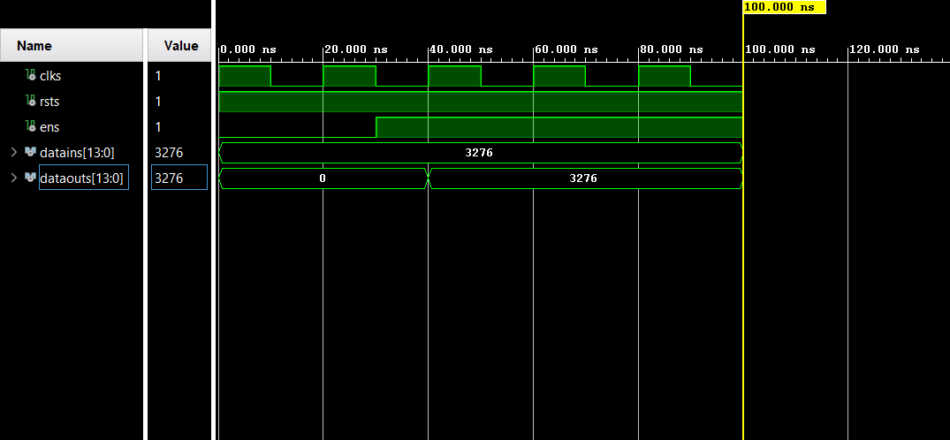
Accumulator - Testbench
Condition | datains (constant) | dataouts – expected
t < 30 ns (en='0') | 3276 ("00110011001100") | 0 - register not loaded yet
t ≥ ~40 ns (en='1') | 3276 ("00110011001100") | 3276 - PIPO register latches input

Slide 7
divide_by - Design
entity divide_by is generic (Nb: integer; log2NFIFO: integer); port ( en, rst, clk : in std_logic; datain : in signed(Nb+log2NFIFO-1 downto 0); dataout : out signed(Nb+log2NFIFO-1 downto 0)); end divide_by; architecture Behavioral of divide_by is constant Nacc : integer := Nb + log2NFIFO; signal reg : signed(Nacc-1 downto 0) := (others => '0'); begin process(clk) begin if rising_edge(clk) then if rst = '0' then reg <= (others => '0'); elsif en = '1' then reg(Nacc-log2NFIFO-1 downto 0) <= datain(Nacc-1 downto log2NFIFO); reg(Nacc-1 downto Nacc-log2NFIFO) <= (others => '0'); end if; end if; end process; dataout <= reg; end Behavioral;
Principle - Right Shift
NFIFO = 2^log₂NFIFO → division by NFIFO = arithmetic right-shift by log₂NFIFO positions. No multiplier or divider needed — implemented as pure wiring in hardware.
Bit Mapping (NFIFO=64, Nb=8)
datain [13:0] - accumulator output yₙ bits [13:6] → integer quotient bits [5:0] → fractional (discarded) dataout [13:0] bits [7:0] → result (0…255) bits [13:8] → '000000' (zero-filled)
Example
datain = 13119 ("11001100111111") 13119 ÷ 64 = 204 → dataout = 204 (Hex check: 333f → 00cc visible in Vivado Objects)

Slide 8
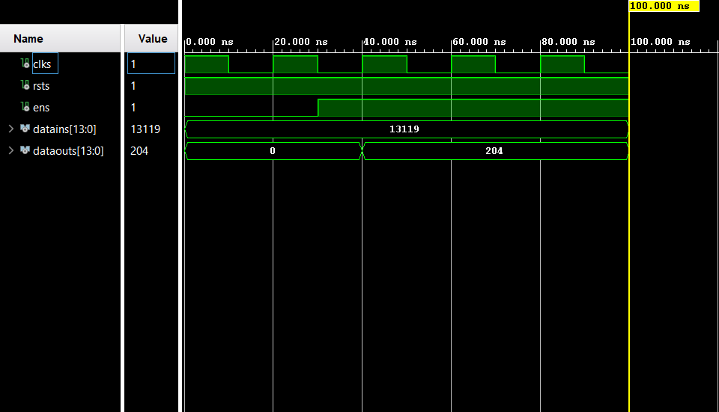
divide_by - Testbench
Signal | Value (dec) | Binary (14 bit) | Note
datains (constant input) | 13119 | 11001100111111 | Constant test vector
dataouts (expected) | 204 | 00000011001100 | 13119 >> 6 = 204
Hex visible in Objects panel | datains=333f | dataouts=00cc | Correct before waveform run

Slide 9
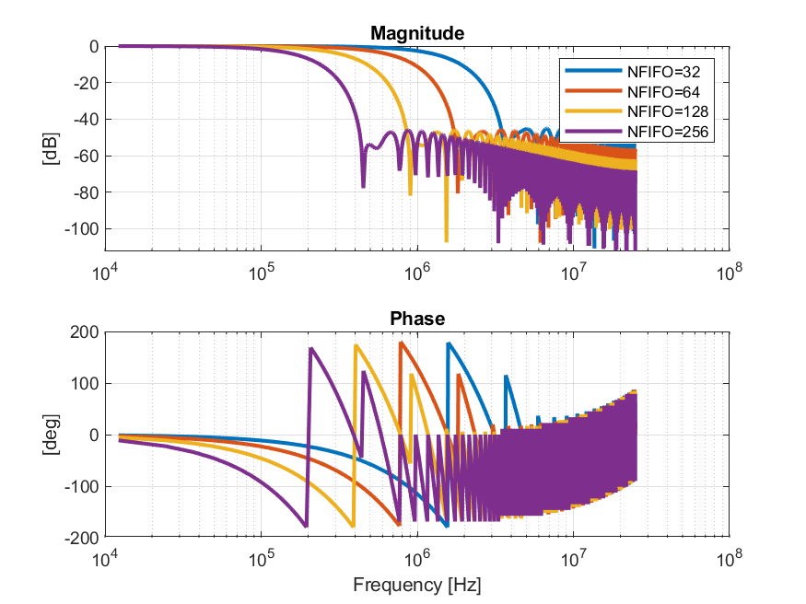
Frequency Response - NFIFO = 32, 64, 128, 256
NFIFO=32
fcutoff = fs/(2*NFIFO) = 781 kHz Wider passband, less noise rejection
NFIFO=64
fcutoff = fs/(2*NFIFO) = 391 kHz Good balance: signal + noise well separated
NFIFO=128
fcutoff = fs/(2*NFIFO) = 195 kHz ≈ f₀ Narrowest band. Signal starts to attenuate!
NFIFO=256
fcutoff = fs/(2*NFIFO) = 98 kHz < f₀ Band now below f₀, signal itself is filtered out
Key: NFIFO=256 pushes fcutoff below f₀, the magnitude plot shows the signal frequency itself now lies in the stop-band.

Slide 10
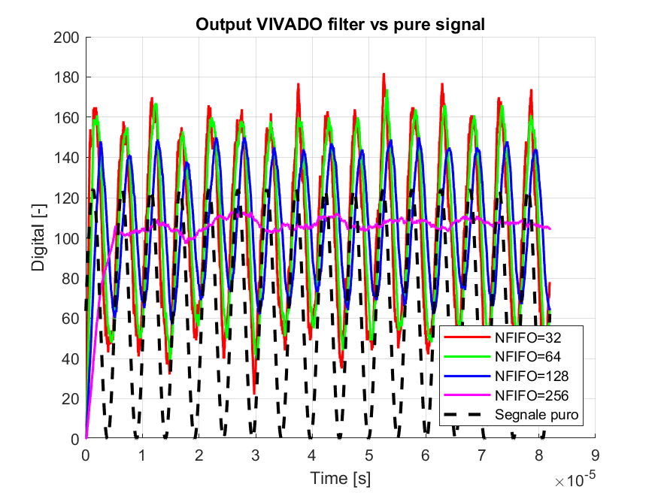
Time Domain - ysignal + ynoise (filter output)
NFIFO=32
More residual noise. 16-sample delay (0.32 µs). Passes more noise.
NFIFO=64
Good balance. Noise clearly reduced, sinusoid well preserved.
NFIFO=128
Smoothest but 64-sample delay (1.28 µs). Signal slightly attenuated at f₀.
NFIFO=256
Signal nearly flat. Filter has removed the sinusoid itself, not just noise.
Pure signal
NFIFO=32/64/128 preserve the sinusoidal shape, NFIFO=256 collapses to a near-flat line, over-filtering.
Lower DC: excludes noise mean offset (pnoise≈44 LSB). Reference only.

Slide 11
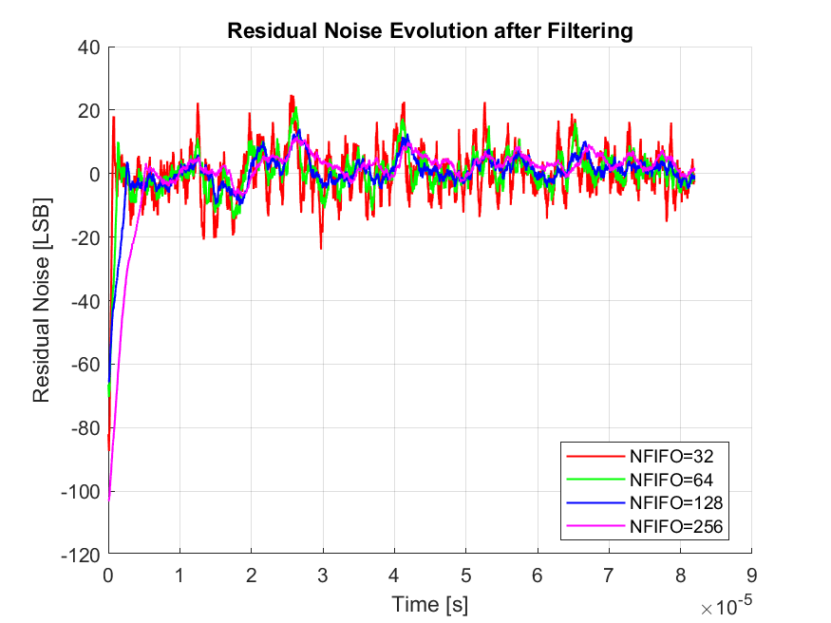
Time Domain - ynoise (Residual Noise Evolution)
NFIFO = 32/64/128
Residual noise clearly visible, amplitude shrinks as NFIFO grows, expected behavior.
NFIFO = 256
Residual looks small, but this is misleading: the signal itself was removed, not just noise.
NFIFO | Noise RMS [LSB] | Reduction vs input | Noise Bandwidth
32 | 6.90 | ≈ 3.4x | 781.25 kHz
64 | 4.79 | ≈ 4.9x | 390.63 kHz
128 | 3.35 | ≈ 7.0x | 195.31 kHz
256 | 4.26 | ≈ 5.5x | 97.66 kHz
Reduction factor worsens from NFIFO=128 (≈7.0x) to NFIFO=256 (≈5.5x), confirms over-filtering, not improvement

Slide 12
Signal to Noise Ratio — NFIFO = 32, 64, 128, 256
NFIFO | fcutoff [kHz] | Noise RMS [LSB] | SNR [dB] | ΔSNR
32 | 781.25 | 6.90 | 15.50 | —
64 | 390.63 | 4.79 | 18.19 | +2.69
128 | 195.31 | 3.35 | 18.66 | +3.16
256 | 97.66 | 4.26 | 9.63 | -5.87
18.19 dB
18.66 dB
15.5 dB
9.63 dB
- SNR rises 32→64→128 (15.50→18.19→18.66 dB), then collapses at 256 (9.63 dB).
- Peak SNR occurs near NFIFO=128, where fcutoff ≈ f₀, the optimal trade-off point.
- Beyond that point (NFIFO=256), fcutoff < f₀: noise keeps dropping but signal loss dominates, so SNR falls.
- Confirms SNR vs NFIFO is non-monotonic, a result not explored in NFIFO=32/64/128-only analyses.
NFIFO=32
NFIFO=64
NFIFO=128
NFIFO=256
SNR [dB]

Slide 13
Summary Table and Comments
Parameter | NFIFO = 32 | NFIFO = 64 | NFIFO = 128 | NFIFO = 256
log₂NFIFO | 5 | 6 | 7 | 8
fcutoff [kHz] | 781.25 | 390.63 | 195.31 | 97.66
Noise Bandwidth | Wide | Medium | Narrow | Below f₀
Noise RMS [LSB] | 6.90 | 4.79 | 3.35 ← best | 4.26
SNR [dB] | 15.50 | 18.19 | 18.66 ← peak | 9.63 ← worst
ΔSNR vs NFIFO=32 | - | +2.69 dB | +3.16 dB | -5.87 dB
Group delay [samples] (theory / measured) | 16 / 16.5 | 32 / 32.9 | 64 / 65.4 | 128 / 117.8 ← worst
Group delay [µs] | 0.32 | 0.64 | 1.28 | 2.56 ← worst
Signal atten. at f₀ | None | Negligible | Significant | Severe
dataout width [bit] | 13 | 14 | 15 | 16
Best use case | Low latency | Balanced | Max noise reject | Not recommended
SNR is non-monotonic, peaking at NFIFO=128 then dropping sharply at NFIFO=256 (fcutoff < f₀). Group delay was independently validated via phase analysis of the fundamental component (Fourier projection), measured values match theory within ~3% up to NFIFO=128.

Slide 14
Conclusions
Moving Average Filter successfully implemented on FPGA in VHDL
All 4 components verified independently with dedicated testbenches and end-to-end with tb_filter_ma
SNR vs NFIFO is non-monotonic, confirmed by extending the analysis to NFIFO=256
SNR rises from 32→64→128 (15.50→18.19→18.66 dB), peaking near NFIFO=128, then collapses to 9.63 dB at NFIFO=256
The peak occurs exactly where fcutoff ≈ f₀: beyond it, the filter removes signal faster than it removes noise
Key trade-off: noise rejection vs group delay vs signal attenuation
NFIFO=128 gives the best SNR with acceptable delay, NFIFO=64 is the best low-latency compromise
Possible improvements:
Weighted MA (Hann/Hamming window) for sharper frequency roll-off
Configurable NFIFO via register to switch filter bandwidth at runtime
Pipelined FIFO for higher throughput at the same clock frequency

