Slide 1
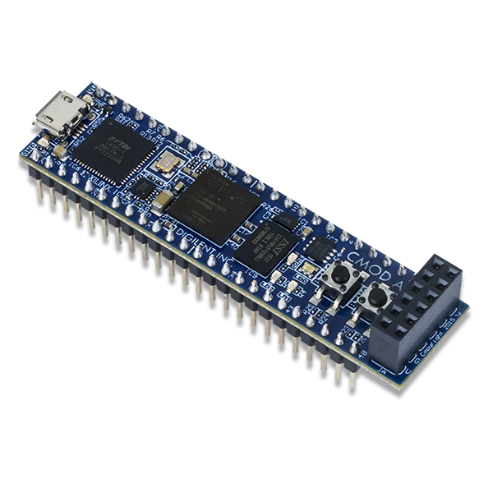


El Hanafi Nadim 894489
Informatica Industriale
n.elhanafi@campus.unimib.it
Microelectronics Group

Slide 2
Introduction - filter_ma Architecture
dfilter_input →
FIFO (delay line)
→
Multiadder
→
Accumulator
→
divide_by ÷NFIFO
→ dfilter_output
↓ dₙ₋ₙFIFO
yₙ = yₙ₋₁ − dₙ₋ₙFIFO + dₙ dfilter_output = yₙ / NFIFO
Port / Generic | Type | Width | Description
Nbf | generic | integer | Number of bits (Nb = 8)
log2NFIFOf | generic | integer | log₂(NFIFO) ∈ {5, 6, 7}
en / rst / clk | in | 1 bit | Enable, Reset active-low, Clock 50 MHz
datain | in | Nbf bits | Input sample (signed)
dataout | out | Nbf + log2NFIFOf bits | Filtered output (signed)
Nb=8 · fs=50 MHz tclk=20 ns f₀=195.3 kHz OVR=128 SNR_input=0 dB · FS=256

Slide 3
Multiadder — Design
entity multiadder is generic (Nb: integer; log2NFIFO: integer); port ( datain_fifo, dataout_fifo: in signed(Nb-1 downto 0); dataout_accumulator: in signed(Nb+log2NFIFO-1 downto 0); dataout: out signed(Nb+log2NFIFO-1 downto 0)); end multiadder; architecture Behavioral of multiadder is signal datain_fifo_large, dataout_fifo_large: signed(Nb+log2NFIFO-1 downto 0); signal mask0: signed(log2NFIFO-1 downto 0) := (others => '0'); begin datain_fifo_large <= mask0 & datain_fifo; dataout_fifo_large <= mask0 & dataout_fifo; dataout <= dataout_accumulator - dataout_fifo_large + datain_fifo_large; end Behavioral;
Formula - Recursive MA Update
yₙ = yₙ₋₁ − dₙ₋ₙFIFO + dₙ Instead of summing NFIFO samples each cycle, only the oldest sample is subtracted and the newest added. O(1) complexity per clock cycle.
Signal Widths
• datain_fifo / dataout_fifo: Nb = 8 bit • dataout_accumulator (yₙ₋₁): Nb+log₂NFIFO bits • dataout (yₙ): Nb+log₂NFIFO bits Inputs UNSIGNED → zero-extension via mask0 (no sign error).
Key Implementation Note
Samples are unsigned (0…255). Upper log₂NFIFO bits padded with '0' using mask0 concatenation. Using signed arithmetic avoids overflow and simplifies accumulator feedback.

Slide 4
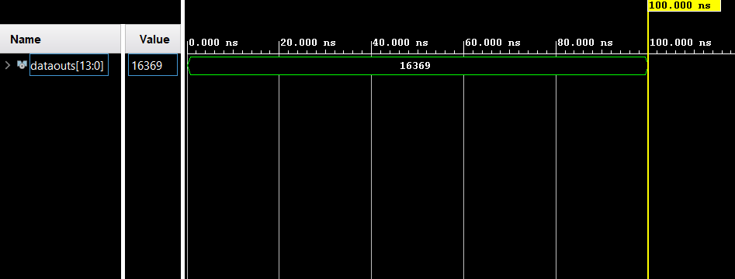
Multiadder - Testbench
Signal | Value (dec) | Binary (14 bit) | Role
datain_fifo | 1 | 00000000000001 | dₙ — current sample
dataout_fifo | 15 | 00000000001111 | dₙ₋ₙFIFO — oldest sample
dataout_accumulator | 16383 | 11111111111111 | yₙ₋₁ — running sum
dataout (expected) | 16369 | 11111111110001 | yₙ = 16383 − 15 + 1

Slide 5
Accumulator - Design
entity accumulator is generic (Nb: integer; log2NFIFO: integer); port ( en, rst, clk : in std_logic; datain : in signed(Nb+log2NFIFO-1 downto 0); dataout : out signed(Nb+log2NFIFO-1 downto 0)); end accumulator; architecture Behavioral of accumulator is signal reg : signed(Nb+log2NFIFO-1 downto 0) := (others => '0'); begin process(clk) begin if rising_edge(clk) then if rst = '0' then reg <= (others => '0'); elsif en = '1' then reg <= datain; end if; end if; end process; dataout <= reg; end Behavioral;
Function - PIPO Register
Synchronous Parallel-In Parallel-Out register. • Stores yₙ on every rising clock edge (en='1') • Output is yₙ₋₁ - the running sum one cycle earlier • Feeds back to the Multiadder input
Reset & Width
rst='0' → synchronous active-low clear (reg ← 0) rst='1' → normal operation Width = Nb + log₂NFIFO = 14 bit for NFIFO=64 Max value = NFIFO x 255 = 16320 → fits in 14 bit

Slide 6
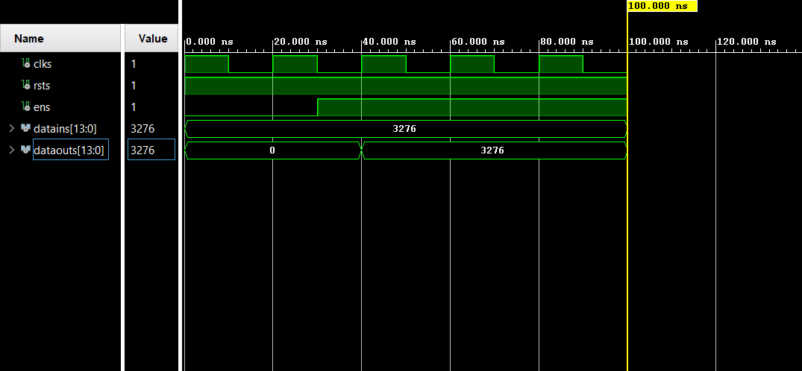
Accumulator - Testbench
Condition | datains (constant) | dataouts – expected
t < 30 ns (en='0') | 3276 ("00110011001100") | 0 - register not loaded yet
t ≥ ~40 ns (en='1') | 3276 ("00110011001100") | 3276 — PIPO register latches input

Slide 7
divide_by - Design
entity divide_by is generic (Nb: integer; log2NFIFO: integer); port ( en, rst, clk : in std_logic; datain : in signed(Nb+log2NFIFO-1 downto 0); dataout : out signed(Nb+log2NFIFO-1 downto 0)); end divide_by; architecture Behavioral of divide_by is constant Nacc : integer := Nb + log2NFIFO; signal reg : signed(Nacc-1 downto 0) := (others => '0'); begin process(clk) begin if rising_edge(clk) then if rst = '0' then reg <= (others => '0'); elsif en = '1' then reg(Nacc-log2NFIFO-1 downto 0) <= datain(Nacc-1 downto log2NFIFO); reg(Nacc-1 downto Nacc-log2NFIFO) <= (others => '0'); end if; end if; end process; dataout <= reg; end Behavioral;
Principle - Right Shift
NFIFO = 2^log₂NFIFO → division by NFIFO = arithmetic right-shift by log₂NFIFO positions. No multiplier or divider needed — implemented as pure wiring in hardware.
Bit Mapping (NFIFO=64, Nb=8)
datain [13:0] - accumulator output yₙ bits [13:6] → integer quotient bits [5:0] → fractional (discarded) dataout [13:0] bits [7:0] → result (0…255) bits [13:8] → '000000' (zero-filled)
Example
datain = 13119 ("11001100111111") 13119 ÷ 64 = 204 → dataout = 204 (Hex check: 333f → 00cc visible in Vivado Objects)

Slide 8
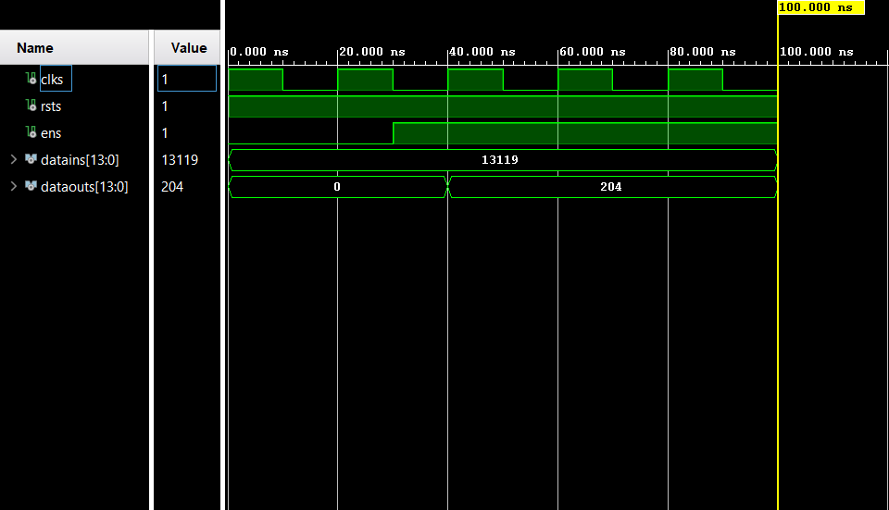
divide_by - Testbench
Signal | Value (dec) | Binary (14 bit) | Note
datains (constant input) | 13119 | 11001100111111 | Constant test vector
dataouts (expected) | 204 | 00000011001100 | 13119 >> 6 = 204
Hex visible in Objects panel | datains=333f | dataouts=00cc | Correct before waveform run

Slide 9
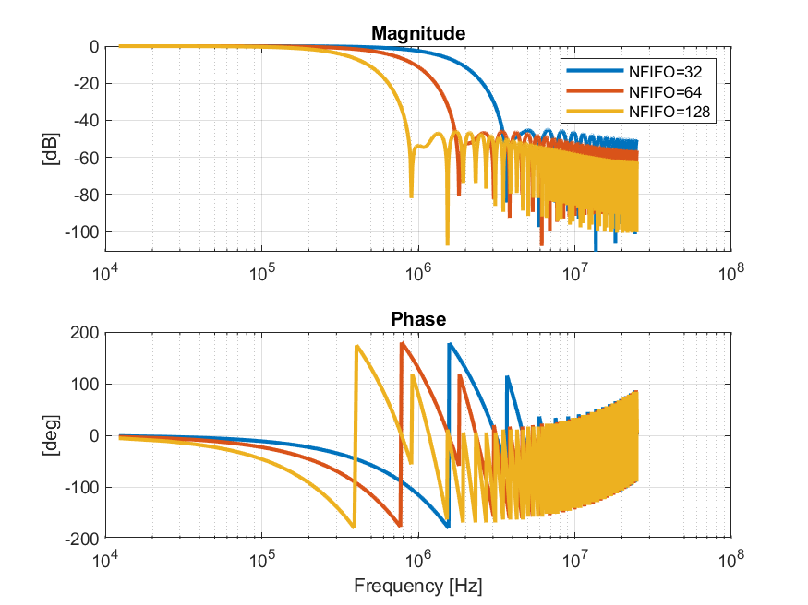
Frequency Response - NFIFO = 32, 64, 128
NFIFO=32
fcutoff = fs/(2·NFIFO) = 781 kHz Wider passband, less noise rejection
NFIFO=64
fcutoff = fs/(2·NFIFO) = 391 kHz Good balance: signal + noise well separated
NFIFO=128
fcutoff = fs/(2·NFIFO) = 195 kHz ≈ f₀ Narrowest band. Signal starts to attenuate!
Key: larger NFIFO → narrower passband → more noise rejection. For NFIFO=128, fcutoff ≈ f₀ → signal itself attenuated.

Slide 10
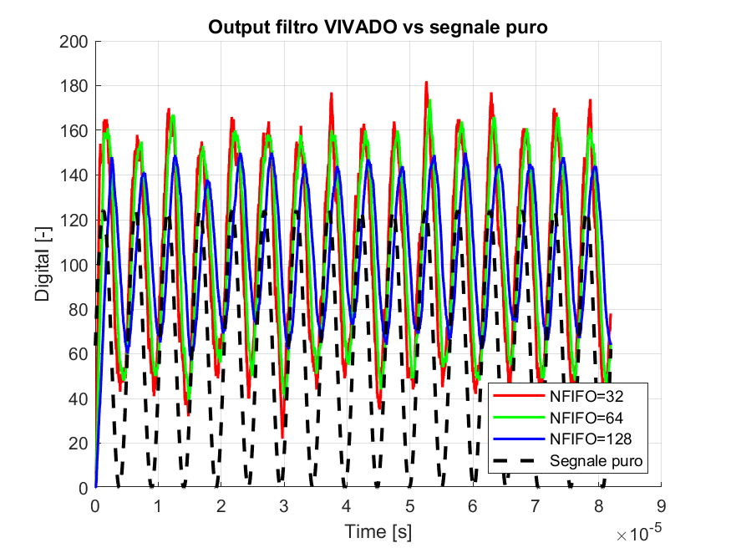
Time Domain - ysignal + ynoise (filter output)
NFIFO=32
More residual noise. 16-sample delay (0.32 µs). Passes more noise.
NFIFO=64
Good balance. Noise clearly reduced, sinusoid well preserved.
NFIFO=128
Smoothest but 64-sample delay (1.28 µs). Signal slightly attenuated at f₀.
Pure signal
Lower DC: excludes noise mean offset (pnoise≈44 LSB). Reference only.
All three filters preserve the sinusoidal shape. Trade-off between noise rejection and group delay is visible.

Slide 11
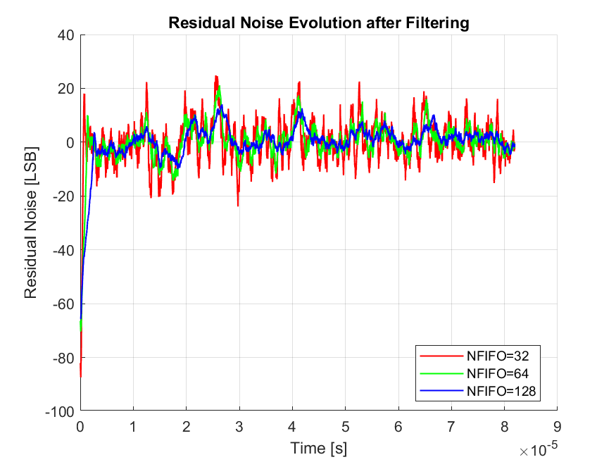
Time Domain - ynoise (Residual Noise Evolution)
NFIFO | Noise RMS [LSB] | Reduction vs input | Noise Bandwidth
32 | 6.90 | ≈ 3.4× | 781.25 kHz
64 | 4.79 | ≈ 4.9× | 390.63 kHz
128 | 3.35 | ≈ 7.0× | 195.31 kHz
Noise RMS decreases monotonically: 6.90 → 4.79 → 3.35 LSB. NFIFO=128 achieves ≈7x noise reduction vs input.

Slide 12
Signal to Noise Ratio - NFIFO = 32, 64, 128
NFIFO | fcutoff [kHz] | Noise RMS [LSB] | SNR [dB] | ΔSNR
32 | 781.25 | 6.90 | 15.50 | -
64 | 390.63 | 4.79 | 18.19 | +2.69
128 | 195.31 | 3.35 | 18.66 | +3.16
18.66 dB
18.19 dB
15.5 dB
- SNR improves monotonically: 15.50 → 18.19 → 18.66 dB.
- NFIFO=32→64: +2.69 dB (significant gain).
- NFIFO=64→128: +0.47 dB only - diminishing returns because fcutoff ≈ f₀.
- For NFIFO=128, filter also attenuates the signal (f₀ = fcutoff = 195 kHz).
- SNR calculated via MATLAB snr() on AC component of VIVADO output.
NFIFO=32
NFIFO=64
NFIFO=128
SNR [dB] (min axis = 12 dB)

Slide 13
Summary Table and Comments
Parameter | NFIFO = 32 | NFIFO = 64 | NFIFO = 128
log₂NFIFO | 5 | 6 | 7
fcutoff [kHz] | 781.25 | 390.63 | 195.31
Noise Bandwidth | Wide | Medium | Narrow ← best
Noise RMS [LSB] | 6.90 | 4.79 | 3.35 ← best
SNR [dB] | 15.50 | 18.19 | 18.66 ← best
ΔSNR vs NFIFO=32 | - | +2.69 dB | +3.16 dB
Group delay [samples] | 16 | 32 | 64 ← worst
Group delay [µs] | 0.32 | 0.64 | 1.28 ← worst
Signal atten. at f₀ | None | Negligible | Significant
dataout width [bit] | 13 | 14 | 15
Best use case | Low latency | Balanced | Max noise reject.
Trade-off: larger NFIFO → better SNR + narrower noise bandwidth, but higher group delay and signal attenuation when fcutoff approaches f₀. NFIFO=64 offers the best practical compromise.

Slide 14
Conclusions
Moving Average Filter successfully implemented on FPGA in VHDL
All 4 components verified independently with dedicated testbenches and end-to-end with tb_filter_ma
SNR improves with NFIFO: 15.50 dB → 18.19 dB → 18.66 dB
Each doubling of NFIFO halves the noise bandwidth with diminishing returns as f₀ → fcutoff
Key trade-off: noise rejection vs group delay vs signal attenuation
NFIFO=64 offers the best practical balance (SNR=18.19 dB, delay=0.64 µs, no signal loss)
Possible improvements:
Weighted MA (Hann/Hamming window) for sharper frequency roll-off
Configurable NFIFO via register to switch filter bandwidth at runtime
Pipelined FIFO for higher throughput at the same clock frequency

