Slide 1
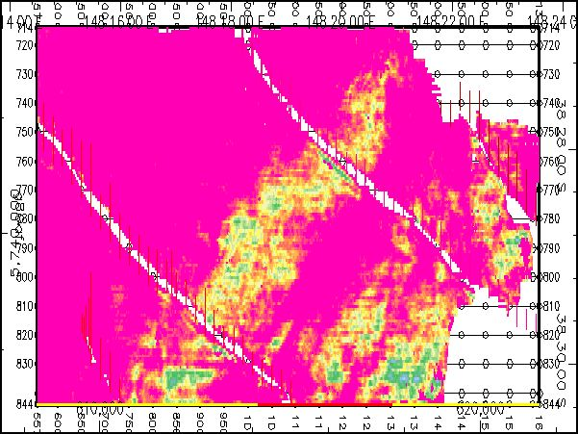
Seismic Facies Mapping Exercise
Above-Orange Peak Amplitude
Weak Amplitude
Strong Amplitude
Schroeder, (2006) Courtesy of ExxonMobil

Slide 2
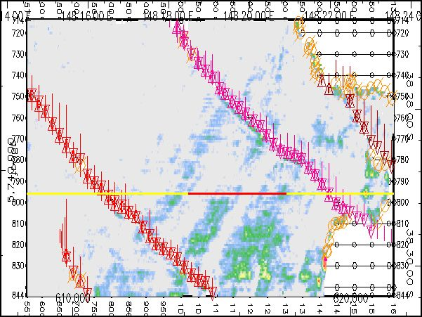
Seismic Facies Mapping Exercise
Below-Orange Trough Amplitude
Weak Amplitude
Strong Amplitude
Schroeder, (2006) Courtesy of ExxonMobil

Slide 3
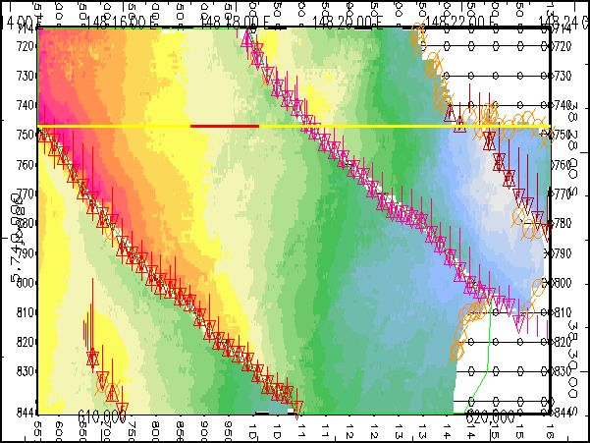
Seismic Facies Mapping Exercise
Orange Time Structure
Deep
Shallow
Schroeder, (2006) Courtesy of ExxonMobil

