Slide 1

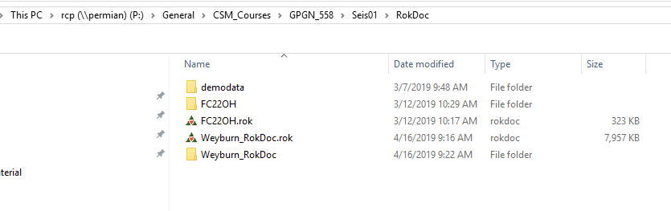
Gassmann

Slide 2
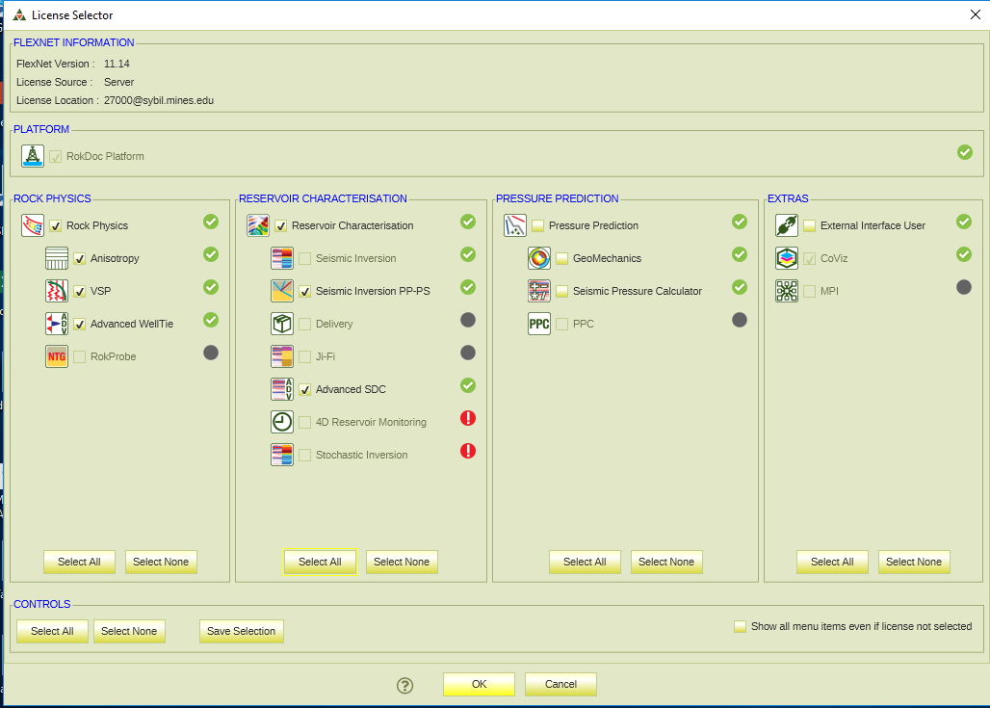
27000@Sybil.mines.edu
Gassmann

Slide 3
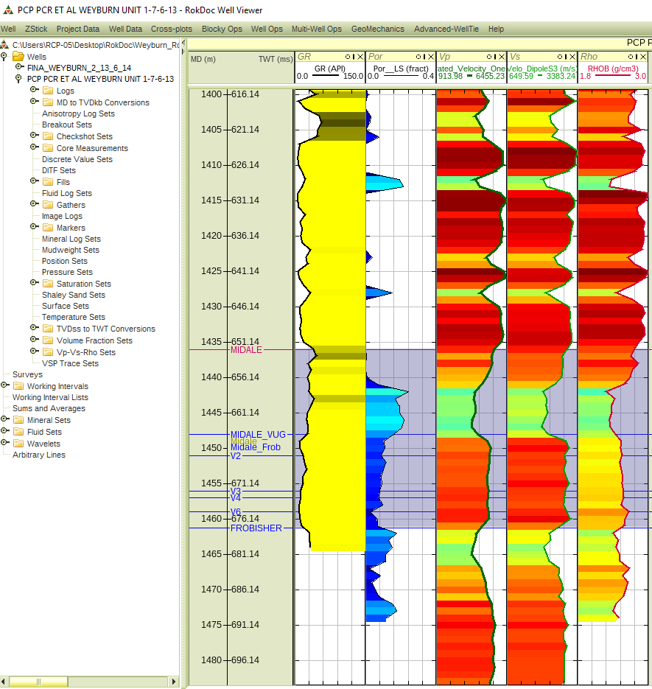
GR Por Vp Vs Den
Gassmann

Slide 4
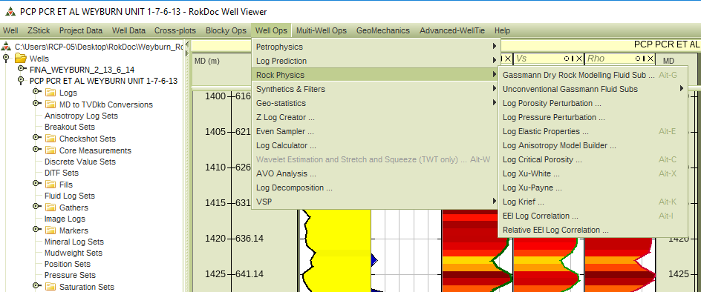
Gassmann

Slide 5
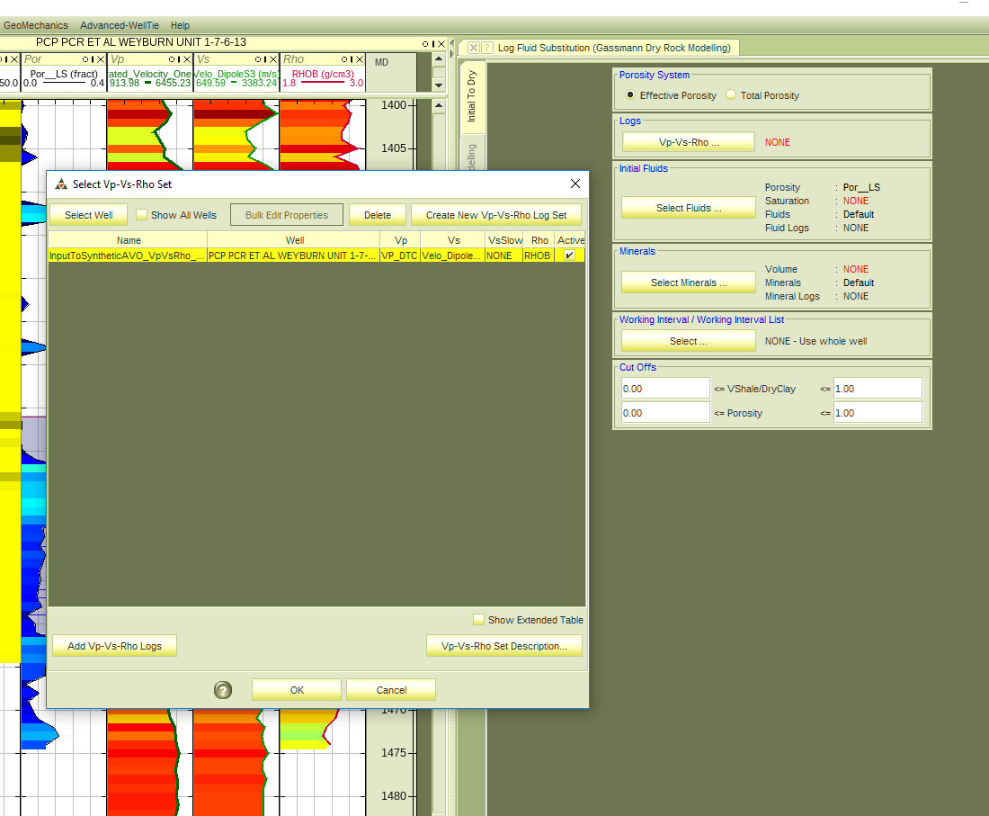
Gassmann

Slide 6
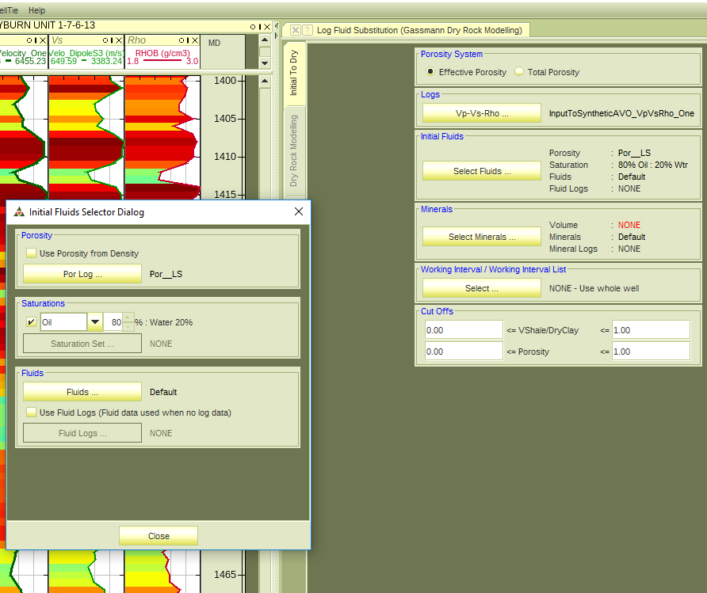
Gassmann

Slide 7
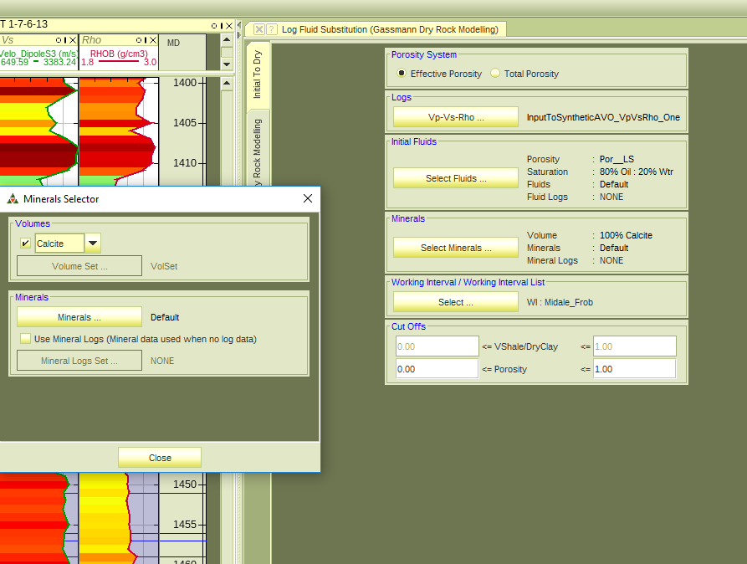
Gassmann

Slide 8
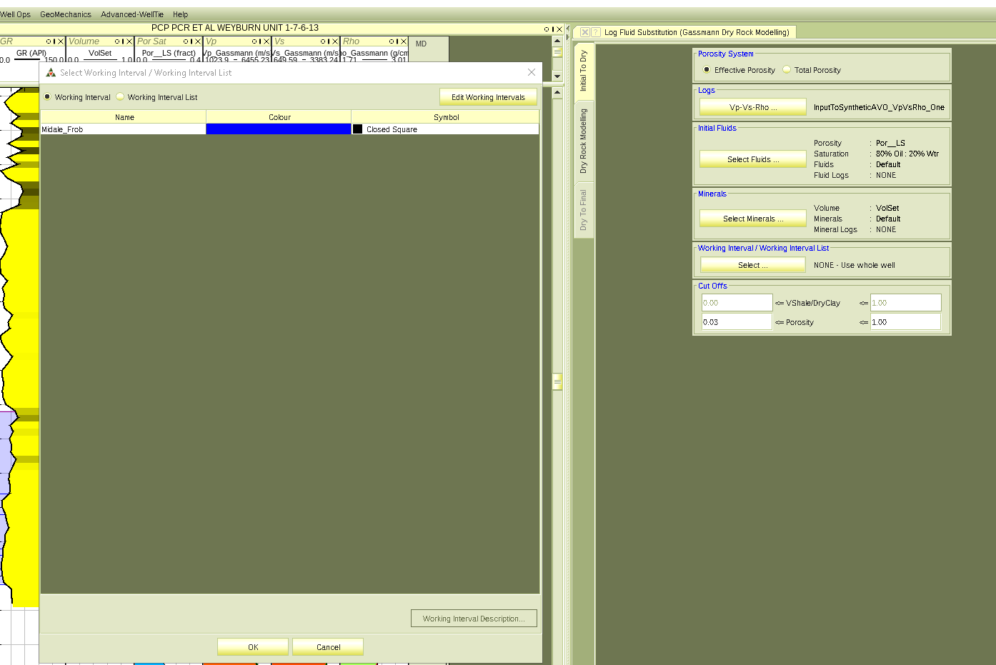
Gassmann

Slide 9
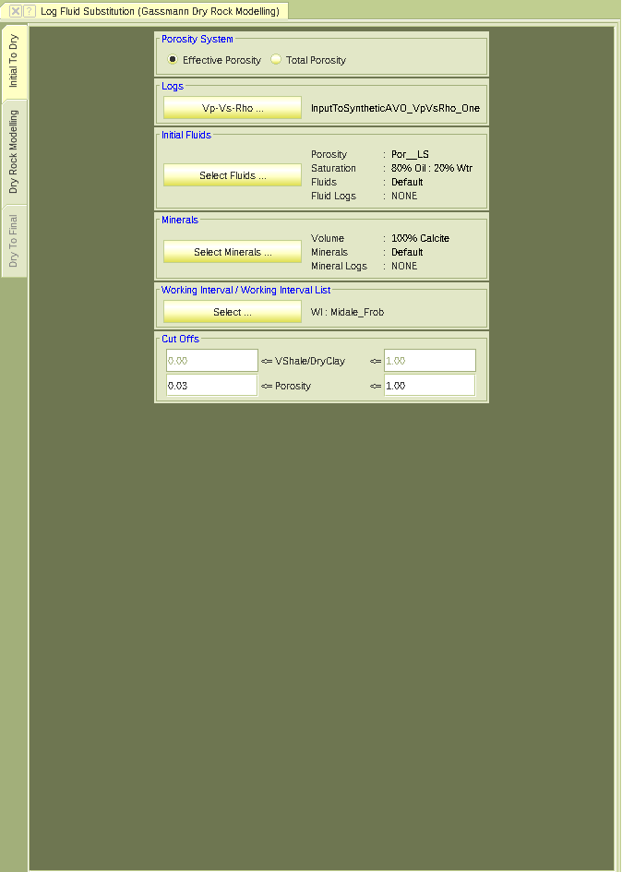
Gassmann

Slide 10
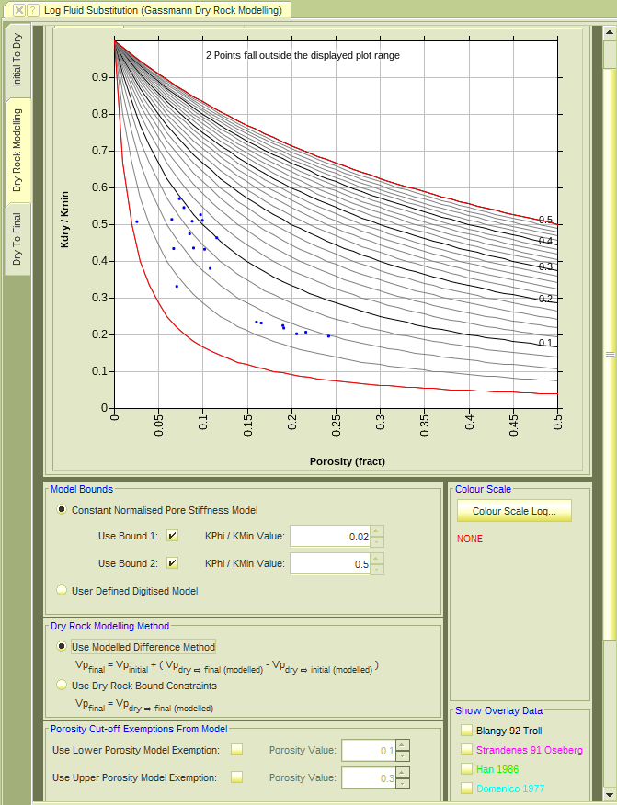
Gassmann

Slide 11
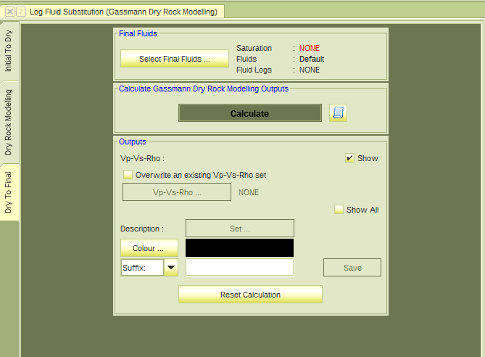
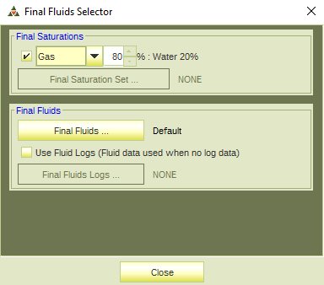
Gassmann

Slide 12
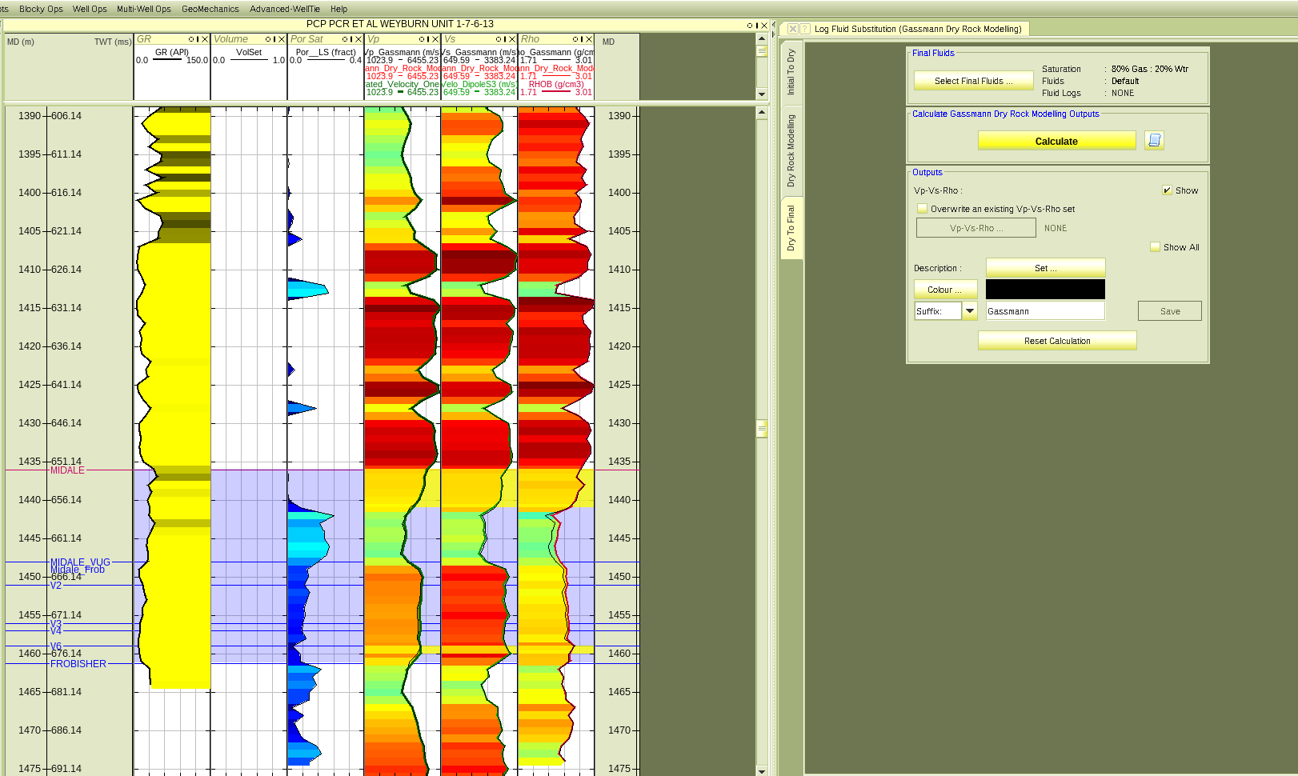
GR Por Vp Vs Den
Gassmann

Slide 13
Make wedge models with the original and Gassmann logs and compare the amplitudes

