Slide 1
Formation Lithology Classification: Evaluation of Machine Learning Methods
CSCI 470: Introduction to Machine Learning
Oil Digger Team:
Mohamed Ibrahim Mohamed
Nadima Dwihusna
Xiaoyu Zhu

Slide 2
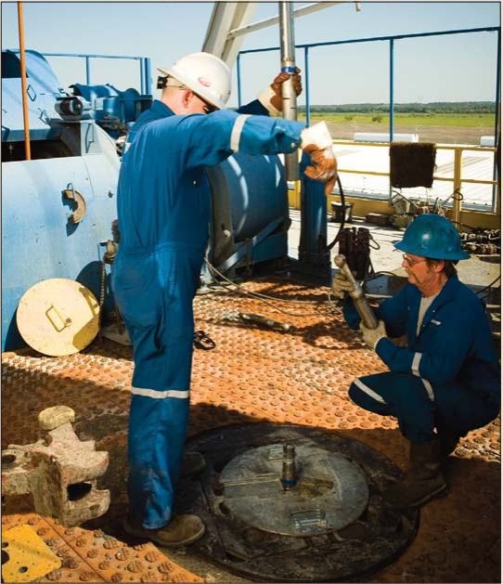
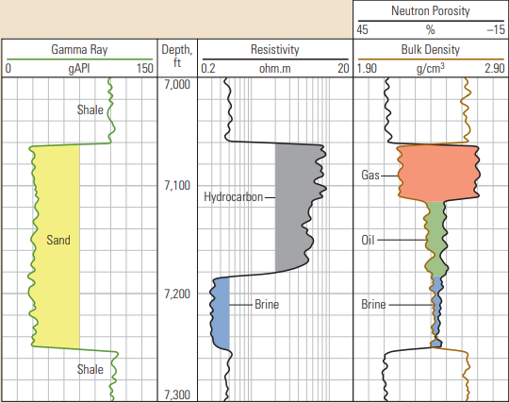

Introduction
What is Well Logs^{[1]} ?
Geologists and petroleum engineers cannot examine the rock insitu.
Measurement of physical properties of rock around a well using special tool lowered into the borehole
The data are displayed as a series of measurements versus depth.
In order to make decision about drilling and production operations.
Sweet Spots
Facies Identification

Slide 3
Introduction
Challenges:
Loading well log points (Big Data).
Visualization software (Commercial software: Expensive!!).
Facies recognition
Hydrocarbon/fluid content
(Done manually and require geophysical and petrophysical models)

Slide 4
Well log Dataset
Large gas field in the north America, the Hugoton and Panoma^{[2]}
Seven training wells
Total points: 3232
20% test set
One blind test well

Slide 5



Well log Dataset
All Data
Training Data
Test Data
Model Data
Validation Data
Test
Learn
Validate
Learn

Slide 6
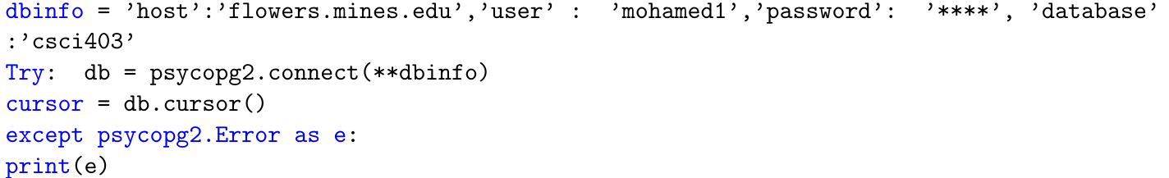
Well log Dataset
SQL
Creating the table:
Copy dataset to table:
Accessing the SQL database from jupyterhub:

Slide 7
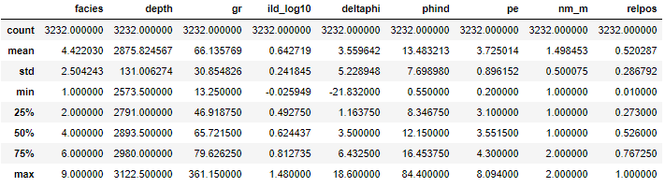
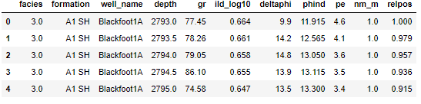
Dataset Processing
Pandas Library
data1.describe()
Data1.head()
Number of observation
Extract feature variables
GR, Resistivity, PE, Neutron density porosity, average Neutron density porosity.
Labels

Slide 8
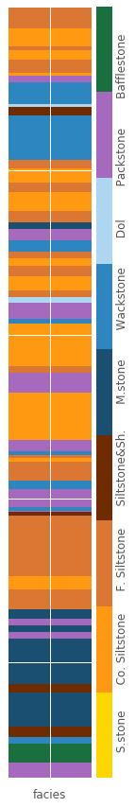
Dataset Processing
Nine discrete rock facies:
Sandstone
Coarse siltstone
Fine siltstone
Siltstone and shale
Mudstone
Wakestone
Dolomite
Packstone
Bafflestone
Depth
Color mapping for each layer

Slide 9
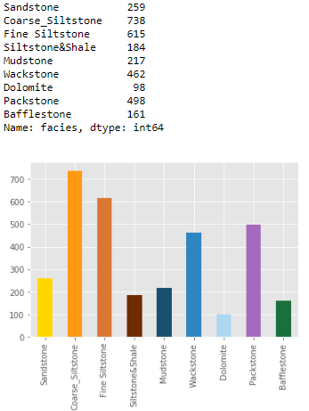
Dataset Processing
Nine discrete rock facies:
Sandstone
Coarse siltstone
Fine siltstone
Siltstone and shale
Mudstone
Wakestone
Dolomite
Packstone
Bafflestone
Statistical distribution

Slide 10
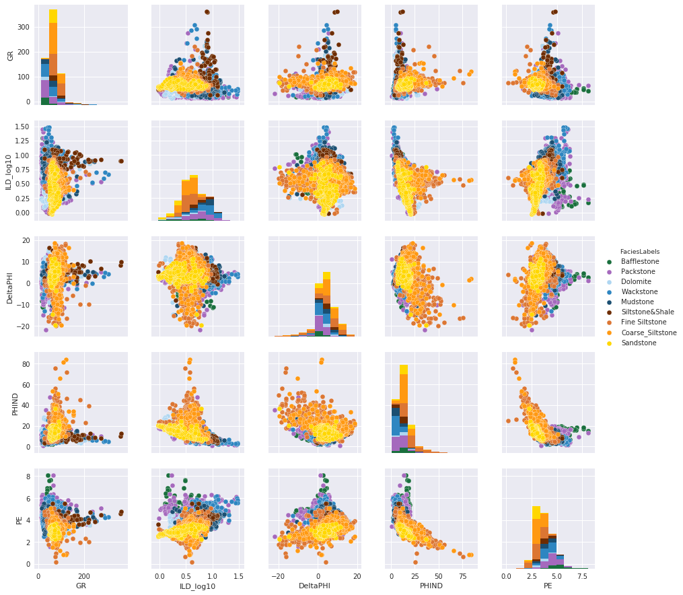
Dataset Processing
Cross plot
Notes:
Explore Data Set and look at the variation with the data

Slide 11

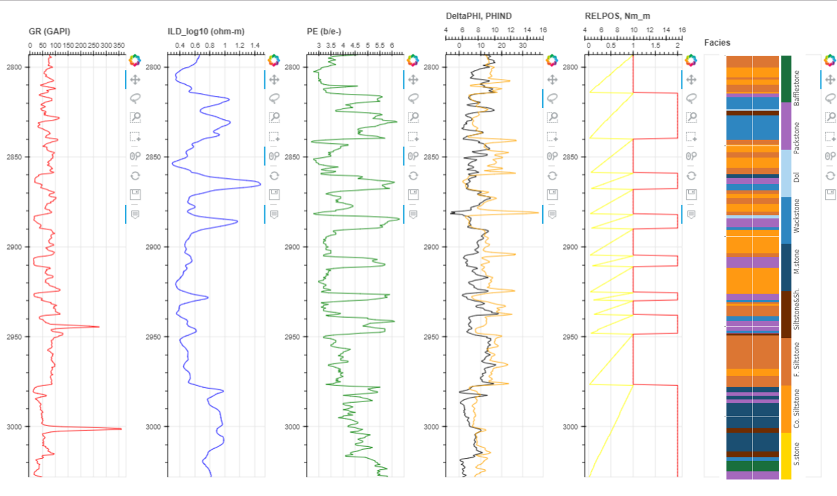
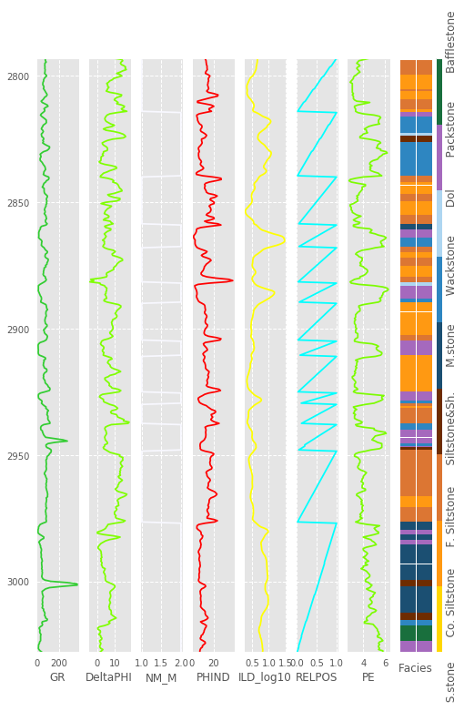
Well Log Visualization
Bokeh
Interactive plotting tool.
https://jupyterhub.mines.edu/user/mohamed1/view/Well%20Logging/fig1.html
Bokeh
Matplotlib
Vs.

Slide 12
Cleaning and Processing the Dataset
Sklearn.preprocessing.StandardScaler().fit()
To grant that features are standard normally distributed
X_train, X_cv, y_train, y_cv = train_test_split(scaled_features, correct_facies_labels)
To split training data into training and test data.
The test set is used to evaluate the algorithm and are not used for training the network.
Notes:
To transform raw features vectors and standardize

Slide 13
Cleaning and Processing the Dataset
X_train, X_cv, y_train, y_cv = train_test_split(scaled_features, correct_facies_labels)
To split training data into training and test data.
The test set is used to evaluate the algorithm and are not used for training the network.
Notes:
To transform raw features vectors and standardize

Slide 14
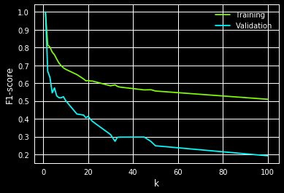
Facies Classifier: Training using the KNN
KNN classifier is a neighbors-based classification k .
k nearest neighbors of each point.
Nested loop to test different k-values.

Slide 15
Facies Classifier: Training using the KNN
The model was then evaluated using the testing data.
F1-score was 69%.
Accuracy of facies classification; the number of correct classifications divided by the number of classifications is 69%.
Accuracy within the adjacent layers 85%.
The model was then evaluated using the blind data.
F1-score was 46%.
Accuracy of facies classification 48%.
Accuracy within the adjacent layers 89%.
Notes:
Noting that there is no definite boundaries between the layers it's possible that the adjacent layers, thus it's important to calculate the

Slide 16
Facies Classifier: Training using SVM
SVM requires Gamma and C.
C is a regularization factor, and tells the classifier how much we want to avoid misclassifying training examples.
A large value of C will try to correctly classify more examples from the training set.
If C is too large it may 'overfit' the data and fail to generalize when classifying new data.
If C is too small then the model will not be good at fitting outliers and will have a large error on the training set.
The gamma parameter describes how far away two vectors in the feature space need to be considered close.

Slide 17
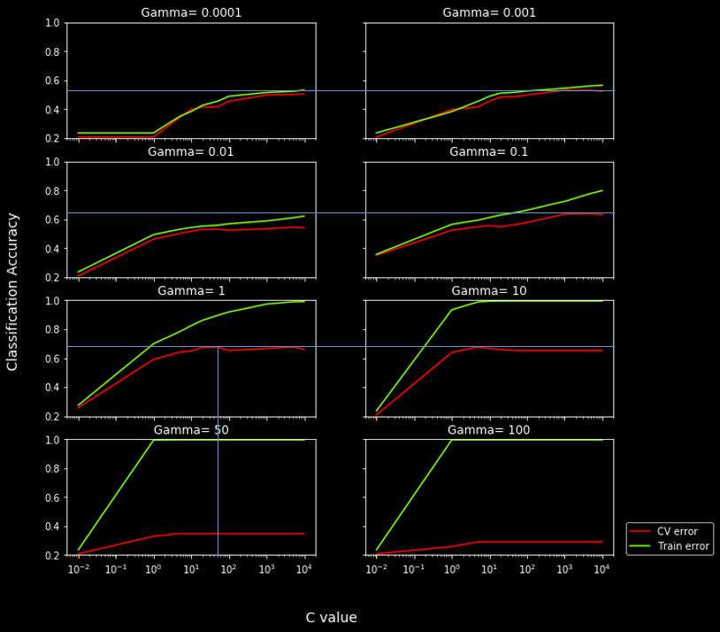
Facies Classifier: Training using SVM
SVM requires Gamma and C.

Slide 18
Facies Classifier: Training using SVM
The model was then evaluated using the testing data.
F1-score was 71%.
accuracy of facies classification; the number of correct classifications divided by the number of classifications is 71%.
accuracy within the adjacent layers 89%.
The model was then evaluated using the blind data.
F1-score was 45%.
accuracy of facies classification 48%.
accuracy within the adjacent layers 89%.

Slide 19
Facies Classifier: Training using the Random Forrest
RandomForest takes input of n_estimators which is number of trees in the forest.
The optimal n estimators was found to be 8
The model was then evaluated using the testing data.
F1-score was 68%.
Accuracy of facies classification is 64%.
Accuracy within the adjacent layers 85%.
The model was then evaluated using the blind data.
F1-score is 42%.
Accuracy of facies classification is 42%.
Accuracy within the adjacent layers is 86%.

Slide 20
Facies Classifier: Training using the Multilayer Perceptron (MLP)
Multilayer Perceptron (MLP) is a feed forward neural network algorithm that trains using Backpropagation (gradient descent).
The model was then evaluated using the testing data.
F1-score was 49%.
Accuracy of facies classification is 51%.
Accuracy within the adjacent layers 90%.
The model was then evaluated using the blind data.
F1-score is 42%.
Accuracy of facies classification is 42%.
Accuracy within the adjacent layers is 86%.
Notes:
Given an artificial neural network and an error function, the method calculates the gradient of the error function with respect to the neural network's weights

Slide 21
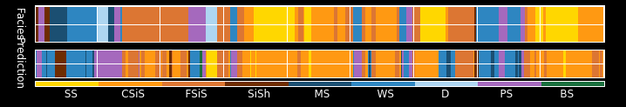
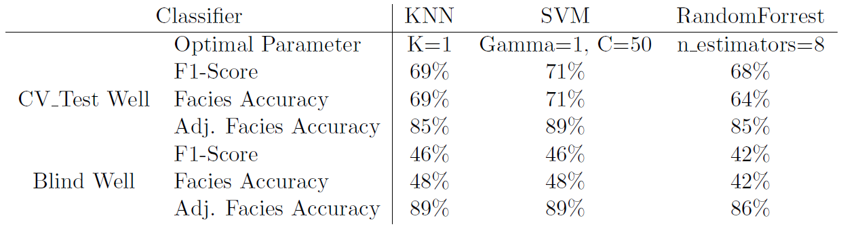
Conclusion and Results

Slide 22
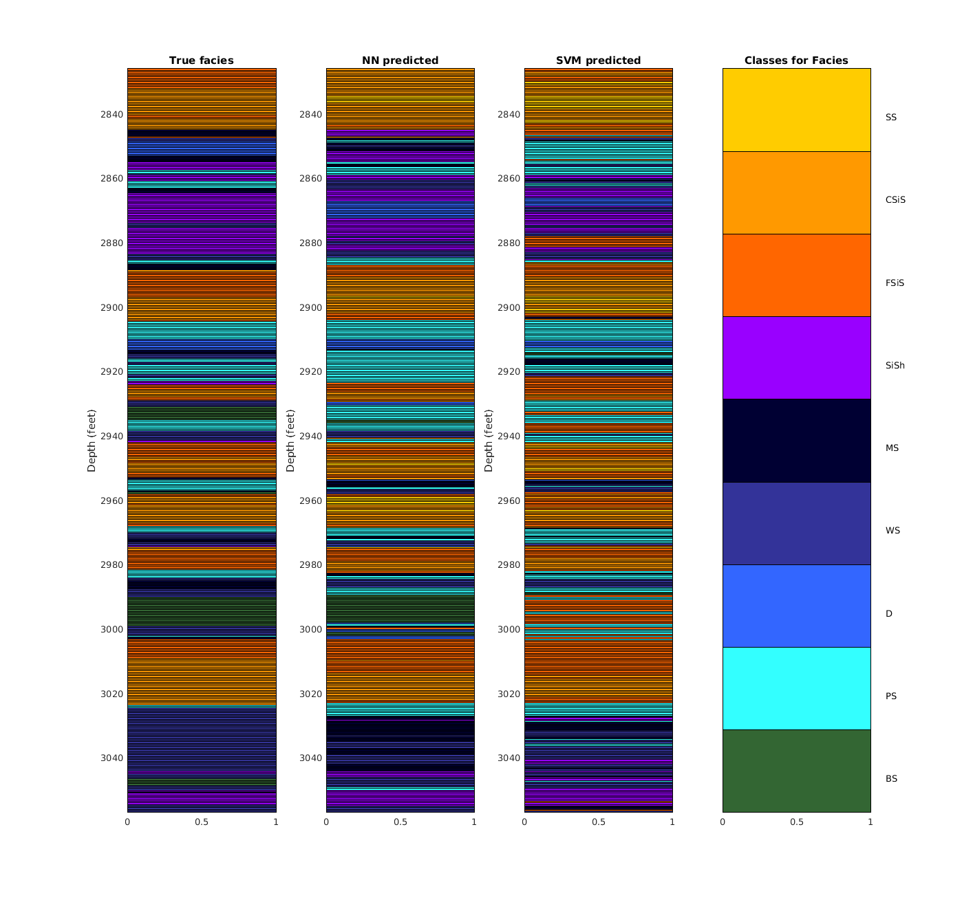
Update!!

Slide 23
Future Work
Neural Networks for predictions.
Compare geophysical and petrophysical models to the ML predicted Facies.
Fluid Content Classification (unsupervised learning/semi-supervised learning).

Slide 24
Thanks
Questions?

