Slide 1


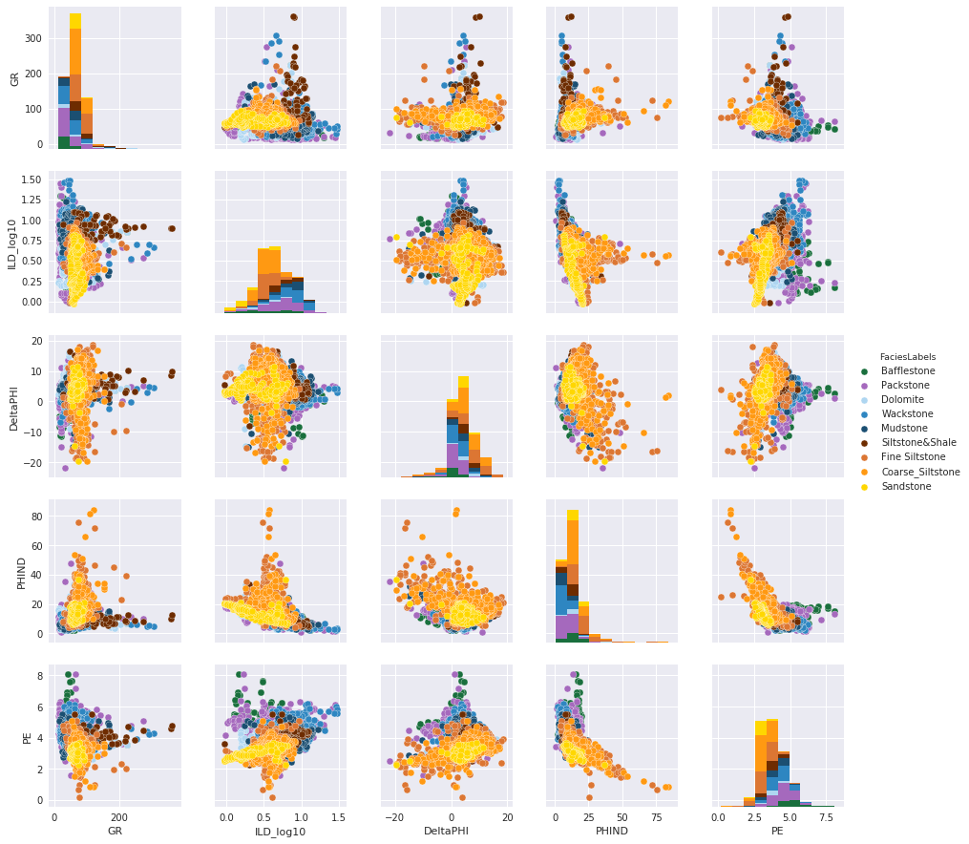
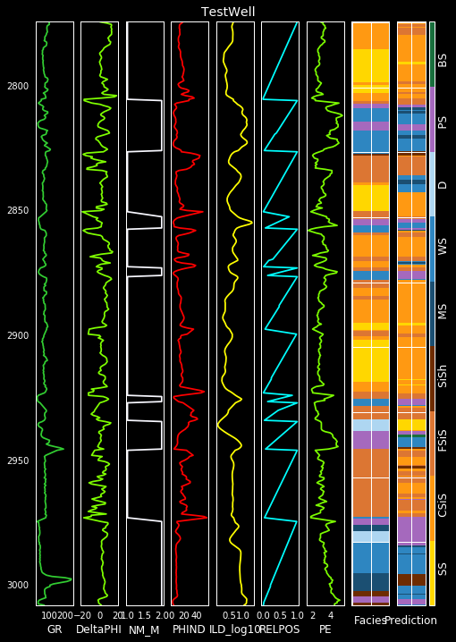
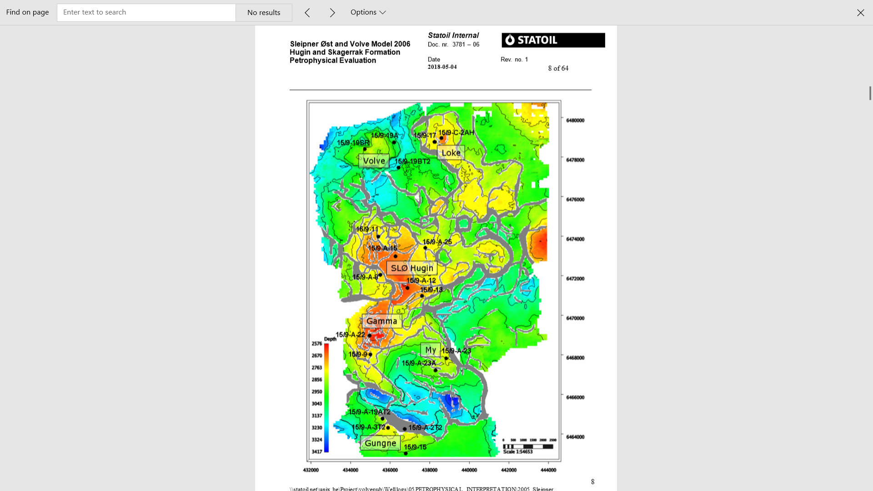
Formation Lithology Classification Using Supervised Machine Learning Methods
Mohamed Mohamed, Nadima Dwihusna, and Xiaoyu Zhu
Objective
Results
Workflow
Objective
Perform litho-facies classification using supervised machine learning
Well logs based
Understand Objective and Problem
.
Facies Target
Get the Data
Analyze / visualize the data
Compare Machine Learning Methods
K-Nearest Neighbors (KNN)
Support Vector Machine (SVM)
Random Forrest
Recurrent Neural Networks
Select Model and Perform Training
QC and Fine-Tune the Model
Improve litho-facies classification and decrease computation time
Figure 1. Scatter Matrix Cross Plot
Present, Launch, Monitor
Well Logs Description
Future Work
Continuous record of rock formation properties with respect to depth
Compare results between different Machine Learning methods
Located in Hugoton and Panoma Gas Fields, N. America
Further develop code by analyzing larger scale heterogeneous datasets to be implemented to other types of reservoir rock formations
Facies Target
Features
Sandstone
Coarse Siltstone
Fine Siltstone
Siltstone, Shale
Mudstone
Wackestone
Dolomite
Packstone
Bafflestone
Gamma Ray
Resistivity
Neutron Porosity
Density
Sonic P, Sonic S
Introduce seismic data into workflow
Figure 2. Blind Test Well Predicted Facies (Log 9)
and Actual Facies (Log 8)
Acknowledgement
Table 1. Summary of Classifier Performance for Blind Well
Thank you to Dr. Wang and Saad Elbeleidy from CSCI 470 Machine Learning Course
for you advice on this project, and to the University of Kansas for well log datsets.
Classifier | KNN | SVM | Random Forrest
Facies Accuracy | 48 % | 48 % | 42 %
Adj. Facies Accuracy | 89 % | 89 % | 86 %
Notes:
1. Objective
Norwegian North Sea Field
Unsupervised ML
KNN
Deep learning
Restricted Boltzmann
Deep belief network
2. Map View of Wells
Location of wells in block 15/9 of Sleipner Ost and Volve Field
3. Available Data
List of Data
Production
Well design
Completion design
Seismic and well logs
Geology
stratigraphy
Static and dynamic models
Each well has
Gamma ray
Neutron porosity
Bulk density
Lithology
Caliper
Bit size and speed
4. Proposed Workflow
Understand objective and problem
Get the data: analyze / visualize the data
Prepare data for ML Algorithm
Select Model and Perform Training
QC and Fine-Tune the Model
Present, Launch, Monitor
5. Results
Improve litho-facies classification and fasten computation time by ML
6. Future Work
Compare results between different Machine Learning methods
Further develop code to determine compaction and depth trends per facies by analyzing larger scale heterogeneous datasets
Application to seismic data
7. Acknowledgement
Thank you Ehsan, Ikon Science
What is tension?
What is unsupervised ml be able to exmplain knn etc
Proposed workflow explain each
Why unsupervised ML when you have labeling
What to say in image section – mention in Ehsan.
Know the difference between ML Methods

