Slide 1
GPGN 461: Advanced Gravity and Magnetic Exploration
Lab 10: Inversion of Magnetic Data
Nadima Dwihusna and Felicia Nurindrawati
Due Date: December 12, 2017

Slide 2
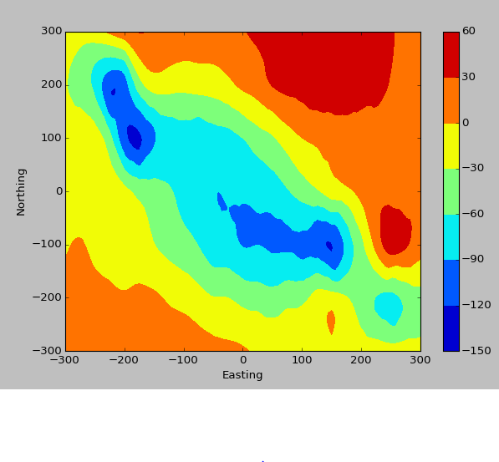
Viewing the data
What kind of susceptibility distribution has produced this data set?
We predicted that this data set is
produced by the following subsurface object.
Northing
Easting
Depth

Slide 3
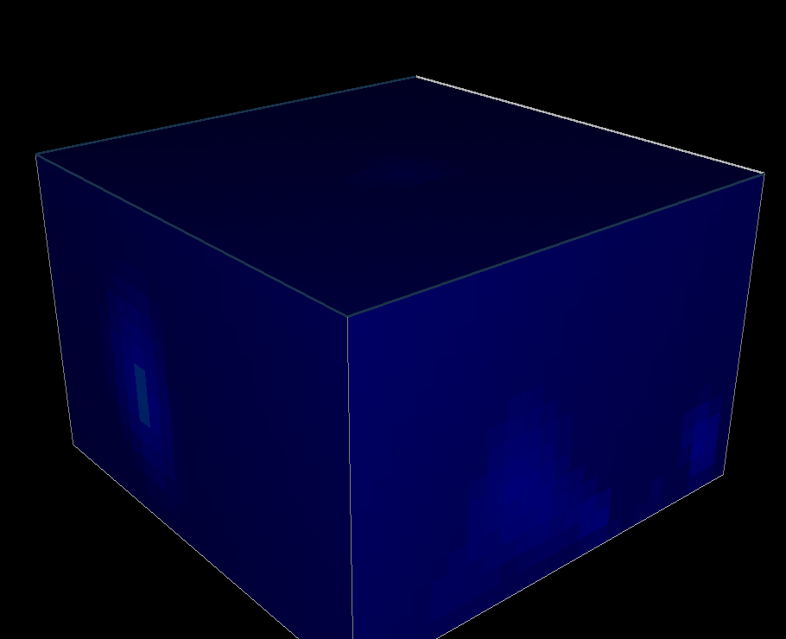
(2) Use the include the input files, first run the sensitivity code to generate the sensitivity matrix (mv_sens.inp), and then execute the inversion code to invert the data (mv_invert.inp). The process will generate a susceptibility model
Susceptibility Model

Slide 4
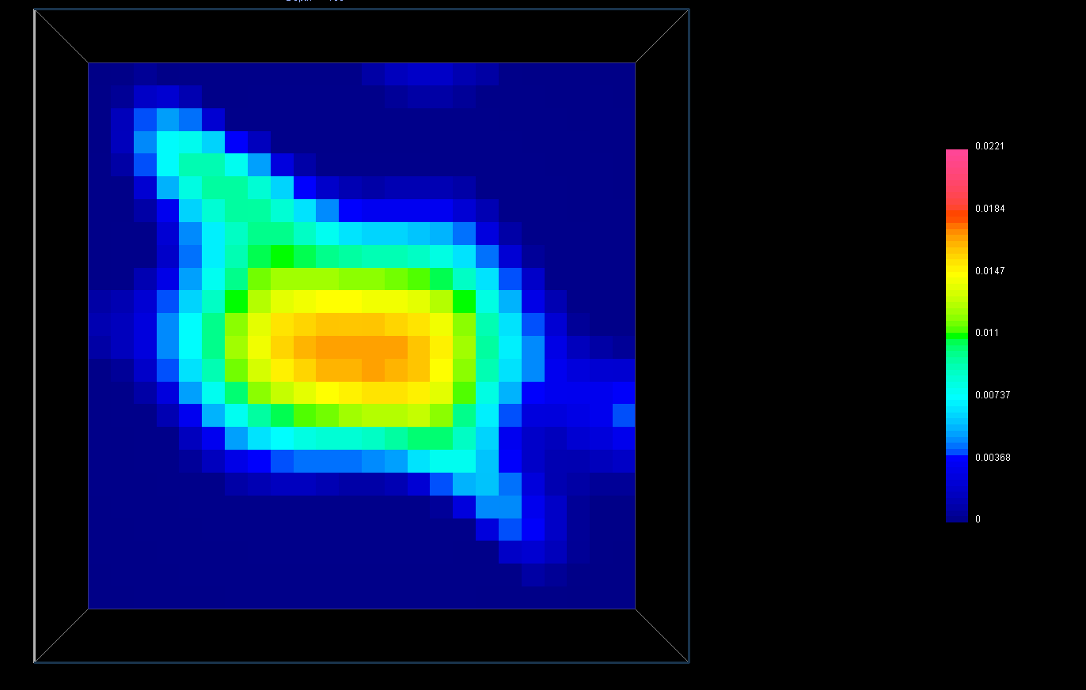
(3) Compare the predicted data with the observation, and examine the recovered model by slicing through the model region and by volume rendering using the included meshtools3d.exe
Our predicted data (left) is somewhat similar in structure to the observation data (right) however the amplitudes of the two data are different.
Predicted Data Observed Data

Slide 5
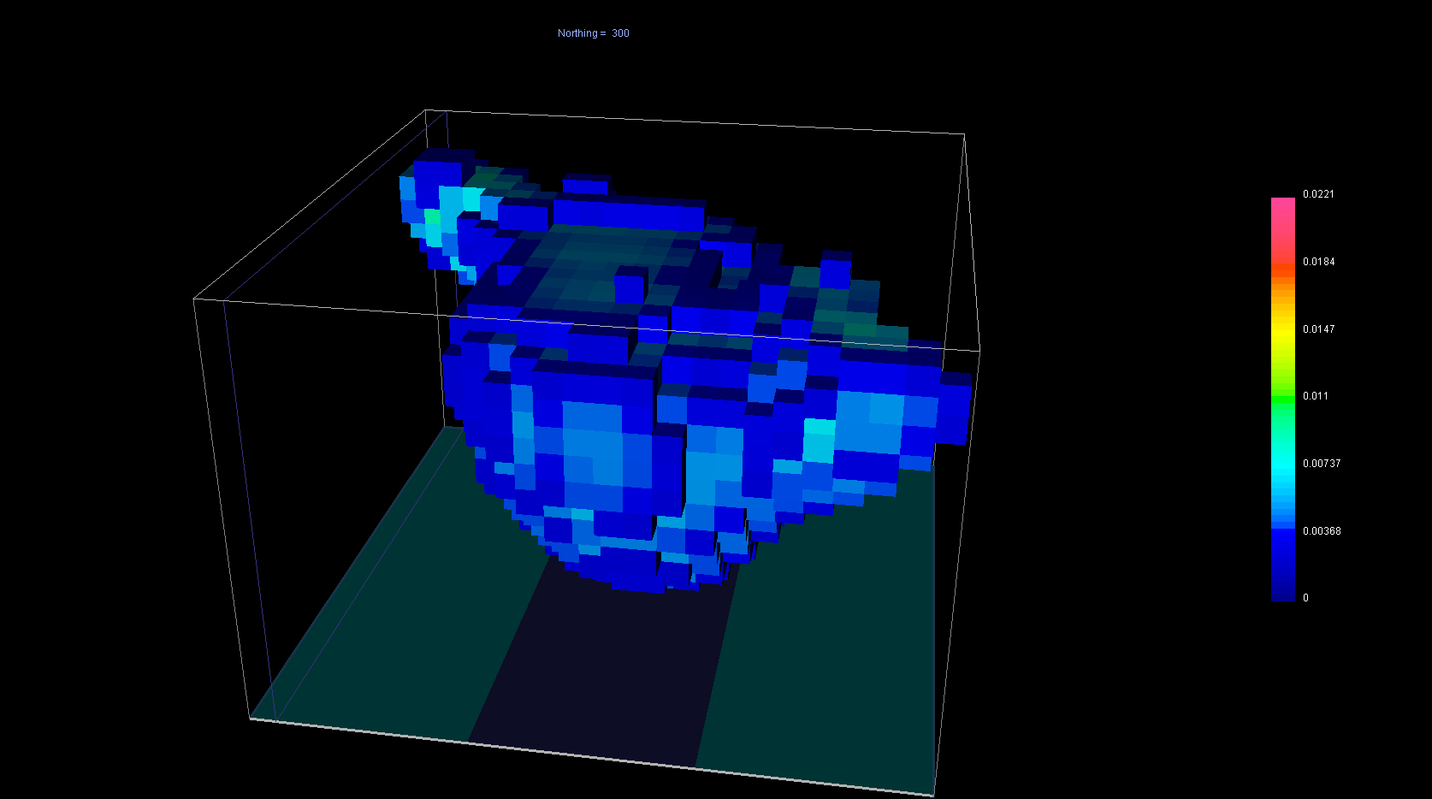
(4) How does the recovered model differ from your initial interpretation based on the inspection of the data map?
Our initial interpretation model (right) is somewhat similar to our recovered model (left) as seen in the figures below. However, the recovered data is not as spherical as we predicted it would be.
Northing
Recovered Model
Easting
Depth
NORMAL/DEFAULT PARAMETER
Predicted Model

Slide 6
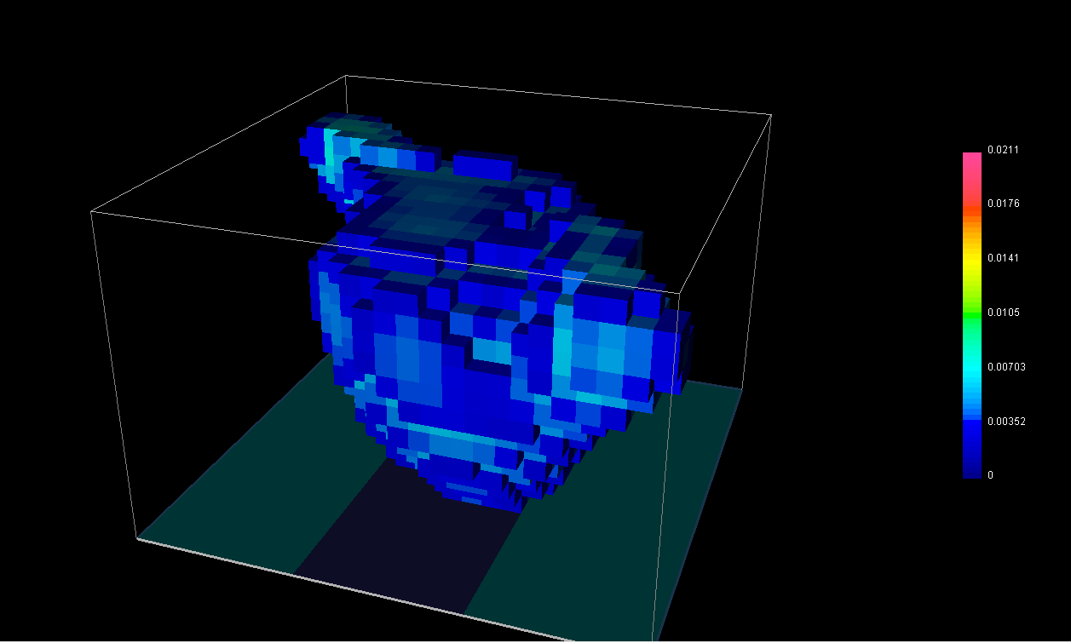
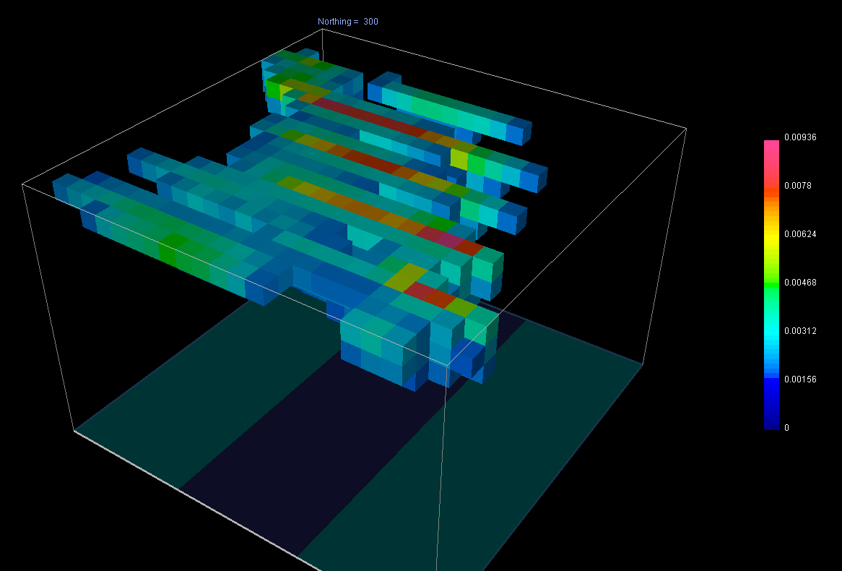
(5) Change the parameters of the inversion to non-default values and redo the inversion
• Change the target misfit by changing chifact to different values (e.g., 0.2 and 5), do the
inversions using the same sensitivity matrix.
• Remove the depth weighting (by setting the parameter to 0 for “Apply depth weighting),
calculate the sensitivity and re-run the inversion with chifact reset to 1.0.
Chifact=5.0
Depth Weighting = 0
(6) Observe the change in the inversion processes and the resulting susceptibility model.
As seen in the figures above, changing the inversion processes results in a different susceptibility model. Changing the chifact to 5.0 changes the sensitivity of the susceptibility model resulting some of the pixels to be removed. Changing the depth weighting to zero results in an inaccurate susceptibility model that does not account susceptibility changes with depth.

