Slide 1

Retail Stores Performance & Sales Matrix (Power BI)
Project Overview
A multi-page interactive Power BI dashboard engineered to monitor multi-location retail store networks, evaluate core sales performance, and track Year-to-Date (YTD) financial matrixes.s
Tech Stack: Power BI Desktop, DAX, Power Query (M)

Slide 2
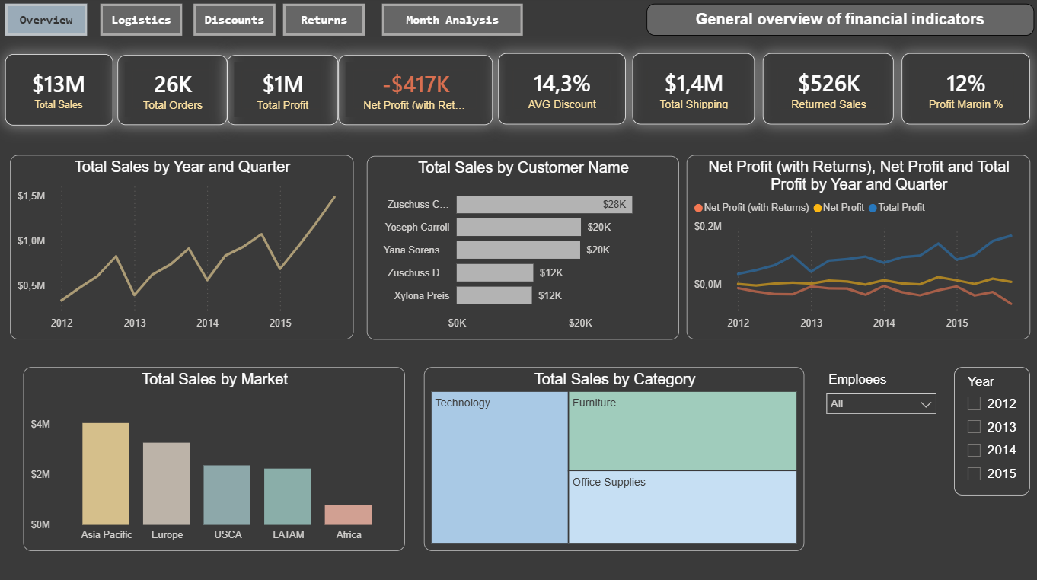

Slide 3
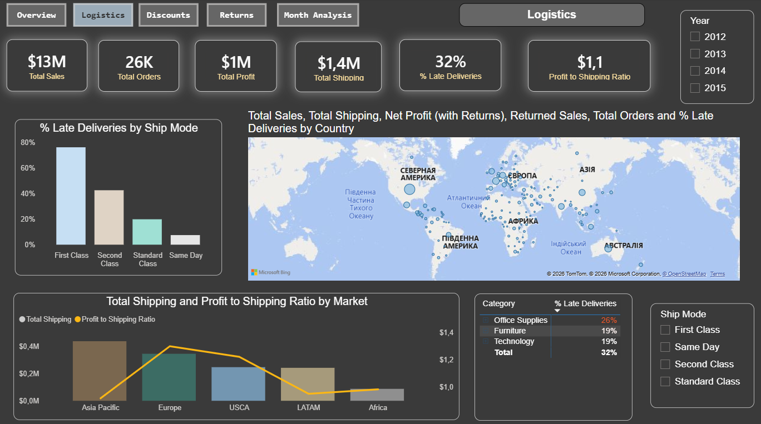

Slide 4
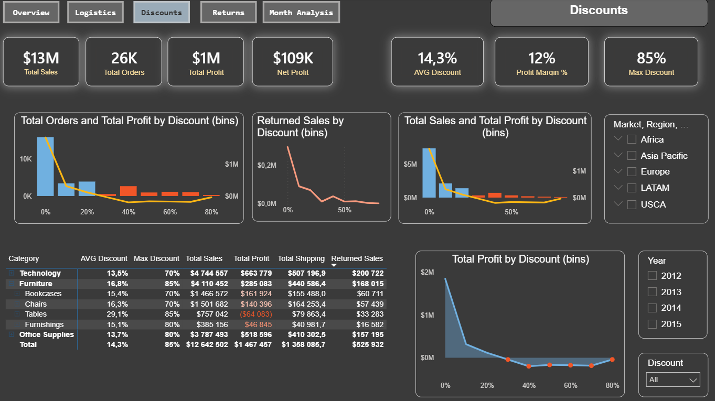

Slide 5
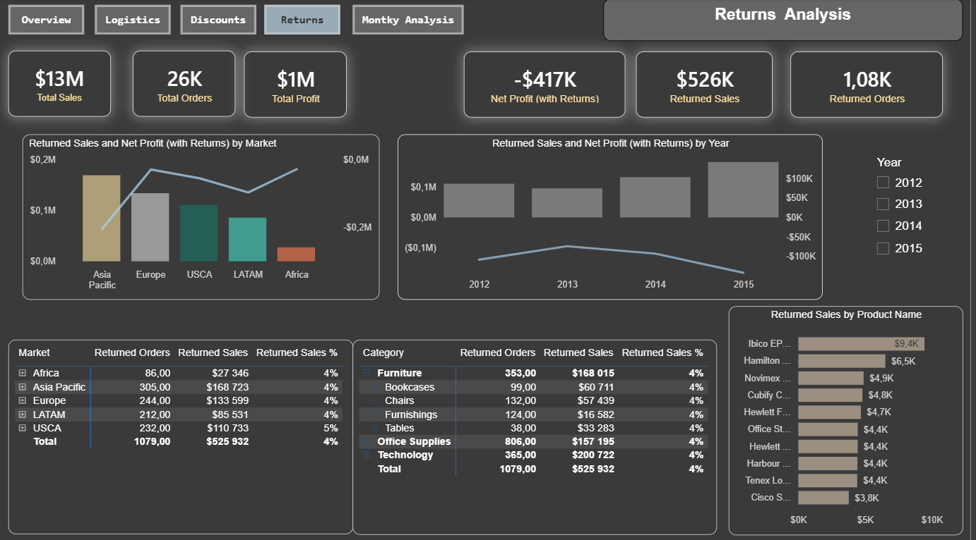

Slide 6
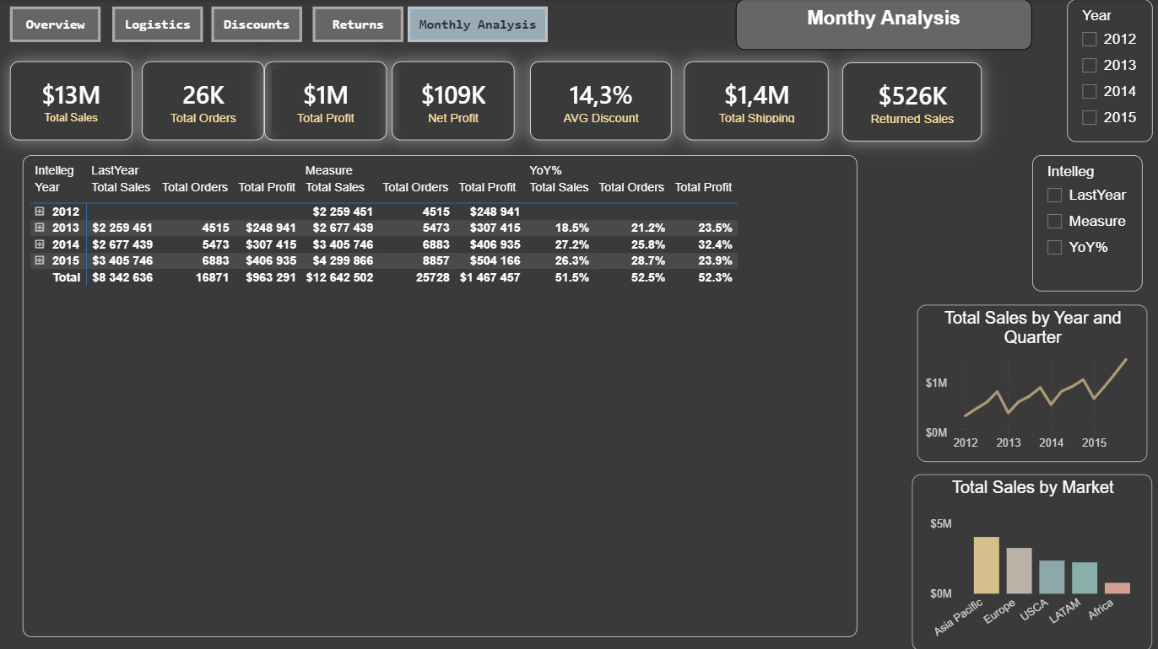

Slide 7
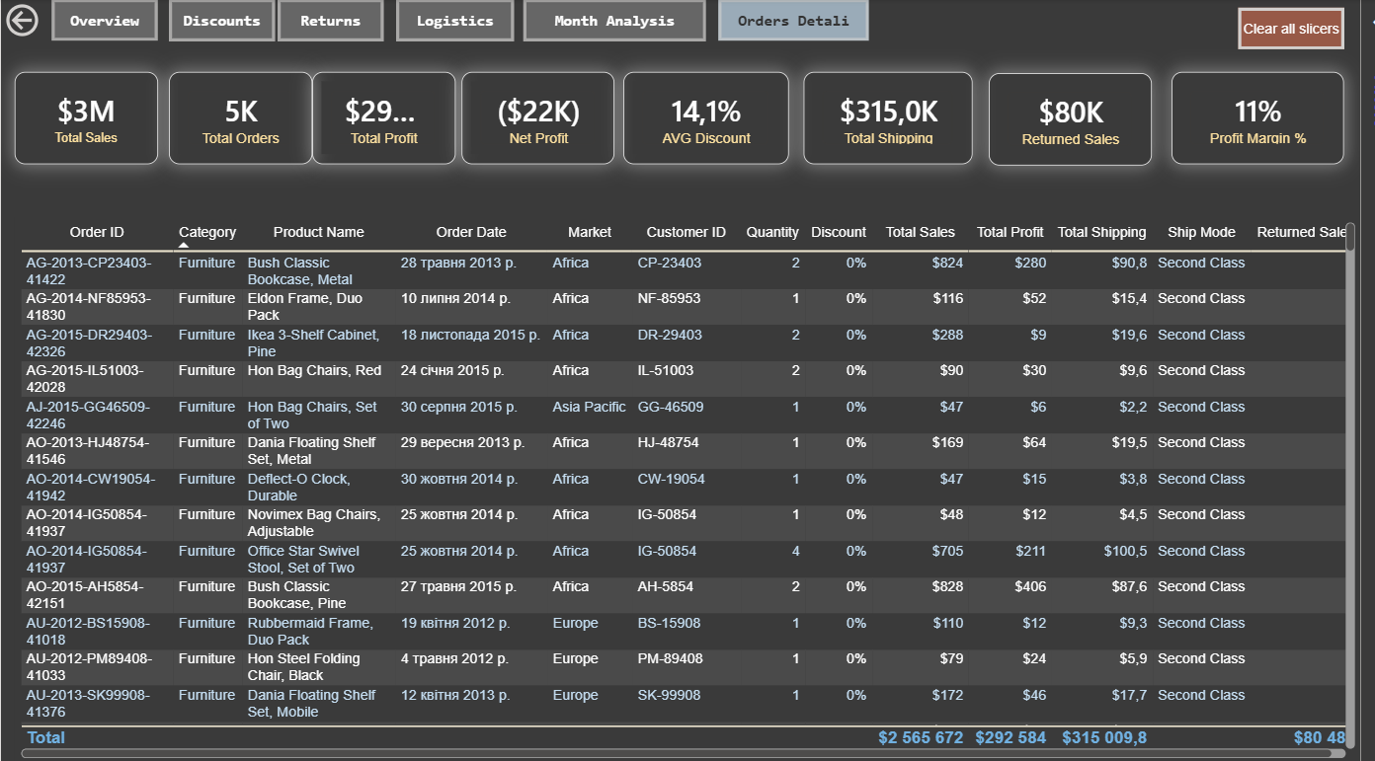

Slide 8
Key insights:
Sales grow by 26-32% annually — but Profit Margin remains at 12%
Discounts over 40% make the business unprofitable — Tables with a 29% discount are the only category in the red -$64K
First Class delivery has 75% delays — the most expensive but the most unreliable
↩️ 4% of sales are returned — $526K annually
Key conclusion: The business is scaling, but without optimizing the discount policy, the growth in turnover does not convert into profit

