Slide 1
Stream Health Data Pipeline
NADINE ANDERLE

Slide 2

Goals
Reliable processing with exactly-once semantics
Efficient data deduplication
Real-time validation of vital signs
Consistent data persistence

Slide 3






Tech Stack
Notes:
Apache Kafka: Message broker para ingestão de dados
Apache Flink: Framework de processamento distribuído
PostgreSQL: Banco de dados para armazenamento
Python: Geração de dados simulados
Java: Implementação do pipeline

Slide 4
Main Features
Data Ingestion
Simulation multiple health devices
Support high events work load
Message delivery guarantee
Real Time Processing
ID and timestamp-based deduplication
Persistence
Consistency assurance Upserts support
Validation of vital data
Checkpointing for recovery
Notes:
Deduplicação baseada em ID e timestamp
Validação de dados vitais
Checkpointing para recuperação
Garantia de consistência
Suporte a upserts

Slide 5
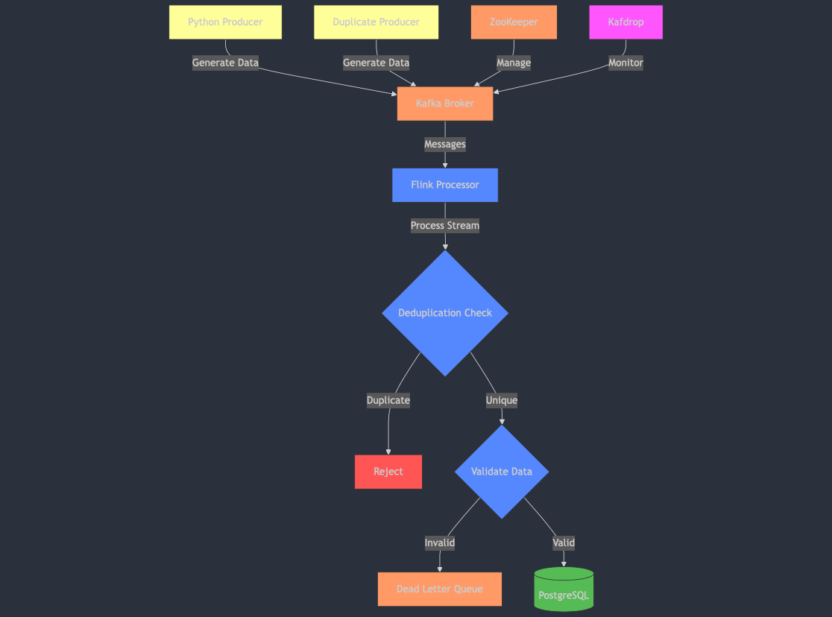
Project Architecture

Slide 6
Structure Data
{ "patientId": "uuid-string", "heartRate": 75.0, "temperature": 36.8, "oxygenSaturation": 98.0, "timestamp": 1645564800000 }

Slide 7
Implementation and Monitoring
Configuration:
Docker infraestructure
Java Pipeline with Apache Flink
Python Producer data simulation
Monitoring:
Kafdrop: http://localhost:9000
Flink Dash: http://localhost:8081

Slide 8
How was my Journey...
I already have experience with some tools, like TechStack
My first experience with Flink
My first experience with Kafka
It has already been a long time since my last experience with java rs
Python I usually use in my routine
PostgreSQL: I have worked with databases for more than 10 years.
I used claude.ai to help me when I had some errors.

Slide 9
Stream Health Data Pipeline
NADINE ANDERLE

