Slide 1

Colorizing images
Mini Project [1]

Slide 2
Submitted by
Eslam Hussein Mohamed.
Nadine Ashraf Adeeb.
Tasneem Yassin Mostafa.
Supervised by:
Dr: Mahmoud Atef.
TA: Abdelrahman Nady.

Slide 3
Read the input image into a matrix.
Divide the image into three equal parts (channels) and store them into three matrices.
Choose a reasonable range for channels alignment.
Choose a reasonable Margin to get rid of the corrupted borders.
Choose a certain channel to behave as a fixed window.
Align the other two channels by searching over the fixed window of possible displacements, score each one using the sum of squared differences (SSD) (euclidean distance) as an image matching metric.
Take the minimum displacement with the best score.
Shift the two channels by according to the displacement selected in the pervious step.
Combine the three channels in one colored image.
Finally to improve the quality of the output image we can use a sharpening filter.

Slide 4
Algorithms
Trivial Solution
Read the input image into a matrix.
Divide the image into three equal parts (channels) and store them into three matrices.
Combine the three channels in one colored image.

Slide 5
Algorithms
SSD Alignment
Read the input image into a matrix.
Divide the image into three equal parts (channels) and store them into three matrices.
Choose a reasonable range for channels alignment.
Choose a reasonable Margin to get rid of the corrupted borders.
Choose a certain channel to behave as a fixed window.
Align the other two channels by searching over the fixed window of possible displacements, score each one using the sum of squared differences (SSD) (euclidean distance) as an image matching metric.
Take the displacement with the best score (minimum).
Shift the two channels by according to the displacement selected in the pervious step.
Combine the three channels in one colored image.
Finally to improve the quality of the output image we can use a sharpening filter.

Slide 6
Algorithms
Enhanced SSD
Read the input image into a matrix.
Divide the image into three equal parts (channels) and store them into three matrices.
Choose a reasonable range for channels alignment.
Crop the three channels into smaller widows to search over wider range .
Choose a certain window to behave as a fixed window.
Align the other two channels by searching over the fixed window of possible displacements, score each one using the sum of squared differences (SSD) (euclidean distance) as an image matching metric.
Take the displacement with the best score (minimum).
Shift the two channels by according to the displacement selected in the pervious step.
Combine the three channels in one colored image.
Finally to improve the quality of the output image we can use a sharpening filter.

Slide 7
Algorithms
Normal Cross Correlation
Read the input image into a matrix.
Divide the image into three equal parts (channels) and store them into three matrices.
Choose a reasonable range for channels alignment.
Apply a canny edge detector on the three images.
Choose a certain channel to behave as a fixed window.
Align the other two channels by searching over the fixed window of possible displacements, score each one using the norm cross correlation as an image matching metric.
select the displacement corresponding to the maximum correlation .
Shift the two channels by according to the displacement selected in the pervious step.
Combine the three channels in one colored image.
Finally to improve the quality of the output image we can use a sharpening filter.

Slide 8
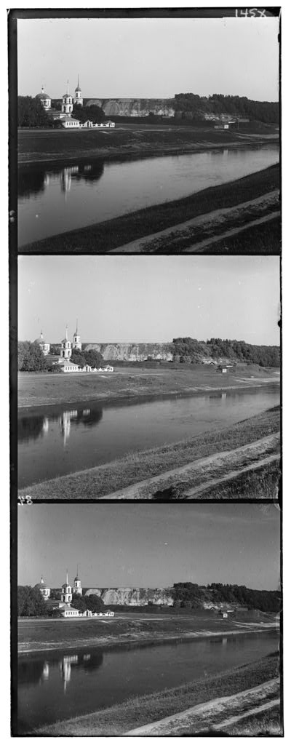
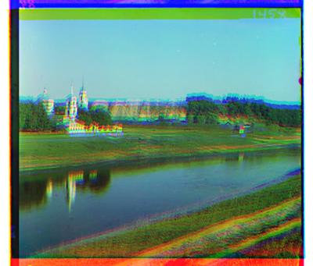
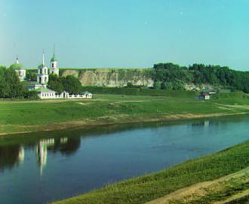
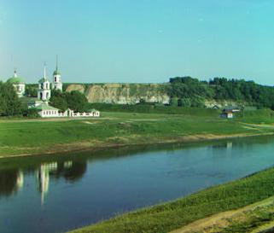
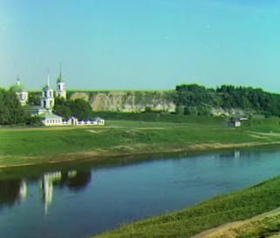
Results
00125v.jpg
Trivial Solution
SSD Alignment
Original Image
Enhanced SSD Alignment
NCC Alignment

Slide 9
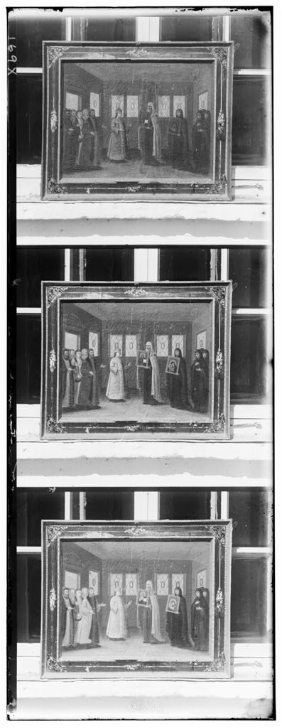
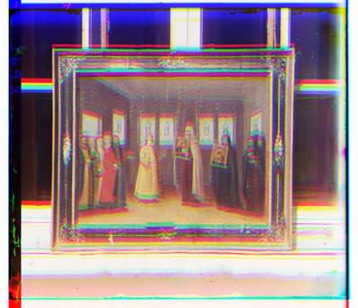
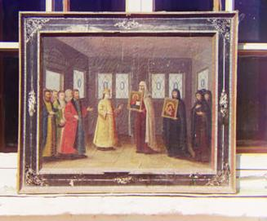
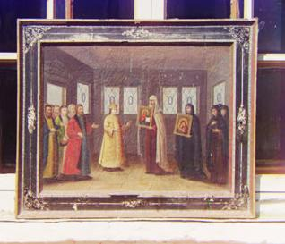
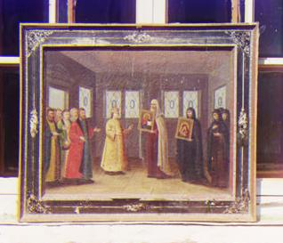
Results
00149v.jpg
Trivial Solution
SSD Alignment
Original Image
Enhanced SSD Alignment
NCC Alignment

Slide 10
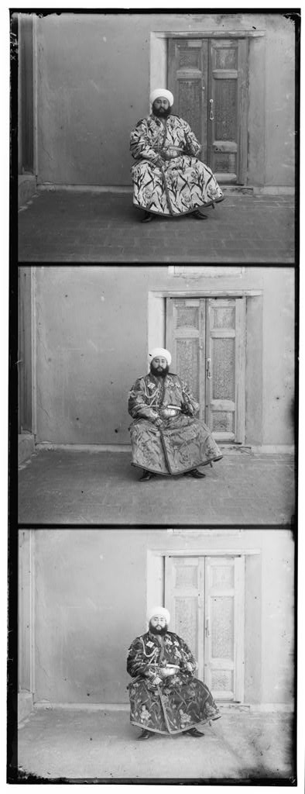
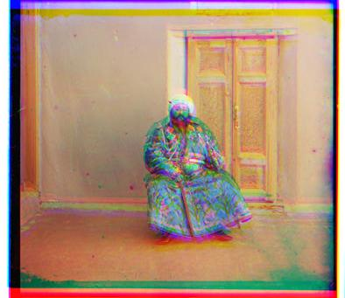
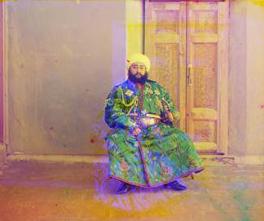
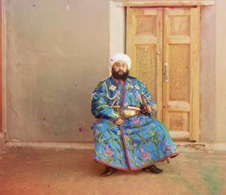
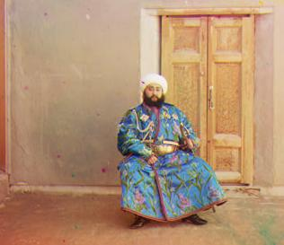
Results
00153v.jpg
Trivial Solution
SSD Alignment
Original Image
Enhanced SSD Alignment
NCC Alignment

Slide 11
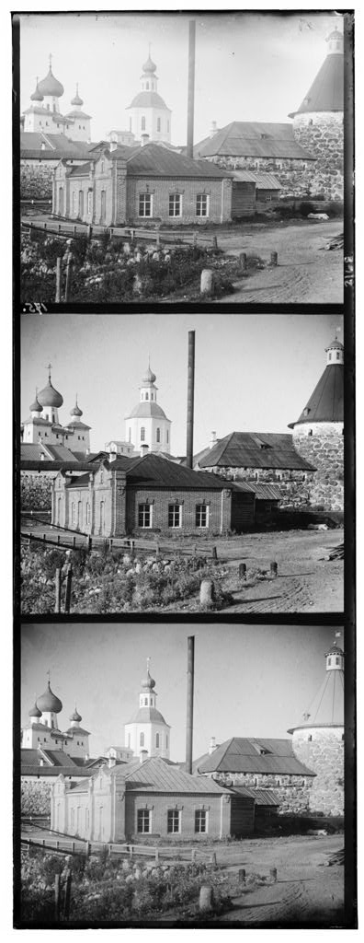
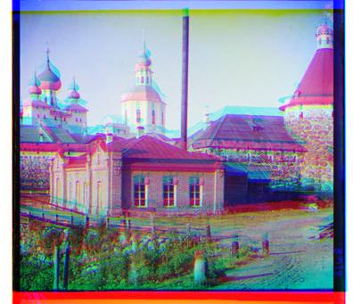
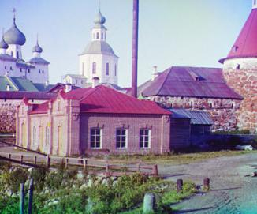
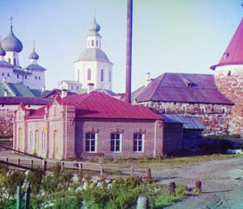
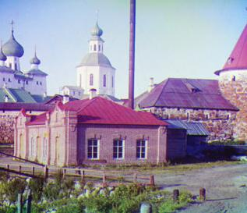
Results
00351v.jpg
Trivial Solution
SSD Alignment
Original Image
Enhanced SSD Alignment
NCC Alignment

Slide 12
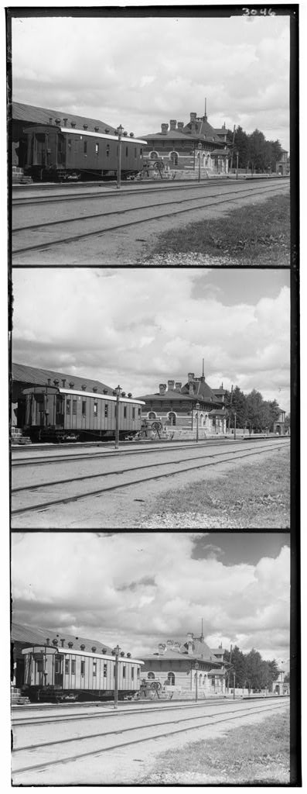
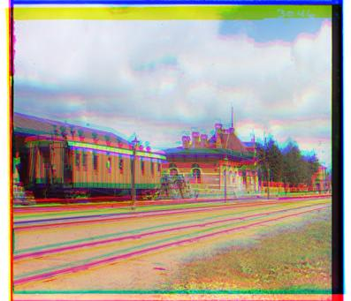
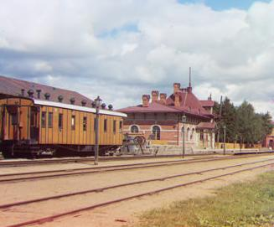
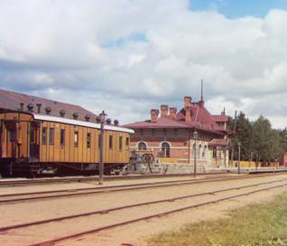
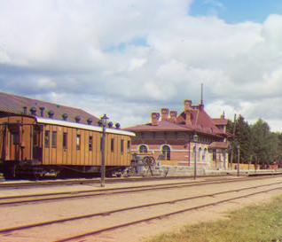
Results
00398v.jpg
Trivial Solution
SSD Alignment
Original Image
Enhanced SSD Alignment
NCC Alignment

Slide 13
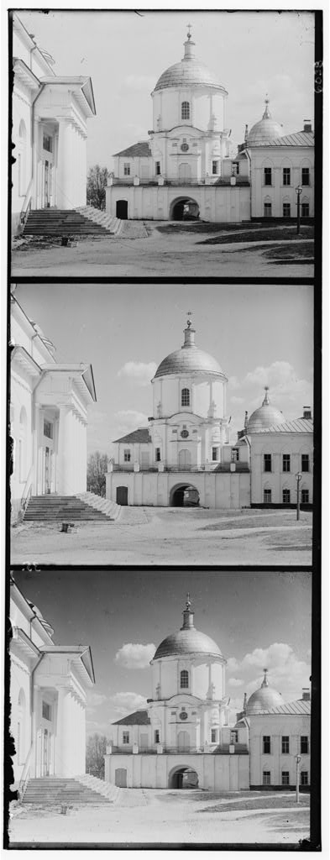
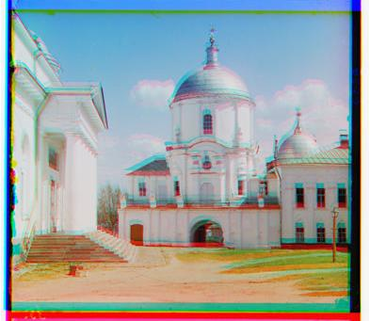
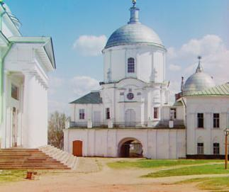

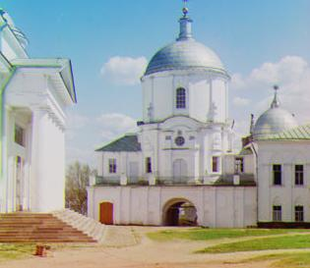
Results
01112v.jpg
Trivial Solution
SSD Alignment
Original Image
Enhanced SSD Alignment
NCC Alignment

Slide 14
Thank you

