Slide 1
Lab 11
Data Preprocessing

Slide 2
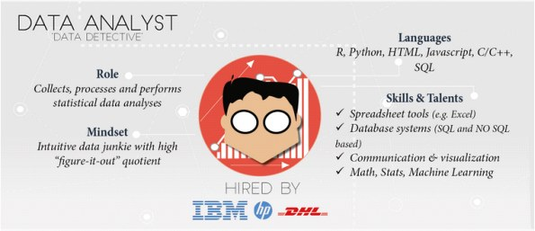
Different data science roles in industry
The Data Analyst

Slide 3
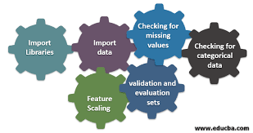
Tabular Data Problems & Preprocessing Techniques
Data preprocessing is a way of converting data from the raw form to a much more usable or desired form, i.e., making data more meaningful by rescaling, standardizing, binarizing, one hot encoding, and label encoding.
The process of getting raw data ready for a Machine Learning algorithm can be summarized in the below steps:

Slide 4
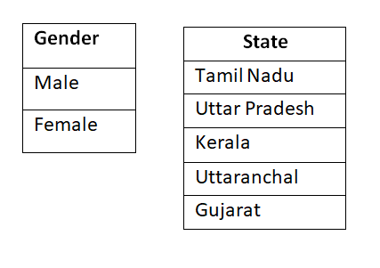
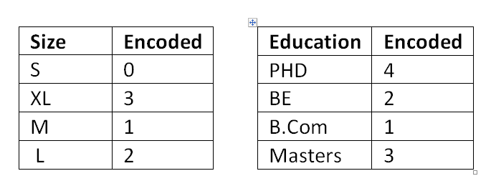
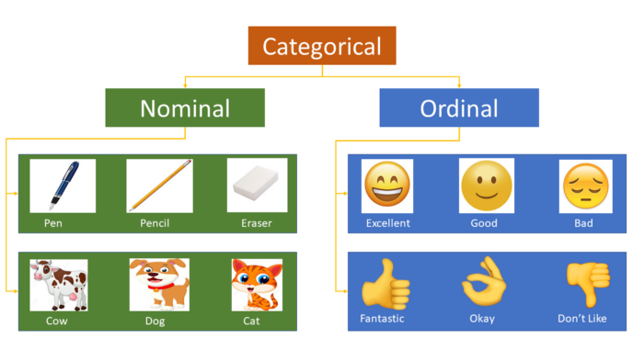
Handling Categorical Variables
Categorical variables are basically the variables that are discrete and not continuous. Ex — color of an item is a discrete variable whereas its price is a continuous variable.
Categorical variables are further divided into 2 types
Ordinal categorical variables — These variables can be ordered. Ex — Size of a T-shirt. We can say that M<L<XL.
Nominal categorical variables — These variables can’t be ordered. Ex — Color of a T-shirt. We can’t say that Blue < Green as it doesn’t make any sense to compare the colors as they don’t have any relationship.
Nominal features
Ordinal features

Slide 5
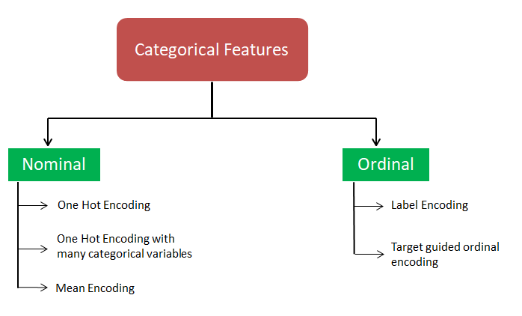
Handling Categorical Variables

Slide 6
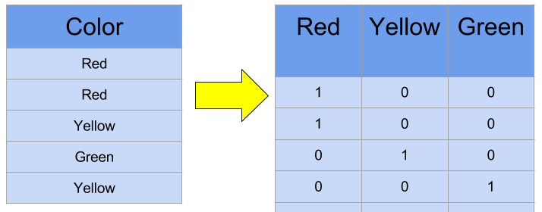
Handling Categorical Variables One Hot Encoding
One hot encoding: It is a technique to encode nominal features in which each category of the feature is mapped to a vector 0 or 1, which represents the presence or absence of that category.
In this, dummy variables are created equal to the number of categories present in the feature but to avoid the dummy variable trap; one column is removed, which basically mean:
Number of columns= Number of categories-1 Why?

Slide 7
Handling Categorical Variables Dummy variable trap
Let's say, we have a column of countries as a categorical data. Having unique values as ['India', 'USA', 'Japan']. As this is categorical data, we need to preprocess the data.
we will apply One Hot Encoder.
Now, Our mathematical equation for the linear model will be like this:-
y = c1*f1 + c2*f2 + c3*f3 + c0 , where f1, f2, f3 are the features of India, USA, Japan as binary data respectively.
Now, we are trapped in dummy variable trap as if we add all the three features in this equation, machine learning algorithm will be confused to give weightage to each coefficient as they are dependent on each other by following equation:-
f1 + f2 + f3 = 1

Slide 8
Handling Categorical Variables Dummy variable trap
If we increase weightage of one variable then weightage of other two will be affected (i.e., will decease) and most of the computation will be consumed to iteratively calculate the weightage and cannot get to the good decision and return the non efficient results.
The Dummy Variable trap is a scenario in which the independent variables are multicollinear - a scenario in which two or more variables are highly correlated; in simple terms one variable can be predicted from the others.
Solution to this problem is to remove one feature after using OneHotEncoder technique i.e. If we are having 10 unique values for the particular column then use 9 and drop one column.

Slide 9
Handling Categorical Variables One Hot Encoding with Many Categorical Variables
One Hot Encoding with many categorical variables: Many times, we come across features having multiple unique values. It becomes infeasible to make separate columns for each of the categories which leads to “curse of dimensionality”.
Solution:
limit one-hot encoding to the 10 most frequent labels of the variable which means that they would make one binary variable for each of the 10 most frequent labels only.

Slide 10
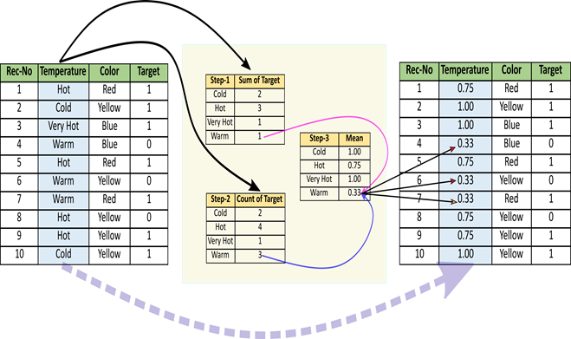
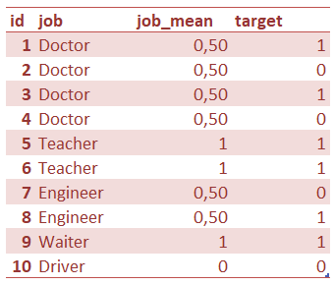
Handling Categorical Variables Mean Encoding
Mean Encoding: Till now, we have seen the methods which simply converted unique categories to binary columns representing the presence or absence that particular category. It is simple to use without making any prior assumptions.
Mean encoding is a technique which encodes categorical variables by capturing information from the target variable. Here, the categorical variable is converted according to the mean of output.
This method creates a monotonic relationship between the categorical variable and the target.

Slide 11

Handling Categorical Variables Ordinal Features
Three simple and neat techniques to transform ordinal CVs
Mapping {'M':1,'L':2}
Label Encoder 0,1,2
Target guided ordinal encoding: give label according to the mean of the target variable with each
Mean encoding is a technique which encodes categorical variables by capturing information from the target variable. Here, the categorical variable is converted according to the mean of output.
This method creates a monotonic relationship between the categorical variable and the target.

