Slide 1
Porter’s Five Forces
Nadine

Slide 2
5 Porter’s Five Forces Templates to Help You Understand the Competitive Landscape

Slide 3
WHY DO 5 FORCES
Porter's Five Forces is a framework used to analyze the competitive forces within an industry. It helps businesses and investors understand the key factors that influence the profitability and competitiveness of a particular industry.
The Five Forces Framework makes it easy for marketers or investors to understand the market, spot opportunities for gaining a competitive advantage, make informed decisions and proactively manage risk.

Slide 4
cont.
To effectively make the most of the five forces framework, use a customizable template, understand your industry and analyze the forces within the context of your industry
Gather data about each force and assess the impact, develop strategies to address each force and implement and monitor changes in the forces.

Slide 5
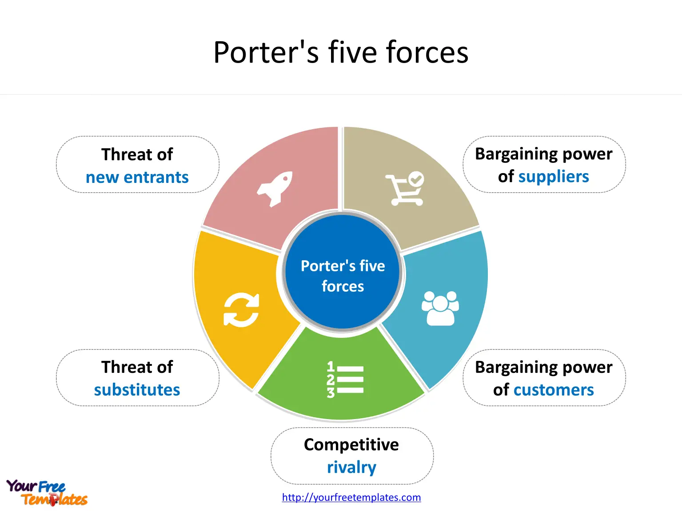

Slide 6
Industry or Competitive Rivalry
analyzes the level of competition within the industry, considering the number of existing competitors and their respective capabilities.
A high degree of rivalry among firms increases the intensity of competition, leading to lower profit margins due to increased price competition and advertising expenses.
Illustrative example: The soft drink market is dominated by a few major players, such as Coca-Cola and Pepsi. Due to the high level of competition, these companies invest significantly in advertising and promotions to differentiate themselves and attract customers. As a result, profit margins are relatively low, and prices are competitive.

Slide 7
Bargaining Power of Suppliers
This force assesses the ability of suppliers to dictate terms and conditions, including prices, affecting the profitability of businesses. With fewer suppliers, their collective bargaining power increases, allowing them to manipulate prices upward or reduce quality without compromising demand.
However, multiple suppliers give businesses the advantage of negotiating better deals and avoiding dependence on any single supplier.
Illustrative example: The global semiconductor industry is dominated by a few large suppliers, such as Intel and Samsung. Due to their substantial influence or oligopolistic power, these suppliers can charge premium prices for their chips, which affects the profitability of downstream manufacturers that rely on them.

Slide 8
Bargaining Power of Buyers
This force gauges the extent to which consumers can pressure businesses to modify prices or product offerings through individual or collective actions. When there are fewer buyers relative to the number of sellers, each buyer has greater leverage in setting prices and determining quality standards.
Assessing buyer concentration, purchase volume, and the ease of switching between vendors is essential to understanding the magnitude of this force.

Slide 9
Illustrative example: The automobile industry caters to a diverse range of customers, from individuals to fleet operators.
With a few big players dominating the market and high switching costs, individual consumers have limited bargaining power.
However, large fleet operators, such as corporations, commercial fleets, government agencies rental car companies, can negotiate better prices and customized features with manufacturers due to their significant purchasing power.

Slide 10
Threat of New Entrants
The likelihood of new competitors entering the market and eroding the market share of established firms.
Significant entry barriers include exclusive access to critical resources, substantial investment requirements, economies of scale, and well-established brands that deter potential entrants from competing directly. Incumbents possessing such advantages can discourage newcomers and protect their turf.
Illustrative example: The aviation industry presents significant entry barriers for new airlines due to the high cost of acquiring aircraft, obtaining operating licenses, and establishing routes. These obstacles allow established carriers like American Airlines and Delta Air Lines to maintain their market position and limit the threat of new entrants.

Slide 11
Threat of Substitutes
It refers to the ease with which consumers can switch to alternative products or services offered by competitors or other providers.
The availability and quality of substitutes depend on several factors, including price differences, quality gaps, and the convenience of switching. If alternatives are abundant, comparable in quality, and easily accessible, consumers are more likely to switch, posing a significant threat to established companies.

Slide 12
To mitigate this risk, businesses can focus on building strong brand loyalty through exceptional customer experiences, offering unique features and benefits, and cultivating long-term relationships with clients.
In addition, investing in research and development to stay ahead of emerging trends and technologies can help companies maintain their competitive edge.
Illustrative example: The coffee industry provides an excellent case study to illustrate the threat of substitutes.
such as Starbucks, that differentiate themselves from traditional diner-style coffee houses by offering distinct flavors, ambiances, and customer experiences.
As a result, they are able to attract a loyal following and command higher prices. Established brands like Folgers and Maxwell House faced a significant threat from these upstart coffee shops, prompting them to adapt their strategies and introduce premium lines to remain competitive.

Slide 13
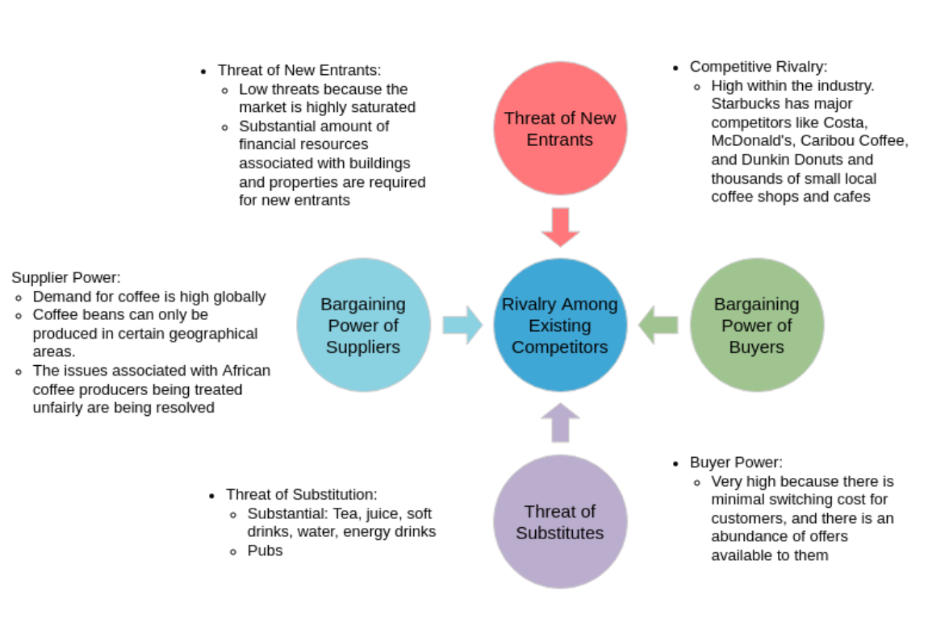
Starbucks

Slide 14
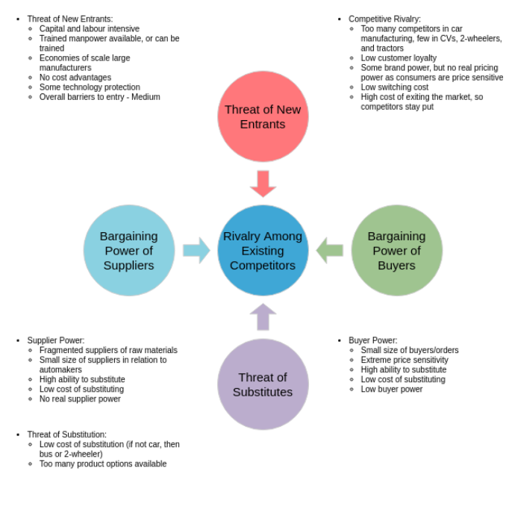
Auto Industry

Slide 15
Your turn!

