Slide 1
Infix to prefix conversion

Slide 2
Pseudocode:
Create two empty stacks, varStack for keeping the operands and opStack for the operators .
Scan the expression from left to right.
If the token is a left parenthesis, push it onto the opStack
If the token is a right parenthesis, pop 2 elements from the varStack into two strings (opearnd1 & operand2), then pop an element from the opStack into string (operator).
Concatenate the 3 strings into one string called tmpString, then push it back again onto the varSatck.
Repeat again till finding the left parenthesis then pop it.

Slide 3
If the token is an operator “^, *, /, +, -” :
If opStack isn’t empty or the operator in the top of the opStack is higher or equal in priority, push it onto the opStack.
Pop 2 elements from the varStack to two strings (opearnd1 & operand2) then pop an element from the opStack to string (operator).
Concatenate the 3 strings into one string called tmpString, then push it back again onto the varSatck .
Repeat again till one of the conditions isn’t satisfied, then push the token to the opStack.

Slide 4
When the input expression has been completely processed check
If opStack isn’t empty, pop 2 elements from the varStack to two strings (opearnd1 & operand2) then pop an element from the opStack to string (operator).
concatenate the 3 strings into one string called tmpString, then push it back again onto the varSatck.
Repeat again till the opStack is empty.

Slide 5
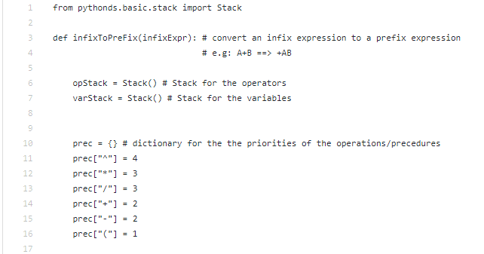
Code:

Slide 6
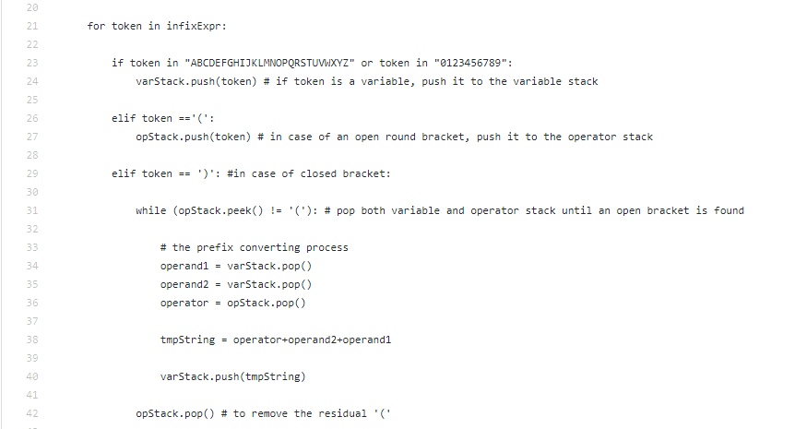
Cont.

Slide 7
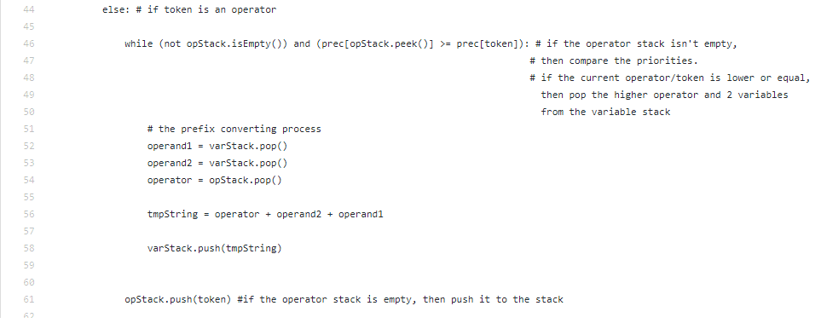
Cont.

Slide 8
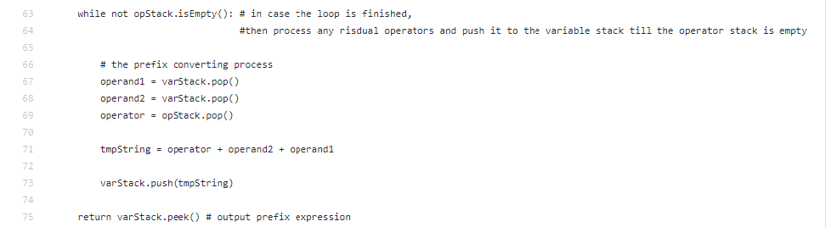
Cont.

Slide 9
Prefix Evaluation

Slide 10
Pseudocode:
Create an empty stack called operandStack.
Convert the string to a list, then reverse it.
Scan the token list from left to right.
If the token is an operand, convert it from a string to an integer and push the value onto the operandStack.
If the token is an operator (^, *, /, +, -), it will need two operands.
Pop the operandStack twice. The first pop is the first operand and the second pop is the second operand.
Perform the arithmetic operation, then push the result back to the operandStack.
When the input expression has been completely processed, the result is on the stack.
Pop the operandStack and return the value.

Slide 11
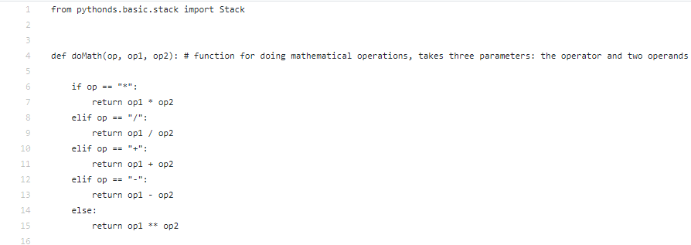
Code:

Slide 12
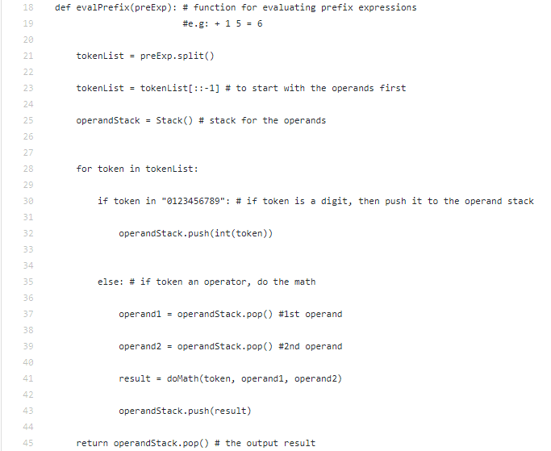
Cont:

Slide 13


Slide 14
THANK YOU

