Slide 1
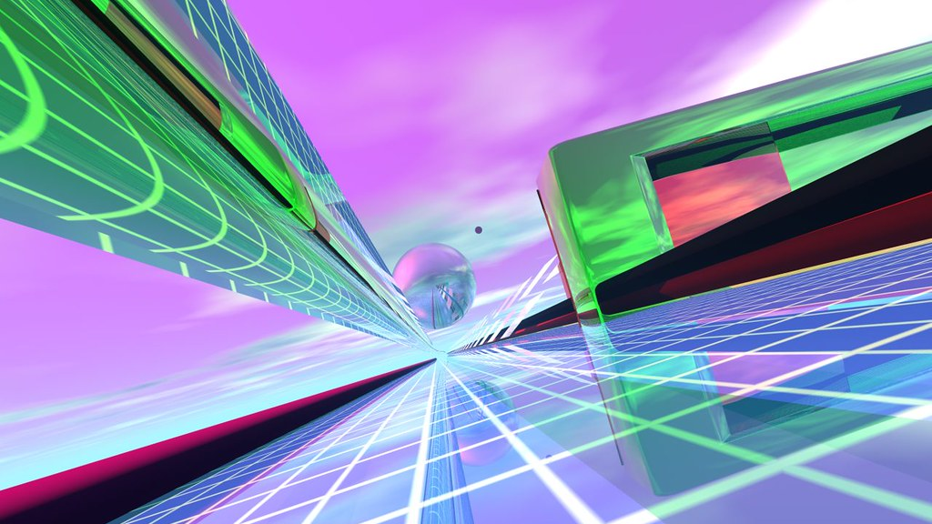
WEBGL
Lecturer: Dr. Khaled
Made by: Sara Ashraf
ID: 20105551
This Photo by Unknown Author is licensed under CC BY

Slide 2
Outline
Definition
Usage
Applications that use WebGL
Some WebGL functions

Slide 3
What is webGL?
JavaScript API
Renders 2D and 3D graphics without the use of plug-ins
Closely related to OpenGL with an addition of HTML functionality

Slide 4
Usage of OpenGL across the internet
Mainly used for 2D rendering
Used in graphical applications, such as games
Used to interpret the 2D objects

Slide 5
Applications that use WebGL
Google Maps, terrain view
Online stores
Interior design
3D model marketplace
Unity, Web version
Vossen3D, car configuration

Slide 6
WebGL’s functions
createTexture()
Generates a texture to be used later on

Slide 7
WebGL’s functions
readPixels(int x, int y, long width, long height, enum type, object pixels)
Pixels in the current framebufer can be read back into an ArrayBufferView object

Slide 8
WebGL’s functions
createFrameBuffer()
Generates a frame buffer, which provides an alternative rendering target to the drawing buffer

Slide 9
WebGL’s functions
getSupportedExtensions()
Detects and enables extensions

Slide 10
WebGL’s functions
getExtension(string name)
Retrieves ectension and enables it

Slide 11
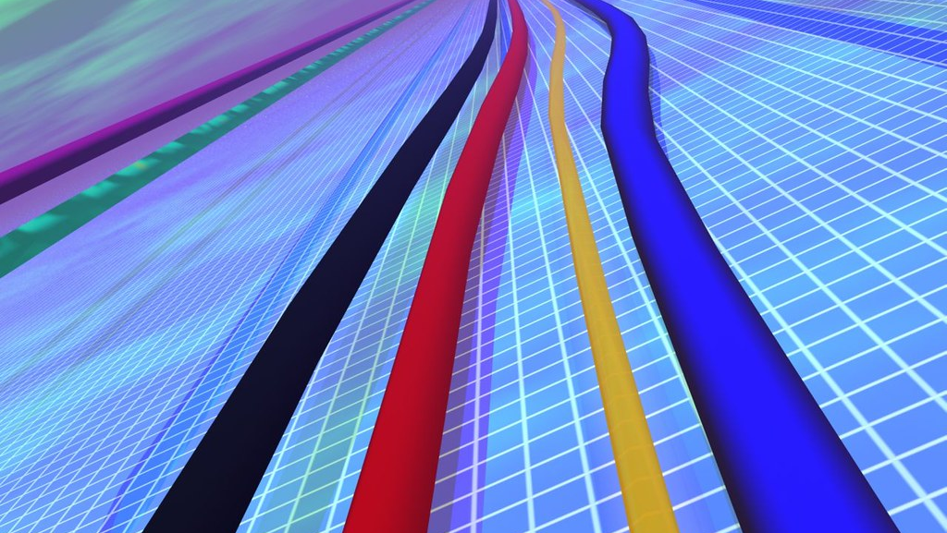
Thank you
This Photo by Unknown Author is licensed under CC BY

