Slide 1
Visa for Lisa Project for Galaxy Bank
Prepared by Nadir Alpeiss
January 2023

Slide 2
Content
1. Problem Description
2. Hypothesis
3. Methodology
preliminary steps
choosing a model steps (problem encountered)
4. Results, assumptions & conclusions
Applying the model

Slide 3
Problem Description
Complex dataset of Galaxy Bank is given
Need to predict clients who would like to use additional service – a personal loan

Slide 4
Hypothesis
Linear dependence of target value (personal loan) on group of independent variables (rest of values)
Hypothesis is proved by the results of the model (see on the next pages)

Slide 5
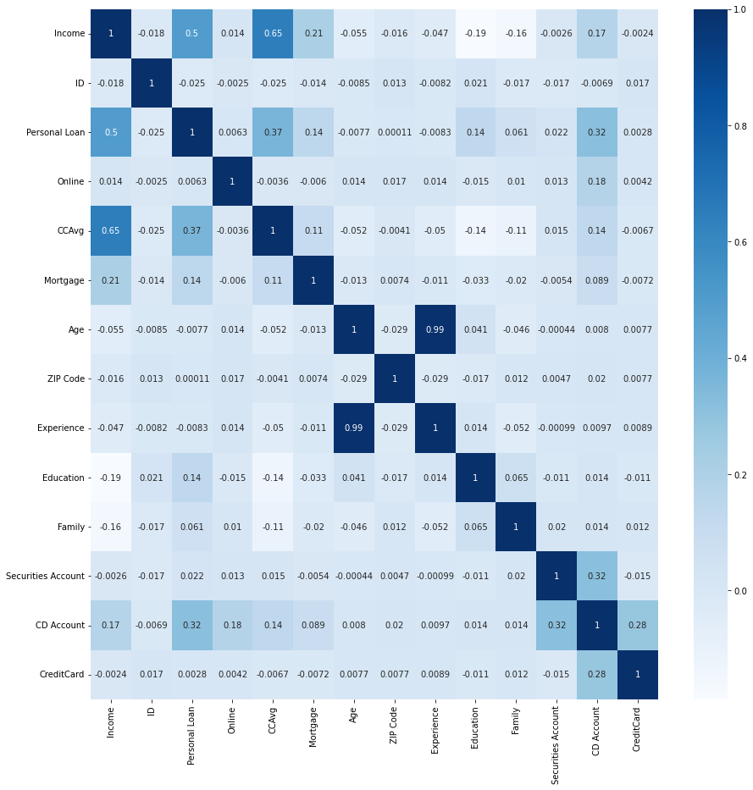
Methodology
Preliminary steps
Heat Map – Interrelation between the parameters
Step 1. Dataset inspection for cleaning
check for data type
check for every column values by p&as isna
deleting unnecessary column (id)
check unique values of every column – negative value is identified (experience)
Step 2. Data investigation for some preliminary conclusions
Initial ratio of those who take personal loans & those who not
Heatmap to identify the parameters which affect the personal loan parameter the most & to see the interrelation between the all parameters
Big values of some parameters are noticed
Logical values of target parameter & some other parameters are noticed

Slide 6
Methodology
Choosing a model steps & Problem encountered
Step 3. Choosing a model
Hypothesis is a linear dependence of target parameter on other set of parameters, hence, firstly, multivariate linear regression is chosen
Problem encountered
Had low accuracy (less than 90%)
Step 4. Self-study
Read some literature on limitations of linear regression (causes of low accuracy)
Identified two main possible causes: absence of scaling & should use another type of regression for cases where the target parameter is a binary value (0 or 1) – logistic regression
Step 5. Applying changes to the solution
Implemented scaling using StandardScaler to the set of independent values
Changed the linear regression model to logistic one

Slide 7
Results, Assumptions & Conclusions
As a result, prediction accuracy of the model is more than 90%
This can lead to:
Significant decrease of the marketing campaign costs
Saving loyalty of the current clients – not showing ads to those who are not interested in the service
Assumptions to be considered
About 4% of inaccuracy of the model can lead to mistaken results
Human factor is still there meaning that customers can behave differently in comparison with the prediction of the statistically derived model
Conclusions
Data type of dataset can be crucial in choosing a suitable model (binary values)
Scaling is an important factor for getting accurate results
Hypothesis is an important part of strategy for solving a problem which however can be mistaken (in this case it is correct)

Slide 8
Applying the model
To get the results DevOps team should:
change csv file to be analyzed in the function called load_dataset() (by changing url value)
press play button for every cell in jupyter notebook file
For convenience of the DevOps team the last cell can be used to get the IDs of the target customers

Slide 9
Thanks for your attention

