Slide 1
PROLIFIC SYSTEMS
&
TECHNOLOGIES PVT. LTD.
Introduction
STEPS OF Embedded Linux

Slide 2
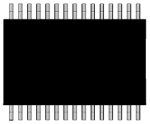
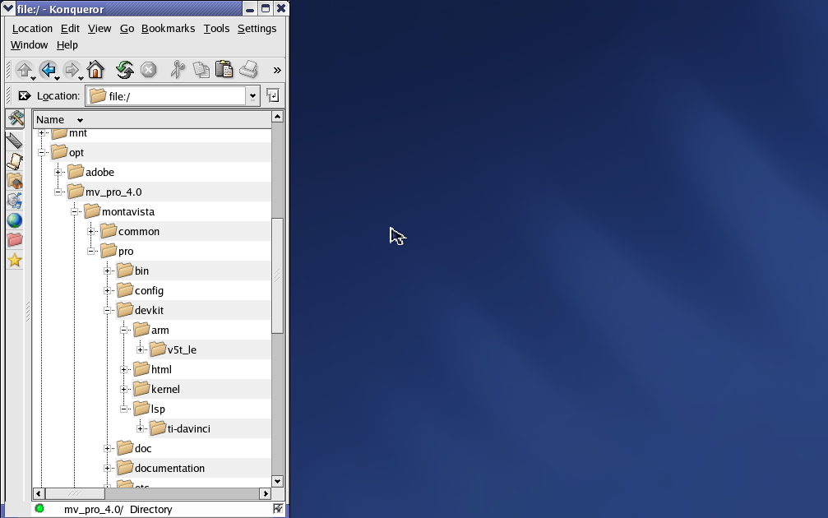
Linux in Three Parts
❶ Bootloader
Provides rudimentary h/w init
Calls Linux kernel and passes boot arguments
Flash
❸ Filesystem
Single filesystem (/ root)
Stores all system files
After init, kernel looks to filesystem for “what’s next”
bootarg tells linux where to find root filesystem
❷ Kernel
Initializes the system (and device)
Manages system resources
Provides services for user programs

Slide 3
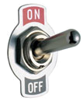
Linux Boot Process
Power On
Boot Loader
U-Boot
ARM assembly code
Passes args to Linux (bootargs)
Linux Kernel
Linux Kernel
Initialize hardware via static drivers
Mount root filesys
File System
Init Process
/sbin/init – 1st process exe by kernel
Login Prompt
Login console
Usually one of first prog’s to run

Slide 4
Where Do You Find …
Where located: | Flash Boot
1a. SBL, UBL or MLO | n/a
1b. Bootloader (U-Boot) | Flash
2. Linux Kernel | Flash
3. Filesystem | Flash
ROM bootloader supports NAND, NOR or SPI-flash boot (determined by BOOTM pins high/low at device powerup)
Linux supports flash-based filesystems such as YAFFS and JFFS
All components may be flashed using U-boot (initial load via MMC or bootp) or JTAG using flashing utility via Code Composer Studio

Slide 5
Where Do You Find …
Where located: | Flash Boot | MMC Boot
1a. SBL, UBL or MLO | n/a | MMC
1b. Bootloader (U-Boot) | Flash | MMC
2. Linux Kernel | Flash | MMC
3. Filesystem | Flash | MMC
Multimedia Card (MMC) or Secure Digital card (SD) may be flashed using an MMC/SD programmer using a variety of utilities
Simple, low cost method for booting Linux (or just U-boot) on a development board that has nothing pre-programmed (or for recovery.)

Slide 6
Booting Linux – MMC/SD Boot
❶
❷
❸
RBL
MLO
U-Boot
Kernel
ROM
Internal RAM
DDR2
DDR2
Device
MMC/SD
MLO
RBL
❶
❷
UBoot
Linux Kernel
MLO
❸
OCMC (on-chip memory controller)
Internal memory
DDR3
UBoot
Linux Kernel
The ROM bootloader cannot make assumptions about external memory, so it can only load to the device’s internal memory
uBoot with MMC driver is too large to fit into internal memory

Slide 7
Where Do You Find …
Where located: | Flash Boot | MMC Boot | NFS Boot
1a. SBL, UBL or MLO | n/a | MMC | bootp / tftp
1b. Bootloader (U-Boot) | Flash | MMC | tftp
2. Linux Kernel | Flash | MMC | tftp
3. Filesystem | Flash | MMC | nfs
NFS boot is typically used for development but not production devices
All components of the system are loaded from host server at each boot
Filesystem changes on host are instantly reflected
UBL, U-boot and Linux Kernel changes are reflected on each reboot
Good method to ensure uniformity across multiple development boards

Slide 8
Step 1
Setup and Rebuild Linux for example :
host $ sudo apt-get update
host $ cd ti-sdk-am335x-evm-xx.xx.xx.xx
host $ sudo ./setup.sh
Installs tftp server, nfs server , minicom and packages needed to rebuild u-boot and kernel (using Aptitude package manager)
Extracts AM335x Linux filesystem to specified location (default ${HOME}/targetfs), exports it via nfs server, and updates Rules.mak EXEC_DIR variable
Configures tftp server with specified read directory (default /tftpboot) and copies in prebuilt Linux kernel
Configures minicom for TTYS0 serial device for 115,200 Baud, 8-bit, no parity, 1 stop bit
Creates setup.minicom script to configure u-boot for desired boot type (mmc or tftp/nfs).

Slide 9
Step 2 Boot Linux from MMC - EXAMPLE
MMC Boot for example :
Attach SD/MMC programmer with inserted Micro-SD adapter
host $ cd ti-sdk-am335x-evm-xx.xx.xx.xx/bin
host $ sudo ./create-sdcard.sh
MLO (i.e. x-loader)
u-boot.img uImage (i.e. Kernel)
ROM bootloader will load a file named “MLO” from partition 1, which must be FAT32 filesystem
MLO (per MMC default config) boots a file named “u-boot.bin” from partition 1 of FAT32 MMC
Partition 1
(FAT32)
Root Filesystem
Partition 2
(EXT3)
Linux root filesystem must be in its own partition.

Slide 10
U-boot Default Scripting
Detect MMC?
Attempt to load uEnv.txt
Attempt to run uenvcmd
Attempt boot from MMC
Boot from NAND
Other Boot Options (Macros in Default U-boot Environment)
NOR Flash boot
SPI Flash boot
TFTP/NFS (network) boot

Slide 11
Rebuilding
Rebuild SDK
host $ make help
host $ make clean
host $ make all
Install rebuilt components to export directory (default ${HOME}/targetfs)
host $ make install
Example :
make all rebuilds:
U-boot
Linux Kernel
OpenGL graphics Demos
Example Applications
Wireless Driver Support

Slide 12
Booting Linux – MMC/SD Boot
❶
❷
❸
RBL
MLO (x-loader)
U-Boot
Kernel
ROM
Internal RAM
DDR2
DDR2
Device
MMC/SD
MLO
(x-loader)
RBL
❶
❷
UBoot
Linux Kernel
MLO
(x-loader)
❸
OCMC (on-chip memory controller)
Internal memory
DDR3
UBoot
Linux Kernel
The ROM bootloader cannot make assumptions about external memory, so it can only load to the device’s internal memory
uBoot with MMC driver is too large to fit into internal memory

Slide 13
MLO (U-boot_min) Build
❶
❷
❸
RBL
MLO (x-loader)
U-Boot
Kernel
ROM
Internal RAM
DDR2
DDR2
host $ cd ti-sdk-am335x-evm-xxx/board_support/u-boot-xxx
host $ make distclean
host $ make ARCH=arm CROSS_COMPILE=arm-arago-linux-gnueabi- am335x_evm_config*
host $ make ARCH=arm CROSS_COMPILE=arm-arago-linux-gnueabi- MLO
* For available configs: host$ ls include/configs

Slide 14
U-Boot Build
❶
❷
❸
RBL
MLO (x-loader)
U-Boot
Kernel
ROM
Internal RAM
DDR2
DDR2
host $ cd ti-sdk-am335x-evm-xxx/board_support/u-boot-xxx
host $ make distclean
host $ make ARCH=arm CROSS_COMPILE=arm-arago-linux-gnueabi- am335x_evm_config
host $ make ARCH=arm CROSS_COMPILE=arm-arago-linux-gnueabi- u-boot.img
Both MLO and u-boot.img may be built simultaneously using
host $ cd ti-sdk-am335x-evm-xxx/board_support/u-boot-xxx
host $ make distclean
host $ make ARCH=arm CROSS_COMPILE=arm-arago-linux-gnueabi- am335x_evm

Slide 15
Kernel Build
❶
❷
❸
RBL
MLO (x-loader)
U-Boot
Kernel
ROM
Internal RAM
DDR2
DDR2
host$ cd ti-sdk-am35x-evm_xxx/board_support/linux-xxx-psp-xxx
host$ make mrproper
host$ make ARCH=arm* am335x_evm_defconfig**
host$ make ARCH=arm menuconfig
host$ make ARCH=arm CROSS_COMPILE=arm-arago-linux-gnueabi- uImage
host$ make ARCH=arm CROSS_COMPILE=arm-arago-linux-gnueabi- modules
host$ make INSTALL_MOD_PATH=${HOME}/targetfs modules_install
* For available ARCH: host$ ls arch/ ** For available configs: host$ ls arch/arm/configs

Slide 16
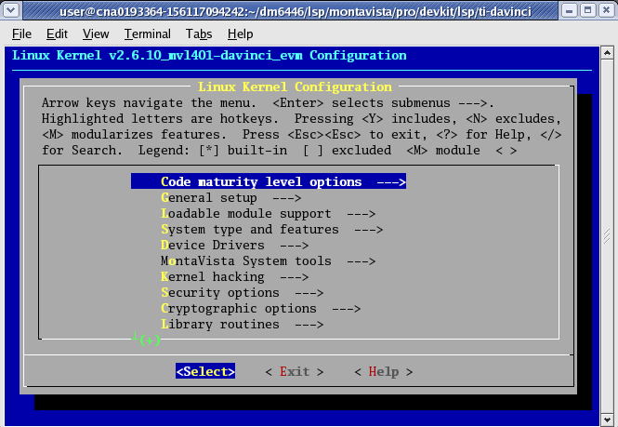
“make menuconfig” options
Why (re)build the Linux kernel?

Slide 17
Kernel Object Modules
1. Static (built-in)
2. Dynamic (insmod)
Kernel Module Examples:
fbdev frame buffer dev
v4l2 video for linux 2
nfsd network file server dev
dsp oss digital sound proc.
audio alsa audio driver
Linux Kernel
oss
fbdev
httpd
v4l2
nfsd
dsp
ext3
Linux Kernel source code is broken into individual modules
Only those parts of the kernel that are needed are built in
# insmod <mod_name>.ko [mod_properties]
Use insmod (short for insert module) command to dynamically add modules into the kernel
Keep statically built kernel small (to reduce size or boot-up time), then add functionality later with insmod
Insmod is also handy when developing kernel modules
.ko = kernel object
Notes:
LIKE OTHER OS’S
PEOPLE LIKE A GIVEN NUMBER OF SVCS, BUT NOT ANY GREATER BUILD SIZE THAN NECESSARY
THUS, LINUX IS A MODULAR OS, BUILDING ONLY THE SVCS AND COMPONENTS YOU REQUIRE
DAEMONS – ALWAYS RUNNING IN BKGND…
WAITING FOR NEW ACTIVITY – EG: INTERNET TCP/IP
FILE SYSTEM – WHICH ONES DO YOU WANT?
EXT3 – HDD SUPPORT… LATER
INSERTMODULE MODULE NAME . KERNEL OBJECT … PROPERTIES
DRIVERS CAN BE STATICALLY BUILT INTO A GIVEN KERNEL OR DYNAMICALLY INVOKED, AS SEEN HERE…

Slide 18
Linux Boot Process
Power On
Boot Loader
U-Boot
ARM assembly code
Passes args to Linux (bootargs)
Linux Kernel
Linux Kernel
Initialize hardware via static drivers
Mount root filesys
File System
Init Process
/sbin/init – 1st process exe by kernel
Login Prompt
Login console
Usually one of first prog’s to run

Slide 19
Linux Initialization Process
The initialization process is launched by the Linux Kernel after the root filesystem is mounted
By default it is located at /sbin/init, but it can be specified as a kernel boot argument
/sbin/init
/etc/inittab
/etc/init.d
bootmisc.sh syslog
mountnfs.sh telnetd
networking thttpd
/etc/rcX.d
S05networking S20syslog
S10telnetd S20thttpd
S20syslog S60mountnfs

Slide 20
SysV Startup
/etc/init.d
bootmisc.sh syslog
mountnfs.sh ...
/etc/rcX.d
S05networking S20syslog
S10telnetd ...
Most Linux distributions use the SysV (“System Five”) startup process
/etc/init.d directory holds all scripts used for boot-up
/etc/rcX.d (i.e. /etc/rc5.d) contains links to these scripts specifying which should run and in what order for a given run level 1-5 (5 is default)
Sxx precedes the name of each link in rcX.d. “S” indicates it is run at startup, “xx” indicates the order

Slide 21
inetd/xinetd
user@ubuntu:~$ ls /etc/xinetd.d
chargen daytime discard echo tftp time
service tftp
{
protocol = udp
port = 69
socket_type = dgram
wait = yes
user = nobody
server = /usr/sbin/in.tftpd
server_args = /tftpboot
disable = no
}
Ubuntu launches xinetd from /etc/rc5.d/S20xinetd
xinetd is a replacement for inetd, the internet services daemon. It listens for requests and forwards to appropriate service according to port number.

Slide 22
/sbin/init vs distribution
/sbin/init
Beaglebone Arago
/etc/inittab
/etc/init.d
bootmisc.sh syslog
mountnfs.sh ...
/etc/rcX.d
S05networking S20syslog
S10telnetd ...
/etc/fstab
Ultimately, the meaning of initialization scripts are driven completely by /sbin/init
Initialization scripts and tables only have meaning for a given distribution if recognized by /sbin/init

Slide 23
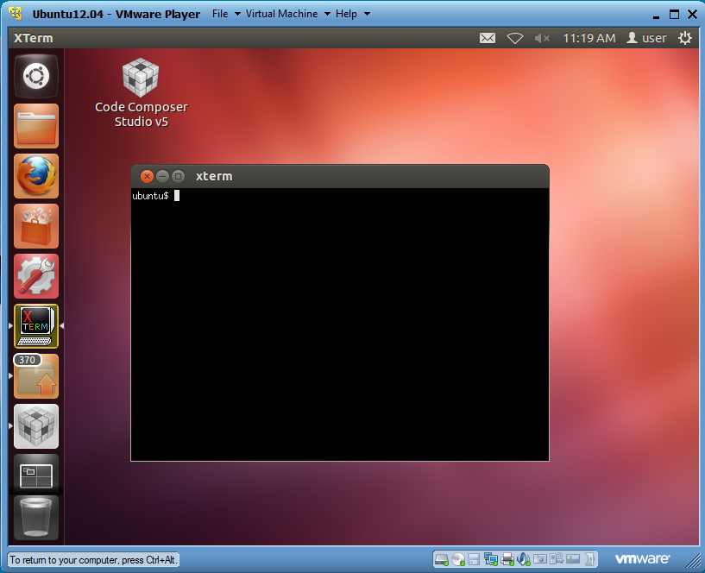
Booting Linux
Ubuntu:
Very popular desktop distribution of Linux
Completely Free

Slide 24
Lab 1: Booting Linux
MLO (i.e. x-loader)
u-boot.img uImage (i.e. Kernel)
Partition 1
(FAT32)
Use mkcard.txt script to format and partition card
Mount micro-SD partitions into root filesystem
Copy MLO, u-boot and uImage into partition 1
De-archive filesystem into partition 2
Root Filesystem
Partition 2
(EXT3)

Slide 25
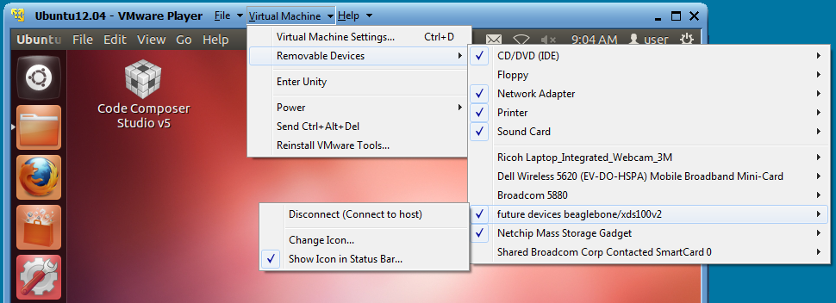
Lab task How to Boot Linux
Launch minicom serial terminal emulator
Manually load Ethernet-over-USB driver.

