Slide 1
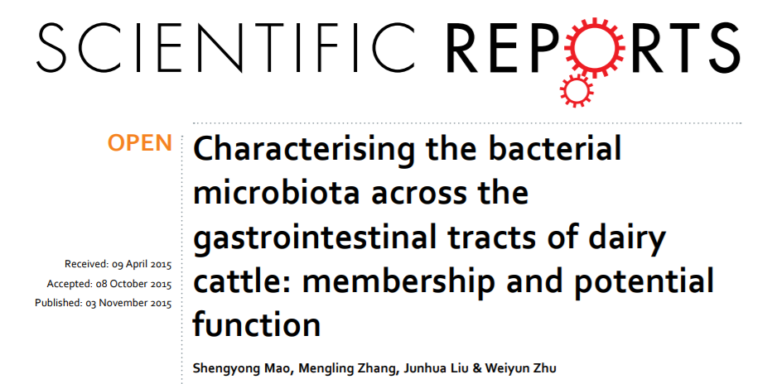
Presented by: Udderly Confused
Hylia Gao, Luke Koester, and Anna Naditz
Iowa State University
College of Agriculture and Life Sciences

Slide 2
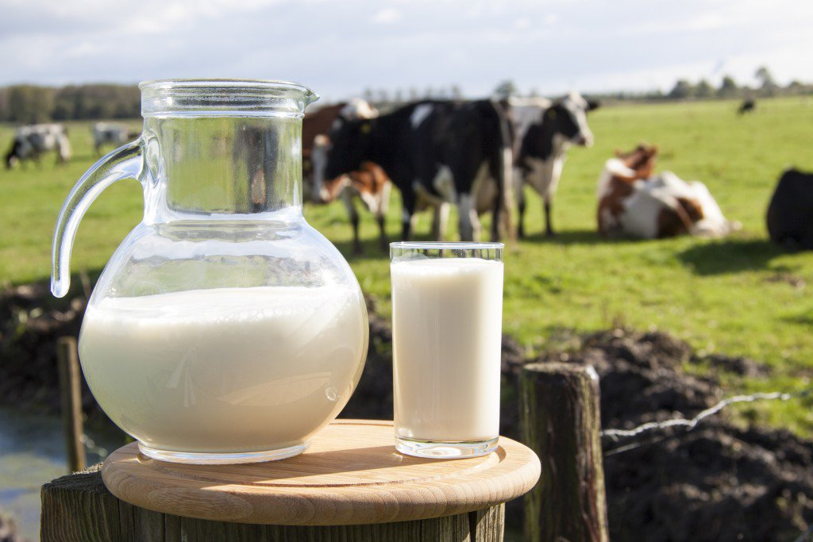

Dairy Cattle and Microbiota
Rumen is important for cellulose breakdown and energy harvesting
The rumen consist of bacterial communities.
  Catabolic and anabolic interaction with host
In dairy cattle, influence milk production and host health.
Iowa State University
College of Agriculture and Life Sciences
Notes:
In rumen of ruminants, plant digestion enables conversion of plant fibres into chemical compounds, which are absorbed and digested by the animal

Slide 3
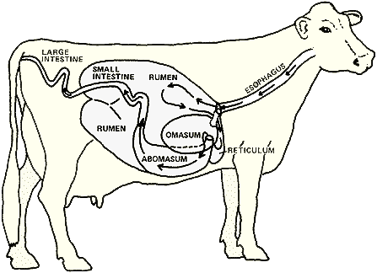
Ruminant Microbiome
Gastrointestinal tracts (GIT) includes all five locations
  rumen
  reticulum
  omasum
  abomasum
  the small and large intestine
Relationship between gastrointestinal bacterial communities and mammalian hosts are complex and beneficial.
Iowa State University
College of Agriculture and Life Sciences
Notes:
Small intestine includes the duodenum, the jejunem and the ileum. The large intestine includes the cecum, the colon and the rectum.

Slide 4
scientific aim of paper
Characterize the compositions and phylogenetic distributions of digesta- and mucosa-associated microbiota in the GITs of Holstein dairy cattle
Iowa State University
College of Agriculture and Life Sciences

Slide 5
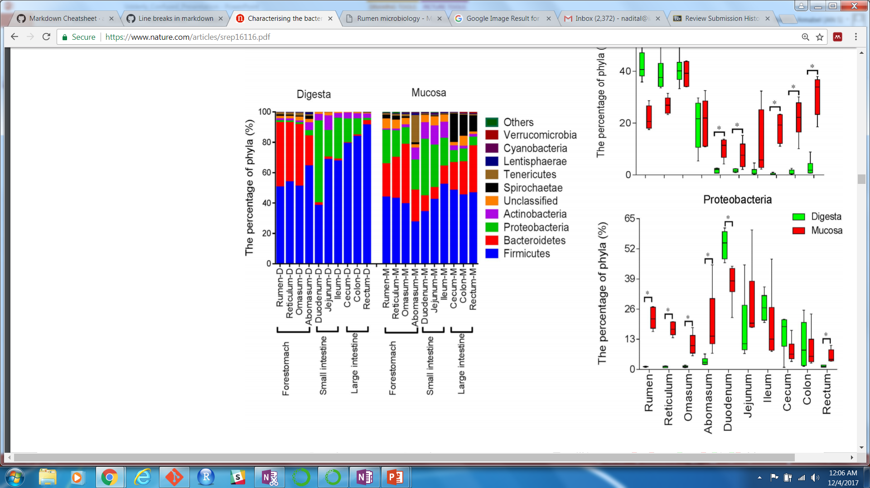
Phylum – level composition
Iowa State University
College of Agriculture and Life Sciences

Slide 6
WORKFLOW
Iowa State University
College of Agriculture and Life Sciences
Iowa State University
College of Agriculture and Life Sciences

Slide 7

QIIME
Pronounced as “chime”
Broadly used software
Free and open-source
Analysis from raw DNA sequencing data (Illumina etc.)
From raw data to publication quality graphics and statistics
Python based (Python 2.7 for QIIME1, Python 3 for QIIME2)
Iowa State University
College of Agriculture and Life Sciences

Slide 8
QIIME WorkFlow
Raw files – Quality Control
Build OTU Table & Assign Taxonomy
Diversity and Rarefaction
Interactive visualization, such as PCoA plots, distance histograms or taxonomy charts.
Trim Barcodes
OTU Selection
Alignment and Trees
Sequencing output files are received from 454, Illumina or Sanger sequencing, typically as fasta, fastq, or qual files.
convert_fastaqual_fastq.py
truncate_fasta_qual_files.py
We convert the fastq files to fasta with convert_fastaqual_fastq.py then truncate the primers to the desired length with truncate_fasta_qual_files.py
We checked the quality of map with validate_mapping_file.py then assigned sequences to samples based on barcoded primers with split_libraries.py
extract_barcodes.py
validate_mapping_file.py
split_libraries.py
Overall goal is to remove primers, demultiplex, and quality filter. We extract the barcodes with extract_barcodes.py.
The goal for this section is to cluster sequences into operational taxonomic units and pick a reference set of sequences. OTU selection can be closed-reference based, open-reference based, or de novo.
Closed-reference OTU picking using the Greengenes database is done with pick_closed_reference_otus.py.
Open reference OTU picking is done with pick_open_reference_otus.py. pick_de_novo_otus.py is used for de novo OTU picking.
picked_closed_reference_otus.py
pick_open_reference_otus.py
pick_de_novo_otus.py
Then we plotted the taxonomy summaries with plot_taxa_summary.py
assign_taxonomy.py
plot_taxa_summary.py
We built an OTU table and summarized the taxonomy data from the OTU table with summarize_taxa.py
summarize_taxa.py
We assigned taxonomy to the representative samples with assign_taxonomy.py
filter_alignment.py
Then we would build an approximately-maximum-likelihood phylogenetic tree with make_phylogeny.py (FastTree)
Sequences would be aligned to the Greengenes core reference alignment with align_seqs.py
We would filter and lane mask our alignment with filter_alignment.py
make.phylogeny.py
align_seqs.py
To produce the comparison plot of the OTUs, we would have used multiple_rarefactions.py
multiple_rarefactions.py
Iowa State University
College of Agriculture and Life Sciences

Slide 9
Results
We were able to obtain their FASTQ files, convert them to the FASTA file.
We were able to truncate all 50, 233 sequences within the FASTQ file based quality.
We filtered the sequence first by demultiplexing the data according to the barcode sequences.
Primers were removed and the sequences were quality filtered using a qual file based on a variety of conditions (too short or long, poor quality, containing ambiguous bases or more than 8 homopolymers) .
OTUs were picked with the closed reference with the Greengenes database.
Taxonomies were assigned to the representative samples and summarized taxonomies from the OTU table.
We plotted the taxonomies, transferred the files to R to recreate the stacked column plot.
Iowa State University
College of Agriculture and Life Sciences

Slide 10
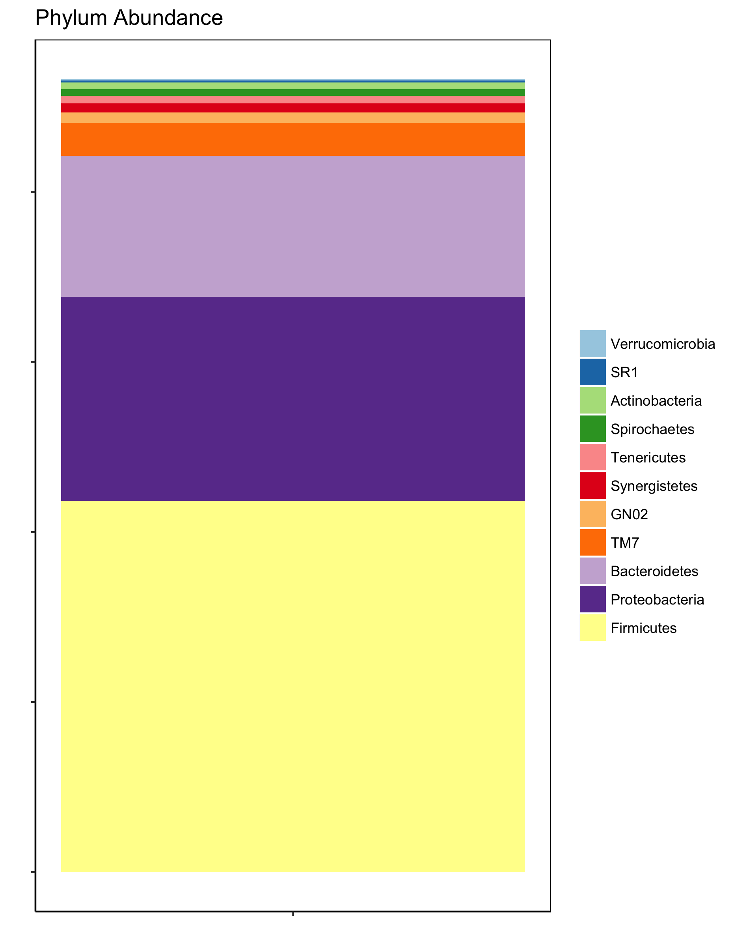
Comparison of paper vs analysis
Iowa State University
College of Agriculture and Life Sciences
Notes:
We analyzed one rumen mucosa sample from one cow. The phylum breakdown from this one sample does not represent the collective data from every cow. This can be seen in the breakdowns of the phyla. We noticed that the phylum composition shift is not completely identical between the single sample versus the entirety. In our sample in particular, proteobacteria seem to be in higher abundance than bacteroidetes, for example. However, all the major representative phyla are there in both analyses, indicating that if all samples were run through our pipeline, the combined data would be very similar to their data.

Slide 11
Future analyses
Once OTUs are plotted, we will be able to align sequences with the Greengenes core reference alignment
We will make approximately-maximum-likelihood phylogenetic tree with the FastTree utility
We will also need to conduct diversity studies.
Our final step will be to create visualization plots, such as PCoA, distance histograms, taxonomy charts etc.
Iowa State University
College of Agriculture and Life Sciences

Slide 12
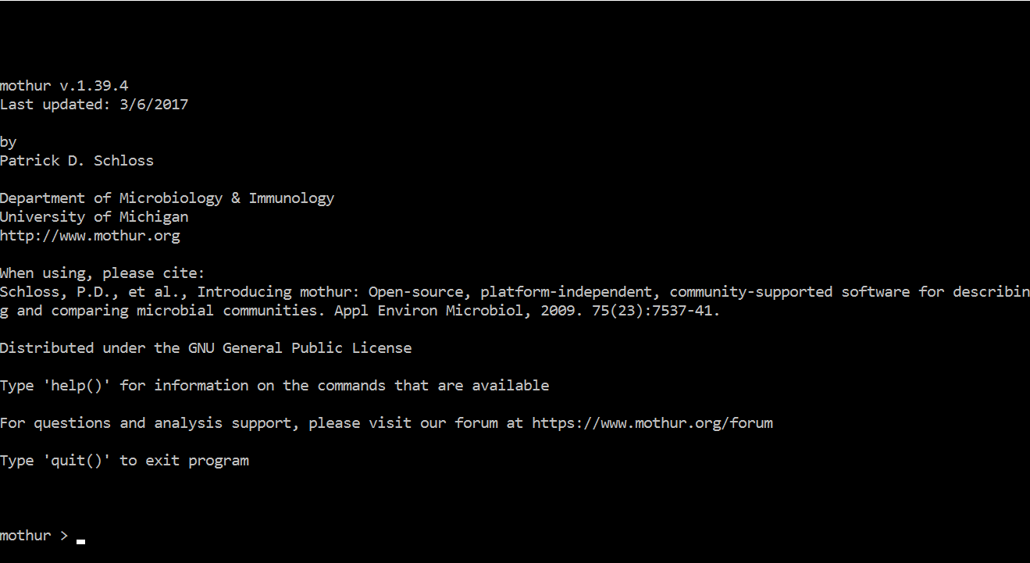
Mothur
In contrast to QIIME, PYNAST, FASTTREE etc., we processed the data with Mothur
Can perform the same tailored steps with nearly no dependency on additional software
Mothur is designed to analyze perform quality control, alignment and classification of sequences generated from next generation sequencing technologies.
Image: https://www.mothur.org/
Iowa State University
College of Agriculture and Life Sciences

Slide 13
Workflow
SRA Database
Fastq file containing all sequences and associated qualities
Fasta file containing only sequences
qual file containing only quality scores
Sequences adjusted based off quality
Unique sequences with the number of hits condensed
Aligned sequences (based on Silva Alignment)
Classified sequences (Using the RDP reference file)
All visualization tools, such as Jcologrid, Venn, and ggplot
fastq.info
trim.seqs
make.groups
You will also need to make groups with your data here, for further analysis. This can be done using the make.groups command.
Using the fastq.info command, we split the original fastq file into a fasta and accompanying quality scores
With the trim.seqs command, we were able to truncate the sequences based on quality scores less than 20 over a sliding window of 10 base pairs
All references files for the alignment and late classification are found on the Mothur website.
unique.seqs
With the unique.seqs command, all sequences with 97% similarity are condensed into one representative sequence and the total number condensed is stored within the file
PCR.seqs
Chimera.uchime
remove.seqs
align.seqs
PCR.seqs was used on the reference file to select only the bases that correspond with the V3-V4 region (selected by the original paper) with the oligos argument.
Chimera.uchime should be run here, but the alignment file wasn’t compatible with the chimera check command in Mothur. For this, we obtained a different reference file. This command marks all sequences it thinks is a chimera. UCHIME is integrated into Mothur.
If the Chimera check had worked, we would use the remove.seqs command to eliminate all of those marked sequences.
Finally, the sequences were aligned to the silva reference file. In the original paper, they used a Greengene references file, but I was unable to get this reference to generate understandable results. align.seqs
classify.seqs
screen.seqs
Using the Ribosomal Database Project reference files, we tried to assign taxonomy to the sequences here using the classify.seqs command. Whether we were using the wrong reference data base or something went wrong upstream, we were unable to classify the sequences. We blasted single sequences to check for viability, and all sequences were viable, unfortunately for us.
Here you could screen the sequences for things like ambiguous bases, homopolymers, or length of sequences using the screen.seqs command.
Iowa State University
College of Agriculture and Life Sciences

Slide 14
Results of Mothur (or lackthereof)
Fortunately, we were able to obtain their FASTQ files and apply their Greengenes reference files
We were able to truncate all 50, 322 sequences within the FASTQ file based quality
All failed sequences (too short or long, poor quality, containing ambiguous bases or more than 8 homopolymers) were successfully removed from the file
Sequences were condensed into a file containing on a single representative sequence and the number of sequences it represents (24,302 sequences)
We were able to identify a start and end position within both the Greengenes and SILVA reference for aligning
UCHIME was successfully included, and the chimeric sequences were removed for further analysis
Summary.seqs was used to monitor all working files generated after command. This allowed us to infer if the data was handles correctly at each step.
Iowa State University
College of Agriculture and Life Sciences

Slide 15
Trials and Tribulations with Mothur
All data from this experiment claimed to be paired end sequences, and the SRA database only had forward reads (fastq.info)
Recreating the quality control of a score >20 over a 10bp sliding reading frame we had to find a solution (Seqtk, Bioawk, Fastx.toolkit and Mothur)
Finding the alignment positions to tailor the size of the reference files (pcr.seqs)
Ensuring the correct reference files were used to classify sequences. Unfortunately there was never an answer here… (Greengenes vs Silva and the Ribosomal Database Project)
Iowa State University
College of Agriculture and Life Sciences

Slide 16
Comparison of Qiime and Mothur
Although we were not able to classify any sequences in the Mothur program (admittedly due to inexperience), here are some thoughts on each software.
QIIME:
  Pro –
    For Mac users, the QIIME download is comprehensive
    Reference databases are included in the QIIME package
  Con –
    Documentation is unclear and not helpful
    It is unwieldly for Windows users
    Not user-friendly for remote server use
Mothur:
  Pro –
    Everything is included in the mothur package
    The community is active and helpful
    wiki is provided, containing every command and several SOPs
  Con –
    Some files become obsolete with new versions
    Often hard to tell which references are compatible with which versions.
Iowa State University
College of Agriculture and Life Sciences

Slide 17
Summary
The paper lacked proper workflows
  Was not provided in paper or supplementary material
We were able to go through most of the workflow with QIIME, despite lack of documentation.
  Alignments for phylogeny and creation of phylogenetic trees will be conducted at a later point
The authors poorly organized and uploaded the data to the SRA
  Claiming paired end sequencing (only forward was provided) and samples were not labeled in any meaningful way
Supplementary data was difficult to locate
Sequences were of high quality, and did indeed contain enough data to be classified (NCBI blast)
We were unable to classify sequences with Mothur due to no workflow and lack of experience.
Iowa State University
College of Agriculture and Life Sciences

Slide 18
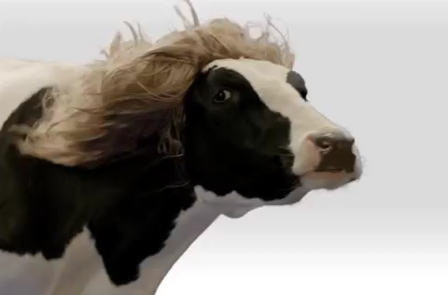
Thank you!

