Slide 1


TABLEAU CITY BIKE ANALYTICS Norma Espinosa
VISUALIZATIONS SUMMARY

Slide 2
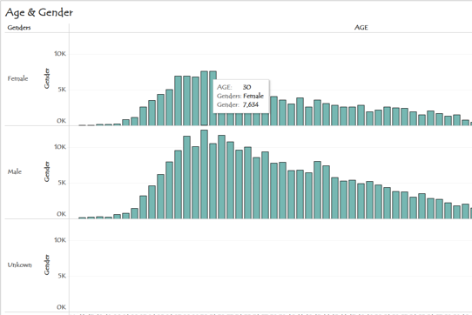
AGE AND GENDER
I did get the age per rider using an equation, then group by Males and Females (unknown gender were customers). As you can see on the visualization the Tooltip gives us the age, gender, and riders number, as we are able to know:
The age that people did ride more frequently. In both genders the 30’s is the age when people use to ride more.
The age where Males and Females stop riding. You can see the difference between both charts that man still riding also when got older.

Slide 3
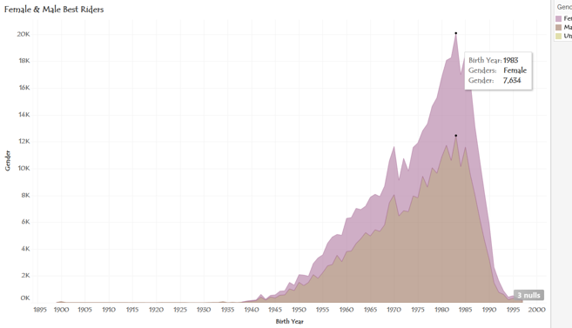
FEMALE AND MALE BEST RIDERS
This visualizations helps us to see who is more active if Males or Females. In this year, 2013, Females were the Top Riders.

Slide 4
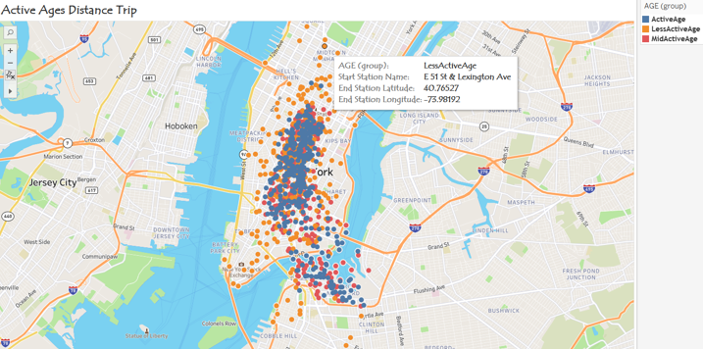
ACTIVE AGES DISTANT TRIPS
People (Active Age) <= 39 years old did ride more between Brooklyn and Midtown East
People (Middle Active Age) > 39 < 69 years old did ride more between Brooklyn and Midtown East as well
People (Less Active Age) > 70 years old did ride more between Brooklyn Bridge to Manhattan

Slide 5
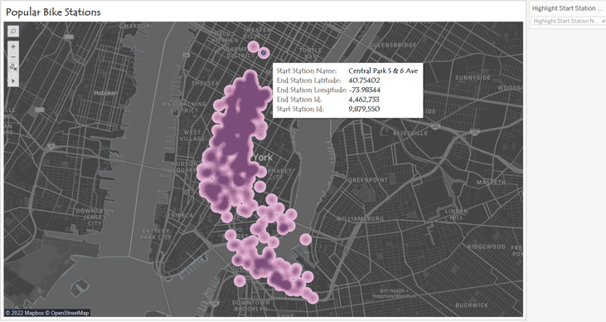
POPULAR BIKE STATIONS
The most popular station is a very useful visualization, since we can know:
The Name of the Station - Location of the station
How many riders start their trip in each station. - How many riders ended their trip in each station

Slide 6
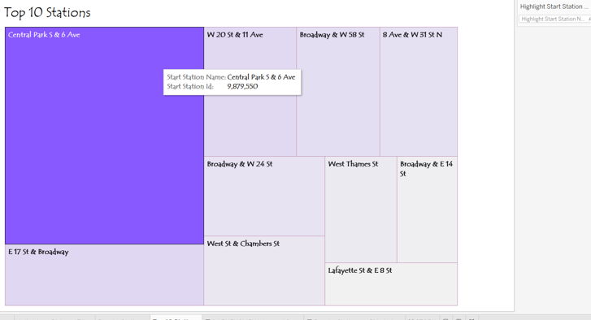
Top 10 stations
This visualization is useful since we know which stations are more popular, so they may need and have more services.

Slide 7
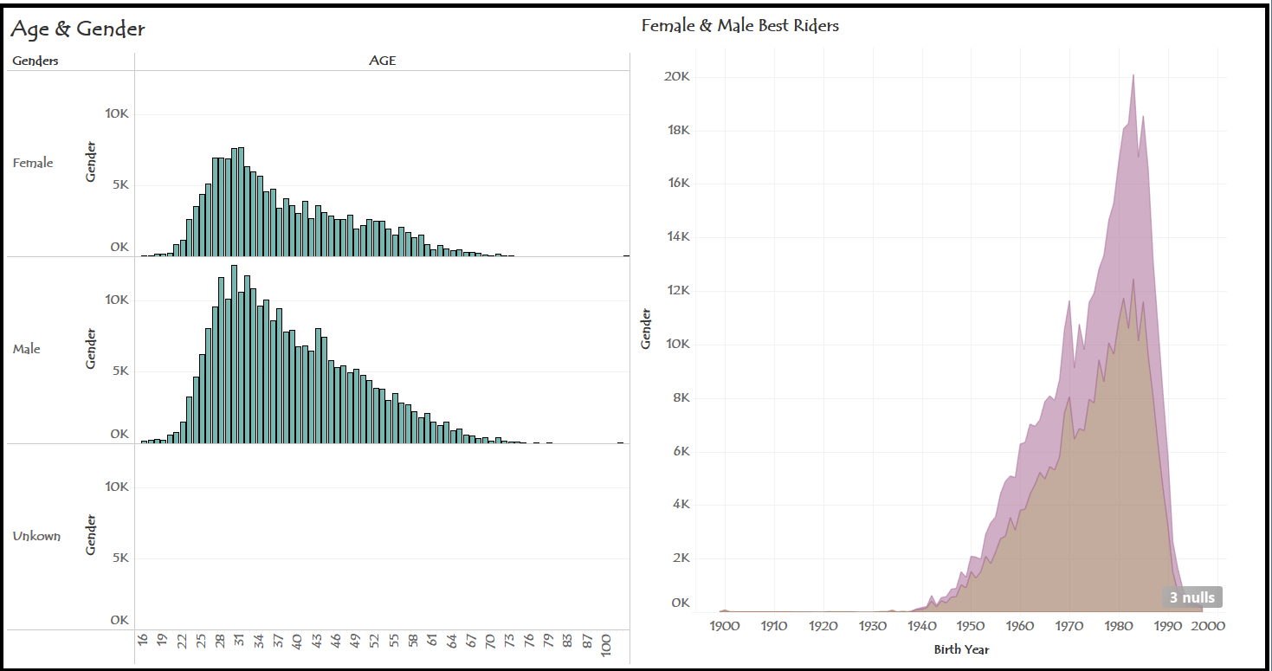
Dashboard #1

Slide 8
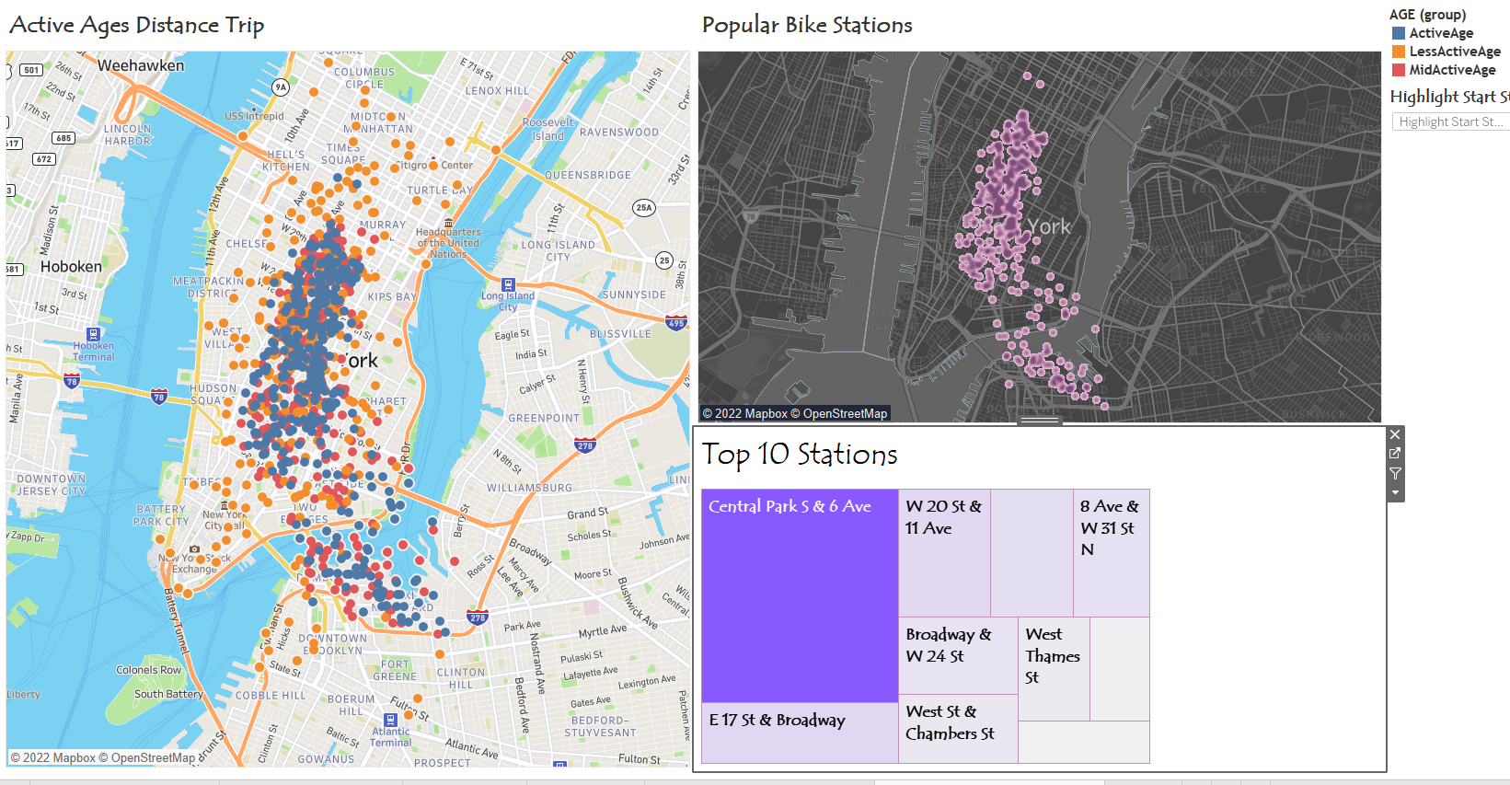
Dashboard #2

