Slide 1
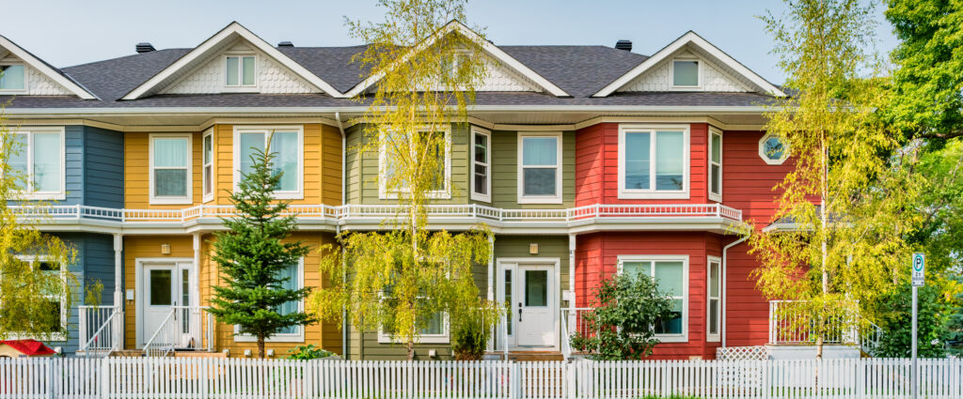
HOUSE PRICE PREDICTION WITH
MACHINE LEARNING

Slide 2




TEAM INTRODUCTION
Norma Espinosa
Carla Lorente
Eddy Salgado
Helen Tan

Slide 3
PURPOSE
To predict the housing price with the most accuracy with the highest R2 score
We trained 2 different machine learning algorithm:
Linear Regression
Random Forest Regression

Slide 4
DATASETS
https://www.kaggle.com/c/house-prices-advanced-regression-techniques
With 80 explanatory variables describing (almost) every aspect of residential homes in Ames, Iowa.

Slide 5
DATASETS
https://www.kaggle.com/c/house-prices-advanced-regression-techniques
With 80 explanatory variables describing (almost) every aspect of residential homes in Ames, Iowa.

Slide 6

DATA CLEANING
Delete rows with null values
Dealing with missing values.
Need at least 50% non-NA values (columns with more than these
will be dropped)
Imputing missing values with mean (it’s an estimate to observe the whole dataset

Slide 7
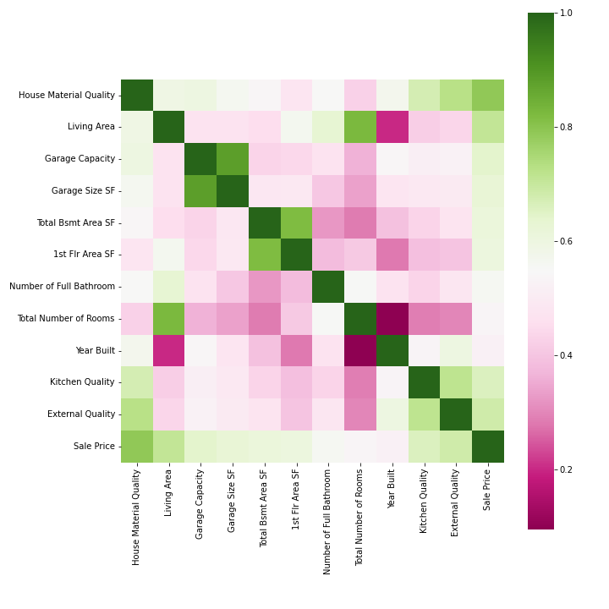
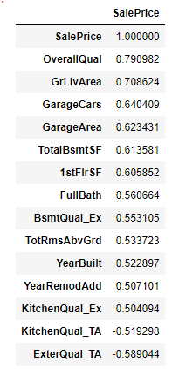
CORRELATION VALUES vs SALE PRICE

Slide 8
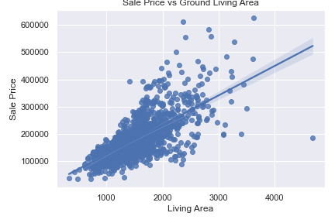
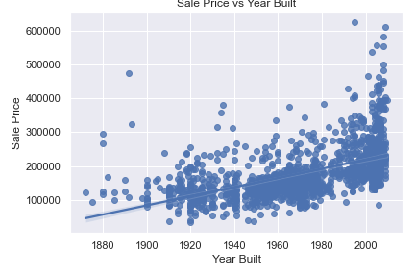
Scatter Plots

Slide 9
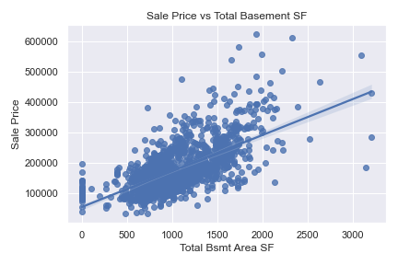
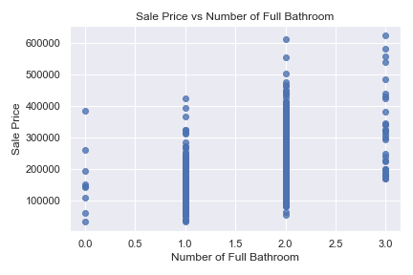
Scatter Plots

Slide 10
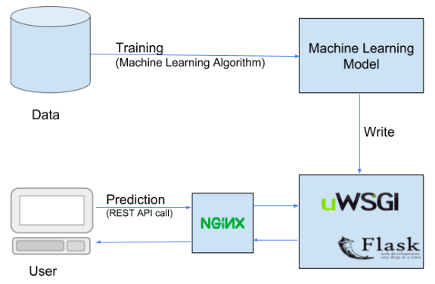
DEPLOYMENT

Slide 11
MACHINE LEARNING - Preprocessing
Reduce from 80 to 16 features: cols = ['GrLivArea', 'Neighborhood', 'OverallQual', 'OverallCond', 'YearBuilt', 'ExterQual', 'TotalBsmtSF', BsmtFinSF1', 'LotArea', 'TotRmsAbvGrd', 'FullBath', 'HalfBath', 'BedroomAbvGr', 'KitchenQual', 'BldgType', 'HouseStyle', 'GarageCars', 'SalePrice']
Convert categorical data to numerical using pd.get_dummies()
Train/test split - (80/20)
Scale data using StandardScaler() from sklearn

Slide 12
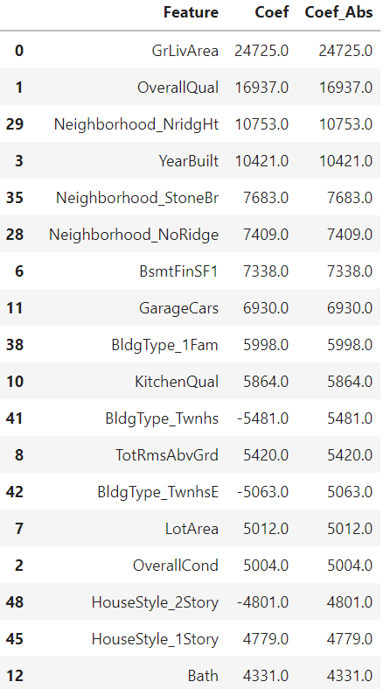
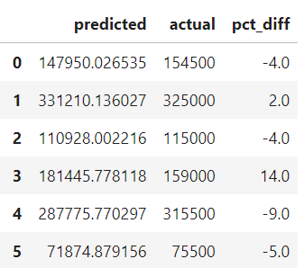
Ridge Regression
# fit linear regression model model = Ridge(alpha=1) model.fit(X_train_scaled, y_train)
model.score(X_test_scaled, y_test) Out[127]:
0.864767217574047

Slide 13
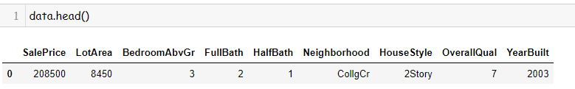
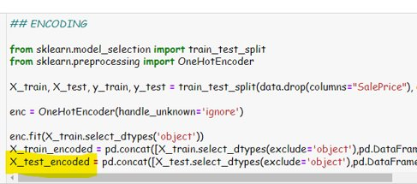
Version 2 - Encoding Data
Last Reduced Data:
One Hot Encoder:
One hot encoding is one method of converting data to prepare it for an algorithm and get a better prediction. With one-hot, we convert each categorical value into a new categorical column and assign a binary value of 1 or 0 to those columns.

Slide 14

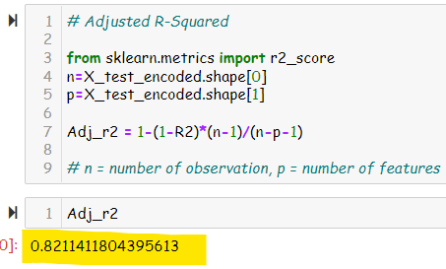
MACHINE LEARNING ALGORITHM
Random Forest Regressor
A random forest is a meta estimator that fits a number of classifying decision trees on various sub-samples of the dataset and uses averaging to improve the predictive accuracy and control over-fitting. The sub-sample size is controlled with the max_samples parameter if bootstrap=True (default), otherwise the whole dataset is used to build each tree.
Adjusted R square
Adjusted R2 is a corrected goodness-of-fit (model accuracy) measure for linear models. It identifies the percentage of variance in the target field that is explained by the input or inputs.
R2 tends to optimistically estimate the fit of the linear regression. It always increases as the number of effects are included in the model. Adjusted R2 attempts to correct for this overestimation. Adjusted R2 might decrease if a specific effect does not improve the model.

Slide 15
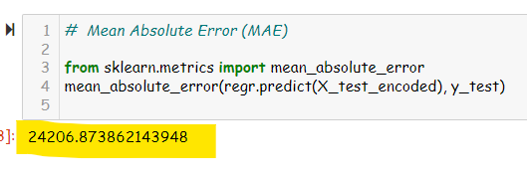
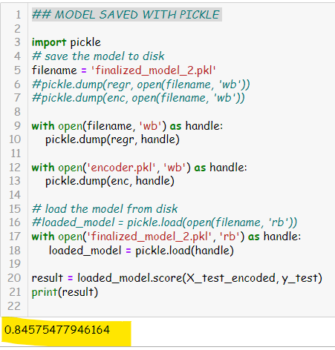
MEAN ABSOLUTE ERROR AND RELOAD MODEL
Mean Absolute Error (MAE)
With any machine learning project, it is essential to measure the performance of the model. What we need is a metric to quantify the prediction error in a way that is easily understandable to an audience without a strong technical background. For regression problems, the Mean Absolute Error (MAE) is just such a metric.
The mean absolute error is the average difference between the observations (true values) and model output (predictions). The sign of these differences is ignored so that cancellations between positive and negative values do not occur. If we didn’t ignore the sign, the MAE calculated would likely be far lower than the true difference between model and data. (https://insidelearningmachines.com/mean_absolute_error/)
MODEL SAVED WITH PICKLE
Why Pickle?
The use of pickling conserves memory, enables start-and-stop model training, and makes trained models portable (and, thereby, shareable). Pickling is easy to implement, is built into Python without requiring additional dependencies, and supports serialization of custom objects.
Pickle is a Standard way of serializing objects in Python. It can be a Machine Learning Algorithm or any other Object.
You can serialize and save the model or Object using Pickle . It is saved in a serialized format as a file.
When you need to re-use or re-load the same Model or Object , you can reload and de-serialize the file using Pickle.

Slide 16
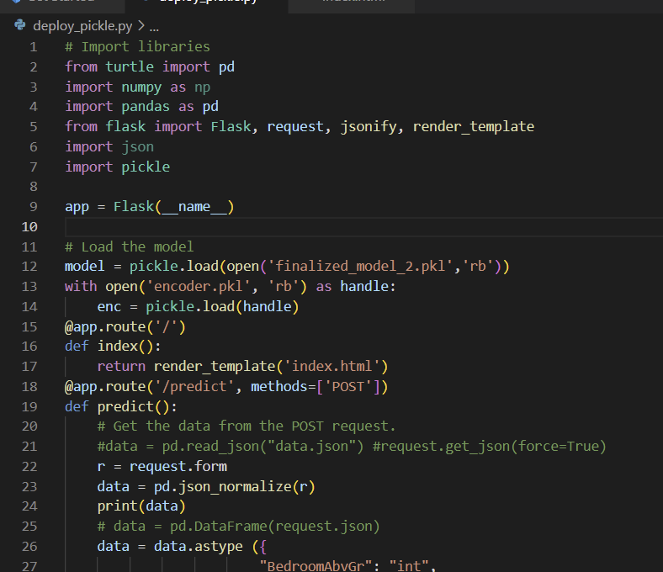
DEPLOY PICKLE MODEL WITH FLASK
It is time to deploy our model now that we are sure that our model achieve an accuracy of 84% approximately, and has been saved it using Pickle.
We used Falsk to deploy our model
Prediction API
The prediction API is quite simple. We give it our data, the area of the house, and pass that into our predict method of our model.
In our route method definition, we restrict the request methods to be GET/POST and if so, we get the JSON of the request body so we can access its data. With that variable, we access the key of the data we want — area and parse it into a float. We also load our model into memory from the persisted file.

Slide 17
PRODUCT DEMO
HOUSE PRICE PREDICTION

