Slide 1
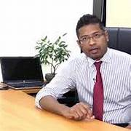


Multi-faceted approach for Parkinson’s Disease Detection, Monitoring, and Management.
TMP-2023-24-042
Dr.Kapila Disanayaka- Supervisor
Ms.Sasini Hathurusighe –co.Supervisor
Dr.Dilum Palliyaguru – External Supervisor

Slide 2

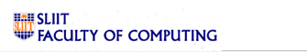
BACKGROUND
Parkinson's disease is characterized by motor symptoms, such as tremors, rigidity, and bradykinesia, as well as non-motor symptoms, including cognitive impairment, depression, and sleep disorders.
While there is no cure for Parkinson's disease, we believe that emerging technologies can play a significant role in monitoring and managing the disease more effectively.
IT20247140 | Disanayaka D.M.N.J. | TMP-2023-24-042

Slide 3

RESEARCH PROBLEM
A comprehensive solution for Parkinson's disease management. Parkinson's disease is a progressive neurodegenerative disorder that affects millions of people worldwide
while there is no cure, advancements in emerging technologies offer promising opportunities to improve symptom monitoring, early detection, and personalized care for individuals with Parkinson's disease.

Slide 4
Main OBJECTIVE
The objective of this study is to explore the integration of emerging technologies in developing a comprehensive solution for Parkinson's disease management.
We will be focusing on four distinct components, each incorporating a novel approach. I will be presenting the first component, which is the development of a "Wearable Device for Real-Time Symptom Monitoring."

Slide 5
SUB OBJECTIVES
post systems
Wearable Device for Symptom Monitoring and predict the stage of the patient
Remote Telehealth Consultation System with Facial Expression Detection
Pre symptoms
Voice and Speech Analysis for Early Detection
Mobile App for Early Symptoms Detection, Monitoring, and Generating Reports

Slide 6
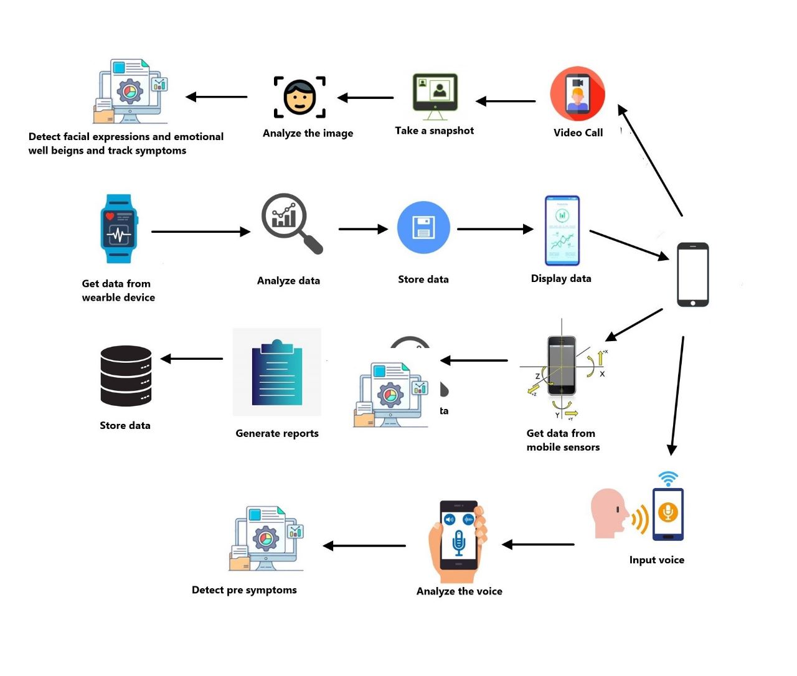
Overall system Diagram

Slide 7
Commercialization
post systems post systems1. Market Research- As of 2019 8.5 Million are victimized by PD worldwide.
Play paid advertisement through websites and commercial ads
Create a Business Model Plan -
Freemium - Offers trail app with less features
Paid App - Offer 2 components
Subscription plan - Entire Application for subscription plan Monthly/ Annually
.Monetized to Private hospitals and Medical Clinics
Legal and Privacy Consideration

Slide 8
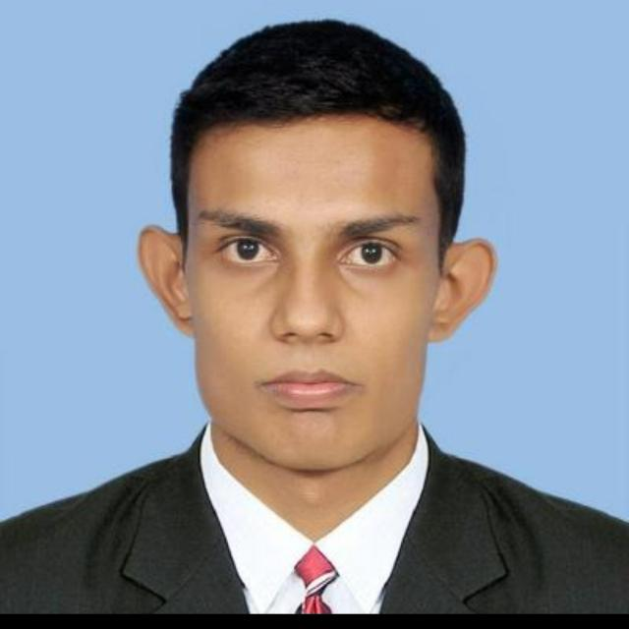
IT20247140|Disanayaka D.M.N.J
Information Technology
IT20247140 | Disanayaka D.M.N.J | TMP-2023-24-042

Slide 9
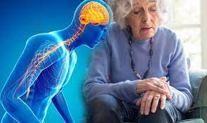
Wearable Device for Real-Time Symptom Monitoring.
TMP-2023-24-042

Slide 10
INTRODUCTION
BACKGROUND
RESERCH GAP
SPECIFIC AND SUB OBJECTIVES
Research Gap
BACKGROUND
IT20247140 | Disanayaka D.M.N.J. | TMP-2023-24-042

Slide 11
BACKGROUND
* Parkinson's disease is a progressive neurodegenerative disorder that affects millions of people worldwide.
* The disease is characterized by a range of motor symptoms, including tremors, rigidity, and bradykinesia.
* The severity of these symptoms can vary depending on the stage of the disease and using wearable device we can see what is the stage.
* There is no cure for Parkinson's disease, but there are treatments that can help to manage the symptoms.
To Identify treatments It is very important to identify what stage the Parkinson patient is in
IT20247140 | Disanayaka D.M.N.J. | TMP-2023-24-042

Slide 12
REASRCH GAP
Paper | Application | platform | Market-Demand | Identify the stage | Mobile application
Research [1] | Freezing Of gait | smartphone | Gait-related parameters | No | No
Research [2] | Remote Monitoring | Wearable sensors | symptoms | No | No
Research [3] | Multi Data | Multi sources | Motor symptoms, cognitive function, medication | No | No
Research [1]
Chen Y, Zhou W, Wang L, et al. Smartphone-based assessment of freezing of gait in Parkinson's disease. JMIR Mhealth Uhealth. 2019;7(10):e12759.
Research [2]
Chen Y, Zhou W, Wang L, et al. Wearable technology for remote monitoring of Parkinson's disease patients. J Med Internet Res. 2021;23(9):e26683.
Research [3]
Chen Y, Zhou W, Wang L, et al. Wearable technology for remote monitoring of Parkinson's disease patients. J Med Internet Res. 2021;23(9):e26683.
Proposed system | Parkinson disease | Wearable sensors | Motor symptoms, cognitive function, medication | Yes | Yes
IT20247140 | Disanayaka D.M.N.J. | TMP-2023-24-042

Slide 13

RESEARCH PROBLEM
Xs Is The current methods for predicting the stage
of Parkinson’s disease are not accurate or reliable?
This can lead to delays in diagnosis and treatment,
which can have a negative impact on the patient’s
quality of life.
IT20247140 | Disanayaka D.M.N.J. | TMP-2023-24-042

Slide 14
SPECIFICS AND SUB-OBJECTIVES
MAIN OBJECTIVES
Wearable Device for Real-Time Symptom Monitoring and give recommendations for doctor which stage the patient is In.
SUB OBJECTIVES
. Development of the wearable device: This would involve selecting the appropriate sensors. Analyze the data using Multi objective optimization algorithms.
Data analysis: This would involve analyzing the data collected from the wearable device to identify patterns and trends in symptom fluctuations.
5. Developing the mobile App
IT20247140 | Disanayaka D.M.N.J. | TMP-2023-24-042

Slide 15
METHODOLOGY
IT20247140 | Disanayaka D.M.N.J. | TMP-2023-24-042

Slide 16
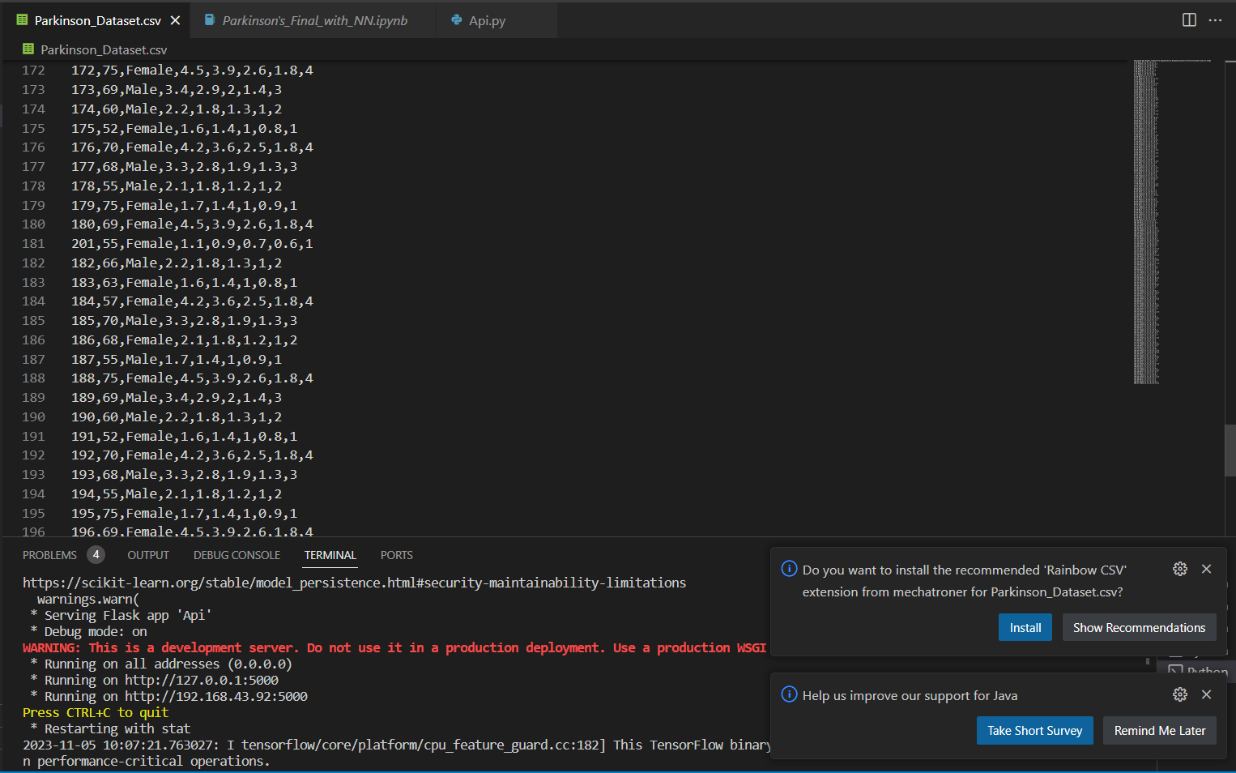
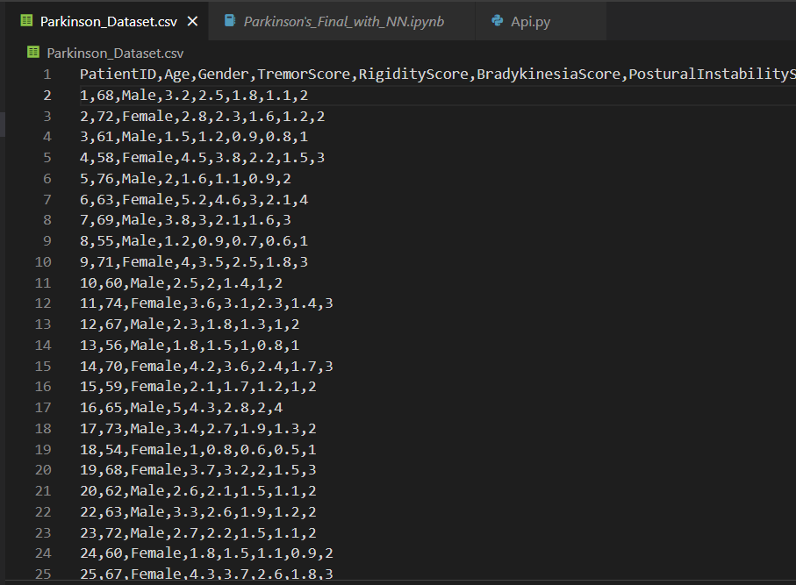
Data SET

Slide 17
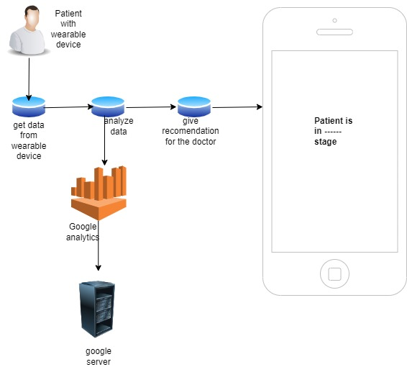
SYSTEM DIAGRAM
IT20247140 | Disanayaka D.M.N.J. | TMP-2023-24-042

Slide 18
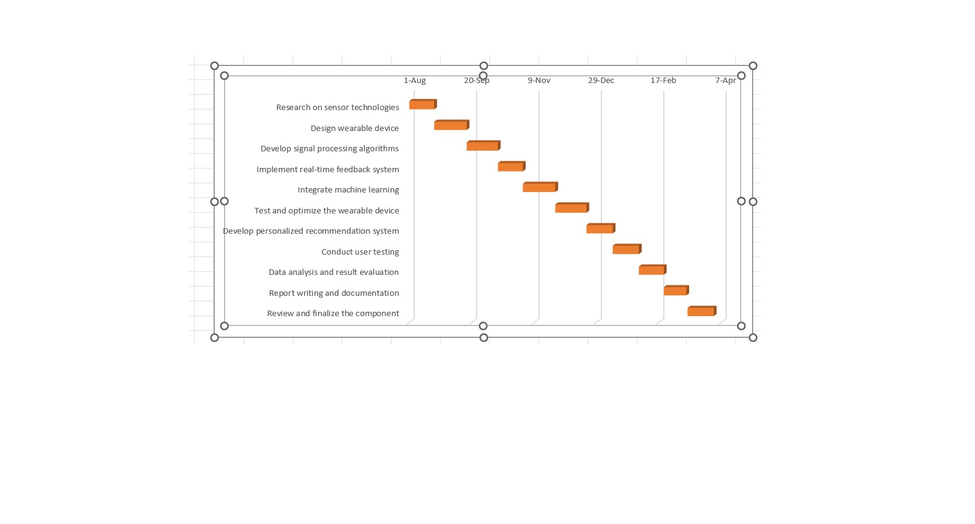
Completion Of the project
IT20247140 | Disanayaka D.M.N.J. | TMP-2023-24-042

Slide 19

TECHNOLOGIES, TECHNIQUES AND ALGORITHMS
TECHNOLOGIES
React Native
Accelerometer
Gyroscope
Heart rate sensors
TECHNIQUES
Google Analytics
Deep Learnings Algorithms
ALGORITHMS
Convolutional Neural Networks
Recurrent Neural Networks
IT20247140 | Disanayaka D.M.N.J. | TMP-2023-24-042

Slide 20
SYSTEM, PERSONNEL AND SOFTWARE SPECIFICATION REQUIREMENTS
SOFTWARE REQUIREMENTS
React Native
Python
Flask Server
Jupyter Notebook
Intellij Idea
FUNCTIONAL REQUIREMENTS
System should be analyzing data sets using deep learning algorithms and identify what is the stage.
System should be analyzing data sets using google analytics.
System should be able to get the accurate data from Patient .
NON- FUNCTIONAL REQUIREMENTS
Interfaces should be User-friendly
Application should properly work for cross platform
Application should be reliable
Higher accuracy of results
Results should be more efficient
Application should be able to give fast results
PERSONNEL REQUIREMENTS
Dr . Dilum Palliyaguru– External Supervisor
Neurologist At Teaching Hospital Kurunegala
IT20247140 | Disanayaka D.M.N.J. | TMP-2023-24-042

Slide 21
WORK BRAKEDOWN STRUCTURE
Wearable Device for Real-Time
Symptom Monitoring and give
recommendations for doctor
1. INITIATION
2. PLANNING
3.DESIGN
4. IMPLEMENTATION
5. FINALIZE
Creating wearable device
Identify the Research Problem
Literature Review
Create use case diagram
Final Presentation
Topic Assessment Form
Requirement Analysis
Create ER diagram
Get Data using the device
Host the Mobile Application
Charter Document and Cover Sheet
Feasibility Study
Create Sequence Diagram
Analyze Data sets using
Google analytics
Deploy the web application
Project Proposal and Presentation
Collect Data for Research Component
Design Wireframes for mobile and web applications
Find what is the stage of the patient
Research Paper
IT20247140 | Disanayaka D.M.N.J. | TMP-2023-24-042

Slide 22
References
[1] Griffiths TD, Marsden CD, Thompson PD. A wearable device for real-time monitoring of Parkinson's disease symptoms. J Neural Transm (Vienna). 2004;111(7):1075-1084. https://www.researchgate.net/publication/370828200_Toward_objective_monitoring_of_Parkinson's_disease_motor_symptoms_using_a_wearable_device_wearability_and_performance_evaluation_of_PDMonitorR?utm_source=twitter&rgutm_meta1=eHNsLUc1YThkY3RYOGJIWWVQK2xlbnY3VDZzTVhMYkZoMHYzQjZEVFNRV3N5NUdhdUhESHNRc052T1NjVE8rR3krVGdDb0JCaEdhMTlYTjJ3eGNrQzFrYWFtMW4%3D
[2] Monje M, O'Sullivan J, O'Neill J, et al. The use of wearable sensors for Parkinson's disease: A review of literature. Sensors (Basel). 2019;19(16):3509.
https://www.researchgate.net/search.Search.html?query=%5B2%5D+Monje+M%2C+O%27Sullivan+J%2C+O%27Neill+J%2C+et+al.+The+use+of+wearable+sensors+for+Parkinson%27s+disease%3A+A+review+of+literature.+Sensors+%28Basel%29.+2019%3B19%2816%29%3A3509.&type=publication
[3] Deb S, Mitra T, Mandal SK, et al. Machine learning algorithms for early Parkinson's disease detection: A systematic review. J Parkinsons Dis. 2022;12(1):11-24.
https://www.researchgate.net/publication/364088323_A_systematic_review_of_adaptive_machine_learning_techniques_for_early_detection_of_Parkinson%27s_disease
[4] Zhou Y, Zhang J, Zhang Y, et al. Predicting Parkinson's disease progression with wearable devices: A machine learning approach. Sensors (Basel). 2022;22(5):2047.
[5] Wang Q, Zhang X, Wang D, et al. Real-time monitoring of tremors in Parkinson's disease using smartwatches. 2016 IEEE Ecuador Technical Chapters Meeting (ETCM)

Slide 23
Thank YOU
TMP-2023-24-042

Slide 24

IT20628536|Mahamithawa W.M.N.D
Bachelor of Science (Hons) in Information Technology
Specializing in Information Technology
IT20628536 | Mahamithawa W.M.N.D| TMP-2023-24-042

Slide 25

Real time Facial Expression Detection for detect hypomimia symptom
TMP-2023-24-042
IT20628536 | Mahamithawa W.M.N.D| TMP-2023-24-042

Slide 26
Introduction and background
Hypomimia, also known as facial masking, is a reduced or loss of facial expression. It is a common symptom of Parkinson's disease, affecting up to 70% of people with the condition.
Common symptoms include:
A fixed or expressionless face
Difficulty smiling or frowning
Difficulty pursing lips
IT20628536 | Mahamithawa W.M.N.D| TMP-2023-24-042

Slide 27

RESEARCH PROBLEM
How to predict whether a Parkinson’s patient experiencing with hypomimia symptom using facial photos?

Slide 28
SPECIFIC AND SUB OBJECTIVES
MAIN OBJECTIVES
predict whether a Parkinson’s patient experiencing
with hypomimia symptom or not
SUB OBJECTIVES
Build model using Convolutional neural network.
The model is learning using supervised learning
technology.
Give accurate predictions.

Slide 29
METHODOLOGY

Slide 30
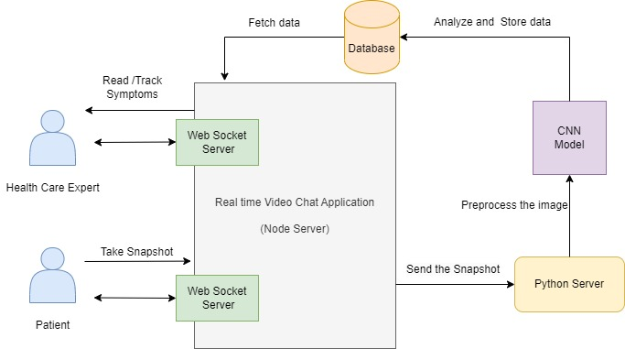
System Architecture
IT20628536 | Mahamithawa W.M.N.D| TMP-2023-24-042

Slide 31
Model Architecture
What is CNN
Convolutional neural networks (CNNs) are a type of deep learning neural network architecture that is commonly used in image recognition and classification tasks.
The basic architecture of a CNN consists of three main types of layers.
Convolutional layers
Pooling layers
Fully connected layers

Slide 32
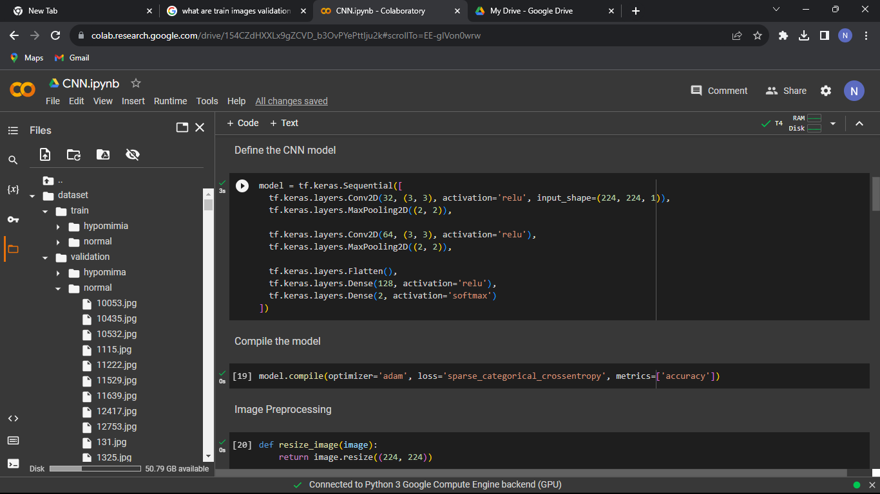
Dataset and Model training

Slide 33
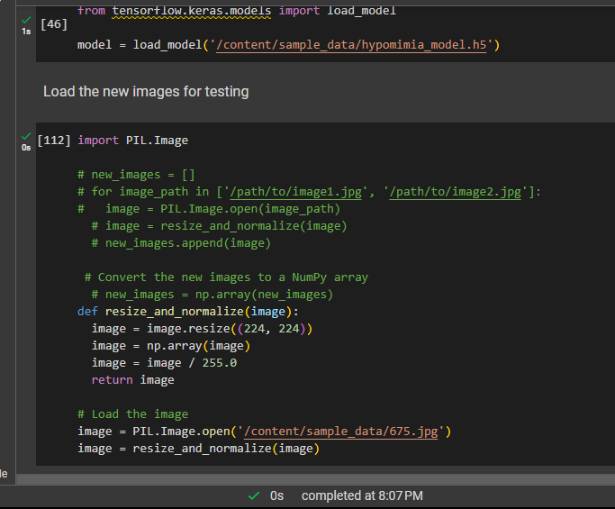
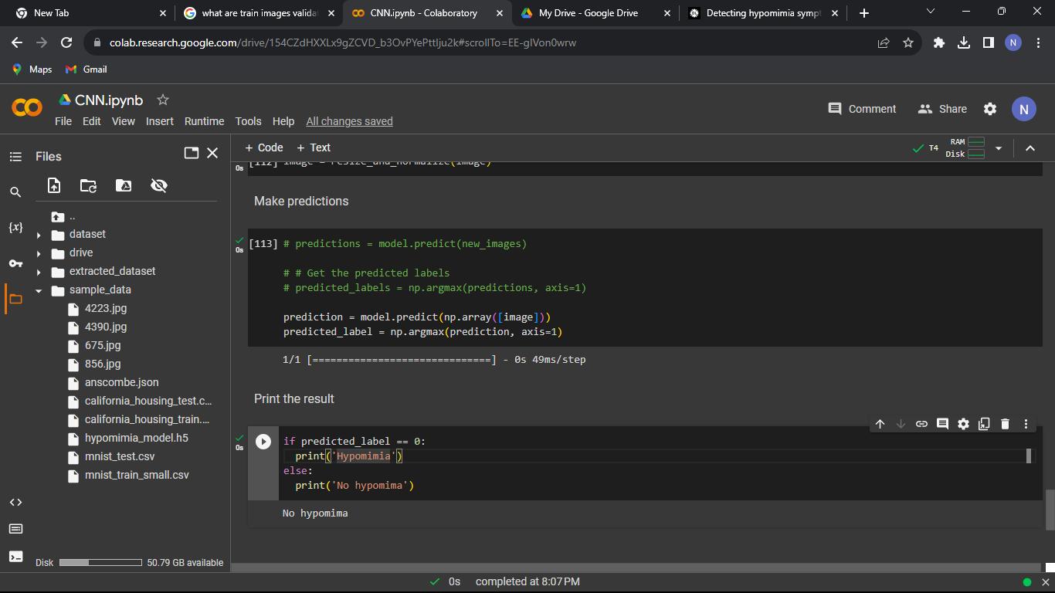
Model testing

Slide 34
Technology and requirements
SOFTWARE REQUIREMENTS
Python Server
Node Server
Keras
TensorFlow
WebSockets-Socket.io
Algorithm- Convolutional Neural network (CNN)
FUNCTIONAL REQUIREMENTS
System should provide seamless and secure video conferencing capabilities for remote consultations.
System should detect and track facial expressions associated with Parkinson's symptoms.
System should develop algorithms to monitor and quantify motor symptoms based on facial expressions during video calls.
NON- FUNCTIONAL REQUIREMENTS
Accuracy
Reliability
User-friendliness
Efficiency
Security
PERSONNEL REQUIREMENTS
Dr . Dilum Palliyaguru– External Supervisor
Nurologist At Teaching Hospital Kurunegala
IT20628536 | Mahamithawa W.M.N.D| TMP-2023-24-042

Slide 35
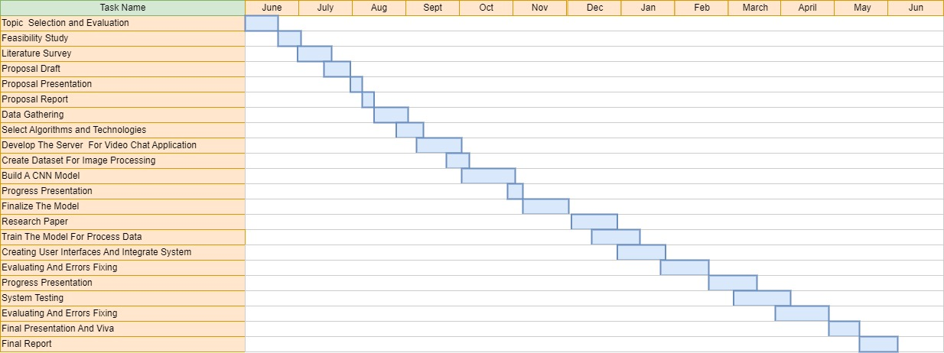
Completion of the project
IT20628536 | Mahamithawa W.M.N.D| TMP-2023-24-042

Slide 36
References
[1] Athina Grammatikopoulou, Nikos Grammalidis, Sevasti Bostantjopoulou, and Zoe Katsarou. 2019. Detecting hypomimia symptoms by selfie photo analysis: for early Parkinson disease detection. In Proceedings of the 12th ACM International Conference on PErvasive Technologies Related to Assistive Environments (PETRA '19). Association for Computing Machinery, New York, NY, USA, 517–522. https://doi.org/10.1145/3316782.3322756
[2] Pigott, Jennifer & Armstrong, Megan & Chesterman, Elizabeth & Read, Joy & Nimmons, Danielle & Walters, Kate & Davies, Nathan & Schrag, Anette. (2022). Remote Consultations for People with Parkinson’s and Cognitive Impairment – A Qualitative Study with Patients, Caregivers and Healthcare Professionals. JMIR Neurotechnology. 1. 10.2196/39974.
[3] Ali, Mohammad & Myers, Taylor & Wagner, Ellen & Ratnu, Harshil & Dorsey, E. & Hoque, Ehsan. (2021). Facial expressions can detect Parkinson’s disease: preliminary evidence from videos collected online. npj Digital Medicine. 4. 10.1038/s41746-021-00502-8.
[4] van den Bergh, R.; Bloem, B.R.; Meinders, M.J.; Evers, L.J.W. The state of telemedicine for persons with Parkinson’s disease. Curr.Opin. Neurol. 2021,34, 589–597.

Slide 37
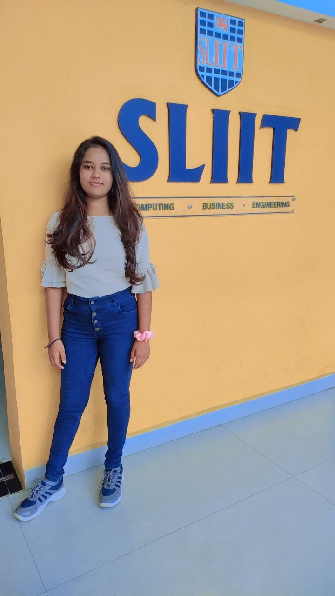
IT20622732 | RANWALA R.D.H.N
Bachelor of Science (Hons) in Information Technology
Specializing in Information Technology
IT20622732 | Ranwala R.D.H.N | TMP-2023-24-042

Slide 38
Mobile App for Early Symptoms Detection, Monitoring and Generating Reports.
TMP-2023-24-042

Slide 39
INTRODUCTION
BACKGROUND
RESEARCH PROBLEM
SPECIFIC AND SUB OBJECTIVES
RESEARCH GAP
BACKGROUND
IT20622732 | Ranwala R.D.H.N | TMP-2023-24-042 02/08/2023

Slide 40
BACKGROUND
As of 2019 8.5 M victimized by Parkinson Disease
The disease is characterized by a range of motor and non-motor symptoms.
Motor symptoms in pre-stage can be tremor, muscle stiffness and slowness in movements.
Detect through Gyroscope & Accelerometer.
Developing a Mobile Application
IT20622732 | Ranwala R.D.H.N | TMP-2023-24-042 02/08/2023

Slide 41

RESEARCH PROBLEM
How accurately can the mobile app utilizing gyroscope & accelerometer detect early motor abnormalities associated with pre-symptoms of Parkinson's disease in individuals without a formal diagnosis.
IT20622732 | Ranwala R.D.H.N | TMP-2023-24-042 02/08/2023

Slide 42
SPECIFIC AND SUB-OBJECTIVES
Specific Objective
Design, develop, and validate a mobile app utilizing gyro sensors and accelerometers for early detection and continuous monitoring of pre-symptoms related to Parkinson's disease, with the capability to generate reports.
Sub - Objectives
Develop an algorithm to analyze sensor data.
PD is detected, the app will advise the individual to continuously monitor the situation via the app for a particular period of time.
Thereafter, the app will generate a report based on the detection and monitoring for the period
IT20622732 | Ranwala R.D.H.N | TMP-2023-24-042 02/08/2023

Slide 43
RESEARCH GAP
Research ID​​ ​​ | Using Gyro-sensor​ & Accelerometer | Store Data in Cloud DB | Run in Mobile Background | Generate Report ​​
​​ [1]​​ | ​✓ | ​✗ | ✗ | ✗
​​ [2]​​ | ✓​​ | ✓ | ✗ | ✗
​​ [3]​​ | ✓ | ✗ | ✗ | ✗
Proposed ​​ System​​ | ✓ | ✓​​ | ✓​​ | ✓
[1] A Smartphone Application for Parkinson Tremor Detection
[2] A Mobile Cloud-Based Parkinson’s Disease Assessment System for Home-Based Monitoring
[3] Use of Mobile Apps for Self-care in People With Parkinson Disease
IT20622732 | Ranwala R.D.H.N | TMP-2023-24-042 02/08/2023

Slide 44
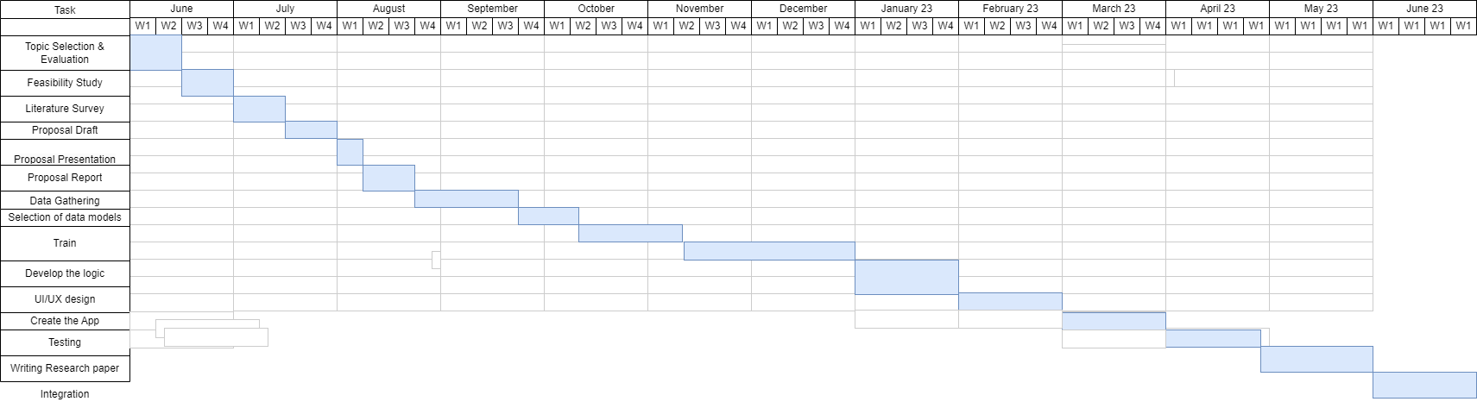
COMPLETION OF THE PROJECT
IT20622732 | Ranwala R.D.H.N | TMP-2023-24-042 02/08/2023

Slide 45
METHODOLOGY
IT20622732 | Ranwala R.D.H.N | TMP-2023-24-042 02/08/2023

Slide 46
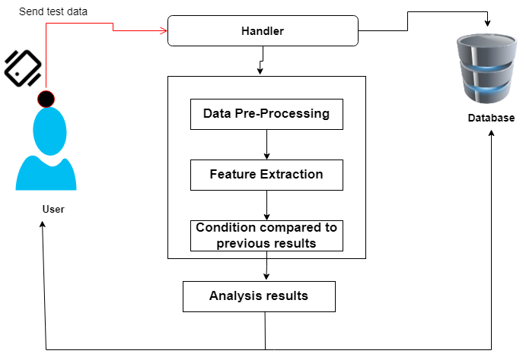
SYSTEM DIAGRAM
IT20622732 | Ranwala R.D.H.N | TMP-2023-24-042 02/08/2023

Slide 47
Evidence for Completion
Gather data of PD and without PD
Train Data Models using Decision trees & Random forests algorithm
Accuracy of the prediction
Completion of the Mobile App
IT20622732 | Ranwala R.D.H.N | TMP-2023-24-042 02/08/2023

Slide 48
SYSTEM, PERSONNEL AND SOFTWARE SPECIFICATION REQUIREMENTS
SOFTWARE REQUIREMENTS
React Native
FireBase
Decision Trees
Random Forests
Python
Tensorflow
FUNCTIONAL REQUIREMENTS
System should be able to detect pre- symptoms of Parkinson disease.
System should be able to monitor for a period.
System should be able to generate a report.
NON- FUNCTIONAL REQUIREMENTS
Interfaces should be User-friendly
Efficient
Application should be reliable
Higher accuracy of results
Results should be more efficient
Application should be able to give fast results
PERSONNEL REQUIREMENTS
Dr . Dilum Palliyaguru– External Supervisor
Neurologist At Teaching Hospital Kurunegala
IT20622732 | Ranwala R.D.H.N | TMP-2023-24-042 02/08/2023

Slide 49
WORK BREAKDOWN STRUCTURE
Mobile App for Early Symptoms Detection, Monitoring and Generating Reports.
1. INITIATION
2. PLANNING
3.TRAIN
4. IMPLEMENTATION
5. FINALIZE
Creating Mobile App
Identify the Research Problem
Read more research works
Gather data
Final Presentation
Topic Assessment Form
Requirement Analysis
Train Models
Analyze data using sensors
Complete Mobile Application
Project proposal & Presentation
Feasibility Study
Compare the results
Checking Accuracy
Integrate all components
Charter Document and Cover Sheet
Collect Data for Research Component
Check Accuracy
Find what is the stage of the patient
Research Paper
IT20622732 | Ranwala R.D.H.N | TMP-2023-24-042 02/08/2023

Slide 50
References
[1] V. Parra, G. Figueras, M. Huerta, A. Marzinotto, R. Gonzalez, R. Alvizu "A Smartphone Application for Parkinson Tremor Detection" 2013
https://www.researchgate.net/publication/266080900_A_Smartphone_Application_for_Parkinson_Tremor_Detection
[2] D. Pan, R. Dhall, A.Lieberman, D.B. Petittie "A Mobile Cloud-Based Parkinson’s Disease Assessment System for Home-Based Monitoring" 2015
https://www.ncbi.nlm.nih.gov/pmc/articles/PMC4392174/
[3] J.Lee , I. Yeonm, Y.Kim, S.Yoo "Use of Mobile Apps for Self-care in People With Parkinson Disease" 2017
https://www.ncbi.nlm.nih.gov/pmc/articles/PMC8817212/
[4] A.Gallego , L. Carbayo, S.Ferro, I.Butterworth, S. Mendoza "Detection of Motor Impairment in Parkinson's Disease Via Mobile Touchscreen Typing" 2020
https://pubmed.ncbi.nlm.nih.gov/28237917/
IT20622732 | Ranwala R.D.H.N | TMP-2023-24-042 02/08/2023

Slide 51
Thank You
TMP-2023-24-042

Slide 52

IT20653972 | MAHEEPALA S.A.D.K.H
B.Sc. (Hons) Degree in Information Technology specializing in Information Technology
IT20653972 | Maheepala S.A.D.K.H| TMP-2023-24-042

Slide 53
Voice and Speech Analysis for Early Detection
TMP-2023-24-042
IT20653972 | Maheepala S.A.D.K.H| TMP-2023-24-042

Slide 54
INTRODUCTION
BACKGROUND
RESEARCH PROBLEM
SPECIFIC AND SUB OBJECTIVES
RESEARCH GAP
BACKGROUND
IT20653972 | Maheepala S.A.D.K.H| TMP-2023-24-042

Slide 55

Background
Parkinson's disease (PD) is characterized by specific voice disorders collectively termed hypokinetic dysarthria.
We here investigated voice changes by using machine learning algorithms, in a large cohort of patients with PD in different stages of the disease.
IT20653972 | Maheepala S.A.D.K.H| TMP-2023-24-042

Slide 56
Research gap
Research ID | Detect Parkinson’s disease in early stage using voice and speech | Display Details of patient disease | Recommend treatment for patient | Detect Parkinson’s disease
[1] | ✗ | ✓ | ✗ | ✗
[2] | ✗ | ✓ | ✗ | ✓
[3] | ✗ | ✗ | ✓ | ✗
Proposed System | ✓ | ✓ | ✓ | ✓
IT20653972 | Maheepala S.A.D.K.H| TMP-2023-24-042

Slide 57
Research Problem
How to detect Parkinson’s disease in its early stages
If the disease is not diagnosed early, it will pose a risk to the patient.
IT20653972 | Maheepala S.A.D.K.H| TMP-2023-24-042

Slide 58

SPECIFICS AND SUB-OBJECTIVES
Main objective
Detect Parkinson’s disease at an early stage and give the patient information about the disease.
Sub objectives
Accurately detect Parkinson's disease from voice and speech data
Users to self-monitor their speech patterns and receive feedback on potential indicators of Parkinson's disease.
IT20653972 | Maheepala S.A.D.K.H| TMP-2023-24-042

Slide 59
METHODOLOGY
IT20653972 | Maheepala S.A.D.K.H| TMP-2023-24-042

Slide 60
Why chose MFCC
What is MFCC?
MFCC is a feature extraction technique widely used in speech and audio processing
Optimizing:
They are derived from the spectrogram of an audio signal and capture the spectral characteristics of the signal in a way that is more suitable for certain machine learning tasks.
Processing:
The MFCC processing is a multi-step technique used to extract essential spectral features from audio signals for various applications.
IT20653972 | Maheepala S.A.D.K.H| TMP-2023-24-042

Slide 61
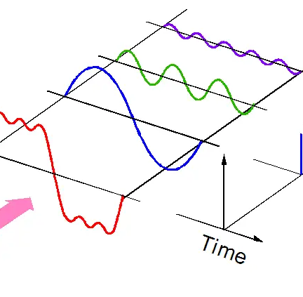
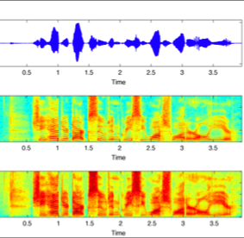
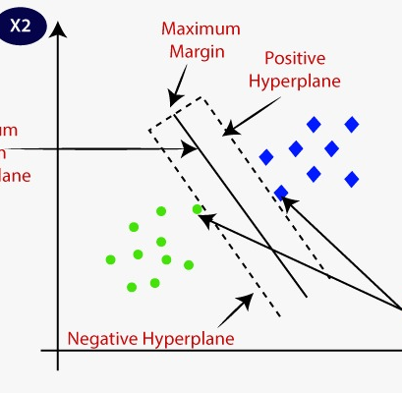
Voice and Speech Analysis
IT20653972 | Maheepala S.A.D.K.H| TMP-2023-24-042

Slide 62
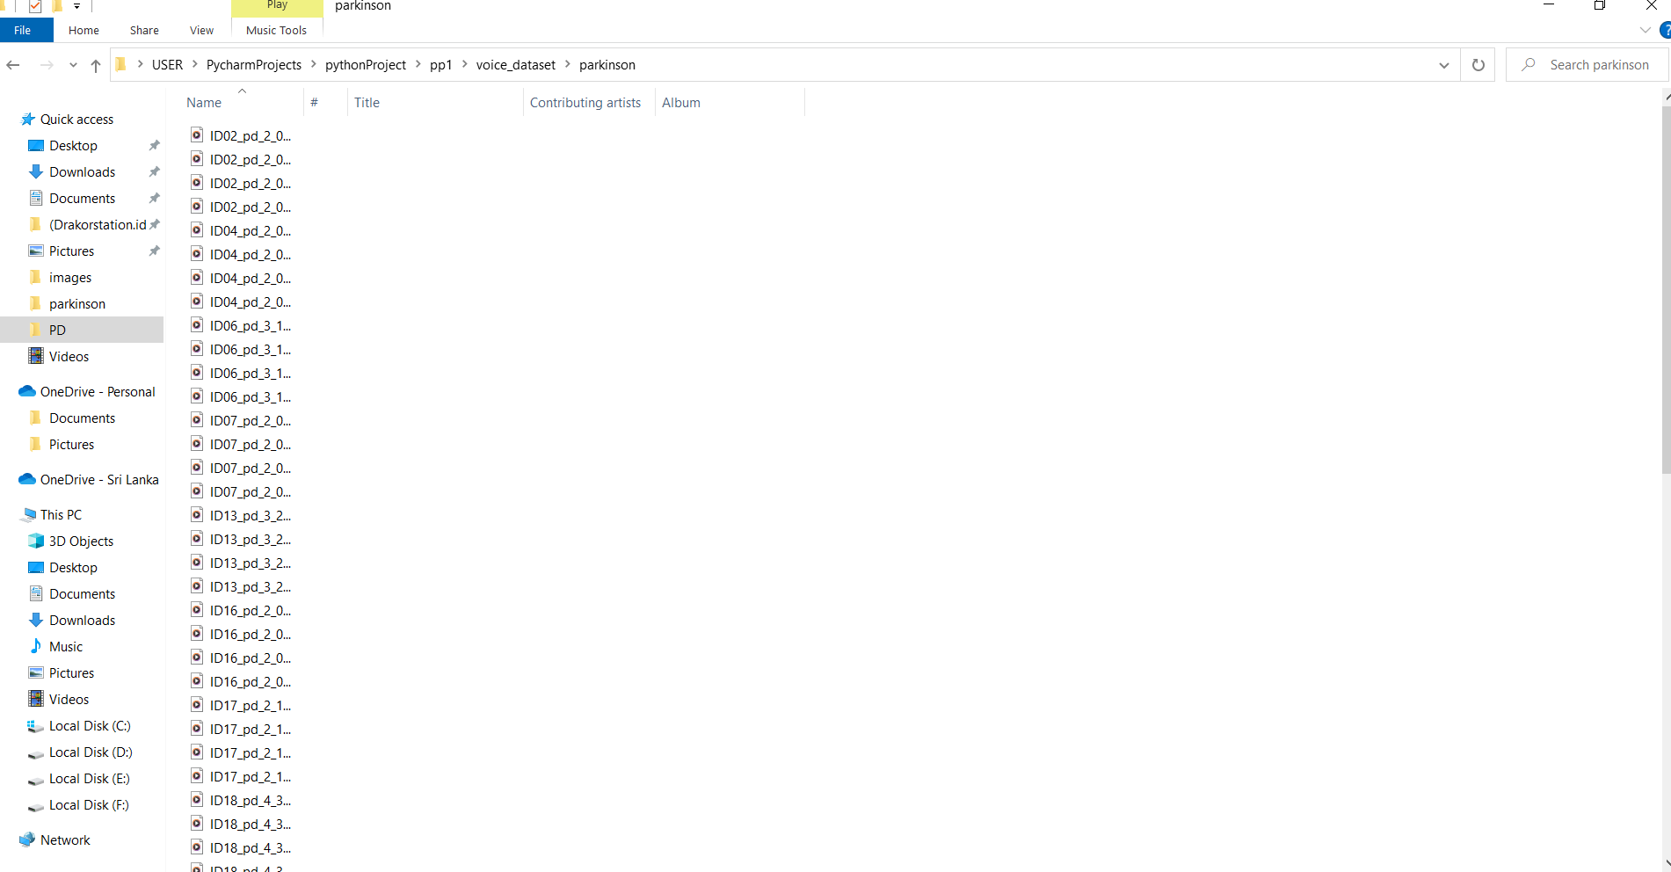
Datasets

Slide 63
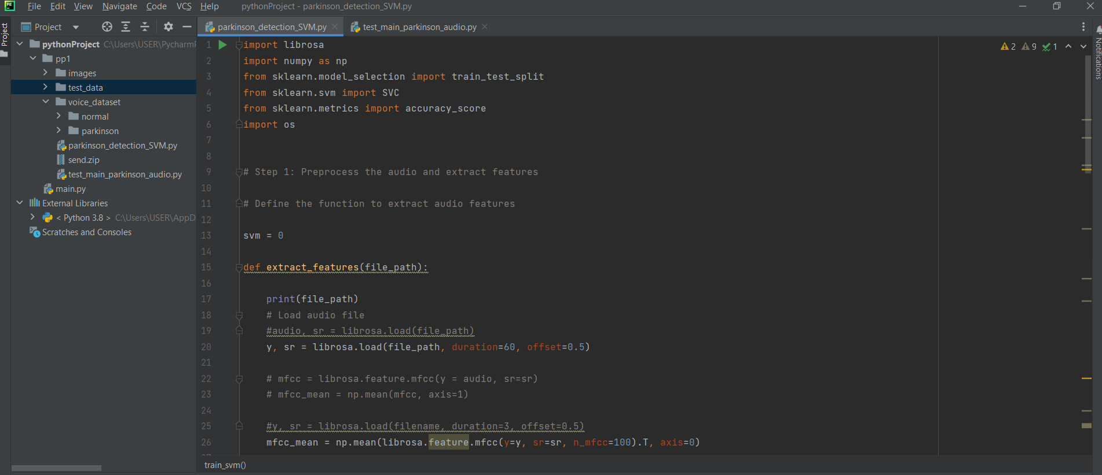
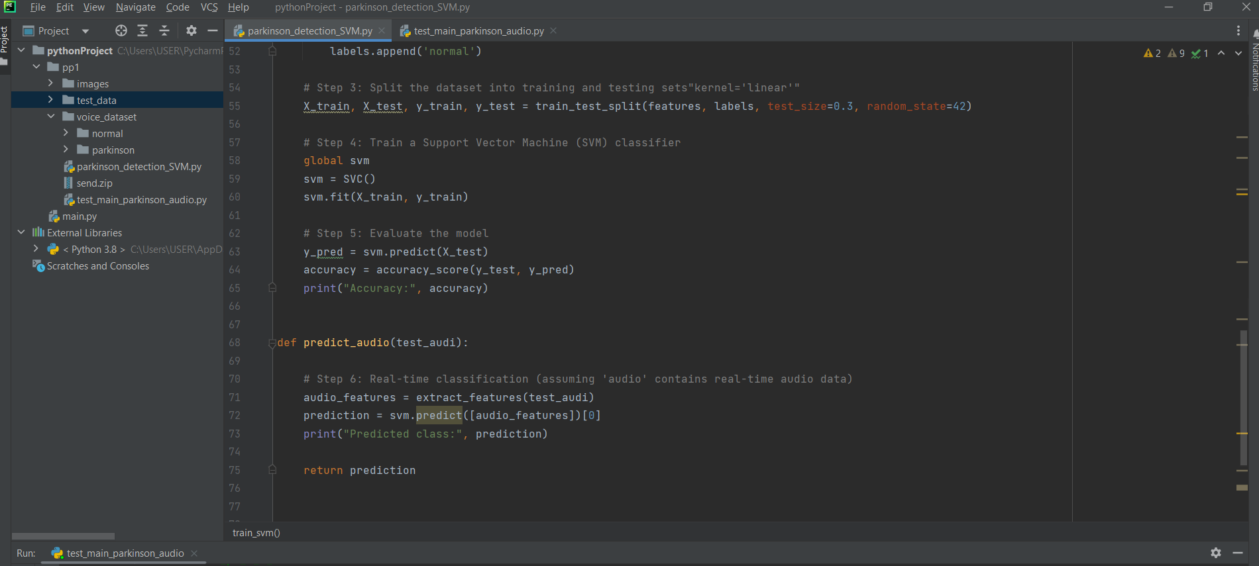
Model Build

Slide 64
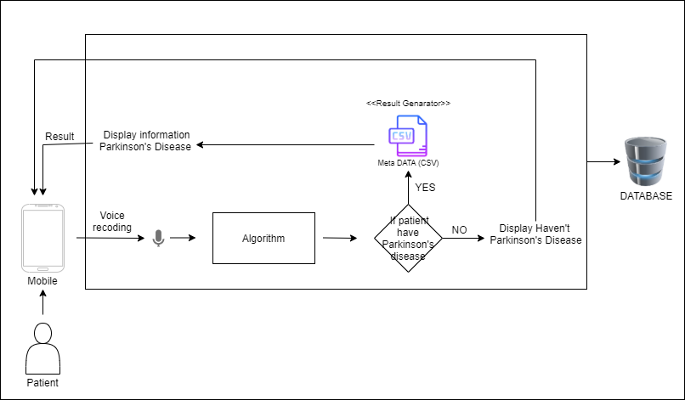
SYSTEM DIAGRAM
IT20653972 | Maheepala S.A.D.K.H| TMP-2023-24-042

Slide 65
TECHNOLOGIES, TECHNIQUES AND ALGORITHMS
Technologies
React native
Python
Anaconda
Node
Flask
Techniques
Feature extraction
Algorithms
Mel Frequency Cepstral Coefficients (MFCC)
IT20653972 | Maheepala S.A.D.K.H| TMP-2023-24-042

Slide 66
SYSTEM, PERSONNEL AND SOFTWARE SPECIFICATION REQUIREMENTS
SOFTWARE REQUIREMENTS
React Native
Python
TensorFlow
Flask Server
Node Server
Jupyter Notebook
NON- FUNCTIONAL REQUIREMENTS
Interfaces should be User-friendly
Application should properly work for mobile platform
Higher accuracy of results
Results should be more efficient
Application should be able to give fast results
FUNCTIONAL REQUIREMENTS
System should be able to detect a Parkinson’s disease.
System should be suggesting the stage of Parkinson disease.
System should be to detect human voice.
System should be able to display a information about patient disease.
PERSONNEL REQUIREMENTS
Dr . Dilum Palliyaguru– External Supervisor
Neurologist At Teaching Hospital Kurunegala
IT20653972 | Maheepala S.A.D.K.H| TMP-2023-24-042

Slide 67
WORK BRAKEDOWN STRUCTURE
Work Breakdown Structure
Voice and Speech Analysis for Early Detection
1. INITIATION
2. PLANNING
3.Development
4. Testing
5. FINALIZE
Integration testing
Identify the Problem
Collecting related dataset
Building the web API
Final Presentation
Analysing the solution
System Architecture design
Mobile application
System testing
Host the Mobile Application
Going through previous solutions
Database design
Integration to the system
Quality assurance
Deploy the web application
Identifying the gaps
Research paper
Research Paper
Constructing the solutions
IT20653972 | Maheepala S.A.D.K.H| TMP-2023-24-042

Slide 68
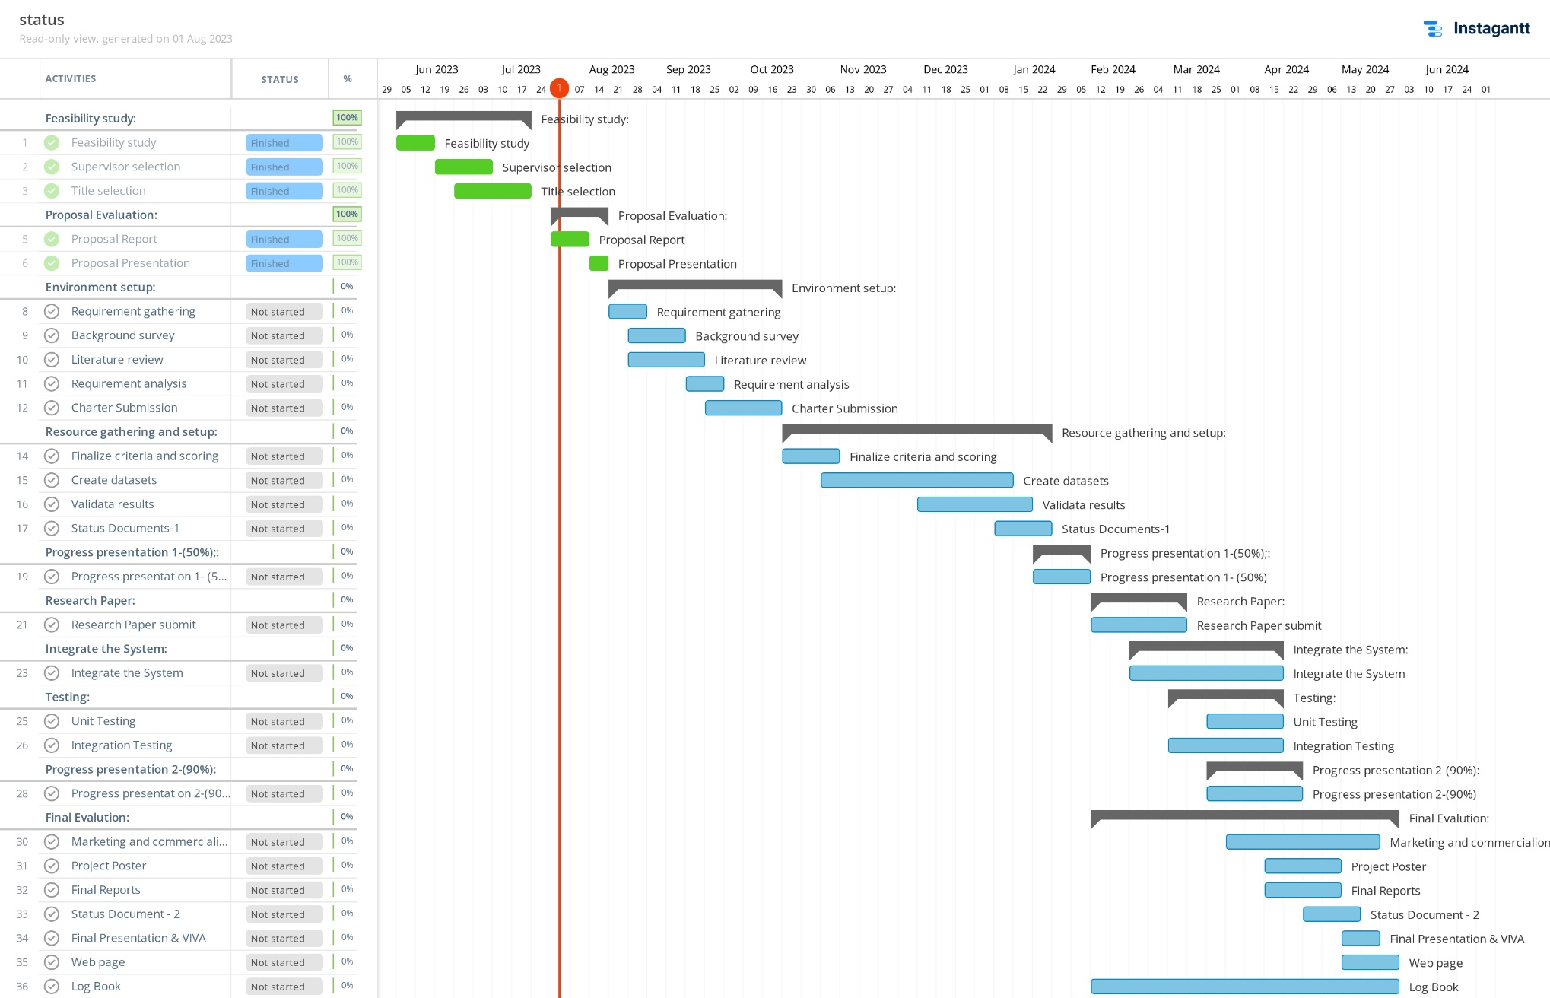
Completion of the project
IT20653972 | Maheepala S.A.D.K.H| TMP-2023-24-042

Slide 69
References
[1] Q. Li, H. Zhang, X. Zhang, and H. Liu Automatic Detection of Parkinson's Disease Based on Various Speech Cues 2020
[2] F. Shah, S. Hossain, A. H. M. S. Rahman, and M. A. UddinParkinson's Disease Detection Based on Speech and Text Features Using Machine Learning 2020
[3] I. Habibah, Y. S. Ong, and T. S. Soon Speech Analysis of Patients with Parkinson's Disease Using Mel Frequency Cepstral Coefficients and Support Vector Machine 2018
[4] Y. M. Mazlan, N. S. M. Razali, and A. R. Ramli A Comparative Study of Acoustic Features and Machine Learning Classifiers for Parkinson's Disease Detection 2017
[5] A. S. Bozkurt, H. Arslan, and S. Yildirim Voice Analysis Algorithms for Early Detection of Parkinson's Disease 2016
IT20653972 | Maheepala S.A.D.K.H| TMP-2023-24-042

Slide 70
Thank You
TMP-2023-24-042

