Slide 1
Android application Development - Project -
MUHAMMAD NADZMI BIN MOHAMED IDZHAM

Slide 2
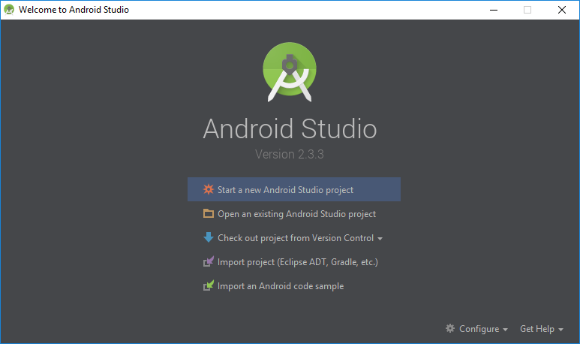
Create New Project

Slide 3
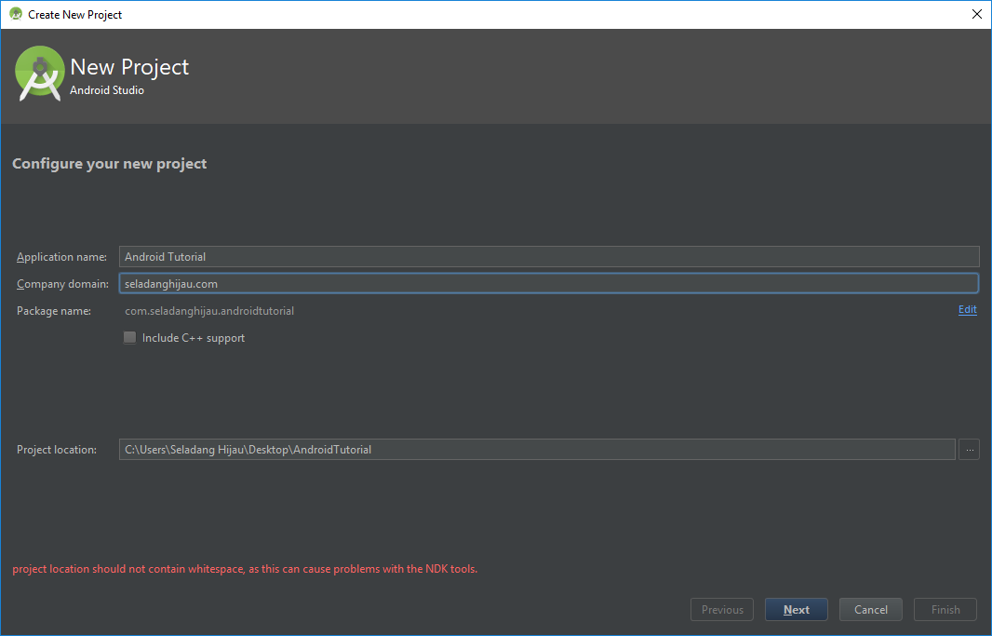
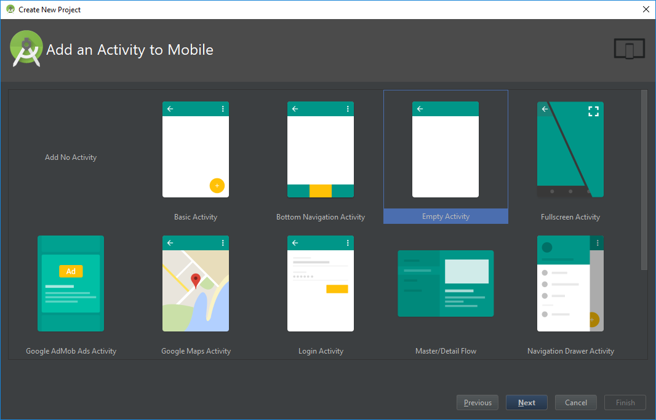
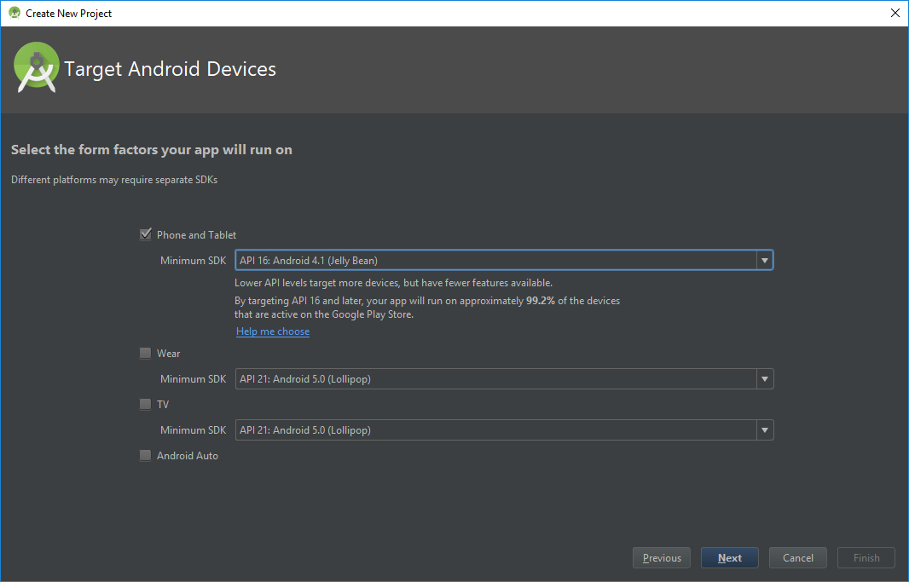
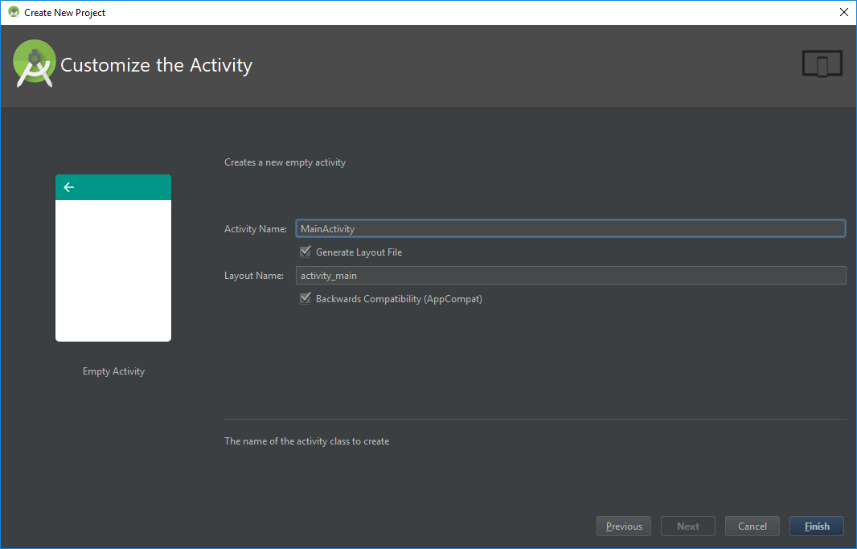

Slide 4
File Structures

Slide 5
Deploy Application

Slide 6
UI

Slide 7
Components

