Slide 1
Android application Development - Project -
MUHAMMAD NADZMI BIN MOHAMED IDZHAM

Slide 2
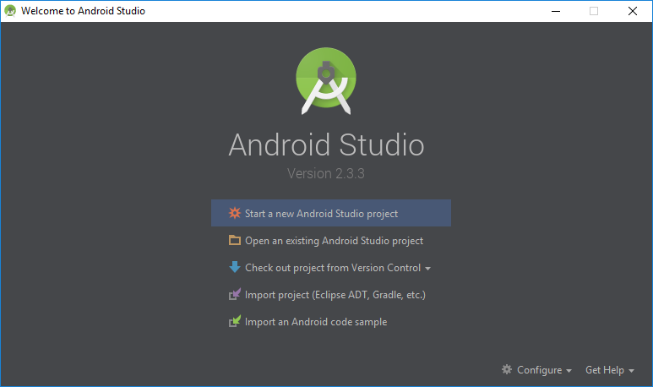
Create New Project

Slide 3
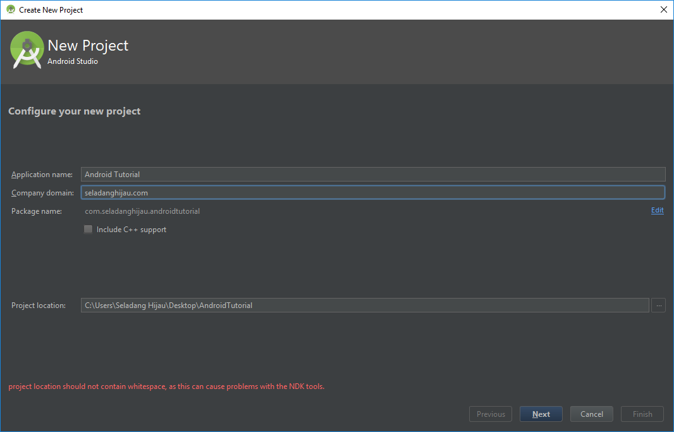
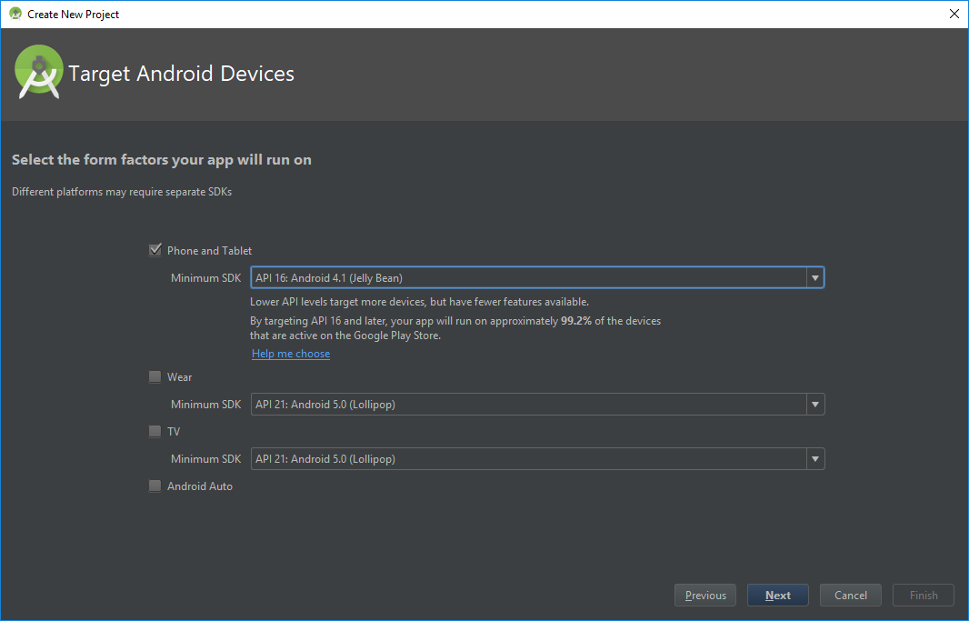
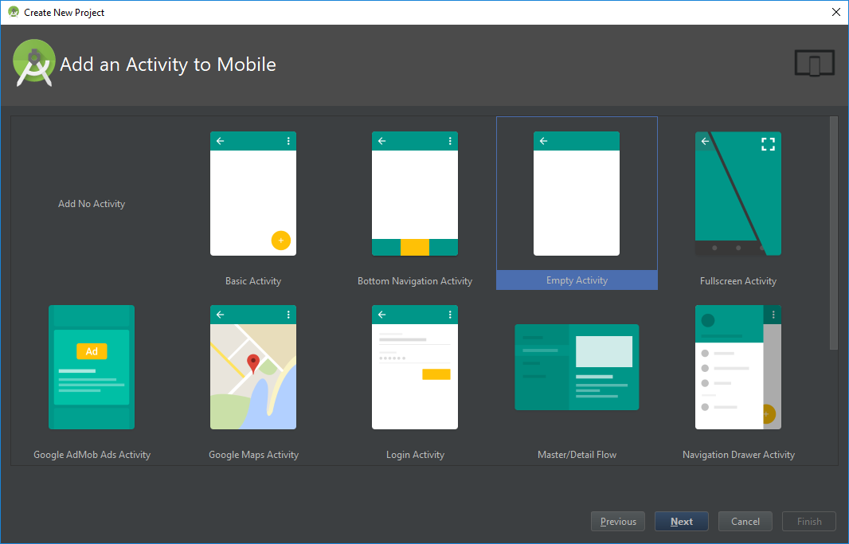
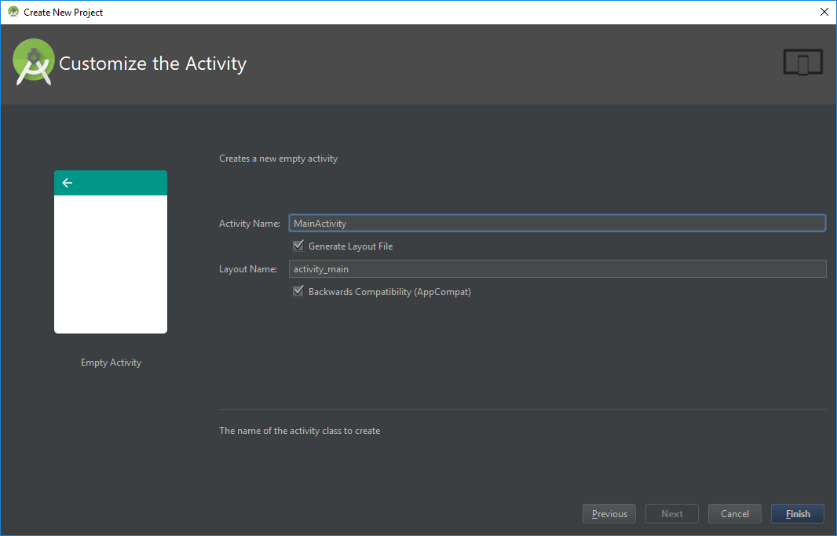
1
2
3
4

Slide 4
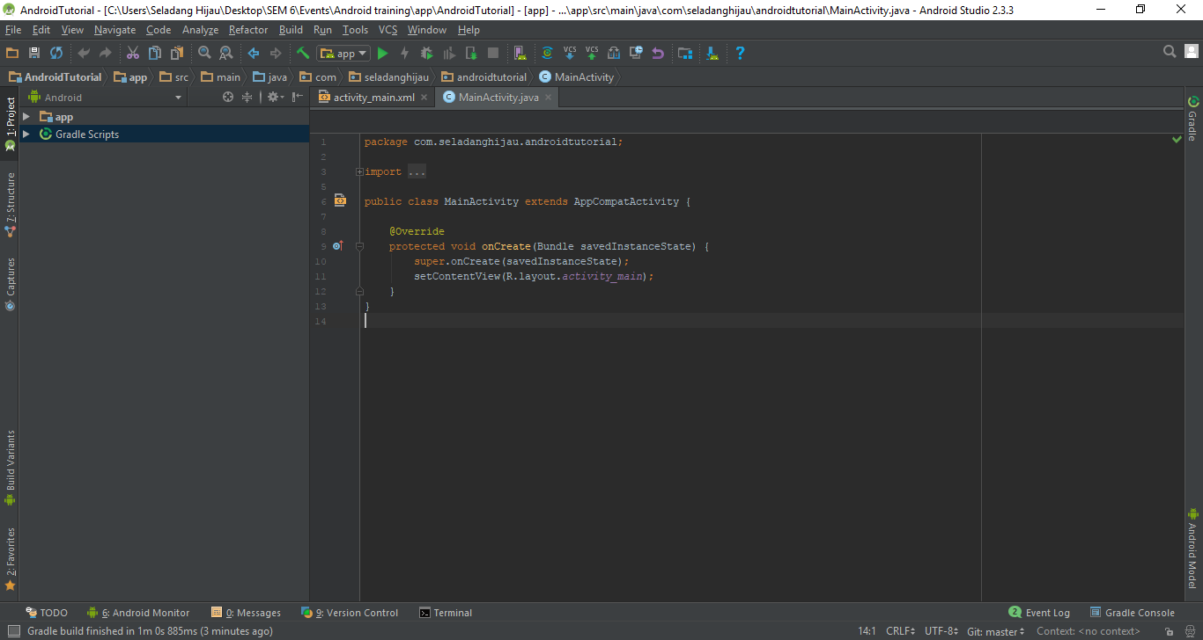

Slide 5
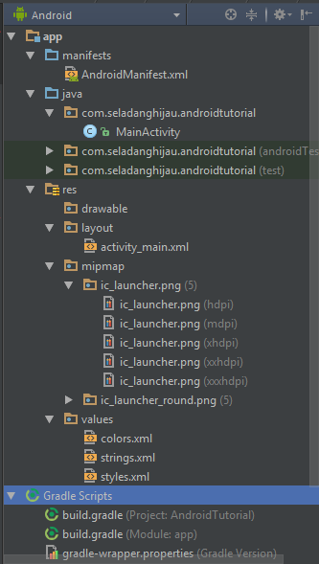
File Structures
App
Manifest
Java
Main Package (com.seladanghijau.androidtutorial)
Res
Drawable
Layout
Mipmap
Values
Gradle script
Build.gradle (Module: app)

Slide 6
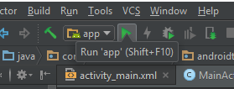
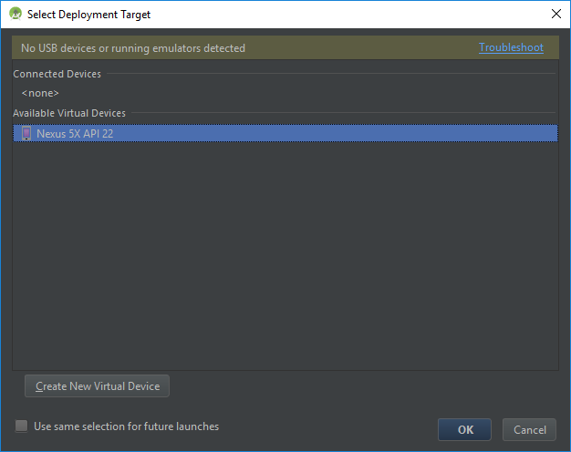
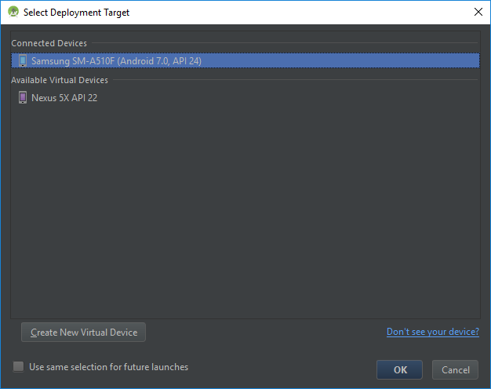
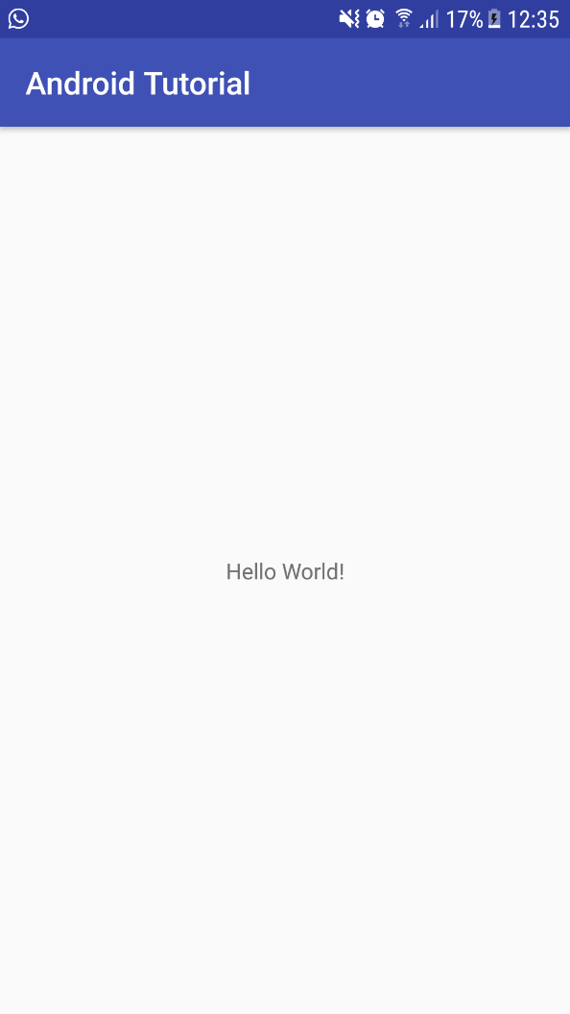
Deploy Application (using external device)
1
2
3
4

Slide 7
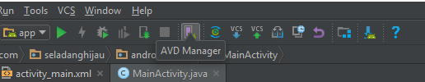
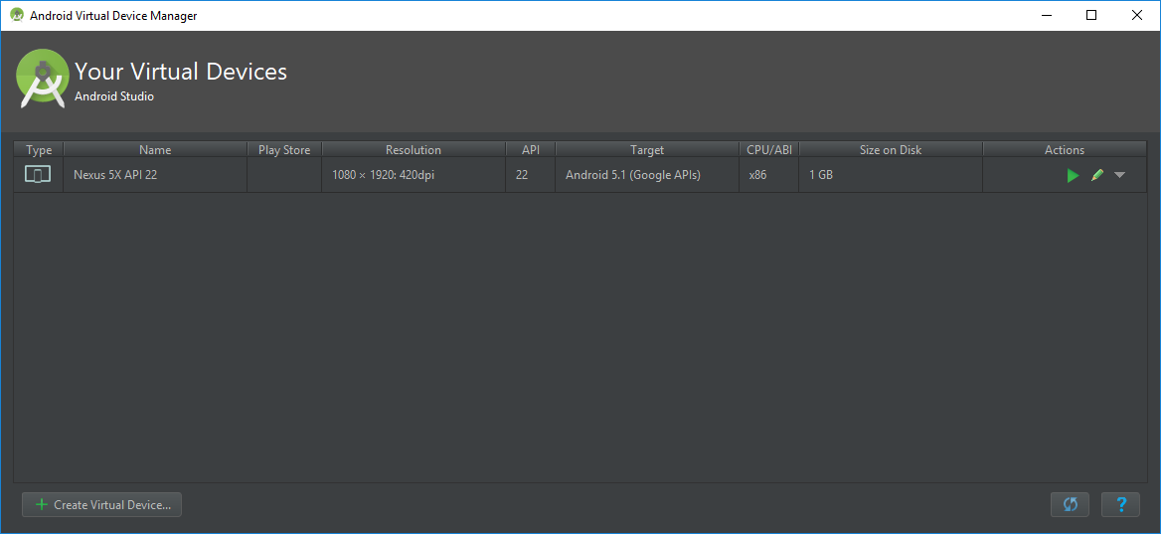
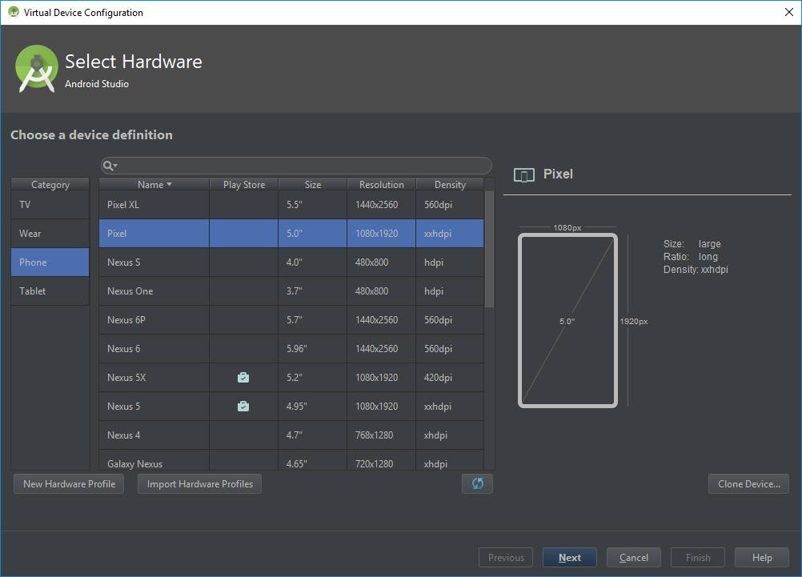
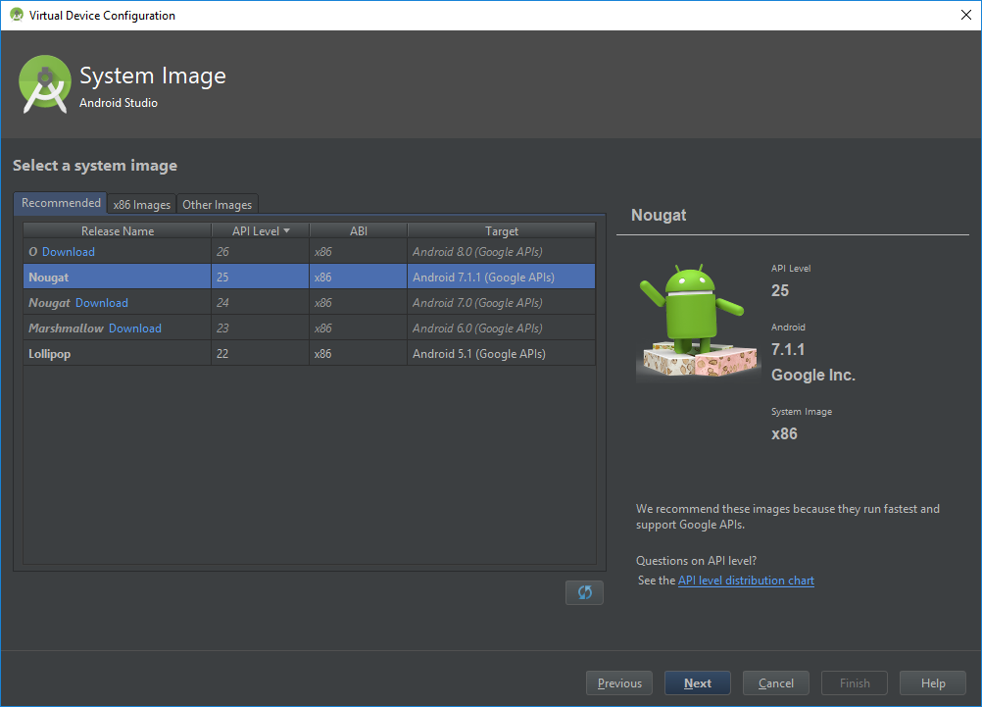
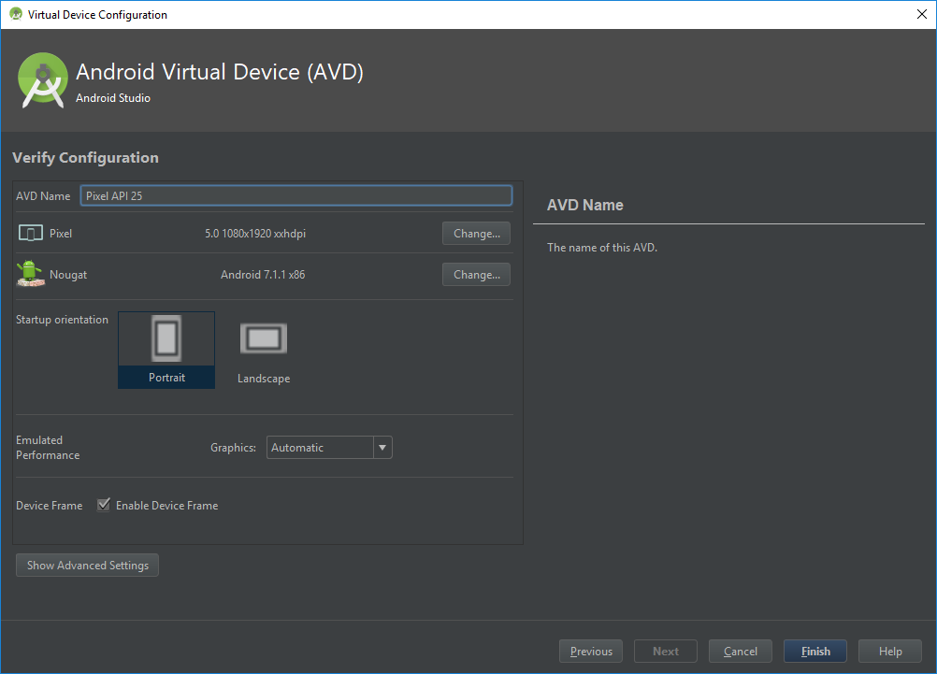
Deploy Application (using virtual device)

Slide 8
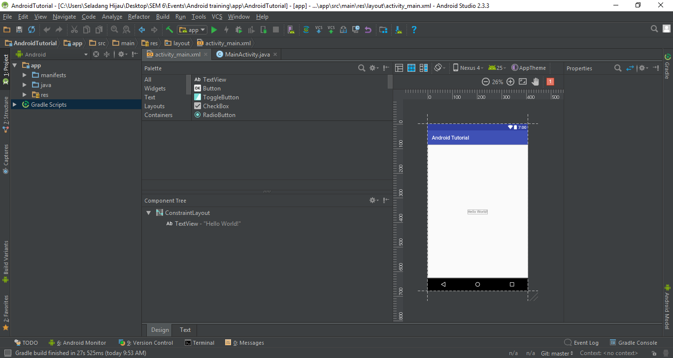
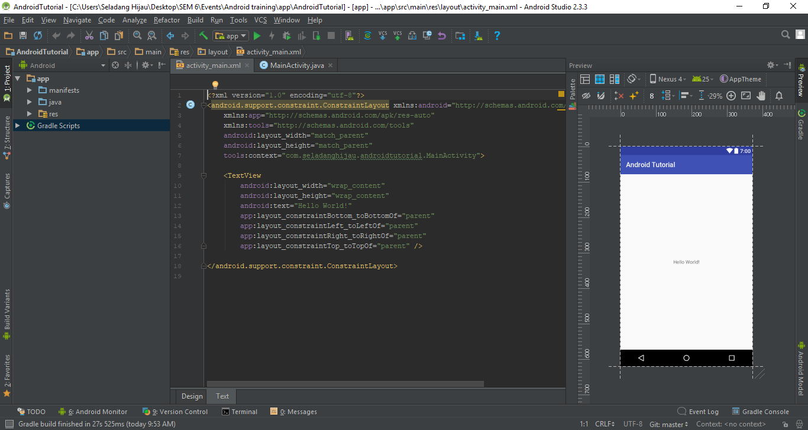
UI

Slide 9

Code area (.xml)
Preview area

Slide 10
Layout
Determine the placement of the views.
Views
Everything that the user can see

Slide 11
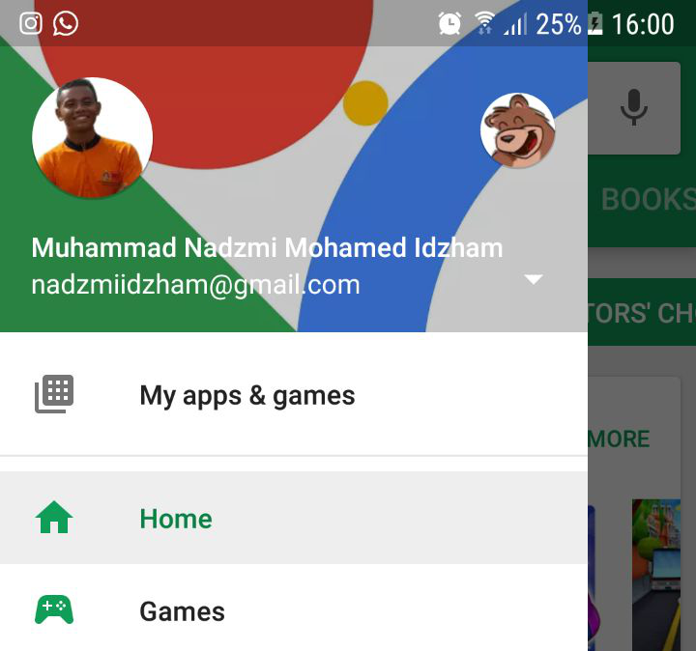
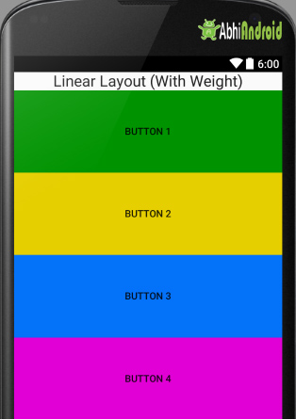
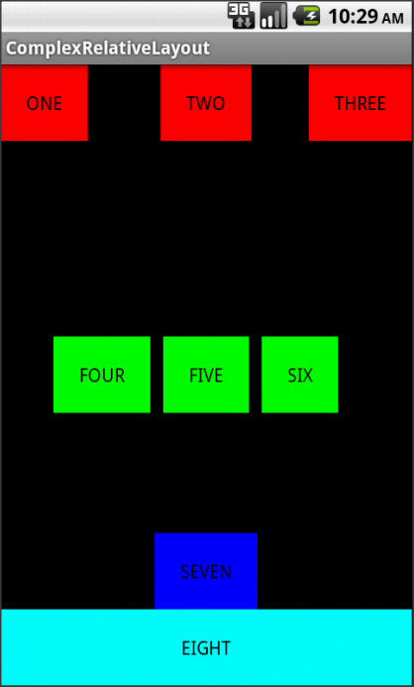
UI Layouts
Characteristic of layout
Properties
Id
Width
Height
Margin
Padding
Orientation
Visible or not
Types of layout
LinearLayout
RelativeLayout
DrawerLayout ***
DrawerLayout
LinearLayout
RelativeLayout

Slide 12
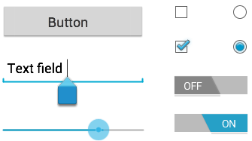
UI Views
Characteristic of views
Properties
Id
Width
Height
Margin
Padding
Focus
Interactive
Visible or not
Types of views
TextView
EditTextView
ButtonView
ScrollView ***

Slide 13
UI View properties
Syntax:
android:<property_name>="<property_value>"
Example: android:layout_width="match_parent"
android:<property_name>="@+id/view_id"
Example: android:id="@+id/show_count"
***
android:<property_name>="@<resource_type>/resource_id"
Example: android:text="@string/button_label_next"

Slide 14
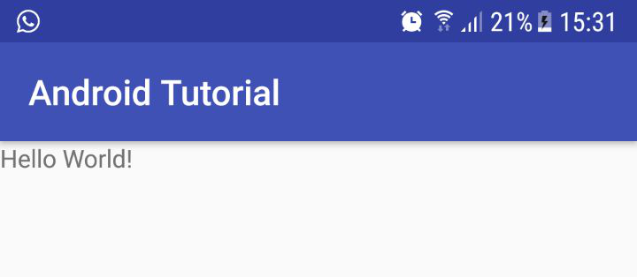
Example of UI Views
<ScrollView android:layout_width="match_parent" android:layout_height="wrap_content"> <!-- view inside of the scrollview (1 view only) --> </ScrollView>
<TextView android:text="Hello World!" android:layout_width="match_parent" android:layout_height="wrap_content" />
Notes:
TextView = output a text
ScrollView = make the page scrollable

Slide 15
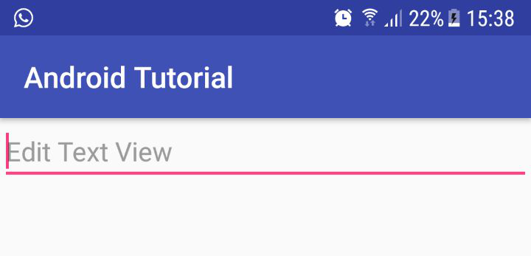
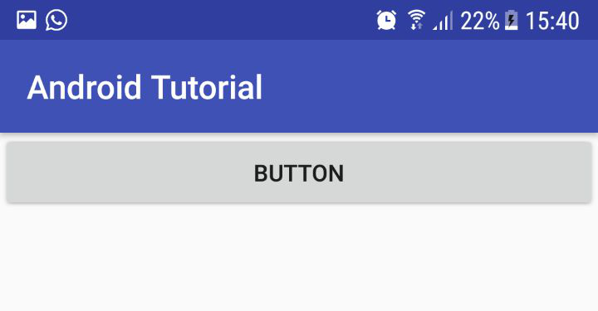
<EditText android:hint="Edit Text View" android:layout_width="match_parent" android:layout_height="wrap_content" />
<Button android:layout_width="match_parent" android:layout_height="wrap_content" android:text="Button" />
Notes:
EditText = input field
Button = standard button

Slide 16
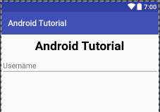
Example
<?xml version="1.0" encoding="utf-8"?> <LinearLayout xmlns:android="http://schemas.android.com/apk/res/android" android:orientation="vertical" xmlns:app="http://schemas.android.com/apk/res-auto" xmlns:tools="http://schemas.android.com/tools" android:layout_width="match_parent" android:layout_height="match_parent" tools:context="com.seladanghijau.androidtutorial.MainActivity"> <TextView android:text="Android Tutorial" android:layout_margin="10dp" android:gravity="center_horizontal" android:layout_width="match_parent" android:layout_height="wrap_content" android:textColor="#000000" android:textStyle="bold" android:textSize="30sp" /> <EditText android:hint="Username" android:layout_width="match_parent" android:layout_height="wrap_content" /> </LinearLayout>

Slide 17
EXERCISE

Slide 18
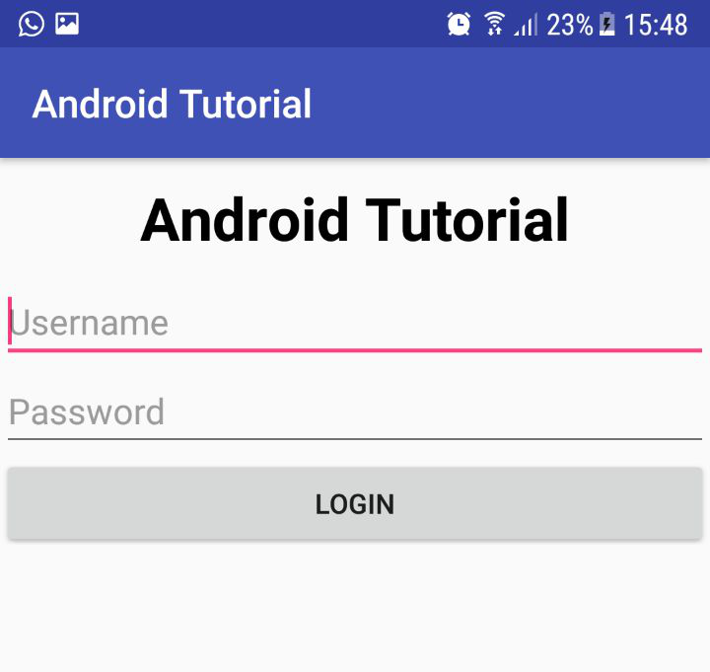
Notes:
Exercise:
Duplicate the above UI

Slide 19
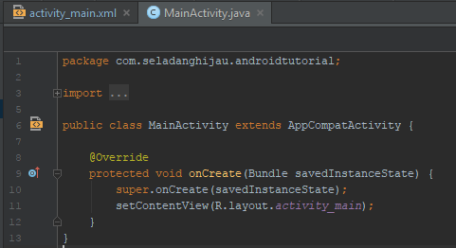
Components
Predefined
Intent
Bundle
All superclasses
User defined
Activity **
AsyncTask Activity **
Fragment
All are Java Classes ***
Activity
Notes:
Explain about the function of the:
onCreate()
setContentView()
R.layout.activity_main

Slide 20
Connect UI with component & do action
Steps:
Initialize ID for every Views that should do something when activated.
Initialize views in component.
Implement OnClickListener class to the UI’s activity class.
Implement OnClick() method in UI’s activity class.
Implement OnClickListener for actionable View.
Implement the action for that view in OnClick() method.

Slide 21
Initialize actionable views’ ID
<EditText android:id="@+id/etUsername" android:hint="Username" android:layout_width="match_parent" android:layout_height="wrap_content" /> <EditText android:id="@+id/etPassword" android:hint="Password" android:layout_width="match_parent" android:layout_height="wrap_content" /> <Button android:id="@+id/btnLogin" android:text="Login" android:layout_width="match_parent" android:layout_height="wrap_content" />

Slide 22
Initialize views in component
public class MainActivity extends AppCompatActivity { EditText etUsername, etPassword; Button btnLogin; @Override protected void onCreate(Bundle savedInstanceState) { super.onCreate(savedInstanceState); setContentView(R.layout.activity_main); // initialize views etUsername = (EditText) findViewById(R.id.etUsername); etPassword = (EditText) findViewById(R.id.etPassword); btnLogin = (Button) findViewById(R.id.btnLogin); } }
<EditText android:id="@+id/etUsername" android:hint="Username" android:layout_width="match_parent" android:layout_height="wrap_content" /> <EditText android:id="@+id/etPassword" android:hint="Password" android:layout_width="match_parent" android:layout_height="wrap_content" /> <Button android:id="@+id/btnLogin" android:text="Login" android:layout_width="match_parent" android:layout_height="wrap_content" />

Slide 23
Implement OnClickListener class and onClick() method in the UI’s activity class
import android.support.v7.app.AppCompatActivity; import android.os.Bundle; import android.view.View; import android.widget.Button; import android.widget.EditText; public class MainActivity extends AppCompatActivity implements View.OnClickListener { EditText etUsername, etPassword; Button btnLogin; @Override protected void onCreate(Bundle savedInstanceState) { super.onCreate(savedInstanceState); setContentView(R.layout.activity_main); // initialize views etUsername = (EditText) findViewById(R.id.etUsername); etPassword = (EditText) findViewById(R.id.etPassword); btnLogin = (Button) findViewById(R.id.btnLogin); } @Override public void onClick(View v) { } }
Import View class
Implement OnClickListener
from View class
Implement onClick() method from
OnClickListener

Slide 24
Implement OnClickListener for actionable View and it’s action in onClick() method
@Override protected void onCreate(Bundle savedInstanceState) {
// initialize views etUsername = (EditText) findViewById(R.id.etUsername); etPassword = (EditText) findViewById(R.id.etPassword); btnLogin = (Button) findViewById(R.id.btnLogin); // initialize OnClickListener btnLogin.setOnClickListener(this); }
1
Setup action when the button is clicked
@Override public void onClick(View v) { switch(v.getId()) { case R.id.btnLogin: String username, password; String message; username = etUsername.getText().toString(); password = etPassword.getText().toString(); message = "Username = " + username + "\nPassword = " + password; Toast.makeText(this, message, Toast.LENGTH_SHORT).show(); break; } }
2
Setup listener for login button to listen for user click
This will produce a popup message

Slide 25
EXERCISE

Slide 26
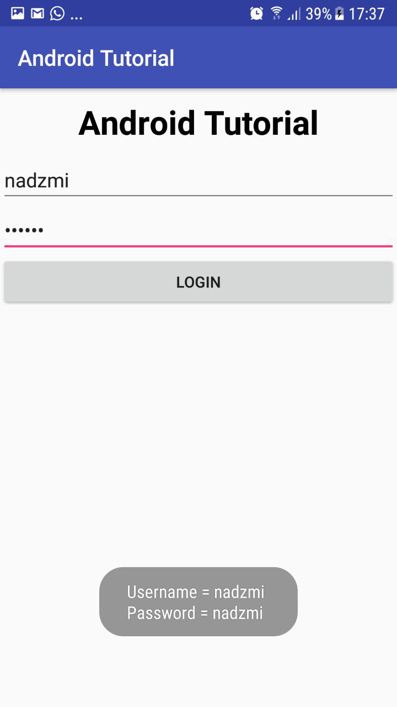
When user click this…
It will output the same thing as
clicking the login button…

Slide 27
Change Activities
Step:
Create new Activity
Trigger new activity with startActivity() function

Slide 28
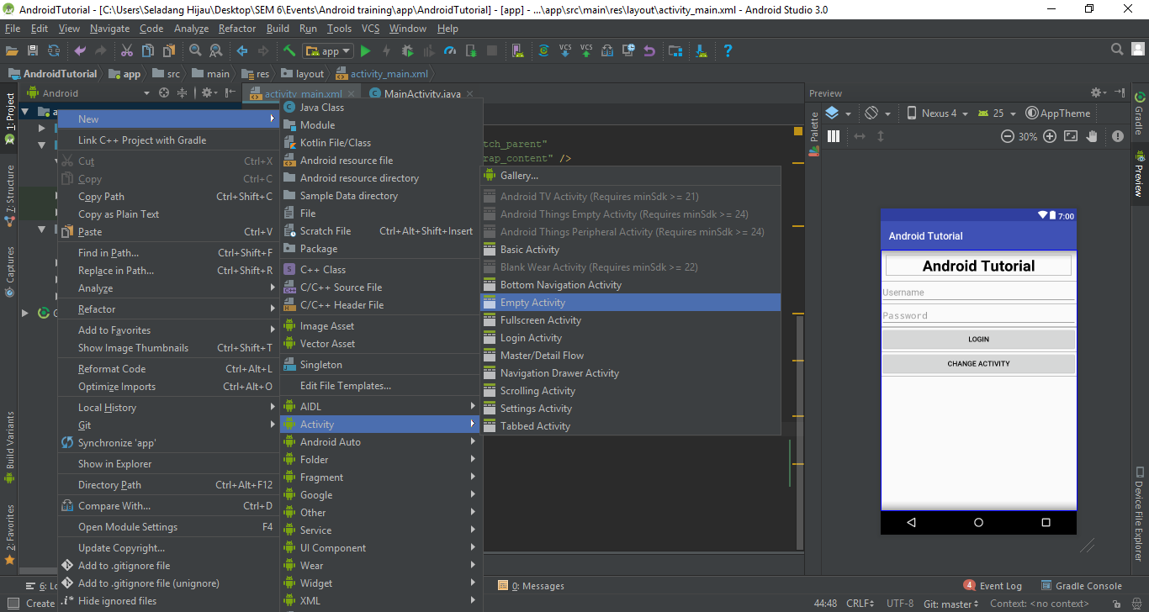

Slide 29
Exchange Data between Activities

Slide 30
Asynctask Activity

Slide 31
Exchange Data with Asynctask

