Slide 1
Android Application Development - Login and Registration -
MUHAMMAD NADZMI BIN MOHAMED IDZHAM

Slide 2
Remote Database
Architecture (Concept)
Technology
PHP
Android Volley library

Slide 3
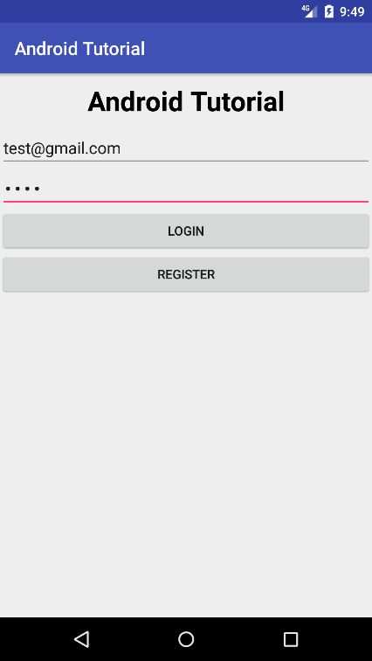
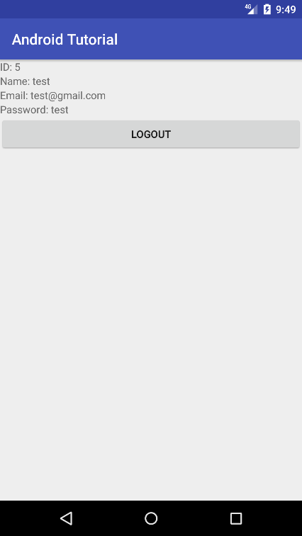
Architexture (Concept)
Request
Database
PHP Application
Response
Remote Server

Slide 4
Technology
PHP
Android Volley library

Slide 6
SQLite Database
Architecture (Concept)
Technology
SQLite
Android Room Persistence library

Slide 7
Architecture (Concept)
Request
DAO
Entity
Response

Slide 8
Technology
PHP
Android Room Persistence library

