Slide 1
Android application Development - Project -
MUHAMMAD NADZMI BIN MOHAMED IDZHAM

Slide 2
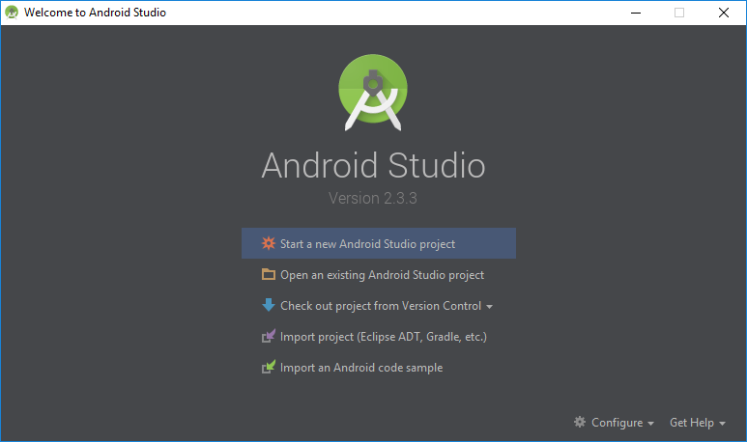
Create New Project

Slide 3
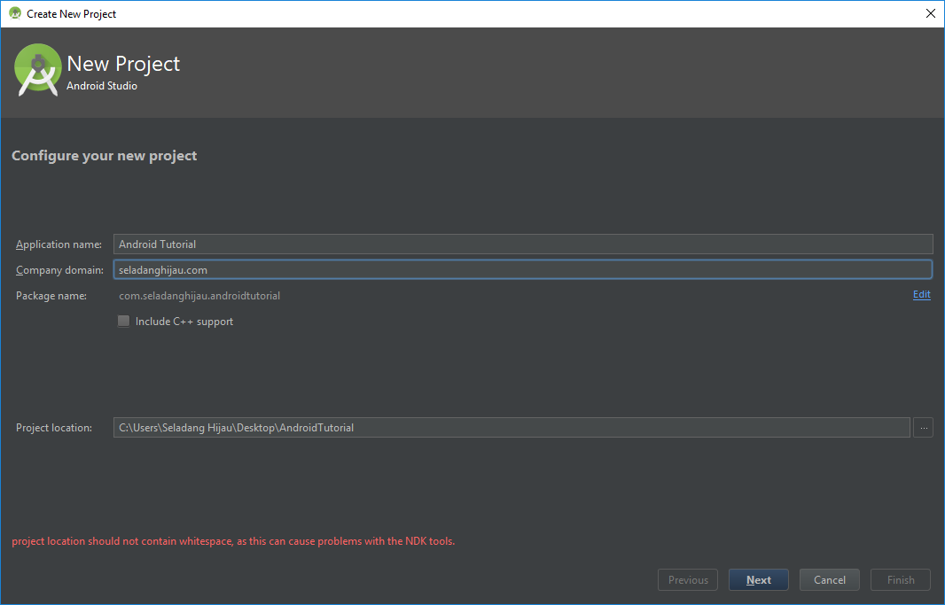
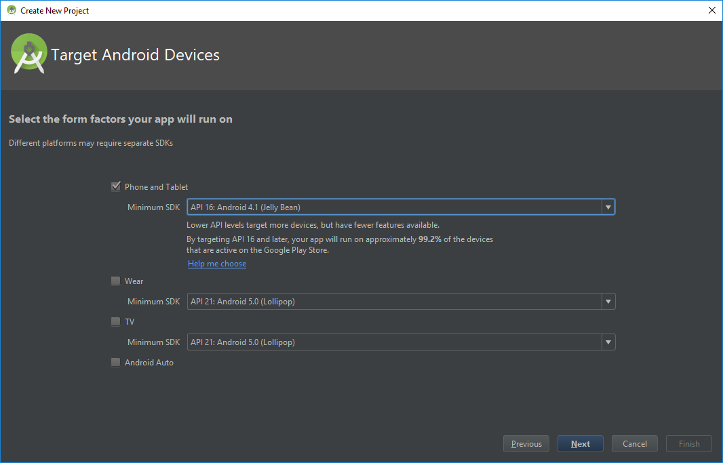
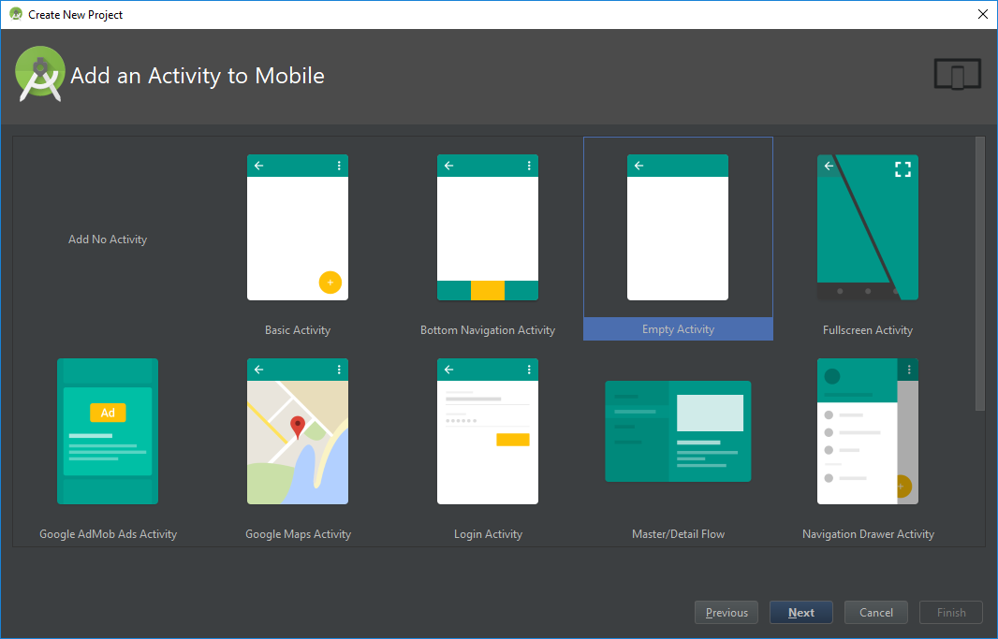
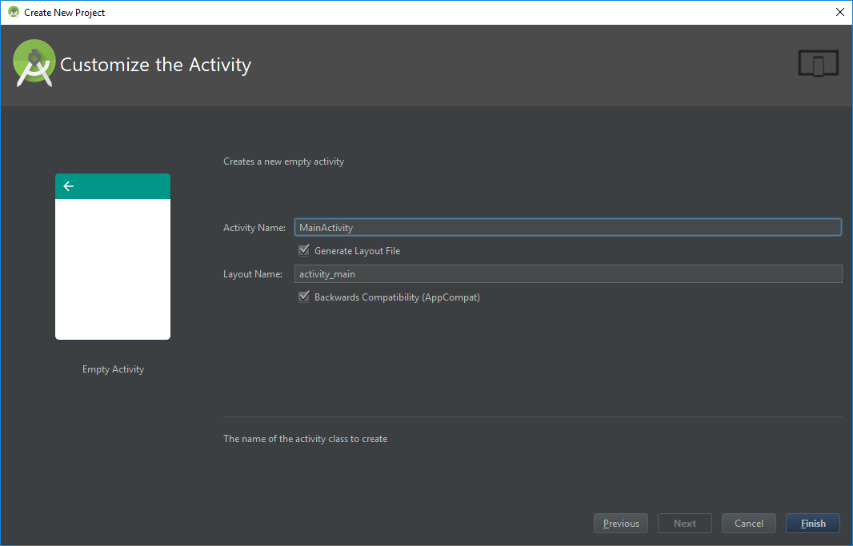
1
2
3
4

Slide 4
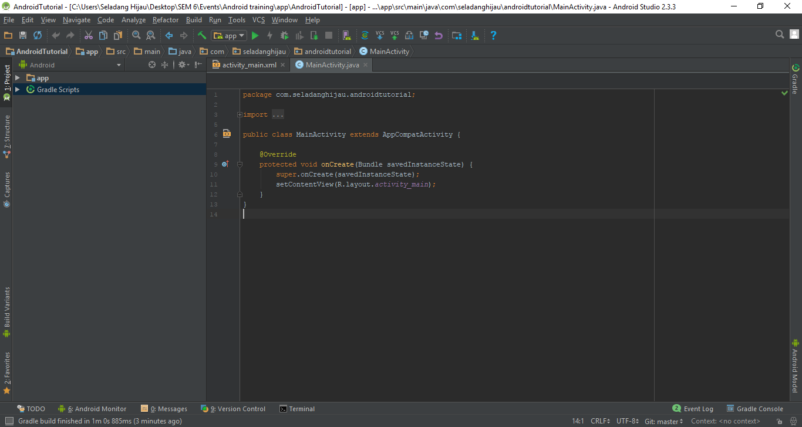

Slide 5
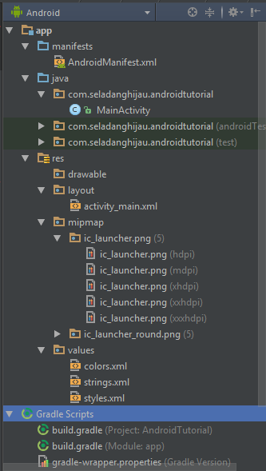
File Structures
App
Manifest
Java
Main Package (com.seladanghijau.androidtutorial)
Res
Drawable
Layout
Mipmap
Values
Gradle script
Build.gradle (Module: app)

Slide 6
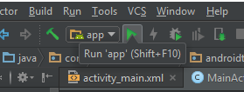
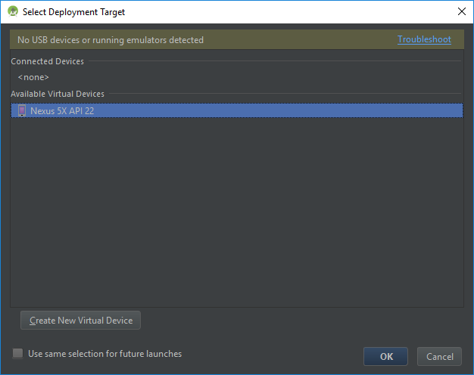
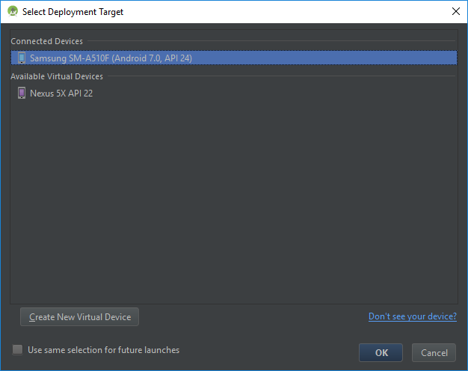
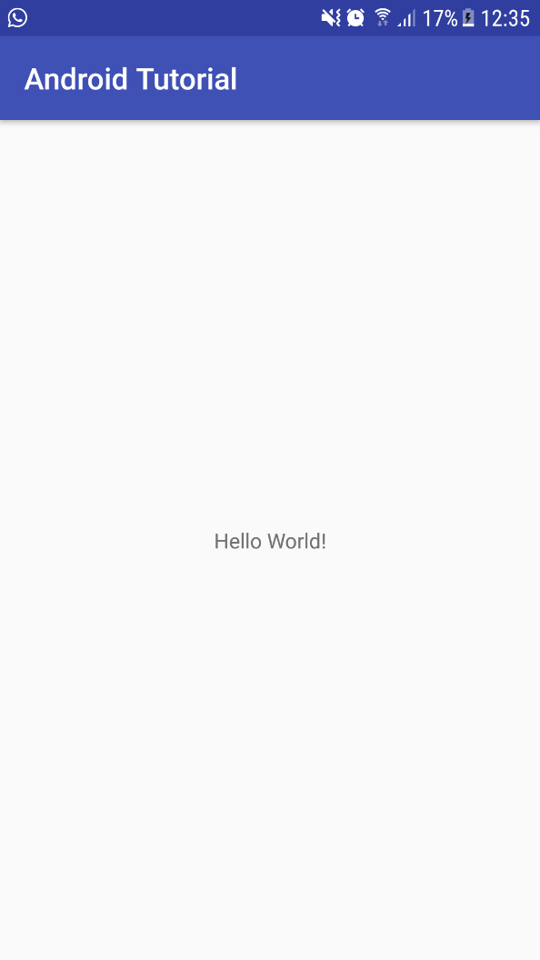
Deploy Application (using external device)
1
2
3
4

Slide 7
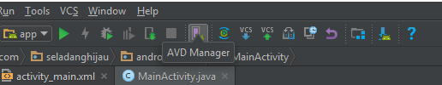
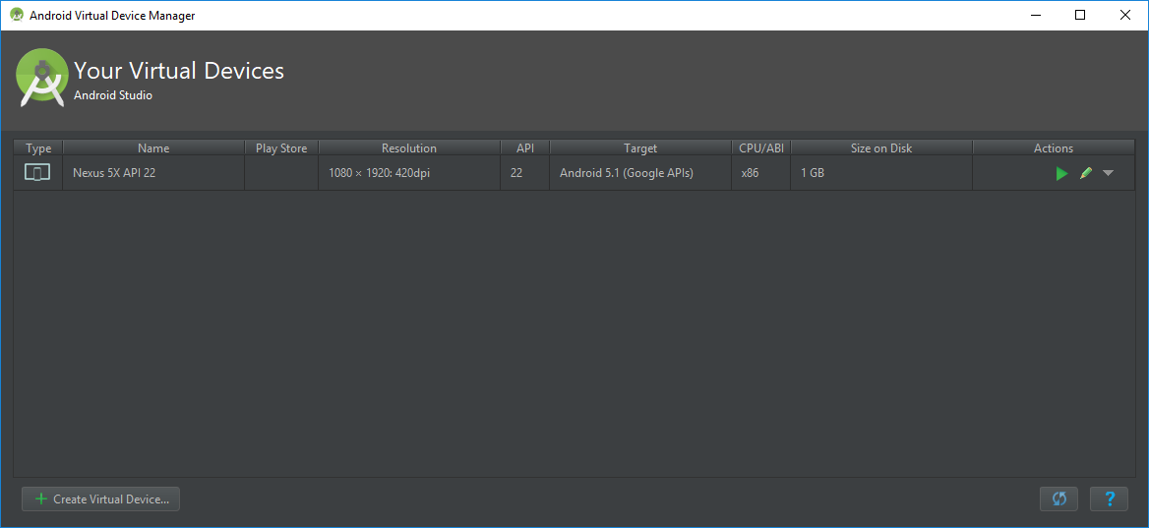
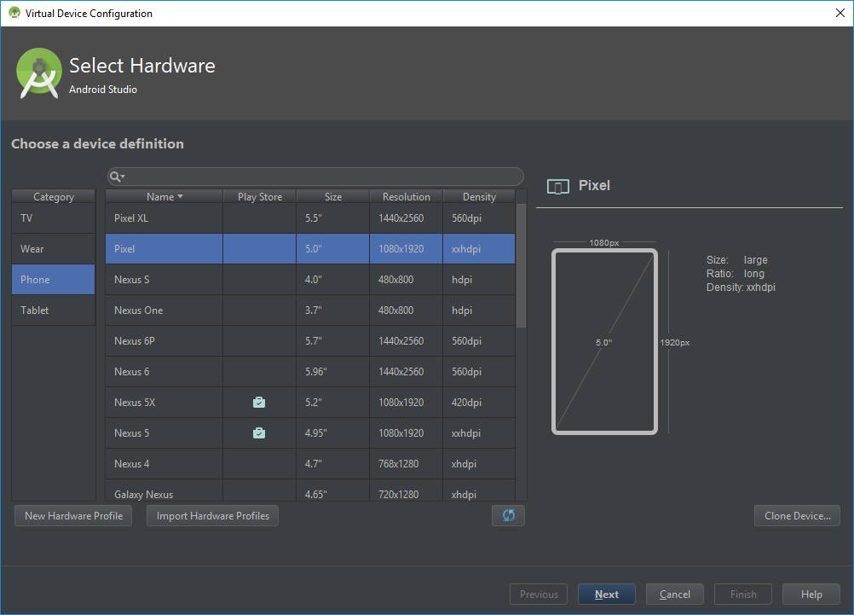
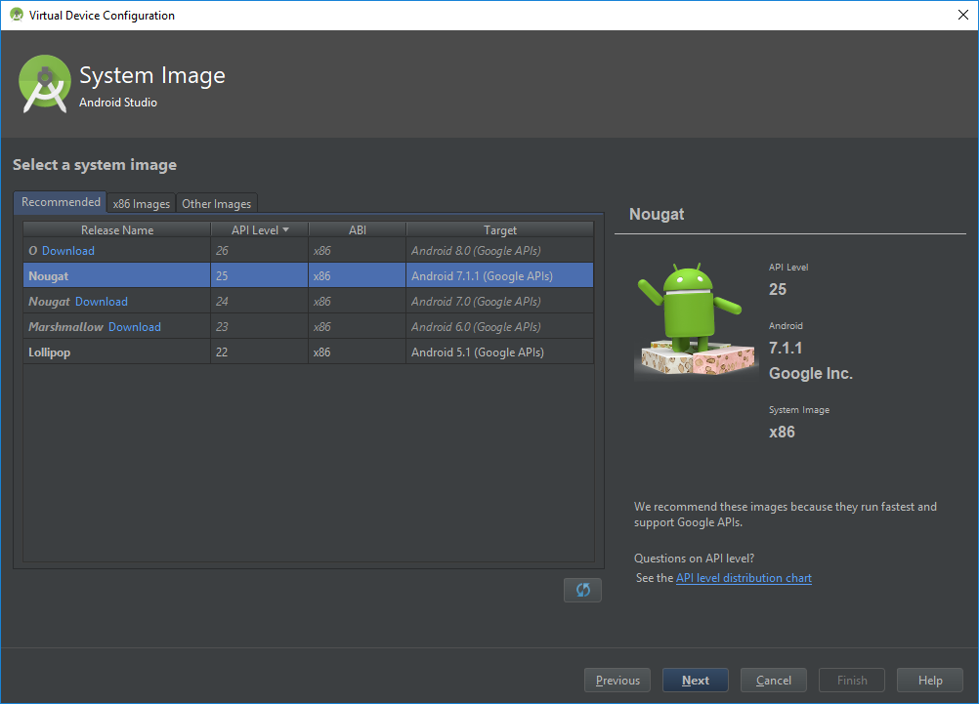
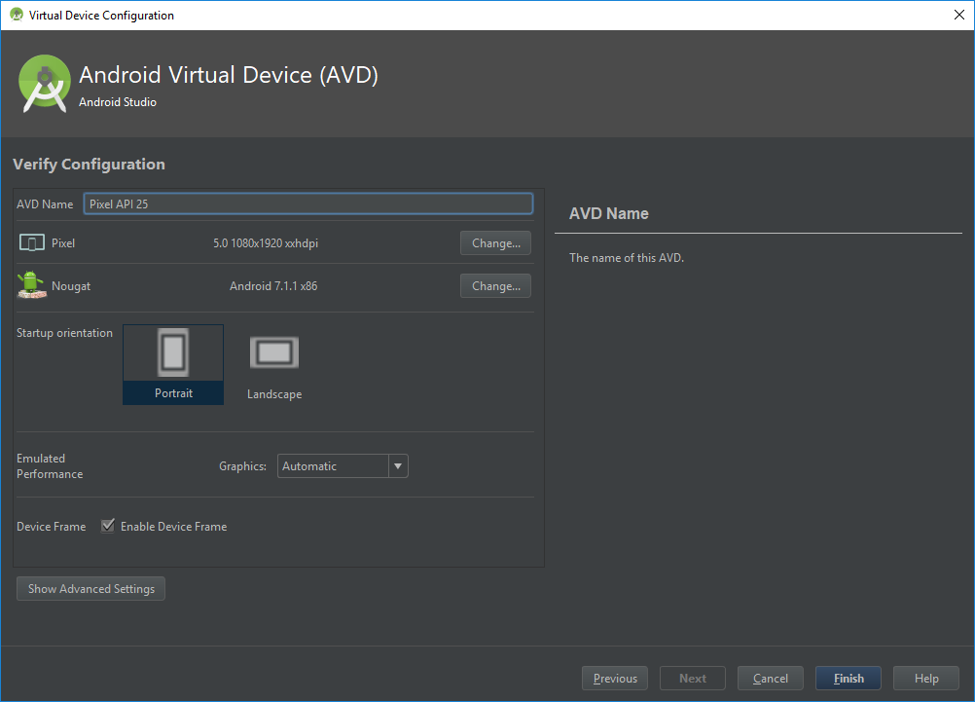
Deploy Application (using virtual device)

Slide 8
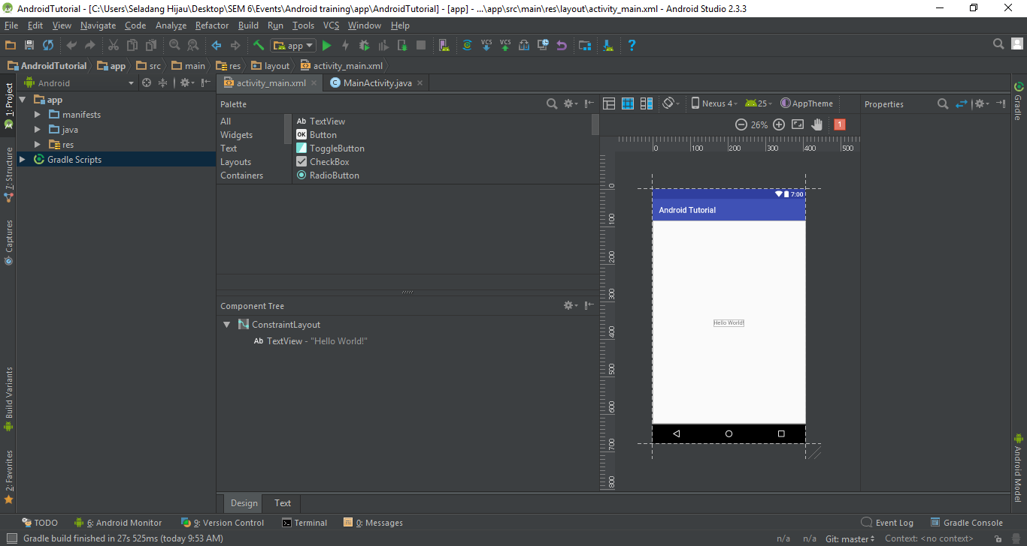
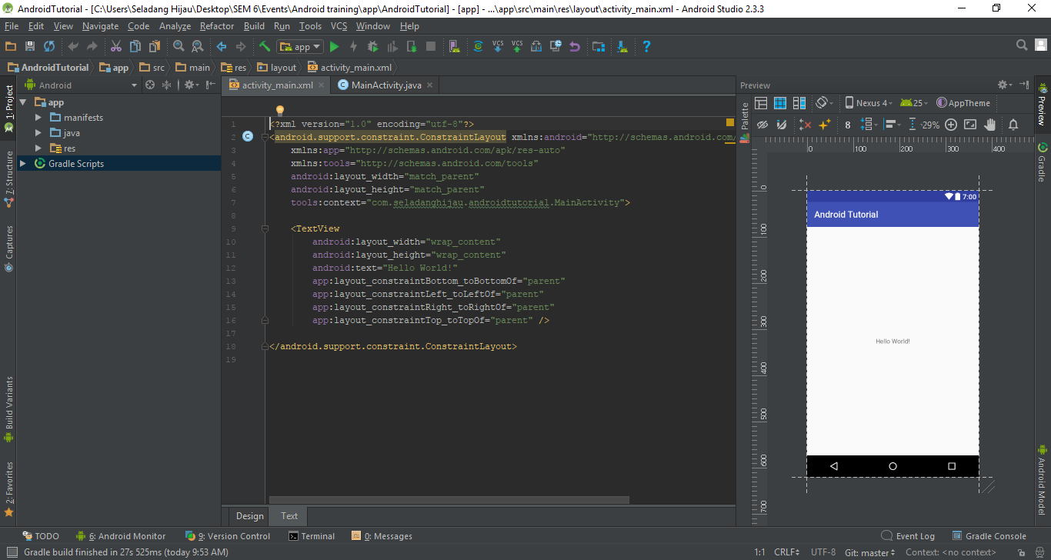
UI

Slide 9

Code area (.xml)
Preview area

Slide 10
Layout
Determine the placement of the views.
Views
Everything that the user can see

Slide 11
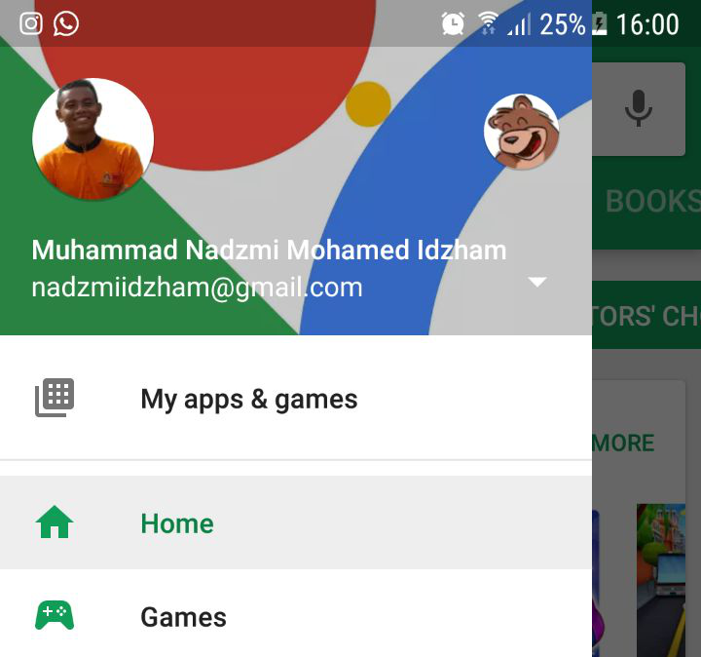
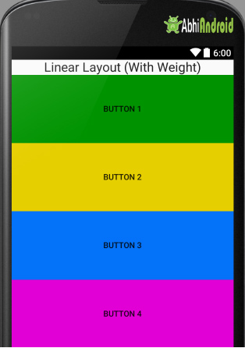
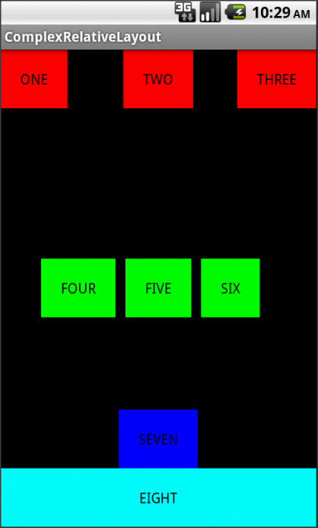
UI Layouts
Characteristic of layout
Properties
Id
Width
Height
Margin
Padding
Orientation
Visible or not
Types of layout
LinearLayout
RelativeLayout
DrawerLayout ***
DrawerLayout
LinearLayout
RelativeLayout

Slide 12
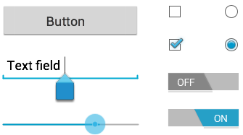
UI Views
Characteristic of views
Properties
Id
Width
Height
Margin
Padding
Focus
Interactive
Visible or not
Types of views
TextView
EditTextView
ButtonView
ScrollView ***

Slide 13
UI View properties
Syntax:
android:<property_name>="<property_value>"
Example: android:layout_width="match_parent"
android:<property_name>="@+id/view_id"
Example: android:id="@+id/show_count"
***
android:<property_name>="@<resource_type>/resource_id"
Example: android:text="@string/button_label_next"

Slide 14
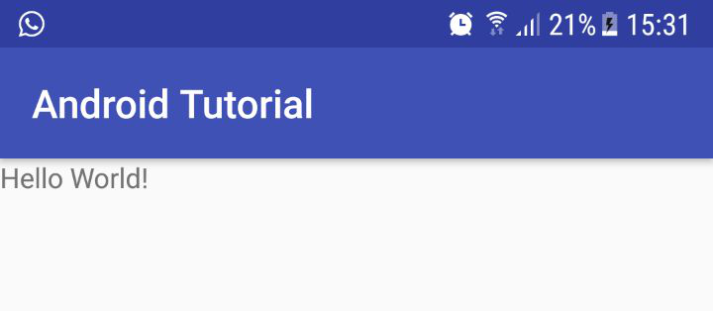
Example of UI Views
<ScrollView android:layout_width="match_parent" android:layout_height="wrap_content"> <!-- view inside of the scrollview (1 view only) --> </ScrollView>
<TextView android:text="Hello World!" android:layout_width="match_parent" android:layout_height="wrap_content" />
Notes:
TextView = output a text
ScrollView = make the page scrollable

Slide 15
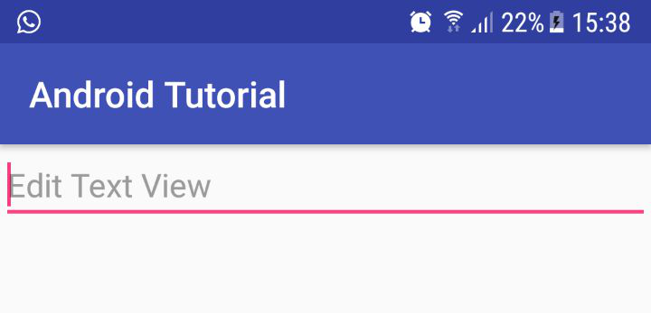
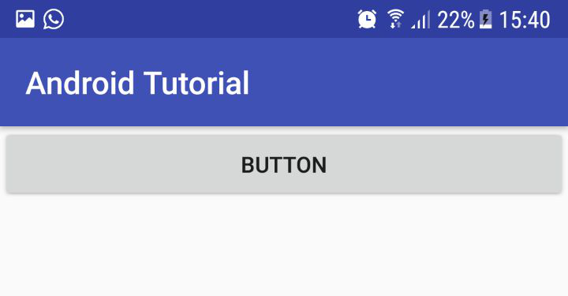
<EditText android:hint="Edit Text View" android:layout_width="match_parent" android:layout_height="wrap_content" />
<Button android:layout_width="match_parent" android:layout_height="wrap_content" android:text="Button" />
Notes:
EditText = input field
Button = standard button

Slide 16
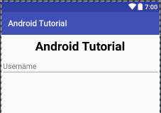
Example
<?xml version="1.0" encoding="utf-8"?> <LinearLayout xmlns:android="http://schemas.android.com/apk/res/android" android:orientation="vertical" xmlns:app="http://schemas.android.com/apk/res-auto" xmlns:tools="http://schemas.android.com/tools" android:layout_width="match_parent" android:layout_height="match_parent" tools:context="com.seladanghijau.androidtutorial.MainActivity"> <TextView android:text="Android Tutorial" android:layout_margin="10dp" android:gravity="center_horizontal" android:layout_width="match_parent" android:layout_height="wrap_content" android:textColor="#000000" android:textStyle="bold" android:textSize="30sp" /> <EditText android:hint="Username" android:layout_width="match_parent" android:layout_height="wrap_content" /> </LinearLayout>

Slide 17
EXERCISE

Slide 18
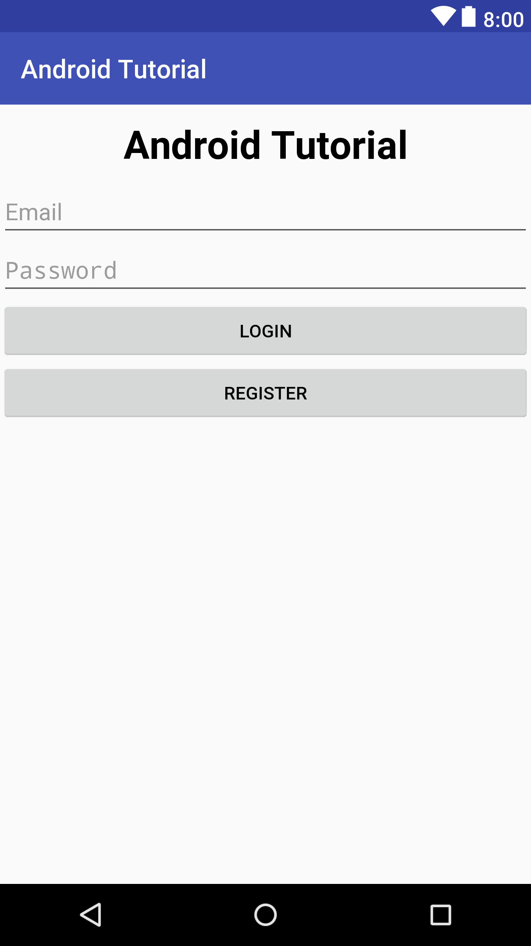
Notes:
Exercise:
Duplicate the above UI

Slide 19
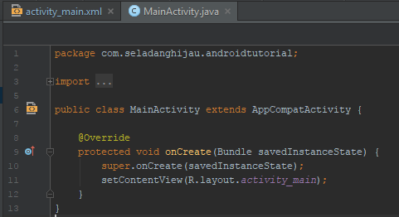
Components
Predefined
Intent
Bundle
All superclasses
User defined
Activity **
AsyncTask Activity **
Fragment
All are Java Classes ***
Activity
Notes:
Explain about the function of the:
onCreate()
setContentView()
R.layout.activity_main

Slide 20
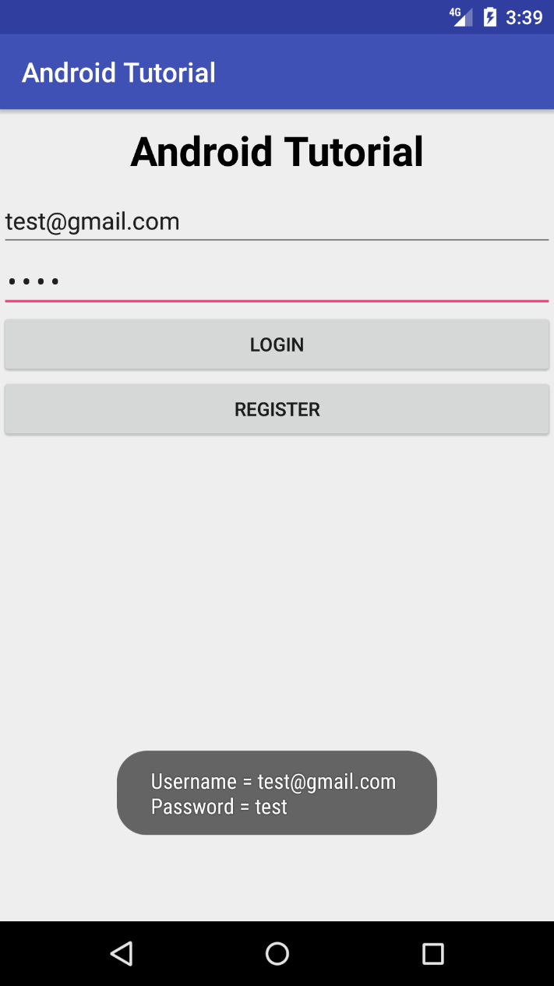
Connect UI with component & do action
Press this
Output this

Slide 21
Connect UI with component & do action
Steps:
Initialize ID for every Views that should do something when activated.
Initialize views in component.
Implement OnClickListener class to the UI’s activity class.
Implement OnClick() method in UI’s activity class.
Implement OnClickListener for actionable View.
Implement the action for that view in OnClick() method.

Slide 22
Initialize actionable views’ ID
<EditText android:id="@+id/etEmail" android:hint=“Email" android:layout_width="match_parent" android:layout_height="wrap_content" /> <EditText android:id="@+id/etPassword" android:hint="Password" android:layout_width="match_parent" android:layout_height="wrap_content" /> <Button android:id="@+id/btnLogin" android:text="Login" android:layout_width="match_parent" android:layout_height="wrap_content" />

Slide 23
Initialize views in component
public class MainActivity extends AppCompatActivity { EditText etEmail, etPassword; Button btnLogin; @Override protected void onCreate(Bundle savedInstanceState) { super.onCreate(savedInstanceState); setContentView(R.layout.activity_main); // initialize views etEmail = (EditText) findViewById(R.id.etEmail); etPassword = (EditText) findViewById(R.id.etPassword); btnLogin = (Button) findViewById(R.id.btnLogin); } }
<EditText android:id="@+id/etEmail" android:hint=“Email" android:layout_width="match_parent" android:layout_height="wrap_content" /> <EditText android:id="@+id/etPassword" android:hint="Password" android:layout_width="match_parent" android:layout_height="wrap_content" /> <Button android:id="@+id/btnLogin" android:text="Login" android:layout_width="match_parent" android:layout_height="wrap_content" />

Slide 24
Implement OnClickListener class and onClick() method in the UI’s activity class
import android.support.v7.app.AppCompatActivity; import android.os.Bundle; import android.view.View; import android.widget.Button; import android.widget.EditText; public class MainActivity extends AppCompatActivity implements View.OnClickListener { EditText etEmail, etPassword; Button btnLogin; @Override protected void onCreate(Bundle savedInstanceState) { super.onCreate(savedInstanceState); setContentView(R.layout.activity_main); // initialize views etEmail = (EditText) findViewById(R.id.etEmail); etPassword = (EditText) findViewById(R.id.etPassword); btnLogin = (Button) findViewById(R.id.btnLogin); } @Override public void onClick(View v) { } }
Import View class
Implement OnClickListener
from View class
Implement onClick() method from
OnClickListener

Slide 25
Implement OnClickListener for actionable View and it’s action in onClick() method
@Override protected void onCreate(Bundle savedInstanceState) {
// initialize views etEmail = (EditText) findViewById(R.id.etEmail); etPassword = (EditText) findViewById(R.id.etPassword); btnLogin = (Button) findViewById(R.id.btnLogin); // initialize OnClickListener btnLogin.setOnClickListener(this); }
1
Setup action when the button is clicked
@Override public void onClick(View v) { switch(v.getId()) { case R.id.btnLogin: String username, password; String message; username = etEmail.getText().toString(); password = etPassword.getText().toString(); message = "Username = " + username + "\nPassword = " + password; Toast.makeText(this, message, Toast.LENGTH_SHORT).show(); break; } }
2
Setup listener for login button to listen for user click
This will produce a popup message

Slide 26
EXERCISE

Slide 27
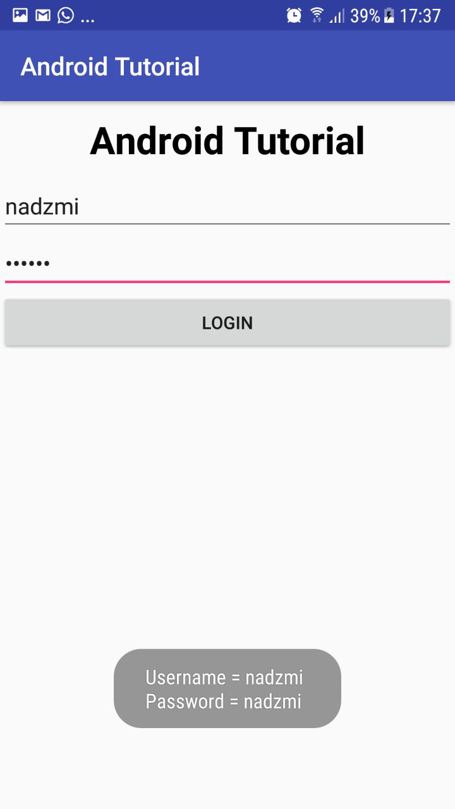
When user click this…
It will output this as Toast

Slide 28
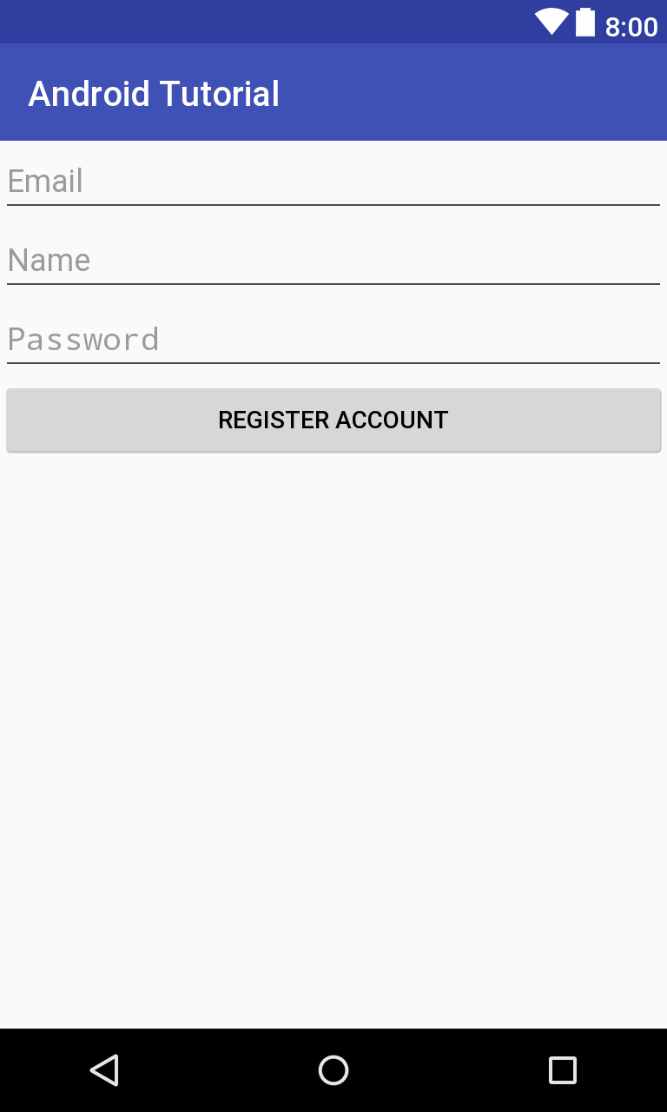
Change Activities

Slide 29
<Button android:id="@+id/btnRegister" android:text="Register" android:layout_width="match_parent" android:layout_height="wrap_content" />

Slide 30
<EditText android:id="@+id/etEmail" android:hint="Email" android:inputType="textEmailAddress" android:layout_width="match_parent" android:layout_height="wrap_content" /> <EditText android:id="@+id/etName" android:hint="Name" android:inputType="text" android:layout_width="match_parent" android:layout_height="wrap_content" /> <EditText android:id="@+id/etPassword" android:hint="Password" android:inputType="textPassword" android:layout_width="match_parent" android:layout_height="wrap_content" />
<Button android:id="@+id/btnRegister" android:text="Register Account" android:layout_width="match_parent" android:layout_height="wrap_content" />

Slide 31
Starting a new activities
Syntax:
Intent <intentName> = new Intent(<context>, <otherActivity>.class);
startActivity(<intentName>);
Example:
Intent registerPage = new Intent(this, Register.class); startActivity(registerPage);
- or -
startActivity(new Intent(this, Register.class));

Slide 32
Implementation
@Override public void onClick(View v) { switch(v.getId()) { case R.id.btnRegister: startActivity(new Intent(this, Register.class)); break; } }

Slide 33
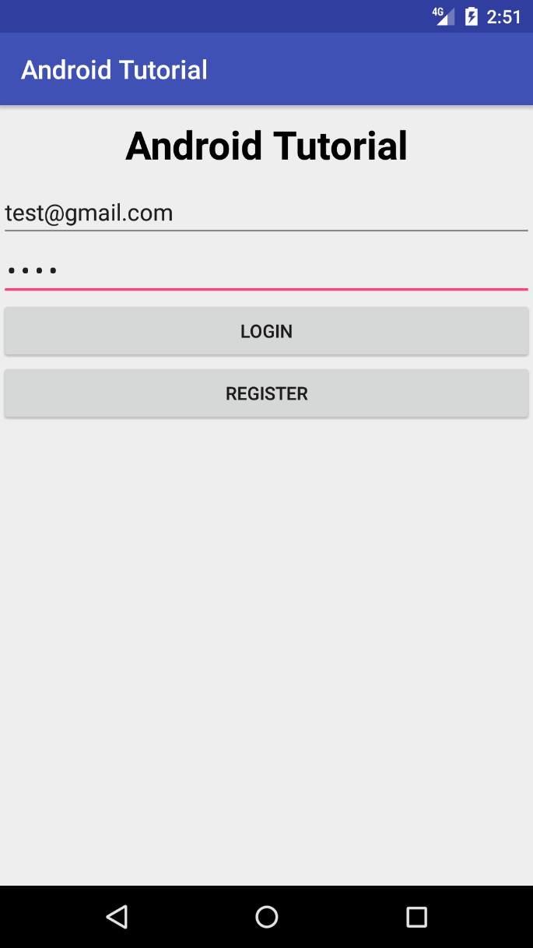
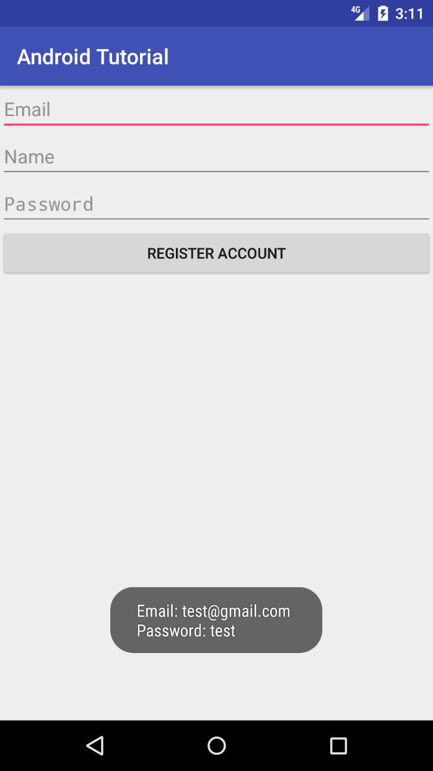
Exchange Data between Activities

Slide 34
Send data
Syntax:
<intentName>.putExtra(<key>, <value>);
Example:
Intent registerPage = new Intent(this, Register.class); registerPage.putExtra("sampleMessage",
"This is a sample message from Login Page."); startActivity(registerPage);

Slide 35
Implementation:
public void onClick(View v) { switch(v.getId()) { case R.id.btnRegister: Intent registerPage = new Intent(this, Register.class); String email = etEmail.getText().toString(); String password = etPassword.getText().toString(); registerPage.putExtra("email", email); registerPage.putExtra("password", password); startActivity(registerPage); break; } }

Slide 36
Receive data
Syntax:
getIntent().getStringExtra(<keyName>);
Example:
String email = getIntent().getStringExtra("email");

Slide 37
Implementation:
protected void onCreate(Bundle savedInstanceState) { super.onCreate(savedInstanceState); setContentView(R.layout.activity_register); // initialize views etEmail = (EditText) findViewById(R.id.etEmail); etName = (EditText) findViewById(R.id.etName); etPassword = (EditText) findViewById(R.id.etPassword); btnRegister = (Button) findViewById(R.id.btnRegister); // initialize listener btnRegister.setOnClickListener(this); String getEmail = getIntent().getStringExtra("email"); String getPassword = getIntent().getStringExtra("password"); Toast.makeText(this, "Email: " + getEmail + "\nPassword: " + getPassword,
Toast.LENGTH_LONG).show(); }

Slide 38
EXERCISE

Slide 39
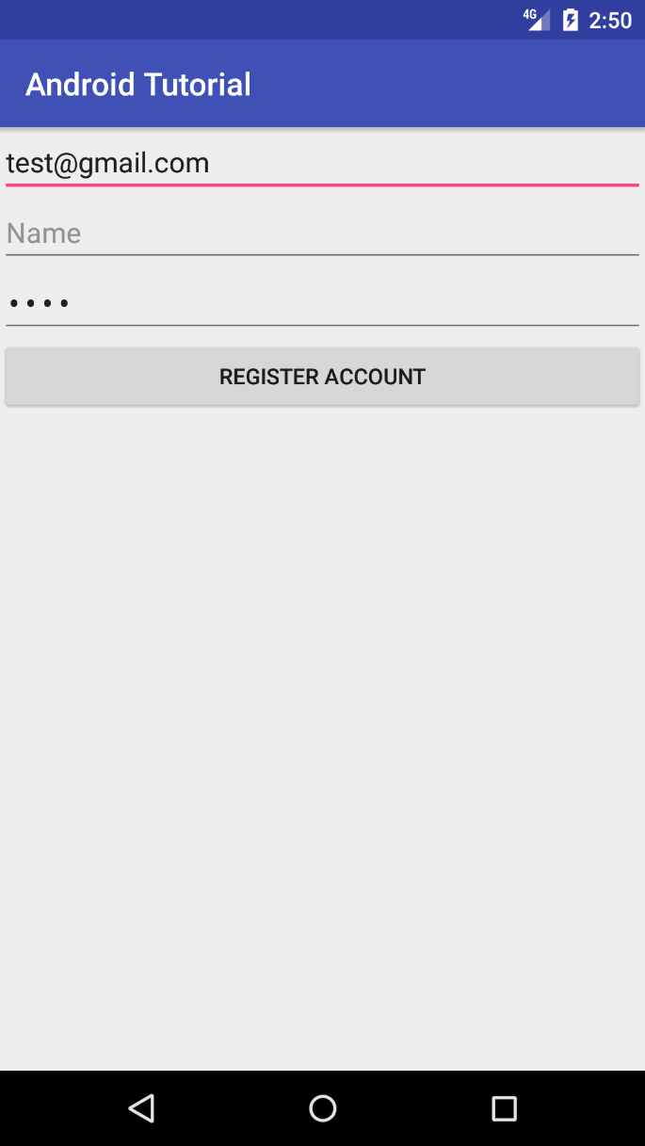

Slide 40
Asynctask Activity

Slide 41
Exchange Data with Asynctask

