Slide 1
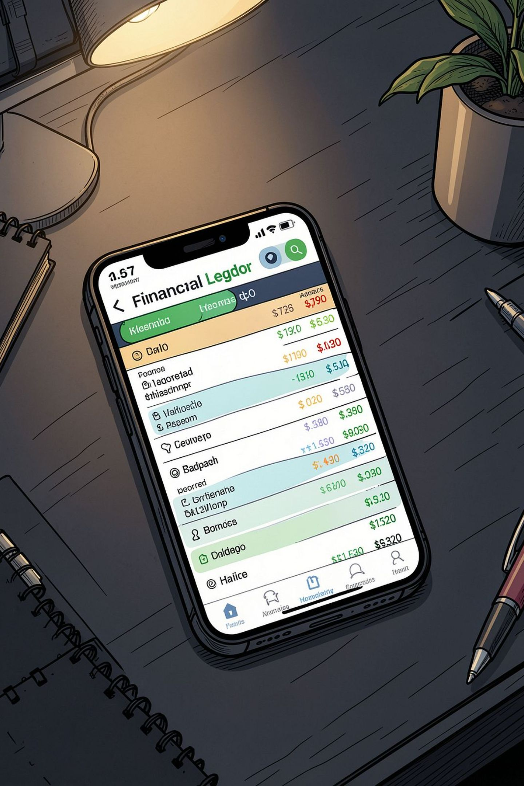
Udharwale
A Personal Ledger & Debt Tracking Web App
Capstone Project Report · MCA · Lovely Professional University Online
Mohammed Naeem Aqueel Ahmed · Reg. No. 324103745

Slide 2
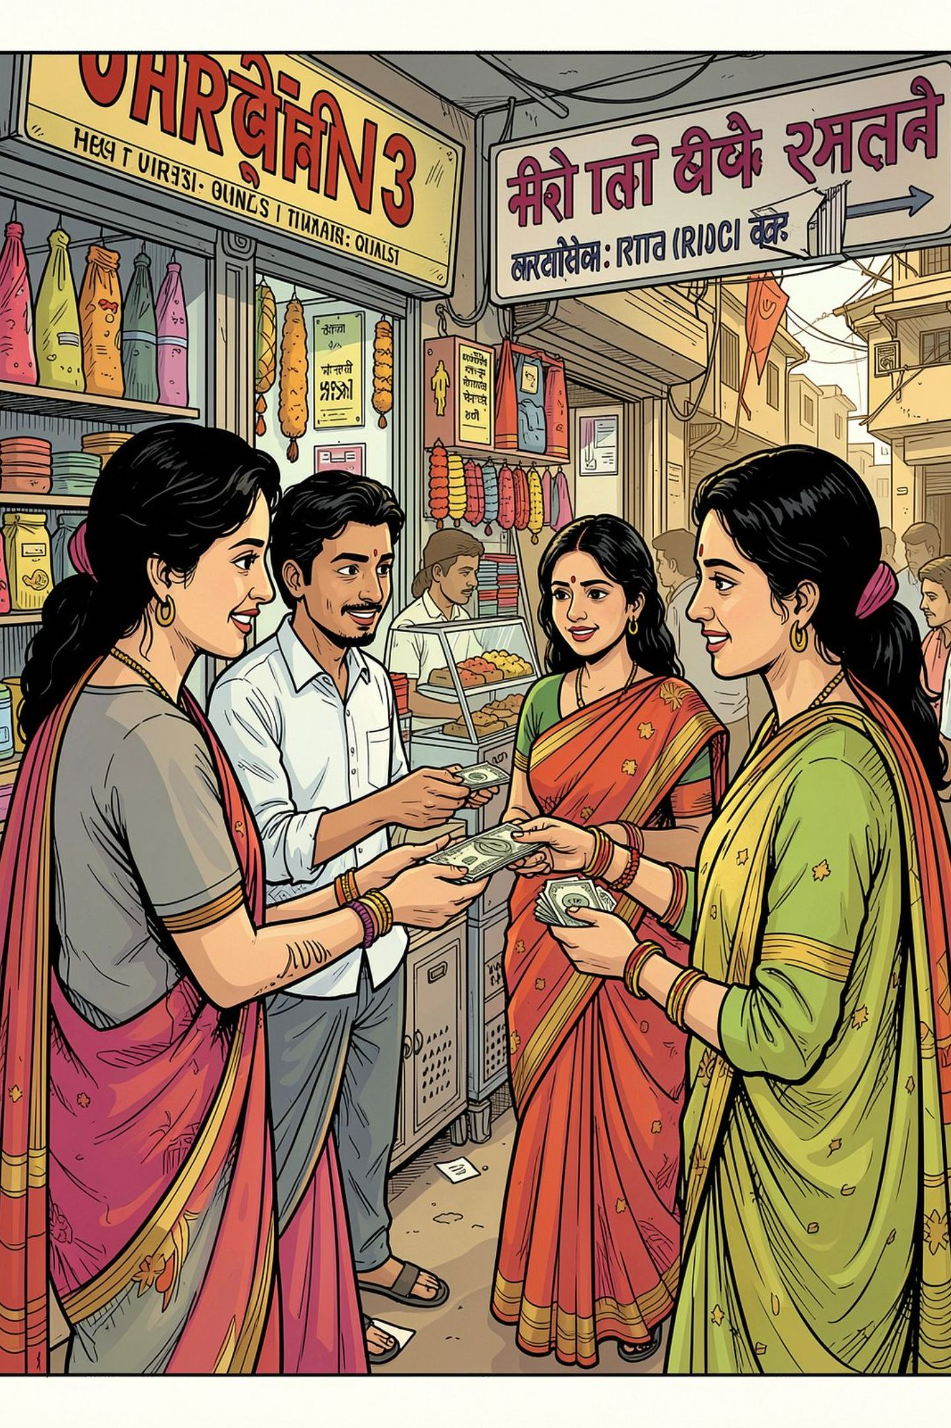
The Problem: Informal Debt Goes Untracked
In many communities, borrowing small amounts, splitting bills, or buying on credit from local shops is everyday reality. Yet these micro-transactions are tracked on paper or memory — leading to errors, confusion, and strained relationships.
Individuals
Shopkeepers
Track money lent to or borrowed from friends and family.
Keep a digital "Khata" of customers who buy on credit.
Students
Manage shared expenses like rent, food, and travel.

Slide 3
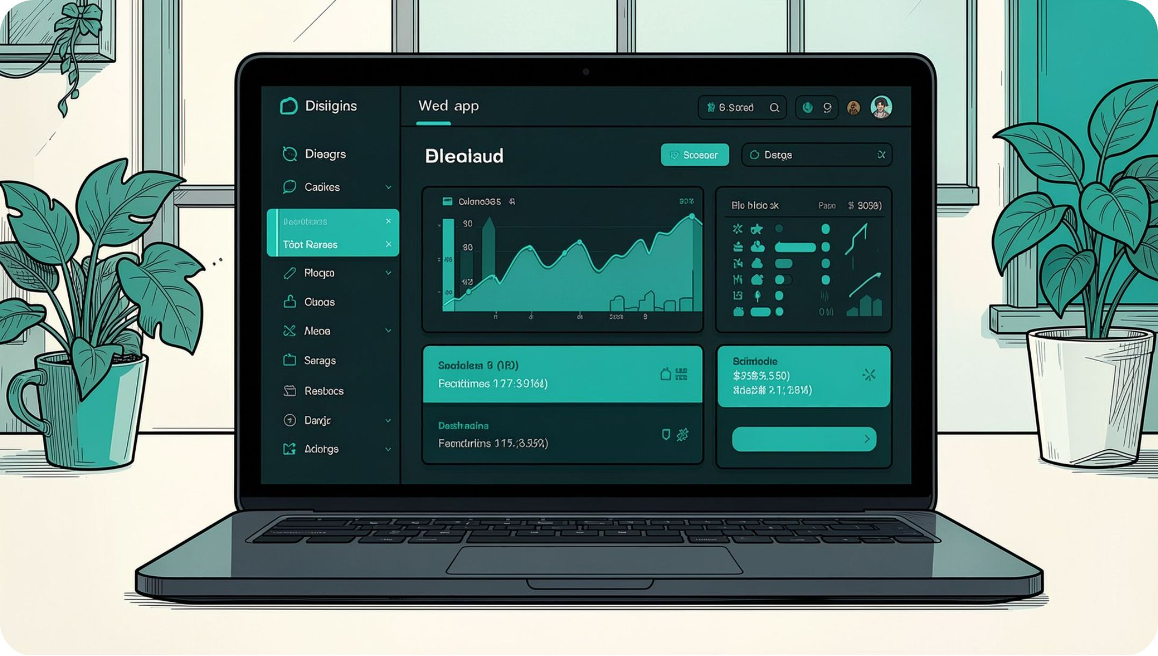



What is Udharwale?
Udharwale digitizes personal debt management — replacing paper ledgers with a secure, intuitive web application.
Categorize Transactions
Dynamic Dashboard
Secure Authentication
Log as "Gave" (Lent) or "Got" (Borrowed).
Real-time overview of total balances and net cashflow.
Login with email, password, and PIN recovery.

Slide 4
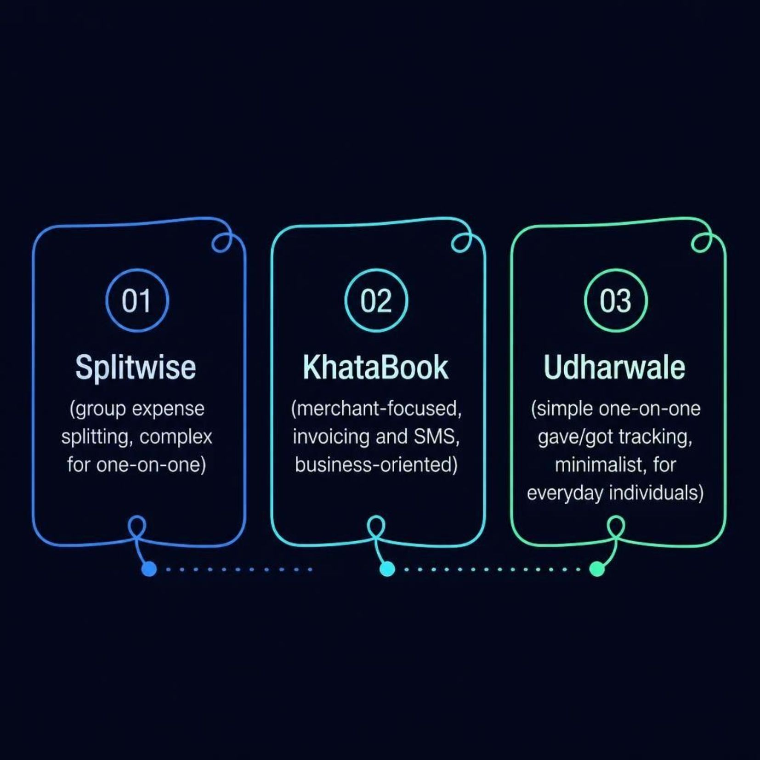

Existing Solutions & The Gap
Why Udharwale?
Splitwise is too group-focused. KhataBook is too business-oriented. Neither serves the everyday individual who simply wants to track "I gave X" and "I got Y" transactions.
Udharwale fills this gap with a minimalist, one-on-one interface accessible to users with minimal technical literacy.

Slide 5





Tools & Technologies
Frontend
Next.js 16 (App Router), React 19, Tailwind CSS 4
Backend
Next.js API Routes in a Node.js environment
Database
MongoDB via Mongoose — flexible document schemas
Language
TypeScript for strong typing and error reduction

Slide 6
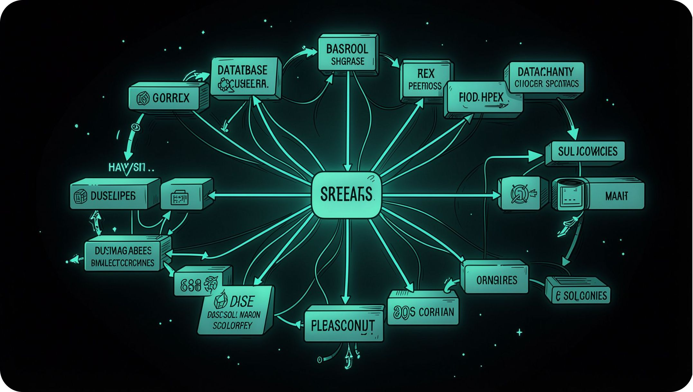


Database Design
Two Primary Collections
Users
Stores name, email, hashed password, recovery PIN, and security answer.
Contacts
Mapped to userId. Stores contact details (name, phone, email) with an embedded array of transactions — each holding amount, type ('gave'/'got'), description, date, and category.

Slide 7




System Modules
Authentication Module
Dashboard Module
Handles secure login, registration, and password recovery using a custom PIN and security question.
Fetches and aggregates all transactions to display total outstanding balances in real time.
Contact Management
Transaction Module
Allows users to add, edit, and view individual contacts with full transaction history.
Enables adding new financial records tied to specific contacts and updates aggregated totals instantly.

Slide 8
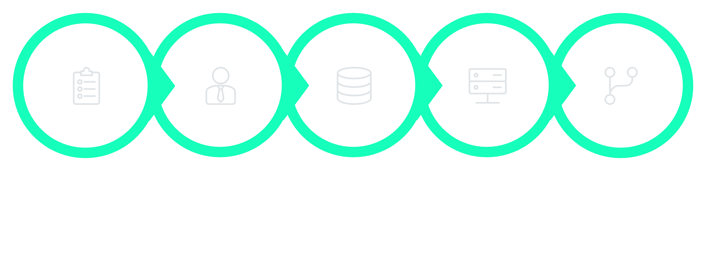
Methodology: Agile Development
Requirements
UI/UX
Schema
Backend
Frontend
Iterative development allowed continuous testing and rapid incorporation of UI/UX improvements throughout the project lifecycle.

Slide 9
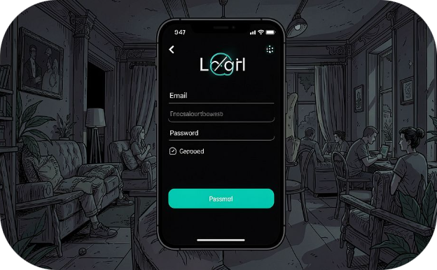
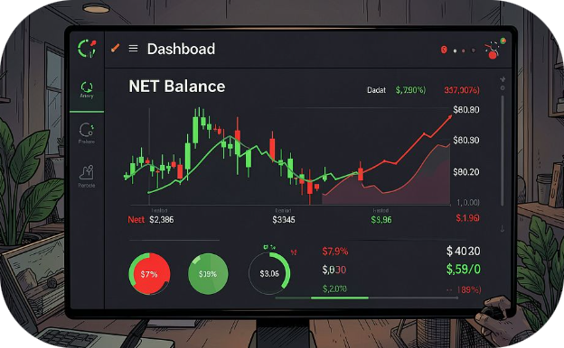
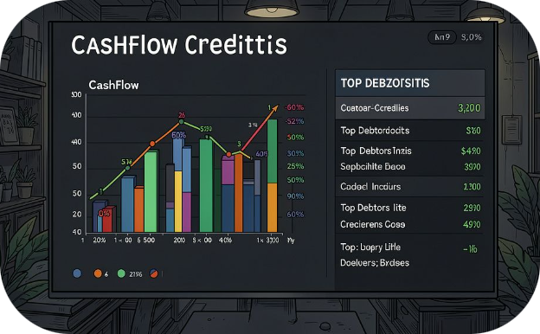

Results: The Application in Action
Login & Registration
Main Dashboard
Overview View
Clean, welcoming authentication screens with PIN-based account recovery backup.
Accurately calculates net balance. Green for money to receive, Red for money owed.
Displays total to receive, total owed, net cashflow ratio, and distribution by category.
Embedding transactions within the Contact model significantly reduced database query times. The app is fully responsive on mobile browsers.

Slide 10
Conclusion & Future Scope
Conclusion
Future Enhancements
Udharwale successfully demonstrates how modern web technologies can solve a practical, everyday problem — reducing the cognitive load of remembering informal debts and minimizing financial disputes among peers.
01
WhatsApp/SMS Integration
Automated reminders for pending payments.
02
Multi-Currency Support
Log transactions in different currencies.
03
Data Export
Export histories to PDF or Excel.
04
Progressive Web App (PWA)
Install natively on smartphones.

