Slide 1
Computational Protein Design Using Chemical Reaction Optimization (CRO)
Supervised By:
Dr. Md. Rafiqul Islam
Professor
Computer Science and Engineering Discipline
Khulna University
Name: Naeema Binthe Ashraf
ID: 160231
Name: Mahfujur Rahman Afnan
ID: 160235

Slide 2
Overview
Introduction
Computational Protein Design
Application Areas
Existing Algorithm and Drawbacks
Chemical Reaction optimization (CRO)
Our Proposed Method
Our Target
Conclusion

Slide 3
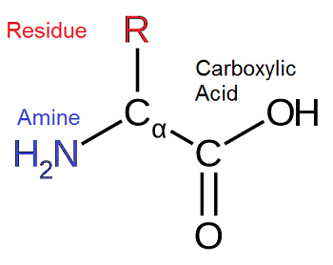
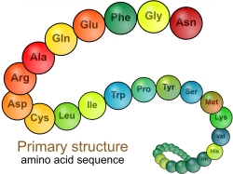
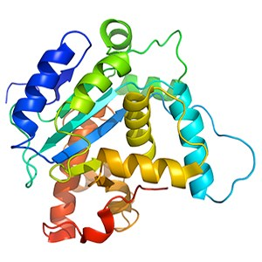
Introduction
Information about Protein
Protein is a bio-polymer consisting of a long polypeptide chain of naturally occurring 20 amino acids: Alanine (Ala), Arginine (Arg), Asparagine (Asn), Aspartic acid (Asp), Cysteine (Cys), Glutamic acid (Glu) ,Glutamine (Gln), Glycine (Gly), Histidine (His), Isoleucine (Ile), Leucine (Leu), Lysine (Lys), Methionine (Met), Phenylalanine (Phy), Proline (Pro), Serine (Ser), Threonine (Thr), Tryptophan (Trp), Tyrosine (Tyr), Valine (Val).
These amino acids are identical from each other in the residue chain.
Amino acid Conformation
Tertiary structure
of a protein in native
State or GMEC

Slide 4
Introduction
Importance of Proteins
Protein is an important biopolymar and used for building and repairing tissues.
It also used for making enzymes, hormones and other body chemicals.
Protein is an important building block of bones, muscles, cartilage, skin and blood.
Protein engineering has become a key technology to medicine, synthetic biology, nanotechnologies and biotechnologies

Slide 5
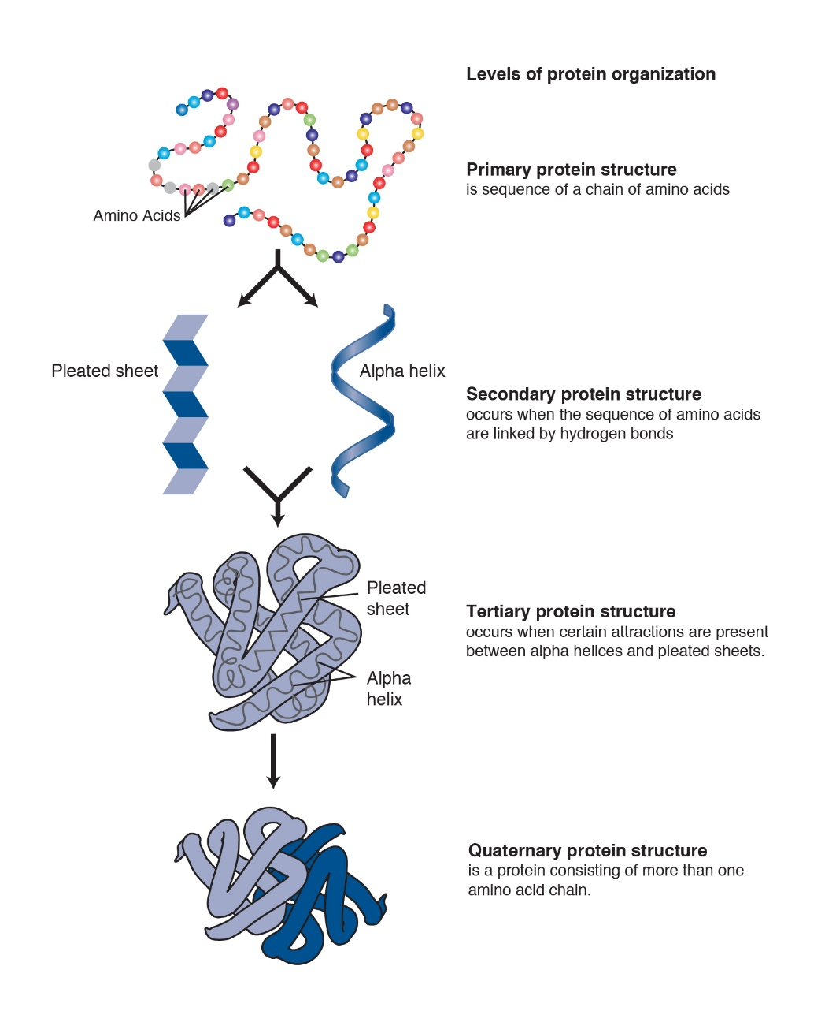
Introduction
Types of Protein Structure

Slide 6
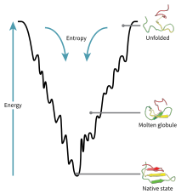
Introduction
Native State of A Protein
The conformation that minimizes the energy is called the GMEC.
How a protein achieves its native state or GMEC.

Slide 7
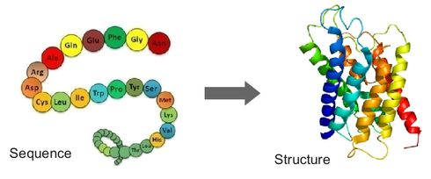
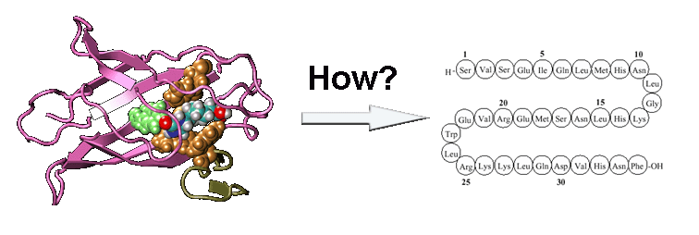
Introduction
Research Problems
In recent years, researchers have been studying with two types of researches in protein-related studies. First one is the Protein Structure Prediction Problem (PSP) or Protein Folding Problem and another one is the Protein Design Problem (PD)
PSP Problem : To predict a protein 3D-structure in GMEC from a given amino acid sequence is known as protein structure prediction problem.
PD Problem : To predict a protein amino acid sequence in GMEC from a given target backbone structure is known as protein structure prediction problem. Our topic is Computational Protein Design.

Slide 8
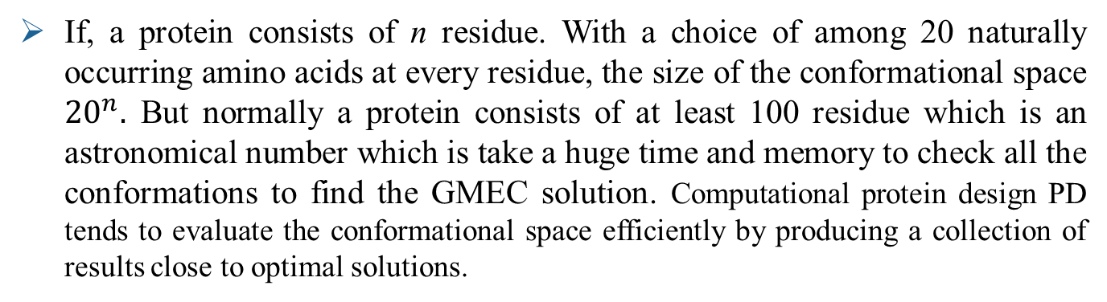
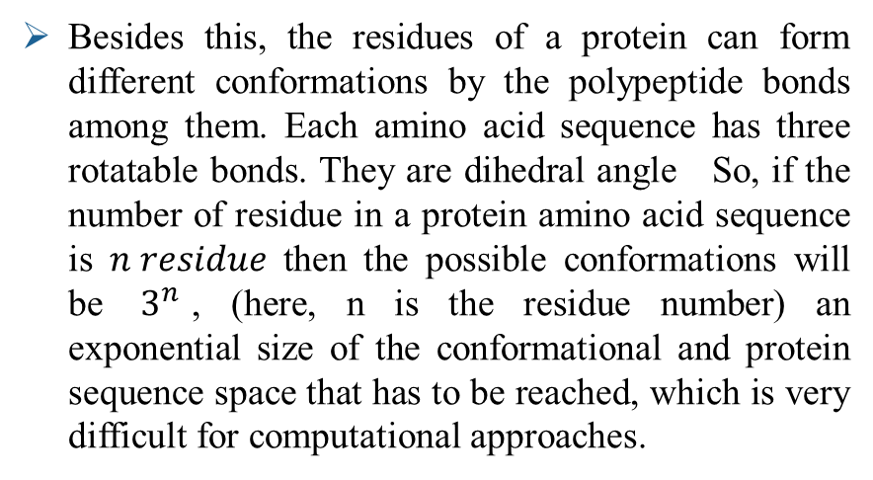
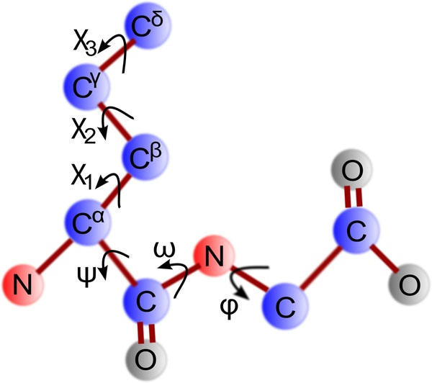
Computational Protein Design
The Problems in Solving of Computational Protein Design

Slide 9

Computational Protein Design
Video of Computational Protein Design Problem

Slide 10
Computational Protein Design
Types of Computational Protein Design
There are two types of protein design
1.Rational Protein Design
2.De novo Protein Design
In Rational Protein Design, most of the residues in the sequence are maintained as their wild-type amino-acid while a few are allowed to mutate.
In de novo design, the entire sequence is designed anew, based on no prior sequence.

Slide 11
Application Area
Application Area of Computational Protein Design
Protein sequence have been designed to fold to specific tertiary structure.
New drugs, antibodies and nano bodies have been developed for therapeutic purpose by designing protein-protein and protein-ligand interfaces.
One of the most desirable uses for protein design is for biosensors. Protein that will sense the presence of specific compounds .
The design of a new enzyme is use of protein design with huge bioengineering and biomedical applications.

Slide 12
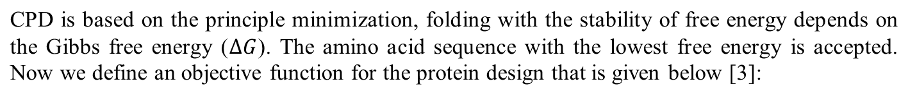
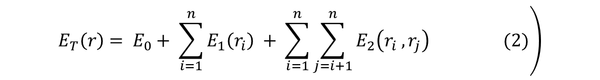
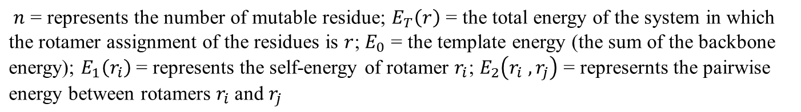
Objective Function
The Problems of Computational Protein Design

Slide 13
Existing Algorithms
Computational Protein Design
Exact Algorithm
Heuristic Algorithm
Meta-heuristic Algorithm
Dead End Elimination with A* Search
AND/OR Branch-and-Bound search
Deep Learning neural network and Genetic Algorithm

Slide 14
Drawbacks of Existing Algorithms
Dead End Elimination (DEE) : Several solvers were unable to solve any instances in the 9000 seconds allocated globally per problem for each approach [1].
AND/OR Branch-and-Bound search : This algorithm is on a single machine. So it is only applicable for small conformational space [2]
Deep Learning Neural Network : Deep learning requires large amount of processing power.
Genetic Algorithm :

Slide 15
Chemical Reaction Optimization (CRO)
Information of CRO
Chemical Reaction Optimization (CRO) is a new metaheuristic for optimization proposed by Lam & Li in 2010 [3]
CRO starts with some unstable molecules with excessive energy. The molecules interact with each other through a sequence of elemintary reactions [3]
The principles of chemical reactions are governed by the first two laws of thermodynamics [3]
CRO has both local and global search properties

Slide 16
Chemical Reaction Optimization (CRO)
Executions of CRO
Chemical Reaction Optimization executes in three steps:
Initializations: Set parameter values for PopSize, KELossRate, moleColl, buffer, initial KE, α and β. Initialize molecules with size equal to popsize.
Iterations : Simulates the reaction process.
Terminations: Output the overall minimum solution, its objective function value and corresponding results.

Slide 17
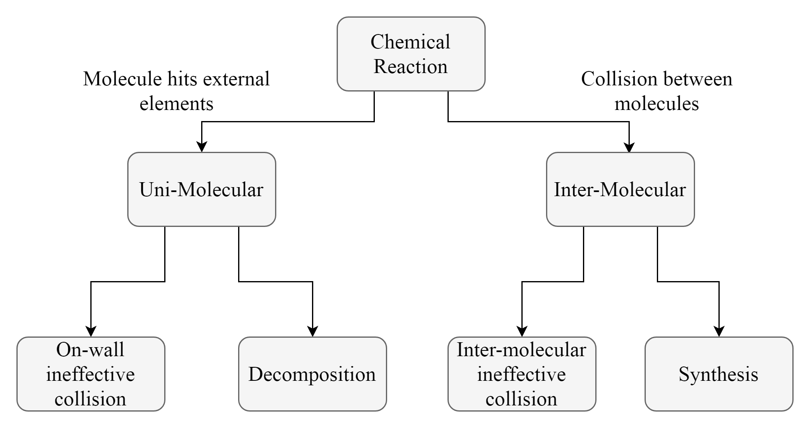
Chemical Reaction Optimization (CRO)
Elementary Reactions in CRO

Slide 18
Chemical Reaction Optimization (CRO)
Parameters of CRO
Symbols | Algorithmic Definition
PopSize | The population size or number of molecules in population space.
KELossRate | The loss rate of kinetic energy in reaction
MoleColl | The parameter which lies between 0 and 1 to make decision whether the reaction is unimolecular or intermolecular
α and β | They rule the intensification and diversification
Buffer | Initial energy of the environment
NumHit | NumHit is a record total number of collision or hit in amolecule
MinHit | MinHit is the number of hits when the molecule has minimum potential energy.
MinStruct | MinStruct is the structur eof molecule with lowest PE
MinPE | When a molecule achieves MinStruct, MinPE is the corresponding PE

Slide 19
Chemical Reaction Optimization (CRO)
Why CRO?
CRO allows placing different operators to suit different problems.
Its variable population size allows the system to adapt to the problems automatically.
The global search technique of CRO resists it to drop into local optimum.
Proper tuning of CRO parameters helps to find better result within a very short time.

Slide 20
Chemical Reaction Optimization (CRO)
Some Applications of CRO
Protein Structure Prediction [4]
Shortest common subsequence problem [5]
0-1 knapsack [6]
Artificial neural network training [7]
Network Coding Optimization Problem [8]
Travelling Salesman Problem [9]
Feature Combination in Bio-Inspired Visual Attention [10]

Slide 21
Our Proposed Method

Slide 22
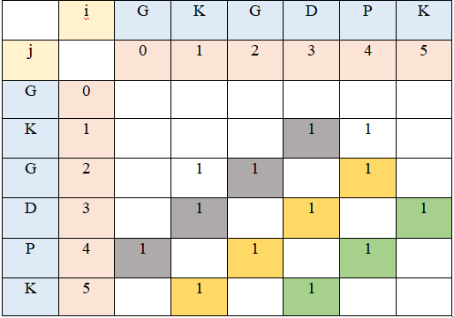
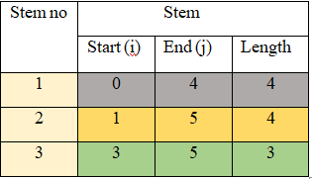
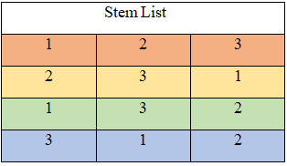
Population Generation
Some Applications of CRO

Slide 23
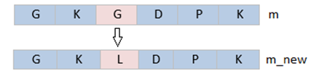
On-Wall Ineffective Collision
Some Applications of CRO
In On-wall ineffective collision, there is a small change in the molecular structure and gives almost an identical solution.
Two values i, j are randomly generated to determine the values for new molecule.
The randomly chosen j is added to the value of i^{th} position of m and
assigned to molecule_2, if the length of molecule is less than or equals to the summation. Otherwise, the randomly selected j is added to m_new.

Slide 24
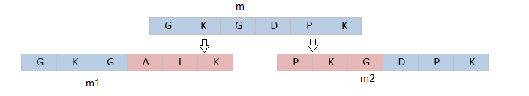
Decomposition
Some Applications of CRO
In the Decomposition, a molecule breaks into several molecules and there occur drastic changes e molecular structures
At first, m breaks down into two equal parts.
A new m_1 is generated by the first part of the m and rest half is picked randomly.
Similarly, m_2 is generated by the last part of the m and rest half is picked randomly.

Slide 25
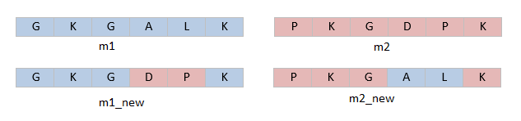
Inter-Moleculer Ineffective Collision
Some Applications of CRO
In intermolecular ineffective collision, several molecules collide with each other.
The number of molecules remains unchanged before and after the collision happens.
Two points generated randomly divide both initial solutions into parts.
The even parts from both molecules are interchanged and odd parts remain same to form the new molecules.

Slide 26
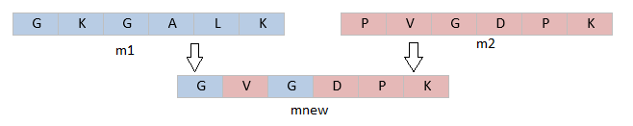
Synthesis
Some Applications of CRO
In synthesis, multiple molecules hit against each other and integrate together to form one new single molecule.
Two molecules m_1 and m_2 are chosen randomly from the population.
A random value raging 0 to 1 helps to determine the molecule to choose.
If the random value is less than 0.5, then me_1 is chosen. Otherwise, m_2 is chosen.

Slide 27
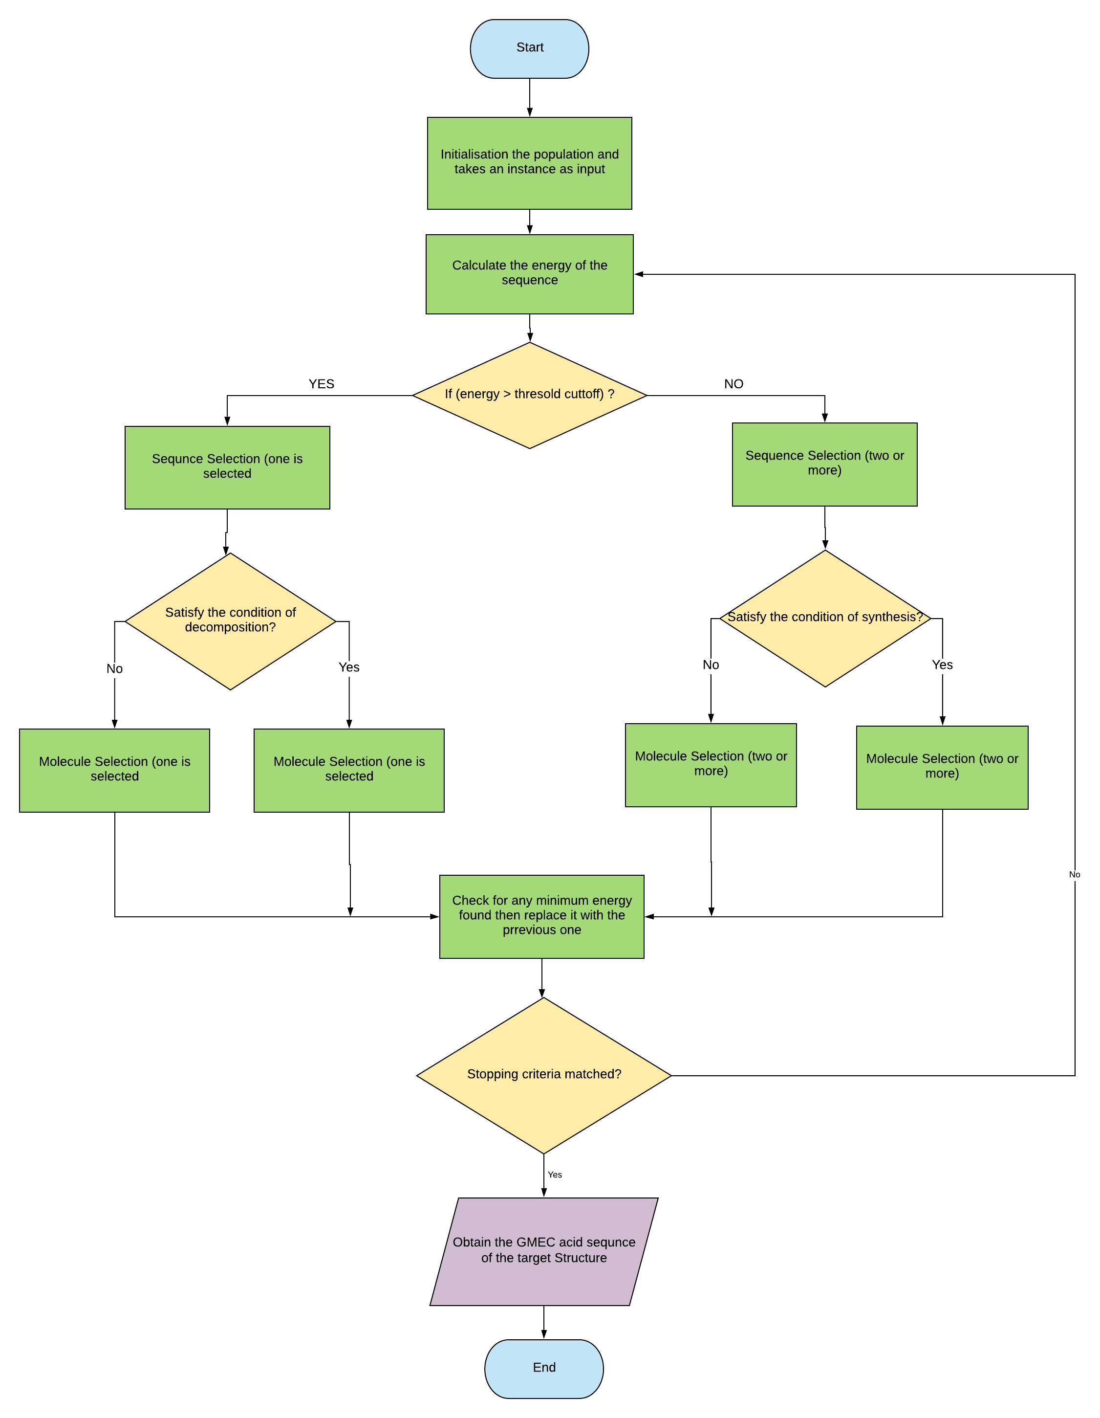
Flowchart of CPD Using CRO

Slide 28
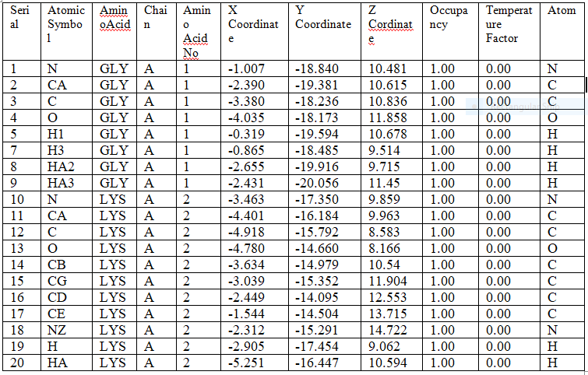
Sample Input

Slide 29
Sample Output
The amino acid sequence of for the target protein structure :
GKGDPKKPRGKMSSYAFFVQTSREEHKKKHPDASVNFSEFSKKCSERWKTMSAKEKGKFEDMAKADKARYEREMKTYIPPKGE
Here, each symbol represents one of the 20 amino acids. The number of residue is 83 and the sequence contains the GMEC for the structure of 1AAB protein.

Slide 30
Our Target
We will redesign the four fundamental reaction operators of CRO.
We will design one or two repair operators to improve the results obtained from basic CRO algorithm.
The outputs of the proposed algorithm will be compared with the outputs of the algorithms shown in above table
Standard statistical tests such as Native State, Stability, Function-measure and INF will be performed to show the performance of the algorithms.
For more detailed outcome, we will show suboptimal solutions.
Algorithm | Performance Measurement
Deep Learning Neural Network | 38.3%
AND/OR Branch and Bound Search | Computational time
Sparse Residue Interaction Graph

Slide 31
Conclusion
In our method, using computational protein design using Chemical Reaction Optimization (CRO), we believe that our algorithm will do a better performance than the existing algorithms.

Slide 32
Thank You!

Slide 33
References
Allouche, D., André, I., Barbe, S., Davies, J., De Givry, S., Katsirelos, G., ... & Traoré, S. (2014). Computational protein design as an optimization problem. Artificial Intelligence, 212, 59-79.
Zhou, Y., Wu, Y., & Zeng, J. (2016). Computational protein design using AND/OR branch-and-bound search. Journal of Computational Biology, 23(6), 439-451.
Lam, Albert YS, and Victor OK Li. "Chemical reaction optimization: A tutorial." Memetic Computing 4, no. 1 (2012): 3-17.
Chatterjee, Sajib, Resheta Ahmed Smrity, and Md Rafiqul Islam. "Protein structure prediction using chemical reaction optimization." In Computer and Information Technology (ICCIT), 2016 19th International Conference on, pp. 321-326. IEEE, 2016.

Slide 34
References
5. Saifullah, CM Khaled, and Md Rafiqul Islam. "Solving shortest common supersequence problem using chemical reaction optimization." In Informatics, Electronics and Vision (ICIEV), 2016 5th International Conference on, pp. 50-55. IEEE, 2016.
6.Truong, Tung Khac, Kenli Li, and Yuming Xu. "Chemical reaction optimization with greedy strategy for the 0–1 knapsack problem." Applied Soft Computing13.4 (2013): 1774-1780.
7. James, J. Q., Albert YS Lam, and Victor OK Li. "Evolutionary artificial neural network based on chemical reaction optimization." In Evolutionary Computation (CEC), 2011 IEEE Congress on, pp. 2083-2090. IEEE, 2011.
8. Pan, Bo, Albert YS Lam, and Victor OK Li. "Network coding optimization based on chemical reaction optimization." Global Telecommunications Conference (GLOBECOM 2011), 2011 IEEE. IEEE, 2011.

Slide 35
References
Allouche, D., André, I., Barbe, S., Davies, J., De Givry, S., Katsirelos, G., ... & Traoré, S. (2014). Computational protein design as an optimization problem. Artificial Intelligence, 212, 59-79.
Zhou, Y., Wu, Y., & Zeng, J. (2016). Computational protein design using AND/OR branch-and-bound search. Journal of Computational Biology, 23(6), 439-451.
Lam, Albert YS, and Victor OK Li. "Chemical reaction optimization: A tutorial." Memetic Computing 4, no. 1 (2012): 3-17.
Chatterjee, Sajib, Resheta Ahmed Smrity, and Md Rafiqul Islam. "Protein structure prediction using chemical reaction optimization." In Computer and Information Technology (ICCIT), 2016 19th International Conference on, pp. 321-326. IEEE, 2016.

