Slide 1



ApexPlanet Software Pvt. Ltd.
07//2026
DATA STORY TELLING
Sales Analytics & Business Intelligence Report
NAME OF PROJECT:
PRESENTED BY:
PRESENTED TO:
Sales Analytics & Business Intelligence
Write here
Write here

Slide 2
Objective
02/13
Project Objective
The objective of this project was to analyze sales data and transform it into meaningful business insights that support data-driven decision-making. Through exploratory analysis, customer segmentation, KPI tracking, and interactive dashboard development, the project aimed to identify sales trends, understand customer purchasing behavior, and uncover opportunities for business growth.
Key Objectives
Analyze overall sales performance using key business metrics.
Understand customer behavior through segmentation and demographic analysis.
Identify high-performing products, categories, and customer groups.
Build an interactive dashboard for real-time business monitoring.
Provide actionable recommendations to improve revenue and customer engagement.

Slide 3
Dataset Overview
03/13
This project analyzes a retail sales dataset containing customer purchase transactions over a one-year period. The dataset was cleaned, validated, and prepared for analysis before performing exploratory data analysis, customer segmentation, KPI calculation, and dashboard development.
Dataset Summary
Metric | Value
Total Records | 1,000
Unique Customers | 947
Product Categories | 5
Products | Multiple Products
Time Period | January 2025 – January 2026
Cities Covered | Multiple Cities
Customer Age Groups | Gen Z, Millennials, Gen X

Slide 4
Dataset Overview (Continuation)
04/13
Data Attributes
Key Takeaway
The dataset includes the following key fields:
Order ID
Order Date
Customer ID & Customer Name
Age & Gender
City
Product & Category
Quantity
Unit Price
Total Sales
The dataset provides a comprehensive view of customer purchases, sales performance, and demographic information, enabling meaningful business analysis and strategic decision-making.
Dataset Summary
Flow diagram
📄 1000 Records
👥 947 Customers
🛍️ 5 Categories
📅 13 Months
🏙️ Multiple Cities
👨‍👩‍👧 3 Age Groups
Raw Dataset
↓
Data Cleaning
↓
EDA & SQL Analysis
↓
Customer Segmentation
↓
Interactive Dashboard
↓
Business Insights

Slide 5
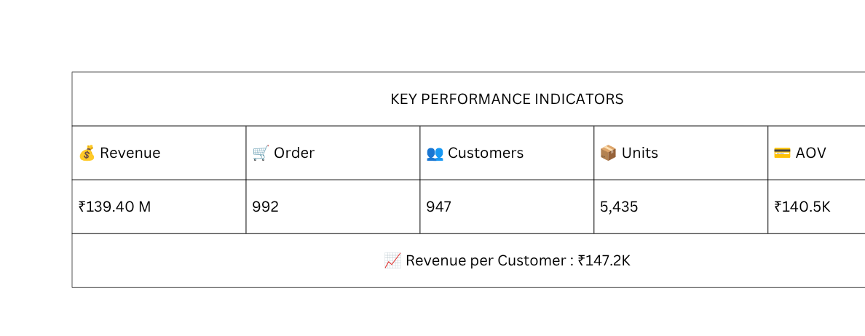
Key Performance Indicators (KPIs)
05/13
The following KPIs provide a snapshot of the overall business performance based on the analyzed sales dataset.
Key Observation
The business generated ₹139.40 million in revenue from 992 orders, with an average order value of ₹140.5K, indicating strong revenue generation and customer spending.

Slide 6
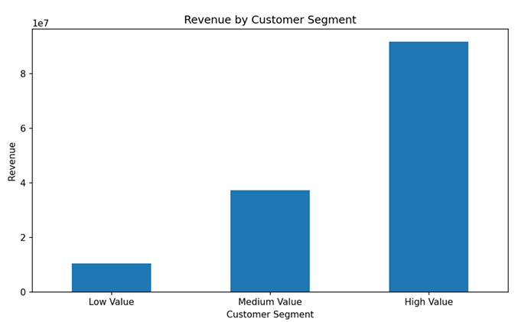
Customer Segmentation Analysis
06/13
Customer Segmentation
To better understand customer purchasing behavior, customers were segmented into High Value, Medium Value, and Low Value groups based on their total purchase value.
Key Insights
High Value → 65.8% Revenue
Medium Value → Growth
Low Value → Opportunity
💡 Business Recommendation:
Focus on retaining High Value customers while nurturing Medium and Low Value customers through targeted marketing and loyalty initiatives.

Slide 7
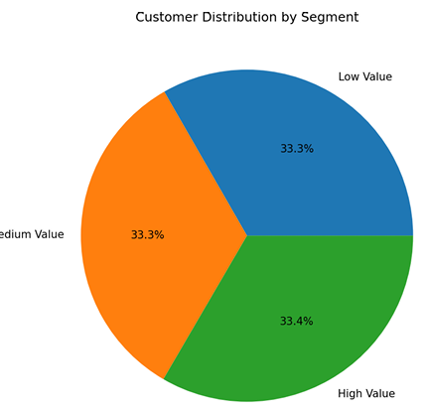
Product Category Performance
07/13
To identify the highest-performing product segments, sales were analyzed across all product categories. This analysis highlights the categories contributing the most to overall revenue and helps identify areas for future business growth.
Key Insights
💻 Electronics generated the highest revenue (₹50.78M) and led all categories.
📚 Education ranked second, showing strong customer demand.
👕 Fashion recorded the lowest revenue, indicating room for growth.
📈 Electronics and Education together contributed over 54% of total revenue.
💡 Business Recommendation:
Increase investment in the Electronics category to maximize revenue while introducing promotional campaigns and targeted marketing strategies to improve the performance of the Fashion category.

Slide 8
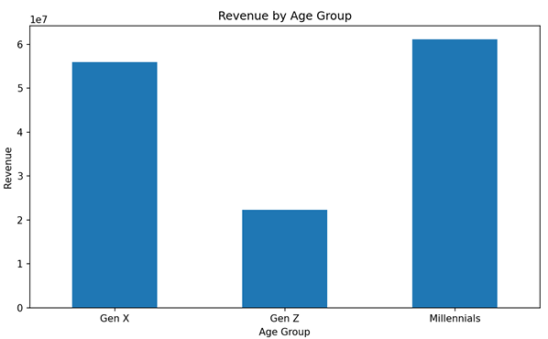
Customer Demographics – Age Group Analysis
08/13
Understanding customer demographics helps identify the most valuable customer groups and supports targeted marketing strategies. Revenue and order analysis by age group reveals the purchasing patterns of different generations.
Key Insights
💻 Electronics generated the highest revenue (₹50.78M) and led all categories.
📚 Education ranked second, showing strong customer demand.
👕 Fashion recorded the lowest revenue, indicating room for growth.
📈 Electronics and Education together contributed over 54% of total revenue.
💡 Business Recommendation:
Increase investment in the Electronics category to maximize revenue while introducing promotional campaigns and targeted marketing strategies to improve the performance of the Fashion category.

Slide 9
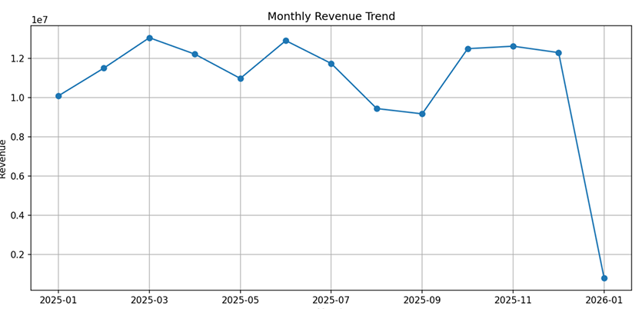
Monthly Sales Trend Analysis
09/13
Analyzing monthly sales trends helps identify seasonal patterns, peak-performing periods, and fluctuations in business performance. These insights support better forecasting, inventory planning, and marketing decisions.
Key Insights
📈 March 2025 recorded the highest monthly revenue (₹13.06 Million), indicating peak sales performance.
📊 Sales remained stable throughout 2025, consistently generating between ₹9M–₹13M per month.
🚀 Q4 (October–December) showed strong revenue, reflecting sustained customer demand toward the end of the year.
📅 January 2026 shows lower revenue because it contains partial data and should not be compared directly with previous months.
💡 Business Recommendation:
Leverage the high-performing periods by planning promotional campaigns, maintaining adequate inventory, and strengthening marketing efforts before peak sales months to maximize revenue.

Slide 10
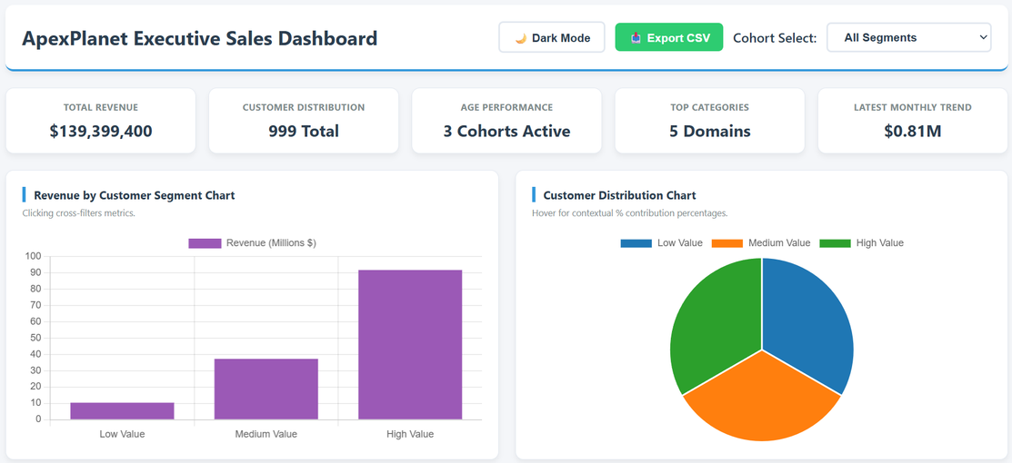
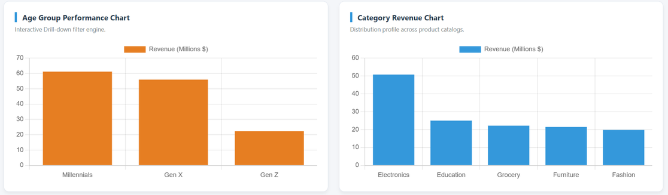
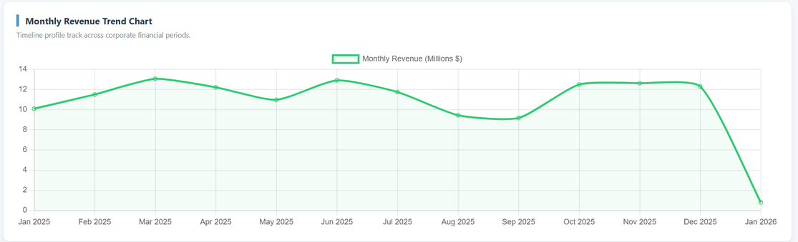
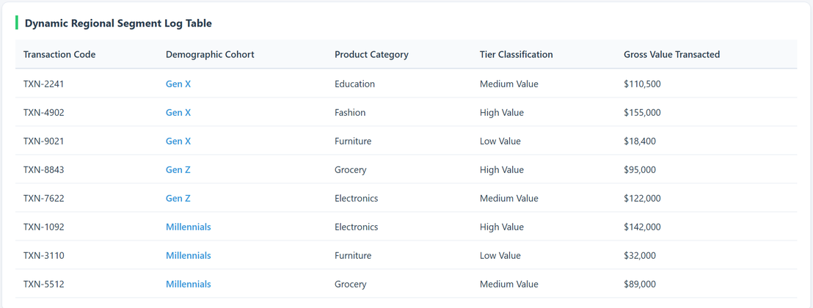
10/13
Interactive Sales Analytics Dashboard
Dashboard Features
📈 Real-Time KPI Cards
Quick overview of Total Revenue, Orders, Customers, Units Sold, Average Order Value, and Revenue per Customer.
🔍 Interactive Filters
Filter data by Category, Month, Age Group, Gender, and City for customized analysis.
📊 Dynamic Visualizations
Interactive charts displaying monthly sales trends, category performance, customer demographics, and revenue distribution.
👥 Customer Segmentation
Analyze High, Medium, and Low Value customer groups to understand purchasing behavior.
💡 Business Insights
Visual summaries and key findings that support data-driven business decisions.
Business Impact
The dashboard enables stakeholders to monitor business performance in real time, identify trends, evaluate customer behavior, and make informed strategic decisions through interactive data exploration.

Slide 11
Strategic Business Recommendations
11/13
Key Recommendations
💎 Retain High-Value Customers
Implement loyalty programs and personalized offers to increase customer retention and lifetime value.
💻 Strengthen Electronics Category
Expand product offerings and continue promotional campaigns for the highest-performing category.
👨‍💼 Target High-Spending Customer Groups
Focus marketing efforts on Millennials and Gen X, as they generate the highest revenue.
👕 Boost Underperforming Categories
Increase promotions and optimize pricing strategies for the Fashion category to improve sales.
📈 Leverage Peak Sales Periods
Plan marketing campaigns and inventory management around high-performing months to maximize revenue.
Expected Business Impact
📈 Increase customer retention and repeat purchases.
💰 Improve overall revenue and profitability.
🎯 Enhance marketing effectiveness through targeted campaigns.
📊 Support faster, data-driven business decisions.

Slide 12
Conclusion
12/13
This project successfully transformed raw sales data into meaningful business insights through data analysis, customer segmentation, KPI evaluation, and interactive dashboard development.
Project Outcomes
Identified key revenue drivers and customer segments through comprehensive data analysis.
Evaluated sales performance across product categories, customer demographics, and monthly trends.
Developed an interactive dashboard to monitor KPIs and support real-time business insights.
Provided data-driven recommendations to improve customer retention, optimize product strategies, and support business growth.
“Data-driven decision-making empowers businesses to understand customer behavior, monitor performance, and make informed strategic decisions that drive sustainable growth.”

Slide 13

“Data-driven decision-making empowers businesses to understand customer behavior, monitor performance, and make informed strategic decisions that drive sustainable growth.”
Thank You

