Slide 1

Reinforcement Learning
Naeemullah Khan
naeemullah.khan@kaust.edu.sa
KAUST Academy
King Abdullah University of Science and Technology

Slide 2


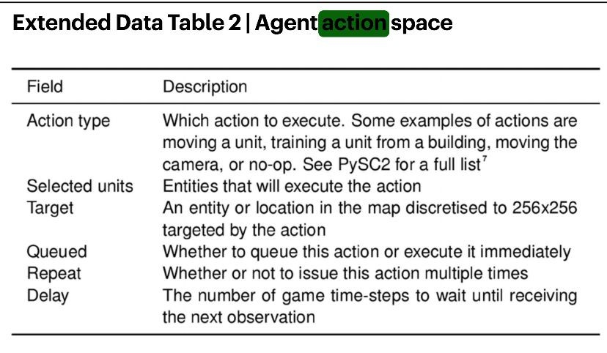
Can reinforcement learning solve robotics?
Alpha Go Zero (Silver et al, Nature, 2017)
Dota 5 (OpenAI et al, 2019, https://cdn.openai.com/dota-2.pdf)
Alpha Star (Vinyals et al, Nature, 2019)

Slide 3
DDPG (Lillicrap et al, 2015)
A first “Deep” crack at RL with continuous action spaces

Slide 4
Deterministic Policy Gradient
DPG (Silver et al., 2014)
Finds deterministic policy
Applicable to continuous action space

Slide 5
Deterministic Policy Gradient
DPG (Silver et al., 2014)
Finds deterministic policy
Applicable to continuous action space
Not learning-based, can we do better?

Slide 6
DDPG
DDPG (Deep DPG) in one sentence:
Extends DPG (Deterministic Policy Gradients, Silver et al., ‘14) using deep learning,
borrowing tricks from Deep Q-Learning (Mnih et al., ‘13)

Slide 7
DDPG
DDPG (Deep DPG) in one sentence:
Extends DPG (Deterministic Policy Gradients, Silver et al., ‘14) using deep learning,
borrowing tricks from Deep Q-Learning (Mnih et al., ‘13)
Contribution: model-free, off-policy, actor-critic approach that allows us to better learn deterministic policies on continuous action space

Slide 8
DDPG
DDPG (Deep DPG) is a model-free, off-policy, actor-critic algorithm that combines:
DPG (Deterministic Policy Gradients, Silver et al., ‘14): works over continuous action domain, not learning-based
DQN (Deep Q-Learning, Mnih et al., ‘13): learning-based, doesn’t work over continuous action domain

Slide 9
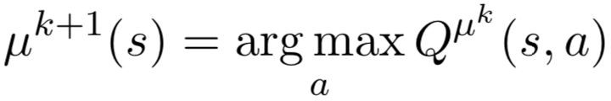
Background - DPG
In Q-learning, we find deterministic policy by

Slide 10
Background - DPG
In Q-learning, we find deterministic policy by
Problem: In large discrete action space or continuous action space, we can’t plug in every possible action to find the optimal action!

Slide 11

Background - DPG
In Q-learning, we find deterministic policy by
Problem: In large discrete action space or continuous action space, we can’t plug in every possible action to find the optimal action!
Solution: Learn a function approximator for argmax, via gradient descent

Slide 12

Background - DPG
Goal:
Derive a gradient update rule to learn deterministic policy

Slide 13
Background - DPG
Goal:
Derive a gradient update rule to learn deterministic policy
Idea:
Adapt the stochastic policy gradient formulation for deterministic policies

Slide 14
Background - DPG
Vanilla Stochastic Policy Gradient:
Source: http://rail.eecs.berkeley.edu/deeprlcourse/static/slides/lec-5.pdf

Slide 15
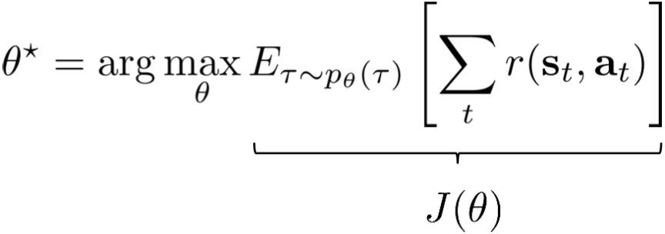
Background - DPG
Vanilla Stochastic Policy Gradient:
Source: http://rail.eecs.berkeley.edu/deeprlcourse/static/slides/lec-5.pdf

Slide 16
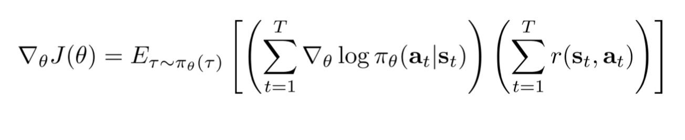
Background - DPG
Vanilla Stochastic Policy Gradient:
Source: http://rail.eecs.berkeley.edu/deeprlcourse/static/slides/lec-5.pdf

Slide 17

Background - DPG
Vanilla Stochastic Policy Gradient:
Source: http://rail.eecs.berkeley.edu/deeprlcourse/static/slides/lec-5.pdf

Slide 18
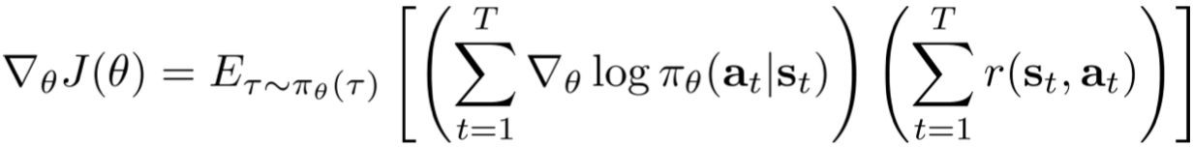
Background - DPG
Vanilla Stochastic Policy Gradient:
model-free
Not trivial to compute!
Source: http://rail.eecs.berkeley.edu/deeprlcourse/static/slides/lec-5.pdf

Slide 19
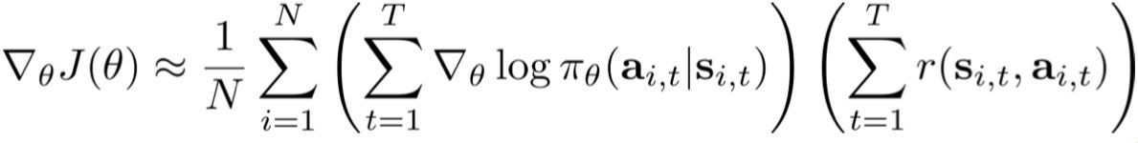
Background - DPG
Vanilla Stochastic Policy Gradient with Monte-Carlo Sampling:
Source: http://rail.eecs.berkeley.edu/deeprlcourse/static/slides/lec-5.pdf

Slide 20
Background - DPG
Vanilla Stochastic Policy Gradient with Monte-Carlo Sampling:
Problem: Point Estimate - High Variance!
Source: http://rail.eecs.berkeley.edu/deeprlcourse/static/slides/lec-5.pdf

Slide 21
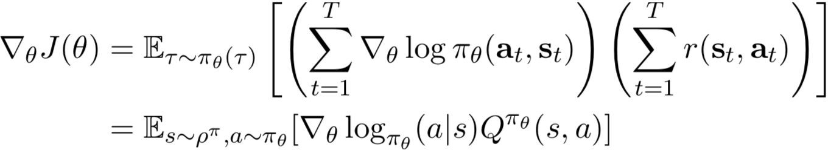
Background - DPG
Vanilla Stochastic Policy Gradient:
Source: http://rail.eecs.berkeley.edu/deeprlcourse/static/slides/lec-5.pdf

Slide 22
Background - DPG
Vanilla Stochastic Policy Gradient:
True value function is still not trivial to compute
Source: http://rail.eecs.berkeley.edu/deeprlcourse/static/slides/lec-5.pdf

Slide 23
Background - DPG
Vanilla Stochastic Policy Gradient:
True value function is still not trivial to compute, but we can approximate it with a parameterized function:
Source: http://rail.eecs.berkeley.edu/deeprlcourse/static/slides/lec-5.pdf

Slide 24
Background - DPG
Stochastic Policy Gradient (Actor-Critic)

Slide 25

Background - DPG
Stochastic Policy Gradient (Actor-Critic)
Actor: Policy function

Slide 26
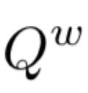
Background - DPG
Stochastic Policy Gradient (Actor-Critic)
Actor: Policy function
Critic: Value function
, which provides guidance to improve the actor

Slide 27
Background - DPG
Deterministic Policy Gradient (Actor-Critic)

Slide 28
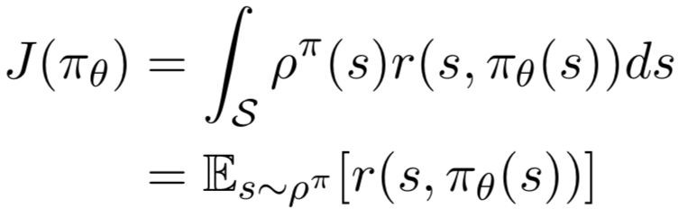
Background - DPG
Deterministic Policy Gradient (Actor-Critic)
Objective:

Slide 29
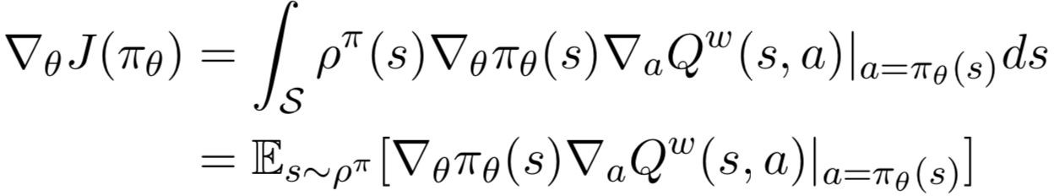
Background - DPG
Deterministic Policy Gradient (Actor-Critic)
Objective:
Policy Gradient:

Slide 30
Background - DPG
Deterministic Policy Gradient (Actor-Critic)
Objective:
Policy Gradient:

Slide 31
Background - DPG
Stochastic Policy Gradient:
Deterministic Policy Gradient:

Slide 32
Background - DPG
Stochastic Policy Gradient:
Deterministic Policy Gradient:
DDPG: Use deep learning to learn both functions!

Slide 33
Background Summary
DPG: Formulates an update rule for deterministic policies, so that we can learn deterministic policy on continuous action domain

Slide 34
Background Summary
DPG: Formulates an update rule for deterministic policies, so that we can learn deterministic policy on continuous action domain
DQN: Enables learning value functions with neural nets , with two tricks:
Target Network
Replay Buffer

Slide 35
Background Summary
DPG: Formulates an update rule for deterministic policies, so that we can learn deterministic policy on continuous action domain
Model-Free, Actor-Critic
DQN: Enables learning value functions with neural nets , with two tricks:
Target Network
Replay Buffer - Off-Policy

Slide 36
Background Summary
DPG: Formulates an update rule for deterministic policies, so that we can learn deterministic policy on continuous action domain
Model-Free, Actor-Critic
DQN: Enables learning value functions with neural nets , with two tricks:
Target Network
Replay Buffer - Off-Policy
DDPG: Learn both the policy and the value function in DPG with neural networks, with DQN tricks!

Slide 37
Method - DDPG

Slide 38

DDPG Problem Setting
Policy (Actor) Network
Deterministic, Continuous Action Space

Slide 39

DDPG Problem Setting
Policy (Actor) Network
Deterministic, Continuous Action Space
Value (Critic) Network

Slide 40

DDPG Problem Setting
Policy (Actor) Network
Deterministic, Continuous Action Space
Value (Critic) Network
Target Policy and Value Networks

Slide 41
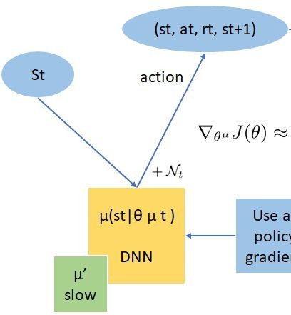
Method
Credit: Professor Animesh Garg

Slide 42
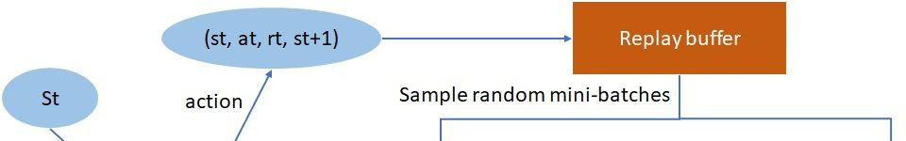
Method
Credit: Professor Animesh Garg

Slide 43
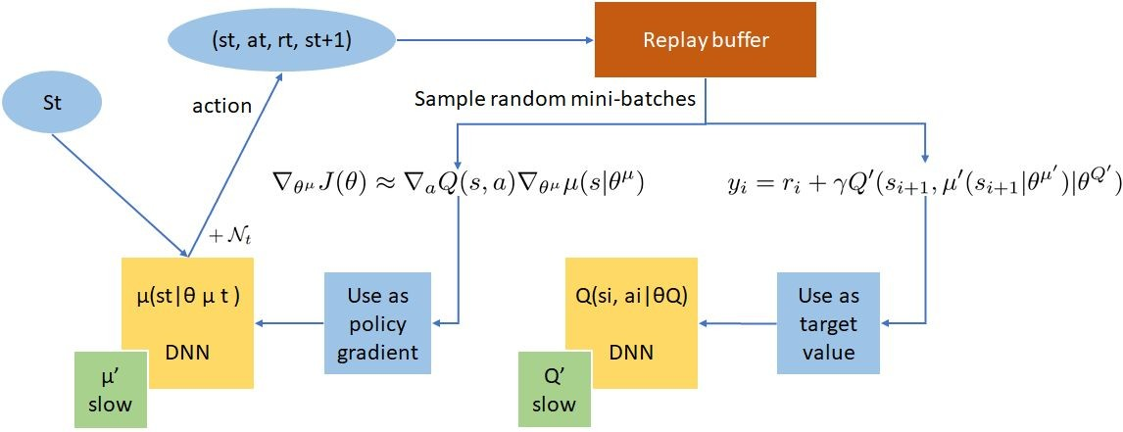
Method
Credit: Professor Animesh Garg

Slide 44
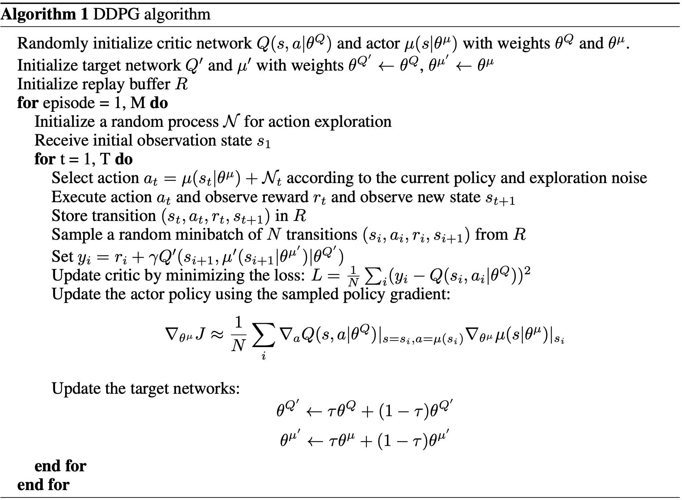
Method

Slide 45
Method
Replay buffer
“Soft” target network update

Slide 46
Method
Add noise for exploration

Slide 47
Method
Value Network Update

Slide 48
Method
Policy Network Update

Slide 49
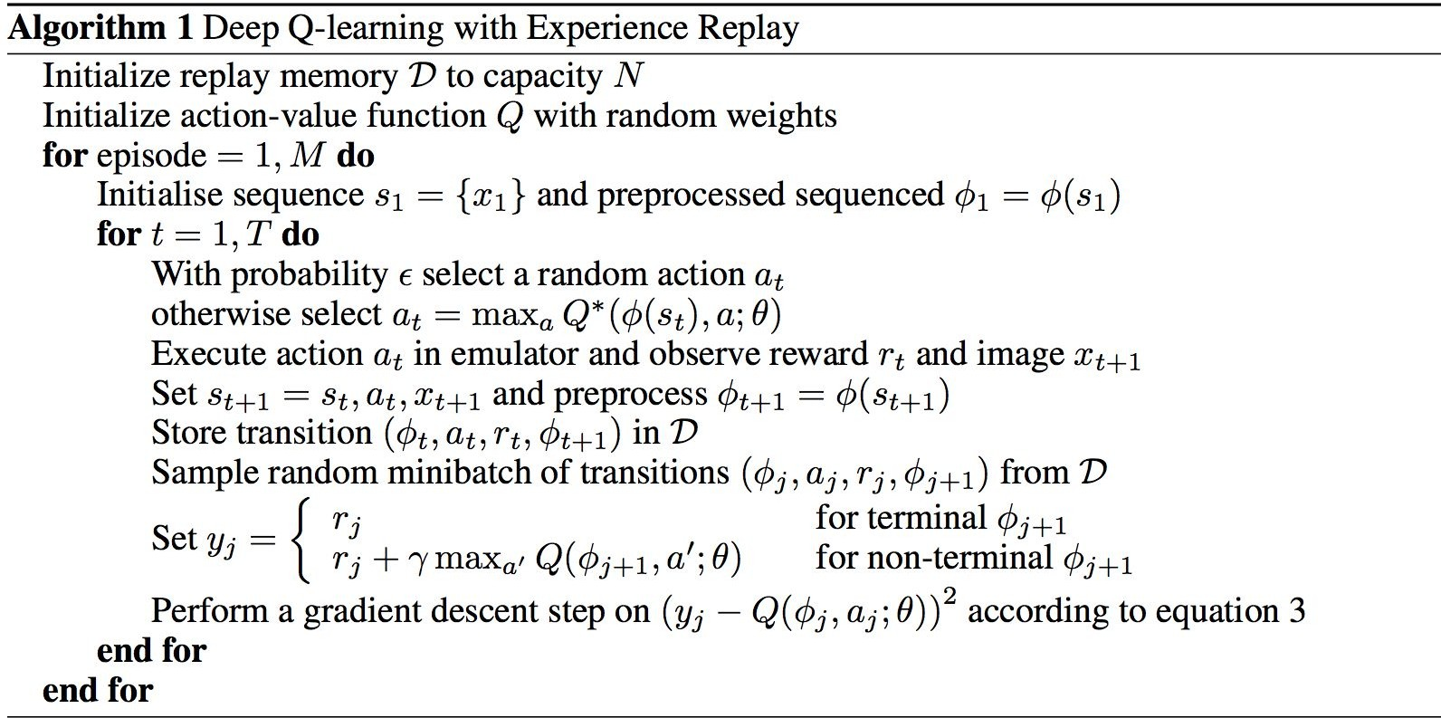
Method

Slide 50
Method
DDPG: Policy Network, learned with Deterministic Policy Gradient

Slide 51
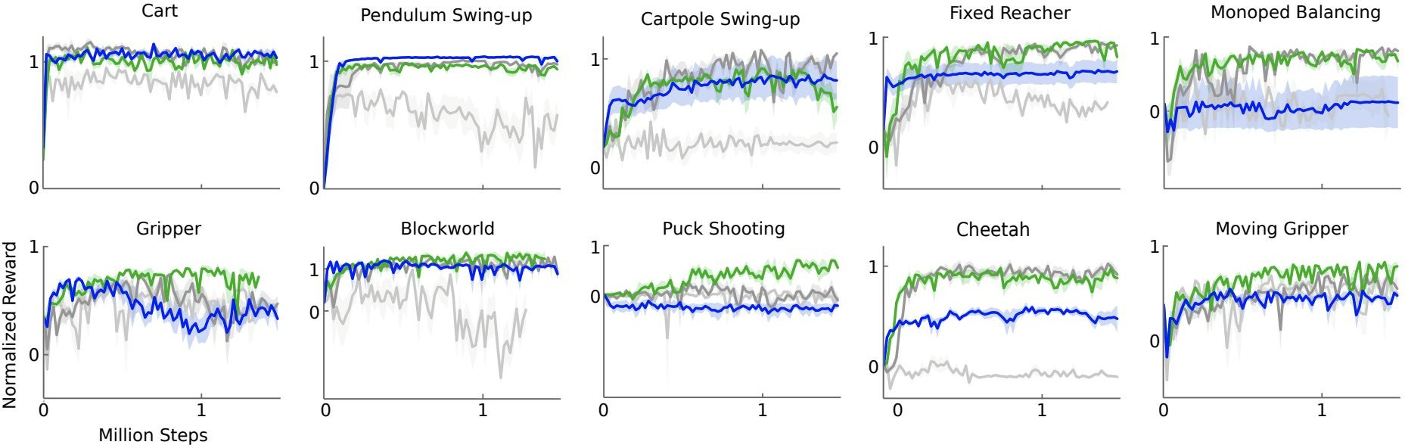
Experiments
Light Grey: Original DPG Dark Grey: Target Network
Green: Target Network + Batch Norm Blue: Target Network from pixel-only inputs

Slide 52
Experiments
Do target networks and batch norm matter?
Light Grey: Original DPG Dark Grey: Target Network
Green: Target Network + Batch Norm Blue: Target Network from pixel-only inputs

Slide 53

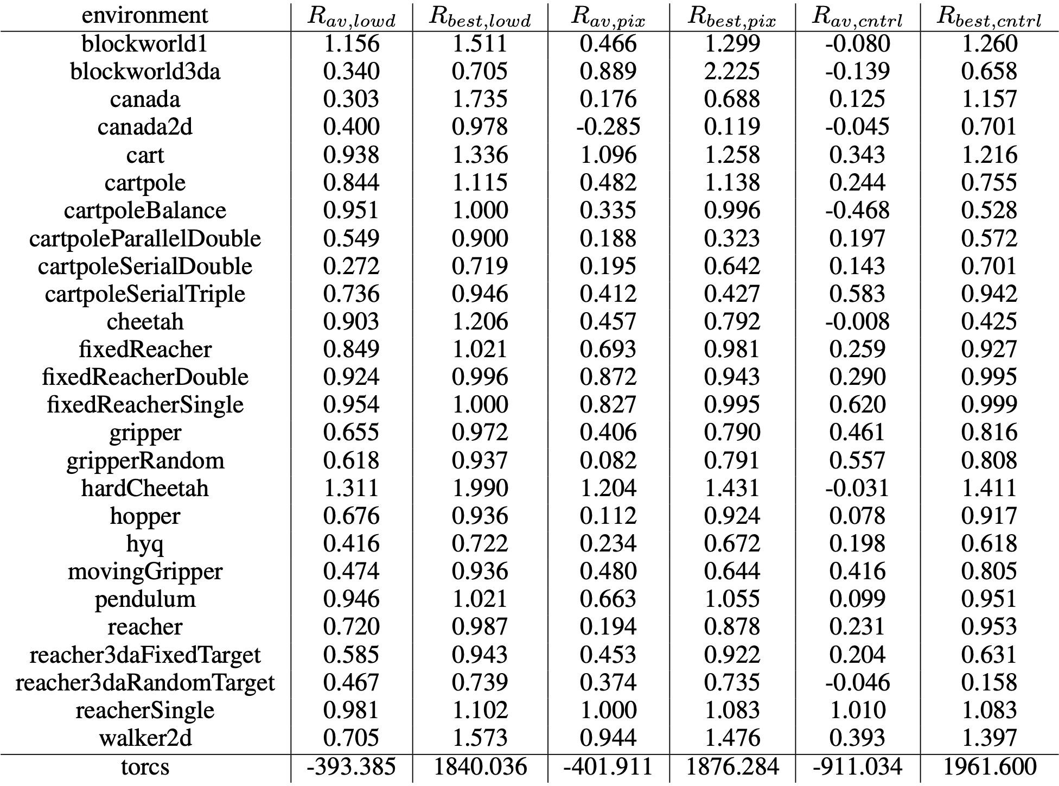
Experiments
DDPG
DPG
Is DDPG
better than DPG?

Slide 54
Experiments
DDPG
DPG
Is DDPG
better than DPG?

Slide 55
Experiments
DDPG
DPG
Is DDPG
better than DPG?

Slide 56
Experiments
DDPG
DPG
Is DDPG
better than DPG?

Slide 57
Experiments
DDPG
DPG
DDPG still exhibits high variance

Slide 58
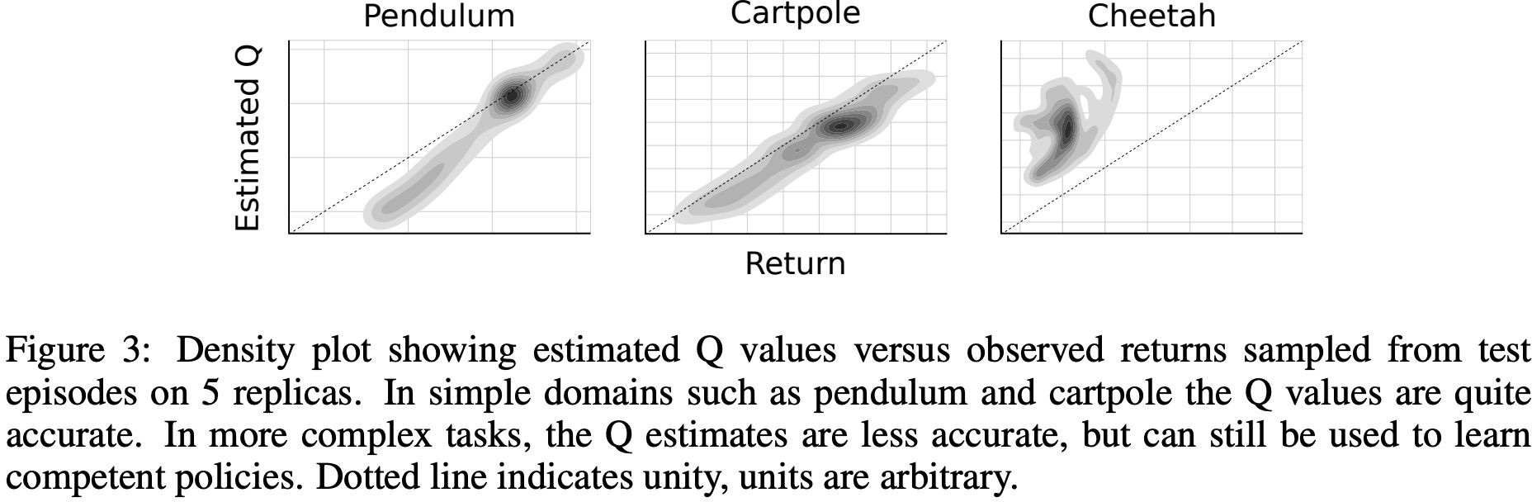
Experiments
How well does Q estimate the true returns?

Slide 59
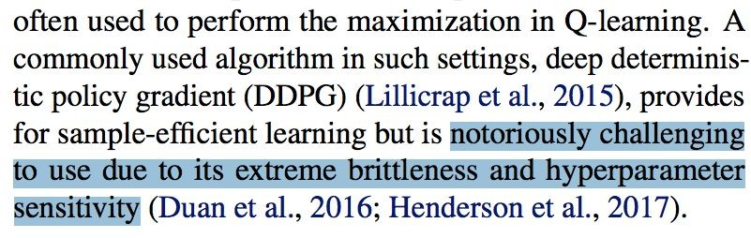
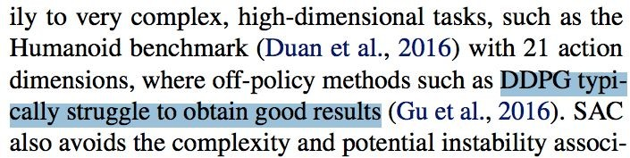
DDPG Follow-up
Model the actor as the argmax of a convex function
Continuous Deep Q-Learning with Model-based Acceleration (Shixiang Gu, Timothy Lillicrap, Ilya Sutskever, Sergey Levine, ICML 2016)
Input Convex Neural Networks (Brandon Amos, Lei Xu, J. Zico Kolter, ICML 2017)
Q-value overestimation
Addressing Function Approximation Error in Actor-Critic Methods (TD3) (Scott Fujimoto, Herke van Hoof, David Meger, ICML 2018)
Stochastic policy search
Soft Actor-Critic: Off-Policy Maximum Entropy Deep Reinforcement Learning with a Stochastic Actor (Tuomas Haarnoja, Aurick Zhou, Pieter Abbeel, Sergey Levine, ICML 2018)

Slide 60

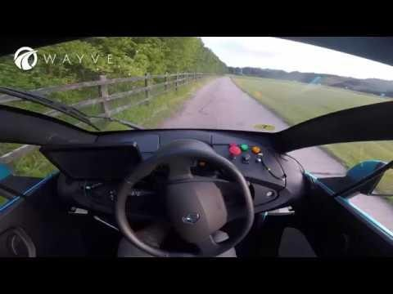
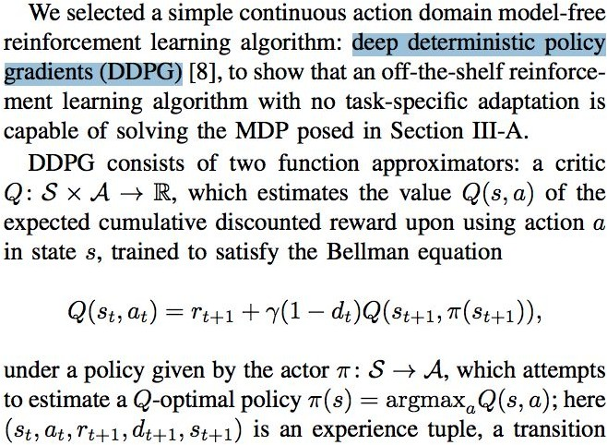
A cool application of DDPG: Wayve
Learning to Drive in a Day (Alex Kendall et al, 2018)

Slide 61
Conclusion
DDPG = DPG + DQN
Big Idea is to bypass finding the local max of Q in DQN by jointly training a second neural network (actor) to predict the local max of Q.
Tricks that made DDPG possible:
Replay buffer, target networks (from DQN)
Batch normalization, to allow transfer between different RL tasks with different state scales
Directly add noise to policy output for exploration, due to continuous action domain
Despite these tricks, DDPG can still be sensitive to hyperparameters. TD3 and SAC offer better stability.

Slide 62
References
These slides have been adapted from
Animesh Garg, CSC2621: Reinforcement Learning in Robotics, University of Toronto

