Slide 1
Team 3
Akil Udayakumar
Muhammad Fazalul Rahman
Shraddha Pandya
Urvi Gandhi
Venkat Nitin Panangati
ThePirateBay.SE

Slide 2
Agenda
Use Case Diagram
Testing
Demo
Issues and Approaches
Lessons learnt

Slide 3
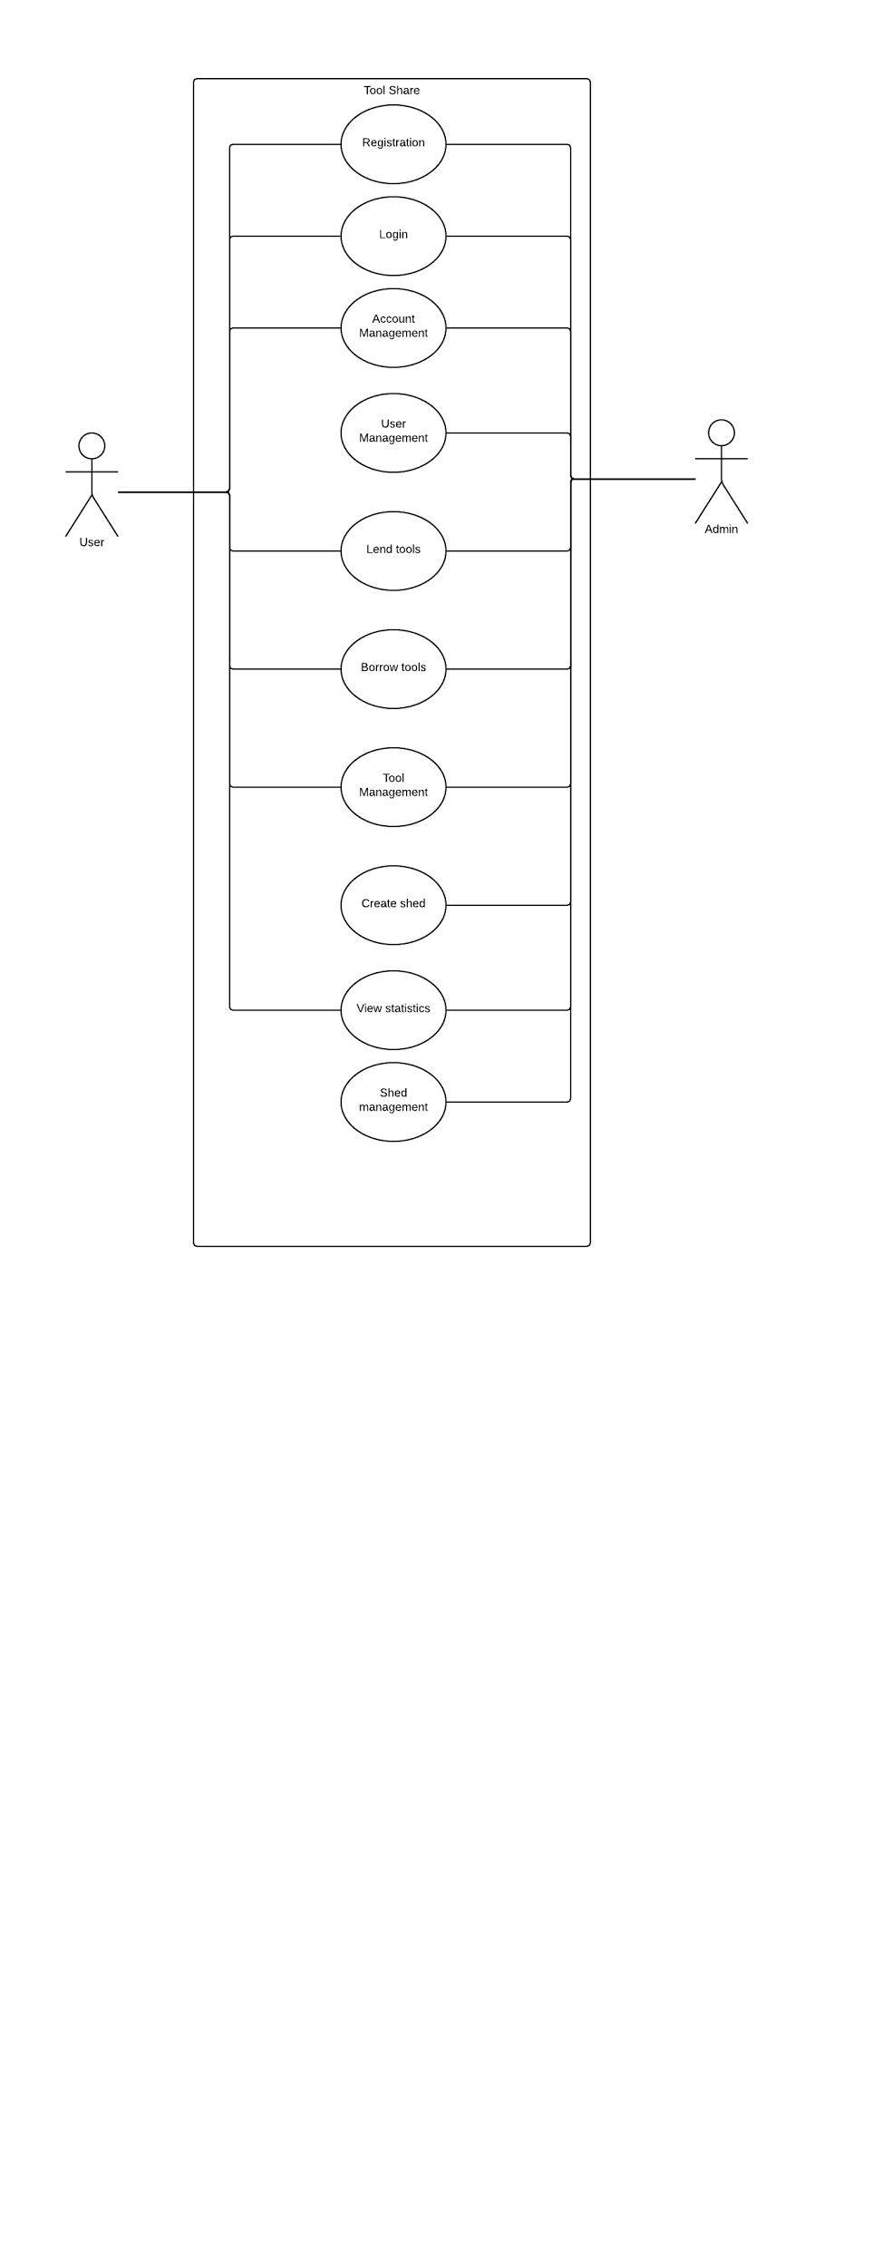
Use Case Diagram

Slide 4
Testing
CSRF Error from R1
Bugs
Unit tests

Slide 5
System Demo

Slide 6
Issues and Approaches
Integrating technologies
SVN conflicts removed code
Unit tests

Slide 7
Lessons Learnt
Importance of Testing
Resolve conflicts within the team
Importance of time management
Adapting to new technologies in a limited time

Slide 8
Thank You

