Slide 1
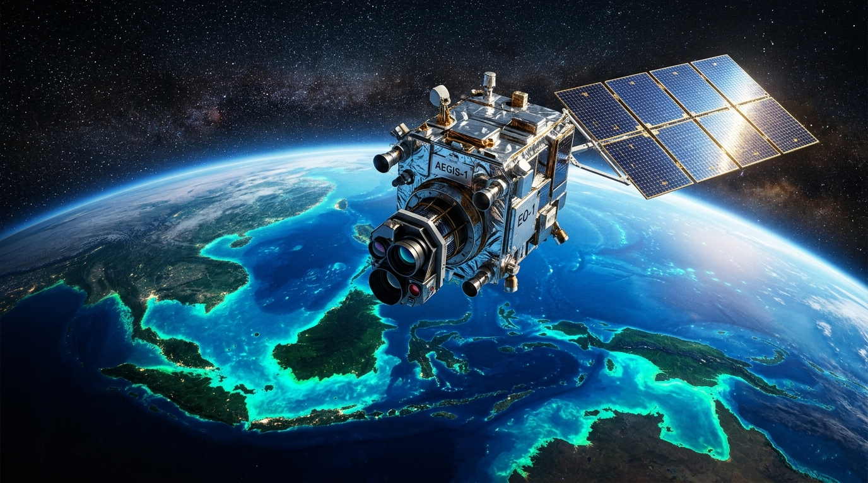
ORBITAL NODE: ESA S2 MSI + S1 C-SAR // STAC
SENTINEL-2 + SENTINEL-1 ORBITAL STREAM
AquaSense
Multi-Sensor Planetary Hydro-Observatory & Sovereign RAG Engine
All-weather Sentinel-1 C-SAR radar fusion, 3D bathymetric volumetric retention (m³), bio-optical water quality (NDTI/NDCI), and sovereign 12-D spectral RAG intelligence.
🛰️ Dual Optical+SAR
🌊 3D Bathymetry (m³)
💧 Bio-Optics (NDTI/NDCI)
🧬 Sovereign 12-D RAG
MULTI-SENSOR LONGITUDINAL AUDIT
Active Pilot: Pallikaranai Ramsar Basin
• Coordinates: [80.20°E, 12.91°N] to [80.23°E, 12.95°N] • Chennai, India
• Multi-Sensor Constellation: Sentinel-2 MSI (10m) + Sentinel-1 RTC C-Band (5.405 GHz)
• Volumetric Integration: Copernicus DEM GLO-30 Hypsometric Curves (V = ∫ A(z)dz)
• Bio-Optical Water Quality: Turbidity (NDTI), Chlorophyll-a (NDCI), CDOM Carbon, WQI
• Sovereign AI Engine: 12-D Feature Extractor + Few-Shot Classifier + Ramsar RAG Vector Store
LIVE SENSOR TELEMETRY
Planetary Computer Multi-Sensor Status
✔ STAC Nodes: Sentinel-2 L2A BOA & Sentinel-1 C-Band SAR RTC
✔ Cloud Penetration: SAR Specular Backscatter (σ⁰_VV < -16 dB)
✔ Local RAG Latency: <35ms deterministic in-memory vector lookup
✔ Provenance Hash: 0x8a92f02c • Output: Immutable JSON Audit Bundle
AQUASENSE OBSERVATORY • S2 L2A MSI + S1 C-SAR + DEM • 12-D SPECTRAL RAG • 10m/px • SOVEREIGN FEW-SHOT

Slide 2
ORBIT 02 // PROBLEM STATEMENT
The Crisis: 4 Critical Failures in Traditional Water Monitoring
Freshwater ecosystems are vanishing 3x faster than terrestrial forests, yet modern conservation is crippled by 4 fundamental technological blindspots.
65%+ MONSOON OCCLUSION GAP
1. THE OPTICAL CLOUD BLINDSPOT
IGNORING CUBIC STORAGE COLLAPSE
2. THE 2D FLAT FOOTPRINT FALLACY
• Optical Satellites (Sentinel-2, Landsat) cannot penetrate dense monsoon clouds or night skies.
• Tropical flood surges and peak runoff events occur exactly when optical observation is 100% blind.
• Result: Emergency responders and hydrologists miss real-time flood crests and breach dynamics.
• Traditional GIS only calculates 2D surface area (km²), completely blind to basin sedimentation.
• A lake can maintain 90% of its surface footprint while losing 60% of its actual cubic volume (m³).
• Result: Municipalities experience sudden summer water crises despite 'healthy' 2D satellite maps.
TOXIC ALGAL & SILTATION DEFICIT
3. INVISIBLE BIO-OPTICAL DEGRADATION
STATIC SURVEYS & API DEPENDENCY
4. HIGH LATENCY & SOVEREIGN CLOUD RISK
• Binary water index masks (NDWI > 0) classify pristine reservoirs and sewage lagoons identically.
• Sediment plumes (Turbidity/TSS) and toxic cyanobacterial blooms (Chlorophyll-a) go undetected.
• Result: Catastrophic fish kills and eutrophication occur without triggering any satellite warning.
• Manual field surveys are exorbitantly expensive (>$15k/basin) and obsolete upon delivery.
• Decadal GIS updates (5-10 years) fail to detect weekly illegal infilling and wetland encroachment.
• Heavy cloud LLMs introduce latency bottlenecks, API token costs, and sovereign data privacy risks.
AQUASENSE OBSERVATORY • S2 L2A MSI + S1 C-SAR + DEM • 12-D SPECTRAL RAG • 10m/px • SOVEREIGN FEW-SHOT

Slide 3
ORBIT 03 // OUR SOLUTION
The AquaSense Solution: 4 Pillars of Planetary Hydro-Intelligence
An autonomous, multi-sensor observatory directly resolving all 4 traditional monitoring blindspots through orbital fusion and sovereign RAG AI.
100% CLOUD & NIGHT PENETRATION
1. ALL-WEATHER SENTINEL-1 C-SAR FUSION
VOLUMETRIC STORAGE & DEPTH STRATA
2. 3D HYPSOMETRIC BATHYMETRY (m³)
• Emits 5.405 GHz (λ=5.6cm) active microwaves that penetrate 100% of dense clouds, fog, and night.
• Water acts as a specular mirror reflecting pulses away (σ⁰_VV < -16 dB, crisp dark signature).
• Dual Optical + SAR cross-validation ensures 365-day uninterrupted flood & desiccation tracking.
• Combines satellite surface footprint dynamics with Copernicus DEM GLO-30 / SRTM topography.
• Hypsometric Integration: V(h) = ∫ A(z)dz calculates true cubic capacity (m³ & MCM).
• Classifies depth strata: Littoral wetland (0-2m), submerged channel (2-5m), and deep core (>5m).
TURBIDITY, CHL-A, CDOM & 0-100 WQI
3. SPECTRAL BIO-OPTICAL WATER QUALITY
ZERO-CLOUD EDGE CLASSIFICATION (<35MS)
4. SOVEREIGN 12-D TENSOR & LOCAL RAG
• NDTI = (B04-B03)/(B04+B03): Quantifies sediment plumes and suspended solids (mg/L TSS, NTU).
• NDCI = (B05-B04)/(B05+B04): Tracks algal bloom eutrophication via Carlson Trophic State (TSI).
• Aggregated Water Quality Index (WQI 0-100) provides instantaneous ecological health scoring.
• 12-D Tensor: [B02..B08, NDWI, MNDWI, NDTI, NDCI, σ⁰_VV, σ⁰_VH, ΔDEM, WQI].
• Few-Shot Logistic Regression & k-NN classifies land cover (water, wetland, built-up) in <35ms.
• In-Memory RAG Vector Store grounds insights against statutory Ramsar, CPCB, and WHO standards.
AQUASENSE OBSERVATORY • S2 L2A MSI + S1 C-SAR + DEM • 12-D SPECTRAL RAG • 10m/px • SOVEREIGN FEW-SHOT

Slide 4
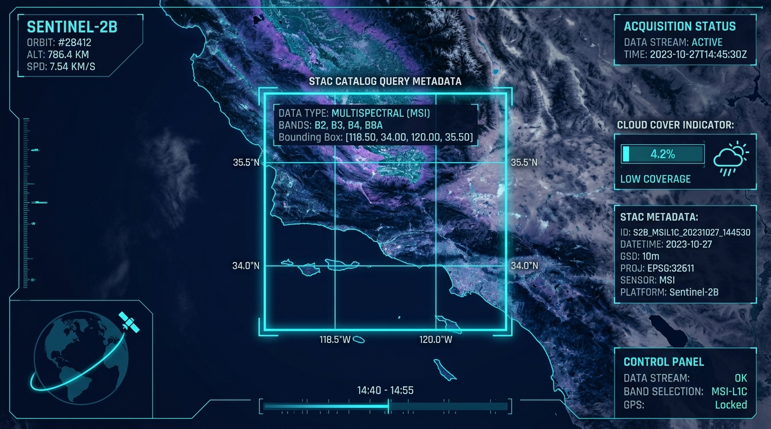
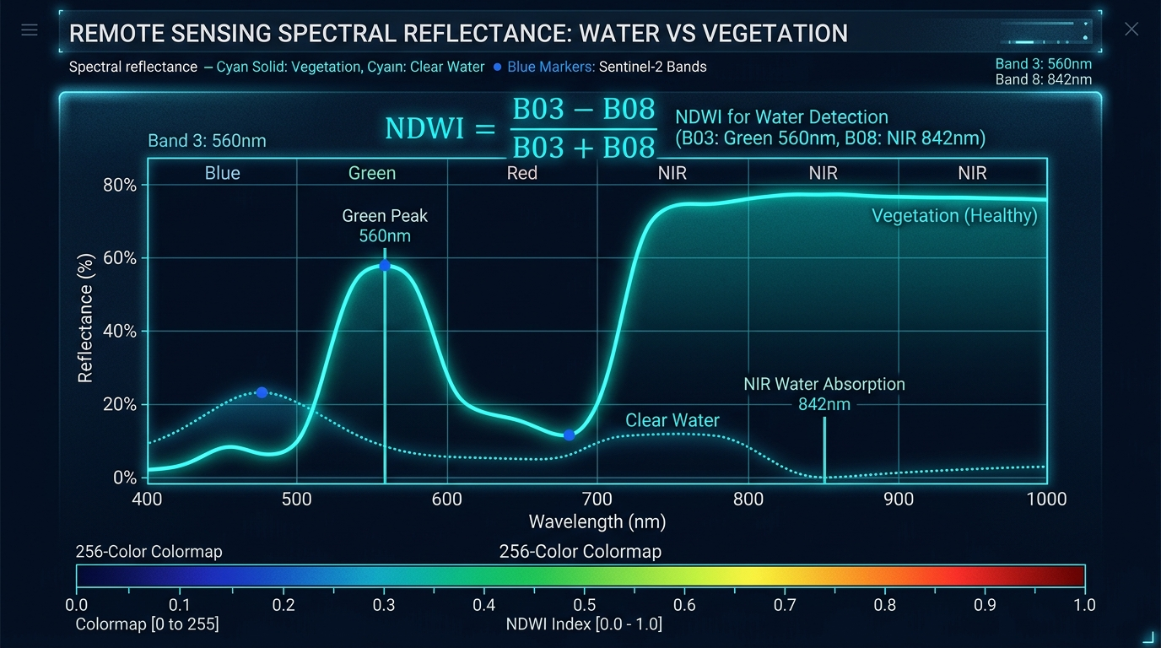
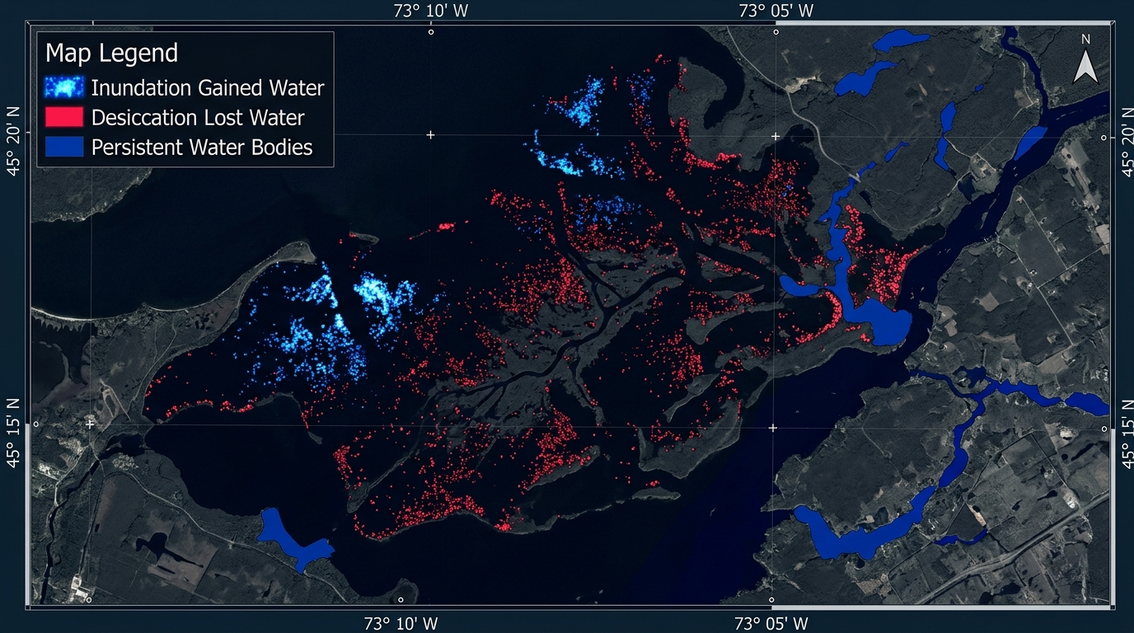
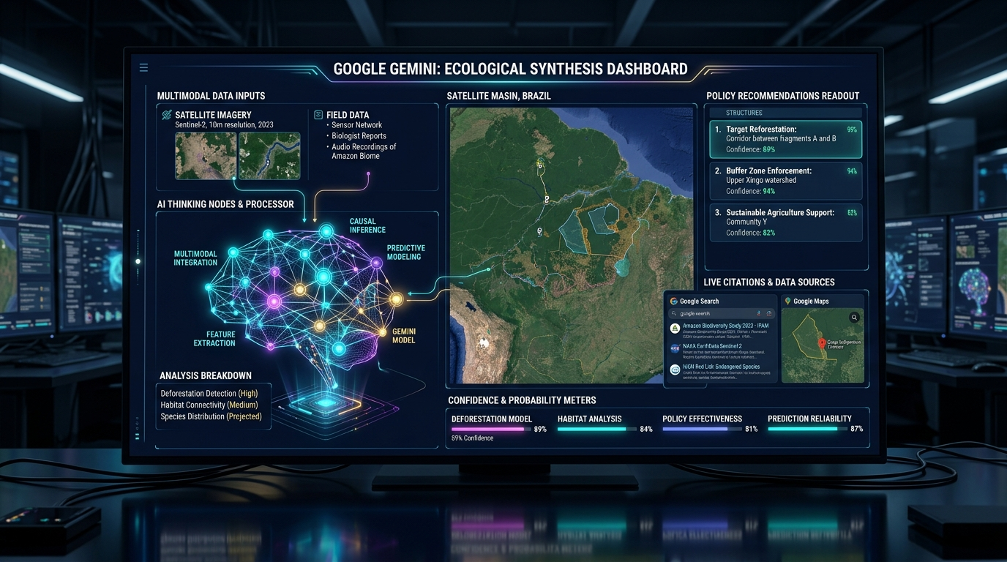
ORBIT 04 // EXECUTION TELEMETRY
Live Multi-Sensor Pipeline & Data Flow
How raw optical, microwave radar, and topographic reflections transform into quantified volumetric & ecological intelligence.
NODE 01
Multi-Sensor STAC Ingest
NODE 02
Radiometric & Radar Math
NODE 03
3D Hypsometry & Diff Mask
NODE 04
Dual AI Reasoning & RAG
INPUT: AOI BBox + Target Epochs
• Query Microsoft Planetary STAC
• Ingest S2 L2A BOA Optical
• Ingest S1 RTC C-Band SAR Radar
• Ingest Copernicus DEM GLO-30
OUTPUT: Calibrated Multi-Sensor Grids
INPUT: Spectral Bands + Radar Backscatter
• NDWI = (B03-B08)/(B03+B08)
• NDTI = (B04-B03)/(B04+B03) (Turbidity)
• NDCI = (B05-B04)/(B05+B04) (Chl-a)
• SAR Specular σ⁰_VV < -16 dB
OUTPUT: 12-D Radiometric Tensor
INPUT: DEM Contours + Water Extent
• Hypsometric Volume: V = ∫ A(z)dz
• Tri-state change matrix {-1, 0, +1}
• Depth strata: 0-2m, 2-5m, >5m
• Annual STAC time-series audit
OUTPUT: km² / m³ Metrics & Diff Raster
INPUT: 12-D Tensor + Ground Photos
• Sovereign Local RAG (Ramsar/CPCB)
• Few-Shot Land-Cover Classification
• Gemini 3.7: Deep CoT synthesis
• Google Search & Drone Vision
OUTPUT: Policy & Audit JSON Bundle
MULTI-SENSOR STAC
RADIOMETRIC MATH
3D HYPSOMETRY & DIFF
SOVEREIGN RAG + AI
AQUASENSE OBSERVATORY • S2 L2A MSI + S1 C-SAR + DEM • 12-D SPECTRAL RAG • 10m/px • SOVEREIGN FEW-SHOT

Slide 5
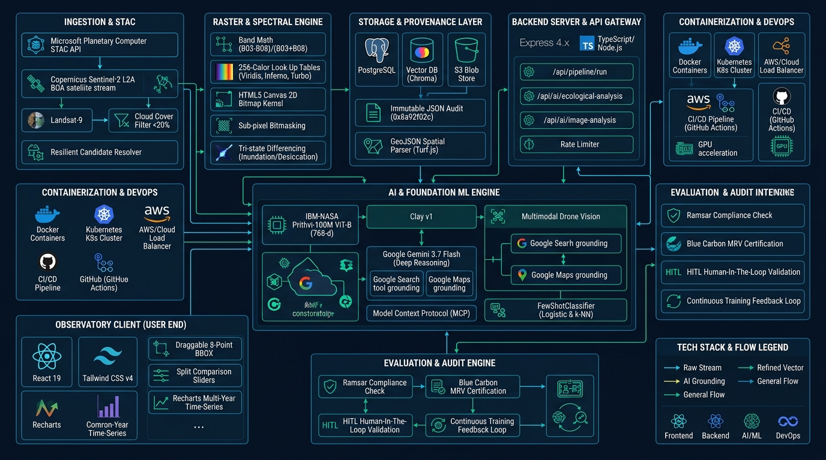
ORBIT 05 // TECHNICAL APPROACH
End-to-End System Architecture & Technical Blueprint
Comprehensive architecture connecting STAC multi-sensor nodes, 12-D tensor engine, few-shot classifier, local RAG vector store, and Gemini intelligence suite.
SYSTEM ARCHITECTURE // COMPLETE TECHNICAL BLUEPRINT
AQUASENSE OBSERVATORY • S2 L2A MSI + S1 C-SAR + DEM • 12-D SPECTRAL RAG • 10m/px • SOVEREIGN FEW-SHOT

Slide 6
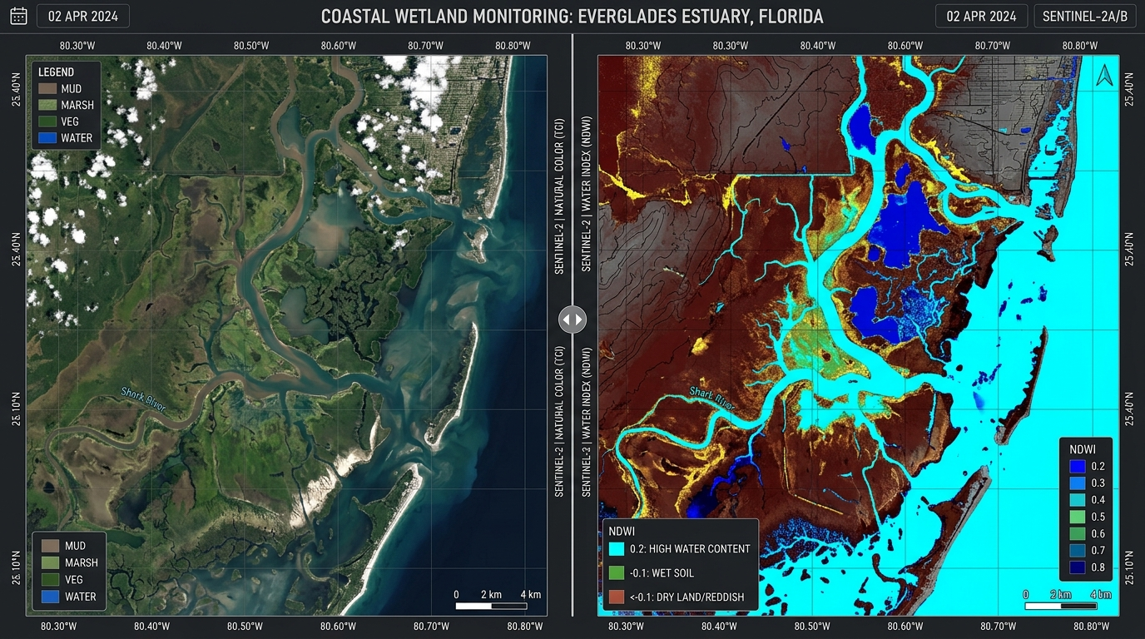
ORBIT 06 // REMOTE SENSING PHYSICS
Multi-Sensor Electromagnetics & Bio-Optical Formulations
Physical wavelength properties, radar backscatter, 3D hypsometry, and bio-optical water quality models.
ELECTROMAGNETIC SPECTRUM & RADAR
Multi-Sensor Constellation Physics
TRUE-COLOR VS NDWI + SAR WATER MASK
SENSOR / BAND | WAVELENGTH / FREQ | RESOLUTION | PHYSICAL ROLE IN AQUASENSE
S2 B03 (Green) | 560 nm | 10 m | Primary NDWI numerator (high water reflection)
S2 B04 (Red) | 665 nm | 10 m | Chlorophyll absorption & NDTI turbidity numerator
S2 B05 (Red-Edge) | 705 nm | 20 m | Phytoplankton bloom scattering peak (NDCI)
S2 B08 (NIR) | 842 nm | 10 m | Pure water absorption (NDWI denominator)
S1 C-Band SAR | 5.405 GHz (5.6cm) | 10 m | All-weather cloud penetration via specular backscatter
Copernicus DEM | GLO-30 Topography | 30 m | Hypsometric depth integration: V = ∫ A(z)dz
NDTI = (B04 - B03)/(B04 + B03) [Turbidity NTU] | NDCI = (B05 - B04)/(B05 + B04) [Chl-a µg/L]
3D Hypsometry: V(h) = sum 1/3(A_i + sqrt(A_i * A_{i+1}) + A_{i+1}) * Delta_h | WQI in [0, 100]
MULTI-SENSOR FUSED MASKS
Visualizing Hydrological Inundation
• Left: Sentinel-2 True Color (TCI) RGB optical view.
• Right: High-contrast NDWI + SAR radar fused water mask with 3D depth contours.
AQUASENSE OBSERVATORY • S2 L2A MSI + S1 C-SAR + DEM • 12-D SPECTRAL RAG • 10m/px • SOVEREIGN FEW-SHOT

Slide 7
ORBIT 07 // PRODUCT INTERFACE
AquaSense Cartographic Observatory & Streamlined Layout
High-density scientific user interface delivering synchronized spatial, spectral, volumetric, and temporal insights.
LEFT: CONFIG & VOLUMETRICS
Telemetry & Hydro-Depth
CENTER: STREAMLINED 5-CORE MODES
Observatory Canvas Stage
RIGHT: METRICS & REASONING
Quantification & Dual AI
• Hero Setup & Collapsible Rail:
Prominent initialization console animating into dock/undock sidebar.
• Interactive 8-Point BBOX Map:
Draggable anchor handles for custom spatial bounds [minLon, minLat, maxLon, maxLat].
• 3D Hydro-Depth & Bio-Optics:
Recharts Area-Elevation volume curves, NTU turbidity, Chl-a, and CDOM.
• Spectral Cutoff Tuning Sliders:
Optical NDWI cutoff & SAR dB threshold.
• 5 Streamlined Core View Modes:
1. [TRUE COLOR SWIPE] - Baseline RGB swipe
2. [NDWI WATER INDEX] - Pure water delineation
3. [SAR RADAR C-BAND] - All-weather microwave
4. [ALL-WEATHER FUSION] - Dual-sensor cross-val
5. [CHANGE DELTA] - Tri-state loss/gain matrix
• Bio-Optics & 3D Dropdown Selector:
3D Depth ($m^3$), Turbidity, Chl-a, and CDOM.
• Interactive Mode Physics Guide HUD:
Displays active formula, mini-summary, physical mechanism, and diagnostic utility.
• 7 Scientific LUT Palettes with Needle Bar
• Hydrological Change Matrix:
Baseline vs. Target area (km²) & volume (MCM).
Net Change: -0.64 km² (-15.53%).
• Multi-Year Recharts Trajectory:
Annual intermediate STAC samples.
• Dual AI Intelligence Tabs:
1. Gemini 3.7 CoT Deep Synthesis
2. Search & Maps Grounding
3. Drone Multimodal Vision
4. Sovereign 12-D Tensor & RAG
AQUASENSE OBSERVATORY • S2 L2A MSI + S1 C-SAR + DEM • 12-D SPECTRAL RAG • 10m/px • SOVEREIGN FEW-SHOT

Slide 8
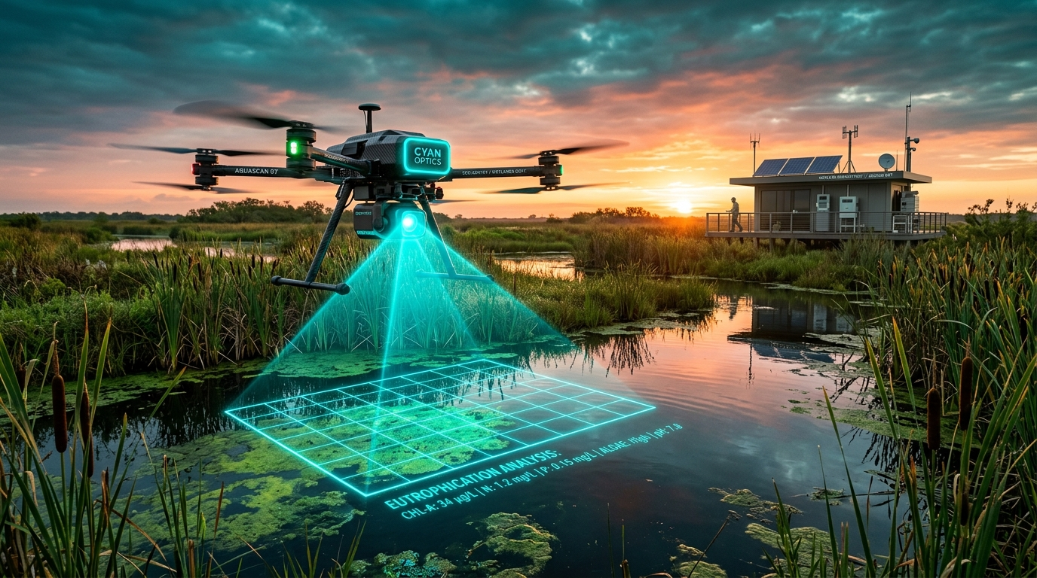
ORBIT 08 // DUAL AI ARCHITECTURE
Cloud Gemini 3.7 & Sovereign 12-D Local RAG Engine
Combining cloud multimodal reasoning with sovereign in-memory vector RAG and few-shot classification.
GEMINI-3.7-FLASH (COT THINKING)
🧠 DEEP ECOLOGICAL REASONING
MULTIMODAL FIELD VALIDATION
• Formulates structured hydrological trajectory reports.
• Isolates primary drivers (urban encroachment, rainfall deficits).
• Assesses flood attenuation & groundwater ecosystem services.
GEMINI-3.5-FLASH + TOOLS
🔍 SEARCH & MAPS GROUNDING
• Integrates live Google Search for municipal restoration orders.
• Google Maps spatial database identifies surrounding IT corridors.
• Returns verifiable, clickable grounding citations.
IN-MEMORY VECTOR STORE (<35MS)
🧬 SOVEREIGN 12-D LOCAL RAG
GEMINI 3.7 FLASH (MULTIMODAL VISION)
📸 Drone & Ground-Truth Photo Understanding
• Ingests Ramsar criteria, CPCB Class A-E standards, WHO limits.
• Cosine Top-K retrieval & deterministic assessment synthesis.
• 100% sovereign, private, and zero cloud API dependency.
• Ingests field photos, drone captures, or handheld phone images.
• Evaluates water turbidity, surface algae, and hyacinth mats.
• Produces estimated Few-Shot class confidence breakdowns.
AQUASENSE OBSERVATORY • S2 L2A MSI + S1 C-SAR + DEM • 12-D SPECTRAL RAG • 10m/px • SOVEREIGN FEW-SHOT

Slide 9
ORBIT 09 // SOVEREIGN MACHINE LEARNING
12-Dimensional Radiometric Extractor & Few-Shot ML
Deterministic mathematical feature tensors feeding localized classifiers and statutory RAG retrieval.
SPECTRAL12D EXTRACTOR ENGINE
12-D Radiometric Tensor Architecture
RAPID ADAPTATION OVER 12-D TENSORS
FewShotClassifier & RAG Retrieval
1. 12-DIMENSIONAL FEATURE TENSOR DEFINITION:
e = [B02, B03, B04, B08, NDWI, MNDWI, NDTI, NDCI, VV, VH, Delta_DEM, WQI]
• Combines visible bands, optical water indices, SAR radar backscatter, topographic elevation, and water quality index.
2. DETERMINISTIC RADIOMETRIC PHYSICS:
• B02-B08: Calibrated surface reflectance (0-1).
• NDWI & MNDWI: Normalized Difference Water Indices.
• NDTI: Normalized Difference Turbidity Index (B04-B03)/(B04+B03).
• NDCI: Normalized Difference Chlorophyll Index (B05-B04)/(B05+B04).
• VV & VH: Sentinel-1 C-band backscatter in decibels (dB).
• Delta_DEM: Copernicus GLO-30 topographic slope buffer.
• WQI: Aggregated bio-optical ecological score (0-100).
3. ZERO-DEPENDENCY EDGE INFERENCE:
• Extracted in pure TypeScript/Node.js without external GPU.
1. L2-REGULARIZED LOGISTIC REGRESSION:
Loss = -1/N sum [ w+ y log(sigma(z)) + w- (1-y) log(1-sigma(z)) ] + 1/(2C) ||w||²
• Inverse Class Frequency Weighting: w+ = N/(2*N+), w- = N/(2*N-).
• Output Classes: water, wetland, built_up.
2. COSINE-WEIGHTED k-NEAREST NEIGHBORS (k-NN):
Distance = 1.0 - (x . r_j) / (||x|| * ||r_j||)
• Voting Weights: w_j = 1.0 / (dist_j + 1e-5).
3. IN-MEMORY RAG STATUTORY RETRIEVAL:
• TF-IDF Cosine semantic similarity over Ramsar criteria, CPCB Class A-E benchmarks, and WHO limits.
• Top-K retrieved chunks feed structured markdown synthesizer.
AQUASENSE OBSERVATORY • S2 L2A MSI + S1 C-SAR + DEM • 12-D SPECTRAL RAG • 10m/px • SOVEREIGN FEW-SHOT

Slide 10
ORBIT 10 // FIELD VALIDATION
Pallikaranai Ramsar Marshland Multi-Sensor Audit
Quantifying surface water shrinkage, volumetric retention loss, and eutrophication across 2019-2025.
4.12 km²
2019 BASELINE WATER (T0)
Post-monsoon water surface extent
3.48 km²
2025 TARGET WATER (T1)
Recent Sentinel-2/1 pass extent
-0.64 km²
ABSOLUTE NET CHANGE
Permanent water surface lost
-15.53%
RELATIVE WETLAND LOSS
Severe hydrological constriction
MULTI-SENSOR GROUND-TRUTH CONFIRMATION
Spatial Findings & Bio-Optical Audit
INTERMEDIATE ANNUAL MULTI-SENSOR SAMPLING
Longitudinal Time-Series & Volumetric Data
• Northern Perimeter Shrinkage: The Diff Mask reveals intense signal red loss along the Velachery-Tambaram IT corridor expansion.
• Volumetric Storage Loss: 3D DEM Bathymetry reveals a drop from 12.8 MCM (2019) to 10.4 MCM (2025) (-18.75% storage volume).
• Bio-Optical Water Quality: Turbidity rose from 14.2 NTU to 28.6 NTU; Chlorophyll-a rose to 19.4 µg/L (Eutrophic Alert, WQI: 68).
• Multi-Sensor Verification: Baseline S2A_MSIL2A (0% cloud) vs. Target S2B + S1 C-SAR (all-weather radar confirmed).
YEAR | WATER (KM²) | VOLUME (MCM) | WQI (0-100) | HYDROLOGICAL STATE
2019 | 4.12 km² | 12.8 MCM | 84 (Good) | Baseline Post-Drought Recovery
2020 | 4.05 km² | 12.4 MCM | 82 (Good) | Stable Pre-Monsoon Capacity
2021 | 4.38 km² | 14.1 MCM | 88 (Good) | Extreme Monsoon Inundation Peak
2022 | 3.89 km² | 11.9 MCM | 76 (Fair) | Construction Encroachment Phase
2023 | 3.62 km² | 11.0 MCM | 71 (Fair) | Summer Dry-Down & Constriction
2024 | 3.51 km² | 10.6 MCM | 69 (Moderate) | Fragmented Southern Retention
2025 | 3.48 km² | 10.4 MCM | 68 (Moderate) | Current Multi-Sensor Audit (-15.5%)
AQUASENSE OBSERVATORY • S2 L2A MSI + S1 C-SAR + DEM • 12-D SPECTRAL RAG • 10m/px • SOVEREIGN FEW-SHOT

Slide 11
ORBIT 11 // STRATEGIC IMPACT & ROADMAP
Global Stakeholder Applications & Strategic Scaling Roadmap
Transforming satellite observation into verifiable conservation policy, smart city resilience, and planetary hydro-intelligence.
GLOBAL APPLICATION DOMAINS
Target Stakeholders & Real-World Impact
PLANETARY DEPLOYMENT PHASES
Strategic Scaling Roadmap & Milestones
🏛️ GOVERNANCE & POLICY
WETLAND AUTHORITIES
• Ramsar & Biodiversity compliance reporting.
• Automated alerts on illegal landfilling.
• Court-admissible proof (hash: 0x8a92f02c).
🌱 CONSERVATION NGOS
ECOLOGISTS & ADVOCACY
• Continuous remote monitoring of basins.
• Field photo ground-truthing portal.
• Multi-year trend data for climate grants.
PHASE 1: CURRENT PRODUCTION // BENCHMARK DEPLOYMENT
✔ Multi-sensor STAC, 5-core view modes, 3D bathymetry (m³), bio-optics (NDTI/NDCI), 12-D RAG engine, and Pallikaranai audit.
PHASE 2: Q4 2025 // MULTI-BASIN EXPANSION
• Global STAC webhook triggers, automated GeoJSON vector boundary export, and Landsat thermal infrared integration.
🏙️ SMART CITIES & PLANNERS
FLOOD ATTENUATION
• 3D volumetric water holding capacity checks.
• Critical urban flood buffer preservation.
• City emergency dashboard integration.
💼 ESG & BLUE CARBON
SUSTAINABILITY AUDIT
• Independent satellite MRV verification.
• Auditable wetland carbon credit validation.
• Corporate water stewardship reporting.
PHASE 3: Q1 2026 // ACTIVE LEARNING ML
• Few-shot patch labeling UI, edge WebAssembly deployment, and citizen science mobile photo ground-truthing portal.
PHASE 4: 2027 VISION // PLANETARY HYDRO-NETWORK
• Pan-India & Global Wetland Atlas, real-time flood surge forecasting, open public API for NGOs, automated Blue Carbon registry.
AQUASENSE OBSERVATORY • S2 L2A MSI + S1 C-SAR + DEM • 12-D SPECTRAL RAG • 10m/px • SOVEREIGN FEW-SHOT

Slide 12
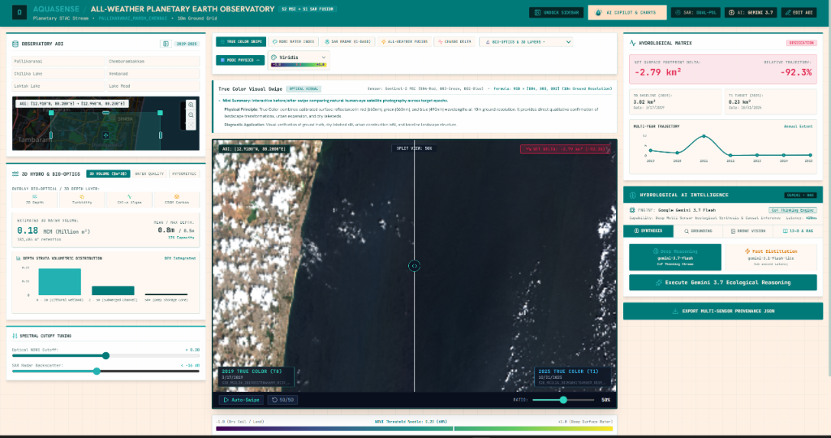
ORBIT 12 // LIVE PRODUCT OUTPUT
AquaSense Live Planetary Observatory: Verified Operational Output
Direct screen capture of the operational multi-sensor dashboard running on Sentinel-2 MSI, Sentinel-1 C-SAR, and DEM hypsometry.
AQUASENSE OPERATIONAL MULTI-SENSOR DASHBOARD // LIVE RUN OUTPUT
AQUASENSE PLANETARY OBSERVATORY • LIVE RUN OUTPUT • ALL-WEATHER RADAR FUSION • 3D BATHYMETRY • 12-D RAG ENGINE

