Slide 1

Department of Information Technology
IT23723 – INTERNSHIP II
NAEHA S
Reg. No: 241001142

Slide 2
About The Company
Merit Software Services Pvt. Ltd.
About The Organization
Merit Software Services Pvt. Ltd. is a Chennai-based IT services company headquartered in Ambattur Industrial Estate, delivering data, analytics, and software solutions to enterprise clients. This internship was completed under its Data & Analytics division.
Internship Engagement
Placement Details
• Position: Data Analyst Intern
• Department: Data & Analytics
• Duration: 4 weeks (17 Jun – 14 Jul 2026)
• Work Mode: Hybrid (online + Chennai office)
• Reporting To: Analytics Manager

Slide 3
Inefficiencies in Enterprise Procurement
Traditional Procurement
Traditional enterprise procurement workflows suffer from structural gaps that limit efficiency and scalability:
• Manual Processes: Heavy reliance on offline spreadsheets, manual data entry, and slow approvals.
• Siloed Data: Disjointed departmental records make consolidated spend visibility impossible.
• Lacks Insights: Inability to proactively predict upcoming supplier risks or budget overruns.
ProcureSense AI
ProcureSense AI introduces an automated enterprise engine that unifies SQL analytics, ML, and interactive BI:
• Supplier Risk: Monitors vendor metrics and maps potential disruption points before they occur.
• Spend Concentration: Analyzes transaction density to consolidate buying power.
• Delivery Delays: Employs predictive analytics to forecast shipment issues early.
Raw Data
Siloed ERPs & Spreadsheets
Analytics Engine
Unified SQL, ML & BI Layer
Decision Support
Interactive BI & Predictive Insights

Slide 4
Risk Prediction & Composite Score
Supplier Risk Visibility
Operational Problem
Lack of real-time visibility into supplier performance and delivery risks.
Project Objectives
Key Deliverables
• Normalize database (28,765 records)
• Build 10 operational SQL queries
• Train 6 ML models for late delivery prediction
• Develop 0–100 Procurement Health Score
• Deploy 5-tab Streamlit dashboard

Slide 5
4-Tier Clean Layered Design
1. Presentation Layer
Streamlit BI Studio (5 tabs)
Architectural Highlights
• Clean Separation: Rigid isolation of analytics pipelines from presentation layers mitigates leakage and preserves system modularity.
• Schema-First Setup: Enforces structured integrity across a 5-table SQLite relational database populated with 28,765 validated records.
• Intelligent Pipelines: Features robust historical PO training via a 6-model ML workflow with deep SHAP explainability.
• Instant UI Rendering: State-preserving interface architecture delivers lightweight queries and immediate visual updates inside 5 Streamlit tabs.
2. Analytics & ML Layer
KPI Engine, 6-Model Pipeline, SHAP
3. Query Layer
10 SQL Portfolio Queries
4. Data Layer
SQLite DB (5 tables, 28,765 records)
Internship II

Slide 6
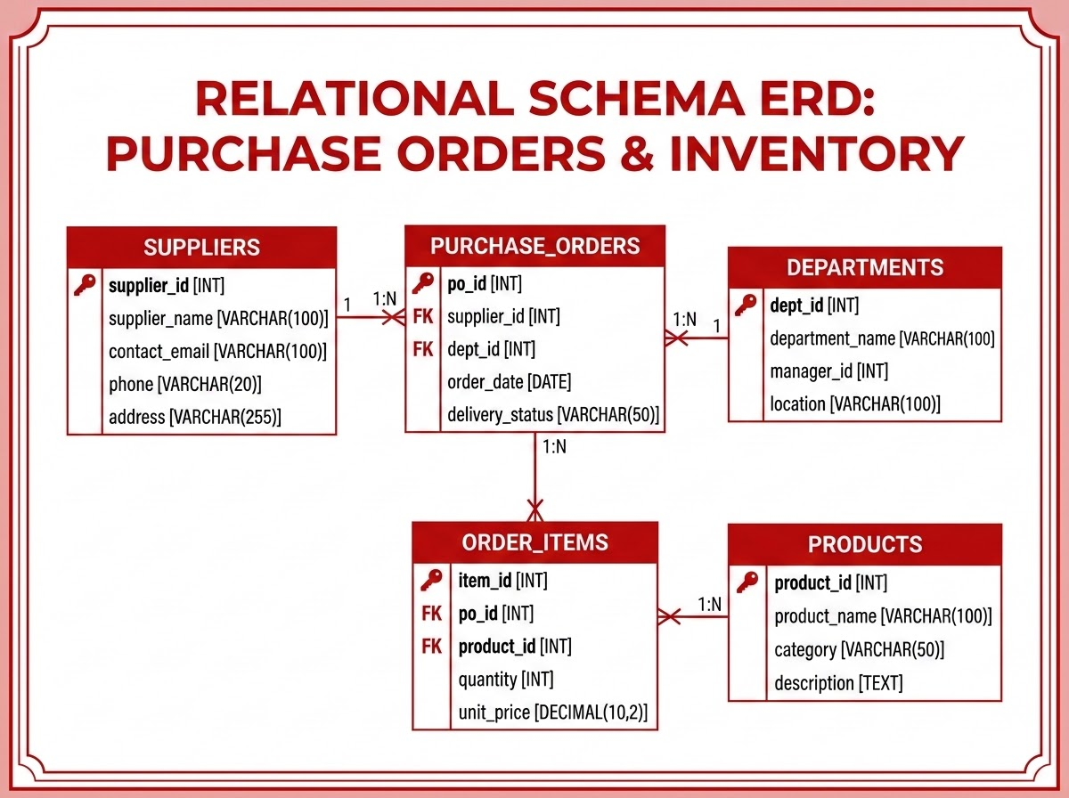
Database Design & SQL Analytics
SQL Highlights
Supplier Risk Scoring: Late delivery and price drift combined to evaluate vendor risk exposure.
Price Drift Detection: Detects YoY changes using advanced LAG analytic window functions.
Spend Pareto (80/20 Rule): Identifies top spend categories driving the vast majority of procurement costs.
Late Delivery Rate Trend: Pinpoints deteriorating performance patterns using rolling trends.
Budget Utilization: Correlates transaction values directly with authorized departmental limits.
ERD Summary
5 interconnected tables (Purchase Orders, Suppliers, Products, Departments, Order Items) illustrating database schemas and relationship maps.

Slide 7
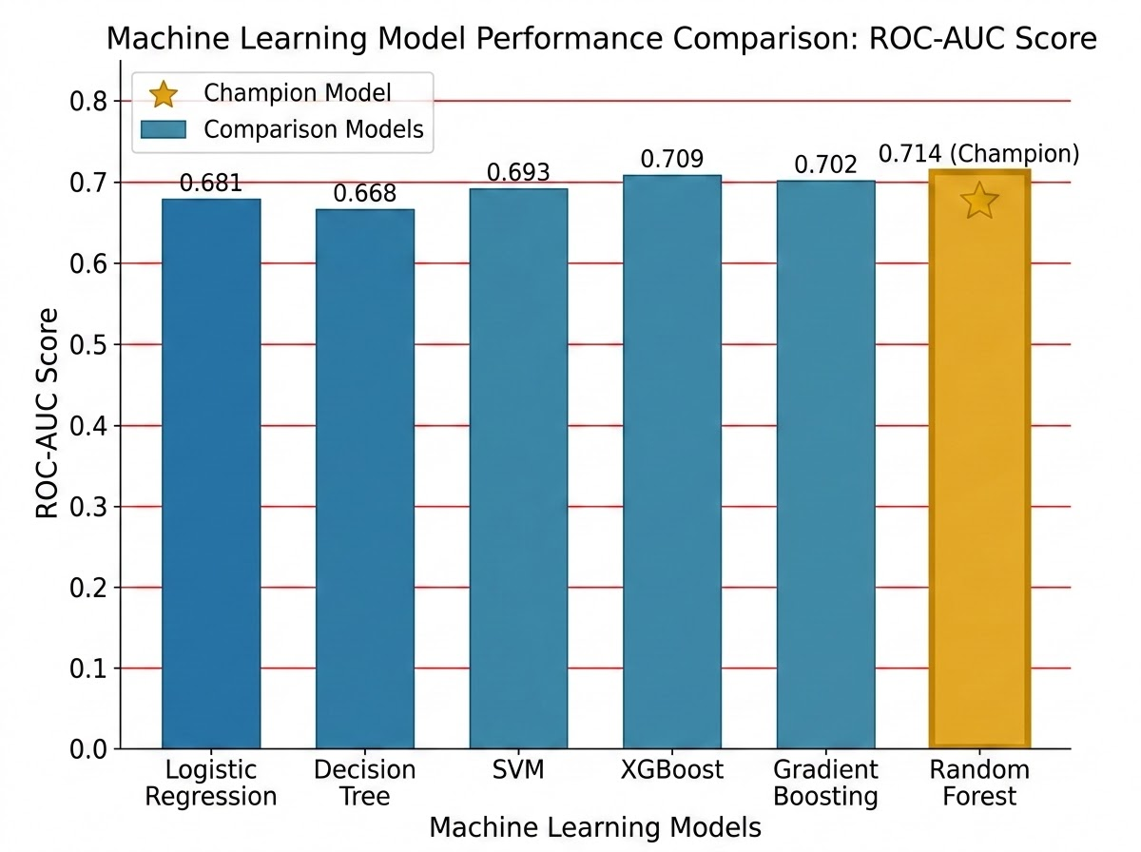
ML Pipeline — Late Delivery Prediction
Pipeline Architecture
Target Definition
Binary Late Delivery (utilizing 12 engineered features with walk-forward validation).
Model Evaluations (ROC-AUC)
• Logistic Regression: 0.641
• Decision Tree: 0.658
• SVM: 0.633
• XGBoost: 0.698
• Gradient Boosting: 0.701
★ Random Forest (Champion): 0.714
Explainability (SHAP)
SHAP feature importance identified supplier risk tier and lead time as the top drivers of predictions.
ROC-AUC Model Comparison
Random Forest achieves champion performance with an AUC of 0.714, followed closely by XGBoost and Gradient Boosting.

Slide 8
Procurement Health Score
System Health Engine
Component Breakdown
Aggregates 6 key operational signals on a weighted 0-100 scale to provide an immediate indicator of end-to-end procurement health and compliance.
On-Time Delivery Weight: 25%
62%
Supplier Risk Weight: 20%
41%
CURRENT COMPOSITE SCORE
Price Stability Weight: 20%
55%
49.1 / 100
Budget Utilization Weight: 15%
78%
Spend Concentration Weight: 10%
33%
⚠ Needs Attention
PO Cycle Time Weight: 10%
48%

Slide 9
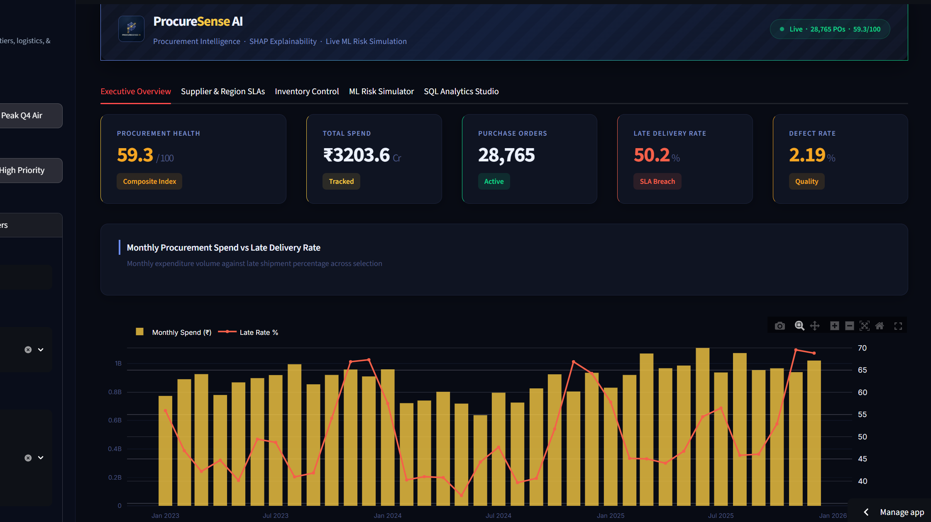
Streamlit BI Studio — 5-Tab Interface
Interactive BI Features
Streamlit Interactivity
Dynamic Python-driven widgets enable instant filtering and multi-dimensional state management across all five tabs.
Plotly Drilldown Capabilities
Interactive charts allow granular exploration of spend categories, procurement timelines, and supplier compliance metrics.
In-Browser ML Inference
Key Feature: Executes client-side model inference (ROC/SHAP) for real-time risk scoring on new purchase orders.
Streamlit BI Application Mockup
Interactive web console built with Python, showing active metrics, spend analytics, and ML risk evaluation tabs.
5-Tab Interactive Console
• Executive Overview • SQL Studio • Supplier Risk Map • ML Insights • Data Explorer

Slide 10
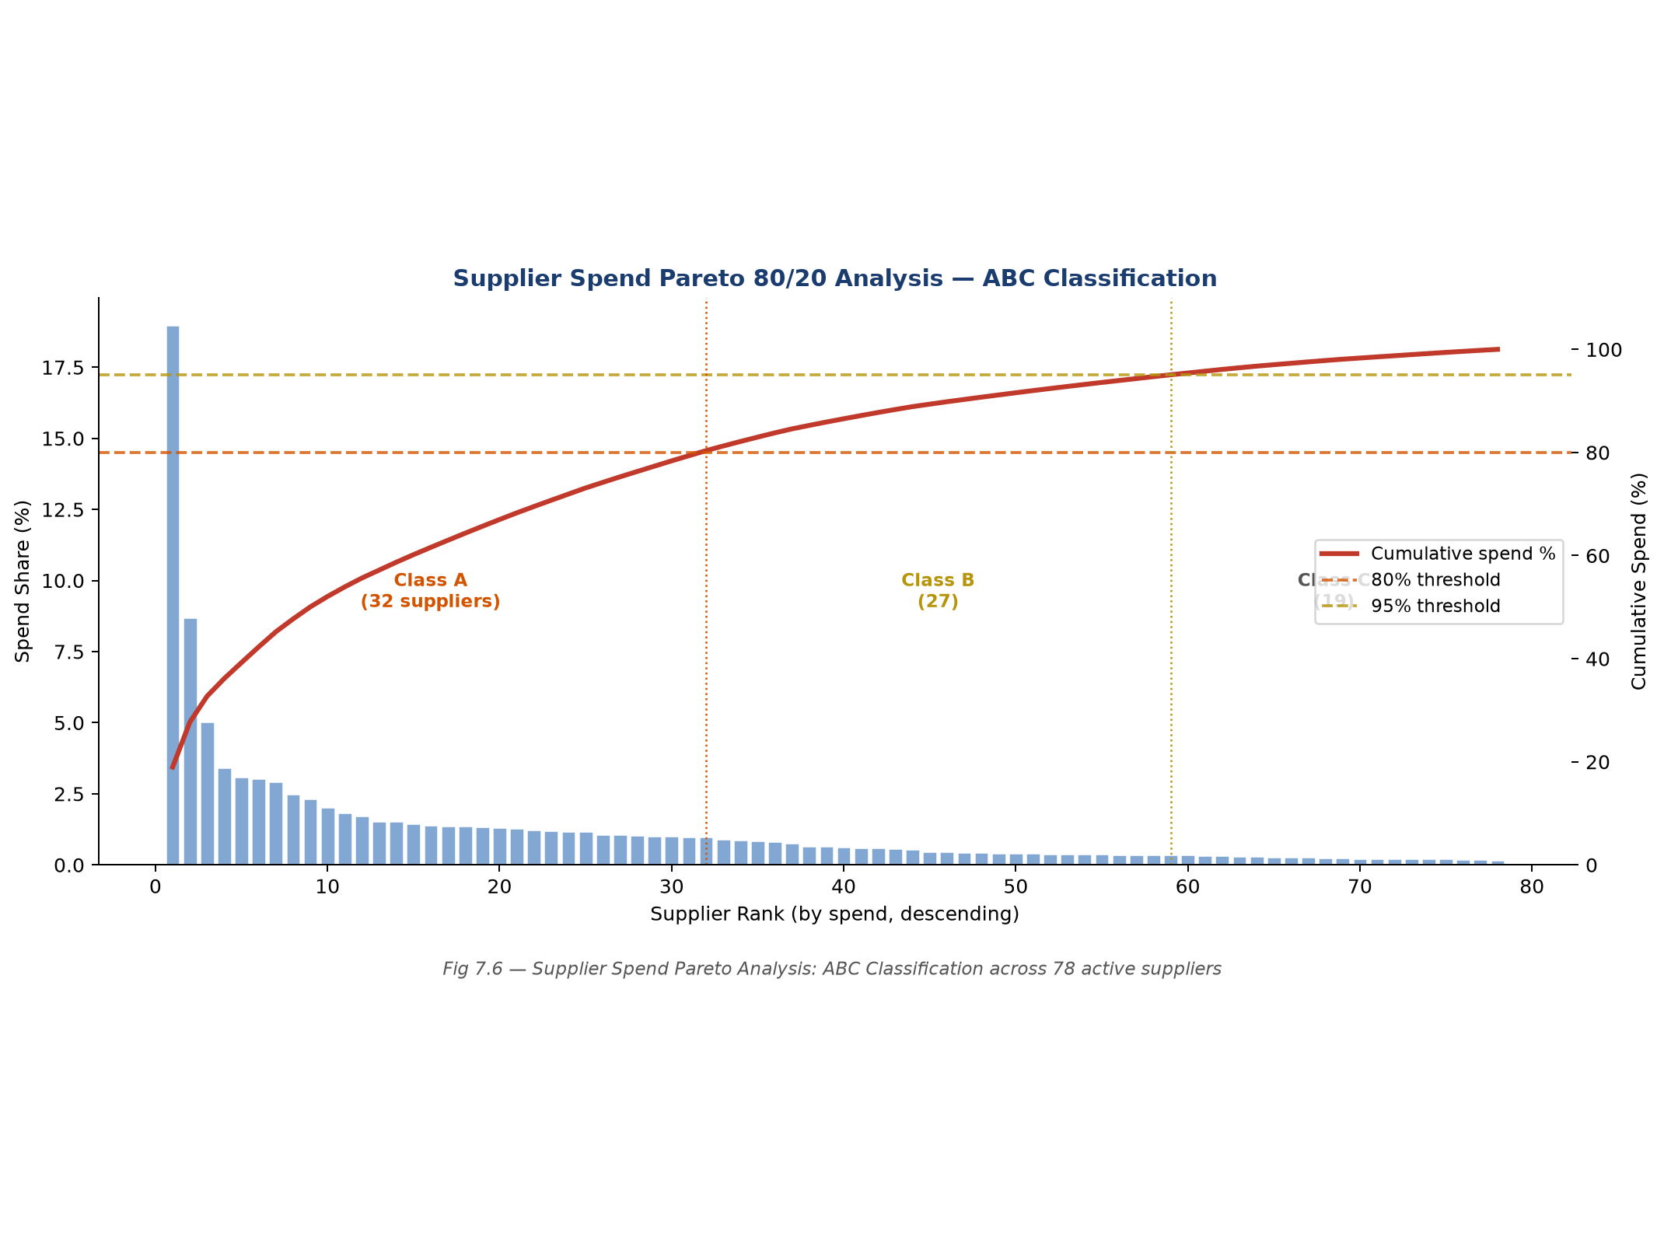
Results & Key Findings
Project Results
Model Performance
Random Forest ROC-AUC 0.714.
Spend Concentration
Top 20% of suppliers hold 78% of total spend.
Risk Distribution
34% of suppliers are High/Critical risk.
Price Drift
8.3% average YoY increase.
Seasonality
Late deliveries peaked at 31% in Q3.
Key Insight
Supplier Risk Tier is the strongest predictor (38% SHAP contribution).
Spend Pareto Curve Analysis
Visualized spend distributions confirm the operational 80/20 rule application across academic suppliers.

Slide 11
End-to-End Analytics Value
Conclusion
Bridged Architecture
Successfully bridged raw transactional data and actionable insights via a modular AI architecture.
Real-time Delivery
Demonstrated the practical value of linking raw relational database environments directly with immediate browser-based machine learning capabilities.
Future Scope
• Real-time ERP API ingestion (SAP, Oracle)
• Automated Slack/Email risk alerts
• Multi-tenant SaaS with role-based access
• LLM-powered natural language SQL queries
• Mobile-responsive layouts

Slide 12
Thank You

