Slide 1

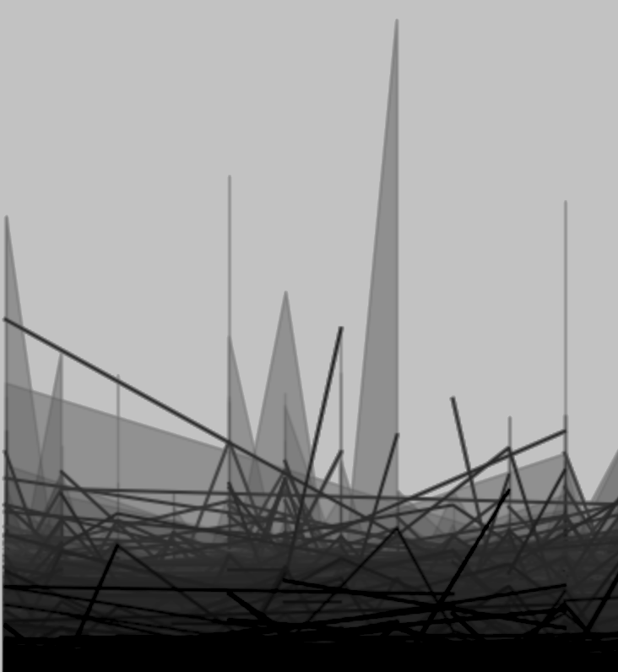
ENIAC
DISCOUNTS
A GOOD STRATEGY?
17 June 2023
Naeimeh Sharghivand,
Henrik &
Sohaib
Notes:
welcome
gathering
look at dataset
technician sent
->transition:
Database Bug

Slide 2


DATASET ASSESSMENT
Cleanup
Quality
2
Notes:
Database Bug
cleanup&quality
not bore with details
was about
remove incomplete data or missing data
drop duplicates
converting datatypes
remove noise
Transition:
Timespan of Dataset

Slide 3
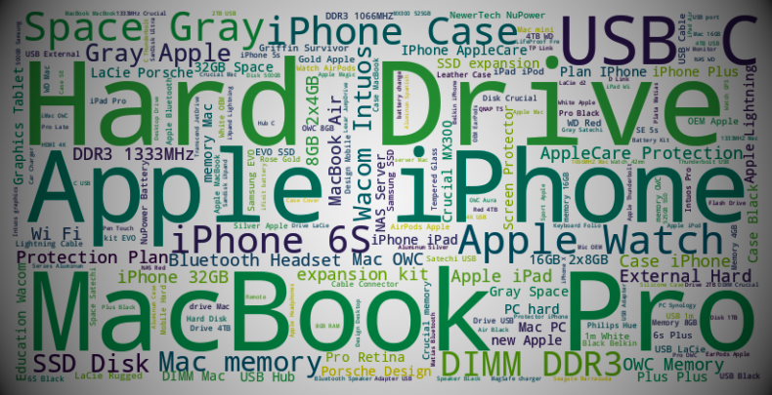
BUSINESS
INFO
54,306
ORDERS
5,131
PRODUCTS
Timespan
≈15
MONTHS
JAN 2017
to
MARCH 2018
≈ € 12 MILLION REVENUE
3
Notes:
12 Million Sales
Transition: potential Categorization
for effective lookup into provided dataset

Slide 4
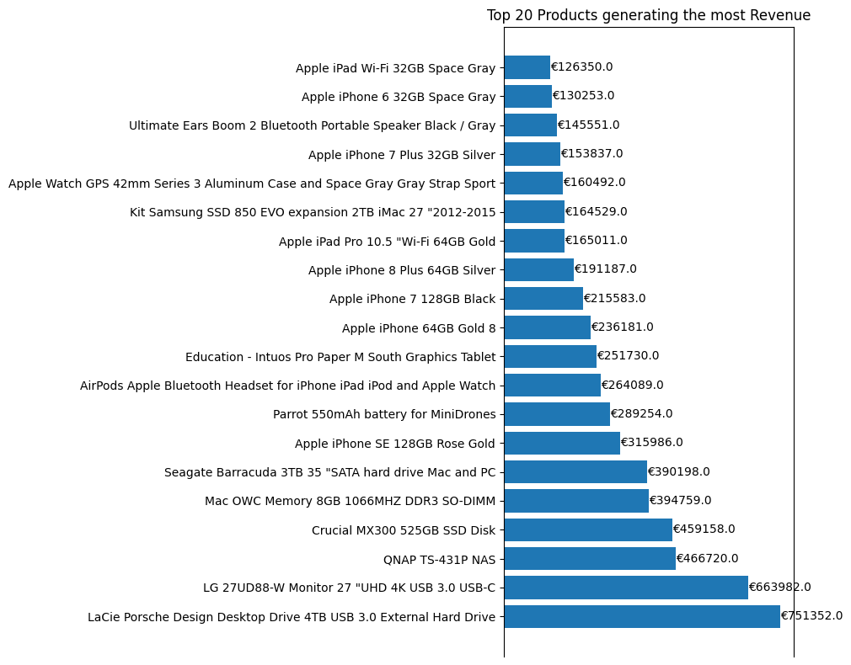
BUSINESS
INFO
Top 20 Products
Generating
~ 50%
of the Revenue
4

Slide 5
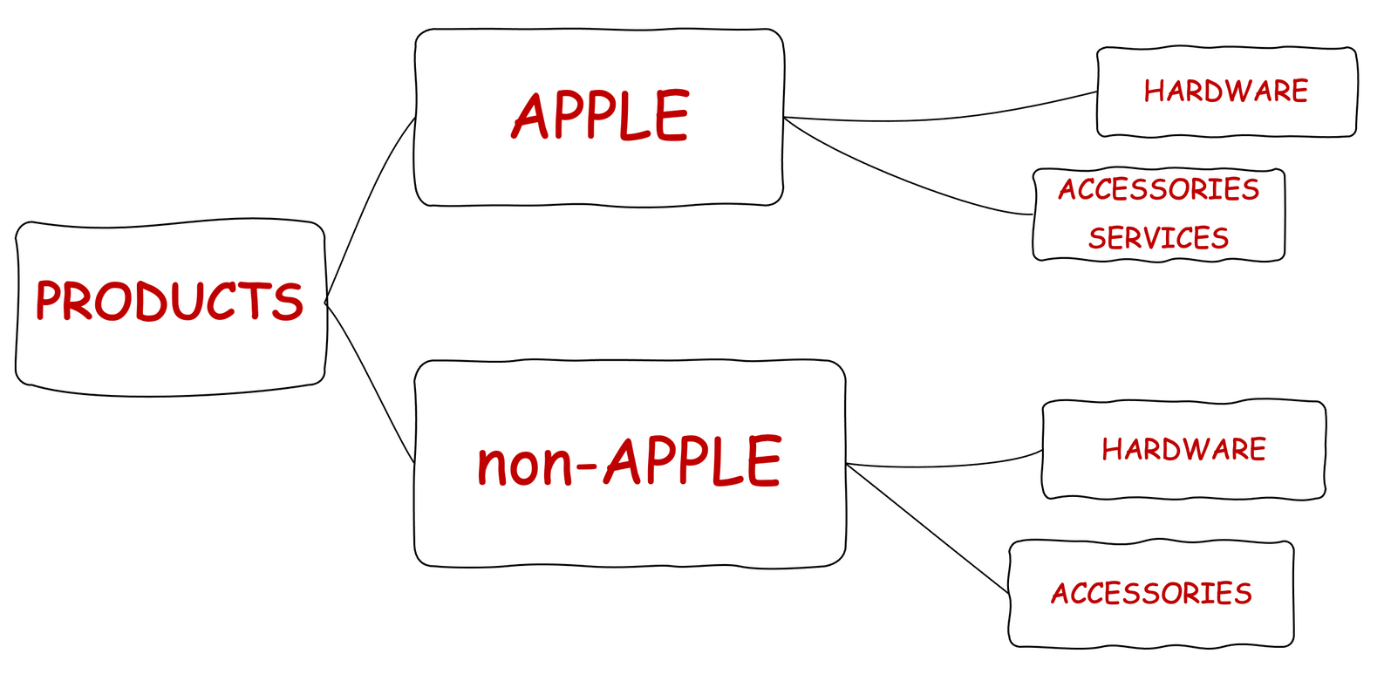
POTENTIAL CATEGORIES
AVERAGE PRICE DISTRIBUTION
€566
€162
€287
€73
€260
€126
€49
5
Notes:
avg prices
apple > nonA
hardware > accessories
Transition:
total amount discounted products

Slide 6
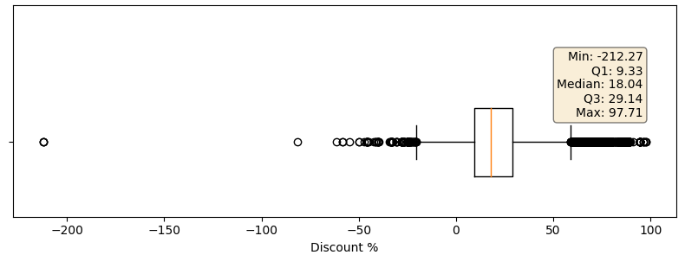
DISCOUNT ANALYSIS
UPTO
97%
93%
PRODUCTS
DISCOUNTED
AVERAGE
22%
6
Notes:
avg 22
Transition:
Seasonality

Slide 7
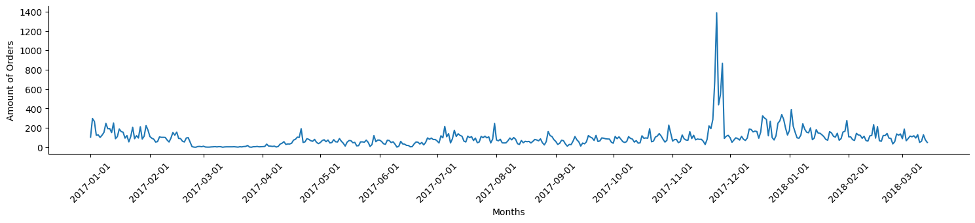
SEASONALLITY
ORDERS INCREASE ON
BLACK FRIDAY
7

Slide 8
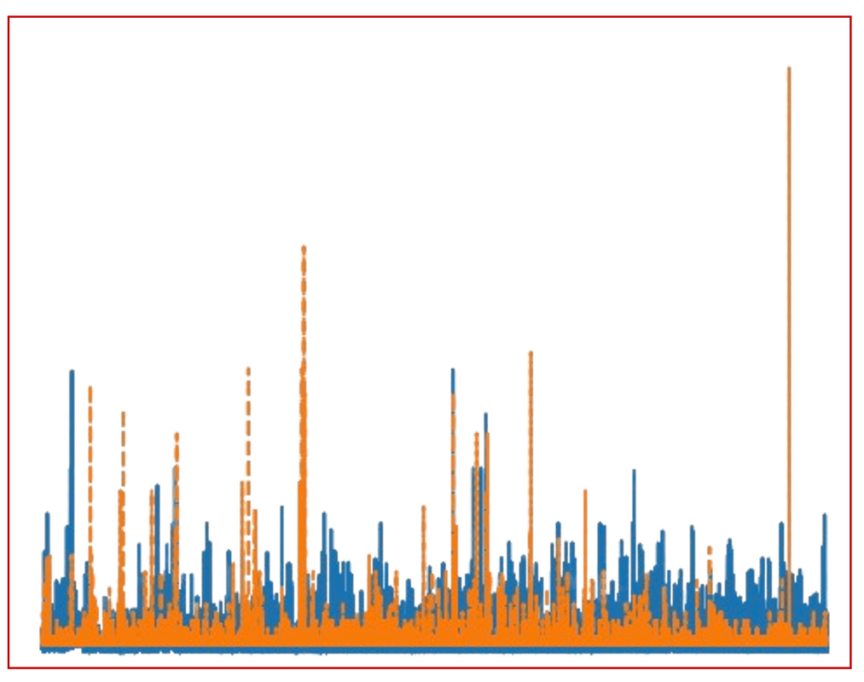
DISCOUNT STRATEGY
DISCOUNTS: A GOOD STRATEGY?
Company Income
Discount
8
Notes:
discount good?
see income n sales over time
expect blue > orange any time
aggr. discounts (tall orange)
Transition:
deeper look into statistics

Slide 9
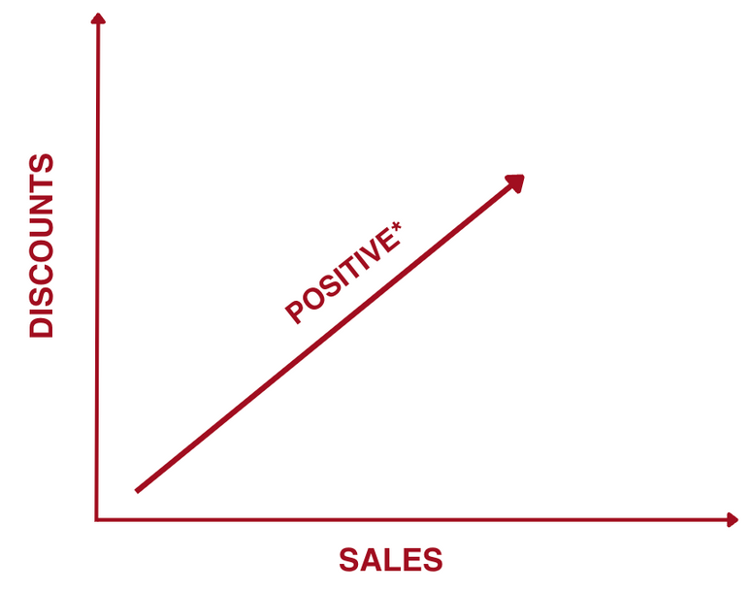
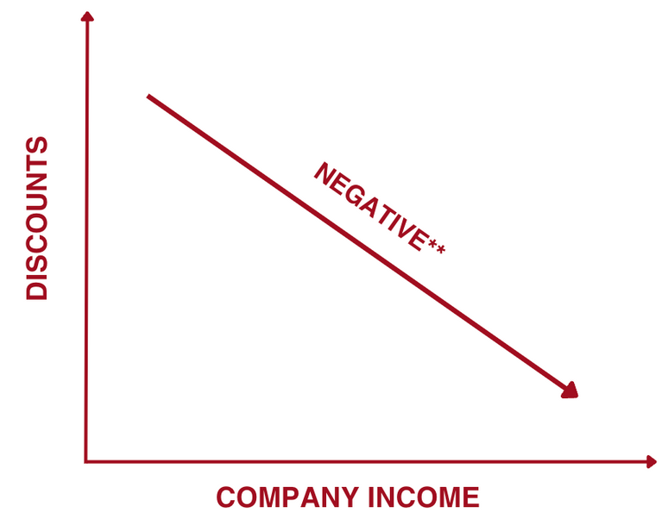
DISCOUNT STRATEGY
STATISTICAL ANALYSIS
*PEARSON CORRELATION COEFFICIENT= 0.015***
**PEARSON CORRELATION COEFFICIENT= -0.251***
HIGHER SALES, BUT LOWER INCOME
9
Notes:
Transition:
Conclusion
-> Discounts not effective
state of art

Slide 10
CONCLUSION
"Discount placements are not effective for company income"
10
Notes:
Transition:
Recommendations
no aggr. discount

Slide 11
RECOMMENDATIONS
IMPROVE
DATA
PROFIT MARGINS,
CLEAN DATA EXPORTS
FURTHER DETAILS
BETTER
DISCOUNT MANAGEMENT
NO
AGGRESSIVE
DISCOUNTS
11
Notes:
further details
deeper level of categorization

Slide 12
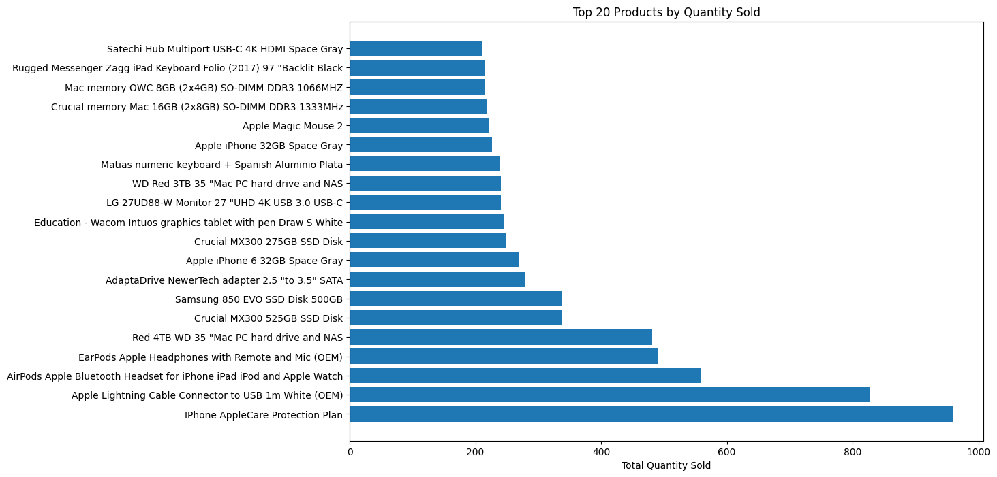
ANNEX
MOST SOLD PRODUCTS

Slide 13

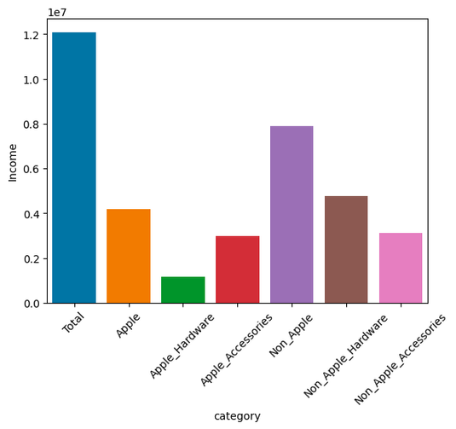
ANNEX

