Slide 1
Benchmarking ML Classifiers for CTG
Fetal Heart Rate Pattern Detection
Naem Haq
FYP Dissertation Presentation
Residency 4 context: INFANT Research Centre (UCC)
CTU-UHB • RF vs 1D-CNN • Reproducible Benchmark
Notes:
Hi, I’m Naem Haq. This final year project benchmarks machine-learning classifiers for fetal heart rate pattern detection in Cardiotocography, CTG for short. The work was shaped during my 4th Residency at INFANT Research Centre, where interpretation variability in labour monitoring highlighted the need for controlled, reproducible evaluation.

Slide 2
Motivation and Context
CTG is widely used in labour monitoring, but interpretation can be subjective.
Clinical variability motivates transparent decision-support benchmarking.
This benchmarking focus was shaped during Residency 4 at INFANT Research Centre.
Notes:
CTG is a core intrapartum monitoring tool, but interpretation can be subjective and variable across clinicians and settings. That variability motivates computational decision support. During my Residency 4 placement at INFANT, this practical need became clear, which directly motivated a controlled benchmarking study rather than an isolated model-building exercise.

Slide 3
Aim and Scope
Aim: benchmark supervised classifiers for fetal heart rate pattern detection.
Models compared: Random Forest (feature-based) vs 1D-CNN (raw-signal).
Scope: within-cohort CTU-UHB benchmark with weakly supervised labels.
Claim boundary: fixed-split comparative evidence, not inferential repeated-run ranking.
Notes:
The aim was to benchmark two model families under the same conditions: Random Forest and 1D-CNN. This is a within-cohort CTU-UHB benchmark with weakly supervised labels. I keep claims bounded to fixed-split comparative evidence, so conclusions are transparent and proportional to executed analysis.

Slide 4
Benchmark Design and Fairness Controls
Shared preprocessing and leakage-aware grouped splitting by record ID.
Common evaluation criteria: class-wise and aggregate metrics.
Additional evidence: efficiency, confusion analysis, threshold behaviour, interpretability.
Reproducibility controls: fixed seed policy, split manifests, JSON/CSV artifacts.
Notes:
A key contribution is fairness of comparison. Both models share the same preprocessing, grouped splitting, and evaluation framework. Record-level grouping prevents leakage between train and test windows from the same labour record. Reproducibility is supported by fixed seeds, stored split manifests, and exported artifacts for auditability.

Slide 5
Pipeline
Signal quality control and preprocessing
Windowing and feature extraction
Model training with grouped holdout protocol
Evaluation, error analysis, thresholding, and post-processing review
Notes:
The pipeline runs from raw CTG through quality control, preprocessing, segmentation and feature construction, then model training and evaluation. Beyond headline metrics, I include class-wise error analysis, threshold behavior, and post-processing effects so the benchmark reflects operational decision-support needs.

Slide 6
Headline Results
Held-out windows: RF 95.55% accuracy, macro-F1 0.945.
Held-out windows: CNN 65.31% accuracy, macro-F1 0.584.
Record-level CNN drops to 48.19% accuracy, macro-F1 0.383.
Result: RF is the stronger current baseline under this data regime.
Notes:
The performance gap is substantial on held-out windows: RF reaches 95.55% accuracy and macro-F1 0.945, while CNN reaches 65.31% and 0.584. At record level, CNN drops further to 48.19% accuracy and macro-F1 0.383. Under this tested regime, Random Forest is the stronger baseline.

Slide 7
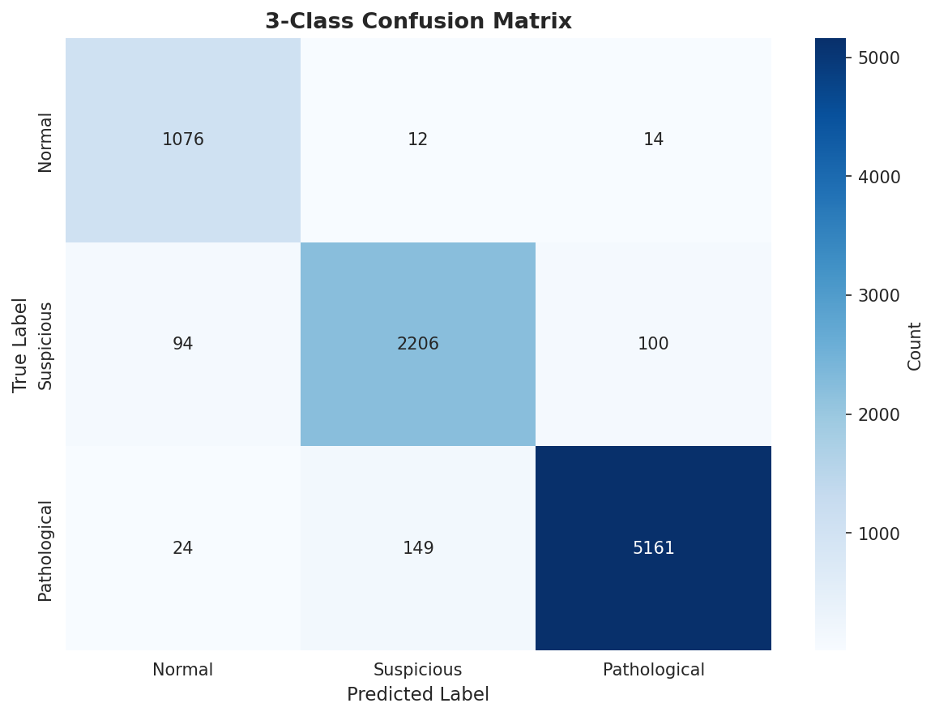
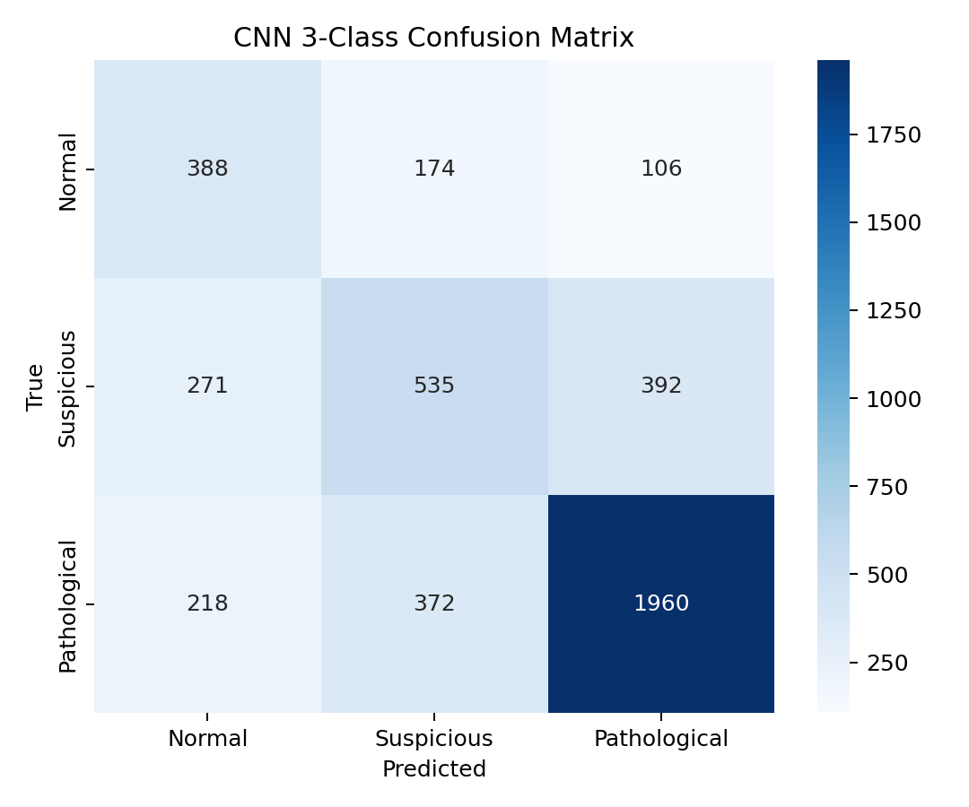
Confusion Matrix Comparison
Random Forest: tighter class separation
1D-CNN: greater off-diagonal confusion
Notes:
These confusion matrices show how the aggregate metric gap appears structurally. RF displays stronger diagonal concentration, indicating better class separation. The CNN matrix shows broader off-diagonal confusion, especially around boundary classes, which contributes to weaker macro-F1 and lower stability after aggregation.

Slide 8
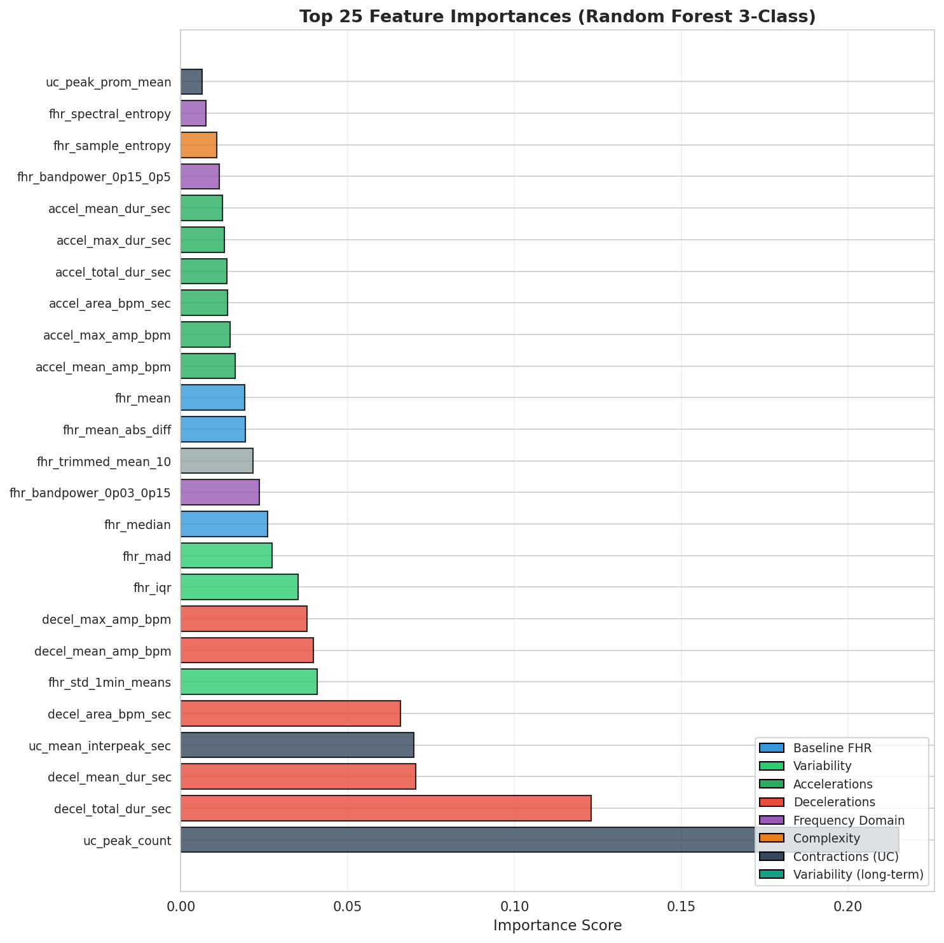
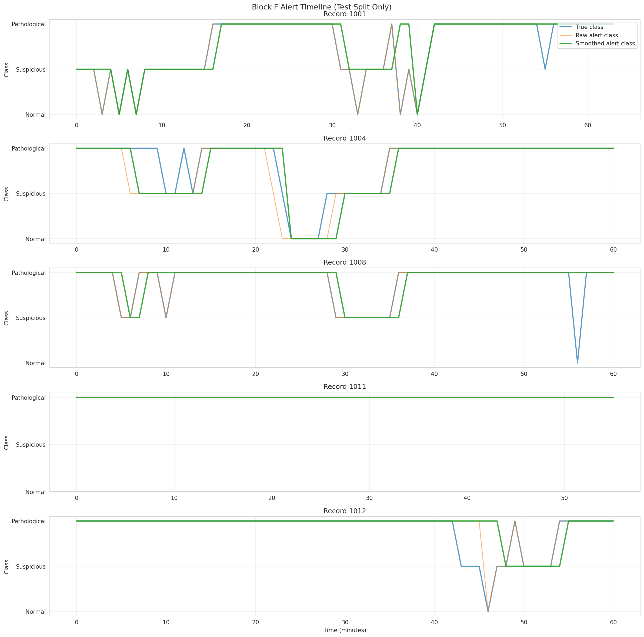
Interpretability and Alert Dynamics
RF feature/domain importance
Temporal alert timeline after smoothing
Notes:
On the left, RF importance outputs provide interpretable evidence about which domains drive model decisions, supporting transparency. On the right, the alert timeline illustrates temporal behavior under post-processing policy, showing that usability and alert stability depend on threshold and smoothing choices, not only classifier architecture.

Slide 9
Conclusion
Under tested conditions, Random Forest is the more suitable transparent baseline.
This does not imply deep learning is always worse in CTG.
The contribution is an auditable benchmark reference for next-stage validation.
Notes:
The conclusion is conditional and scoped: under the tested conditions, Random Forest is currently the more suitable transparent benchmark baseline. This is not a universal claim against deep learning. The study contributes an auditable foundation that future work can extend.

Slide 10
Limitations and Next Steps
Findings are bounded to CTU-UHB and weak-label regime.
Repeated grouped resampling and stronger uncertainty quantification are future extensions.
External validation across broader datasets is required for stronger transportability claims.
Pathway: prospective, clinician-facing translation aligned with INFANT/AI4Life goals.
Notes:
These findings are specific to the CTU-UHB cohort and weak-label setting used in this benchmark. Next steps are uncertainty-focused repeat evaluation and external validation on broader datasets to support prospective clinician-facing translation in INFANT/AI4Life contexts.

