Slide 1
TECHNICAL PROJECT REVIEW
Decentralized Role-Leasing
IoT Protocol
Capability aggregation, temporary role ownership, and recovery
Student: [Name] Registration: [Number]
Institution: [Institution] Department: [Department]
Guide: [Name]
01 / 12
Notes:
Introduce this as a software simulation of coordination in agricultural IoT. The central contribution is selecting temporary role holders using recursive capability, migration costs, and lease rules. The supplied folder does not identify the student, institution, department, or guide, so replace the marked fields before presenting. The implementation and stored experiments support statements about this model, not a deployed farm network. Allow about 18 minutes for slides 1–33 and use the appendix for questions.
Implementation evidence: Project.md; simulation/config.py
Panel prompt: Explain the implementation boundary and how the evidence supports this slide.

Slide 2
The fixed-assignment problem
Fixed ownership
Changing physical conditions
Sensor 1
Assigned gateway
Gateway fails
or battery depletes
Sensor 2
The old destination persists
until the policy can replace it.
Sensor 3
A controller dependency can also prevent grants and recovery.
simulation/runner.py: control_source; simulation/protocols.py: step; _select_for_role
02 / 12
Notes:
Start with one subnet gateway receiving traffic from nearby sensor nodes. If that holder fails or depletes its energy, an assignment that remains unchanged loses its useful destination. A fixed controller creates a second dependency in the modeled hierarchical baseline. That baseline does attempt replacement when a holder becomes unavailable, provided the controller and a physical route remain available. It does not continuously optimize holder capability. The project investigates whether adaptive role ownership can improve service without excessive switching. The figures are conceptual diagrams of implemented behavior, not deployed field observations.
Implementation evidence: simulation/runner.py: control_source; simulation/protocols.py: step; _select_for_role
Panel prompt: Explain the implementation boundary and how the evidence supports this slide.

Slide 3
Baseline, proposed contribution, and objectives
Shared infrastructure
Predefined hierarchy, physical mesh, sensor load, and energy counters
A: fixed hierarchical baseline
B–D: proposed coordination
Fixed controller
Random eligible holder
Scope representative
Capability-based temporary holder
Retain until unavailable
Recover only if controller and route work
Aggregate capability, lease roles, recover
Cost and hysteresis limit optional migration
Objective: maintain role service while accounting for the communication cost of adaptation.
simulation/protocols.py; simulation/runner.py; patent-study/run_patent_study.py
03 / 12
Notes:
Both designs share a predefined hierarchy, physical routes, sensor traffic, and the same energy accounting. In arm A, the hierarchical policy selects a seeded random fixed controller and random eligible holders. They remain fixed until unavailable, and controller loss makes baseline roles unavailable. The proposed policy uses scope representatives, recursive role capability, temporary adaptive leases, renewal, and cost-aware migration. The optional energy gate is an extension rather than the core contribution. Objectives are to preserve role availability, recover when possible, and expose coordination overhead. A versus B is a bundled comparison: the experiment does not isolate leases from all the other policy changes. These algorithms are not a validated networking standard.
Implementation evidence: simulation/protocols.py; simulation/runner.py; patent-study/run_patent_study.py
Panel prompt: Explain the implementation boundary and how the evidence supports this slide.

Slide 4
System architecture and hierarchy
Root scope: seed 42 example
Gateway holder: Network 2
Bottom-up capability aggregation
Network 0
4 subnet candidates
Networks 1 and 2
3 subnet candidates each
Network 0: four subnets
Each selects a node gateway
Networks 1 / 2: six subnets
Each selects a node gateway
100 sensor nodes in a physical multi-hop mesh
Messages use physical mesh routes. Optional backhaul follows gateway scopes.
simulation/entities.py; simulation/capability.py; simulation/runner.py: _route_sensor_traffic
04 / 12
Notes:
Read the diagram from the sensors upward. Physical nodes are organized into ten subnets, then three networks, then one internetwork. The four role names are gateway, anomaly detection, health monitoring, and discoverability. Every parent scope selects one immediate child per role, producing 56 role/scope assignments. At subnet level a holder is a node. At network level a holder is a subnet entity. At the root a holder is a network entity. A container communicates through its first available descendant representative, which can differ from the node chosen by a lower-scope gateway lease. Capability information travels through bottom-up calculations in shared memory. Solid data arrows denote routed sensor and optional aggregate backhaul exchanges on the physical mesh. No membership link automatically creates a physical edge.
Implementation evidence: simulation/entities.py; simulation/capability.py; simulation/runner.py: _route_sensor_traffic
Panel prompt: Explain the implementation boundary and how the evidence supports this slide.

Slide 5
Core protocol flow
Apply events
check depletion
Refresh capability
leaves to root
Check epochs
and lease state
Assign missing lease
Else renew + consider migration
Harvest energy
route sensor load
Check depletion
refresh + record
One Mesa coordinator executes this order for every matched protocol variant.
simulation/runner.py: step; simulation/protocols.py: step; _assign; _migrate
05 / 12
Notes:
Walk through the same order used by RoleSimulationModel. Events and depletion affect availability first, followed by a bottom-up capability refresh. ProtocolEngine updates the epoch, checks holder and lease state, and distinguishes an absent or invalid lease from an active one. Missing ownership takes the assignment path. Existing proposed leases renew when due, and then optional migration evaluates utility and hysteresis before the solar gate. A migration transfers the existing lease object after a successful control exchange. An ordinary grant creates a new active lease only when LEASE_GRANT succeeds. The model harvests energy after policy decisions and before sensor traffic, then checks depletion, refreshes capabilities, and records metrics. This common order makes matched policy experiments interpretable.
Implementation evidence: simulation/runner.py: step; simulation/protocols.py: step; _assign; _migrate
Panel prompt: Explain the implementation boundary and how the evidence supports this slide.

Slide 6
Capability aggregation and role selection
Node vectors
1 Bottom-up aggregation
leaf[node] = node.capability_vector()
for parent in subnets, networks, root:
parent.vector = weighted_mean(children)
Subnet vectors
C(parent, r) = Σ wᵢ C(childᵢ, r) / Σ wᵢ
2 Initial selection and grant
Network vectors
eligible = available + reachable children
holder = max(known_capability, ID tie-break)
if LEASE_GRANT succeeds: activate lease
Root vector
Gateway score = .40 energy + .35 link quality + .25 initial degree centrality.
nodes.py: ROLE_WEIGHTS; simulation/capability.py: refresh_capabilities; weighted_aggregate; simulation/protocols.py: _select_for_role
06 / 12
Notes:
The implementation computes leaf vectors, then iterates through subnets, networks, and the root rather than calling a recursive function. It has the same bottom-up dependency as a recursive hierarchy traversal. Gateway scoring uses .40 energy, .35 link quality, and .25 initial normalized degree centrality. Anomaly detection and health monitoring use .50 energy and .50 health, while discoverability uses .34 energy, .33 link quality, and .33 health. Failed nodes return zero capability. Parent vectors use normalized nonnegative child weights, uniform by default. Failed children keep their weight in the denominator. Selection evaluates immediate children that are available and reachable, then chooses maximum known capability with a stable string-ID tie break. Do not imply that the role labels execute real anomaly detection or discovery payload algorithms.
Implementation evidence: nodes.py: ROLE_WEIGHTS; simulation/capability.py: refresh_capabilities; weighted_aggregate; simulation/protocols.py: _select_for_role
Panel prompt: Explain the implementation boundary and how the evidence supports this slide.

Slide 7
Role leases and epoch validation
grant succeeds
expiry or invalidation
PENDING
ACTIVE
EXPIRED / INVALID
RENEWING
update timing
MIGRATING
update holder + timing
Local epoch validation before replacement
epoch mismatch / unavailable holder: invalidate old lease, then attempt new grant
Epoch rollover: regrant by default, or relabel existing leases when retention is on
simulation/leases.py; simulation/protocols.py: step; _advance_epoch; _renew_if_due
07 / 12
Notes:
A new lease begins pending and activates after the grant exchange succeeds. Active ownership can renew, migrate, expire, or become invalid. For proposed policy, duration equals minimum plus capability times the lease-duration range, and renewal is checked at .7 of the duration by default. During step processing, an inactive lease, unavailable holder, or epoch mismatch causes _invalidate before _assign. At an epoch boundary the default _advance_epoch invalidates and regrants immediately. With retain_valid_leases_on_epoch, the method instead relabels existing leases with the new epoch. The stored study enables retention. This is local epoch consistency in a single process. There is no implemented receiver-side protocol that rejects delayed stale network messages, and no proof of distributed split-brain safety.
Implementation evidence: simulation/leases.py; simulation/protocols.py: step; _advance_epoch; _renew_if_due
Panel prompt: Explain the implementation boundary and how the evidence supports this slide.

Slide 8
Failure detection and recovery sequence
Old holder
ProtocolEngine
Replacement holder
fail()
availability false
Detect + wait delay
Invalidate old lease
Select reachable child
Send LEASE_GRANT
Current-epoch lease
Activate on grant success
Record recovery time
No replacement or failed grant: keep the role unassigned and retry. Emergency recovery bypasses the gate.
simulation/protocols.py: step; _invalidate; _assign; simulation/runner.py: holder_unavailable_since
08 / 12
Notes:
The sequence shows a simulated holder failure followed by detection in ProtocolEngine. The configured delay defaults to zero, but is measured from the recorded unavailable time when set. For a container holder, availability is any online descendant, so one failed child need not invalidate the parent holder. Once the delay elapses, the engine invalidates and removes the old lease before selecting a reachable replacement. It sends LEASE_GRANT, constructs the new lease with current epoch, activates it, and records recovery time. If there is no eligible candidate or communication fails, the assignment remains absent for retry on a later step. The solar migration gate does not run in this recovery path. A stale epoch is invalidated by the same in-process check, not by a simulated distributed receiver.
Implementation evidence: simulation/protocols.py: step; _invalidate; _assign; simulation/runner.py: holder_unavailable_since
Panel prompt: Explain the implementation boundary and how the evidence supports this slide.

Slide 9
Optional energy-aware migration gate
Emergency recovery?
yes
Yes: bypass gate
Use recovery assignment
No: utility + hysteresis
must already pass
Migration route exists?
no
No: reject optional move
Eproj = clamp(E + H(h − c),
0, capacity)
Usable = max(0, Eproj − reserve)
Yes: estimate route energy
and projected reserve benefit
h: harvest per tick, c: observed mean use
H: projection horizon
Benefit > route energy + margin?
Yes: send MIGRATE, then update lease
No: retain current holder
simulation/protocols.py: _consider_cost_aware_migration; _solar_migration_is_worthwhile; _projected_reserve_energy; _migrate
09 / 12
Notes:
Separate this extension from core role management. Emergency recovery calls _assign and bypasses the optional gate. For a discretionary change, candidate utility and hysteresis must already pass. The gate then requires a scope control source, a representative for the candidate, and a physical route. It estimates exact modeled control energy for that route. For each available descendant it projects current energy plus H times constant harvest minus observed mean communication use, clamps to capacity, subtracts reserve, and averages projected usable reserves for a container. The difference between candidate and current reserve must strictly exceed migration energy plus safety margin. Default H is 500 and margin is .01. Route failure or insufficient benefit rejects the optional migration. If the gate passes, _migrate still sends the control exchange before updating ownership. This extrapolation is not a solar or traffic forecast.
Implementation evidence: simulation/protocols.py: _consider_cost_aware_migration; _solar_migration_is_worthwhile; _projected_reserve_energy; _migrate
Panel prompt: Explain the implementation boundary and how the evidence supports this slide.

Slide 10
Reproducible four-arm simulation
30 matched seeds × 4 scenarios × 4 arms × 20,000 ticks = 480 runs
Arm | Role policy | Harvest | Gate | Contrast
A | Fixed hierarchy | None | Off | Baseline
B | Proposed leases | None | Off | B − A: bundled policy
C | Proposed leases | .0002 × node factor | Off | C − B: harvest
D | Proposed leases | .0002 × node factor | On | D − C: gate
All arms share the seeded topology and event schedule. Cluster gap 1.5 ranges,
distance-energy weight 1, backhaul on. Proposed arms retain leases across epochs.
patent-study/run_patent_study.py; simulation/config.py; .presentation_build/tests.txt
10 / 12
Notes:
The stored design has 30 matched seeds from 42 to 71, four scenarios, four arms, and 20,000 ticks per run: 480 runs. Within each seed and scenario the arms share topology and injected events. Cluster separation is 1.5 communication ranges, distance-energy weight is one, backhaul is enabled, and proposed leases retain holders across epochs. C and D use mean configured harvest .0002 with a seeded per-node multiplier between .5 and 1.5. Arm A uses Lease objects internally with horizon-long duration, but has no adaptive leasing policy, renewal, or discretionary migration. Thus its table entry says fixed holders rather than implying there are no Lease objects in code. C minus B isolates harvesting and D minus C isolates the optional gate. Fresh earlier review validation ran 82 tests with Mesa 3.3.1 and two short simulations. The stored 480-run study was checked, not rerun in full.
Implementation evidence: patent-study/run_patent_study.py; simulation/config.py; .presentation_build/tests.txt
Panel prompt: Explain the implementation boundary and how the evidence supports this slide.

Slide 11
Results: service, delivery, energy, and lifetime
Normal B − A delivery: +68.02 percentage points (95% paired CI +65.68 to +70.35)
Normal scenario, mean of 30 seeds. C / D lifetime values are right-censored at 20,000.
Gate D − C: migrations −26.23 · energy/item +0.446 × 10⁻⁶
Total communication energy +0.730 · CSC change 0.000
patent-study/results_20000/per_run_metrics.csv; paired_comparison.csv; threshold_crossings.csv
11 / 12
Notes:
The four editable charts show normal-scenario means over 30 seeds from the supplied records. CSC is role-state availability, and sensor delivery measures arrival at the subnet gateway. A has CSC .26113 and sensor delivery .15366. B reaches .9999755 and .8338158. C and D both reach one for these metrics in normal. Residual batteries differ because service duration and harvested energy differ. Lifetime shows mean time to first cumulative delivery fraction below .9, restricted to the 20,000-tick horizon. C and D are censored at that horizon, not observed to fail there. Normal B minus A delivery is +68.02 percentage points with paired 95 percent t interval +65.68 to +70.35. The small gate panel shows fewer normal-scenario migrations but slightly more total energy and energy per item. Detailed C/D means and paired intervals are in the appendix. Cross-scenario original plots follow there as well.
Implementation evidence: patent-study/results_20000/per_run_metrics.csv; paired_comparison.csv; threshold_crossings.csv
Panel prompt: Explain the implementation boundary and how the evidence supports this slide.

Slide 12
Limitations, novelty hypothesis, and conclusion
What the implementation demonstrates
Recursive capability + temporary leases + epoch handling + simulated recovery
What the experiments establish
Harvest sustains service in this configuration. The optional gate reduces some
migrations, while its energy-efficiency advantage remains unproven.
Limits and next steps
Predefined hierarchy, global in-memory discovery, abstract radio / energy, no hardware validation.
Add asynchronous messages, real role services, root delivery, and calibrated energy.
Novelty and patentability remain hypotheses requiring prior-art verification.
simulation/; requirements.txt; patent-study/results_20000/paired_comparison.csv
12 / 12
Notes:
The project demonstrates a simulation framework combining recursive capabilities, temporary role leases, epoch handling, and recovery. That combination is the proposed contribution. Scientific novelty and patentability remain hypotheses requiring a separate prior-art search. The hierarchy is predefined, default capability discovery reads global in-memory state, and communication, harvesting, and failures are abstract models. No physical IoT validation, contention, retransmissions, or sensing/CPU energy appears. Epoch validation is in-process, and role availability does not prove that anomaly detection or another task ran. Sensor delivery is only the subnet leg, and only online nodes generate load. The gate reduces migration count in normal but does not show a general energy-efficiency advantage over harvest alone. Next steps are asynchronous messages, real role-task execution, root delivery tracking, calibrated energy, and matched ablations. Pin compatible dependencies: Mesa 3.5.1 breaks model.scenario assignment while Mesa 3.3.1 passed the tested configuration.
Implementation evidence: simulation/; requirements.txt; patent-study/results_20000/paired_comparison.csv
Panel prompt: Explain the implementation boundary and how the evidence supports this slide.

Slide 13
Node lifecycle: online, failure, and recovery
Create NodeAgent
initial="online"
fail() / energy reaches zero
ONLINE
Available for scoring and traffic
FAILED
Unavailable, capability = 0
recover() event
or depleted-node recharge to reserve
Role ownership is separate. An online node can hold zero, one, or several role leases.
nodes.py: NODE_STATES; simulation/runner.py: _fail_energy_empty_nodes; _harvest_solar_energy
13 / appendix
Notes:
The real NodeAgent state machine has exactly two states: online and failed. Construction starts online. A scheduled fail event or the coordinator detecting zero energy invokes fail(). Both paths remove node availability and trigger graph invalidation. Scheduled recover events invoke recover(). Only nodes tracked in _energy_depleted_node_ids can rejoin automatically after solar charging reaches minimum_energy_reserve. Solar charging alone does not repair an explicit scheduled failure. Energy and link degradation update attributes rather than introducing extra states. Role ownership lives in ProtocolEngine.assignments, outside this state machine. A node may be online without holding any role, and becoming online does not guarantee a lease or route. Explain this distinction before discussing role selection.
Implementation evidence: nodes.py: NODE_STATES; simulation/runner.py: _fail_energy_empty_nodes; _harvest_solar_energy
Panel prompt: Use this supporting slide to answer a focused technical question.

Slide 14
Role assignment at the subnet level
SCOPE: network_0_subnet_0
Seed 42, proposed policy, initial assignments
Node 0
0.739898
Node 1
0.805483
Node 2
0.832320
Node 3
0.749120
Node 4
0.852662
Node 5
0.751647
Node 6
0.802835
Node 7
0.793679
Node 8
0.830349
Node 9
0.686894
Available + reachable candidates
Maximum gateway capability
GATEWAY LEASE
Holder: Node 4
Control source: node 0
Physical representative: node 4
anomaly detection: Node 4 / health monitoring: Node 4 / discoverability: Node 4
simulation/entities.py: scope_candidates; simulation/protocols.py: _select_for_role; _assign
14 / appendix
Notes:
This is an actual initial proposed-policy snapshot from SimulationConfig(seed=42). At scope network_0_subnet_0, immediate child nodes 0 through 9 compete. The control source is physical node 0. The engine filters unavailable or unreachable representatives and ranks known capability. The initial gateway lease holder is node 4. All four roles happen to select node 4 in this subnet, but the code evaluates each role independently and does not require that coincidence. Displayed node scores are sampled just after initialization and include the tiny control-energy effects of initial grants. Container scores were refreshed before those grants. The numbers illustrate the stored assignment, not a new benchmark. A failed grant would leave the role unassigned.
Implementation evidence: simulation/entities.py: scope_candidates; simulation/protocols.py: _select_for_role; _assign
Panel prompt: Use this supporting slide to answer a focused technical question.

Slide 15
Role assignment at the network level
SCOPE: network_0
Seed 42, proposed policy, initial assignments
Subnet 0
0.784504
Subnet 1
0.824220
Subnet 2
0.805624
Subnet 3
0.830605
Available + reachable candidates
Maximum gateway capability
GATEWAY LEASE
Holder: Subnet 3
Control source: node 0
Physical representative: node 30
anomaly detection: Subnet 0 / health monitoring: Subnet 0 / discoverability: Subnet 0
simulation/entities.py: capability; representative_node_id; simulation/protocols.py: _assign
15 / appendix
Notes:
At network_0, candidates are the subnet entities network_0_subnet_0 through network_0_subnet_3. They carry aggregated capability vectors, rather than being evaluated as individual nodes. The observed gateway lease selects subnet 3. The model represents that container physically through node 30, its first available descendant. This representative is not necessarily the subnet gateway selected by a different lease. Anomaly detection, health monitoring, and discoverability choose subnet 0 in this snapshot. Stress that the holder ID is a subnet string at this level. The scope representative still sends the abstract grant over the physical mesh.
Implementation evidence: simulation/entities.py: capability; representative_node_id; simulation/protocols.py: _assign
Panel prompt: Use this supporting slide to answer a focused technical question.

Slide 16
Role assignment at the internetwork level
SCOPE: internetwork
Seed 42, proposed policy, initial assignments
Network 0
0.811238
Network 1
0.823788
Network 2
0.823820
Available + reachable candidates
Maximum gateway capability
GATEWAY LEASE
Holder: Network 2
Control source: node 0
Physical representative: node 70
anomaly detection: Network 2 / health monitoring: Network 2 / discoverability: Network 2
simulation/entities.py: scope_candidates; simulation/capability.py: refresh_capabilities; simulation/protocols.py
16 / appendix
Notes:
At the internetwork scope, the candidates are network_0, network_1, and network_2. Their capability vectors aggregate their child subnets. In the seed-42 initial proposed run, network_2 holds all four root roles. Its first available descendant is physical node 70. Gateway scores for networks 1 and 2 are close, so show six decimal places to avoid an apparent rounded tie. The max selection tie-breaker is string ID only when score values tie. The root selects a network entity, not a single node across the entire deployment. There is one root scope, so this contributes four of the total 56 role assignments.
Implementation evidence: simulation/entities.py: scope_candidates; simulation/capability.py: refresh_capabilities; simulation/protocols.py
Panel prompt: Use this supporting slide to answer a focused technical question.

Slide 17
Lease lifecycle and epoch handling
activate
expire / invalidate
PENDING
ACTIVE
EXPIRED
renew
begin_migration
RENEWING
update timing
MIGRATING
update holder + timing
commit_renewal
migrated
Invalidation can also expire a renewing or migrating lease.
Epoch rollover regrants by default. Retention updates epoch labels in place.
simulation/leases.py; simulation/protocols.py: _advance_epoch; _lease_duration
17 / appendix
Notes:
The transitions library prohibits illegal jumps. New leases start pending and activate. Renewal temporarily enters renewing and updates timing before returning active. Migration enters migrating and replaces holder, epoch, and timing in the same lease object. Expiry or invalidation ends availability. Duration in proposed is 10 + capability times 90 by default, so a .8 score gives 82 ticks and renewal becomes due at 57.4 ticks, checked on integer ticks. Epochs advance every 20 ticks. Default behavior regrants assignments, while retention updates existing epoch labels in place. This is an in-process fencing model, not a distributed stale-message rejection protocol.
Implementation evidence: simulation/leases.py; simulation/protocols.py: _advance_epoch; _lease_duration
Panel prompt: Use this supporting slide to answer a focused technical question.

Slide 18
Appendix: exact role-management ordering
advance_epoch_if_due() # regrant or configured retention
for each (role, scope):
observe holder availability and honor detection delay
if invalid state / failed holder / wrong epoch: invalidate + remove
elif expired: expire + remove
if no lease: attempt assignment; continue
renew_if_due(); if renewal fails: attempt assignment; continue
consider optional migration: cost, hysteresis, enabled gate
on MIGRATE delivery: update the existing lease object
simulation/protocols.py: step; _assign; _renew_if_due; _migrate
18 / appendix
Notes:
This is pseudocode of the implemented proposed-policy step. Epoch rollover occurs before the per-key loop and has a separate configurable retention path. Detection delay can defer handling an unavailable holder. Invalid state, holder failure, or epoch mismatch invalidates and removes the lease, while timed expiry expires and deletes it. If no lease remains, _assign runs and the loop continues, so a freshly assigned lease does not immediately enter optional migration during that same loop iteration. Existing leases renew before discretionary migration. Renewal failure invalidates and can trigger assignment. Optional migration checks cost, hysteresis, and an enabled gate, sends MIGRATE, then updates the same lease object. This is not make-before-break across independent distributed devices.
Implementation evidence: simulation/protocols.py: step; _assign; _renew_if_due; _migrate
Panel prompt: Use this supporting slide to answer a focused technical question.

Slide 19
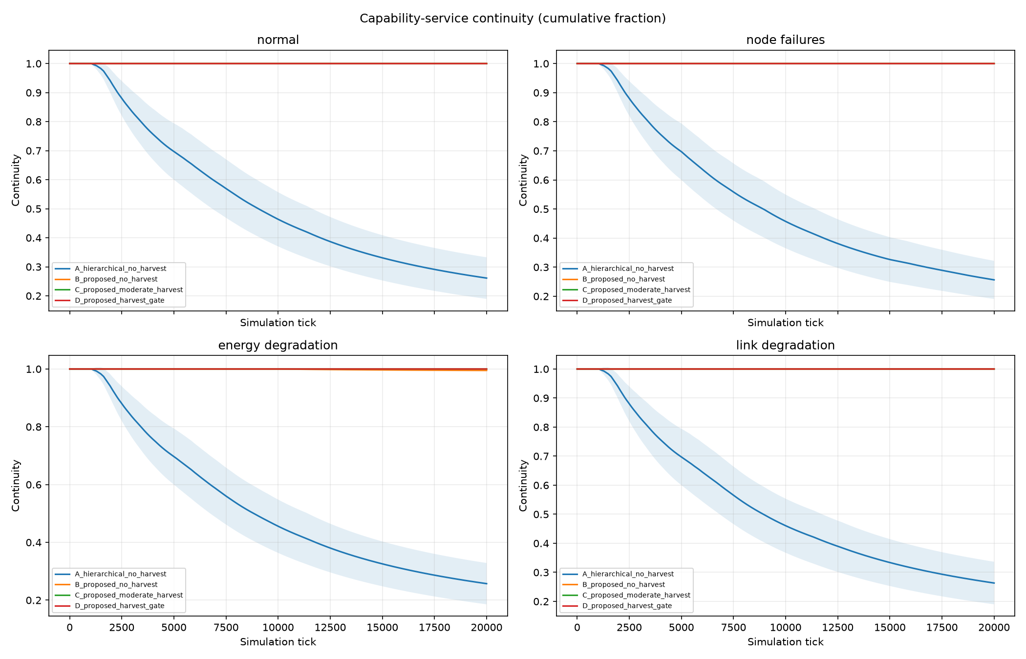
Service continuity across all scenarios
Role availability is a lease/holder proxy. C and D nearly overlap and the gate does not add a demonstrated availability benefit.
patent-study/results_20000/capability_service_continuity.png
19 / appendix
Notes:
Role availability is a lease/holder proxy. C and D nearly overlap and the gate does not add a demonstrated availability benefit. The image is the genuine supplied study figure. Curves summarize seeds 42–71 with the stored four-arm and four-scenario configuration. Do not generalize beyond the model or reinterpret normalized ticks as hours.
Implementation evidence: patent-study/results_20000/capability_service_continuity.png
Panel prompt: Use this supporting slide to answer a focused technical question.

Slide 20
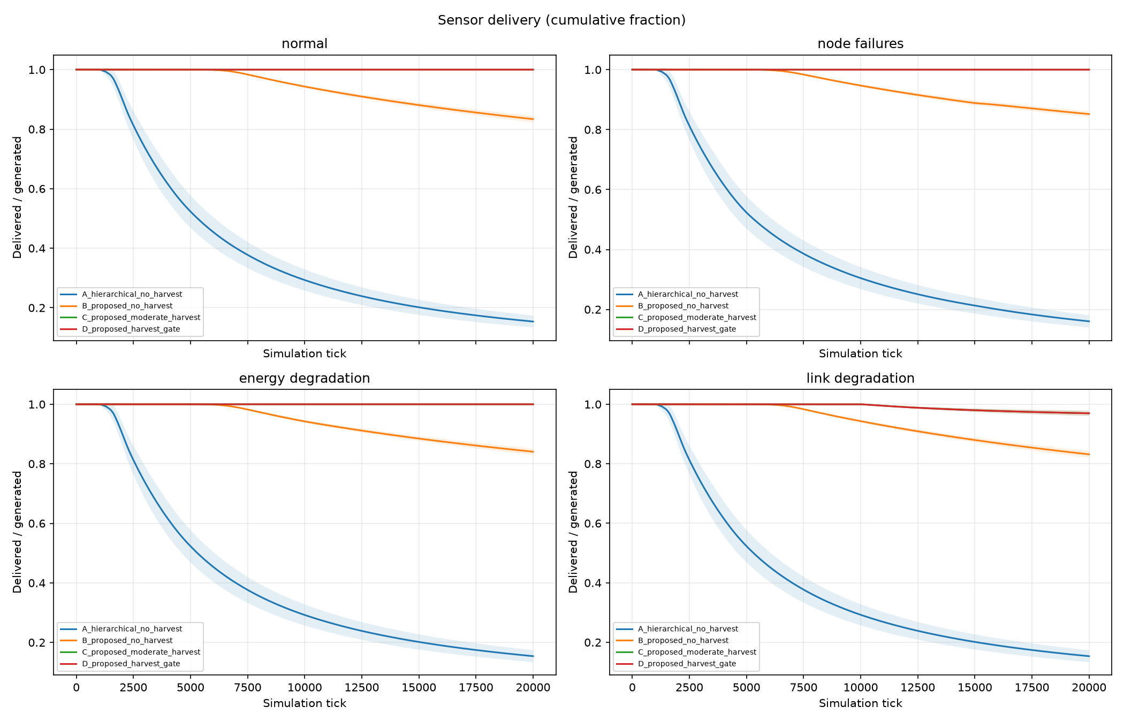
Sensor delivery across all scenarios
Counts measure sensor-to-subnet delivery. They include generated but unrouted items, but only online nodes generate load.
patent-study/results_20000/sensor_delivery.png
20 / appendix
Notes:
Counts measure sensor-to-subnet delivery. They include generated but unrouted items, but only online nodes generate load. The image is the genuine supplied study figure. Curves summarize seeds 42–71 with the stored four-arm and four-scenario configuration. Do not generalize beyond the model or reinterpret normalized ticks as hours.
Implementation evidence: patent-study/results_20000/sensor_delivery.png
Panel prompt: Use this supporting slide to answer a focused technical question.

Slide 21
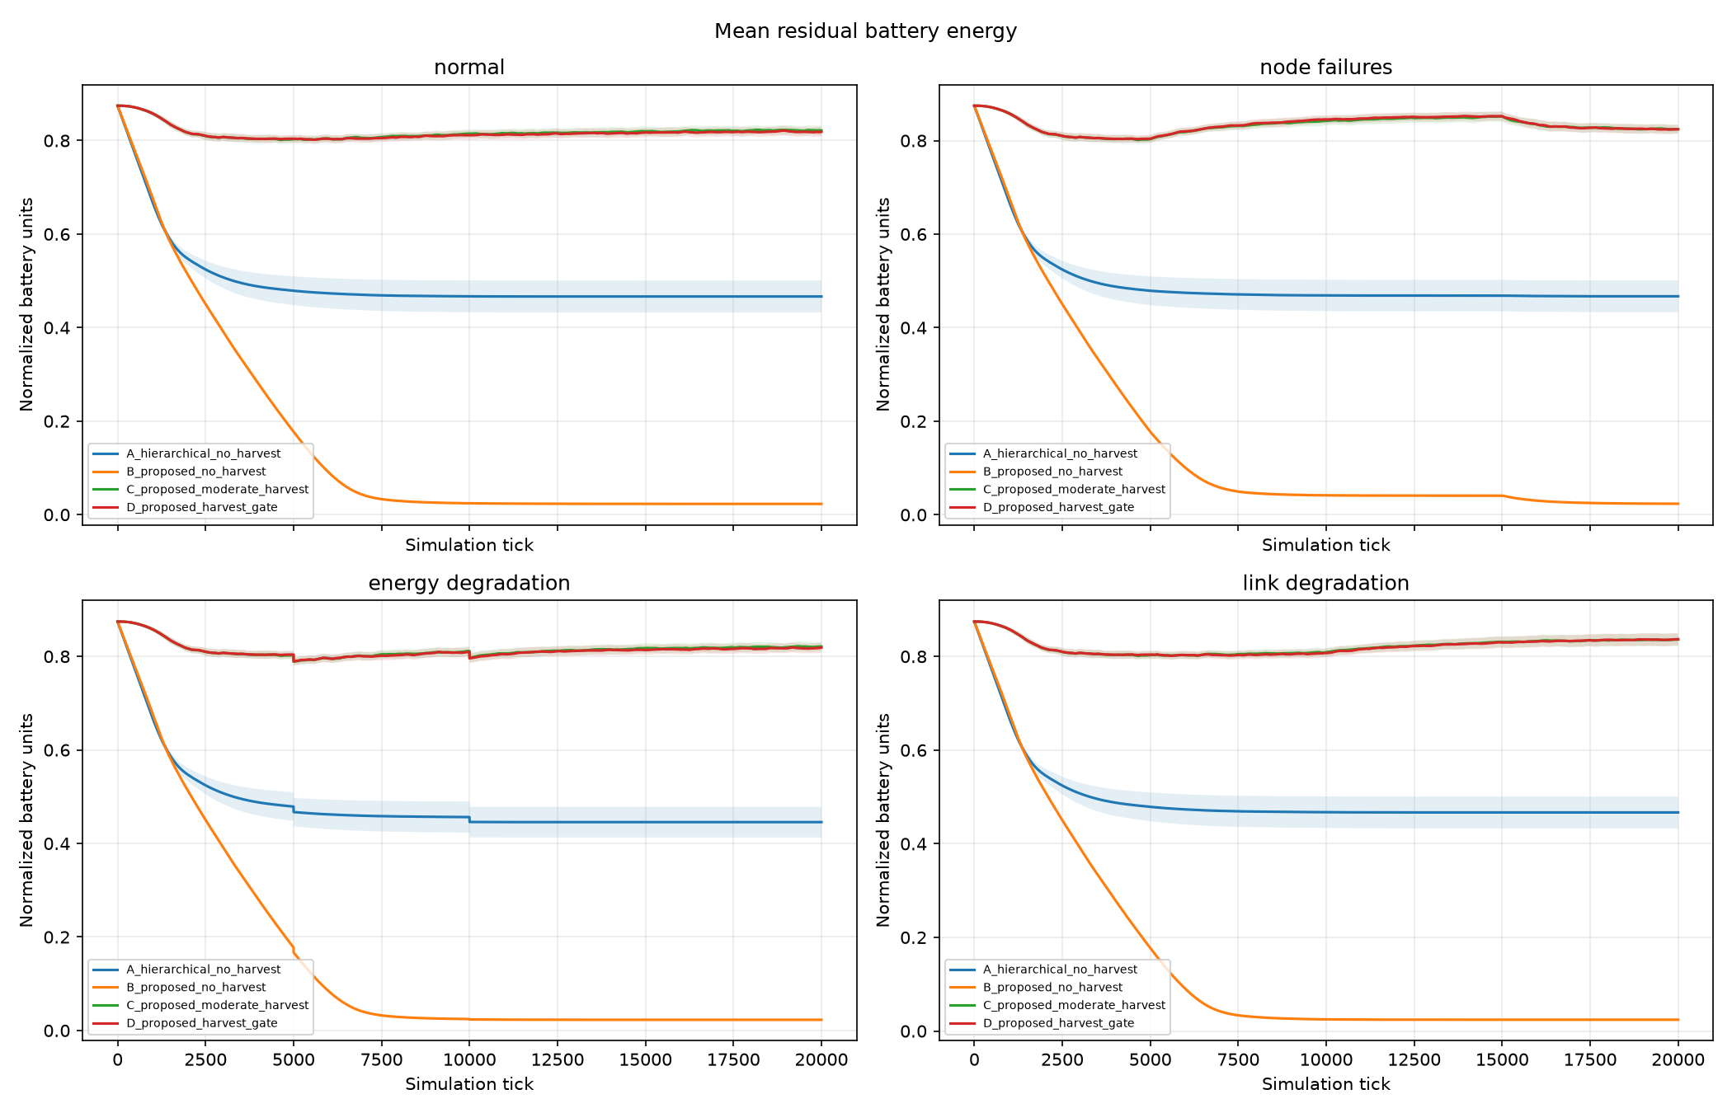
Residual battery across all scenarios
High battery can coexist with service failure. Communication cost and harvested energy must be interpreted together.
patent-study/results_20000/residual_battery.png
21 / appendix
Notes:
High battery can coexist with service failure. Communication cost and harvested energy must be interpreted together. The image is the genuine supplied study figure. Curves summarize seeds 42–71 with the stored four-arm and four-scenario configuration. Do not generalize beyond the model or reinterpret normalized ticks as hours.
Implementation evidence: patent-study/results_20000/residual_battery.png
Panel prompt: Use this supporting slide to answer a focused technical question.

Slide 22
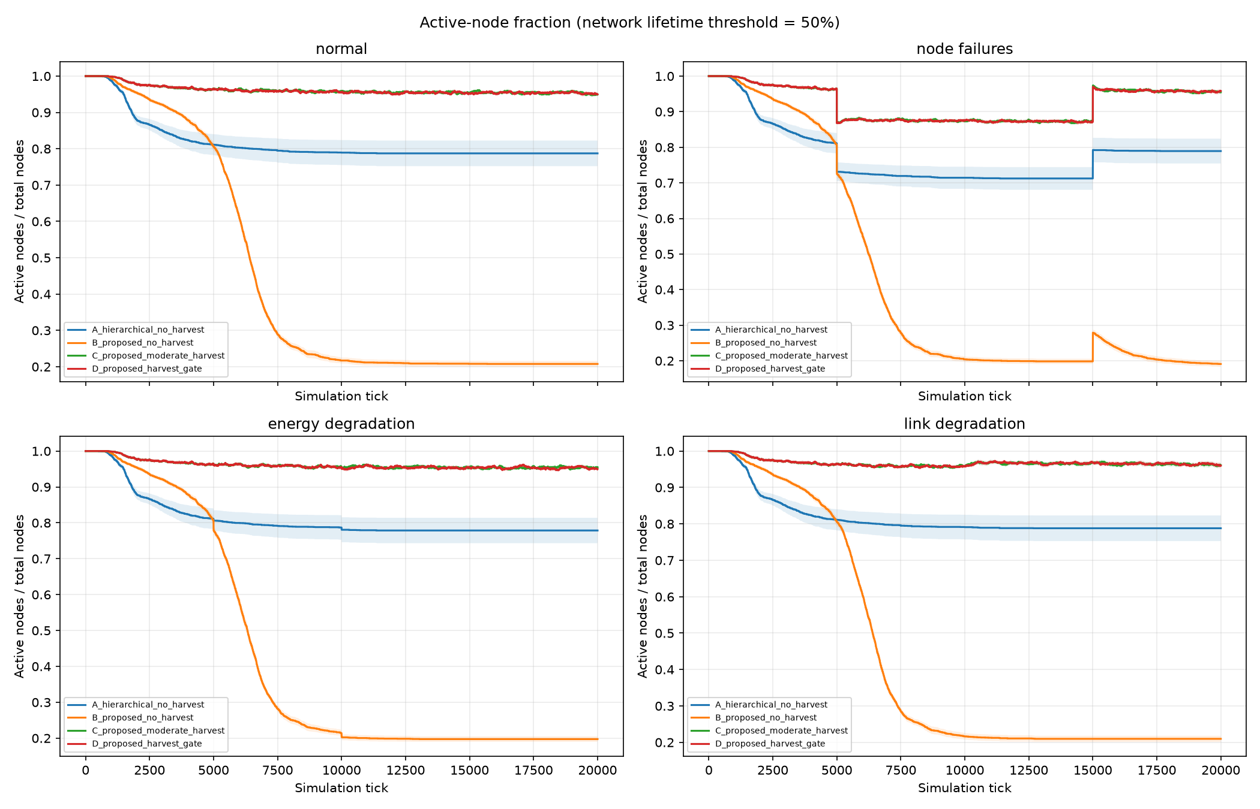
Active-node fraction across all scenarios
Node survival differs from role continuity and sensor delivery. Network lifetime uses the first active fraction below .5.
patent-study/results_20000/active_node_fraction.png
22 / appendix
Notes:
Node survival differs from role continuity and sensor delivery. Network lifetime uses the first active fraction below .5. The image is the genuine supplied study figure. Curves summarize seeds 42–71 with the stored four-arm and four-scenario configuration. Do not generalize beyond the model or reinterpret normalized ticks as hours.
Implementation evidence: patent-study/results_20000/active_node_fraction.png
Panel prompt: Use this supporting slide to answer a focused technical question.

Slide 23
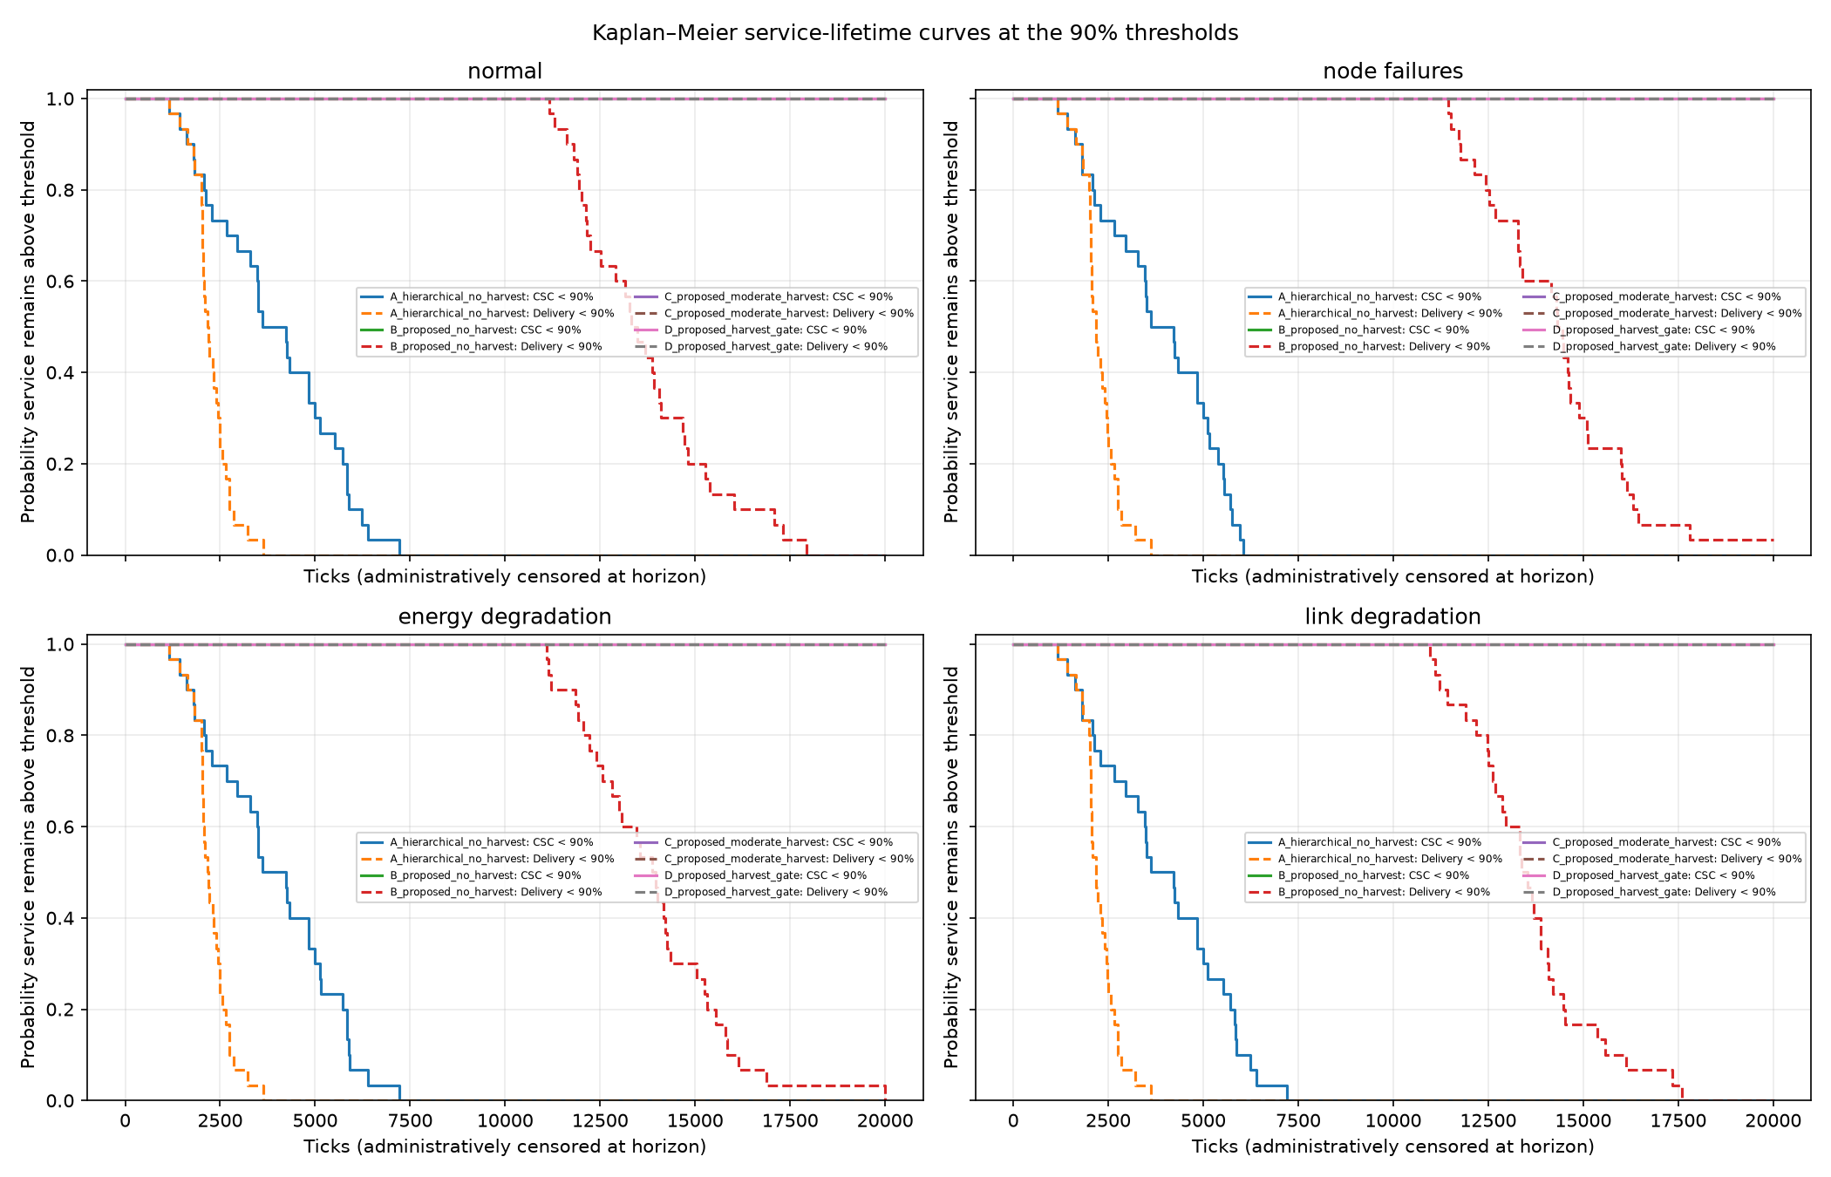
Service lifetime and right-censoring
No crossing by 20,000 ticks is right-censored. Censored horizons are not observed field failure times.
patent-study/results_20000/service_lifetime.png
23 / appendix
Notes:
No crossing by 20,000 ticks is right-censored. Censored horizons are not observed field failure times. The image is the genuine supplied study figure. Curves summarize seeds 42–71 with the stored four-arm and four-scenario configuration. Do not generalize beyond the model or reinterpret normalized ticks as hours.
Implementation evidence: patent-study/results_20000/service_lifetime.png
Panel prompt: Use this supporting slide to answer a focused technical question.

Slide 24
Focused C versus D assessment
Normal scenario: paired D − C differences across 30 seeds
Metric | C: harvest | D: + gate | D − C | 95% paired CI
Migrations | 542.03 | 515.80 | -26.23 | [-39.88, -12.59]
Energy/item × 10⁻⁶ | 154.377 | 154.823 | 0.446 | [0.056, 0.836]
Communication energy | 297.082 | 297.813 | 0.730 | [0.012, 1.449]
CSC | 1.0000 | 1.0000 | 0.0000 | [0.0000, 0.0000]
Fewer migrations do not imply lower energy use.
Energy intervals include zero in other scenarios. Energy uses normalized model units.
patent-study/results_20000/per_run_metrics.csv; paired_comparison.csv
24 / appendix
Notes:
All displayed normal-scenario mean values come from per_run_metrics.csv. D minus C confidence intervals come from paired_comparison.csv, which computes per-seed paired differences with a t interval. Negative migration difference indicates fewer recorded migrations, but positive energy differences indicate more modeled communication energy. In normal the count reduction interval is fully below zero, and energy per item and total communication energy intervals are above zero. CSC difference is zero. Other scenarios do not establish a consistent gate energy benefit: several energy intervals include zero. This is why migration suppression alone must not be called improved energy efficiency. The reported intervals do not correct for all possible multiple comparisons or establish hardware behavior.
Implementation evidence: patent-study/results_20000/per_run_metrics.csv; paired_comparison.csv
Panel prompt: Use this supporting slide to answer a focused technical question.

Slide 25
Implementation references and verification
Protocol and world: nodes.py and simulation/{entities,capability,leases,protocols,runner}.py
Routing and model costs: simulation/communications.py and config.py
Study execution and statistics: patent-study/run_patent_study.py and analyze_patent_study.py
Evidence: results_20000/{per_run_metrics,paired_comparison,threshold_crossings}.csv and runs/
Verification: 82 tests passed on Mesa 3.3.1. Newest Mesa compatibility requires pinning.
nodes.py; simulation/; tests/; patent-study/
25 / appendix
Notes:
Primary sources are the active source files and stored experiment records. The original Project.md motivates the design, while FINAL_SPRINT_PLAN.md supersedes older handoff instructions. Library selection is visible through imports: Mesa, transitions, NumPy, Pandas, Matplotlib, and SciPy for the study analyzer. No external prior-art search or patent opinion was performed. The earlier execution passed 82 tests with Mesa 3.3.1, and validated 480 unique run records plus 30 NPZ archives. The current edit changes presentation artifacts only. Existing PDFs remain unchanged by request.
Implementation evidence: nodes.py; simulation/; tests/; patent-study/
Panel prompt: Use this supporting slide to answer a focused technical question.

Slide 26
Viva preparation 1 of 6
Why separate logical hierarchy from physical mesh?
Membership defines role candidates and aggregation. Physical adjacency determines whether their representatives can actually communicate.
How many assignments does the default world require?
Four roles across ten subnet, three network, and one internetwork scopes: 4 × 14 = 56.
Does anomaly_detection execute a detection model?
No. It is a role label scored from energy and health. No anomaly classifier or sensor-payload detector is implemented.
How are node scores calculated?
ROLE_WEIGHTS defines normalized weighted sums. Gateway uses .40 energy, .35 link quality, and .25 initial degree centrality.
simulation/entities.py; simulation/topology.py; simulation/config.py; ProtocolEngine.assignment_keys; nodes.py; simulation/runner.py; nodes.py
26 / appendix
Notes:
Use these answers as starting points and point to the named implementation when challenged. Explain assumptions explicitly. If an evaluator asks about measured runtime, radio calibration, deployment security, or statistical coverage beyond these artifacts, state that the repository provides no such evidence. The answers distinguish assignment policy from application service execution and avoid interpreting simulated counters as field measurements.
Implementation evidence: simulation/entities.py; simulation/topology.py; simulation/config.py; ProtocolEngine.assignment_keys; nodes.py; simulation/runner.py; nodes.py
Panel prompt: Use this supporting slide to answer a focused technical question.

Slide 27
Viva preparation 2 of 6
What happens to a failed node during aggregation?
Its capability becomes zero but its child weight remains in the denominator, reducing the parent aggregate.
Is the root aggregate the global average node score?
Not necessarily. Default aggregation averages immediate children at each level, and the networks have unequal descendant counts.
How is a container represented on the physical mesh?
The first available descendant node in its stored order represents it. This is an abstraction rather than optimized representative election.
What prevents optional migration oscillation?
Candidate capability minus weighted migration cost must strictly exceed current capability plus hysteresis. Cooldown and adaptive hysteresis are optional.
nodes.py; simulation/capability.py; simulation/capability.py; SimulationConfig.subnet_counts; EntityHierarchy.representative_node_id; ProtocolEng...
27 / appendix
Notes:
Use these answers as starting points and point to the named implementation when challenged. Explain assumptions explicitly. If an evaluator asks about measured runtime, radio calibration, deployment security, or statistical coverage beyond these artifacts, state that the repository provides no such evidence. The answers distinguish assignment policy from application service execution and avoid interpreting simulated counters as field measurements.
Implementation evidence: nodes.py; simulation/capability.py; simulation/capability.py; SimulationConfig.subnet_counts; EntityHierarchy.representative_node_id; ProtocolEngine._consider_cost_aware_migration
Panel prompt: Use this supporting slide to answer a focused technical question.

Slide 28
Viva preparation 3 of 6
How is migration cost different from charged energy?
The score cost combines estimated messages, transfer, route-based energy, and disruption. Actual router counters charge the modeled exchanges that execute.
How do lease renewal and epoch retention interact?
Renewal updates lease timing at its configured fraction. Without retention, epoch changes regrant leases, potentially occurring before long leases renew.
Does epoch fencing solve distributed split-brain?
No. Epoch labels and invalidation operate in one process. Independent receivers, delayed messages, and stale-epoch rejection are not simulated.
Why does routing sometimes choose more hops?
Dijkstra minimizes quality-weighted cost, so two reliable edges can cost less than one poor edge.
calculate_migration_cost; ProtocolEngine._migrate; ProtocolEngine._renew_if_due; _advance_epoch; simulation/protocols.py; simulation/leases.py; N...
28 / appendix
Notes:
Use these answers as starting points and point to the named implementation when challenged. Explain assumptions explicitly. If an evaluator asks about measured runtime, radio calibration, deployment security, or statistical coverage beyond these artifacts, state that the repository provides no such evidence. The answers distinguish assignment policy from application service execution and avoid interpreting simulated counters as field measurements.
Implementation evidence: calculate_migration_cost; ProtocolEngine._migrate; ProtocolEngine._renew_if_due; _advance_epoch; simulation/protocols.py; simulation/leases.py; NetworkRouter._current_graph; _routes_from
Panel prompt: Use this supporting slide to answer a focused technical question.

Slide 29
Viva preparation 4 of 6
When are cached routes invalidated?
Failure, recovery, link degradation, and depletion invalidate usable graph and source-route caches.
What is the routing complexity caveat?
Heap-based shortest paths are followed by explicit reconstruction of every destination path. Path storage can dominate textbook distance-only bounds.
How is solar energy modeled?
A constant seeded per-node rate charges batteries up to capacity. Overflow is curtailed, and depleted nodes rejoin after reaching reserve.
Can the solar gate block failure recovery?
No. The gate restricts optional migrations. Assignment after holder failure takes the recovery path instead.
simulation/runner.py; NetworkRouter.invalidate_graph; NetworkRouter._routes_from; RoleSimulationModel._harvest_solar_energy; ProtocolEngine.step;...
29 / appendix
Notes:
Use these answers as starting points and point to the named implementation when challenged. Explain assumptions explicitly. If an evaluator asks about measured runtime, radio calibration, deployment security, or statistical coverage beyond these artifacts, state that the repository provides no such evidence. The answers distinguish assignment policy from application service execution and avoid interpreting simulated counters as field measurements.
Implementation evidence: simulation/runner.py; NetworkRouter.invalidate_graph; NetworkRouter._routes_from; RoleSimulationModel._harvest_solar_energy; ProtocolEngine.step; _solar_migration_is_worthwhile
Panel prompt: Use this supporting slide to answer a focused technical question.

Slide 30
Viva preparation 5 of 6
What does CSC measure?
The fraction of required role-time intervals whose lease and holder satisfy role_available. It excludes time zero and does not prove service-task execution.
Is sensor delivery measured at the root?
No. It counts successful sensor items reaching subnet gateways. Optional aggregate backhaul has separate counters.
Why can high residual energy coexist with poor service?
A failed controller or unavailable gateway can suppress traffic and leave nodes alive but unable to provide modeled service.
What does right-censored lifetime mean?
The threshold did not cross during the observation horizon. The horizon is a bound on observation, not a measured failure time.
MetricsRecorder.record; ProtocolEngine.role_available; RoleSimulationModel._route_sensor_traffic; simulation/runner.py; stored per_run_metrics.cs...
30 / appendix
Notes:
Use these answers as starting points and point to the named implementation when challenged. Explain assumptions explicitly. If an evaluator asks about measured runtime, radio calibration, deployment security, or statistical coverage beyond these artifacts, state that the repository provides no such evidence. The answers distinguish assignment policy from application service execution and avoid interpreting simulated counters as field measurements.
Implementation evidence: MetricsRecorder.record; ProtocolEngine.role_available; RoleSimulationModel._route_sensor_traffic; simulation/runner.py; stored per_run_metrics.csv; simulation/metrics.py; patent-study/analyze_patent_study.py
Panel prompt: Use this supporting slide to answer a focused technical question.

Slide 31
Viva preparation 6 of 6
Why compare paired seeds?
The arms share topology and event schedules for each seed/scenario, reducing unrelated world variation in within-seed differences.
What does D minus C establish about the gate?
In the stored study it does not establish an overall delivery or energy-efficiency improvement. Normal delivery is unchanged and energy/item slightly rises.
What security mechanisms exist?
Input validation and state consistency checks exist. Authentication, encryption, authorization, and adversarial-node defenses do not.
What should be improved first?
Define real role-task execution and end-to-end item delivery, then add asynchronous communication and calibrated energy before deployment claims.
patent-study/run_patent_study.py; patent-study/results_20000/paired_comparison.csv; simulation/config.py; simulation/leases.py; Architectural rec...
31 / appendix
Notes:
Use these answers as starting points and point to the named implementation when challenged. Explain assumptions explicitly. If an evaluator asks about measured runtime, radio calibration, deployment security, or statistical coverage beyond these artifacts, state that the repository provides no such evidence. The answers distinguish assignment policy from application service execution and avoid interpreting simulated counters as field measurements.
Implementation evidence: patent-study/run_patent_study.py; patent-study/results_20000/paired_comparison.csv; simulation/config.py; simulation/leases.py; Architectural recommendation based on implementation
Panel prompt: Use this supporting slide to answer a focused technical question.

