Slide 1
EXASOL HACKATHON • SMARTENERGY
Understand energy.
Spot the unusual. Act smarter.
An energy analytics prototype for consumption insights, anomaly review, and practical optimization ideas.
BUILT WITH EXASOL PERSONAL
KAPILESH VS-24BDS0112
NAETHRA KG -24BCI0145
PRS AISJWARYA-24BCI0165
SMARTENERGY | Exasol Hackathon Prototype
01

Slide 2
01 • PROBLEM
Energy data is useful when it becomes actionable
Consumption records can be difficult to interpret at a glance.
SEE THE PATTERN
NOTICE THE EXCEPTION
CHOOSE AN ACTION
When does usage rise or fall?
Which readings look unusually high?
What could be shifted or reduced?
SMARTENERGY brings these questions into one dashboard so users can explore data and review potential next steps.
SMARTENERGY | Exasol Hackathon Prototype
02

Slide 3
02 • SOLUTION
One dashboard. Five useful capabilities.
A working prototype using data stored in Exasol Personal.
Consumption insights
Prediction review
Explore hourly usage patterns.
Compare actual and predicted consumption.
Anomaly review
Optimization ideas
Filter flagged events by date and severity.
Review recommendations and estimated savings.
What-if calculator
Estimate the effect of a hypothetical usage change.
SMARTENERGY | Exasol Hackathon Prototype
03

Slide 4
03 • ARCHITECTURE
Exasol Personal is the data platform
The Streamlit application reads stored data from Exasol and presents it in the dashboard.
01
02
03
04
Energy data
→
Exasol Personal
→
Python app
→
Streamlit UI
Historical consumption
and derived results
SMARTENERGY schema
and project tables
pyexasol + pandas
retrieval and analysis
Charts, filters,
recommendations
Tables: HOURLY_CONSUMPTION • ENERGY_PREDICTIONS • ENERGY_ANOMALIES
SMARTENERGY | Exasol Hackathon Prototype
04

Slide 5
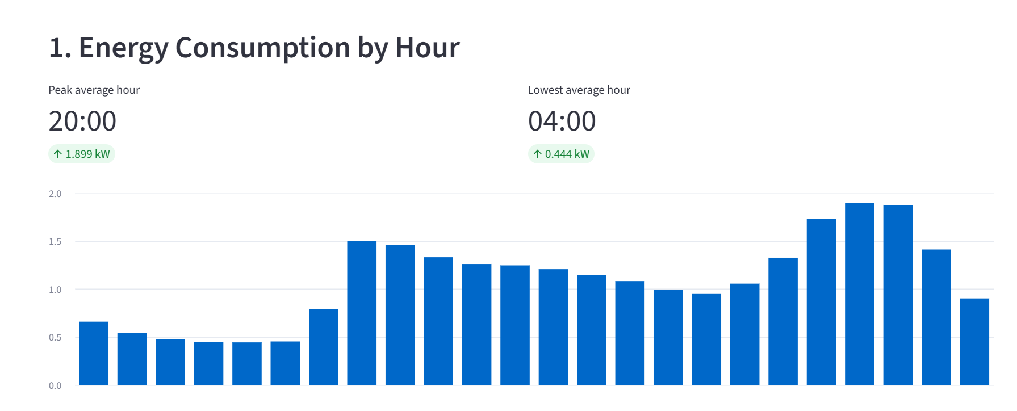
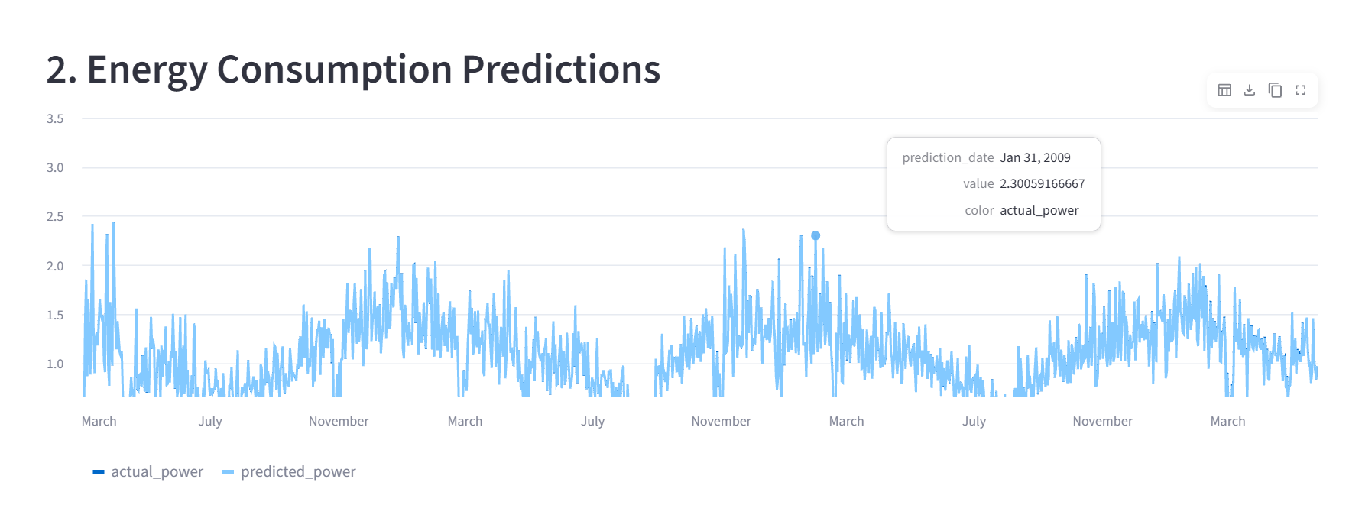
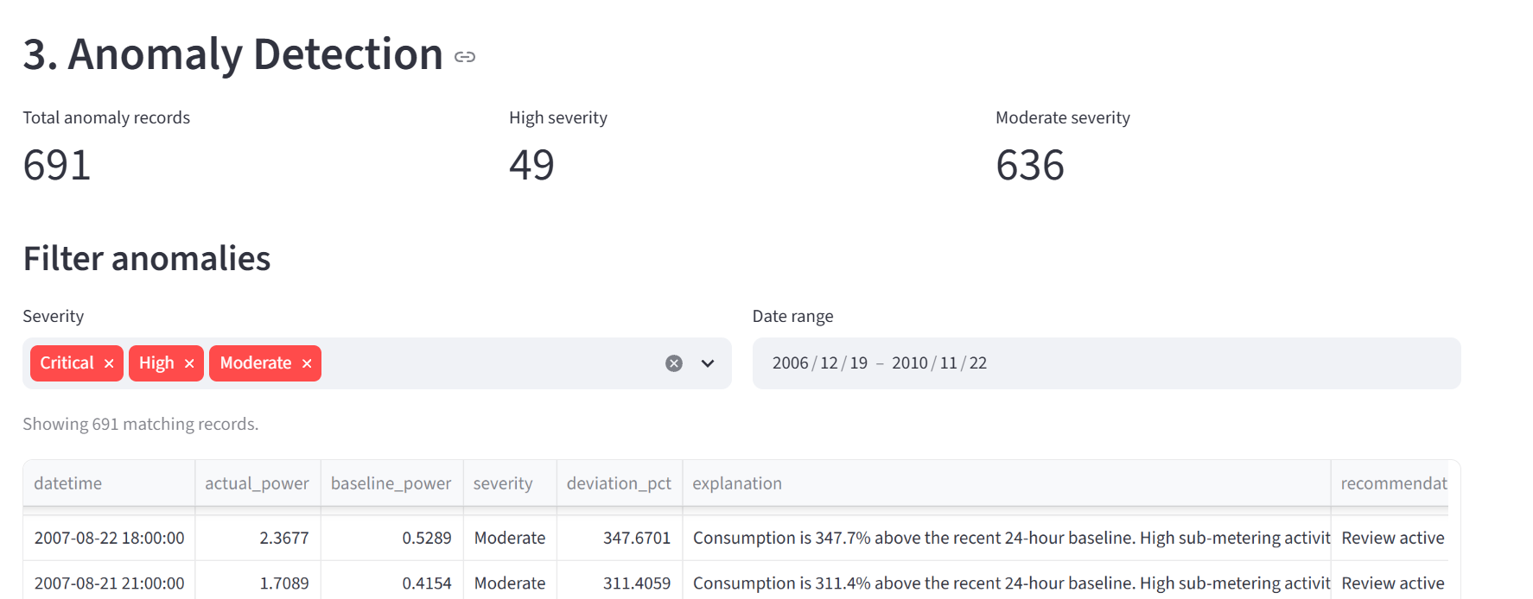
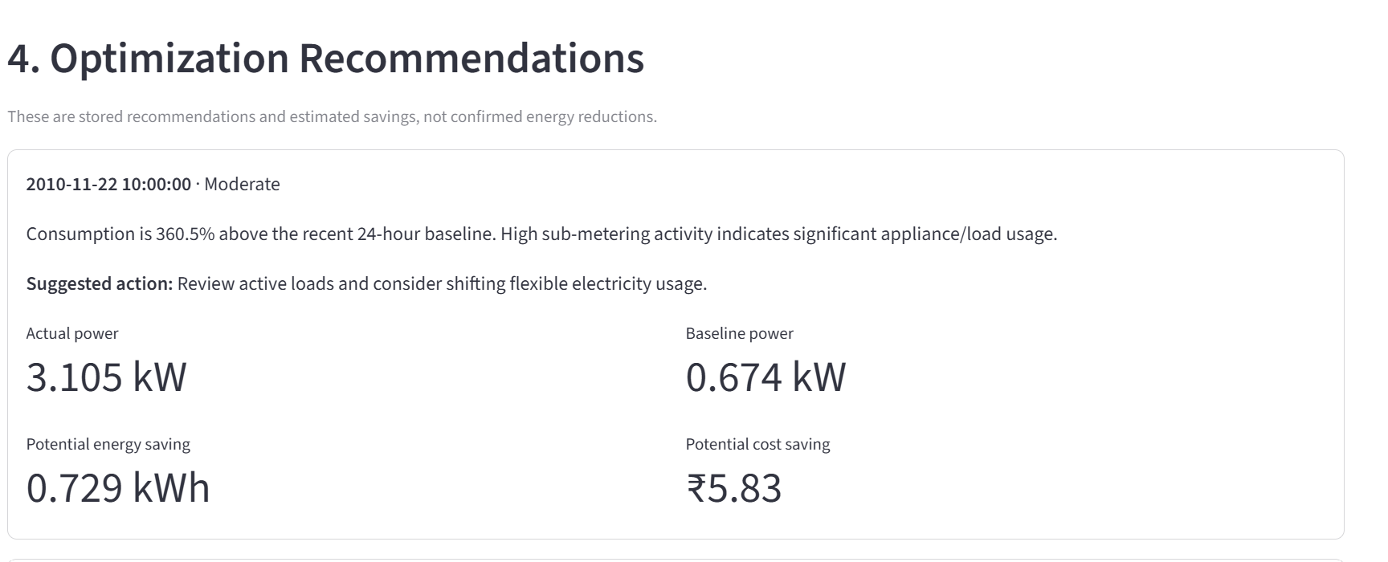
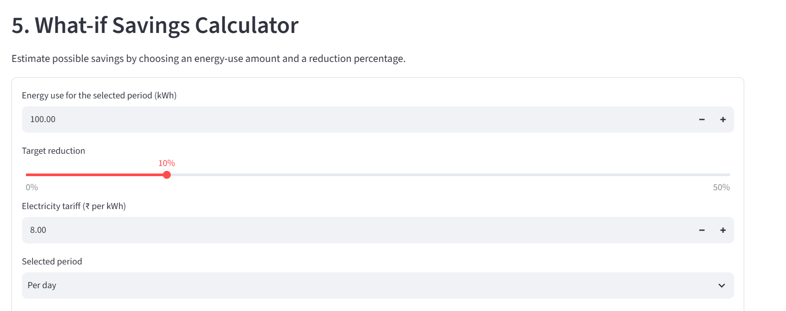
04 • DEMO WALKTHROUGH
From overview to a possible action
SMARTENERGY | Exasol Hackathon Prototype
05

Slide 6
05 • IMPACT & NEXT STEPS
A practical starting point for smarter energy use
The prototype turns stored energy data into insights users can investigate.
WHAT IT DEMONSTRATES
NEXT IMPROVEMENTS
A connected workflow for consumption analysis, anomaly review, and savings exploration—powered by Exasol Personal.
Validate predictions with a clear evaluation split; track model runs; improve savings assumptions; and explore a shareable deployment.
Metrics are preliminary; estimated savings are illustrative and not guaranteed.
Thank you •
SMARTENERGY | Exasol Hackathon Prototype
06

